Slide 1
Estimating the Noise Floor of Sonic Boom Metrics Across the USA
Will Doebler
NASA Langley Research Center
179th Meeting of the Acoustical Society of America
December 2020

Slide 2
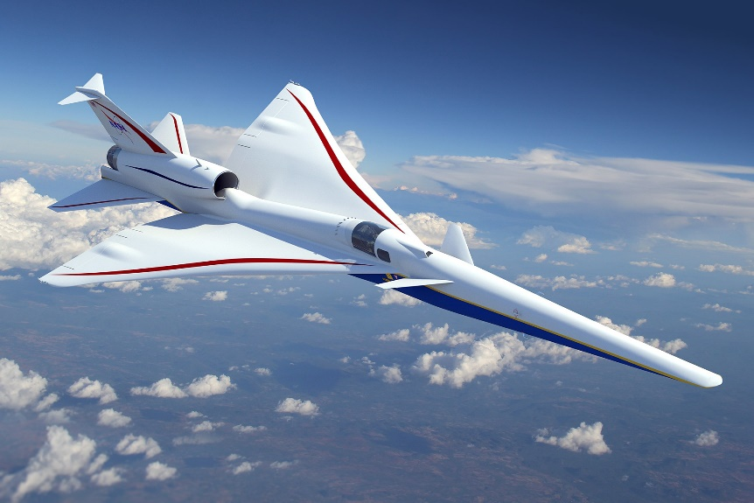
X-59 Mission Introduction
X-59 Community Tests start in 2023
  Six community tests planned
    X-59 will fly supersonic over a community
    Noise monitors will record the low-booms
    Survey participants will record their annoyance
  Boom level vs. annoyance data will be provided to
    International Civil Aviation Organization (ICAO)
    US Federal Aviation Administration (FAA)
    for consideration in noise certification standards
Where should noise monitors be placed in communities?
What signal to noise ratio is expected?
X-59 QueSST
Quiet SuperSonic Technology Demonstrator

Slide 3
Monitor placement approach from previous tests
For moderately sized test area (100 mi² (160km²)):
Use online maps to find potential locations
  Public land such as parks, government buildings, etc.
Scout and rate potential locations
  Ambient noise level, security of location, etc.
Future X-59 community tests will encompass a much larger area,
roughly 2,500 mi² (4,000 km²)
  Many more potential monitor locations than previous tests
    May not be viable to visit them all in person
  Ambient noise floor estimate may be useful screening aid

Slide 4
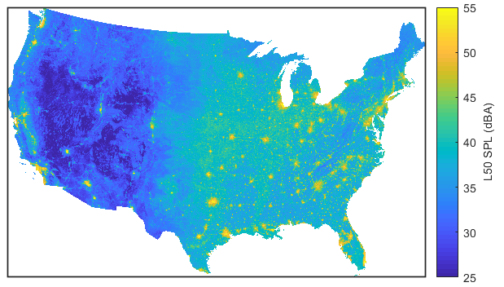
National Park Service Ambient SPL Map
Noise data
  A-weighted L₅₀ SPL during a summer day
    Median A-weighted Sound Pressure Level
  Generated by random forest model
    270,000+ hours of noise data at 190 locations
    Explanatory variable categories:
      Location, climatic, land cover, hydrologic anthropogenic, temporal, and equipment
Map resolution
  0.17 by 0.17 mi (270 by 270 m)
    Corresponds to ~3 city blocks
  Data at over 100 million locations!
A-weighted SPL is not typically used for quantifying sonic boom measurements
Ambient SPL
D. Mennitt, K. Sherrill, and K. Fristrup, “A geospatial model of ambient sound pressure levels in the contiguous United States,” J. Acoust. Soc. Am., 135, 2746-2765 (2014); https://doi.org/10.1121/1.4870481
Notes:
Location: e.g., lat/lon, elevation, slope, and classification (e.g. flat, ridge, valley, etc.)
Climatic: e.g., precipitation, temp, and wind data from past 30 years
Land cover: e.g., developed, barren, forest, etc. from Anderson Level I & II 2006 National Land Cover Data. Hydrologic: distance to bodies of water from Natl Hydrography Daset (NHD), NHD Plus, and NPS Hydrographic Impairment Data.
Anthropogenic: e.g., road density, flight frequency, etc. Road data from NPScape based on ESRI39. Road density & classification data from GIS. Military flight info from DOD data.
Temporal: e.g., day length
Equipment: noise floor of recorder from manufacturer specs
Additional info and their importance in the model are in backup slides.

Slide 5
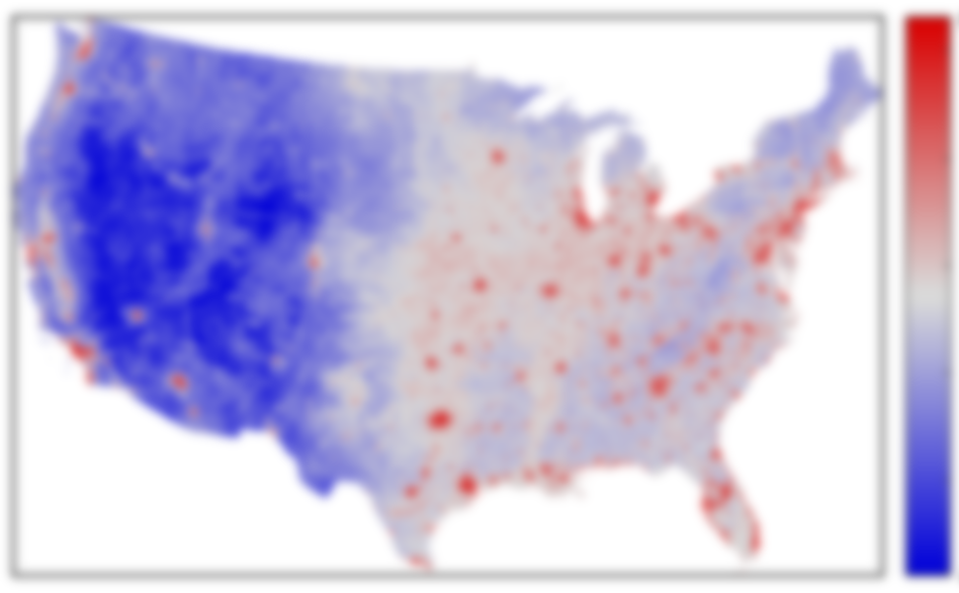
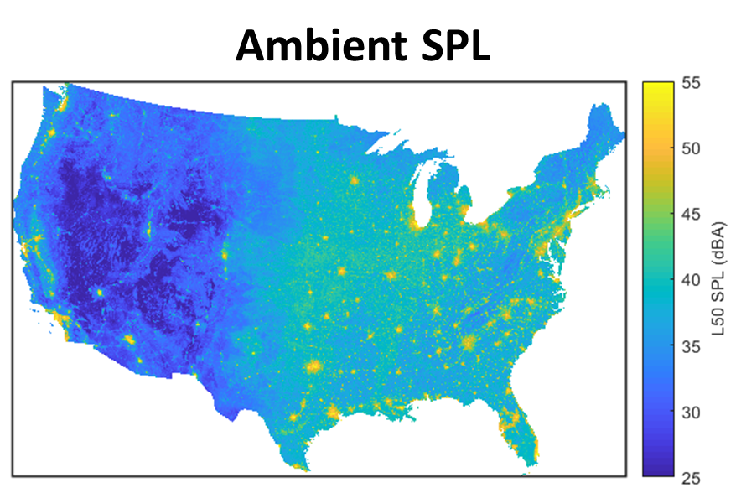
Sonic boom metrics under consideration for regulations
ICAO, FAA, and NASA have identified six metrics that may be used in future sonic boom noise regulations
  A-, B-, D-, and E-weighted Sound Exposure Level (SEL)
  Stevens’ Perceived Level (PL)
  Indoor Sonic Boom Annoyance Predictor (ISBAP)
Goal: adapt ambient SPL map to these metrics
Ambient ASEL
Ambient BSEL
Ambient DSEL
Ambient ESEL
Ambient PL
?
?
Ambient ISBAP
?
?
?
?
?
?
?
?
?

Slide 6

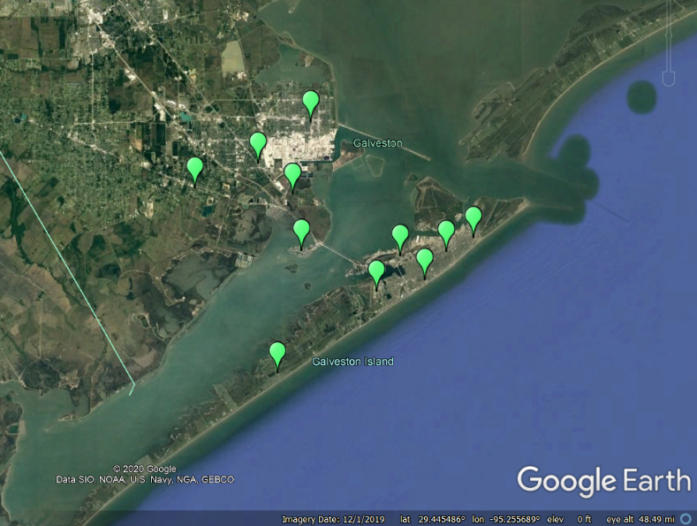
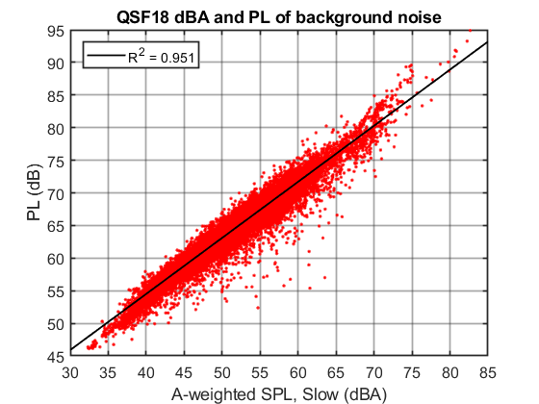
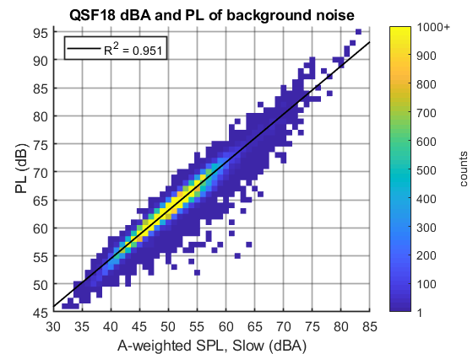
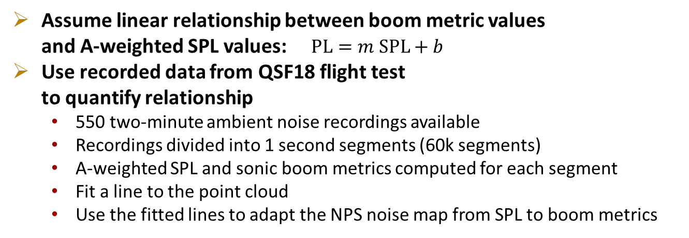
Adapting the NPS SPL map for sonic boom metrics
Assume linear relationship between boom metric values
and A-weighted SPL values: $\text{PL}=m \text{SPL}+b$
Use recorded data from QSF18 flight test
to quantify relationship
  550 two-minute ambient noise recordings available
  Recordings divided into 1 second segments (60k segments)
  A-weighted SPL and sonic boom metrics computed for each segment
  Fit a line to the point cloud
  Use the fitted lines to adapt the NPS noise map from SPL to boom metrics
Noise monitor locations
~10 mi (16 km)
Same data, but shown as a binned heatmap

Slide 7
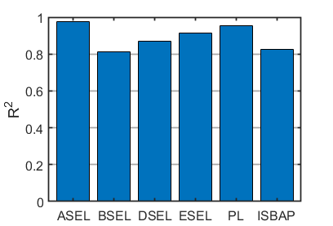
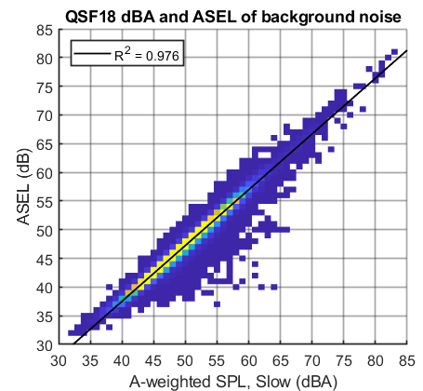
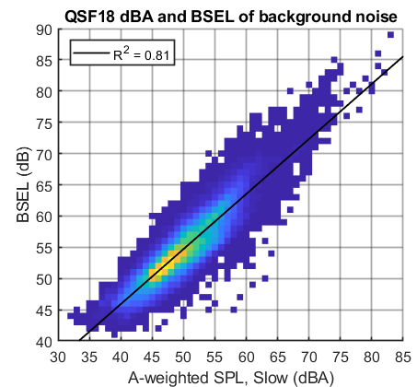
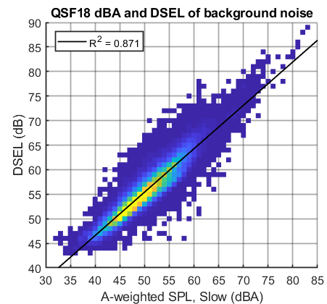
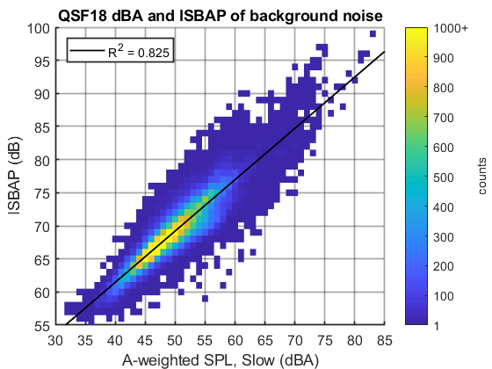
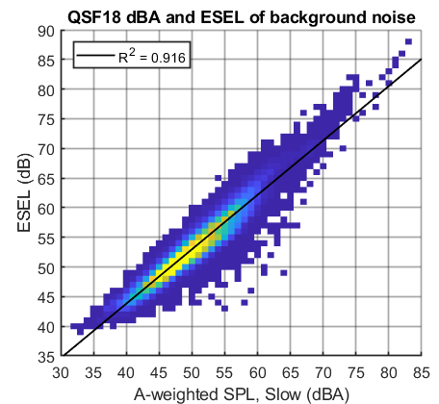
Results of linear fits to noise metrics of recording segments
ASEL (dB)
BSEL (dB)
DSEL (dB)
Counts
R² between 0.810 and 0.976 for the linear fits to the metrics
ESEL (dB)
PL (dB)
ISBAP (dB)
Notes:
Decent R^2 values for the linear fits. Majority of data fall within a dB or two of the fit line.

Slide 8
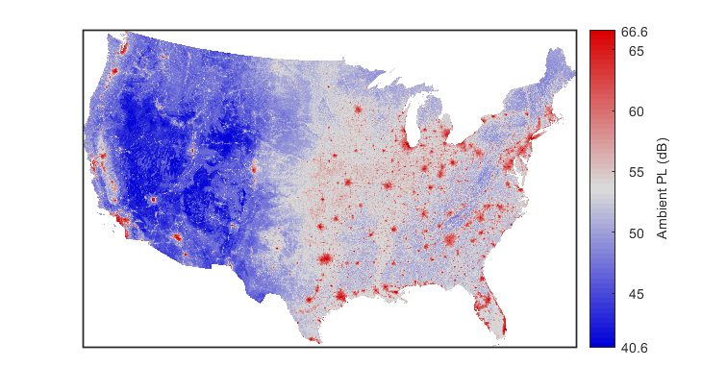





Sonic boom metric ambient levels across the USA
Colorbar limits are 0.1th to 99.9th percentiles of the noise data on the map
  For example, 0.1% of the data is below 40.6 PLdB

Slide 9
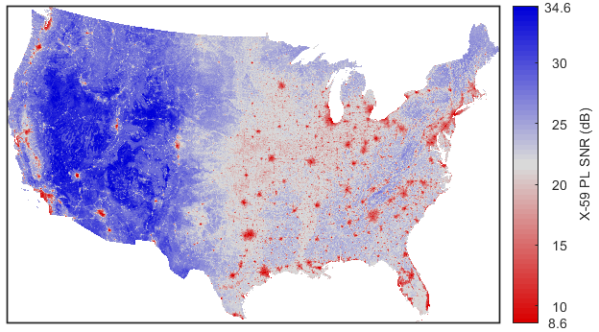
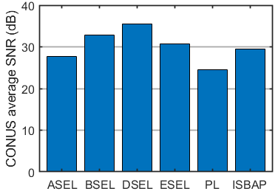
Signal to noise ratio (SNR) maps for a standard undertrack X-59 boom
Simulated Undertrack X-59 Boom Levels
Using Standard Atmosphere
PL SNR = X-59 PL – Ambient PL
PL (dB) | ASEL (dB) | BSEL (dB) | DSEL (dB) | ESEL (dB) | ISBAP (dB)
75.2 | 60.9 | 74.8 | 78.2 | 70.5 | 87.5
Average SNR (over CONUS) by metric
DSEL and BSEL have greater expected X-59 boom SNR than PL
Notes:
Table shows X-59 undertrack levels for the different metrics
Map shows PL SNR, repeated this for other metrics (shown in backup).
Bar chart shows the average SNR for the 6 sonic boom metrics.
The implications of the bar chart are that we will be more confident in our dose-response curves that use DSEL and BSEL than PL due to better SNR.

Slide 10
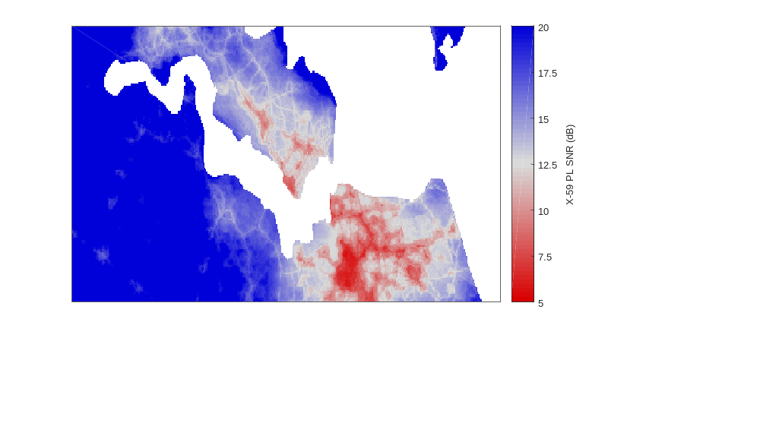


Example: noise near NASA Langley
Consider a scenario where the communities near NASA Langley were selected for an X-59 test
Two sites were under consideration for a noise monitor
  Norfolk City Hall SNR: 5 PLdB
  Jeff Robertson Park SNR: 13 PLdB
Jeff Robertson Park’s higher expected SNR makes it a better candidate for a noise monitor
10 statute miles

Slide 11
Future Work
Include ambient noise data from other locations in the fits
Make use of other ambient noise maps as they become available and improve

Slide 12
Summary
Ambient noise levels may be useful screening metric for placing boom monitors
National Park Service’s A-weighted SPL map of the CONUS was adapted
to six boom metrics (PL, A-, B-, D-, E-weighted SEL and ISBAP)
  Assumed linear relationship between each metric and A-weighted SPL
  Used 60k 1-second segments of ambient noise data from Galveston, Texas to fit relationship
Map data enabled estimation of X-59’s geographically average undertrack SNR
for each metric
  DSEL and BSEL had higher expected SNR than PL

Slide 13
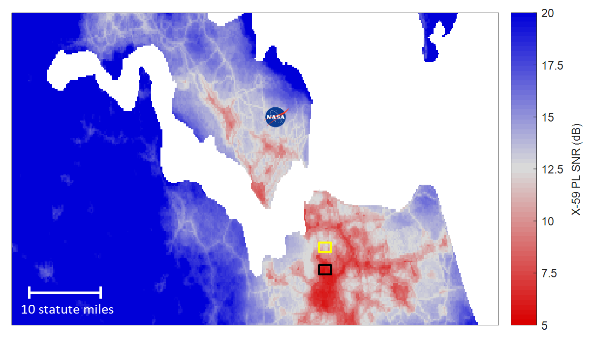
Thank you
PL SNR = X-59 PL – Ambient PL

