Slide 1

Epoxy Matrix Resins with Offset Stoichiometry for Predictable Joints in Composite Assemblies
Frank L. Palmieri¹, Tyler B. Hudson¹, Austin J. Smith¹, Jin Ho Kang², Yi Lin², and Roberto J. Cano¹
1. NASA Langley Research Center, Hampton, VA
2. National Institute of Aerospace, Hampton, VA
Notes:
Hello and thank you for selecting this presentation. I am Frank Palmieri from NASA’s Langley Research Center and I am going to tell you about the most recent developments at NASA on the topic of Epoxy Matrix Resins with Offset Stoichiometry for Predictable Joints in Composite Assemblies.

Slide 2


About the Speaker
Frank Palmieri
NASA Langley Research Center
Research Materials Engineer
~10 years of experience
  bonded assembly of composites
  surface engineering
frank.l.palmieri@nasa.gov
Notes:
First a little bit about me. I have been researching composite materials for aircraft structural applications at NASA’s Langley Research Center since about 20-10. My primary focus has been on secondary bonding technologies and surface engineering.

Slide 3
Acknowledgements
Coauthors:
  Tyler B. Hudson¹, Austin J. Smith¹, Roberto J. Cano¹, Jin Ho Kang², Yi Lin², Kathryn M.Crossett³, Bryson Clifford³, Isaac J. Barnett³, and John W. Connell¹
    NASA Langley Research Center, Hampton, VA, 23681, USA
    National Institute of Aerospace, Hampton, VA, 23666, USA
    NASA Internships Fellowships and Scholarships Program, Hampton, VA, 23681, USA
Supporting Roles:
  FWT Testing: Jon Salem
  BVID/CIA Testing: Mike Pereira
  Engineering: James Ratcliffe, Cyrus Kosztowny, and Carlos Davila
  Composites Processing: Sean Britton, Hoa Luong, and Kelvin Boston
  Machining: Mike Oliver, Thomas Hall, Steve Whitt, and Janet Dail
Notes:
Before I get into the technical details, I would like to acknowledge my coauthors and their affiliations for their contributions to this research as well as other team members from various NASA aeronautics research centers that made this work possible. So thank you Team members for all you hard work.

Slide 4
Congratulations Kash Mittal on 75 Years!
Wide World of Adhesion celebrates Kash’s 75 birthday!
Palmieri, F. L. and Wohl, C. J., "Topographical Modification of Polymers and Metals by Laser Ablation to Create Superhydrophobic Surfaces." In Mittal, K.; Laser Technology: Applications in Adhesion and Related Areas 2018, 1-68.
  He is probably cringing at this citation format, 😐.
Excellent editor to work with who prides himself in thorough and thoughtful proofing and revision
  Taught me the difference between surface energy and surface free energy
Has an interesting way of witing emails
Notes:
And we can’t forget that this symposium is in honor of Kash Mittal for his 75th birthday in spite of being a virtual event this year. I know Kash through a collaboration on a recent book chapter titled Topographical Modification of Polymers and Metals by Laser Ablation to Create Superhydrophobic Surfaces which appears in his recent book, Laser Technology: Applications in Adhesion and Related Areas. I'm sure Kash is quite pleased that I am plugging his new book, so there you go, that is your birthday present, Kash. I am sorry about any errors in my citation format. I know you always have your red pen ready. But seriously, Kash is an excellent editor to work with. He takes great pride in the quality of his publications and expends great effort to support and improve each text. And as I recall, he even taught me the difference between surface energy and surface-free energy, so thank you for that. One interesting quirk about Kash you will notice if you ever correspond with him via email is that his messages are somehow revised with ink on paper before they are sent. Now don’t forget that Kash had a long career at IBM, so I'm not sure what this may indicate about computer industry. Perhaps it is evidence of an underlying conspiracy. ☺.

Slide 5
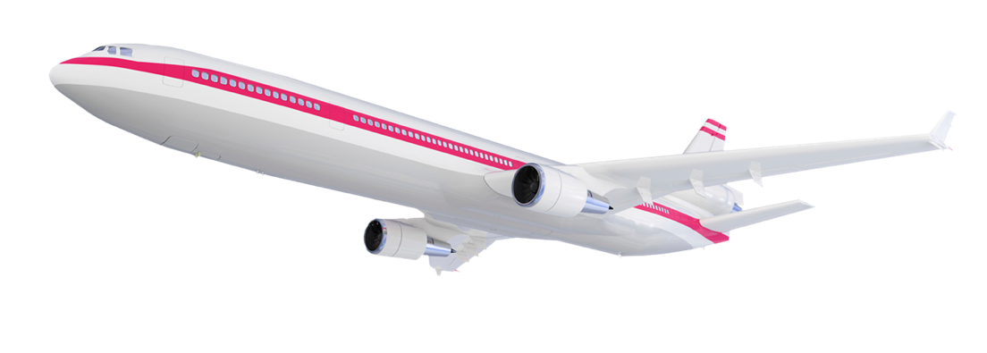

Challenge for Commercial Aircraft Industry
Global Growth in Aviation
2017
4 BILLION
PASSENGER TRIPS
2036
7.8 BILLION
PASSENGER TRIPS
Airbus / Europe
Bombardier / Canada
Irkut /
Russia
Boeing
Comac /
China
41,030
New Aircraft Deliveries
$6.1 Trillion
Market Value
78%
of New Aircraft Deliveries are
Single Aisle Class
(including Regional Jets)
Asia-Pacific
Market is Nearly
40%
of New Aircraft Deliveries
Embraer /
Brazil
Global Competitors
Notes:
The international air transport association (IATA) regularly reports the air transportation outlook for the next twenty years.
They forecasted a doubling of passenger trips between 2017 and 2036, which means that aircraft manufacturers will need to respond with a proportional increase in new aircraft production.
And for sustainability of such high growth rates, there is ever increasing pressure to build sustainable, efficient aircraft, which are highly dependent on high performance composite structures.

Slide 6
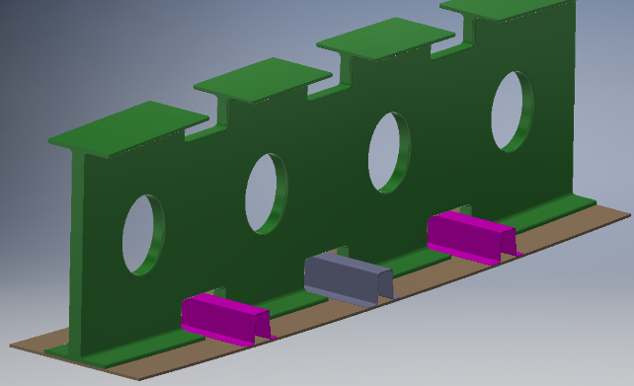
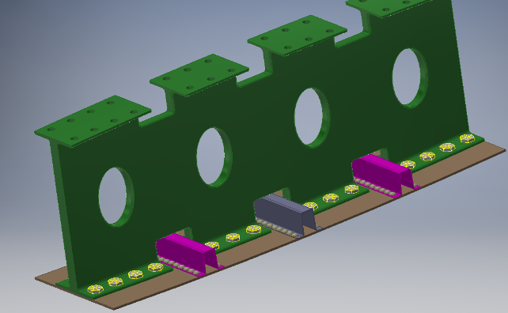
Manufacturing Bottleneck
Bonded Wing
Structures
Airframes are assemblies of many parts
Composites can be assembled rapidly with adhesives
Redundant load path (bolts) is required for certification
Thousands of drilling and installation steps
Composites should be replacing metals in aircraft but…
Fastener installation is too slow causing a bottleneck
Production rates cannot meet demand
rib
skin
stiffener
Bolted Wing
Structures
rib
skin
stiffener
Notes:
… but there is a manufacturing bottleneck for composite structures during the assembly process. Composite airframes are composed of many parts, which can be assembled rapidly with structural adhesive bonding. However, redundant load paths, such as bolts, are required for certification resulting in thousands of drilling and installation steps that slows down assembly. In addition to decreasing the manufacturing rate, bolts can cause stress concentrations at the drill site, add mass, and have the potential for corrosion. To the right, you see drawings of some common wing structures. The top drawing shows the simplest possible assembly of the rib with the skin and stiffeners using an adhesive or co-cure process. The bottom picture shows the many holes and fasteners that are add to bonded structures to meet certification requirements.

Slide 7

Fasteners in a Single-Aisle Composite Airframe
Wing 2
~21,000 bolts
Wing 1
~21,000 bolts
Fuselage
~70,000 bolts
Notes:
The impact of eliminating redundant fasteners is enormous. A systems analysis performed at NASA Langley Research Center estimated that approximately 21,000 bolts per wing could be removed from the composite wingbox of a of single-aisle, commercial transport airframe. In addition, information gathered on fuselage components indicated approximately 70,000 bolts could be removed from the fuselage.

Slide 8
Assembly of Composites
Co-Cure
uncured prepreg
Method limited by part complexity
Cure Process
Co-bond
cured
uncured
adhesive
Secondary Bond
cured
uncured
Unpredictable interfaces formed
adhesive
cured
Co-cure produces predictable components and joints but is limited by complexity
Bonded/Co-bonded joints are susceptible to weak bonds
Unpredictable bonds are a concern in primary structure
A redundant load path is used to ensure structural integrity
Notes:
To understand the dependence on redundant fasteners, we have to look at how large scale composite structures are assembled. There are essentially three primary methods for assembling composites: co-cure, co-bond, and secondary bond. During co-cure, two or more parts are cured together in an autoclave resulting in unitized structure. In other words, co-cured joints have continuous matrix resin through the joint. In contrast, co-bonded and secondary bonded joints use adhesive to bond together one or more previously cured components. The adhesive bond results in a material discontinuity that can be observed microscopically.
Co-cured joints are inherently predictable because the joint is inherently interface-free.
First animation
However, co-cure is limited in application by part complexity and size. Quite simply, you cannot produce an entire aircraft or even an entire wing in single cure process. The tooling would be too expensive.
Bonding and co-bonding simplify the assembly of complex structures, but the resulting joints are susceptible to weak bonds leading to unpredictable performance.
Second animation
The lack of predictability in bonded interfaces is a concern in primary structure. So airframers are compelled to use redundant fasteners to ensure structural integrity.

Slide 9
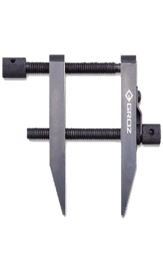
The AERoBOND Method
The reliability of co-cure in a “bonded” assembly
Joining Layer A
conventional materials (uncured)
Joining Layer A
Primary Cure
Co-cure reliability from “bonded” assemblies
partially cured
surfaces
cured laminate
partially cured interface
Assembly with
Joining Layer B
Secondary Cure
Co-cured structure
Notes:
The AERoBOND process enables the reliability of a “co-cured” joint and the manufacturability of a “secondary bonding process”
Modified epoxy layers, shown here in blue as joining layer A, are applied to the bonding surfaces of conventional, epoxy matrix preforms, shown here as a green bar.
The primary cure process causes the component prefrom to fully cure, but leaves the joining surface only partially cured and able to reflow when heated.
The two partially cured surfaces are then assembled with a complimentary epoxy layer, shown here at Joining Layer B, between them, clamped in a fixture, and cured as an assembly, analogous to a secondary bonding process with adhesive.
During secondary cure, the partially cured layers reflow, allowing joining layers A and B to mix together, and fully cure forming a co-cured assembly.

Slide 10
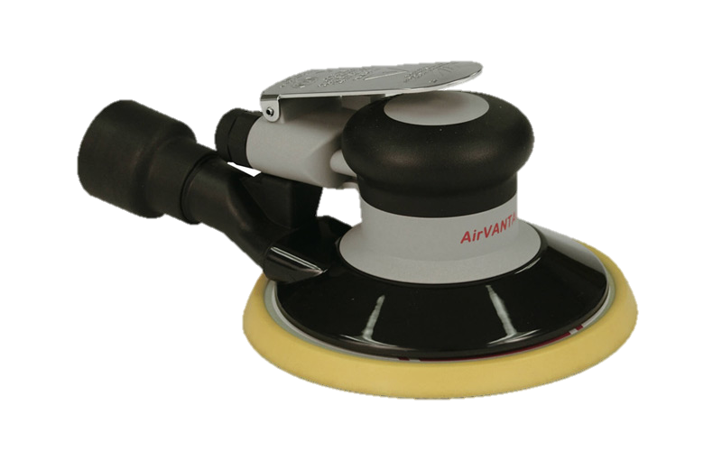
AERoBOND VS SoA
AERoBOND
State-of-the-Art (SoA)
Preform
Preform
Primary
Cure (~6 h)
Preform
Preform
Component
Component
Component
Component
Surface Treatment
(~2 h)
Joining
Layer B
Component
Assembly
(~2 h)
Adhesive
Secondary
Cure (~4 h)
Adhesive
Cure (~4 h)
Co-cured structure
Bonded structure
Total Time: ~12 h
Install bolts (~6 h)
Bonded and
Bolted
AERoBOND is ~40% Faster!
Total Time: ~20 h
Cure/assembly times are notional
Notes:
1. I know the AERoBOND method appears complex, but its actually much simpler than the state of art?
2. The primary cure process is identical to the state of art with the exception of the modified epoxy layer shown here in blue.
3. After primary cure, the state of the art method requires surface preparation such as sanding, grit blast, peel-ply removal, or solvent wipe, NONE of which are used in the AERoBOND method.
4. The assembly and secondary cure processes are identical replacing only the adhesive layer with the AERoBOND material shown here in yellow.
5. The AERoBOND method results in co-cured structure whereas the state-of-art produces a bonded structure.
6. Even though the likelihood of a weak bond is low, the bonded structure generally requires redundant fasteners to ensure joint performance.
7. By eliminating the surface preparation and installation of bolts, the AERoBOND method is approximately 40% faster than the state-of-art. In addition, the AERoBOND method can be accomplished using existing equipment for assembly and cure, and thus requires little to no new capital expenditures to add to a production line. It drops directly into any thermoset manufacturing process.

Slide 11
Failure Mode and Certification
AERoBOND Failure
Bond Failure
Cohesive Failure
Cohesive Failure
Adhesive Failure
AERoBOND eliminates the potential for weak bond failure mode
Goal: AERoBOND mechanical properties similar to conventional co-cured laminates.
Notes:
AERoBOND eliminates the potential for a weak bond failure mode by eliminating the interface. The only possible failure mode in an AERoBOND joint is cohesive failure either in the joint or in the surrounding laminate. The properties of the materials can be tested and certified to meet specifications using current practices. Therefore engineers can design and certify structures based on those measurable, repeatable properties.
In bonded joints, the vast majority of failures are also cohesive in nature, but the weak, adhesive failure mode remains a possibility. It may be impossible to measure and certify the interfacial properties of a bonded joint because of the nature of the nearly two-dimensional, microscopic interface between the adhesive an substrate. So with bonded joints, the only thing that’s absolutely certain stick, are the redundant fasteners.
So the Goal of the AERoBOND project is not be stronger than SoA joints, but simply to achieve mechanical properties and reliability similar to conventional co-cured laminates.

Slide 12
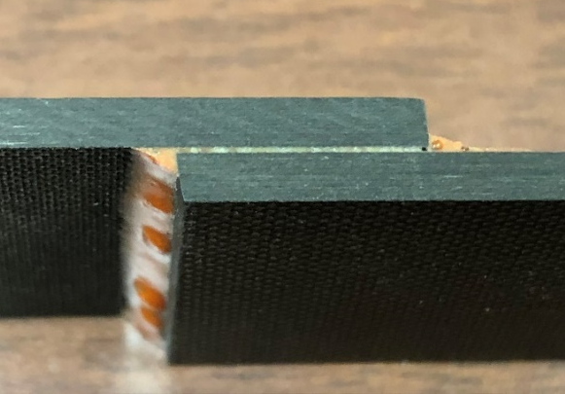
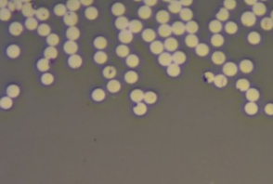
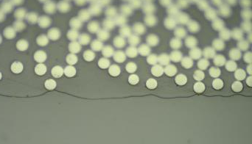
Adhesive Bondline vs. AERoBOND
AERoBOND Joint
Adhesive Bondline
Matrix Resin
AERoBOND Joint
Adhesive
The AERoBOND joint is indistinguishable from the matrix resin of adherends
Quantifiable, certifiable resin properties
Cured matrix resin cannot mix with adhesive
Potential for weak bonds
Notes:
I’m showing on the left, an AERoBOND laminate being peeled open, and a micrograph of the AERoBOND joint in cross-section before testing. The resins of the two joining layers have diffused across the interface. This results in quantifiable and certifiable resin properties. The white circles visible in both joints are polished ends of carbon fiber which are about 6 microns in diameter.
In contrast, the adhesively bonded joint on the right has a cured matrix resin, which did not mix with the adhesive during the bonding process resulting in this clearly visible interface, which you see as a line in the micrograph. This interface is susceptible to weakness.

Slide 13
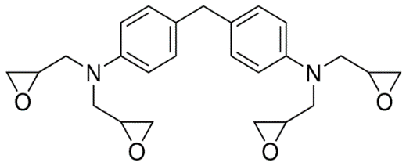
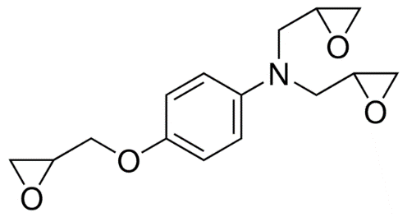
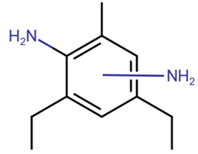
Resin Chemistry
Kaneka API-60 Part A
  ~65% tetrafunctional epoxy
  ~20% trifunctional epoxy
  ~15% proprietary toughener
  Epoxy equivalent weight EEW = 131 g/mol
Diethyltoluenediamine (DETDA)
  Ethacure 100 from Albemarle® Corp.
  Mixture of isomers
  Liquid at RT
  EEW = 45 g/mol
Notes:
To make AERoBOND bond materials we use convential tetrafunctional and trifunctional epoxy materials show here. The part A material we use was obtained from Kaneka and has a toughener mixed. The hardener we are using is probably not so common in aerospace composites, but we wanted something that was liquid at room temperature like this DETDA material.
By using commercially available precursors, the AERoBOND process is readily scalable for high-volume production of large structures. In addition, the AERoBOND method could be applied to other epoxy or thermoset chemistries.

Slide 14
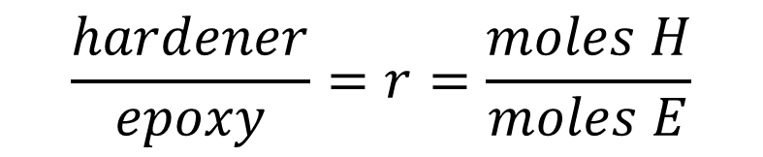
Thermoset Epoxy Basics
Hardener groups (H) react with epoxy groups (E) to form polymer
H
H
H
H
E
E
H
E
E
E
…
E
E
H
H
Molecular weight is limited by applying an offset to the stoichiometry
$$\frac{hardener}{epoxy}=r=\frac{moles H}{moles E}$$
r = 1 : Equivalent Mixture
r > 1 : Hardener Rich (HR)
r < 1 : Epoxy Rich (ER)
Notes:
The formation is modified by offsetting the stoichiometry of the epoxy mixture. For the AA/BB step-growth polymerization scheme, you can see that leaving out one of the two components in this system means that the reaction cant go to completion, in the ideal case. Epoxies can undergo various side reactions that generally lead to chain extension and crosslinking even without the presence of a hardener, but the epoxy homopolymerization is much slower than the epoxy-amine reaction, and is neglected analysis we used to determine degree of cure. The r-value defined here is how we describe the offset of epoxy and hardener in an AERoBOND formulation. I will refer to resins with r>1 has hardener rich and r<1 as epoxy rich.

Slide 15
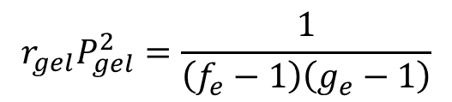
Offset, Molecular Weight, and Gelation
Gel Formed
$$r_{gel}P_{gel}^{2}=\frac{1}{\left(f_{e}−1\right)\left(g_{e}−1\right)}$$
Monomer functionalities, f_{e} = 4 and g_{e} = 3.75, for tetrafunctional hardener and a mixture of tetra- and tri-functional epoxies
For 100% conversion of the limiting monomer, gelation occurs for: 0.12 < r < 8.25
Macosko, Miller. Molecular Weights of Nonlinear Polymers. 9(2) 1976.
Notes:
We exploited the stoichiometric offset to limit the degree of cure and prevent gelation of the resin during the primary cure of composite components. The equation presented here along with the monomer functionalities can be used to estimate the r-value needed to prevent gelation. For the material system we chose, gelation is expected to occur between r values of 0.12 and 8.25. In practice, the numbers are slightly different, but this gave us a good starting point for resin formulation.

Slide 16
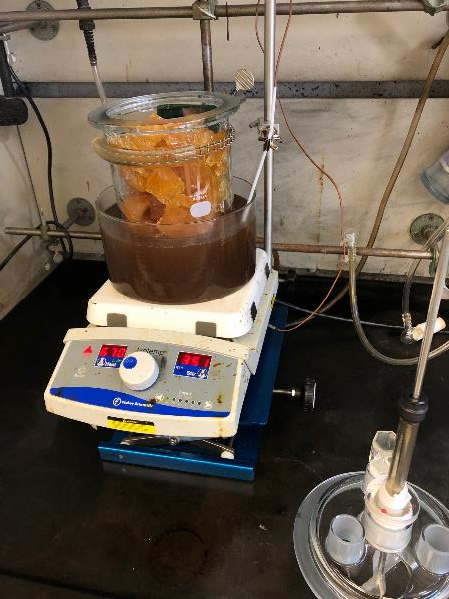
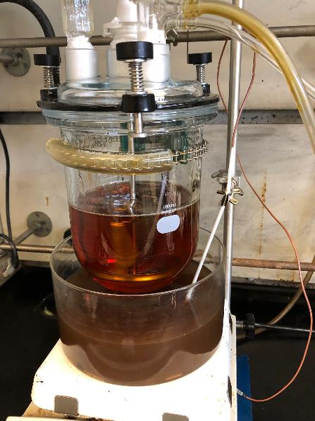
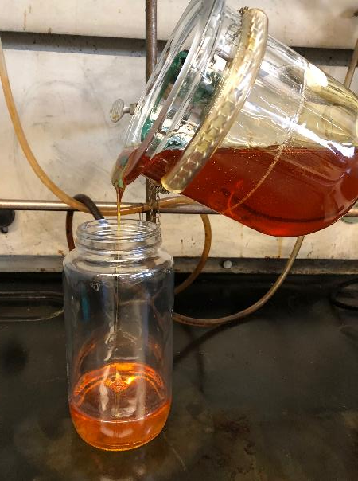
Resin Preparation
API-60 Part A and DETDA stirred 1 - 2.5 h at 100 -110 °C
Prepolymer diluted with 15 wt.% methyl ethyl ketone (MEK) prior to producing prepreg
Commercially available precursor, readily scalable process
Notes:
These pictures show how we formulate the resin in our labs. The Part A epoxy and DETDA hardener are added to a resin kettle. On the left you see the solid chunks of frozen epoxy in the flask. The materials are mixed and heated using an oil bath and a hot plate. The polymerization reaction is advanced only slightly to prevent separation of the components. The prepolymer is poured into jars and diluted with 15 wt.% MEK prior to prepregging.

Slide 17
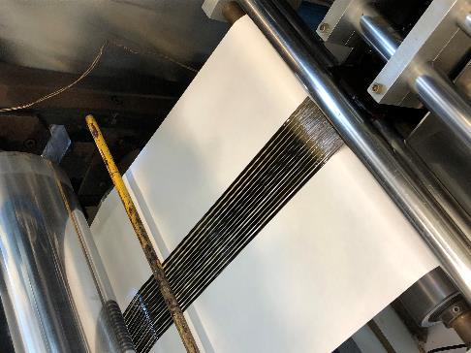
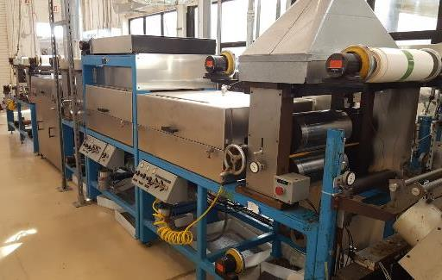
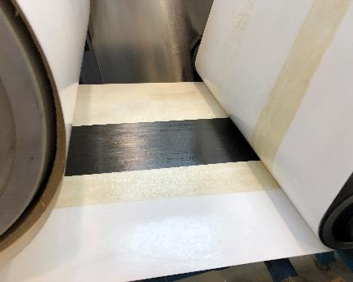
Prepreg Tape Production
Prepared prepreg tape using a custom tape machine at NASA Langley Research Center
  Fiber: IM7G, 14 to 16 tows (12k fibers/tow), 75-100 mm wide tape
  Better uniformity and larger batches compared to hand-painted film
  Process development is complex/challenging
Notes:
We make prepreg tape from the resin/MEK solutions using a custom prepregger at NASA Langley Research Center. We use 14 to 16, 12k fiber tows to get a 3-4’’ wide tape. The prepegging process is critical because it determines the ply thickness, resin/fiber content, and initial DoC in the prepreg.

Slide 18
Preliminary Development and Testing
Two-step fabrication process
  1. Fabricate panels with epoxy rich (ER) surfaces
  2. Join panels with hardener rich (HR) ply
Conventional material used in backer laminate
  Hexcel® IM7/8552 prepreg
  190 g/m² fiber areal weight (FAW), 35% resin content
Test parameters
  Resin formulation (r-value, degree of cure)
  Ply thickness & resin content
  Cure process (time and temperature)
  Bagging scheme
Rapid screening with End-Notched Flexure (ENF) test
  Mode-II (Shear) Fracture Toughness
  Simple specimen fabrication and testing
Laminate Configuration
Hexcel IM7/8552 backer laminate
Epoxy Rich Ply
Hardener Rich Ply
Epoxy Rich Ply
Hexcel IM7/8552 backer laminate
End-Notched Flexure (ENF) Test
Fiber direction
Crack starter
Layup: [0]₂₄
Non-Precracked (NPC) vs Precracked (PC)
Notes:
1. To develop the AERoBOND process, we fabricated a series of joints and mechanically tested them. As I mentioned, the AERoBOND process is two steps. First, two panels are laid up and cured with epoxy rich surfaces. These two parts are then assembled with a hardener rich ply and cured again.
2. The panel is primarily composites of a commercially available, conventional IM7/8552 material from Hexcel which is shown here as the laminate back in the laminate configuration diagram.
3. Our test parameters included the r-value of the resin, which is the ratio of epoxy to hardener in the AERoBOND ER and HR plies, as well as the initial degree of cure of the materials, ply thickness, resin content, time and temperature of curing, as well as the bagging scheme.
4. The end-notched flexure test was used to rapidly screen each configuration. The ENF test measures Mode II, shear, fracture toughness with relatively simple specimen fabrication and testing. Two types of ENF tests are run on each sample and the names are quite confusing. There is a non-precracked test that has a manufactured pre-crack created with an thin crack starter film. There is also a pre-cracked test condition that has a naturally sharp crack tip which is obtained from the previous NPC test. I will present both NPC and PC data, and there is distinct difference.

Slide 19
Baseline Properties
Measured properties for a series of laminates fabricated using:
  AERoBOND epoxy system (API-60 Part A)
  Conventional hardener (diaminodiphenyl sulfone)
  Conventional stoichiometry (r = 0.8)
  Co-cure processing
Baseline properties used to set AERoBOND performance goals
Notes:
Before I can show you the results of the testing, you need to know about benchmark properties against which we compare our results. We measured the fracture toughness from a set of laminates that were co-cured using the same API-60 resin system used in AERoBOND but with a conventional r-value which is probably around 0.8. I can’t tell you the exact ratio, because the baseline API-60 resin was formulate by the manufacturer. So you will see these baseline properties on the following charts which determined our goals AERoBOND materials.

Slide 20
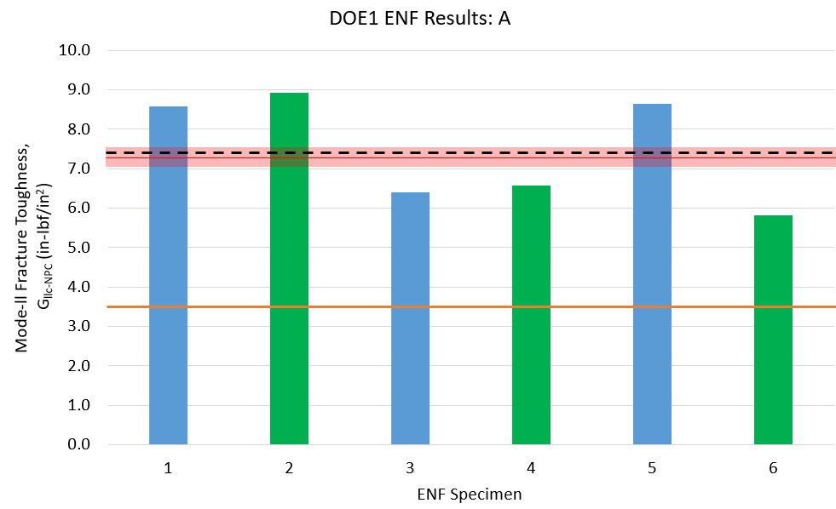
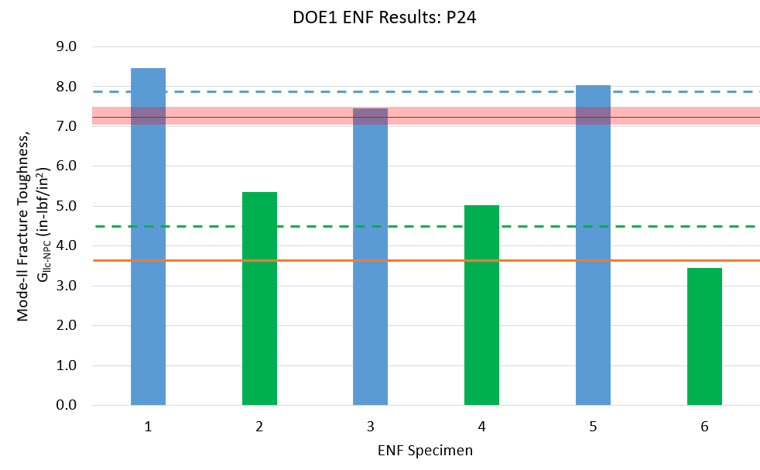
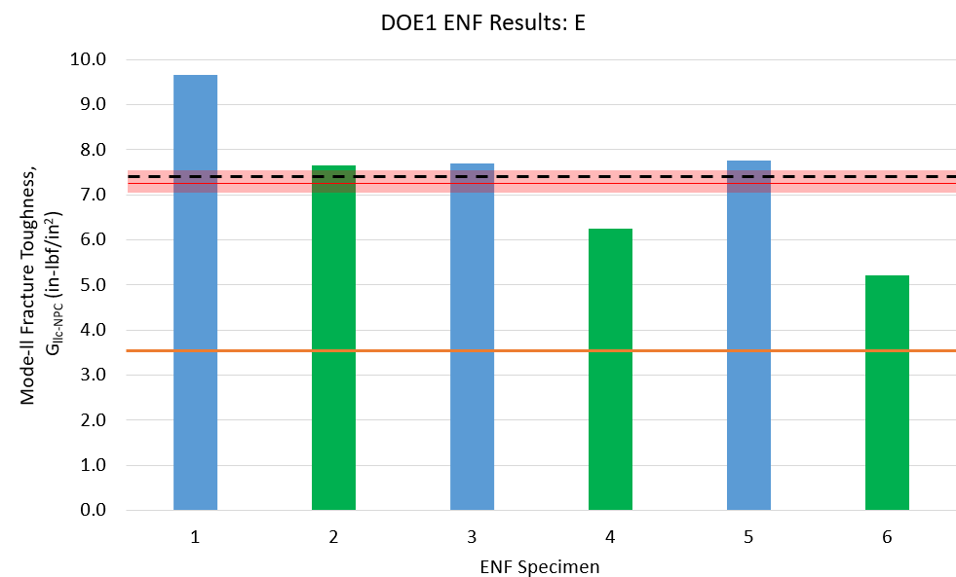
Mode-II Fracture Toughness/Non-Precracked (G_{IIc-NPC})
Ave: 7.496 in-lbf/in² %Baseline: 105%
Experiment A1
Matched and exceeded co-cure properties
  Baseline (Co-cure) properties (red bar)
  Preliminary goal - 50% baseline (orange line)
  Blue bars - “ER activated”
  Green bars – “HR activated”
8
6 4 2 0
Mode-II Fracture Toughness (in-lb/in²)
Experiment 24
1 2 3 4 5 6
8
6 4 2 0
Ave: 7.379 in-lbf/in² %Baseline: 103%
Dependence on Specimen Orientation (face-up vs. face-down)
blue bars 111% baseline
green bars 64% baseline
(artifact of manufactured precrack)
Experiment A5
8
6 4 2 0
Mode-II Fracture Toughness (in-lb/in²)
Mode-II Fracture Toughness (in-lb/in²)
1 2 3 4 5 6
ENF Specimen
1 2 3 4 5 6
Units conversion: 1 in-lb/in² = 175 J/m²
Notes:
Here are the ENF test results from a few different samples. The first thing you should notice is that we not only matched by exceeded the baseline co-cured properties across multiple sample configurations. Baseline co-cured properties are indicated by red bar and one our preliminary goals of 50% baseline is indicated by the orange line. The average of the AERoBOND results are indicated by the dashed lines. The green and blue data sets indicate the orientation of the specimen during ENF testing, and here we see that NPC (that’s with a manufactured crack tip) fracture toughness depends on whether the crack is being driven towards the ER or the HR layer in experiment 24.

Slide 21
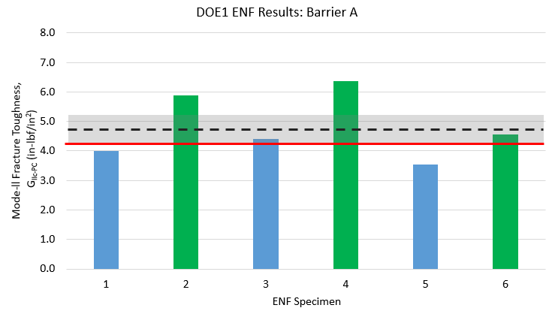
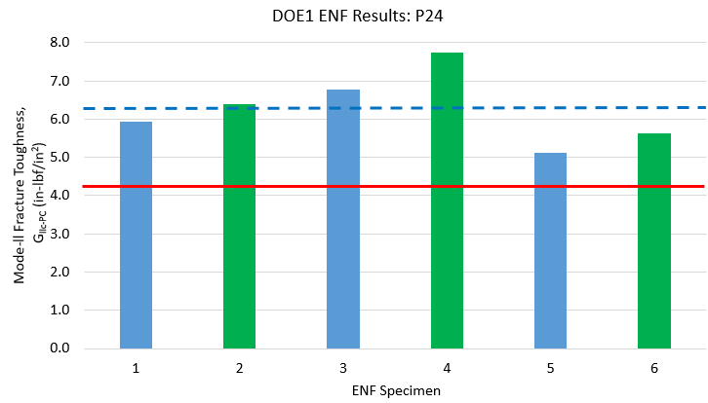
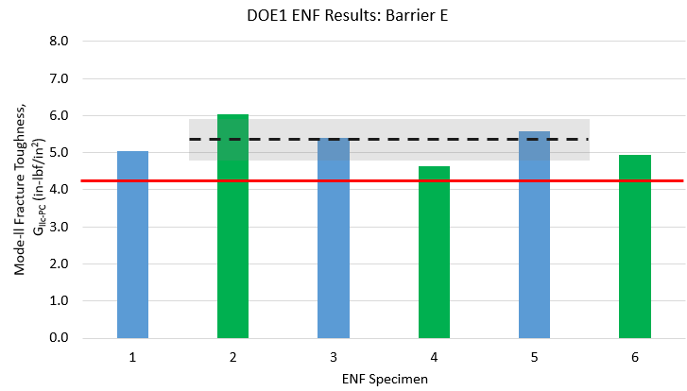
Mode-II Fracture Toughness/Precracked (G_{IIc-PC})
Ave: 4.79 in-lbf/in² %Baseline*: 113%
Experiment A1 PC
Exceeded co-cure properties by wide margin
  Baseline (Co-cure) properties (red line)
  Blue bars – “ER activated”
  Green bars – “HR activated”
6 4 2 0
Shear Fracture Toughness (in-lb/in²)
Ave: 6.26 in-lbf/in² %Baseline*: 148%
1 2 3 4 5 6
Experiment 24 PC
Ave: 5.410 in-lbf/in² %Baseline* : 128%
6 4 2 0
No dependence on specimen orientation with sharp crack tip
Experiment A5 PC
Shear Fracture Toughness (in-lb/in²)
6 4 2 0
Shear Fracture Toughness (in-lb/in²)
1 2 3 4 5 6
1 2 3 4 5 6
*IM7/8552 material property (not part of baseline dataset)
Unit conversion: 1 in-lb/in² = 175 J/m²
Notes:
The results were even more impressive from precracked ENF tests, which had a naturally sharp crack tip, as would be the case in a real structure. Not only did the AERoBOND configurations significantly outperformed the baseline properties, we also observed that the toughness from precracked specimens was no longer dependent on specimen orientation indicating the variation we saw on the previous slide was an artifact of the crack tip manufacturing and not a material property.

Slide 22
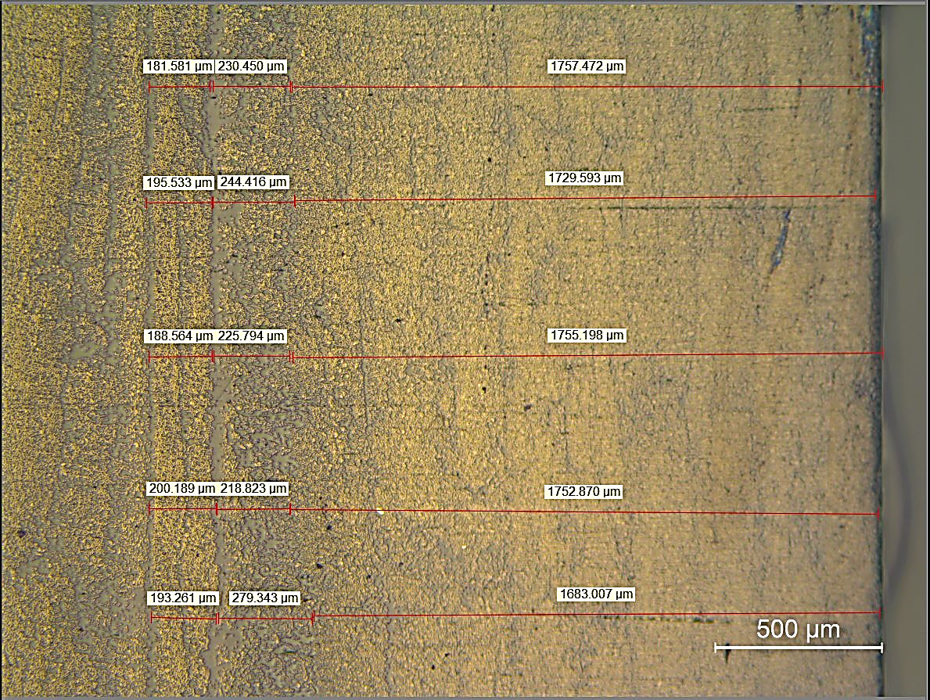
Optical Inspection of Interface
182 µm
230 µm
1757 µm
196 µm
244 µm
1730 µm
189 µm
226 µm
1755 µm
200 µm
219 µm
1753 µm
193 µm
280 µm
1683 µm
HR
(2plies)
ER
(2plies)
IM7/8552 Backer Laminate
(9plies)
Notes:
We also took specimens from these sample samples for optical microscopy. Here you see a low magnification image of a polished cross-section showing about 1-half of the laminate. There are 9 plies of conventional material on the right hand side. The joint is on the left side of the image, and you can see multiple plies of HR and ER material.

Slide 23
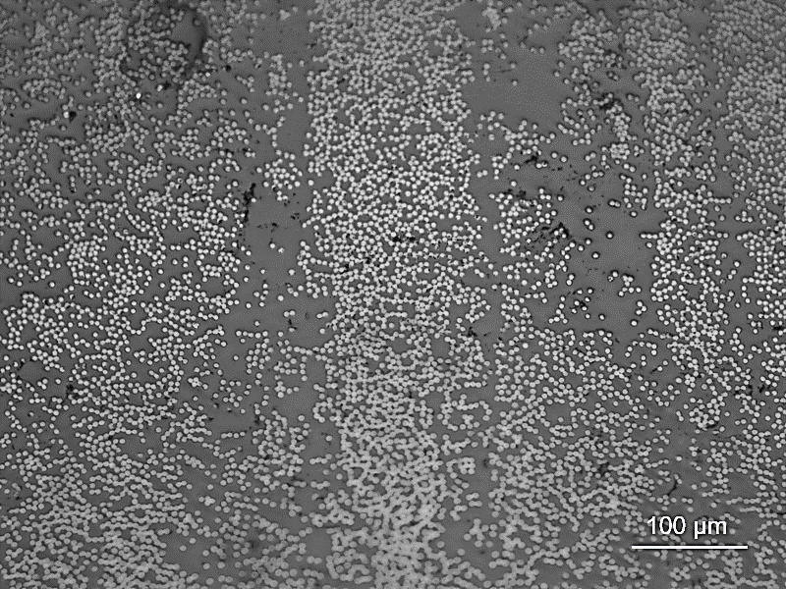
Looks like Co-cure
ER (2plies)
HR (2plies)
ER (2plies)
Find the interface
Notes:
When I zoom in a bit closer and focus on the AERoBOND plies, you can see more clearly the intermixing that was achieved between the ER and HR layers during secondary cure. Like a co-cured laminate, there is no visible interface between the plies of this AERoBOND joined laminate.

Slide 24
Additional Test Methods
Double Cantilever Beam (DCB) & End-Notched Flexure (ENF)
Quasi-static testing
ASTM D5528 (DCB) & D7905 (ENF) for mode I & mode II interlaminar fracture toughness (G_{lc} & G_{llc})
ASTM D3165 (SLS) & D3528(DLS): Interlaminar
shear strength (ILS)
ASTM D6415 (CB): Interlaminar tensile strength (ILT)
Fiber direction
FEP crack starter
Single-Lap Shear (SLS) & Double-Lap Shear (DLS)
Fiber direction
Fiber direction
Curved Beam (CB)
Notes:
In addition to ENF testing to measure mode II fracture toughness, several other mechanical tests are being conducted on the optimized AERoBOND configuration. Here I am showing 4 additional quasi-static testing techniques we are working on. We will measure mode I interlaminar fracture toughness using double cantilever beam, apparent shear strength using single and double lap shear tests, and interlaminar tensile strength using curved beam.

Slide 25
Additional Test Methods
Flatwise Tension (FWT)
Quasi-static testing
ASTM D7291: Interlaminar Tensile Strength (ILT)
Impact and Quasi-static testing
ASTM D7136 (BVID) and ASTM D7137 (CAI): Damage tolerance
Barely Visible Impact Damage (BVID) & Compression After Impact (CAI)
Step 1
Step 2
Notes:
We will also measure the interlaminar tensile strength using the flatwise tension technique using the thin laminate configuration shown on the left rather than the thick laminate configuration with reduced gage section shown at the right. We also plan to assess damage tolerance using the barely visible impact damage test followed by compression after impact.

Slide 26
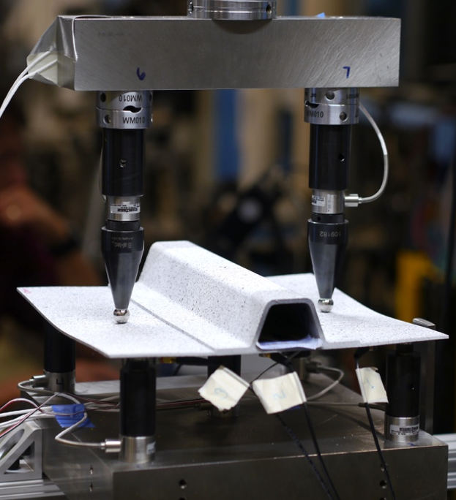
Sub-element Testing Concept
Derived from previous NASA project
Seven-point Bend (7PB) test on hat stiffened panels
Stiffener separation is a major concern for primary aircraft structures
Mimics buckled half-wave deformation in stiffened composite panels
  Separation between the flange and skin interface
  Combined opening and shear loads
Notes:
In addition the coupon level tests, we are planning a, sub-element level test derived from a stringer stiffen panel test developed and used under the NASA Advanced Composites Project. Stiffener separation is a major concern for primary aircraft structures. This Seven-Point Bend test uses five static supports under the panel and to load points above to mimic a buckled half-wave deformation. The test combines opening and shear loads to separate the flange from the skin which will allow us to test AERoBOND joints.

Slide 27
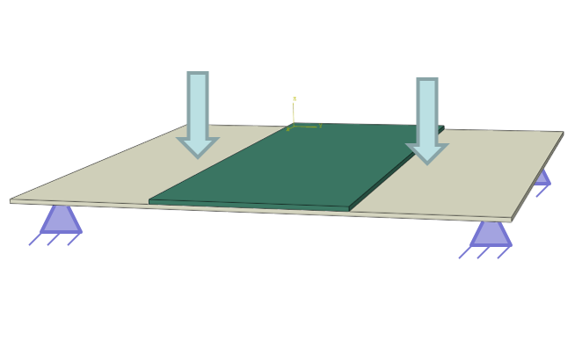
Sub-element Test Advantages
Simple fabrication
Tooling and test fixture are available
Simple geometry
  Building upon coupon characterization effort
Stable failure progression may be possible
Can add simulated damage (FEP insert)
Readily scaled to larger or more complex specimen designs
  Hat or other stiffened geometries
  Single-stringer compression panels
  Multi-stringer combined loading panels
Notes:
For the AERoBOND project, we are replacing the hat stiffener with a flat doubler for fabrication simplicity and also because the tooling is available in our labs. This test may exhibit stable failure progression, which is helpful for characterization. Delaminations and precracks can be added during fabrication for specific test cases. The test can be scaled to larger or more complex specimen designs such as hat or other stiffened geometries, single-stringer compression panels, and multi-stringer combined loading panels.

Slide 28
Conclusions
AERoBOND Method:
  Goal is predicable joints in composite assemblies
  Based on aerospace precursor materials
Visual inspection indicates good mixing at AERoBOND interface
  AERoBOND joint indistinguishable from interlaminar region
ENF results exceeded 100% of baseline properties in multiple samples
  Three AERoBOND configurations shown
  Non-precracked and precracked configurations
Next steps
  Demonstration of 80% or better properties for interlaminar tensile strength (ILT), interlaminar shear strength (ILS), and mode-I fracture toughness (G_{lc})
  Sub-element scale joint test
  Chemical microscopy of cured joints to measure mixing and cure state
Notes:
In conclusion, the AERoBOND method is a rapid, reliable assembly technique for composite structures to reduce or eliminate the need for redundant fasteners. It enables unitization without complex tooling or processing and is practical for near-to-mid-term implementation. The precursor materials are commercially available, and, in some cases, already in-use by the aerospace industry.
Microscopic inspection indicated good mixing at the AERoBOND interface is achievable, making the an AERoBOND joint indistinguishable from a co-cured interlaminar region.
Recent ENF testing that measured mode II fracture toughness showed that the AERoBOND process can match co-cure properties and I showed you three different configurations with as manufactured crack tips and naturally sharp crack tips.
Very soon we plan to measure the interlaminar tensile and shear strengths, mode I fracture toughness, and damage tolerance in a series of quasi-static coupon tests. And I also showed you some plans for a sub-element scale test that we are planning for later this year.

Slide 29
Thank You !
Notes:
Thank you for attending this virtual presentation. Please don’t hesitate to contact me to learn more about this topic. My email address is on slide 3.

