Slide 1
Ionic Polyimides: New High Performance Polymers for Additive Manufacturing
PI:
Enrique Jackson, Ph.D. EM22
NASA/Marshall Space Flight Center

Slide 2
Collaborators
Jason Bara, Ph.D. – The University of Alabama – Tuscaloosa
Kendall Byler, Ph.D. – The University of Alabama – Huntsville
Aaron Adams, Ph.D. – Alabama A&M University
Erica West – Florida A&M University
Tim Huff – EM22
Brian Thomas – Alabama A&M University
Yi Tuan – University of California – Irvine
Gala Solis – University of Texas – El Paso
Tomekia Simeon, Ph.D. – Dillard University

Slide 3
Agenda
Abstract
Introduction
Experimental Activities
  Synthesis
  Thermal Characterizations
    DSC
    TG
    Modeling
Papers Published
Future Work

Slide 4
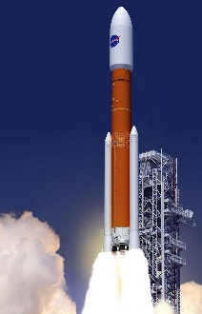
Background
There is a very limited amount of polymers functional enough for 3D printing.
Within additive manufacturing, there is a need for a larger assortment of materials such as polymers that can be controlled and manipulated through its chemical, physical, mechanical, and thermal properties.
Ionic polyimides present us with new possibilities due to the detailed research of conventional polymers.
Advanced polymer materials such as polyimides, and polymeric ionic liquids are spearheading the new approaches on polymer synthesis with new advantages. These materials will play a vital part in the continuous research of polymers being used in additive manufacturing and 3D printing.
Image credit: NASA, NASA's Space Launch System, or SLS, which offers numerous benefits for scientific missions, from larger spacecraft mass to reduced travel time through the solar system in route to other worlds.

Slide 5
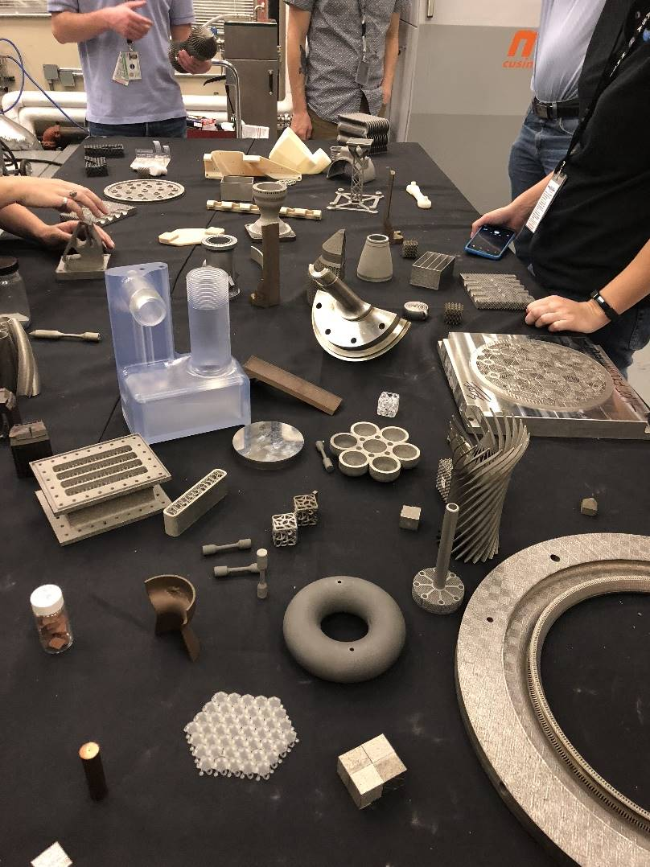
Polyimides and Ionic Liquids (ILs) for Spacecraft Exploration
In order to advance space craft development, there is a need for an understanding the possible utility of these components.
Characterizing their thermal properties and simulating the behaviors of the building blocks of the polymeric structures will aid in the development of fabricated novel pellets.
This well take precedence over the next step, which will be development of filament feedstock used for 3D printing. Through synthesizing, characterization, and simulation, a set of structure-property relationships will be developed.

Slide 6
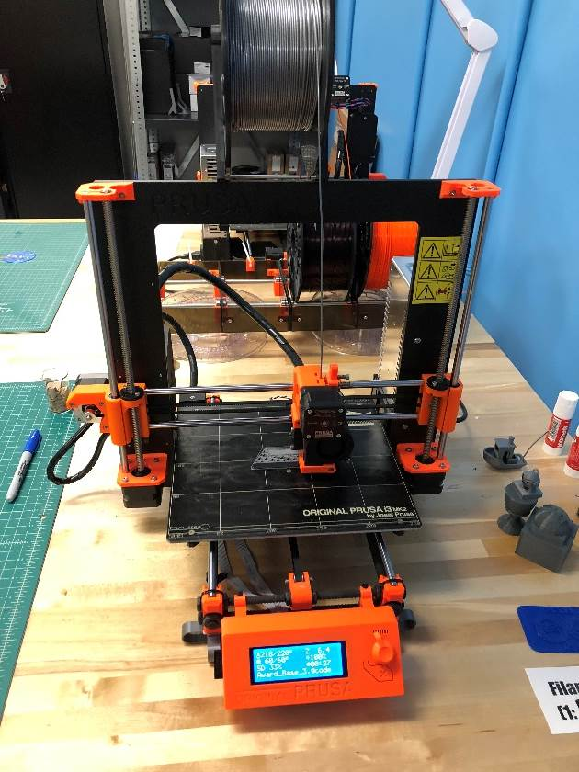
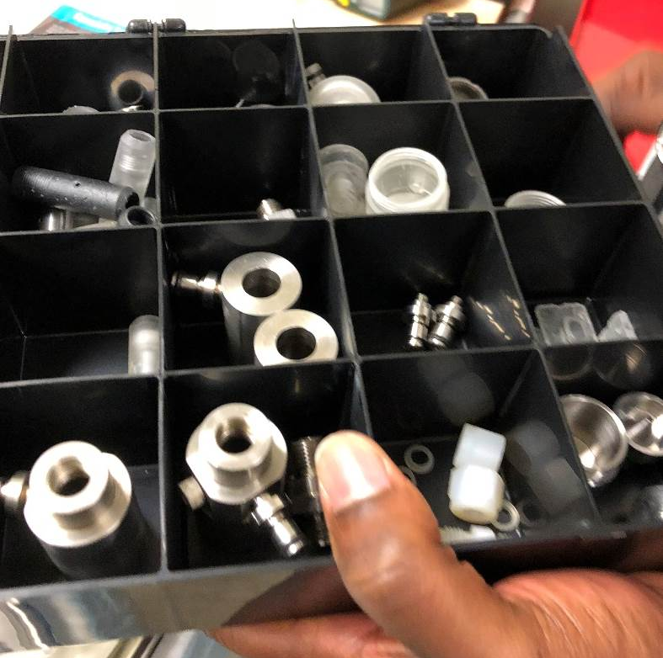
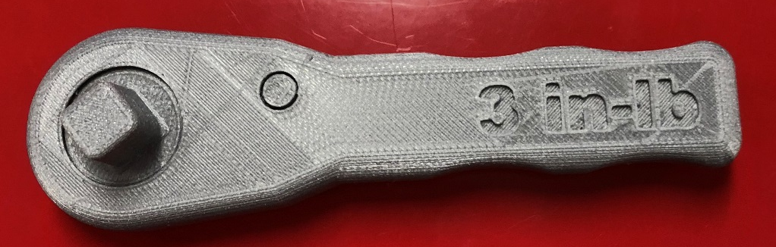
Polyimides and Ionic Liquids (ILs) for Spacecraft Exploration

Slide 7
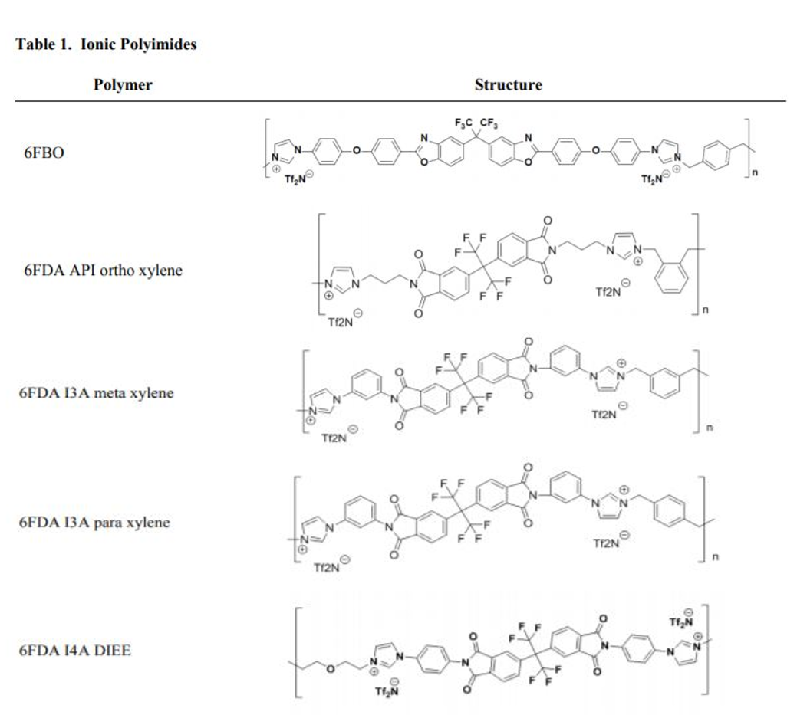
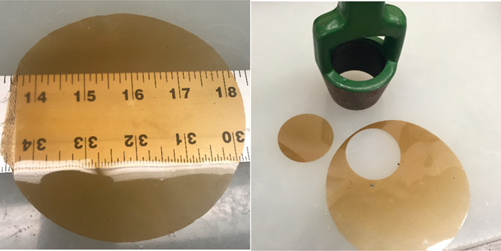
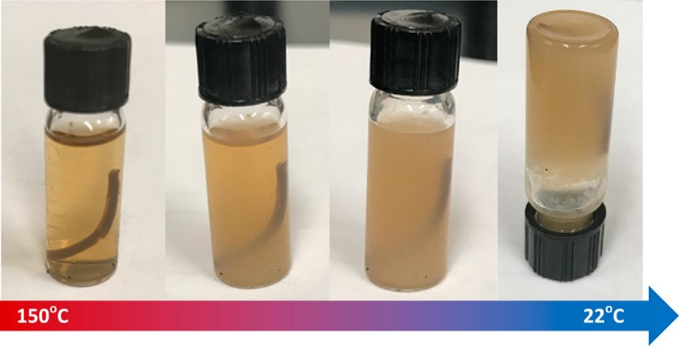
Example of Studied Complexes/Models
Images of a large area melt-pressed film (left)
and film with 47 mm disc punched (right).
Ionic Liquids

Slide 8
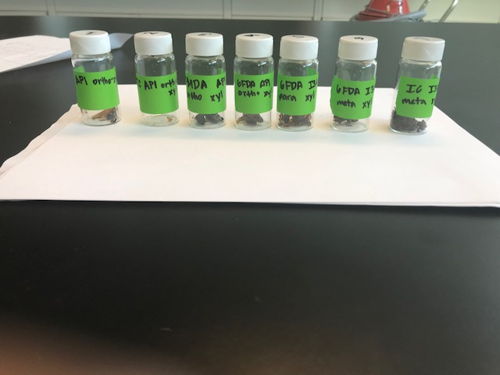
Ionic Polyimides

Slide 9
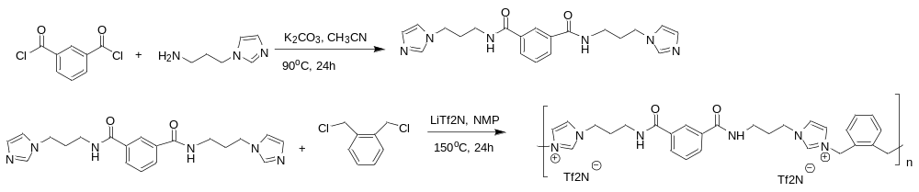
Ionic Polyimide Synthesis
IC API ortho xylene

Slide 10
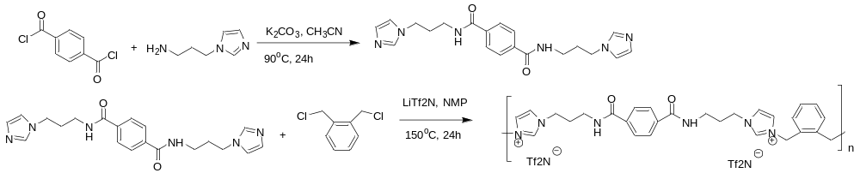
Ionic Polyimide Synthesis
TC API ortho xylene

Slide 11
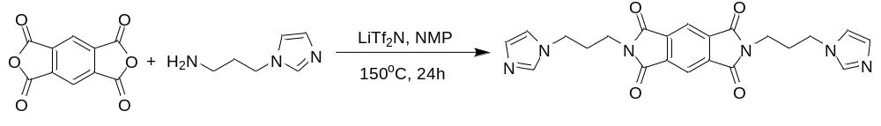
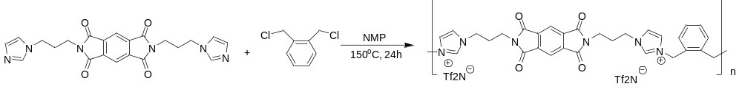
Ionic Polyimide Synthesis
PMDA API ortho xylene

Slide 12
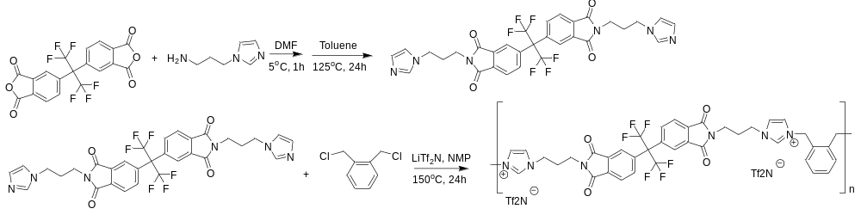
Ionic Polyimide Synthesis
6FDA API ortho xylene

Slide 13
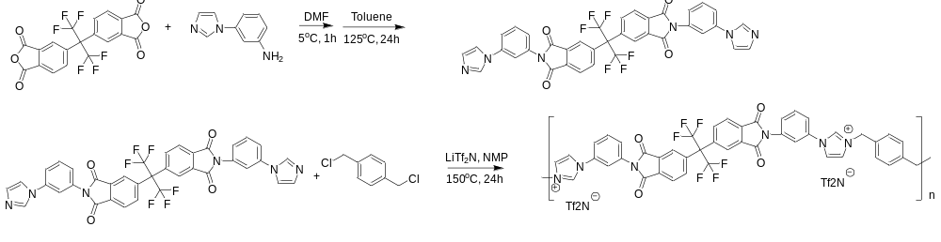
Ionic Polyimide Synthesis
6FDA I3A para xylene

Slide 14
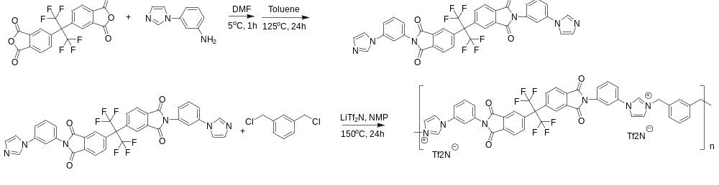
Ionic Polyimide Synthesis
6FDA I3A meta xylene

Slide 15
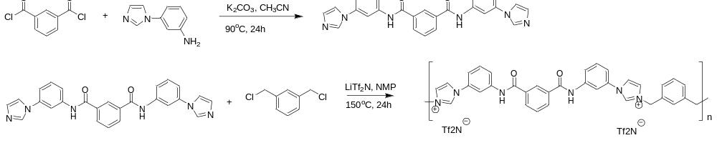
Ionic Polyimide Synthesis
IC I3A meta xylene

Slide 16
Thermal Characterization Techniques – Differential Scanning Calorimetry (DSC)
DSC is a technique in which the difference in energy inputs into a substance and a reference materials reassured as a function of temperature while the substance and reference is subjected to a controlled-temperature program

Slide 17
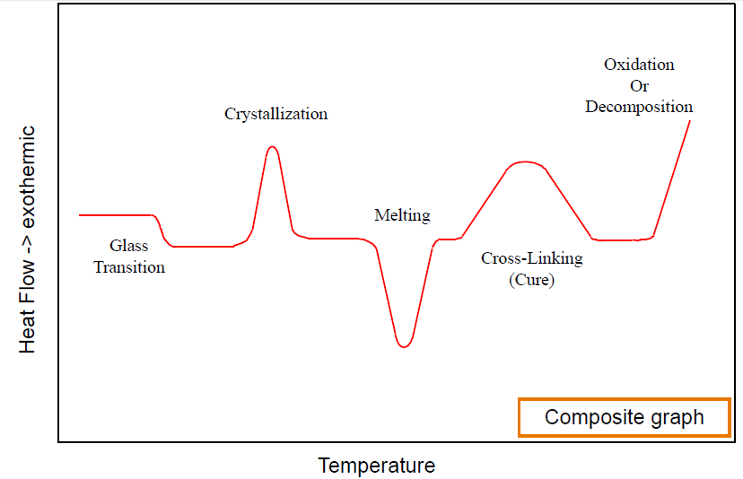
Typical DSC Transitions
DSC Training – TA Instruments

Slide 18
DSC Results – Starting Materials
Samples | Endothermic Transition 1 (J/g) | Endothermic Transition 2 (J/g) | Endothermic Transition 3 (J/g) | Exothermic Transition (J/g)
Sample 1 Onset Temperatures (°C) | 10.34 ± 0.08 229.15 ± 0.33 | 196.45 ± 10.68 265.83 ± 0.13 | 140.65 ± 4.31 287.85 ± 0.16
Sample 2 Onset Temperatures (°C) | 37.59 ± 4.43 229.15 ± 0.33 |  |  | 48.08 ± 0.92 374.22 ± 4.07
Sample 3 Onset Temperatures (°C) | 356 304.67
Sample 5 Onset Temperatures (°C) | 12.65 ± 1.27 74.54 ± 1.02 | 61.73± 21.45 171.95 ± 0.21
Sample 6 Onset Temperatures (°C) | 186.5 ± 1.13 116.79 ± 18.83 | 153.2 ± 4.80 232.97 ± 16.67
Sample 7 Onset Temperatures (°C) | 105.85 ± 1.91 47.75 ± 0.16 | 218.4 ± 55.58 282.66 ± 4.11
Sample 8 Onset Temperatures (°C) | 490.45 ± 232.28 256.81 ± 2.96
Sample TC Onset Temperatures (°C) | 9.79 ± 0.26 71.06 ± 0.16 | 122.65 ± 3.18 85.96 ± 0.41 | 280.05 ± 0.92 277.37 ± 0.56
Sample 6FDA Onset Temperatures (°C) | 110.45 ± 6.71 247.56 ± 0.19

Slide 19
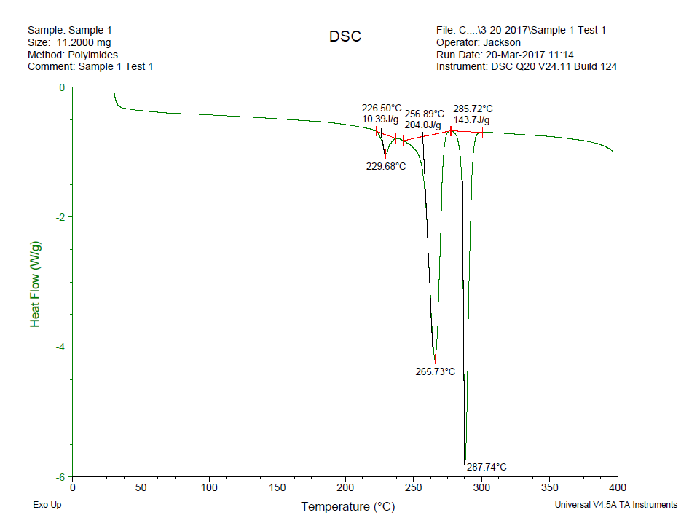
DSC Results – Starting Materials

Slide 20
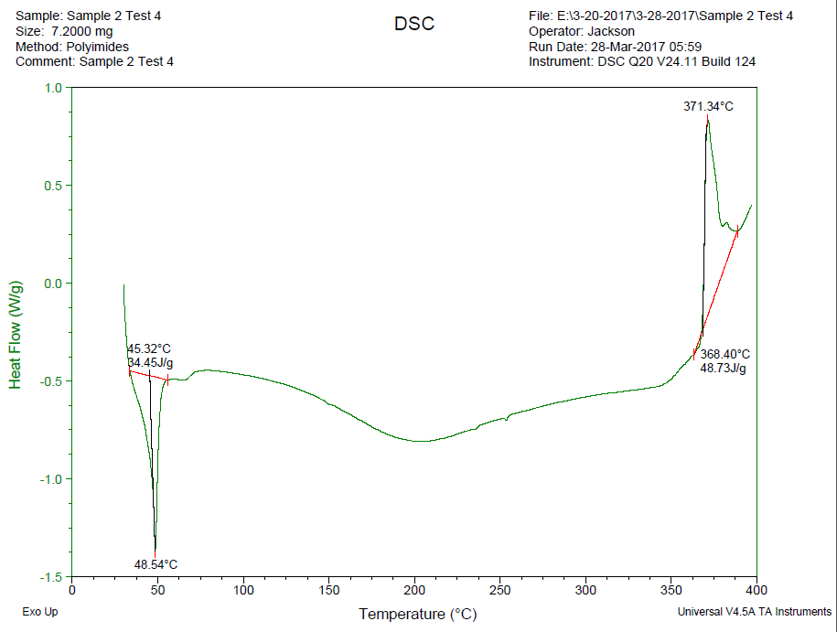
DSC Results – Starting Materials

Slide 21
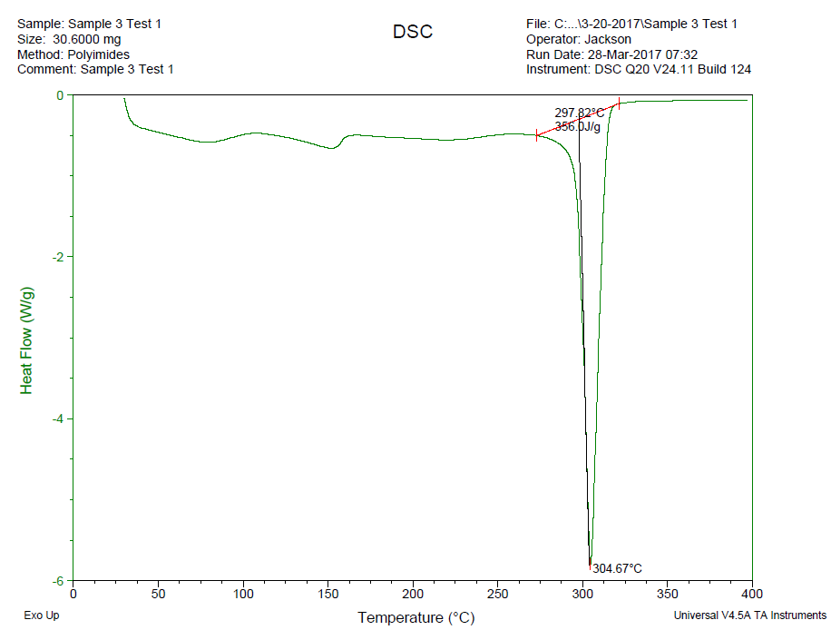
DSC Results – Starting Materials

Slide 22
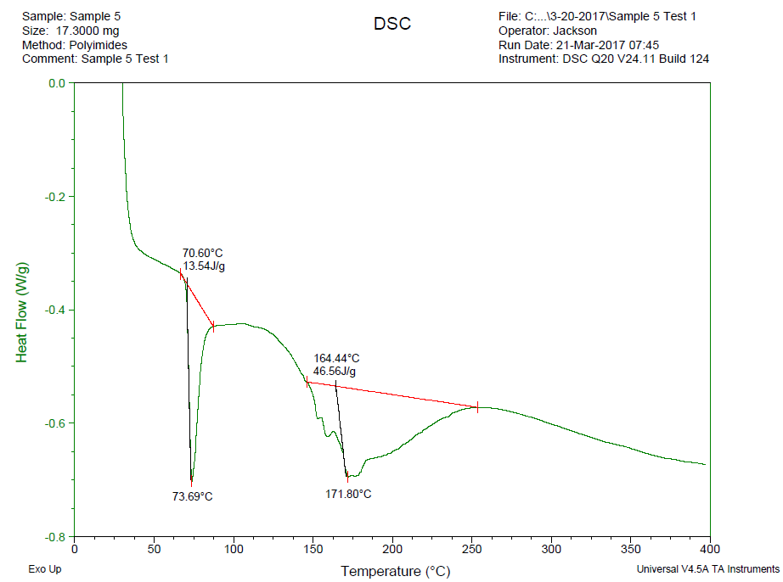
DSC Results – Starting Materials

Slide 23
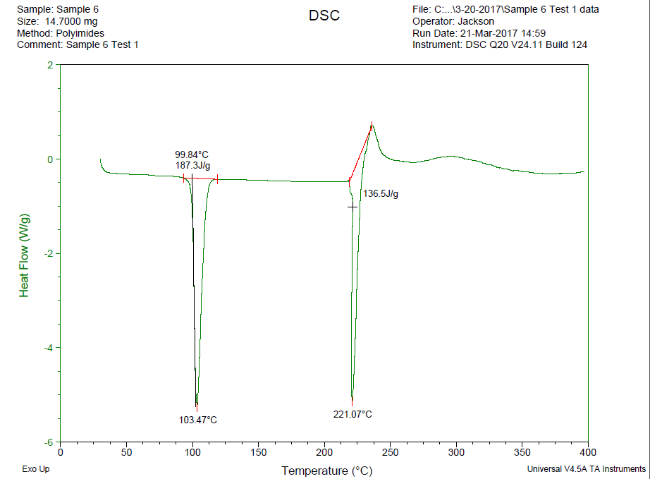
DSC Results – Starting Materials

Slide 24
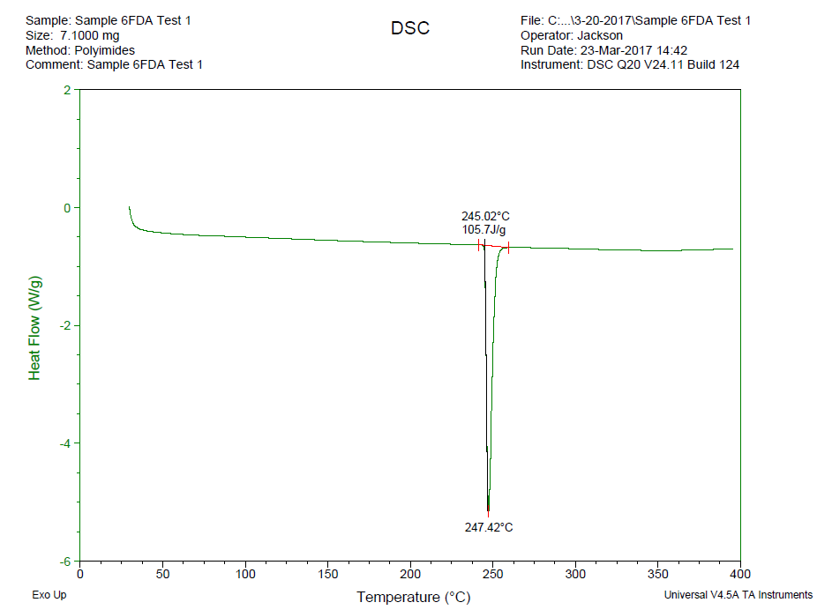
DSC Results – Starting Materials

Slide 25
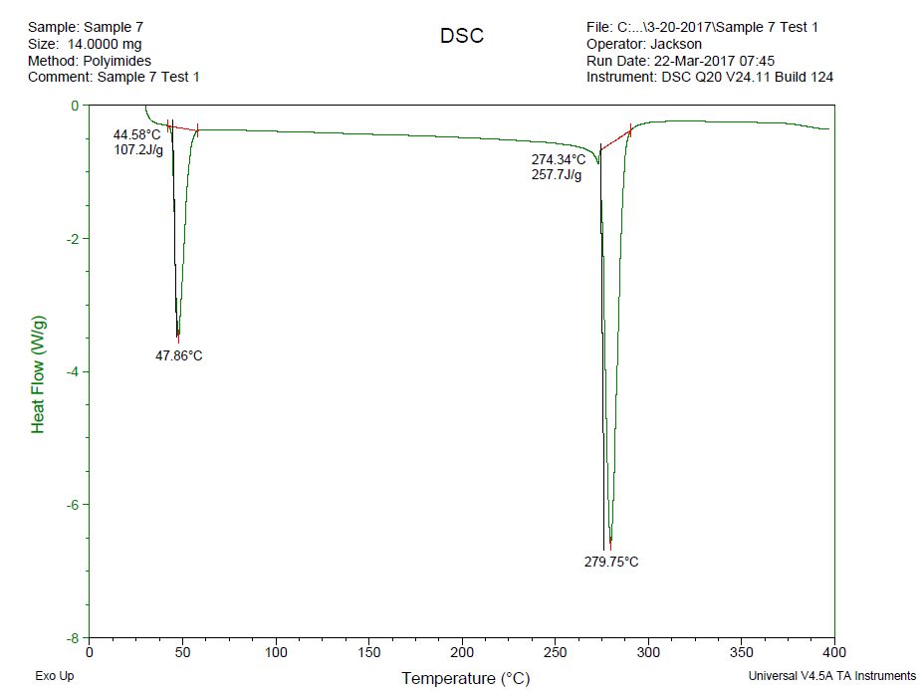
DSC Results – Starting Materials

Slide 26
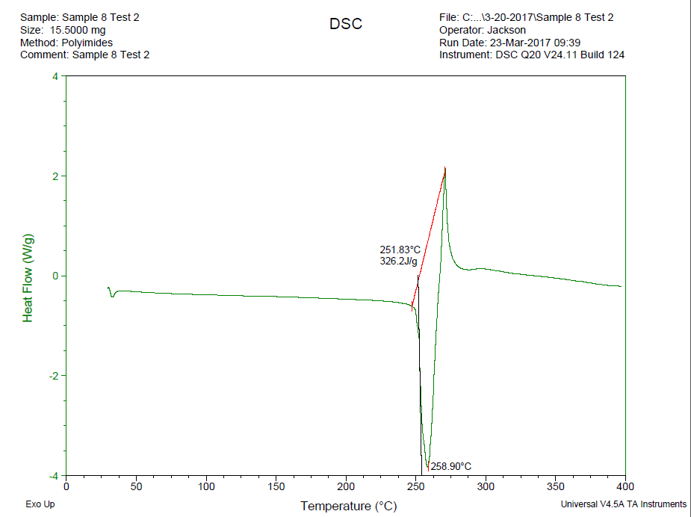
DSC Results – Starting Materials

Slide 27
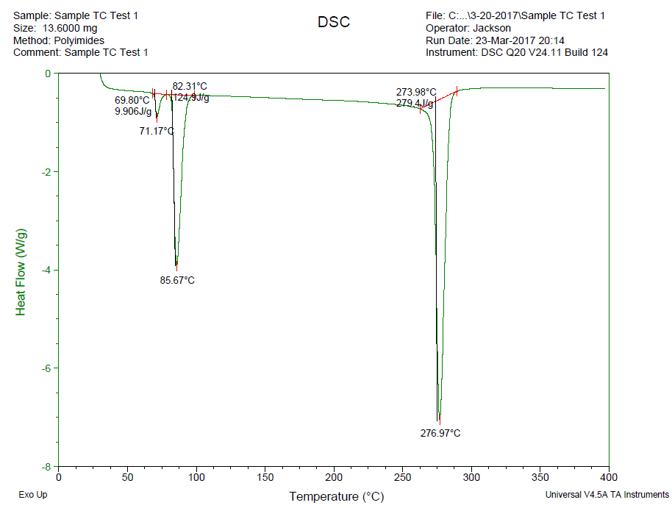
DSC Results – Starting Materials

Slide 28
DSC Results – Polymeric Materials
 | TC | 6FDA | 6FDA-Meta | 6FDA-Para | PMDA-API-P-XYL | TC-API-M-XYL | 6FDA-Starting Mat'L | BPADA-APT-P-XYL
Endotherm #1 | 67.62 ± 0.36 | 244.25 ± 0.12 | 101.21 ± 6.75 | 80.14 ± 9.98 | 166.26 ± 8.61 | 139.16 ± 3.97 | 244.47 ± 0.05 | 129.37 ± 5.21
Heat of Fusion #1 | 9.35 ± 0.63 | 104.8 ± 4.11 | 4.90 ± 0.51 | 50.57 ± 5.12 | 21.51 ± 0.61 | 5.86 ± 1.29 | 98.94 ± 9.80 | 20.62 ± 8.12
Melting Point #1 | 69.94 ± 0.77 | 246.3 ± 0.16 | 108.62 ± 7.85 | 132.58 ± 3.80 | 193.76 ± 1.15 | 151.07 ± 5.90 | 246.63 ± 0.21 | 142.32 ± 5.35
Endotherm #2 | 81.70 ± 0.38 |  |  |  |  | 321.81 ± 2.46
Heat of Fusion #2 | 109.27 ± 6.34 |  |  |  |  | 0.28 ± 0.24
Melting Point #2 | 85.06 ± 1.67 |  |  |  |  | 324.17 ± 4.23
Endotherm #3 |  |  |  |  |  | 340.96 ± 5.92
Heat of Fusion #3 |  |  |  |  |  | 0.17 ± 0.08
Melting Point #3 |  |  |  |  |  | 341.48 ± 5.90

Slide 29
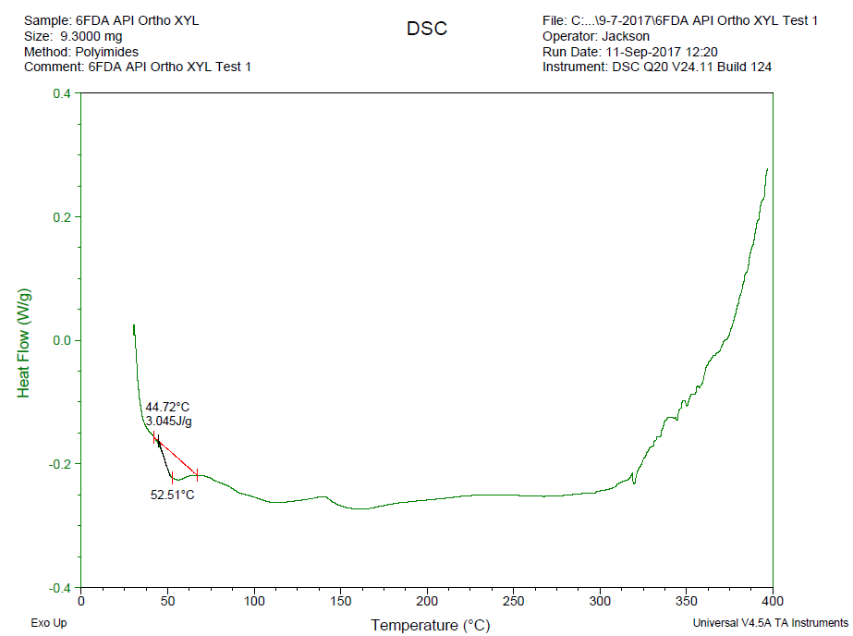
DSC Results – Polymeric Materials

Slide 30
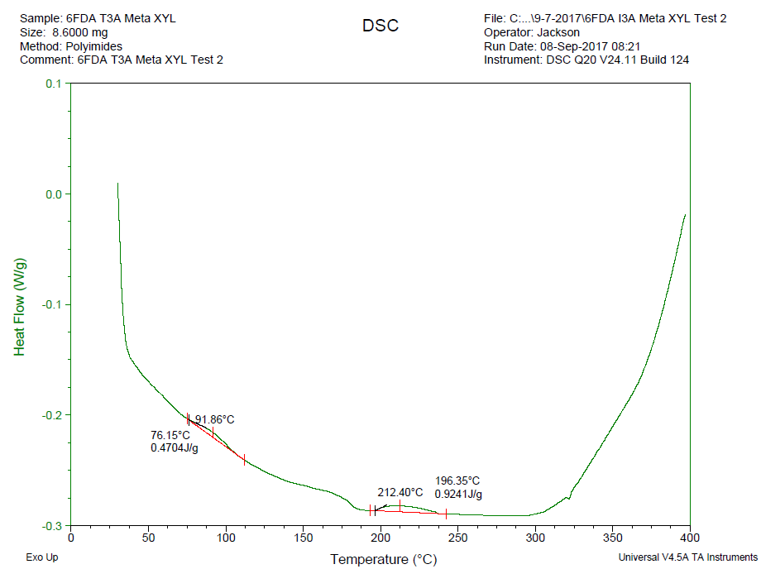
DSC Results – Polymeric Materials

Slide 31
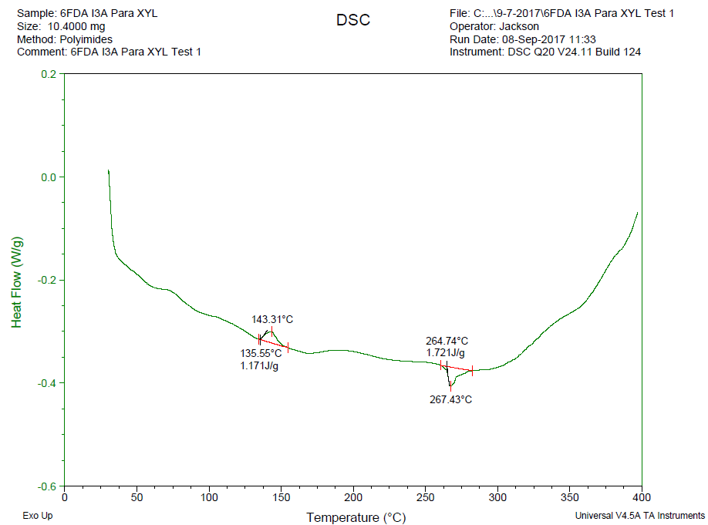
DSC Results – Polymeric Materials

Slide 32
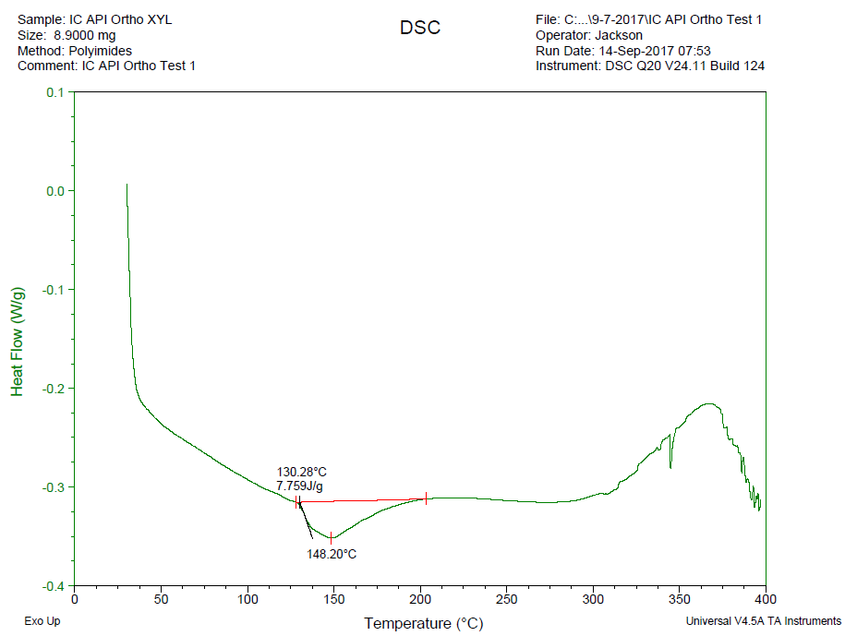
DSC Results – Polymeric Materials

Slide 33
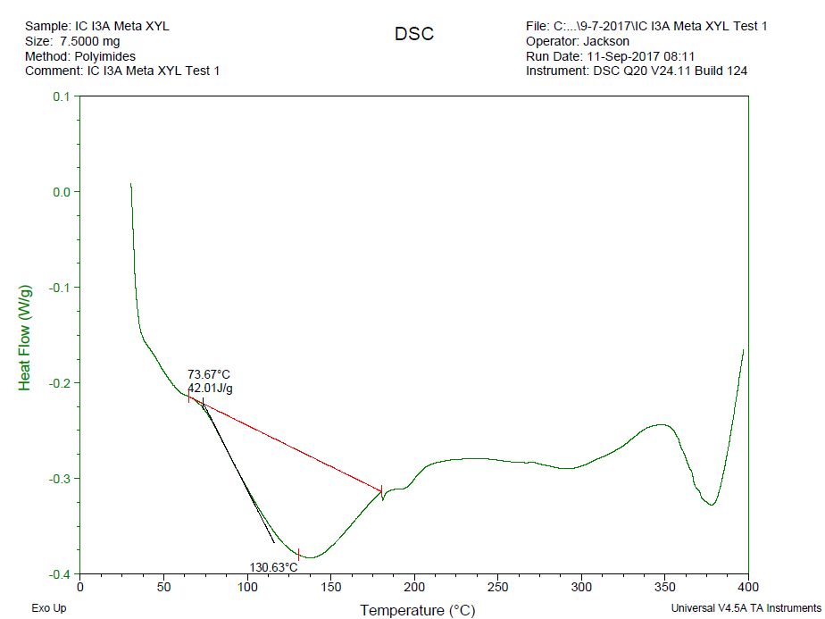
DSC Results – Polymeric Materials

Slide 34
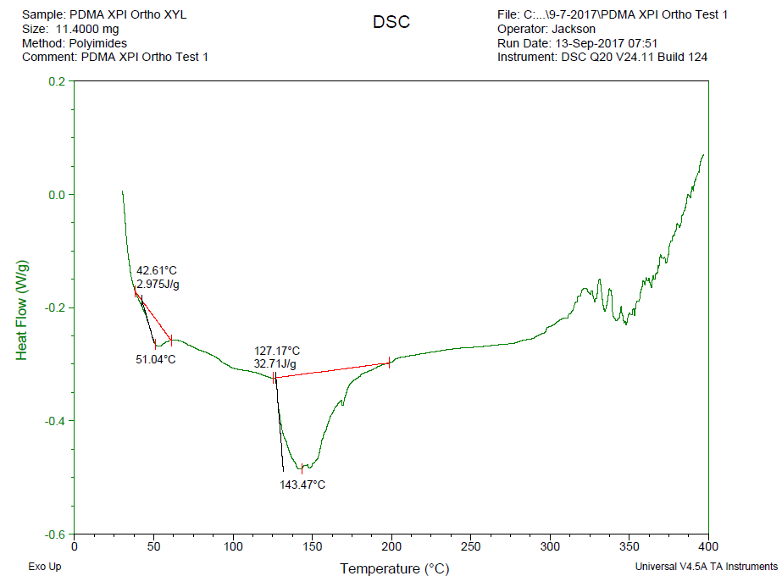
DSC Results – Polymeric Materials

Slide 35
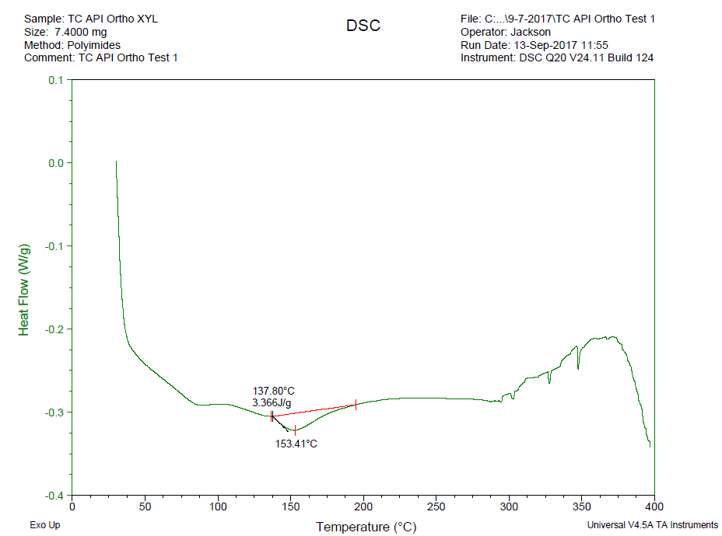
DSC Results – Polymeric Materials

Slide 36
TG-IR
Thermogravimetric analysis (TG) follows changes in mass of the sample as a function of temperature and/or time.
TG gives characteristic information about the composition of the measured sample, in particular the amounts of the various components and their thermal behavior.
In addition, further measurements are possible such as kinetic analysis of thermal decomposition.

Slide 37
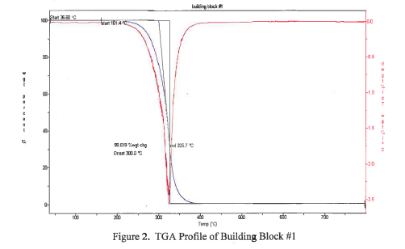
TG Data

Slide 38
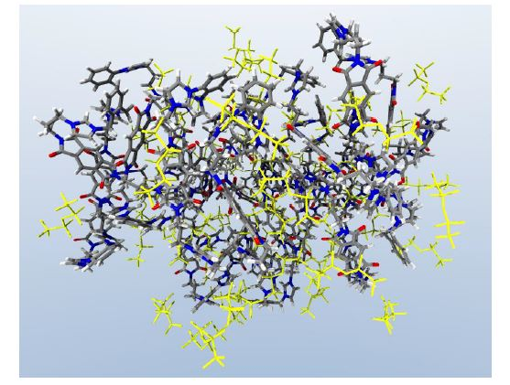
(2) High-performance computing
Structure-Property Calculations of Ionic Polyimides: Hybrid Polymer Architectures and Composites
Condensed structure of PMDA API ortho xylene oligomer with bistriflimide counterions

Slide 39
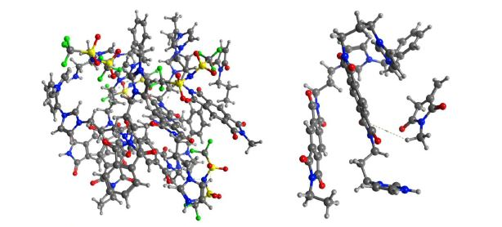
Structure-Property Calculations of Ionic Polyimides: Hybrid Polymer Architectures and Composites
Portions of condensed PMDA API ortho xylene polymer structure
used for DFT-SAPT calculations

Slide 40
Motivation
It is clear that there is now a significant opportunity for making a major step forward in our understanding of ionic polyimide folding and shape memory behavior through the use of high performance computation.
Empirical potential classical molecular dynamics calculations are now possible for whole polymer structures, and such calculations on an HPC system for a long enough time (~ 1 microsecond) to equilibrate structures that include explicit water and ions would enable us to determine useful information about intermolecular forces including both covalent linkages and solvent dependence effects.
A key issue that needs to be established is whether CHARM and/or Amber force fields are providing qualitatively accurate information about the polymers’ change in structure as the temperature is increased and if this same structural change corresponds with experimental observed endotherms?

Slide 41
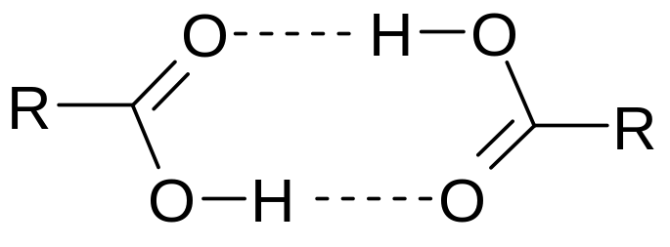
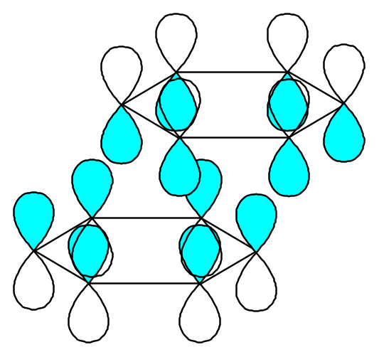
Motivation
To understand the non-bonding energetic contributions as a function of temperature during folding/buckling.
Types of non-covalent interactions
  Hydrogen bonding
  Ionic bonds
  van der Waals forces
  Hydrophobic interactions

Slide 42
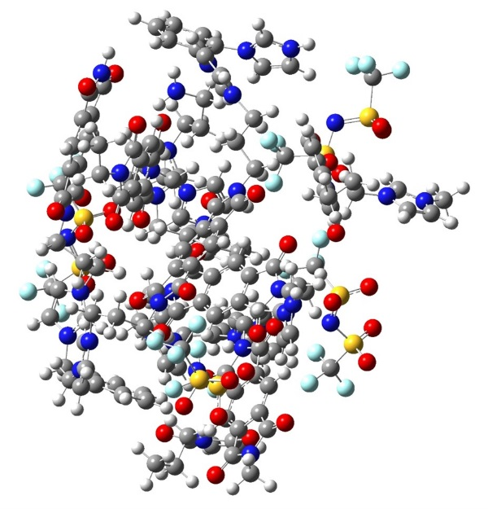
Simulation Details
electron deficient
Calibrating DFT-SAPT with FMO method
for ionic polymers
Electronic Structure Calculations: Initial constrained optimizations Subsequent, single-point calculations at the HF, MP2 and DFT level of theory were performed.
QChem was used for all electronic structure calculations.
Density Functional Theory-Symmetry Adapted Perturbation Theory (DFT-SAPT) calculations performed using Molpro.
Fragment Molecular Orbital (FMO) method.
electron rich

Slide 43
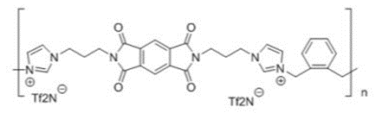
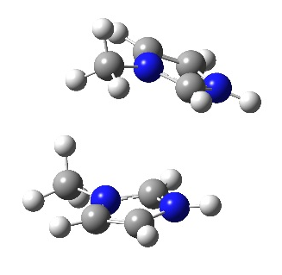
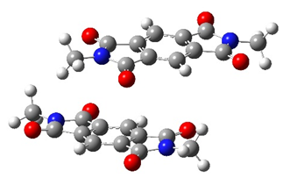
Example of Modeled Complexes
PMDA API ortho xylene polymer short oligomer.
The fragmentation scheme for
π-π stacking in PMDA API ortho xylene polymer labeled Complex A. A total of 15 fragments was taken from optimized globular structure and used for DFT-SAPT calculations.
The fragmentation scheme for
H-bonding in PMDA API ortho xylene polymer labeled Complex B. A total of 15 fragments was taken from optimized globular structure and used for DFT-SAPT calculations.

Slide 44
Ab Initio Calculations
Heats of formation are calculated using a Gaussian-3 (G3) formulation, which isolates sources of error in individual methods and derives total energy from the ensemble of energies:
  Equilibrium structure optimized at HF/6-31G(d)
  Zero-point energy calculated using harmonic frequencies scaled for 6-31G(d) basis
  Geometry optimized at MP2/6-31G(d), single-point at MP4/6-31G(d); used in subsequent single-point calculations:
    Diffuse correction: MP4/6-31+G(d)
    Polarization correction: MP4/6-31G(2df,p)
    Correlation correction: QCISD(T)/6-31G(d)
    Basis correction: “G3Large” basis (3d 2f 2df)++**
    Spin-orbit and valence corrections: empirical
  Total energy equivalent to QCISD(T)(full)/6-311++G(3df 2df 2dp)

Slide 45
Objective
To calibrate computational methods DFT-SAPT and FMO-PIEDA for ionic polyimides to understand intermolecular interactions and compare to experimental data.

Slide 46
DFT-SAPT
Density Functional Theory (DFT)-Symmetry Adapted Perturbation Theory (SAPT) consists of two steps.
1. First, is the so-called SAPT(KS), where electrostatics, first-order exchange,
induction, exchange-induction, dispersion, and exchange-dispersion are
obtained.
2. For meaningful results, SAPT(KS) requires asymptotically corrected (AC)
Kohn-Sham calculations.
3. SAPT(KS) does not reproduce dispersion correctly. The dispersion (and
induction) energies should be calculated from frequency-dependent density
susceptibility (FDDS) functions, obtained from the time-dependent DFT
(TD-DFT) theory at the coupled Kohn-Sham (CKS) level.
The total SAPT(DFT) interaction energy (up to second order in V ) can be defined as:

Slide 47
Fragmentation Methods
There are three types of fragmentation methods:
  Divide and conquer methods (separate countries)
  Transferable approaches such as ONIOM
  Fragment interaction approaches such as, the Fragment Molecular Orbital Method (FMO). This last type of method allows for an all environment treatment of the system
Specifically FMO takes into account the influence of the entire system during each individual fragment calculation

Slide 48
Basic Ideas
Exchange and self-consistency are local in most molecules
We can treat non-local parts using just the Coulomb operator, thereby ignoring exchange
Do the molecular calculations individually in the rigorous Coulomb field of the whole system
Improved by explicit many-body corrections for pairs and triples (dimers & trimers)
The Coulomb bath allows for fragmentation without hydrogen capping

Slide 49
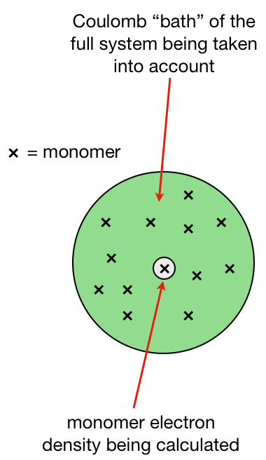
Basic FMO Methodology
Divide molecule into fragments and assign electrons to these fragments
Calculate initial electron density distribution of the fragments in the Coulomb “bath” of the full system
Construct the individual fragment Fock operators using the densities calculated in 2 and solve for the fragment energies
Determine if the density has converged for all the fragments. If not, go back to step 3
Construct Hamiltonians for each dimer (trimer) calculation using the converged monomer densities from steps 3-4
Calculate total energy and electron density

Slide 50
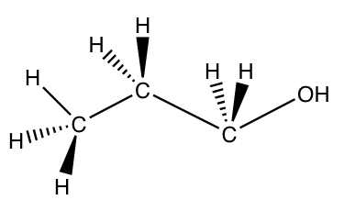
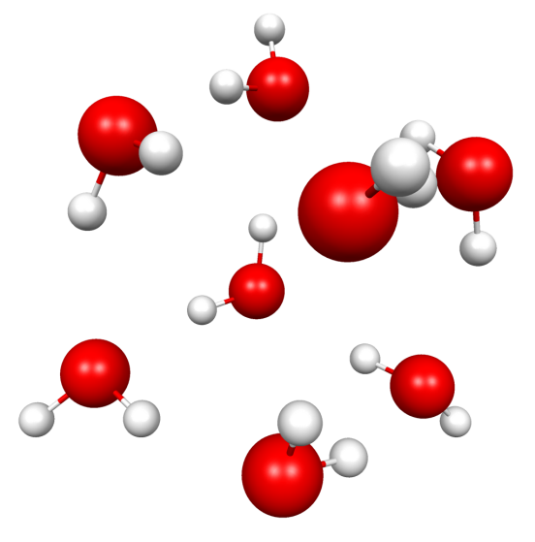
FMO Fragmentation
FMO Fragmentation
For covalently bonded molecules, we divide the fragment into pieces so as not to destroy bond electron pairs.
In water clusters, fragmentation is easier, requiring no covalent bond breaking. We can have one water per fragment, four waters per fragment etc.

Slide 51
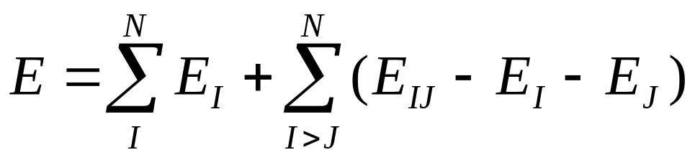
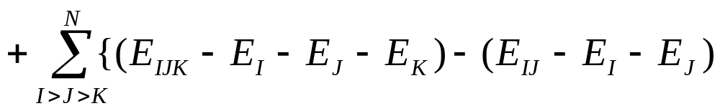
Basic FMO Methodology
The total energy of the system can be written as
where the monomer (I), dimer (IJ) and trimer (IJK) energies are obtained using the standard SCF method.

Slide 52
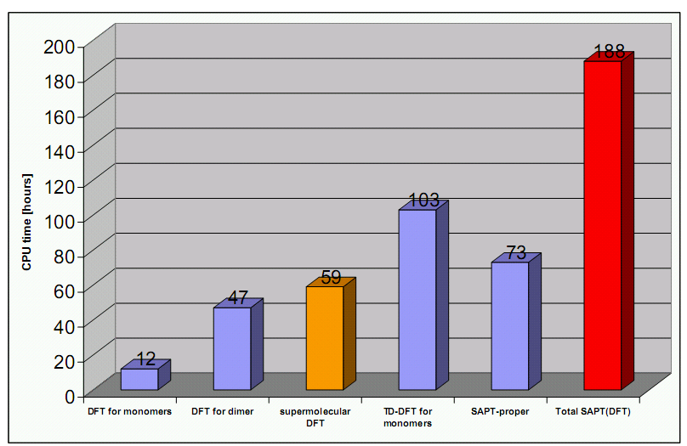
DFT-SAPT vs. FMO-PIEDA Methodology
The total energy of the system
Pair Interaction Energy Decomposition Analysis (PIEDA).
3 times or more or more

Slide 53
Sample Modeled Complexes
PMDA API ortho xylene polymer short oligomer.
The fragmentation scheme for
π-π stacking in PMDA API ortho xylene polymer labeled Complex A. A total of 15 fragments was taken from optimized globular structure and used for DFT-SAPT calculations.
The fragmentation scheme for
H-bonding in PMDA API ortho xylene polymer labeled Complex B. A total of 15 fragments was taken from optimized globular structure and used for DFT-SAPT calculations.

Slide 54








DFT-SAPT/PIEDA Results
Second-order DFT-DFT-SAPT/PIEDA results in kcal/mol for Complex A and B components.
Complex |  |  |  |  |  |  |  | + | PIEDA
A
cc-pVDZ | -23.6 | 3.6 | -15.8 | -18.6 | 1.1 | -10.5 | -21.9 | -81.1
cc-pVTZ | -25.9 | 3.6 | -17.0 | -24.7 | 1.3 | -14.0 | -26.4 | -85.0 | -96.8
aug-cc-pVDZ | -26.3 | 3.5 | -17.2 | -26.0 | 1.4 | -14.8 | -27.5 | -84.3
aug-cc-pVTZ | -26.4 | 3.6 | -17.3 | -27.0 | 1.5 | -15.6 | -28.2 | -84.8
B
cc-pVDZ | -18.6 | 7.7 | -14.1 | -36.5 | 2.6 | -17.5 | -22.3 | -23.7
cc-pVTZ | -21.9 | 7.8 | -15.9 | -44.8 | 2.9 | -21.2 | -28.0 | -28.6 | -45.2
aug-cc-pVDZ | -22.5 | 7.5 | -16.3 | -46.0 | 3.0 | -22.6 | -29.2 | -29.2
aug-cc-pVTZ | -22.6 | 7.7 | -16.4 | -47.3 | 3.1 | -23.6 | -30.1 | -30.1

Slide 55
Results
The DF-DFT-SAPT complexation energies deviate by 11.2 and 15.2 kcal/mol, respectively from the estimated FMO-PIEDA complexation energies, which is an amazingly close result in view of the differing theoretical foundations of both approaches.
The SAPT dispersion energy evaluated with the aug-cc-pVDZ basis set is comparable with the aug-cc-pVTZ basis set.
We found that induction interactions dominate in Complex A while dispersion interactions play a bigger role in Complex B.
Study shows DF-DFT-SAPT is useful in the rigorous determination of individual energy contributions to the total interaction energy and could be useful for future theoretical descriptions and force field parameterizations in other supramolecular assemblies.

Slide 56
Papers
Kammakakam, I.; Bara, J. E.; Jackson, E. M. Synthesis and Characterization of Imidazolium-Mediated Tröger's Base Containing Poly(amide)-Ionenes for High-Performance CO₂ Separation Membranes. J. Mater. Chem. A In Review.
Kammakakam, I.; Bara, J. E.; Jackson, E. M. Dual Anion-Cation Crosslinked Poly(ionic liquid) Composite Membranes for Enhanced CO₂ Separation. ACS Appl. Polym. Mater. In Review.
O’Harra, K. E.; Noll, D. M.; Kammakakam, I.; DeVriese, E. M.; Solis, G. C.; Jackson, E. M.; Bara, J. E. Designing Imidazolium Poly(amide-amide) and Poly(amide-imide) Ionenes and Their Interactions with Mono- and Tris(imidazolium) Ionic Liquids. Polymers 2020, 12, 1254. doi:10.3390/polym12061254 *Invited Contribution – Innovative Polymer Electrolytes Special Issue
Kammakakam, I.; Bara, J. E.; Jackson, E. M.; Lertxundi, J.; Mecerreyes, D.; Tome, L. C. Tailored CO₂-philic Anionic Poly(ionic liquid) Composite Membranes: Synthesis, Characterization and Gas Transport Properties. ACS Sustain. Chem. Eng. 2020, 8, 5954-5965. doi:10.1021/acssuschemeng.0c00327
O’Harra, K. E.; Kammakakam, K. E.; Noll, D. M.; Turflinger, E. M.; Dennis, G. P.; Jackson, E. M.; Bara, J. E. Synthesis and Performance of Aromatic Polyamide Ionenes as Gas Separation Membranes. Membranes 2020, 10, 51. doi:10.3390/membranes10030051 *Invited Contribution – Ionic Liquid-based Materials for Membrane Processes

Slide 57
Papers
O’Harra, K. E.; Kammakakam, I.; Bara, J. E.; Jackson, E. M. Understanding the Roles of Backbone and Anions in the Structure and Thermal Stability of Imidazolium Polyimide-Ionenes. Polym. Int. 2019, 68, 1547-1556. doi:10.1002/pi.5825
O’Harra, K. E.; Kammakakam, I.; DeVriese, E. M.; Noll, D. M.; Bara, J. E.; Jackson, E. M. Synthesis and Gas Separation Performances of Membranes Comprised of 6-FDA-Derived Polyimide Ionenes and Ionic Liquids. Membranes 2019, 9, 79. doi:10.3390/membranes9070079
Kammakakam, I.; O’Harra, K. E.; Dennis, G. P.; Jackson, E. M.; Bara, J. E. Self‐Healing Imidazolium‐based Ionene‐Polyamide Membranes: An Experimental Study on Physical and Gas Transport Properties. Polym. Int. 2019, 68, 1123-1129. doi:10.1002/pi.5802
Kammakakam, I.; O’Harra, K. E.; Bara, J. E.; Jackson, E. M. Design and Synthesis of Imidazolium-Mediated Tröger's Base-Containing Ionene Polymers for Advanced CO₂ Separation Membranes. ACS Omega 2019, 4, 3439-3448. doi:10.1021/acsomega.8b03700
Bara, J. E.; O’Harra, K. E.; Durbin, M. M.; Dennis, G.P.; Jackson, E. M.; Thomas, B.; Odutola, J. Synthesis and Characterization of Ionene-Polyamide Materials as Candidates for New Gas Separation Membranes. MRS Advan. 2018, 3, 3091-3102. doi:10.1557/adv.2018.376

Slide 58
Future Work
Continue synthesizing different variations of these polyimides
Characterize these polyimides with different thermal characterization techniques
  DSC
  TG
Continue modeling these polyimides via ab-initio calculations
Develop filament feedstock materials from these ionic liquids to additively manufacture these materials for aerospace applications

Slide 59

Questions?

