Slide 1
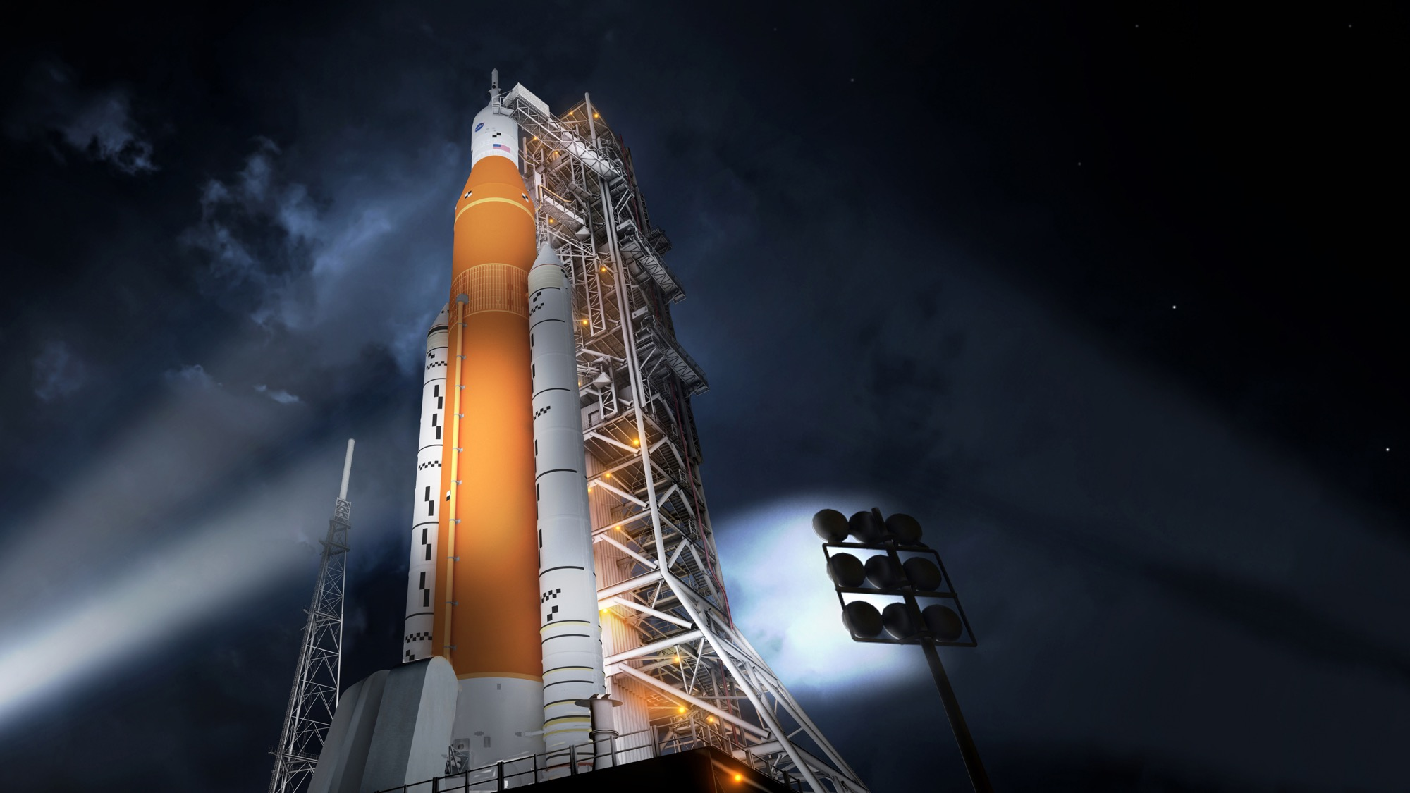

NASA’s Space Launch System Progress Toward the launch pad
August 24, 2020
CHRIS CIANCIOLA
Deputy Manager
Space Launch System Program
Notes:
Welcome
I’d like to provide what is really a brief overview of our most visible highlights.
Understand that there is a lot of other work taking place to get SLS ready for 2021 and beyond.
Much has gone into precautions and procedures related to the current Coronavirus situation.

Slide 2
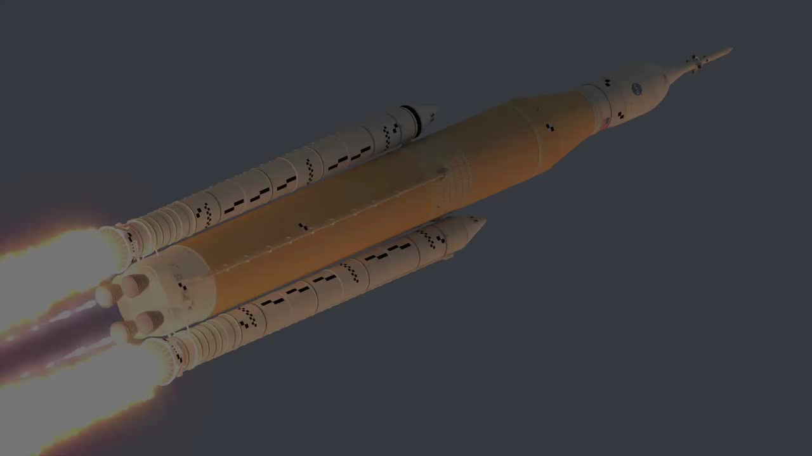
Progress Video
Notes:
Progress Video [music, no narration] 1:10
I’d like to start with a quick visual look at our progress and a preview of my presentation.

Slide 3

SPACE POLICY DIRECTIVE-1
REINVIGORATING AMERICA’S HUMAN SPACE EXPLORATION PROGRAM
“Lead an innovative and sustainable
program of exploration with commercial
and international partners to enable human expansion across the solar system and to bring back to Earth new knowledge and opportunities.
Beginning with missions beyond low-Earth orbit,
the United States will lead the return of humans to the Moon for long-term exploration and utilization, followed by human missions to Mars and other destinations.”
Notes:
We are working to fulfill the goal of Space Policy Directive 1 issued by the President in 2017 and the announcement by the Vice President in 2019 to put humans on the Moon in 2024. Very clear about a return to the Moon.
Going forward to the Moon, because we are going like never before. And, all of that is imbedded in SPD-1
Sustainably – going to stay…not a permanent human presence starting in 2024, but continual access to any part of the Moon, at any time for a strategic presence…with landers, rovers, robots…and with humans.
With Commercial Partners – instead of NASA purchasing, owning/operating the systems – in many cases we will buy services from companies. Leaves NASA to use our tax dollars to focus on those things ONLY NASA can do.
With International Partners – building a coalition of nations that will be involved in these missions. Canada has already signed up – committing to 24 years!
Utilization of resources – 2008/2009 we learned there were 100s of 1000’s of tons of water ice at the south pole. Air, water, rocket fuel.
We knew this was coming – and because we knew it, NASA had a plan to put humans back on the Moon by 2028.

Slide 4
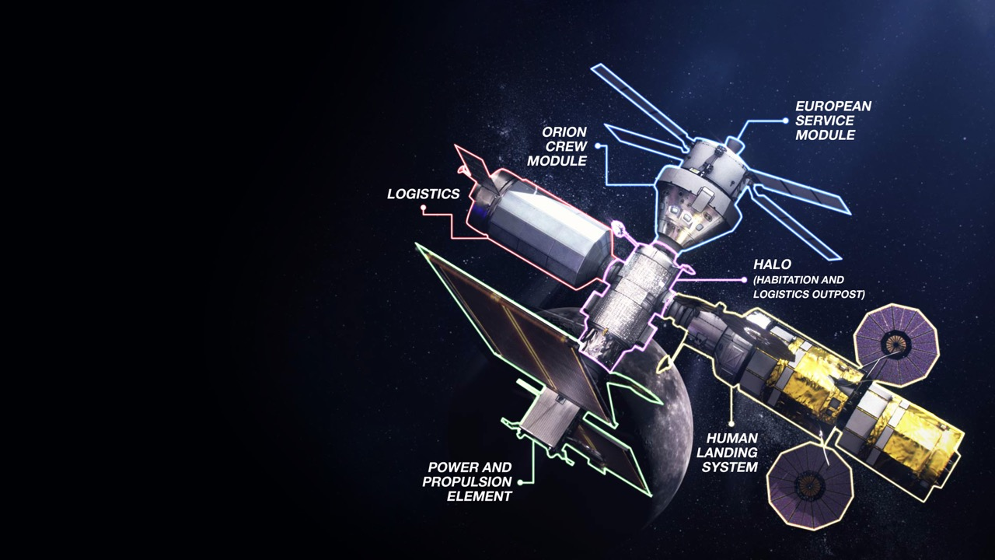
Gateway Enables Lunar and
Mars Exploration
Strategic presence around
the Moon
Resilience, sustainability and robustness in the lunar architecture
Open architecture and interoperability standards are building blocks for partnerships and future expansion
Notes:
This is happening in 2 phases:
Phase 1 is all about speed – get there
Phase 2 is about sustainability – stay there.
Initial Gateway focuses on the minimum systems required to support a 2024 human lunar landing while also supporting Phase 2
Provides command center and
aggregation point for 2024 human landing
Establishes strategic presence around
the Moon – US in the leadership role
Creates resilience and robustness
in the lunar architecture
Provides building block for the future,
expanded capabilities on and around
the Moon
And, the key to both phases is the Gateway. You may have heard about it earlier – but given the new timeline – this will be Gateway lite with only those components absolutely necessary for the landing in 2024.
However, it will form the hub around which we will build out for phase 2. It is, in effect, a permanent command service element at the Moon.
It will be in a near-rectilinear halo orbit around the moon balanced between the earth’s gravity and the moon’s gravity. Solar electric propulsion (very light thrust) to maneuver and give access.

Slide 5
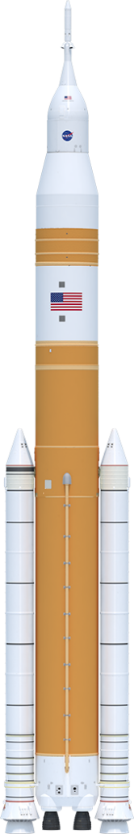
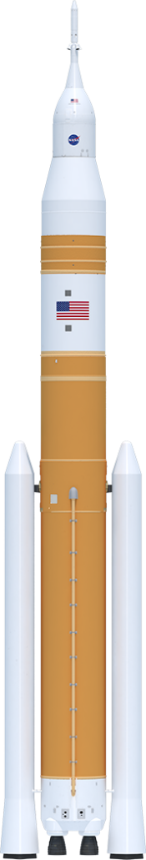
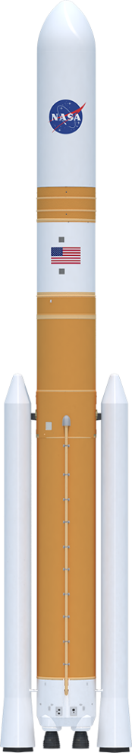
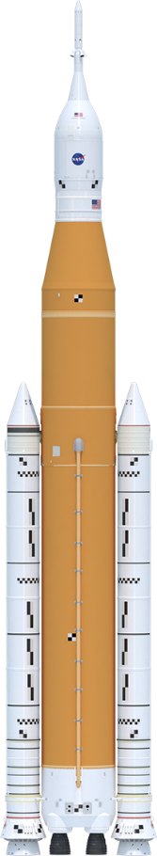
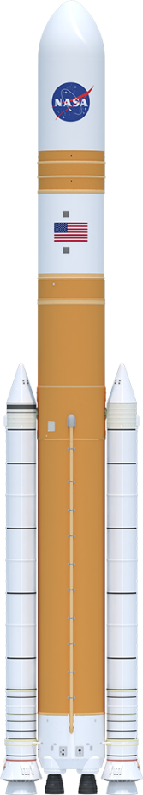
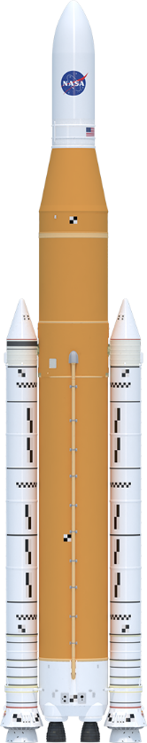
SLS Evolvability
Foundation for a generation of deep space exploration
322 ft.
Up to 313 ft.
365 ft.
325 ft.
365 ft.
355 ft.
Universal
Stage Adapter
Universal
Stage Adapter
Launch Abort System
5m Class Fairing
(up to 63’)
8.4m Fairing
Short (Up to 63’)
8.4m Fairing
Long (Up to 90’)
Orion
Interim Cryogenic
Propulsion Stage
Exploration Upper Stage
Exploration Upper Stage
Exploration Upper Stage
Launch Vehicle
Stage Adapter
Interstage
Interstage
Interstage
Core Stage
Core Stage
Core Stage
Solid
Rocket
Boosters
Solid
Rocket
Boosters
Evolved
Boosters
RS-25 Engines
RS-25 Engines
SLS Block 1
SLS Block 1 Cargo
SLS Block 1B Crew
SLS Block 1B Cargo
SLS Block 2 Crew
SLS Block 2 Cargo
> 27 t (59.5k lbs)
> 27 t (59.5k lbs)
38 t (83.7k lbs)
42 t (92.5k lbs)
> 43 t (94.7k lbs)
> 46 t (101.4k lbs)
Payload to TLI/Moon
Notes:
We are focused on Block 1, 2021 first launch and 2024 human landing.
But SLS was designed to evolve to greater power, mass and volume based on the basic core stage design and evolved propulsion systems.
There are 3 Block variants with crew and cargo versions of each.
This capability allows us to grow from more than 27 metric tons (59,000 pounds) to the Moon to more than 46 metric tons (101,000 pounds) to the Moon.
In space exploration, bigger, heavier stuff isn’t just a convenient nice-to-have capability. It translates into less hardware complexity, less mission complexity, less risk, and greater chances of success in the unforgiving space environment.
While we are focused on the early Artemis missions, we are also making tangible progress toward future lunar and Mars exploration.

Slide 6
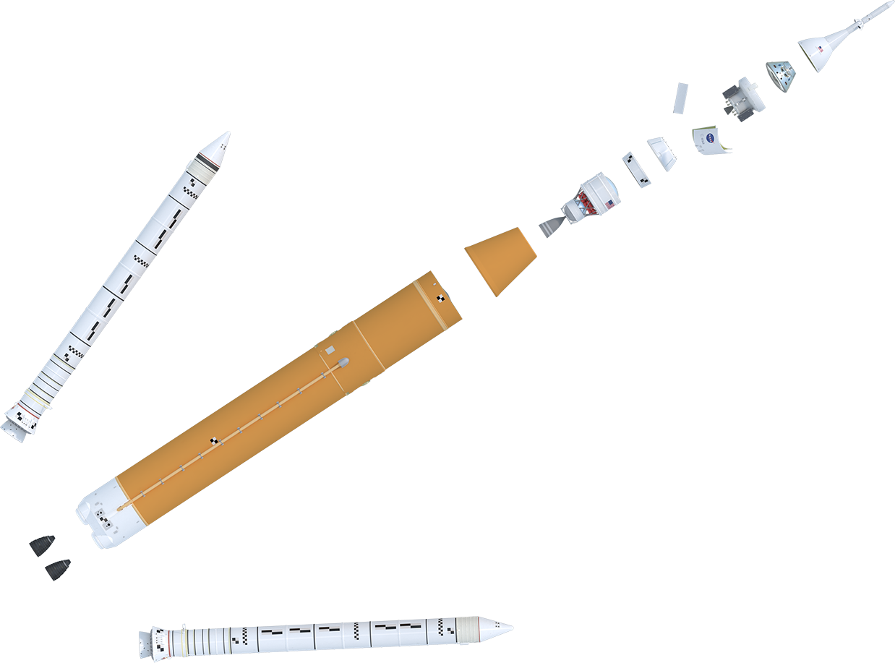
NASA’S SPACE LAUNCH SYSTEM
BACKBONE OF DEEP SPACE EXPLORATION
Launch Abort System (LAS)
BLOCK 1 CONFIGURATION
Crew Module (CM)
Service Module (SM)
Encapsulated Service Module (ESM) Panels
Spacecraft Adapter
Orion Stage Adapter
Orion Multi-Purpose
Crew Vehicle
Lockheed Martin
RL10 Engine
Aerojet Rocketdyne
5 Segment Solid Rocket Booster (2)
Northrop Grumman
Interim Cryogenic
Propulsion Stage (ICPS)
Boeing/United Launch Alliance
Launch Vehicle Stage Adapter
Teledyne Brown Engineering
Core Stage & Avionics
Boeing
RS-25 Engine (4)
Aerojet Rocketdyne
Notes:
Let’s take a look at the SLS configuration for our maiden Artemis I mission:
Expanded view of Block 1
Block 1 will be more capable than any current launch vehicle, able to deliver >27 metric tons (59.5k lb) to the Moon.
DISCUSS VARIOUS COMPONENTS – engines, core stage boosters, ICPS/RL10, LVSA, OSA
All Artemis I components are done an much of the Artemis II vehicle is manufactured.
We are in test 4 of 8 on our final major Green Run test series before shipping the Artemis I core stage to KSC.
Block 1 is just the first of larger and even more powerful and capable configurations that will take astronauts and cargo to Mars

Slide 7
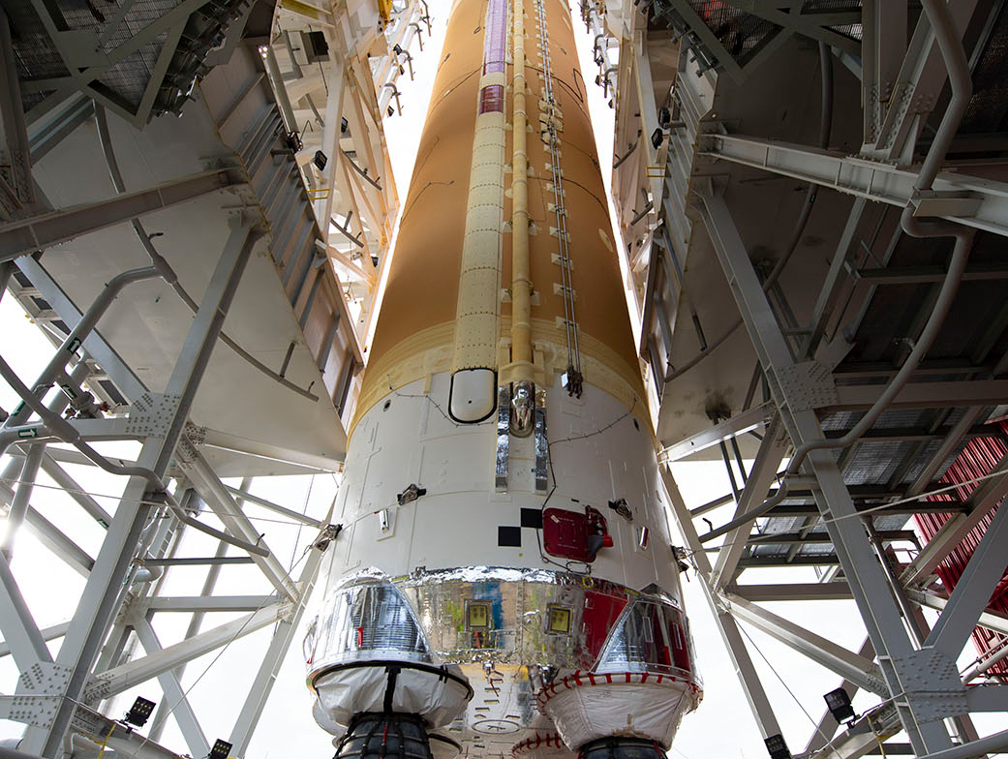
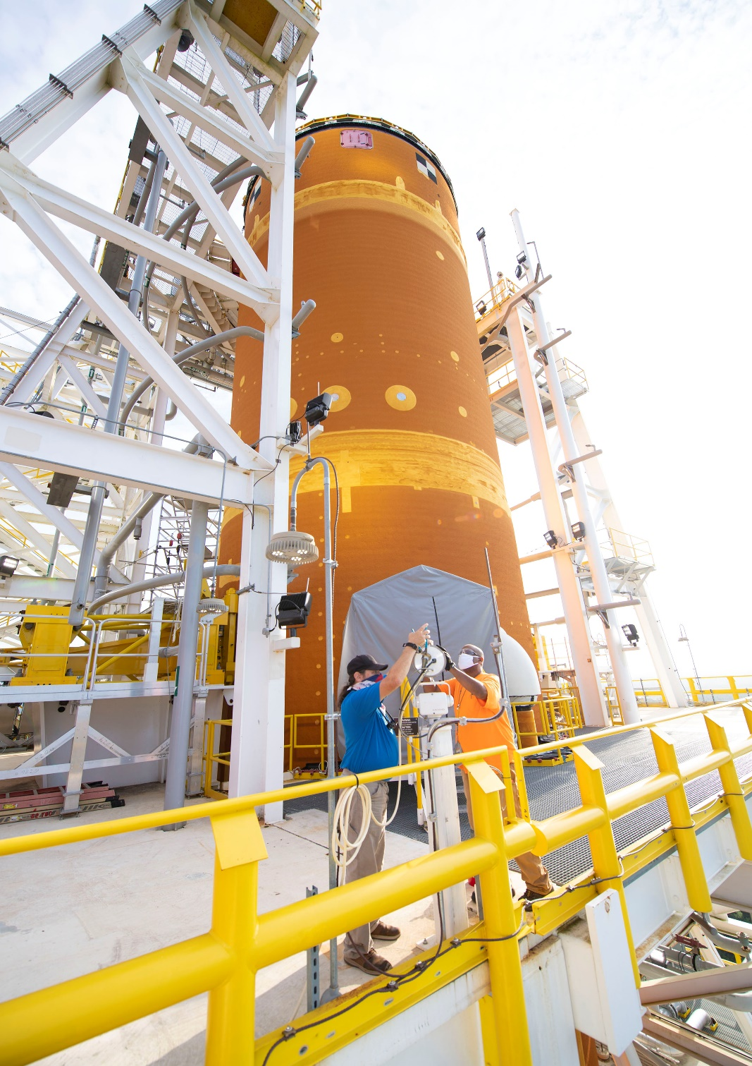
ARTEMIS I CORE STAGE
Notes:
Left/Right: Artemis I core stage in B-2 stand at Stennis Space Center
Boeing completed attachment of the four RS-25 engines in late 2019 and the completed stage shipped to Stennis Space Center in January 2020 for “green run” testing
The core stage was lifted and installed in the B-2 Test Stand at Stennis in January 2020.
Green run test series of 8 test cases –
Modal
Avionics
Safing
MPS/engine leak/functional checks
Pneumatics/TVC
ADDED: Safing Checks with Phase 2 Stage Controller Software
Simulated Countdown Demo
Wet Dress Rehearsal
Hotfire
Fast Facts
The SLS core stage is an all new development.
The SLS Core Stage will be the tallest rocket stage ever flown. When completed, the Core Stage will be 212 feet tall (64.6 m) and 27.6 ft. (8.4 m) in diameter.
It will weigh 2.3 million pounds when fueled.
The liquid hydrogen tank measures more than 130 feet tall, comprises almost two-thirds of the core stage and holds 537,000 gallons of liquid hydrogen cooled to minus 423 degrees Fahrenheit.
The Core Stage was built by prime contractor Boeing at Michoud Assembly Facility outside New Orleans, LA, using state-of-the-art manufacturing tools, including the world’s largest friction-stir welding tool, the Vertical Assembly Center.

Slide 8
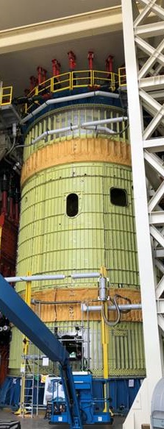
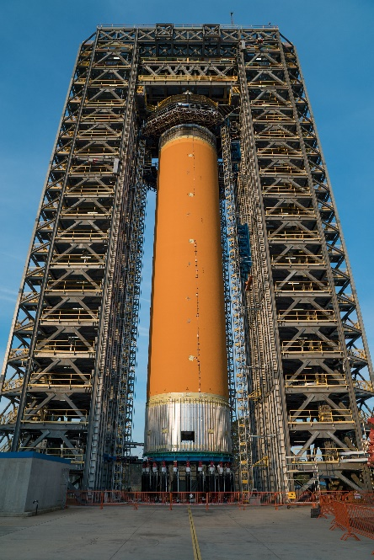
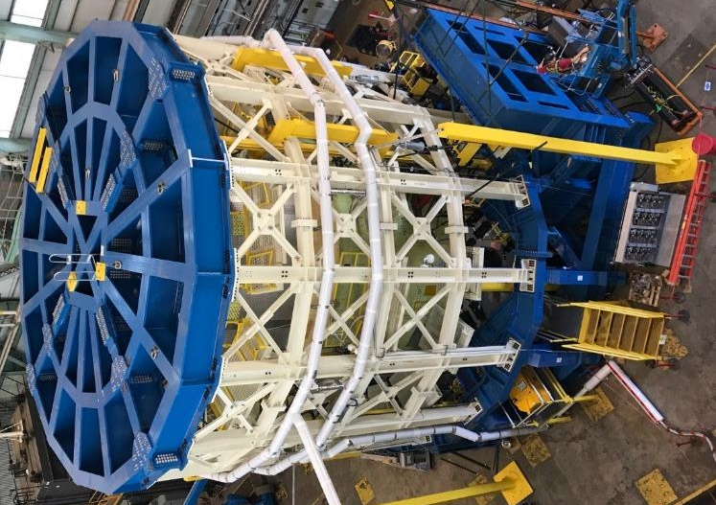
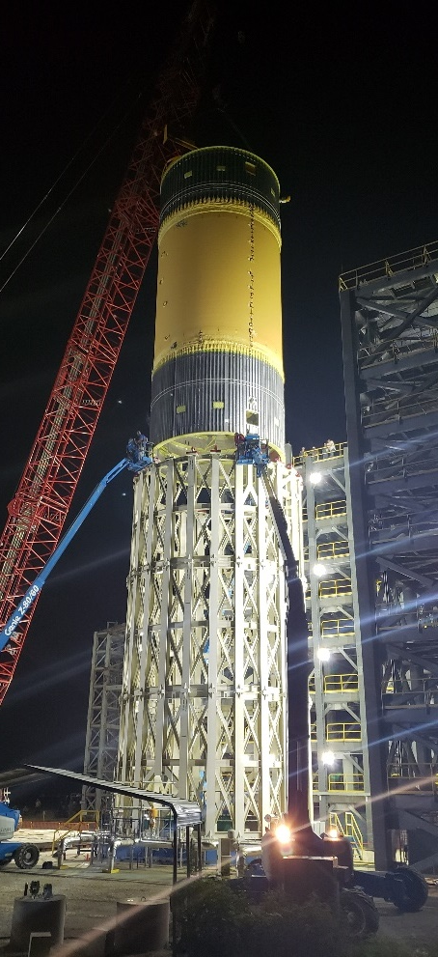
Sls STRUCTURAL TESTING
Notes:
SLS structural testing 2015 – 2019 – largest structural test campaign at MSFC since Shuttle
Left – Right: engine section, intertank, LH tank, LOX tank structural test articles at MSFC
Not shown: Integrated Structural test of the ICPS, Orion Stage Adapter, LVAS and adapters (not shown)
Summary: 5 structural test articles underwent 199 separate test cases and more than 421 gigabytes of data were collected to add to computer models used to design the rocket

Slide 9
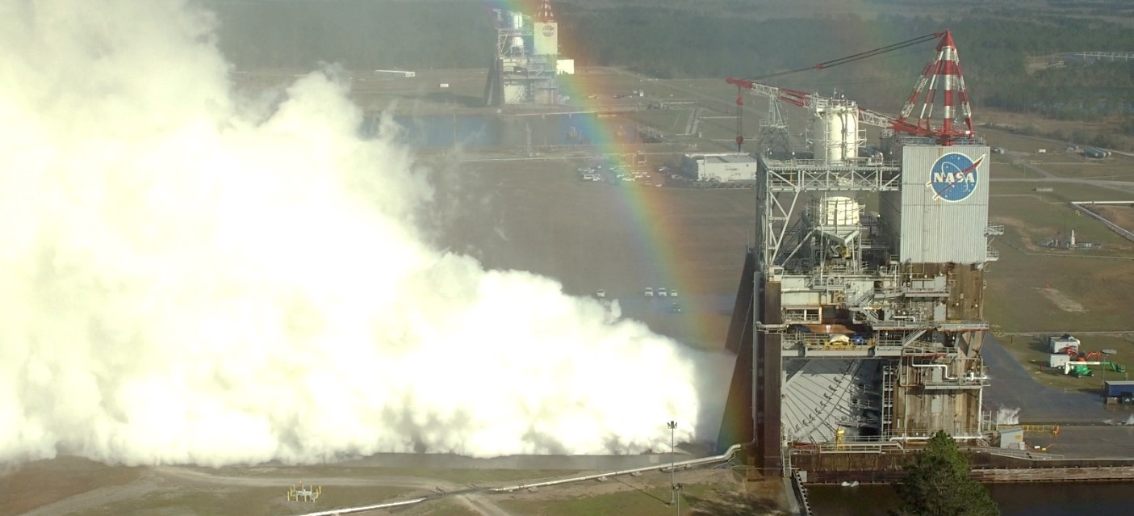
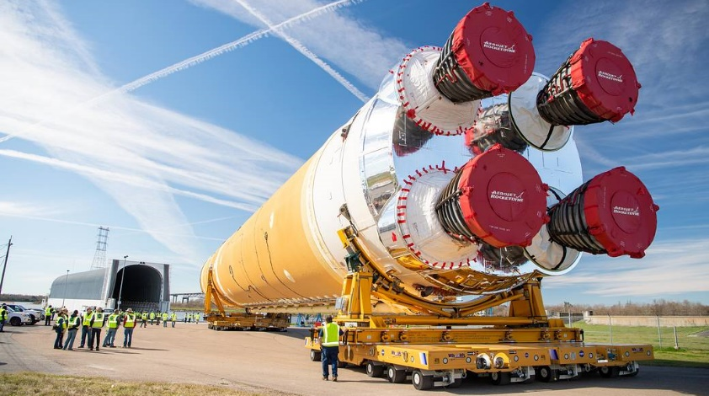
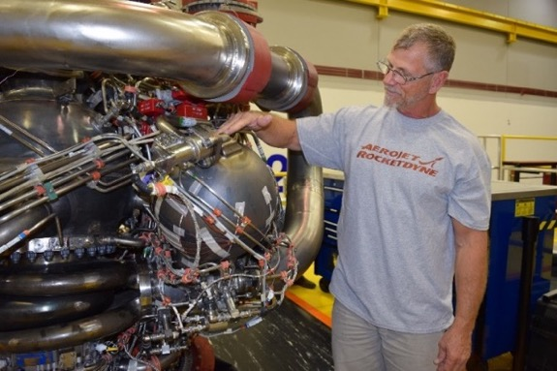
Artemis I ENGINES
Notes:
Right RS-25 testing at SSC
Left/top: Artemis I engine processing complete
Bottom/right: development engine with 3-D printed Pogo accumulator (bottom)
There are four RS-25 engines versus three for Shuttle
The engines produce 109% thrust vs 104.5%. Each engine produces more than 500,000 lbs thrust for more than 1 million seconds total ground and flight time.
They have new controller and software and nozzle insulation
The program starts with 14 flown engines and 2 new serial number engines built from spares.
“Adaptation” hotfire series from 2015 to 2019 certified engine to SLS requirements/environments, green ran 18 new controllers and tested new parts for restart engines.
Adaptation series accumulated a total of 32 tests amassed nearly 15,000 seconds of hot fire time. Development engine testing is scheduled to resume in September 2020 with additional new engine components aimed at new engine production.
As of preparation of this paper, the Artemis I RS-25 flight set had been integrated into the Artemis I core stage and was undergoing green run testing with the stage at SSC. Additionally, the Artemis II engine flight set had completed preparations, including installation of all controllers, and was awaiting a request for stage integration.

Slide 10
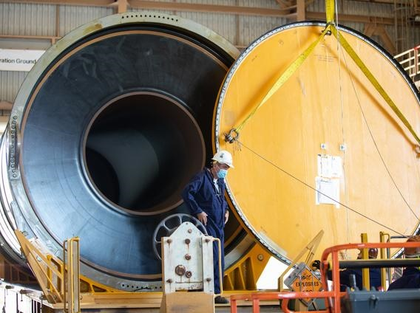
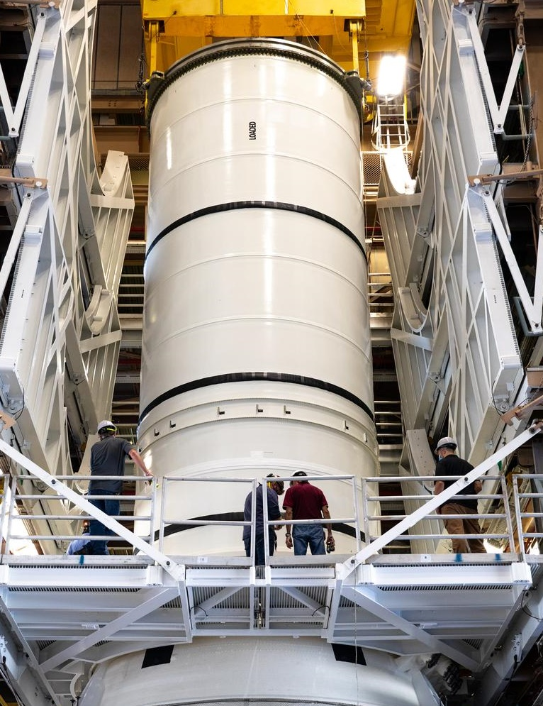
ARTEMIS I SOLID ROCKET BOOSTERS
Notes:
SLS boosters leverage shuttle boosters
Five segments, instead of four
All-new avionics, asbestos-free insulation
Left: All booster segments complete and delivered to KSC for Artemis 1
Right: Assembly for the first booster aft segment has begun
Booster fast facts [if needed]:
Prime contractor Northrop Grumman
Each 177 feet or 17 stories tall – taller than the Statue of Liberty
Each is 12 feet in diameter
Each booster burns through 1,385,000 pounds of propellant in two minutes – an average of 5.5 tons of propellant every second
Each booster’s thrust is greater than 14 four-engine Boeing 747s at full take-off power
During flight, the temperature of the motor chamber gases reach more than 5,000°F – hot enough to boil steel!

Slide 11
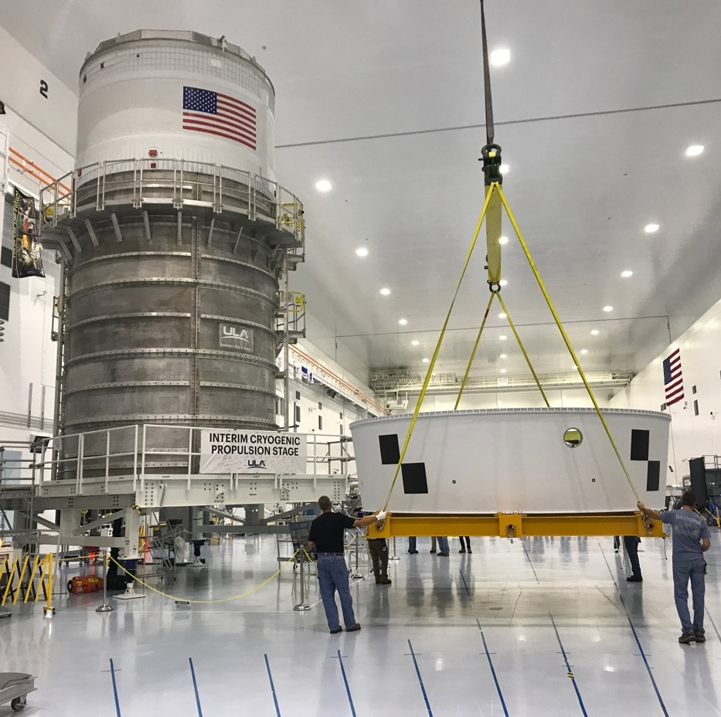
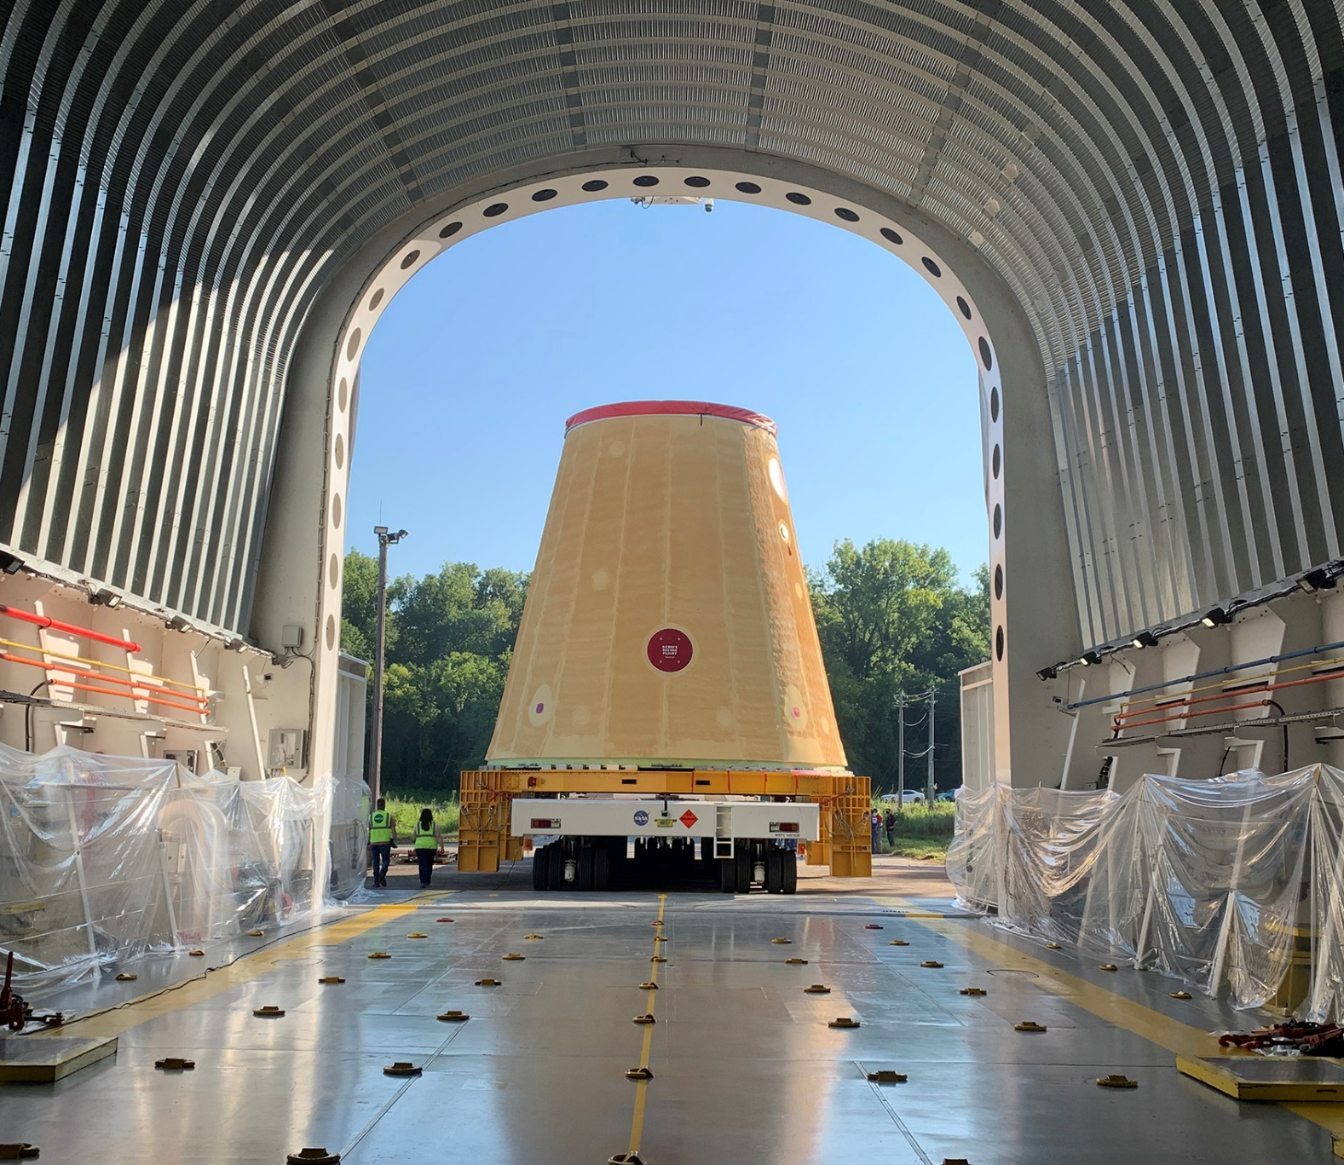
ARTEMIS I In-Space Stage And Adapters
Notes:
Left: Interim Cryogenic Propulsion System and Orion Stage Adapter at Kennedy Space Center until needed for integration operations and stacking
Right: The launch vehicle stage adapter (LVSA) as it is loaded onto barge Pegasus July 17, 2020.
ICPS:
The ICPS was built by Boeing/ULA.
The Delta Cryogenic Second Stage was modified by lengthening LH2 tank, adding hydrazine bottles for attitude control and minor avionics changes.
It is 42’ tall x 16’ wide and powered by one AR RL-10B-2 engine. This engine produces 24,750 lbs of thrust as well as TLI burn for Orion (Artemis I).
LVSA:
The LVSA connects the core and upper stages.
It is 27.5’ long and 27.5’ wide at base, tapers to 5 m at top.
It’s made of friction-stir welded lightweight aluminum alloy.
The LVSA was manufactured by Teledyne Brown at MSFC.
OSA:
THE OSA connects ICPS and Orion.
It’s 5’ high, and around 18’ in diameter.
It holds 13 cubesats plus the avionics unit for Artemis I.

Slide 12
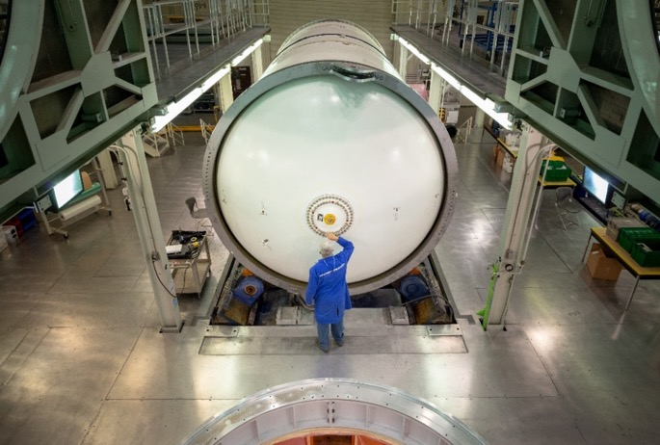
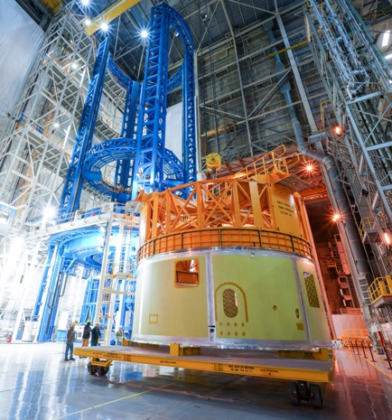
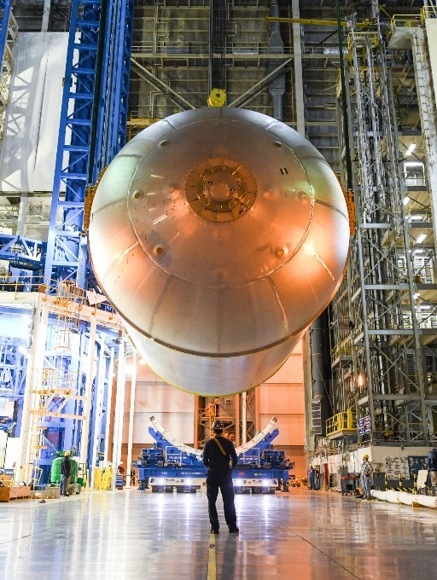
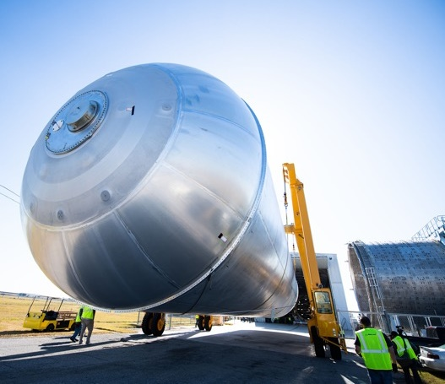
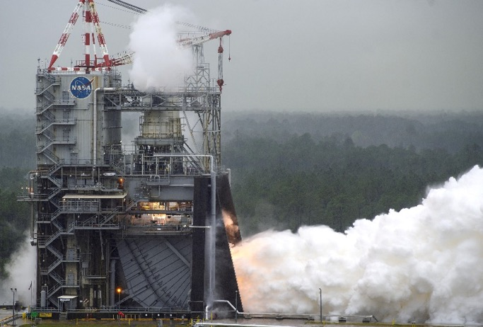
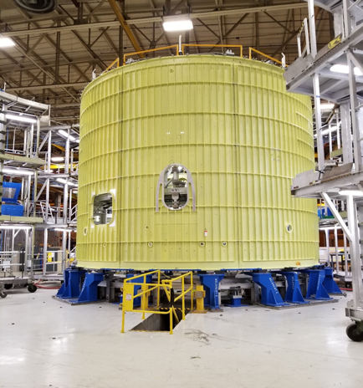
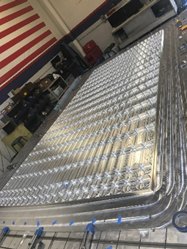
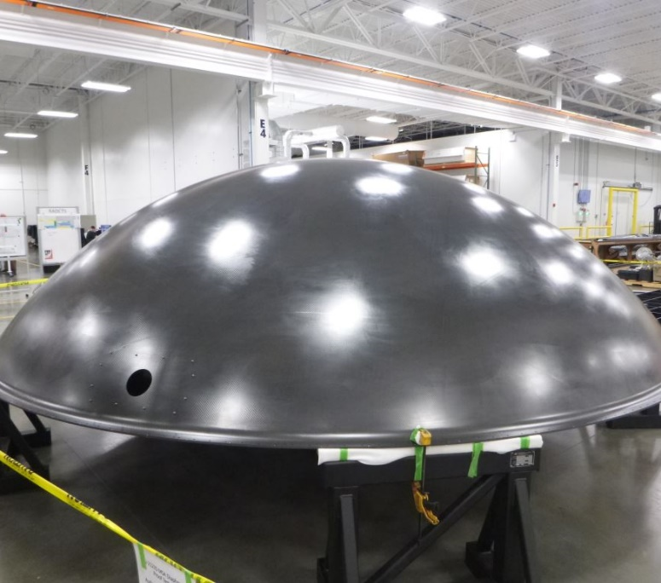
SLS PROGRESS TOWARD ARTEMIS II
All Booster motor segments complete
Core stage forward skirt
Liquid oxygen tank
Liquid hydrogen tank
RS-25s engines complete,
controllers green run
Intertank
LVSA, OSA,
ICPS panels
OSA diaphragm complete
Notes:
Left: All 10 booster motor segments cast for second flight; 6 complete in barn
Left/middle, right/middle, right: Core Stage 2: All components manufactured and in various stages of prep and outfitting
Bottom/right/middle: In-Space Stage adapters being welded at MSFC; Interim Cryogenic Propulsion Stage in progress
Bottom Left: All four flight engines complete and stored in place; all controllers green run
Also realizing production improvements in building CS-2:
Although we have prioritized our resources to complete CS-1, the Artemis 2 core stage production schedule currently is averaging 50% improvement in schedule over the Artemis 1 core stage
We have so far seen a 70% improvement in labor hours on the engine section and 33% improvement on the intertank.
To break that down further, for the engine section, the most complex section of the core stage, we have seen a significant improvement in manufacturing discrepancies, a 97% improvement in rework hours and an overall 70% improvement in baseline labor hours required.

Slide 13
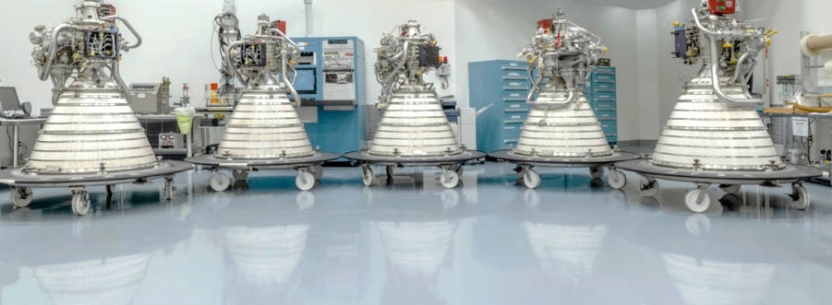
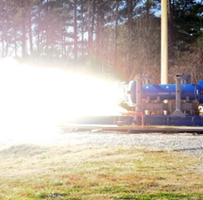
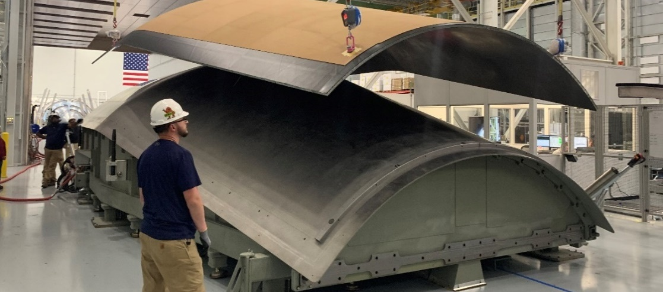
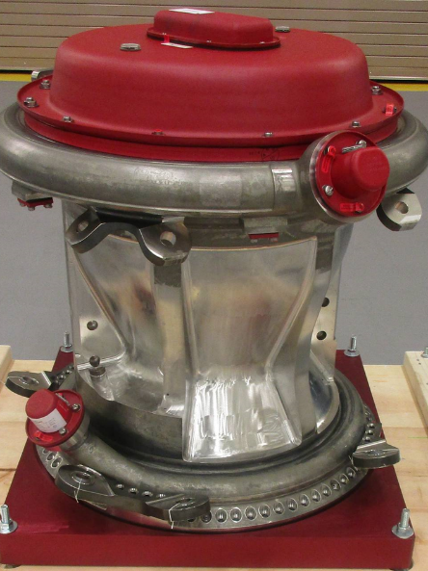
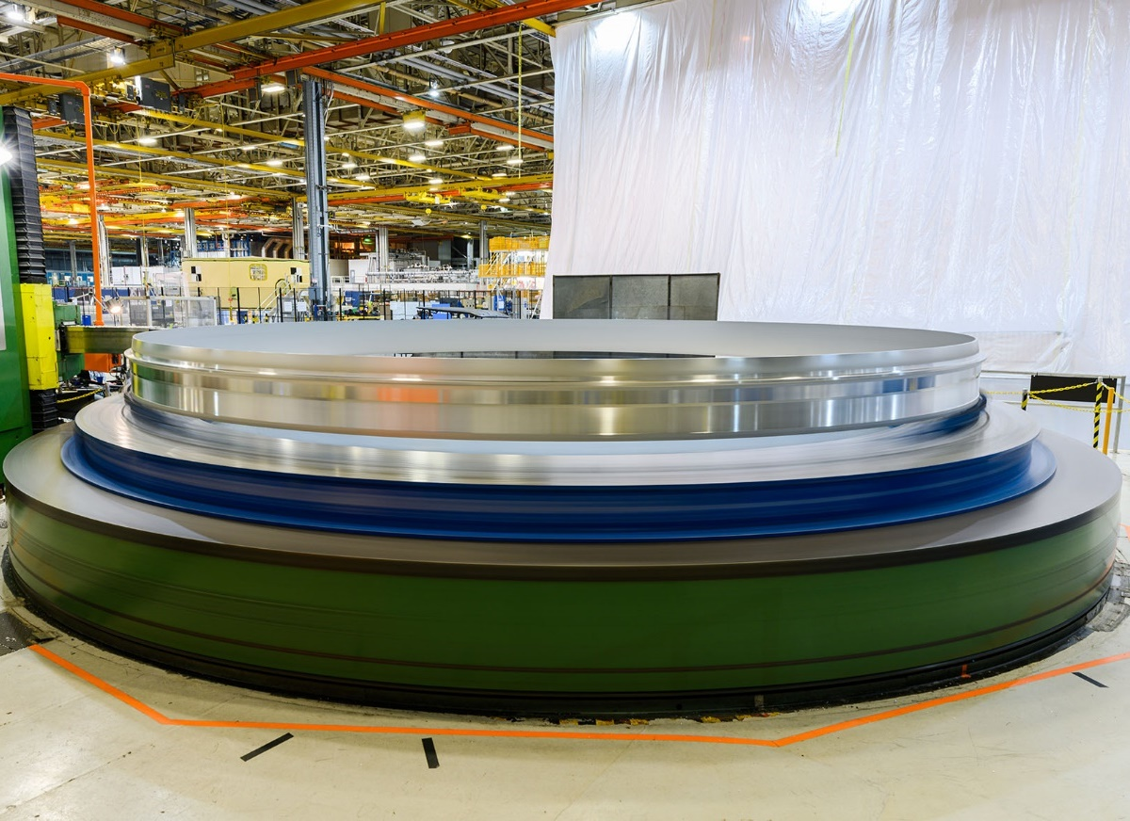
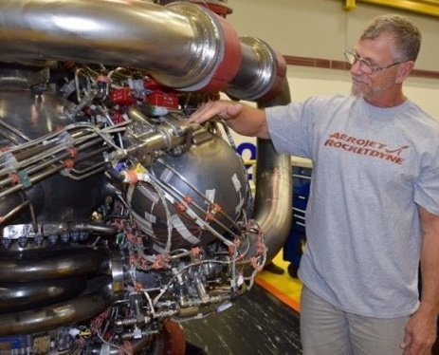
BEYOND Artemis II
RL-10s complete
BOLE subscale motor test fire
Universal Stage Adapter manufacturing demonstration article
RS-25 HIP-bonded main combustion chamber
EUS weld confidence, development articles
Additively manufactured pogo accumulator
Notes:
Top left: Six RL-10s tested and complete for Artemis II, Artemis III and EUS for Block IB. (five shown)
Top center: Boosters processing and casting for third flight, as well as FSB-1
Top right: Payload adapter manufacturing work @ MSFC for Block IB
Bottom Left and Right: Much work is under way on developing a new more affordable, expendable variant of the RS-25 that costs at least 33 percent less and operates at 111% (521,000 lbs) thrust. In September, we will resume hotfire tests that continue testing new components like a 3D printed pogo accumulator (bottom right) and a hot isostatic pressure (HIP) bonded main combustion chamber (bottom left).
AR awarded initial contract for 6 new “restart” engines, which are under way AND a follow-on contract for additional 18 engines that will operate at 111% thrust and cost 30% less than the shuttle engines.
Bottom center: EUS weld confidence articles: on the right is a ring segment; left is a barrel panel; mention EUS JOFOC
Not Shown: Planning underway for modifications at Michoud Assembly Facility to accommodate expanded core stage/EUS production.

Slide 14
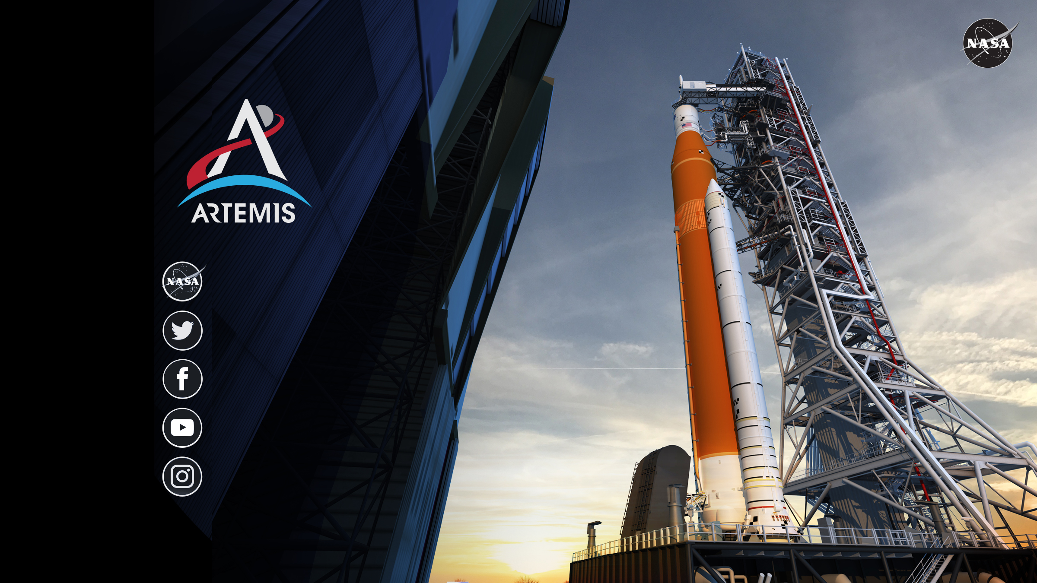
www.nasa.gov
@NASA_SLS
NASASLS
youtube.com/nasa
@explorenasa
Notes:
Thanks for your time and attention.
We’ve made a lot of progress in developing SLS and our first vehicle that will pay dividends from Artemis II to Mars.
We are working hard toward launch in 2021.
Please follow our progress on any and all of these online information sources.

