Slide 1
Space Launch System
Flight Readiness Analysis Cycle Approach
Evan Anzalone
NASA/MSFC/EV42
2020 AIAA/AAS
Astrodynamics Specialist Conference
07/31/2020
Co-Authors: Ivan Bertaska, A. Scott Craig, Young Kim, Paul Von der Porten, Daniel Tyler, Ben Burger, Jimmy Compton, Ashley Hill, Thomas Park, John Wall, Adam Harden, Jayden Hauglie, Matthew Hawkins, Seth Thompson

Slide 2
Outline
Introduction to SLS Flight Readiness Analysis Cycle
Approach to Integrated Analysis
Initial Results from FRAC-0
Lessons Learned and Next Steps

Slide 3
Overview of FRAC Process
FRAC is used to provide expected mission performance and coordinate mission across partners
  Design of algorithms and implementation complete during DAC
  Verification Analysis Cycle (VAC) verified design can meet vehicle-level performance
  Focus on verifying dispersions across launch windows and flight day performance expectations
Needs:
  Analysis of planned flight days
  Verification of flight performances
  Development of flight day parameters
Feeds:
  Vehicle integration
  Launch window selection
  Certification of Flight Readiness
Captures:
  GNC and Flight Mechanics expectations

Slide 4
VM FRAC-0 Process flow
Part 1
TDDP
Input Models
POST
Traj. Team
POST deck
SLS-VDD-103 App A
GR&A
Set throttle bucket based on mean monthly PMBT. Perform monthly PMBT sweep.
Traj. Review
Mean Monthly traj.
Months each period?
Guid. Team
2 Launch Periods
1
1 deck for period
CHANGO
2
Redo
PMBT Sweep data and throttle bucket
Update CHANGO VCFs to capture monthly variations. Submit into CM.
2 decks for period
Targets
Gen.
Redo
Part 2
Traj. Team
EMPT Review
Upload TLI targets
TDDP
Run POST Hypergrid. Use Copernicus to ascent & TLI targets for LWs.
Ascent targets & Launch Times
POST deck
Traj. Review
SLS-VDD-103 App A
Redo
MAVERIC
Dev.
MM Traj.
6DOF Team
Setup MAVERIC for FRAC (1st time). Include mass properties (1st time). Port Mean Monthly.
6DOF Review
TDDP
POST
/MAV Compare
MAVERIC tag 1
Guid. Review
CHANGO tag
CHANGO
SLS-VDD-103 App A
Redo
Redo
Notes:
Wrapping VM FRAC-0 process continuing on next slide. Schedule from left to right each row isn’t perfect depiction of start/stop of processes (e.g. CHANGO/MAV development and Target Generation). MAVERIC tag numbers are representative. Team reviews are within the purview of the technical team. EMPT review is as negotiated between SLS and Orion review teams. All reviews leading up to EV40 Mgmt review should be formally captured for mgmt. vetting before VM deliveries. AFSITT review will focus only on the approach to develop the products (Targets Generation, Launch Window polynomials, and 1-minute Check Cases).

Slide 5
VM FRAC-0 Process flow (Continued)
Part 3
LW Polynomial
TDDs
Update 3DOF launch time and Core Sep States
Guid. Team
Ascent Tgts
Fit inclination and RAAN targets to polynomial. Run MAVERIC throughout the window and fit change in Chi Table yaw to for optimal launch-to-orbit to a polynomial.
Guid. Review
Guid. Monthly
TDDs
Guid. Team
MAVERIC tag 3
Guid. Review
MAVERIC tag 2
MAV tag 1
Update monthly Time Dependent Data (TDD).
Redo
Redo
Nav. Review
Nav. Team
RINU DUT1 and leapsec TDDs
SLS-VDD-103 App A
Redo
Part 4
1-minute
Check Cases
Start Monte Carlos
Deliver TLI targets and 1-min check
6DOF Team
Upload check cases
Guid./6DOF Review
EV40 Mgmt 1
AFSITT 1
Run nominal 6-DOF for every 1-minute for every launch day in the 2 launch periods.
MAV tag 3
Redo
Redo
Redo
Process and Products
Products
Notes:
Wrapping VM FRAC-0 process continuing on next slide. Schedule from left to right each row isn’t perfect depiction of start/stop of processes (e.g. CHANGO/MAV development and Target Generation). MAVERIC tag numbers are representative. Team reviews are within the purview of the technical team. EMPT review is as negotiated between SLS and Orion review teams. All reviews leading up to EV40 Mgmt review should be formally captured for mgmt. vetting before VM deliveries. AFSITT review will focus only on the approach to develop the products (Targets Generation, Launch Window polynomials, and 1-minute Check Cases).

Slide 6
VM FRAC-0 Process flow (Continued)
Part 5
Fixed time MC
(first time)
Variable time
MCs
6DOF Team
6DOF Team
Deliver Monte Carlos
GN&C/6DOF Review
GN&C/6DOF Review
Start MCs
Run a fixed time Monte Carlo for agreed upon epoch.
Run a Monte Carlo throughout launch window for all launch days for 2 launch periods.
EV40 Mgmt 2
AFSITT 2
Redo
Redo
Redo
Redo
Process and Products
Products
Data products include:
  Trajectory time histories
  Performance envelopes and re-entry conditions for core and boosters
After initial process complete several more steps:
  Continued analysis on stage separation and lift-off clearance
  Continued analysis on abort capability and performance
Data products delivered to ULA for their ICPS analysis:
  Generates upper stage trajectories
  Provides states at disposal and stage separation across launch windows
Upon data provided back to NASA:
  Verification of integrated SLS performance
  Data passed on to MPCV for vehicle analysis and mission design
Notes:
Wrapping VM FRAC-0 process continuing on next slide. Schedule from left to right each row isn’t perfect depiction of start/stop of processes (e.g. CHANGO/MAV development and Target Generation). MAVERIC tag numbers are representative. Team reviews are within the purview of the technical team. EMPT review is as negotiated between SLS and Orion review teams. All reviews leading up to EV40 Mgmt review should be formally captured for mgmt. vetting before VM deliveries. AFSITT review will focus only on the approach to develop the products (Targets Generation, Launch Window polynomials, and 1-minute Check Cases).

Slide 7
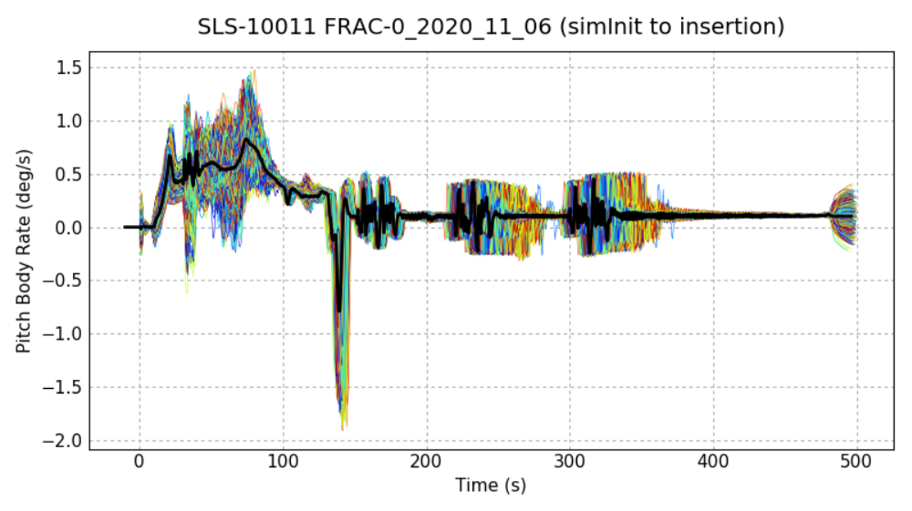
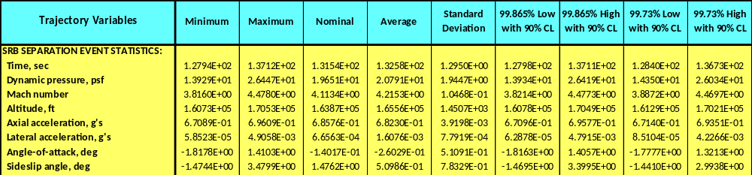
Notional GNC Outputs – per Monte Carlo

Slide 8
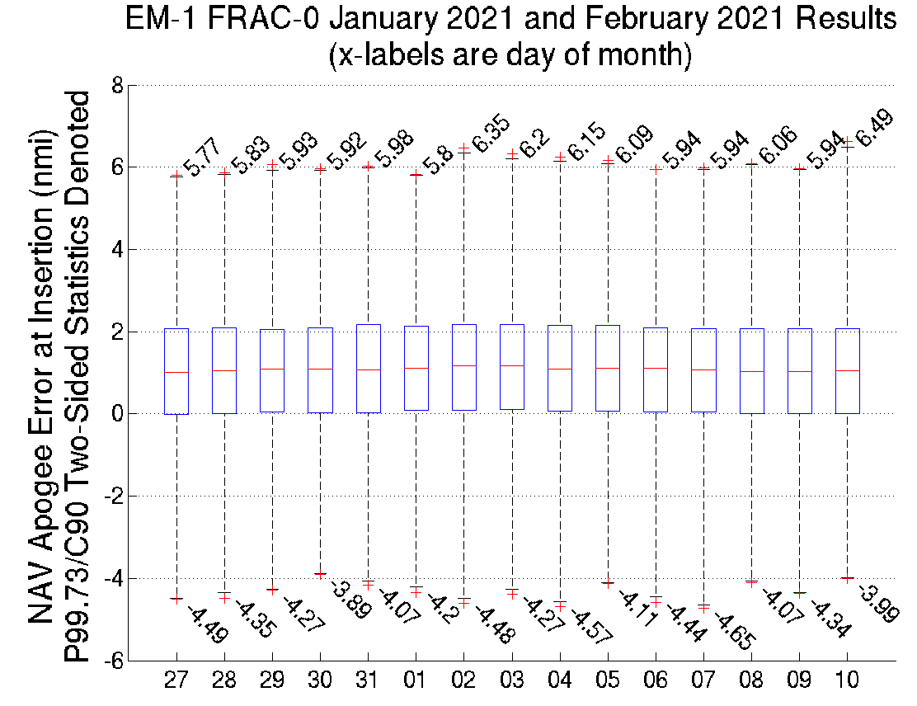
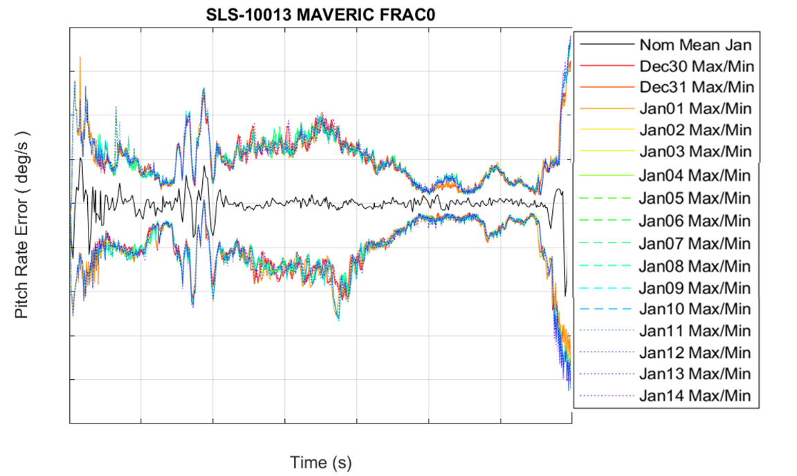
Notional GNC Outputs – Across Monte Carlos
Controller Performance
Navigation Performance

Slide 9
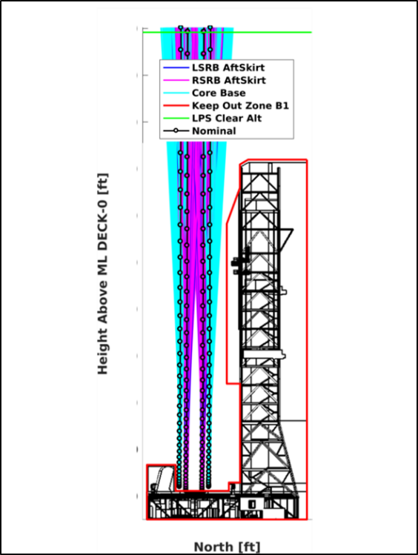
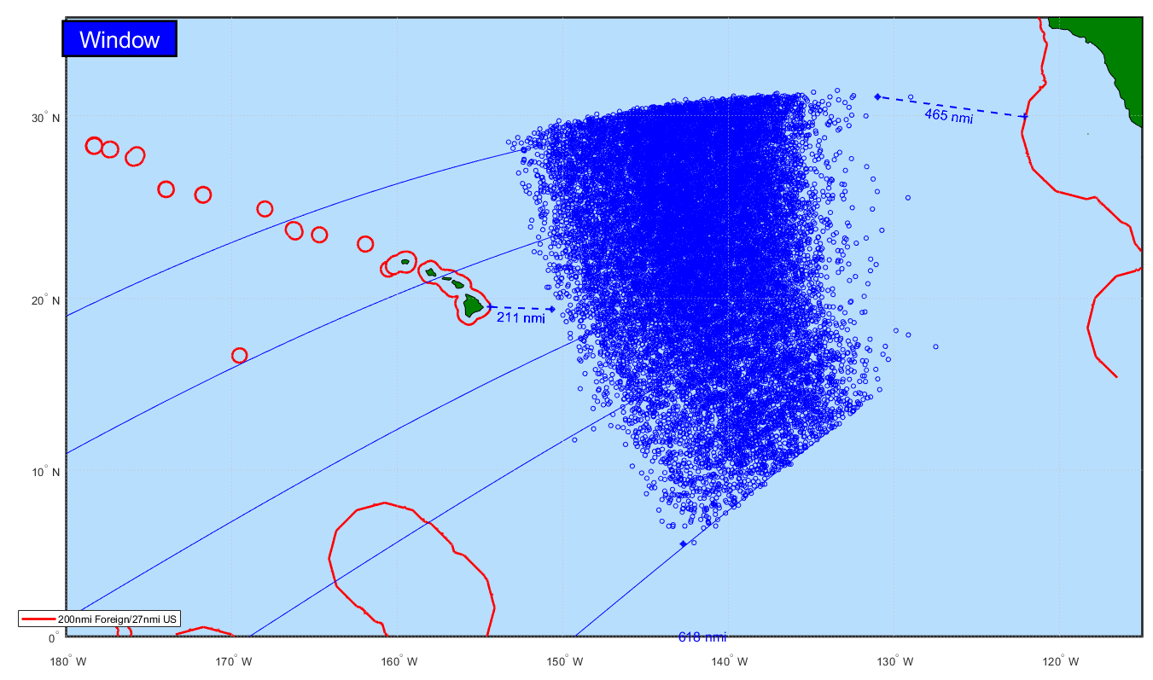
Additional Results
Stage Disposal
Tower Clearance

Slide 10
Lessons Learned and Next Steps
Automate tools as much as possible
  Generation of plots to track variation across launch vehicle
  Formalized/standard products to be able to integrate results as Monte Carlo complete
Practice makes perfect
  FRAC-0 useful in exercising process, understanding the schedule drivers
  Training important for team to know/understand tools for data processing and integration
  Due to long duration of analysis, need multiple backup levels to accommodate other activities and team schedules
Next Steps
  Implementation of FRAC-1 – This Fall
  Move to rolling targets, staying ahead of launch dates
  Certification of flight software parameters via Hardware in the Loop laboratories
  Flight-day processes for Day of Launch Activities

Slide 11




