Slide 1
Artificial Gravity Research
Alice Elberfeld, Cody Beard, Beth Westfall
Mentors: Ryan Joyce, Gabe Merrill

Slide 2
Background and Motivation
Humans experience multiple, significant negative effects in the space environment, believed to primarily stem from microgravity and radiation exposure
  Current countermeasures reduce the negative effects but do not solve the problems
NASA is currently considering “fast” Mars missions relative to previous conjunction class missions in order to address these crew health issues
  Results in a 4-8x increase in gross mass of the Mars Transport Vehicle
  This solution does not address the root cause of the issue
This approach warrants reconsideration of a slow, shielded, artificial gravity mission
  May be achievable in a safer manner for less mass and reduced cost
  This solution begins to address the challenges of living off-planet for the long haul
Current understanding suggests any habitat that does not fully address the microgravity and radiation exposure issues of deep space will be insufficient to sustain long duration human presence beyond Earth.
Artificial gravity and radiation shielding are currently theorized to be the most effective solutions

Slide 3
Negative Impacts of Microgravity
Alice Elberfeld

Slide 4
Establishing the Problem
Currently any time spent in space results in an exposure to microgravity.
The human body responds to this environment, often in ways that are unfavorable to overall health.
Examples of negative effects of microgravity:
Muscle deconditioning
Bone decalcification
Visual Impairment Intracranial Pressure Syndrome (VIIP)
Fluid shift

Slide 5
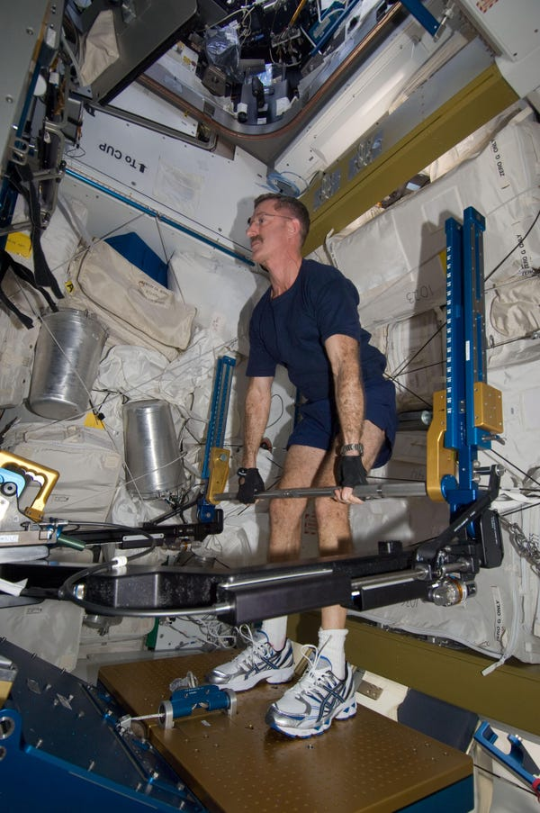
Muscle Deconditioning
Health effects: Weakness, increased recovery time upon return to Earth.
The disuse of muscles while in microgravity results in atrophy in a matter of days without proper countermeasures.
Countermeasures: Resistive Exercise for up to 2.5 hrs a day
Increased focus on endurance training exercise shows potential to better counteract the negative metabolic effects.
Artificial gravity as a potential countermeasure: By creating forces similar to Earth, Muscle will be used to stand and move around. Effectively replicating conditions on Earth.
Astronauts still face some significant muscle loss during extended stays on the ISS, long-duration missions are at higher risk for greater levels of muscle loss due to increased time spent in microgravity.
Credit: NASA

Slide 6
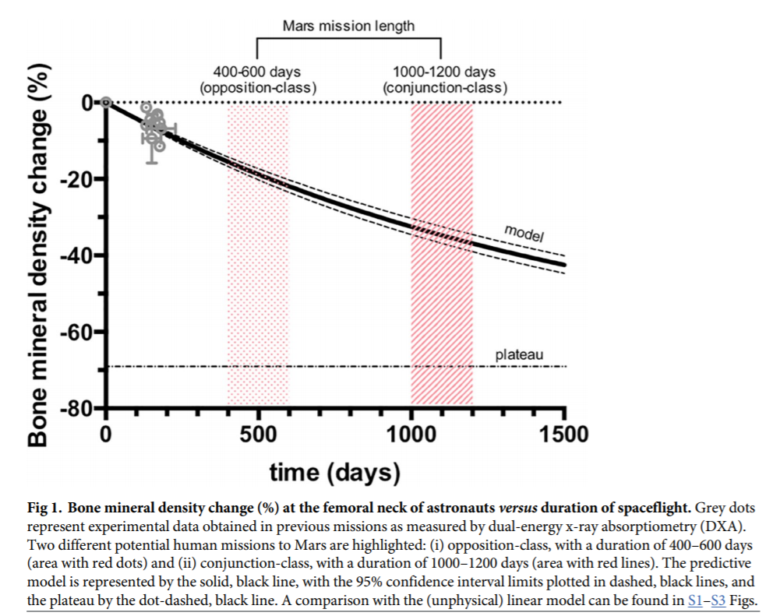
Bone Decalcification
Health effects: Osteopenia, osteoporosis, increased susceptibility for bone fractures, increased levels of calcium in the blood.
Due to the lack of loading on weightbearing bones, bones start to breakdown.
Countermeasures: Resistive exercise can be used to counteract some of the loss but is only partially effective.
Artificial gravity as a potential countermeasure: “Downward” forces will provide the loading on bones necessary for normal health. Gravity gradients may effect the amount of force on different bones in the body.
Long duration / Mars missions face serious risk of astronauts developing osteopenia or osteoporosis, greatly increasing their risk of bone factures.
Bone mineral density change over time without countermeasures
Bone mineral density change at the femoral neck of astronauts versus duration of spaceflight. (Predictive Model)
- Grey dots represent experimental data obtained from previous missions before ARED implementation in 2009.
Source: Axpe E, A human Mission to Mars: Predicting the bone mineral density loss of astronauts

Slide 7
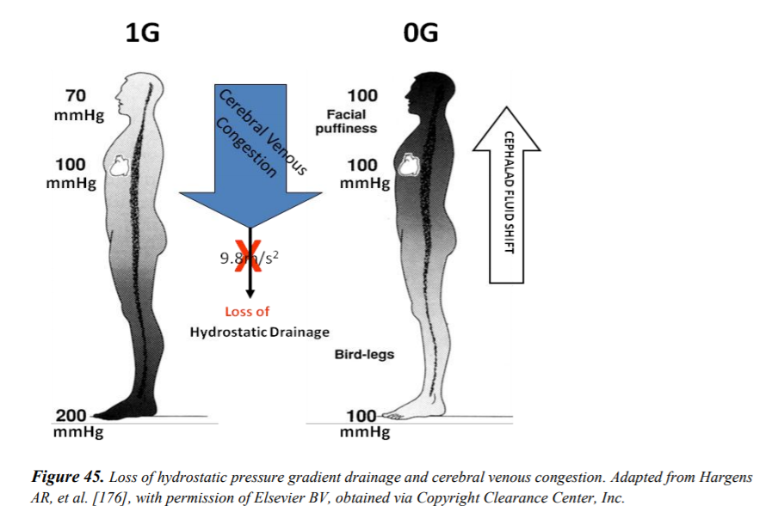
Fluid Shift
Health effects: “Bird-legs” and puffy face, increased intracranial pressure, VIIP, nasal congestion, headaches.
As the body is no longer working against gravitational forces, fluid starts to shift away from the lower extremities and into the upper body.
Countermeasures: There are currently no countermeasures to effectively control fluid shift
Possible countermeasures: Small human centrifuges and lower body negative pressure suits are current proposals for counteracting fluid shift.
Artificial gravity as a potential countermeasure: By providing forces similar to those experienced on Earth, fluids will return to the lower body.
Long duration / Mars missions are high risk for complications, extended exposure to increased intracranial pressure may result in permanent vision changes.
Fluid shift visualization
Source: Risk of Microgravity-Induced Visual Impairment/Intracranial Pressure (Pg. 72)

Slide 8
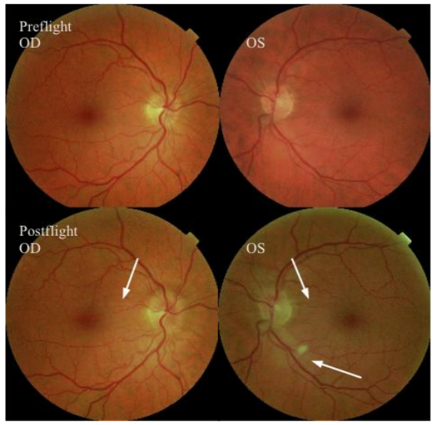
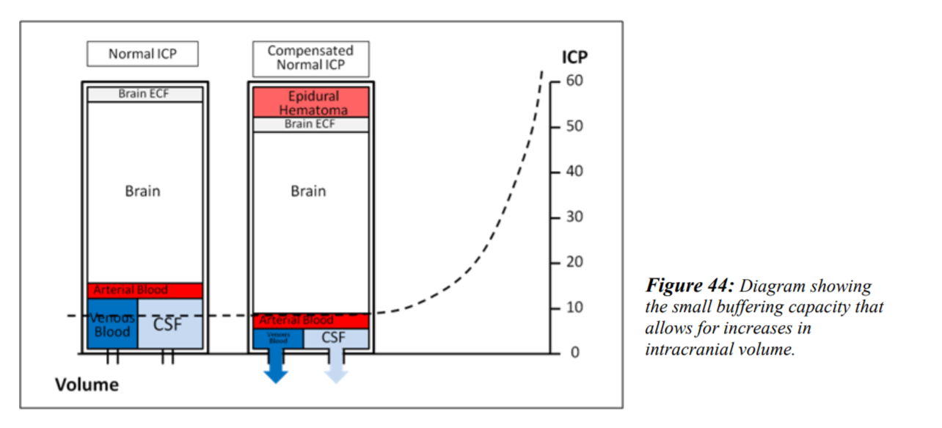
Visual Impairment Intracranial Pressure Syndrome (VIIP)
Health Effects: Changes in vision, blurry vision, spots, decreased peripherals, swelling of the optic nerve
VIIP encompasses any vision changes experienced during spaceflight due to increased pressure on the ocular cavity. It theorized to be caused by the increased intracranial pressure that results from fluid shift in microgravity. 80% of ISS astronauts have report negative effects to their vision during their stay.
Countermeasures: There are currently no countermeasures. Adjustable glasses are used to provide relief for vision loss and maintain astronauts ability to focus. Any method that effectively controls fluid shift in microgravity could potentially provide relief for VIIP.
Artificial gravity as a potential countermeasure: Fluid shift management by artificial gravity will relieve the increased pressure on the upper body and the optical nerve.
Long duration / Mars missions are uncharted territory. We still don’t know the full effects of VIIP or what the long duration missions may mean for astronauts vision.
Fundus examination of visual changes from long-duration spaceflight. Fundoscopic images showing, choroidal folds (white arrows) in the papillomacular bundle area in the right eye and left eye and a cotton-wool spot (bottom arrow) at the inferior arcade in the left eye. Both optic discs show grade 1 disc edema.
Source: Risk of Microgravity-Induced Visual Impairment/Intracranial Pressure (Pg. 11)
Diagram showing the small buffering capacity that allows for increases in intracranial volume.
Source: Risk of Microgravity-Induced Visual Impairment/Intracranial Pressure (Pg. 71)

Slide 9
Why AG may be a solution
By providing similar forces to the ones we feel on earth there is potential to entirely mitigate many of the negative effects currently experienced in microgravity
Bones and muscles will be subjected to full or partial 1g forces consistently, decreasing the need for exercise as a countermeasure
Fluid will be directed back towards the lower body relieving intracranial pressure
Recovery time will be less of an issue for transferring to a body with substantial gravity
Reaction times should be immediate and muscles will be ready to resist the gravity of the Earth, Moon, or Mars

Slide 10
Physics, Challenges, and Constraints
Cody Beard

Slide 11
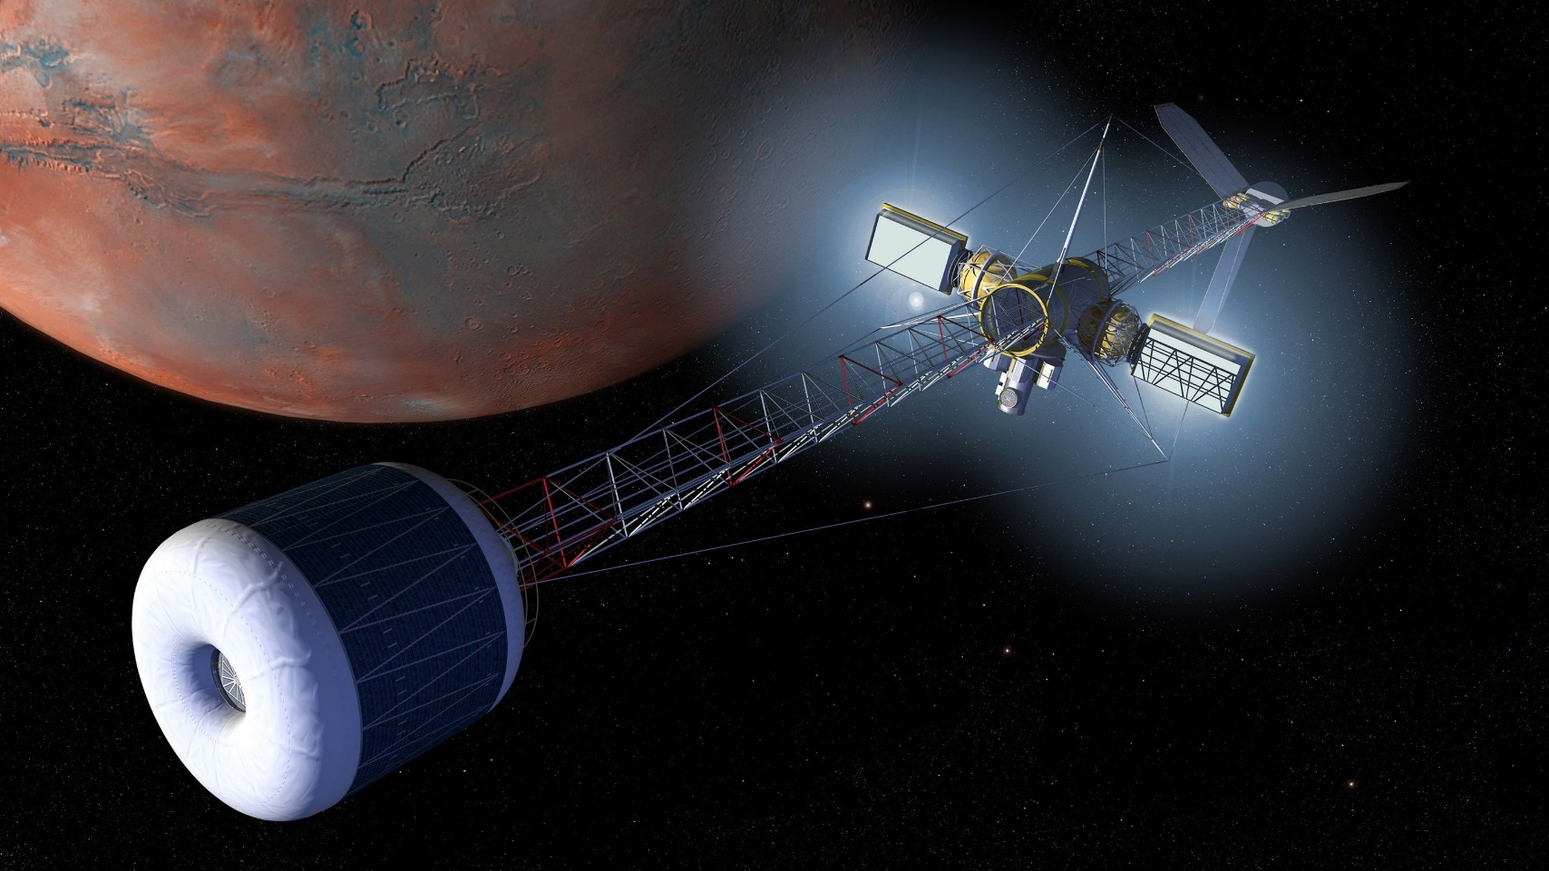
Identify Major Challenges and Constraints
Relationship of radius and rotational rate
Coriolis Effect and force
Gravity Gradient
Other physical challenges and limitations (Cross-Coupled Angular Acceleration)
Source: NASA

Slide 12
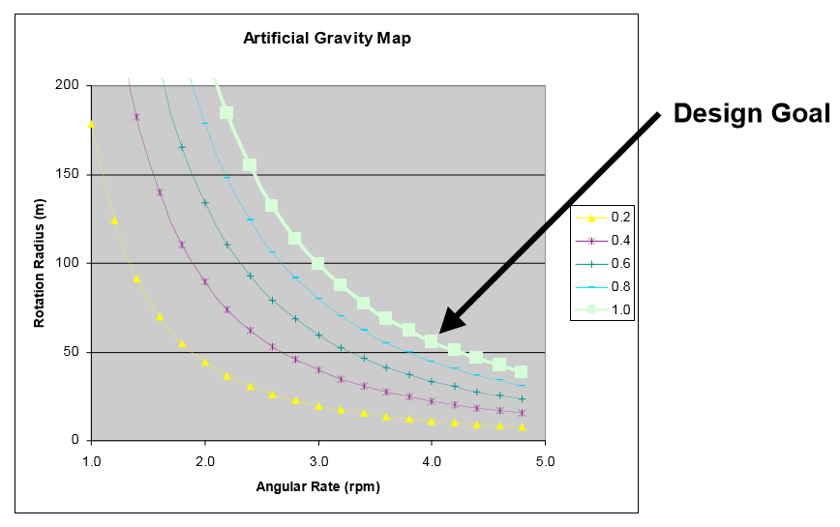




Relationship between the radius and the rotational rate
= rotational speed in radian/sec
v = velocity in m/s
r = radius of the circle
T = time period (time it takes to complete one rotation)
= centripetal acceleration
Source: NASA
The relationship between the radius and rotational rate is quadratic. The rate of rotational speed is squared compares to the rate of the radius.

Slide 13
Coriolis Effect
Happens when an object or subject moving in a rotating structure
Equation:
= The rotational rate
m = The mass of the object or subject
v = linear velocity of the object or subject
For example, if you and your friend are playing catch in a rotating merry go round, if you pass the ball to your friend the ball appears to be curving against the rotation of the merry go round. However, to the observer from the outside of the merry go round, the ball appears to move linearly.

Slide 14
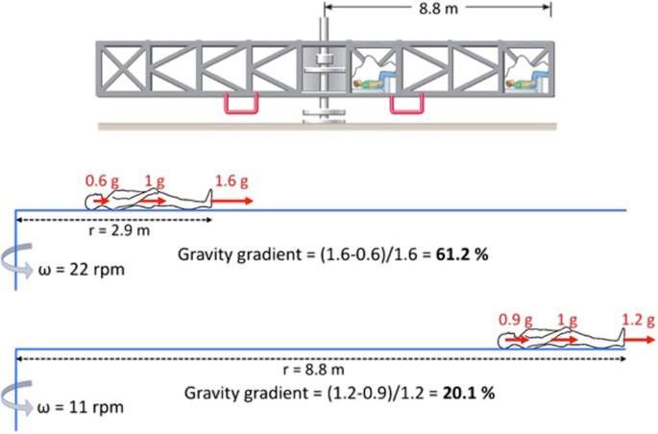
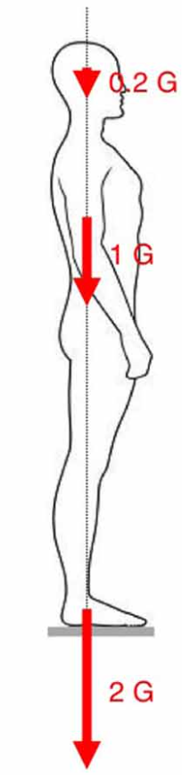


Gravity Gradient
Ratio of Head acceleration to Feet acceleration
  Equation:
Hydrostatic pressure -The pressure exerted by a fluid at a given point on the body, due to the force of gravity
  Equation:
Source: Clément NASA Author (2017)
Source: Clément NASA Author (2015)

Slide 15
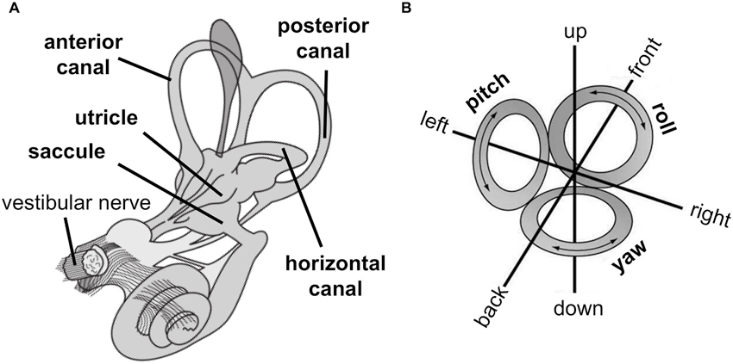

Cross-Coupled Angular Acceleration or Vestibular Coriolis
This occurs when a subject rotates his or her head about a plane axis that’s not aligned with the rotation of the habitat.
Equation:
= rotational speed of the centrifuge
= rotational speed of the subject’s head
Source: Pfeiffer (2014).

Slide 16
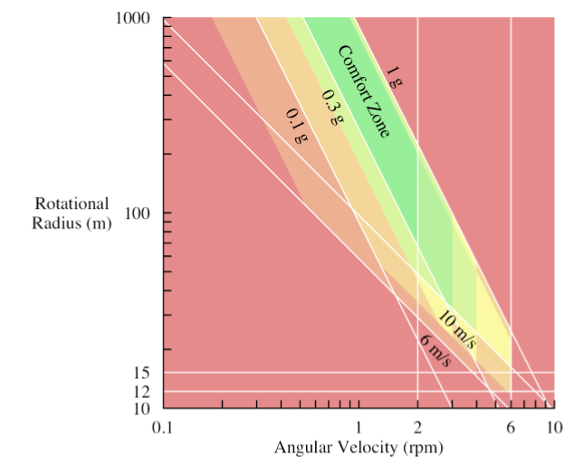
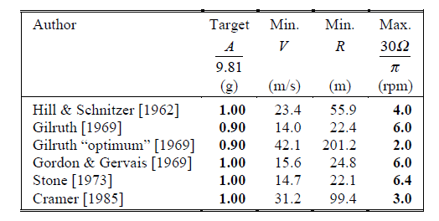
Comfort Zone
Source: Hall, T. W [6]
Source: Hall, T. W [6]

Slide 17
Past Artificial Gravity Concepts
Beth Westfall

Slide 18
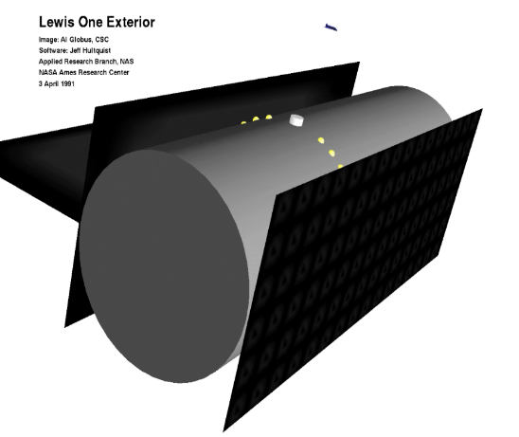
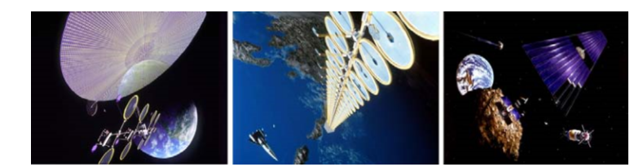
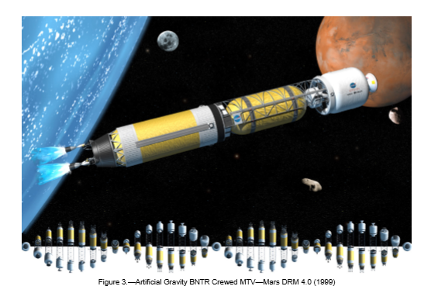
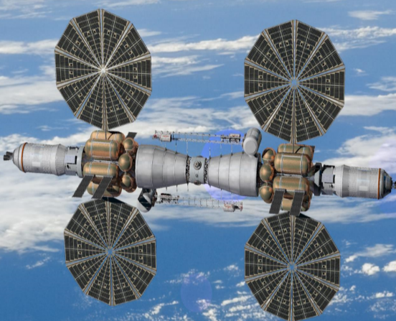
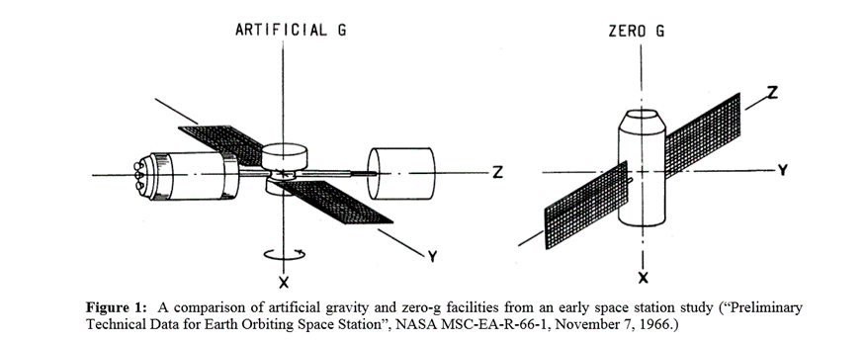
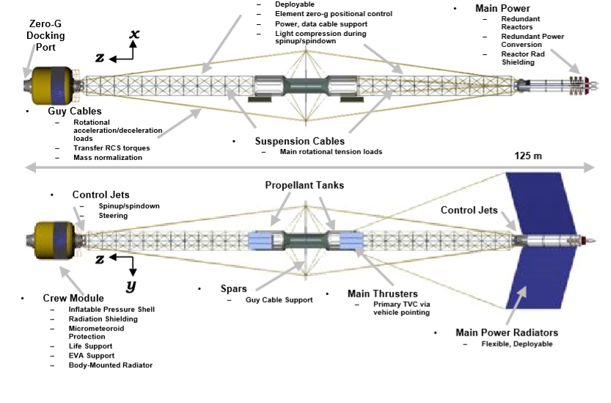
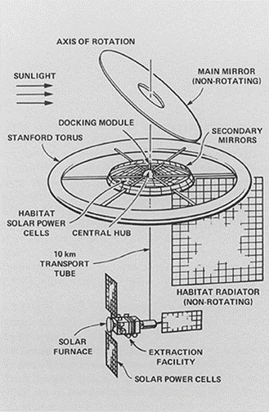
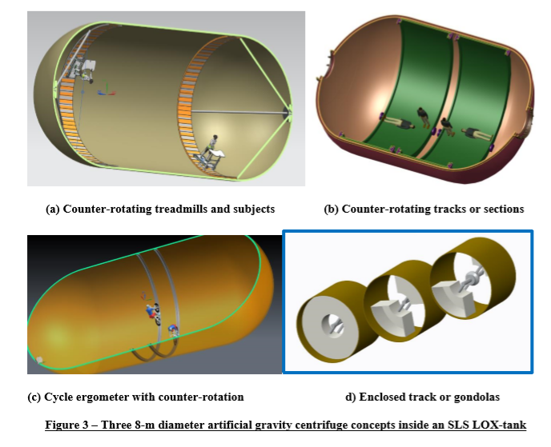
Build a Better Solution
AG concepts:
Stanford Torus
Bernal Sphere
O’Neill Cylinder
Lewis One
Bimodal Engine
ARMSTRong Model
Kalpana One
SLS LOX Tank
Suspension Cables
Tether Module
Linear Sled
Image citations are referenced throughout the presentation

Slide 19
Stanford Torus
This concept has a great energy protocols that allow numerous features and allows for a larger radius which would allow for more supplies and room to move around.
This concept has notable challenges such as the potential giant mirror, which isn’t absolutely necessary. It would also need to be scaled down in size as it was designed for a whole space colony.
It would need to be adapted for near-term implication because it allows for a spacious living environment and creates an artificial gravity environment.
This design shows promise although it is not the best design.
Citation: (Martelaro 2017)

Slide 20
Bernal Sphere
This concept includes several different gravity levels within the space craft as well as a spacious design.
This concept is another design concept built in mind of having a space colony, however if it is scaled back it does have some good features.
It would need to be adapted for near-term implication because it allows for a spacious living environment and creates an artificial gravity environment.
This design shows promise although it is not the best design.

Slide 21
O’Neill Cylinder
This concept has benefits such as the ample space inside of the craft as well as a good setup for artificial gravity implementation.
This concept has challenges such as the severe Coriolis effect and how expensive it would be to build a solid steel cylinder.
It would need to be adapted for near-term implication because it allows for a spacious living environment and creates an artificial gravity environment.
This design shows promise although it is not the best design.
Citation: (Curreri & Detweiler 2011)

Slide 22
Kalpana One
•This features a similar design to that of the O’Neill cylinder as it is essentially just a short and fat version of the tall and skinny O’Neill cylinder. This design has more wobble control and natural light advantages than its counterparts as it its rotational axis is that of the Solar System’s north-south axis.
•This is another design concept that was made with the idea of a whole space colony so we would need to drastically downsize this model for it to be considerable.
•It would need to be adapted for near-term implication because it allows for a spacious living environment and creates an artificial gravity environment.
•This design shows promise although it is not the best design.

Slide 23

Lewis One
This concept features a range of gravitational forces throughout, ranging from the Moon to Earth in small increments. This would be critically important as it would be very helpful in the adjustment the crew would face.
The flaw is the incredibly large design as it was designed in the late nineteen hundred’s when scientists were looking at artificial gravity in order to form a space colony.
It would need to be adapted for near-term implication because it allows for a spacious living environment and creates an artificial gravity environment.
This design shows promise although it is not the best design.
Citation: NASA

Slide 24
Bimodal Engine – Rotating NTP
•This provides high thrust propulsion and continuous twenty-four seven electrical power. It would be rotated about its center of mass and perpendicular to the flight vector would create the centrifugal force and the artificial gravity environment. This design is naturally equipped to be an artificial gravity environment.
•These are high thrust engines which would require a lot of energy or fuel which would be expensive.
•It would need to be adapted for near-term implication because it allows for a spacious living environment and creates an artificial gravity environment.
•This concept shows great promise as it has a natural design and few downfalls.
Citation: (Borowski, McCurdy, & Packard 2014)

Slide 25
ARMSTRong Model-Artificial Gravity Rotating Modular Space Transport
•This design has a main hub and two deployable wings. This design is more cost efficient than others because of the flexible wings that deploy.
•If the wings are inflatable or made of a material that is flexible that does add the challenge of the stability of them once they are deployed in space. The temperature of the wings is also of concern as the material will not support moderate temperatures.
•It would need to be adapted for near-term implication because it allows for a spacious living environment and creates an artificial gravity environment.
•This design shows promise but needs to have the physics worked on.

Slide 26
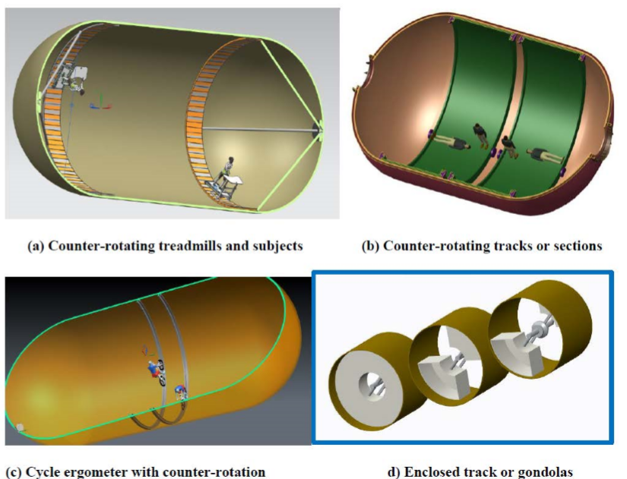
SLS LOX Tank
•This design concept features a tank that would rotate as opposed to rotating the whole spacecraft. This tank could be inflatable with a steel shell or just made from metal entirely. It could have tracks on the inside.
• It will have the Coriolis effect and it will be a challenge to deal with since we are shortening the radius the spin rate will have to increase and that could lead to negative health effects.
•It would need to be adapted for near-term implication because it allows for a spacious living environment and creates an artificial gravity environment.
•This shows a good deal of promise as it simplifies some the rotational variables but will lead to complications.
Citation:(Zipay 2019)

Slide 27
Tether Module
•This design cuts down cost by using tethers and will allow for the radius to be rather large which will help in rpm calculations. The docking port would act as a center for low gravity operations and as a counterweight for the crew module.
•There would need to be a mechanism to spin up and spin down the facility quickly which has yet to be developed. Another challenge would be tracking inertial targets form a rotating facility of this design. The tethers are also not as sturdy as it would be preferred.
•It would need to be adapted for near-term implication because it allows for a spacious living environment and creates an artificial gravity environment.
•This design shows a great deal of promise but needs to have some physics worked out.
Citation: (Sorensen 2005)

Slide 28
Suspension Cables
This design features suspension cables(tension cables) which are a sturdier way to cut cost down but increase the radius; this will allow for the rotation rate to be kept at a conservative number.
Challenges include CG offsets in habitat and power modules causing stability concerns; there are a lot of moving parts so there is a lot of error sources.
It would need to be adapted for near-term implication because it allows for a spacious living environment and creates an artificial gravity environment.
This concept shows great promise and once the minor issues get worked out, this could be the best design.
Citation: (Joosten 2002)

Slide 29

Linear Sled
•This design would create artificial gravity by linear acceleration. It would achieve this by attaching a track to a space craft and then accelerating an astronaut forward and then flipping them and decelerating them(feet above head) on a sled on the track. This limits the Coriolis effect as they are not rotating the entire space craft.
•The length of the track and acceleration rate is similar ratio debate to that of radius and spin rate; there is simply not enough research done to be able to give a concrete number.
•It would need to be adapted for near-term implication because it allows for a spacious living environment and creates an artificial gravity environment.
•This design needs to be furthered researched before it is seriously considered.
Citation: (Gruber 2018)

Slide 30
Where we go from here…
This work is a first step and provides a foundation for future work
  Negative health effect caused by microgravity and current countermeasures
  Artificial gravity as a countermeasure
  Physics of artificial gravity spacecraft
  Artificial gravity spacecraft concepts
  Artificial gravity community of practice
Near term goal: Develop an alternative to "going fast" for human missions in the inner solar system
  Continue developing body of knowledge through research
  Discussions with AG advocates across the agency, focus on barriers to acceptance
  Develop concept for AG habitat and associated campaign for comparison
Long term goal: Ability for humans to safely live in space for decades
Artificial Gravity on SMAB SharePoint

Slide 31
References
Alexander, D. J., MD, Gibson, C. R., OD, Hamilton, D. R., MD, PhD, Lee, S. M., MS, Mader, T. H., MD, Otto, C., MD, . . . Zanello, S. B., PhD. (2012). Risk of Spaceflight-Induced Intracranial Hypertension and Vision Alterations. Human Research Roadmap, 1-109. Retrieved from https://humanresearchroadmap.nasa.gov/evidence/reports/viip.pdf
Axpe E, Chan D, Abegaz MF, Schreurs AS, Alwood JS, Globus RK, et al. (2020) A human mission to Mars: Predicting the bone mineral density loss of astronauts. PLoS ONE 15(1): e0226434. https://doi.org/10.1371/journal. pone.0226434
Ball, John R. Safe Passage Astronaut Care for Exploration Missions. National Academy Press, 2002. https://www.ncbi.nlm.nih.gov/books/NBK223785/
Barbeau, Z., Fehrenbach, S., Jacob, J. (2013, January 05). Development and Testing of and Inflatable Artificial gravity System. Aerospace Research Central. https://arc.aiaa.org/doi/10.2514/6.2013-730
Borowski, S., McCurdy, D., & Packard, T. (2014). Conventional and Bimodal Nuclear Thermal Rocket (NTR) Artificial Gravity Mars Transfer Vehicle Concepts. NASA Technical Reports Server. https://ntrs.nasa.gov/archive/nasa/casi.ntrs.nasa.gov/20160014801.pdf
Carroll, Joseph A. (2010). Design Concepts for a Manned Artificial Gravity Research Facility. http://www.spacearchitect.org/pubs/IAC-10-D1.1.4.pdf
Clément, G., Bukley, A., &amp; Paloski, W. (2015, May 30). Artificial gravity as a countermeasure for mitigating physiological deconditioning during long-duration space missions. Retrieved July 24, 2020, from https://www.frontiersin.org/articles/10.3389/fnsys.2015.00092/full
Clément, Gilles R et al. (2015, June) “Artificial gravity as a countermeasure for mitigating physiological deconditioning during long-duration space missions.” Frontiers in systems neuroscience vol. 9 92. 17, doi:10.3389/fnsys.2015.00092 https://www.ncbi.nlm.nih.gov/pmc/articles/PMC4470275/
Clément, G. (2017, November 24). International roadmap for artificial gravity research. Retrieved July 24, 2020, from https://www.nature.com/articles/s41526-017-0034-8
Curreri, Peter A., & Detweiler, Michael K. (2011, January 01). A Contemporary Analysis of the O’Neill-Glaser Model for Space-based Solar Power and Habitat Construction. NASA Technical Reports Server. https://ntrs.nasa.gov/archive/nasa/casi.ntrs.nasa.gov/20120001744.pdf
Dunnill, C. (2018, July 11). Method of making oxygen from water in zero gravity raises hope for long-distance space travel. Retrieved July 22, 2020, from https://phys.org/news/2018-07-method-oxygen-gravity-long-distance-space.html
Fredericksen, Dick. (n.d). Bernal Sphere Space Settlement Detail. National Space Society. https://space.nss.org/bernal-sphere-space-settlement-detail/
Globus, Al. (1991, May). The Design and Visualization of a Space Biosphere. https://settlement.arc.nasa.gov/LewisOne/lewisOnePaper.pdf
Globus, A., Arora, N., Bajoria, A., & Strout, J. (2007). The Kalpana One Orbital Space Settlement Revised. http://alglobus.net/NASAwork/papers/2007KalpanaOne.pdf
Gruber. J., Seyedmndani, K., & Clark, T. K. (2018, February 14). Linear Sled Hybrid Artificial Gravity Concept. NASA Technical Reports Server. https://ntrs.nasa.gov/search.jsp?R=20190001171
Hall, Theodore W. (2006). Artificial gravity Visualization, Empathy, and Design. American Institute of Aeronautics and Astronautics. file:///C:/Users/eawestfa/Documents/AIAA-2006-7321.pdf
Joosten, B. (n.d.). Artificial Gravity for Human Exploration Missions. AG Constraints, 6-11. Retrieved 2002, from https://history.nasa.gov/DPT/Technology%20Priorities%20Recommendations/Artificial%20Gravity%20Status%20and%20Options%20NExT%20Jul_02.pdf
Joosten, Kent. (2002, July 16). Artificial gravity for Human Exploration Missions. https://history.nasa.gov/DPT/Technology%20Priorities%20Recommendations/Artificial%20Gravity%20Status%20and%20Options%20NExT%20Jul_02.pdf
Martelaro, Nikolas. (2017, May 18). Powering the Stanford Torus. Stanford University. http://large.stanford.edu/courses/2016/ph240/martelaro2/
Pfeiffer, C., Serino, A., &amp; Blanke, O. (2014, March 20). The vestibular system: A spatial reference for bodily self-consciousness. Retrieved July 24, 2020, from https://www.frontiersin.org/articles/10.3389/fnint.2014.00031/full
Raykin, J., Forte, T., Wang, R., Feola, A., Samuels, B., Myers, J., Nelson, E., Gleason, R., & Ethier, R. (2016, February 08). Optic Nerve Sheath Mechanics in VIIP Syndrome. NASA Technical Reports Server. https://ntrs.nasa.gov/search.jsp?R=20160012465&hterms=viip+syndrome&qs=N%3D0%26Ntk%3DAll%26Ntt%3Dviip%2520syndrome%26Ntx%3Dmode%2520matchallpartial
Scharmen, Fred. “The Shape of Space: NASA Designs for Orbital Space Settlements.” Places Journal, 1 Aug. 2018, placesjournal.org/article/the-shape-of-space/?cn-reloaded=1.
Sorensen, Kirk. (2005). A Tether-Based Variable-Gravity Research Facility Concept. http://www.artificial-gravity.com/JANNAF-2005-Sorensen.pdf
Zipay, John J. (2019, January 07). Near-Term Artificial Gravity Concepts for Deep Space Missions. NASA Technical Reports Server. https://ntrs.nasa.gov/search.jsp?R=20190000843&hterms=Near-Term+Artificial+Gravity+Concepts+Deep+Space+Missions&qs=N%3D0%26Ntk%3DAll%26Ntt%3DNear-Term%2520Artificial%2520Gravity%2520Concepts%2520for%2520Deep%2520Space%2520Missions%26Ntx%3Dmode%2520matchallpartial

