Slide 1
Modeling Radiation Sources for
Experimental Validation
Juliana Simon
Mentors: Sheila A. Thibeault and Martha S. Clowdsley
2020 Summer NIFS Research Symposium
August 7, 2020

Slide 2
Challenge
Modeling lab setups computationally to check experimental results
Experimental results come from composite materials exposed to neutron source (to look at their shielding effectiveness against secondary neutron production on planetary surfaces)
Materials were originally developed to look at materials processing methods and viability of using as construction materials on the Moon and Mars

Slide 3
Objective
Big picture is to determine the shielding effectiveness of materials in space radiation environments
This project seeks to validate experimental data and maintain a model that can be used alongside lab exposures
Provides a more rigorous approach to testing materials and extrapolating to space environments (which is severely limited experimentally)

Slide 4
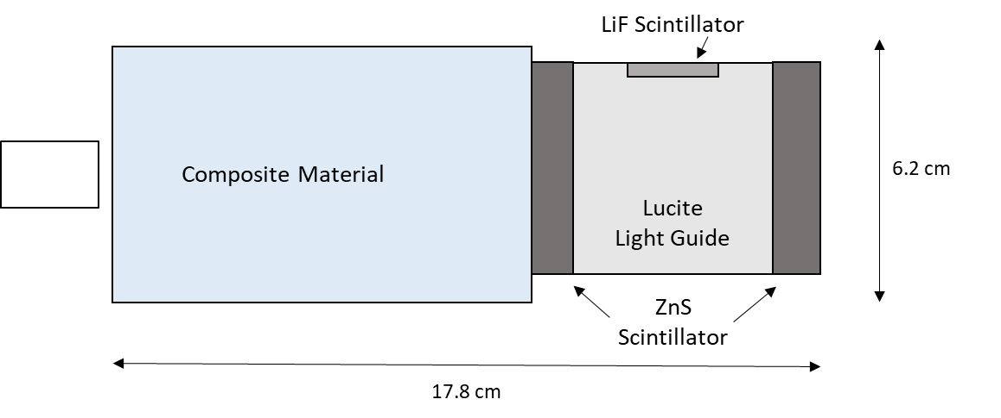
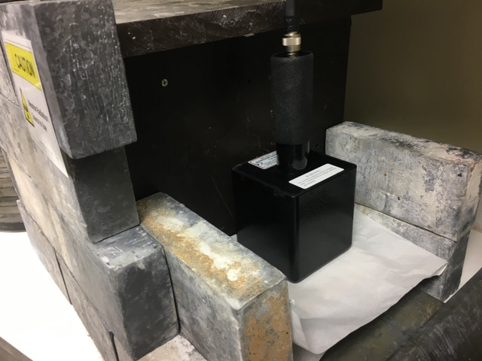
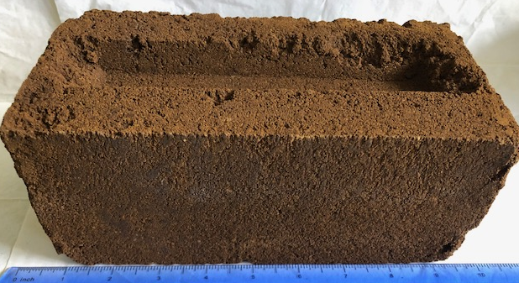
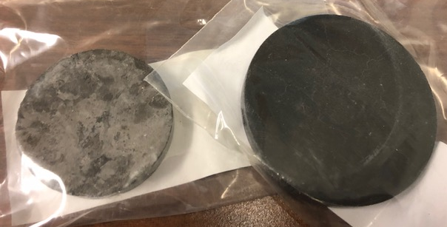
Approach
Adapting physical parameters of system into MCNP6 (Monte Carlo N-Particle) transport code to simulate real conditions
Neutron Source
Image: Neutron source and detector.
Schematic: Basic geometry of model adapted to coordinate system in MCNP6 code.
Images: Martian and Lunar regolith composite
specimens, respectively.

Slide 5
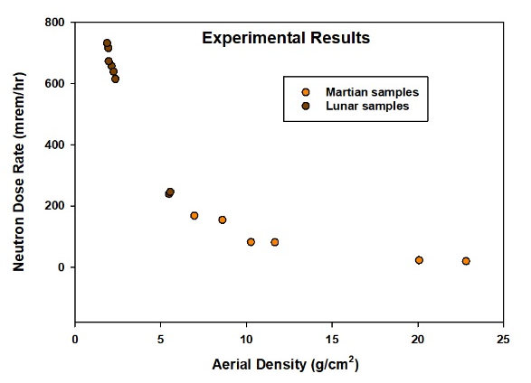
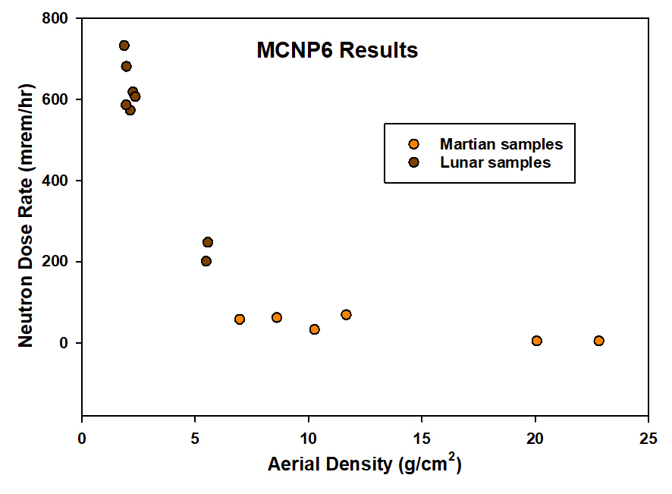
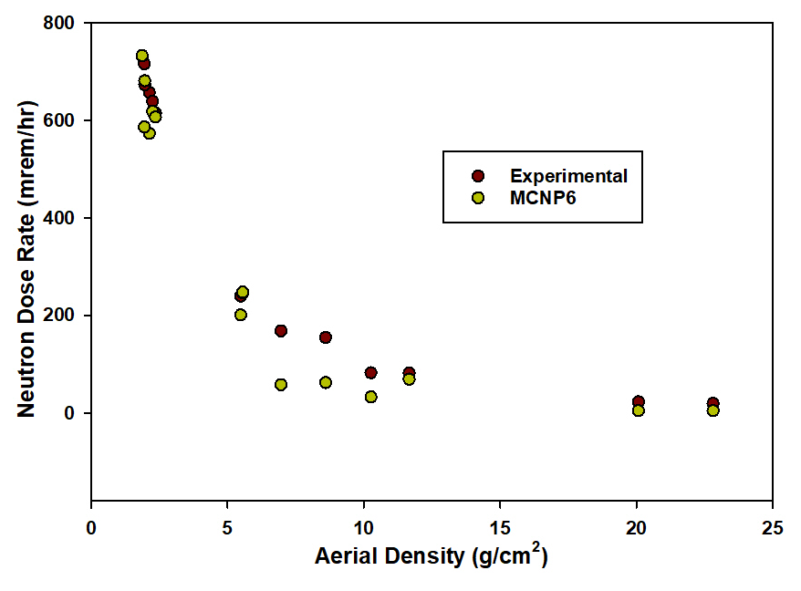
Results
Preliminary results
Getting the right overall trend,
but results for individual points
are inconsistent
Regolith Type | Sample | Shape | Thickness of Axis (cm) | Areal Density (g/cm^2) | Experimental Neutron Dose Rate (mrem/hr) | MCNP6 Neutron Dose Rate (mrem/hr) | Percent Error
Lunar | 20w% PE | square tile | 1.30 | 2.13 | 656.70 | 572.71 | 12.79
Lunar | 10w% PE | square tile | 1.20 | 1.95 | 715.70 | 585.96 | 18.13
Lunar | 30w% PE | disk | 1.00 | 1.96 | 672.85 | 680.74 | 1.17
Lunar | 7w% PE | disk | 1.20 | 2.25 | 638.61 | 618.10 | 3.21
Lunar | 20w% PE | disk | 0.90 | 1.87 | 731.75 | 732.30 | 0.08
Lunar | 20w% PP | disk | 1.20 | 2.36 | 614.60 | 606.46 | 1.32
Lunar | 30w% PE | disk | 3.30 | 5.48 | 239.35 | 200.79 | 16.11
Lunar | 20w% PE | disk | 2.90 | 5.56 | 246.01 | 247.79 | 0.72
Martian | 12v% UF | cylinder | 7.00 | 6.96 | 168.03 | 57.54 | 65.76
Martian | 15v% UF | cylinder | 7.30 | 8.60 | 154.53 | 61.92 | 59.93
Martian | 12v% UF | brick | 22.50 | 20.08 | 22.56 | 4.30 | 80.95
Martian | 15v% UF | brick | 22.50 | 22.82 | 19.25 | 4.46 | 76.86
Samples
PE = Polyethylene
PP = Polypropylene
UF = Urea Formaldehyde

Slide 6
Analysis/Summary
The early approach used simplified geometries and a macroscopic response (average energy deposition), but need a more sophisticated model to reproduce accurately the results
  Energy distribution of pulses created in detector requires far more detail because we are now looking at each individual radiation particle
Disk-shaped Lunar samples performed best in preliminary tests
  Geometric simplifications are cylindrical
Martian specimens performed worse in general
  Variability of physical specimens – shape, possibly composition

Slide 7
Next Steps/Outlook/Future Work
With a few more weeks, I would complete the fixes necessary to obtain data from updated version
With a few more months, I would apply the work to other experiments (materials, radiation sources) to try to reproduce results
This work could be broadened for other radiation exposures (e.g., protons) - in some cases, the research is unable to be performed experimentally, so modeling is the only approach

Slide 8
Acknowledgements
Dr. Robert C. Singleterry (NASA Langley Research Center)
AES (Advanced Exploration Systems) RadWorks

