Slide 1
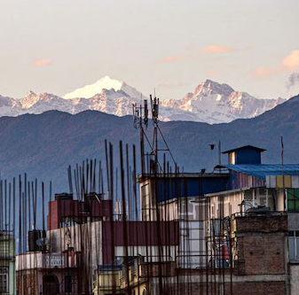
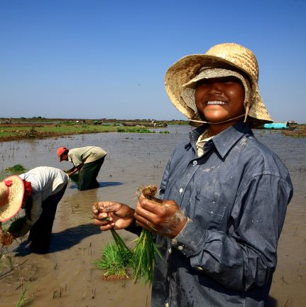
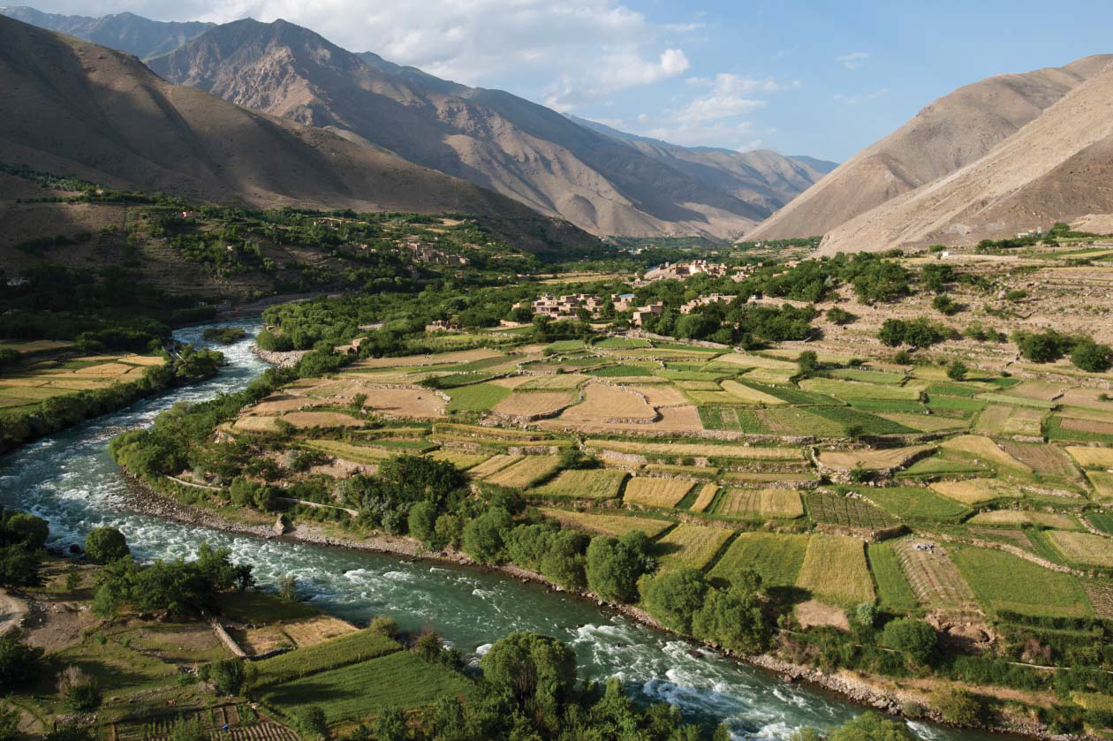

SERVIR Asia Hubs
Overview & Highlights
Timothy Mayer
NASA – SERVIR Regional Science Coordination Lead Hindu Kush Himalaya
Notes:
Image credit Lee Ellenburg and SERVIR Service Catalog

Slide 2

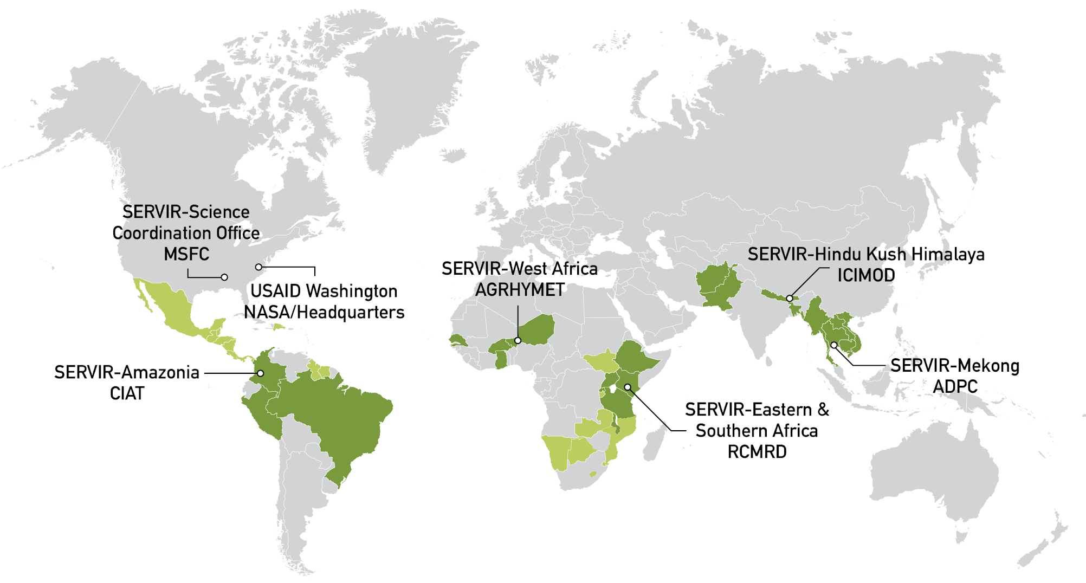

Notes:
The SERVIR Global Network – Asia, Africa, Americas

Slide 3




  Agriculture and Food Security
  Water and Water Related Disasters
  Land Use and Ecosystems
  Weather and Climate
Notes:
Tim - SERVIR Thematic Areas

Slide 4

West Africa
Eastern & Southern Africa
0
Hindu Kush Himalaya
Mekong
Amazonia
Food Security and
Agriculture
Water and
Water Related
Disasters
Land Cover & Land
Use Change and
Ecosystems
Weather and
Climate
Notes:
Tim - Snapshot of SERVIR Services by theme and region

Slide 5


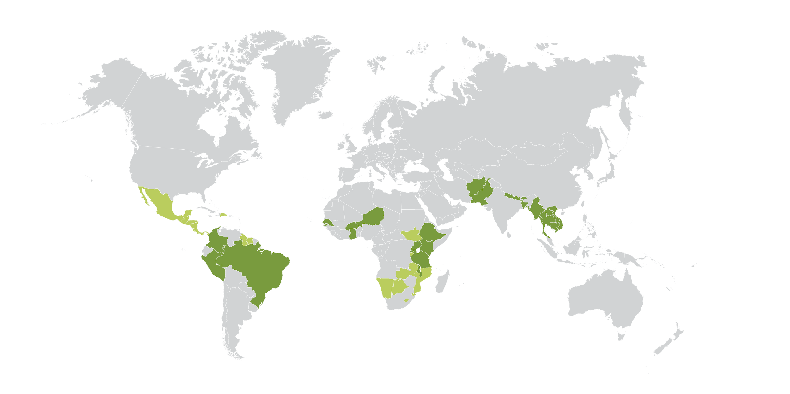
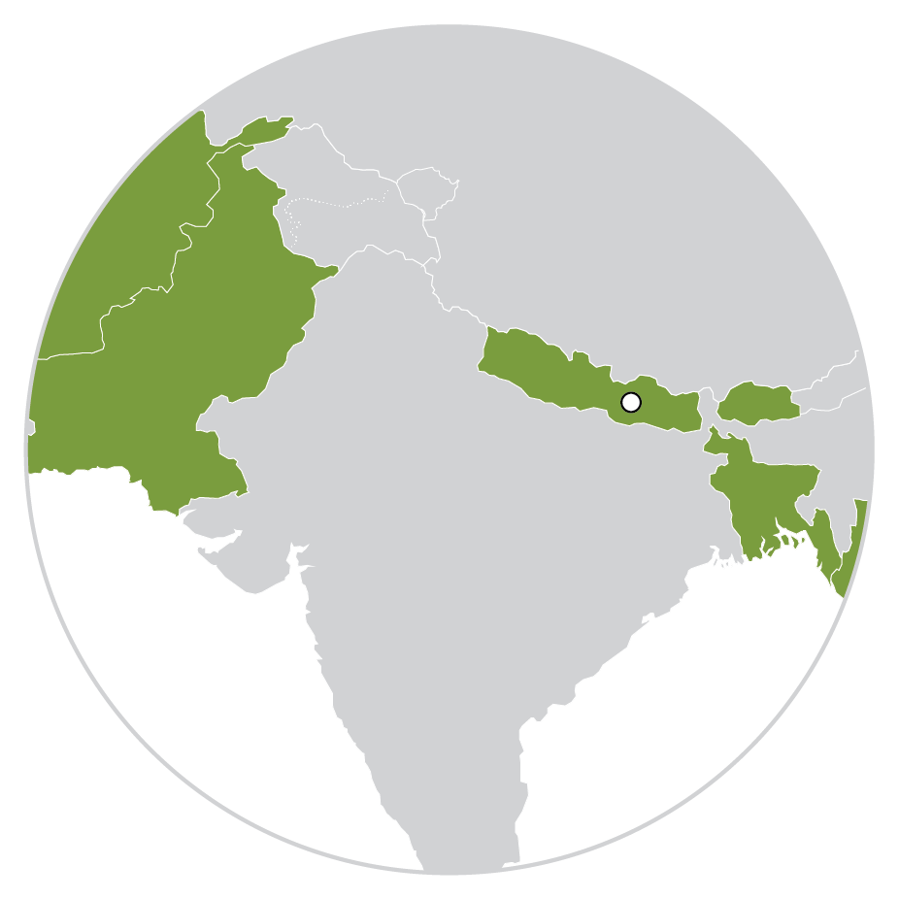
Services
Regional land cover monitoring service
Regional drought monitoring and early warning
Agro-met advisory for national and local level planning in Nepal, Bangladesh, and Pakistan
Food security vulnerability information system of Nepal
In-season wheat crop sown area assessment for Afghanistan
Enhancing flood early warning systems
River and flood plain information management system
Forest vulnerability and management information system in Nepal
Monitoring extreme weather
Notes:
SERVIR Hindu Kush Himalaya(EST. 2010)

Slide 6


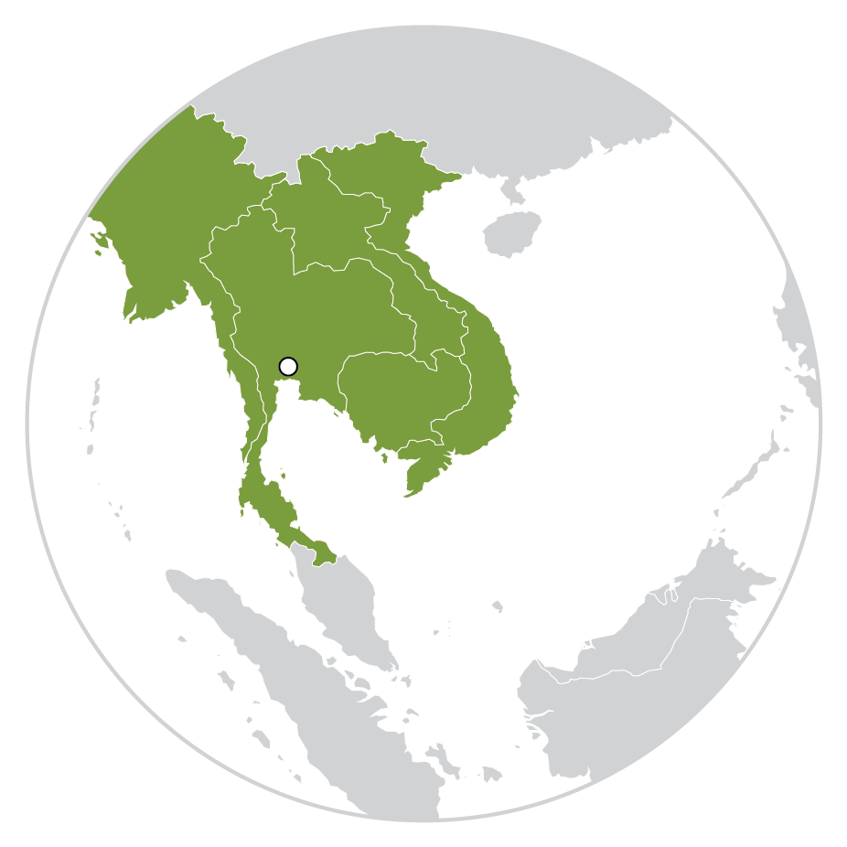
Services
Regional land cover monitoring service
Supporting Myanmar to respond to floods
Improving agricultural planning in Vietnam
Supporting Mekong River Commission's regional drought forecasting
Crop-type mapping in Vietnam to improve agriculture management and support food security
Improving rainfall estimates for flood forecasting in Cambodia
Improving Mekong River Commission’s regional flood modelling using land cover information
Notes:
Consortium (EST. 2014)

Slide 7
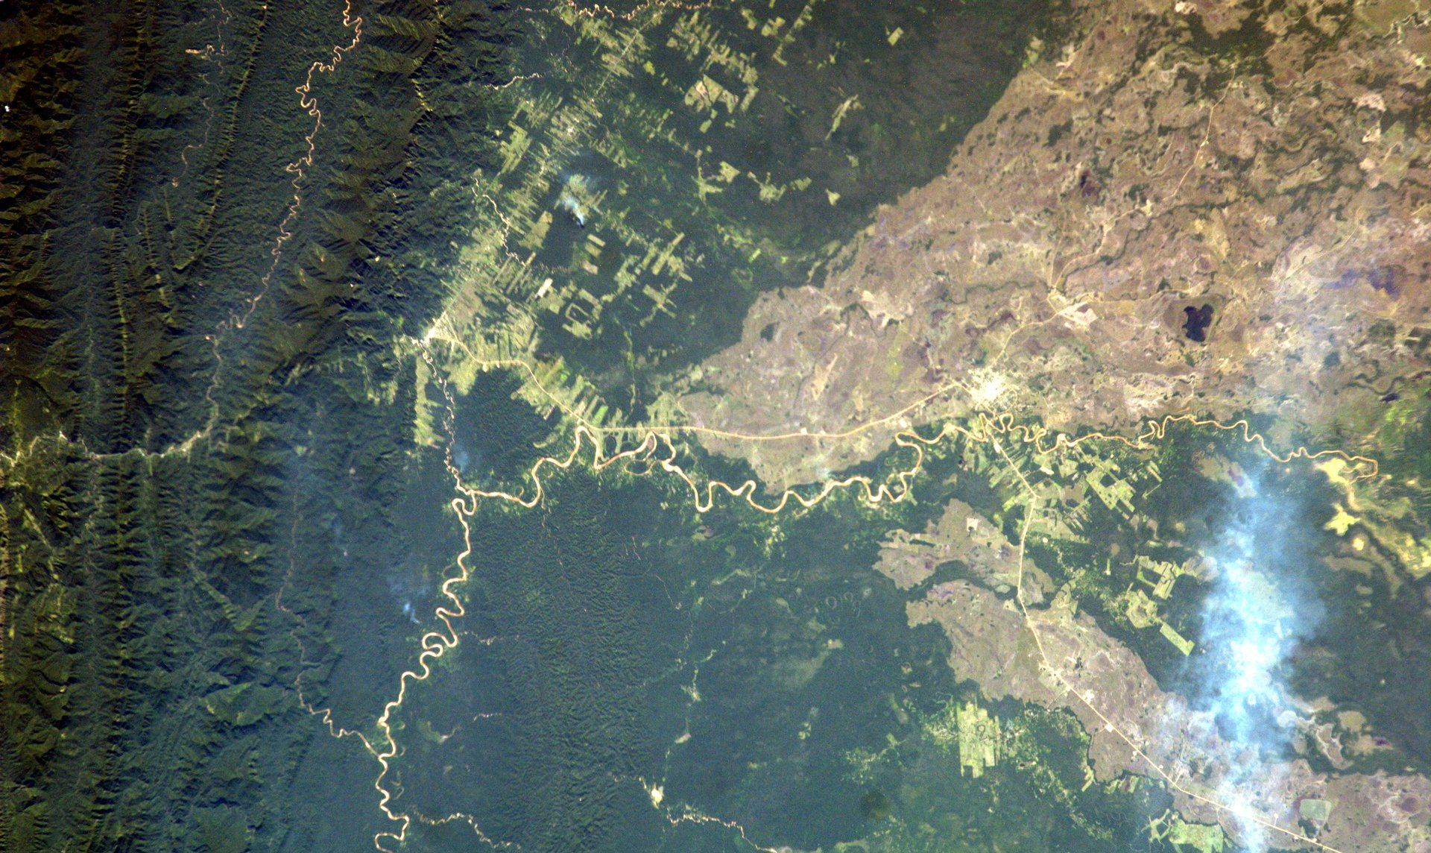
NASA SERVIR:
Land Use and Ecosystems Highlight
Notes:
Image Credit: Sally Ride EarthKAM http://images.earthkam.org/main.php?g2_view=core.DownloadItem&g2_itemId=1270164
Yungas Foothills

Slide 8
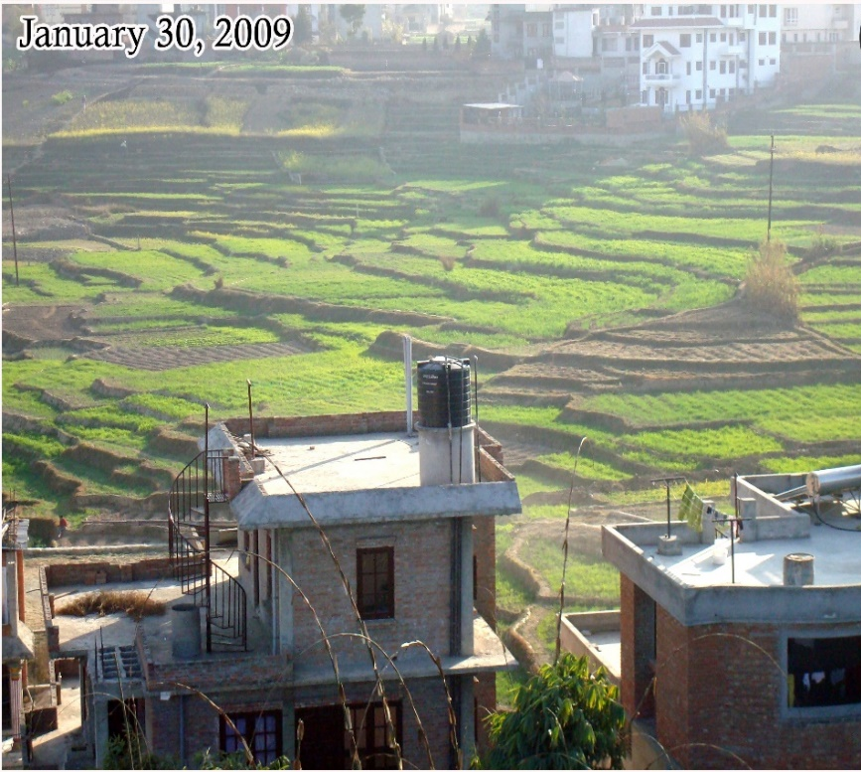

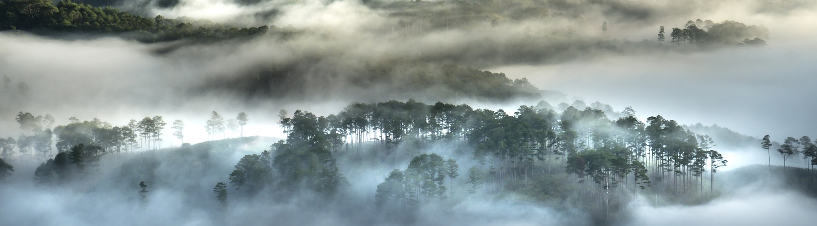
SERVIR LCLUC & Ecosystems
Regional land cover monitoring service
The Hindu Kush Himalaya and Lower Mekong Regions have experienced dramatic and rapid land cover change in recent years.
SERVIR Hub organizations build the capacity of end users through service Co-Development.
Notes:
Image Credit Kabir Uddin SERVIR HKH and SAR handbook
The Hindu Kush Himalaya and Lower Mekong Regions have experienced dramatic and rapid land cover change in recent years.
For instance in Myanmar, a shared HKH and Mekong focus country, the United Nations Food and Agriculture Organization (FAO) Forest Resource Assessment (FRA) reports, Myanmar's forest cover drastically declined from 58% in 1990 to 43% in 2015.
To meet the need for effective land cover and especially forest monitoring essential for the United Nations Framework Convention on Climate Change (UNFCCC), both SERVIR-HKH and SERVIR-Mekong co-developed along with [National Forest Departments and government groups: Nepal Forest Research and Training Center; Afghanistan Ministry of Agriculture Irrigation and Livestock; Bangladesh Forest Department]. Spatial Informatics Group, USFS, OneMap Myanmar and University of Maryland the Regional Land Cover Monitoring System (RLCMS)

Slide 9
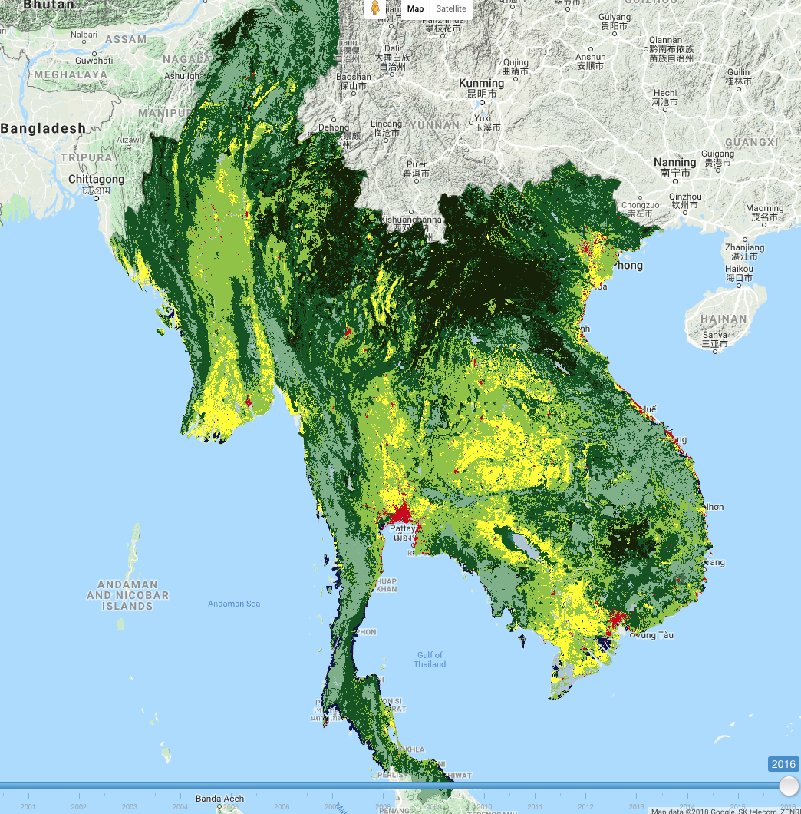
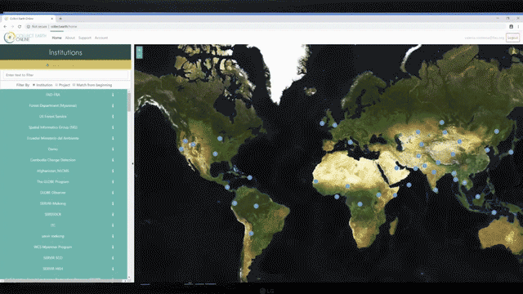
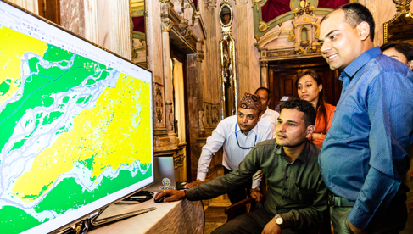
Regional Land Cover Monitoring System (RLCMS)
Regional land cover monitoring service
RLCMS is a web-based tool being developed using cloud-based technology to produce land cover maps on a yearly basis
Collect Earth Online (CEO) system
The LCMS is a web-based tool being developed using cloud-based technology, Google Earth Engine, that will use the historical Landsat Satellite series (Landsat 5, 7, & 8) to produce wall-to-wall land cover maps on a yearly basis starting from 1990 to the present for land cover monitoring purposes. To validate and improve the accuracy of these maps, the service uses Collect Earth Online to collected reference data in addition to available ground-truth data. The land cover products generated by the service will be used for assessing national-level land use/land cover and for reporting to the Food and Agriculture Organization of the United Nations (FAO) Forest Resource Assessment (FRA) and the United Nations Framework Convention on Climate Change (UNFCCC).
at the national level, and also at the Hindu Kush Himalaya (HKH) regional level. Land cover assessment and its dynamics are essential for the sustainable management of natural resources, environmental protection, and food security. Socioeconomic drivers can induce changes in land cover that may disrupt socio-cultural practices and the institutions associated with managing natural resources, which in turn increases the vulnerability of communities to the effects of climate change. The operationalization and generation of annual land cover maps will enable national agencies to effectively manage and enforce land cover and land use policies.
Notes:
Image Credit: Amanda Markert, Lee Ellenburg, Kabir Uddin, and SERVIR Service Catalog
The Regional Land Cover Monitoring System (RLCMS) LCMS is a web-based tool being developed using cloud-based technology, Google Earth Engine, that will use the historical Landsat Satellite series (Landsat 5, 7, & 8) to produce wall-to-wall land cover maps on a yearly basis starting from 1990 to the present for land cover monitoring purposes.
The system generates annual land cover data based on Landsat 5,7,8 satellite data for Afghanistan, Bangladesh, Nepal, and Myanmar
SERVIR-Co-Developed Collect Earth Online (CEO) to Be Used in 190 Countries for Forest Resource Assessment which is an essential tool for collecting the reference inout data essential for the RLCMS machine learning framework

Slide 10
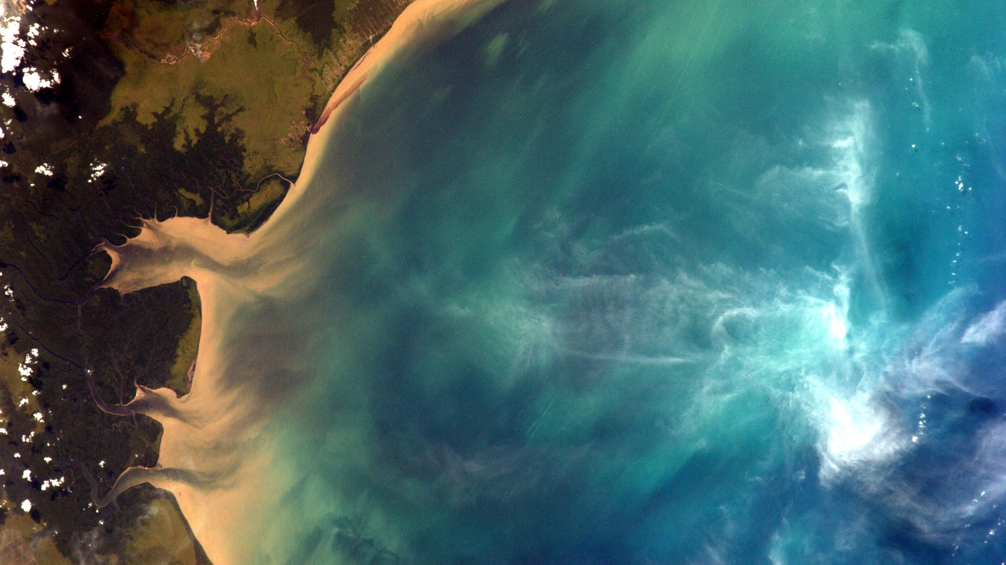
NASA SERVIR:
Water and Water Related Disasters Highlight
Notes:
Image Credit: Sally Ride EarthKAM http://images.earthkam.org/main.php?g2_itemId=1267459
South Sumatra Indonesia

Slide 11
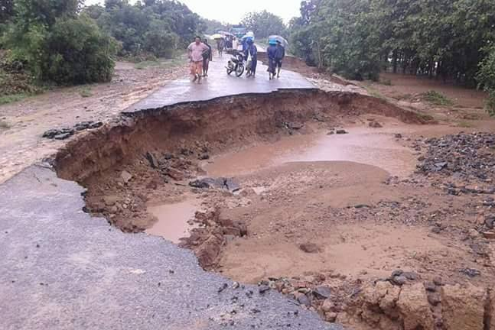
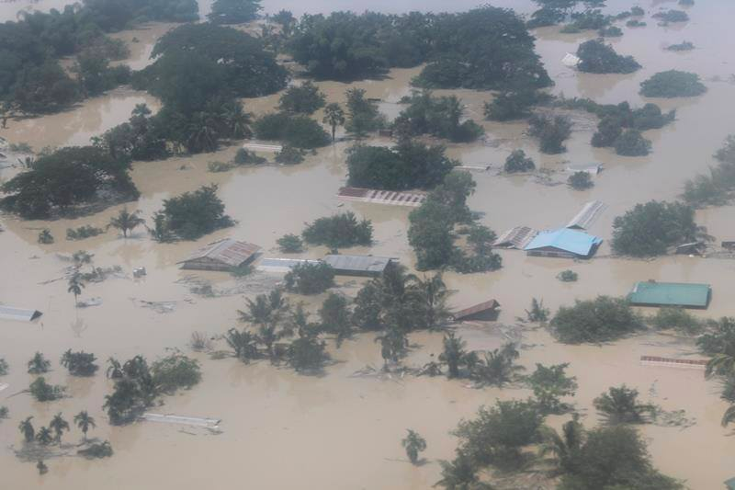
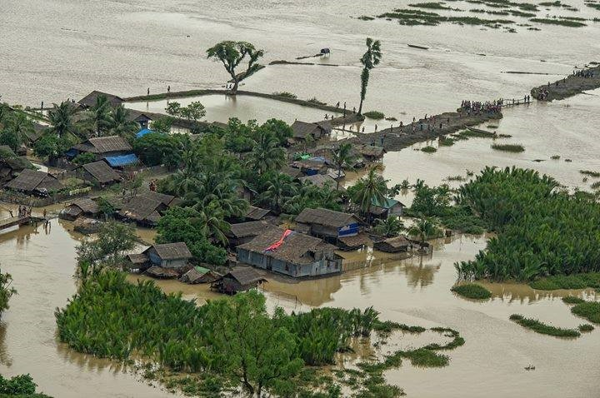
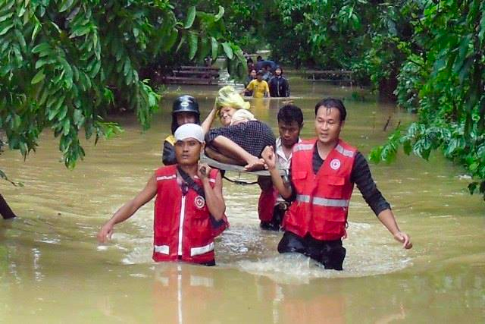
Water & Water Related Disasters
Supporting Near Real-Time
Flood Monitoring in Myanmar
Myanmar is greatly affected due to monsoon rains and tropical cyclones
Co-Development of geospatial tool is a mechanism for capacity building.
Notes:
Image Credit: Amanda Markert and SERVIR Service Catalog
Monsoon rains and tropical cyclones cause recurrent floods in Myanmar.
There exists a dire need to monitor and disseminate information regarding inundated area in near real-time to allow emergency response operations and support relief activities by national and international organizations.
In addition, a Near Real-Time (NRT) monitoring system is essential to warn people in downstream flood-prone areas about the possible threat to lives and property.
To meet the need of rapid flood monitoring map products SERVIR- Mekong, Spatial Informatics Group, Deltares, Stockholm Environment Institute Co-Developed with OneMap Myanmar, Myanmar Department of Disaster Management (DDM), Department of Meteorology and Hydrology (DHM) The HYDrologic Remote sensing Analysis for Floods (HYDRAFloods) system

Slide 12
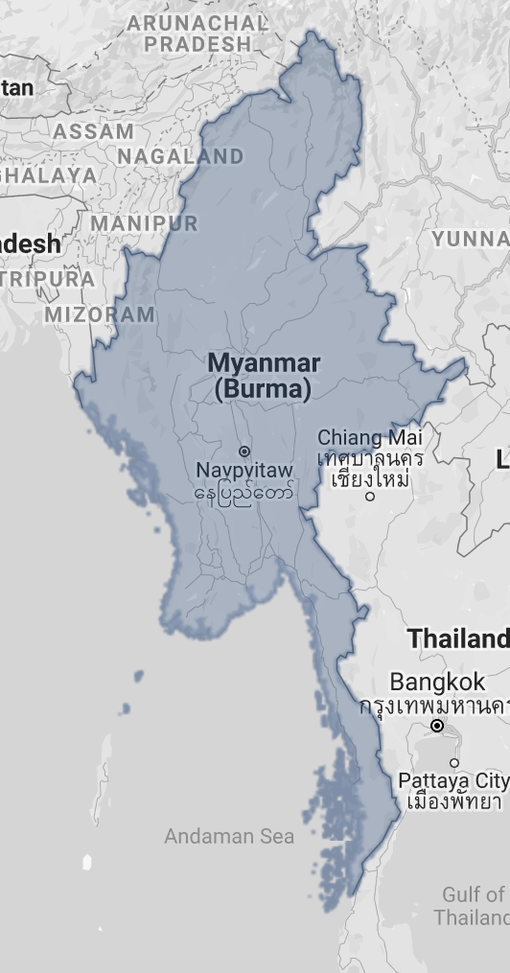
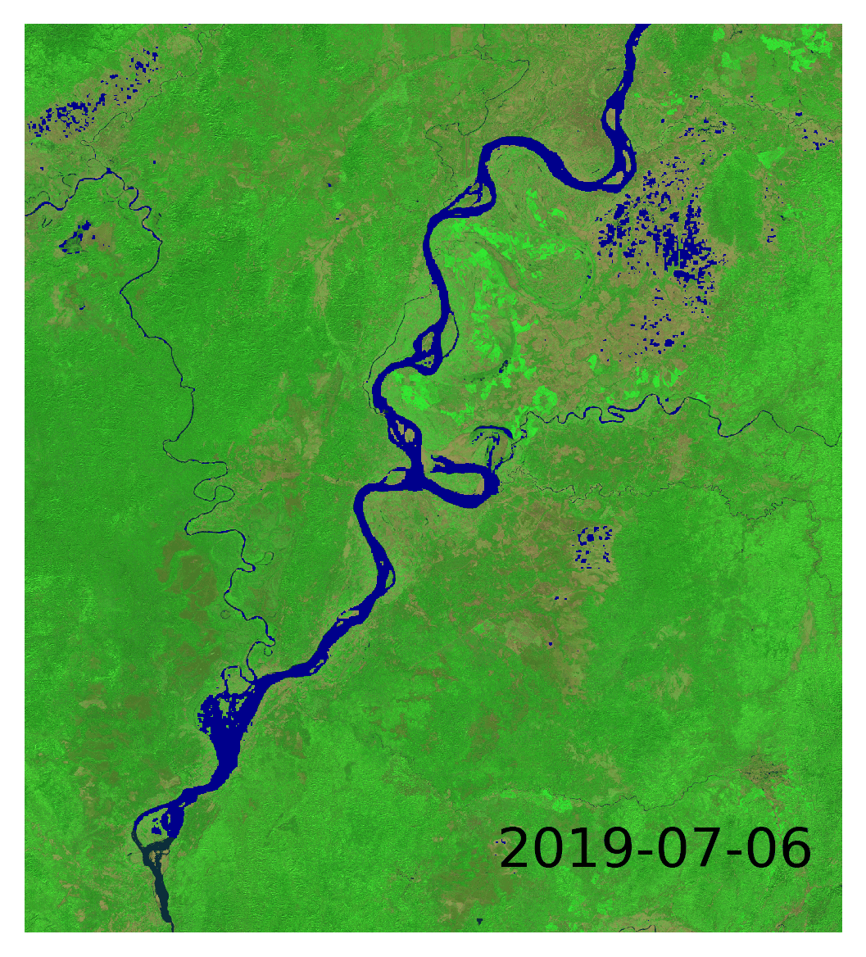
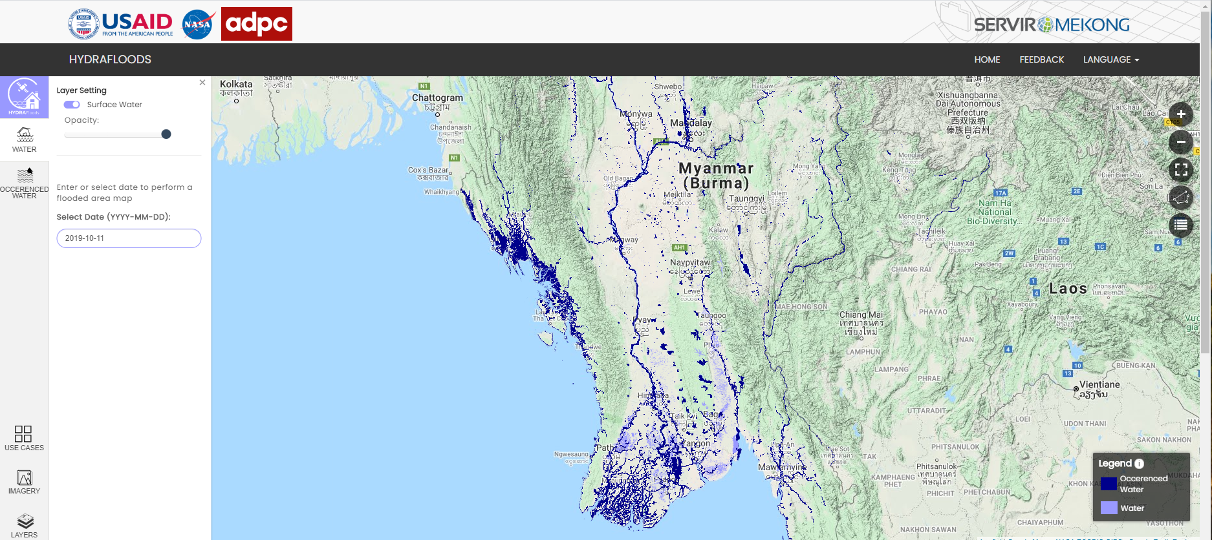
Hydrological Remote Sensing
Analysis of Floods
HYDRAFloods, a web-based multiple satellite tool that generate daily flood water maps.
Flooding Event
Date: July 2019
Location: Myitkyina,Myanmar
Notes:
Image Credit: Amanda Markert and Kel Markert
Service
The objective of the Supporting Near Real-Time Flood Monitoring in Myanmar Service is to develop a multi-sensor based near real-time flood monitoring tool to support the Myanmar Department of Disaster Management (DDM), Department of Meteorology and Hydrology (DHM), in monitoring flood events.
HYDRAFloods system, a web-based (Hydraviewer) tool that leverages the most recently available remotely sensed data acquired by multiple satellite platforms and Data fusion techniques to generate daily flood water maps.
The HYDRAFloods tool employs the most recently available optical, active- and passive- microwave remote sensing data from the MODIS, VIIRS, ATMS, Sentinel 1, Sentinel 2, and Landsat 5,7,8 sensors to generate flood maps enabling more timely, in-depth analysis, and monitoring of flood events.

Slide 13


Thank you to the rest of the SERVIR Science Coordination Office, SERVIR Hubs, and Applied Science Team that make all of these services possible.
Thank You.
For further questions, please contact:
timothy.j.mayer@nasa.gov
Notes:
Image Credit: Amanda Markert

