Slide 1
Satellite Beach
Energy
Restructuring the Energy Balance in Satellite Beach, Florida, by Quantifying Solar Energy Production Potential using NASA POWER Data Products and LiDAR
Spencer Nelson, Katherine Beall, John Dialesandro,
Julia Marturano
Arizona – Tempe
Notes:
Speaker: Our team members are Spencer (Project Lead), Katherine, Julia, and John from the NASA DEVELOP Tempe, Arizona node. We partnered with government officials at the city of Satellite Beach, and Orlando to help measure solar energy potential of rooftops. The City of Satellite Beach has a goal to reach 100% Renewable Energy by 2050. Since wind energy is not a viable option, they plan to achieve this goal via solar. We developed a method to quantify the solar potential throughout the city of Satellite Beach using NASA Earth Observations and high resolution LiDAR data.
Image Credit:
ArcGIS Pro (Created by Team)

Slide 2
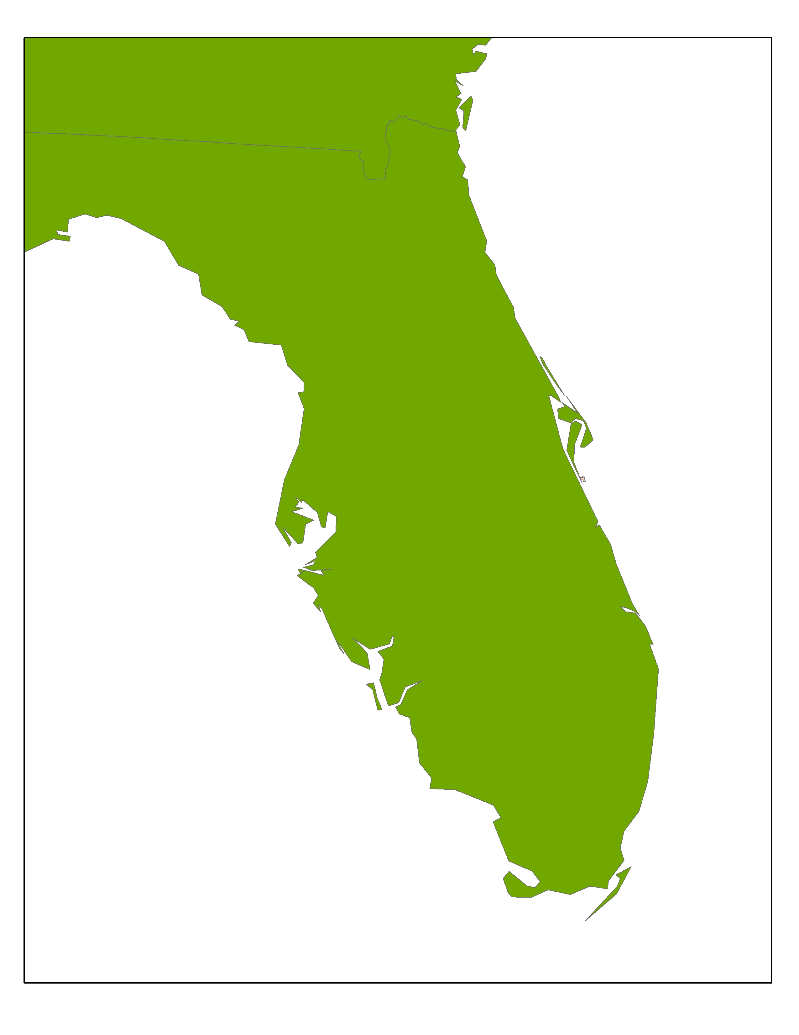
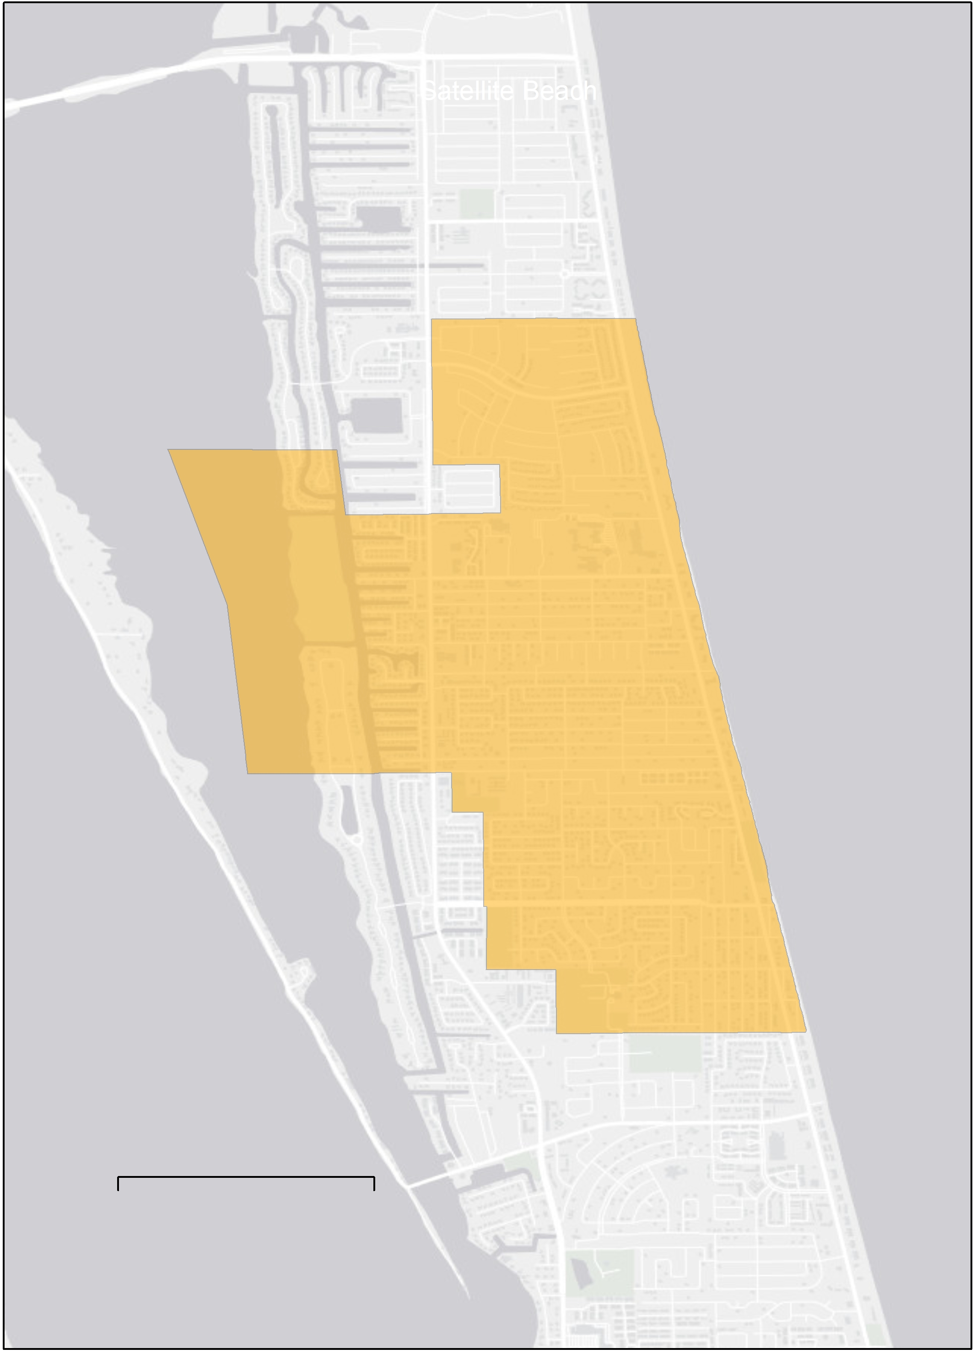


Study Area & Period
Satellite Beach
Land Area: 4.5 miles²
Population: 11,000
Orlando
Atlantic Ocean
Study Period
Solar Analysis (1984-2013)
LiDAR (2019)
LST/NDVI (2015-2019)
Satellite Beach
Mi
2
0
Notes:
Speaker: The City of Satellite Beach is located on the central Atlantic Coast of Florida. The city has a population of 11,000 residents. The area receives 239 sunny days a year (Weatherspark.com). The mean summer high temperature is 91° F.
Image Credit:
ArcGIS Pro (Created by Team)

Slide 3
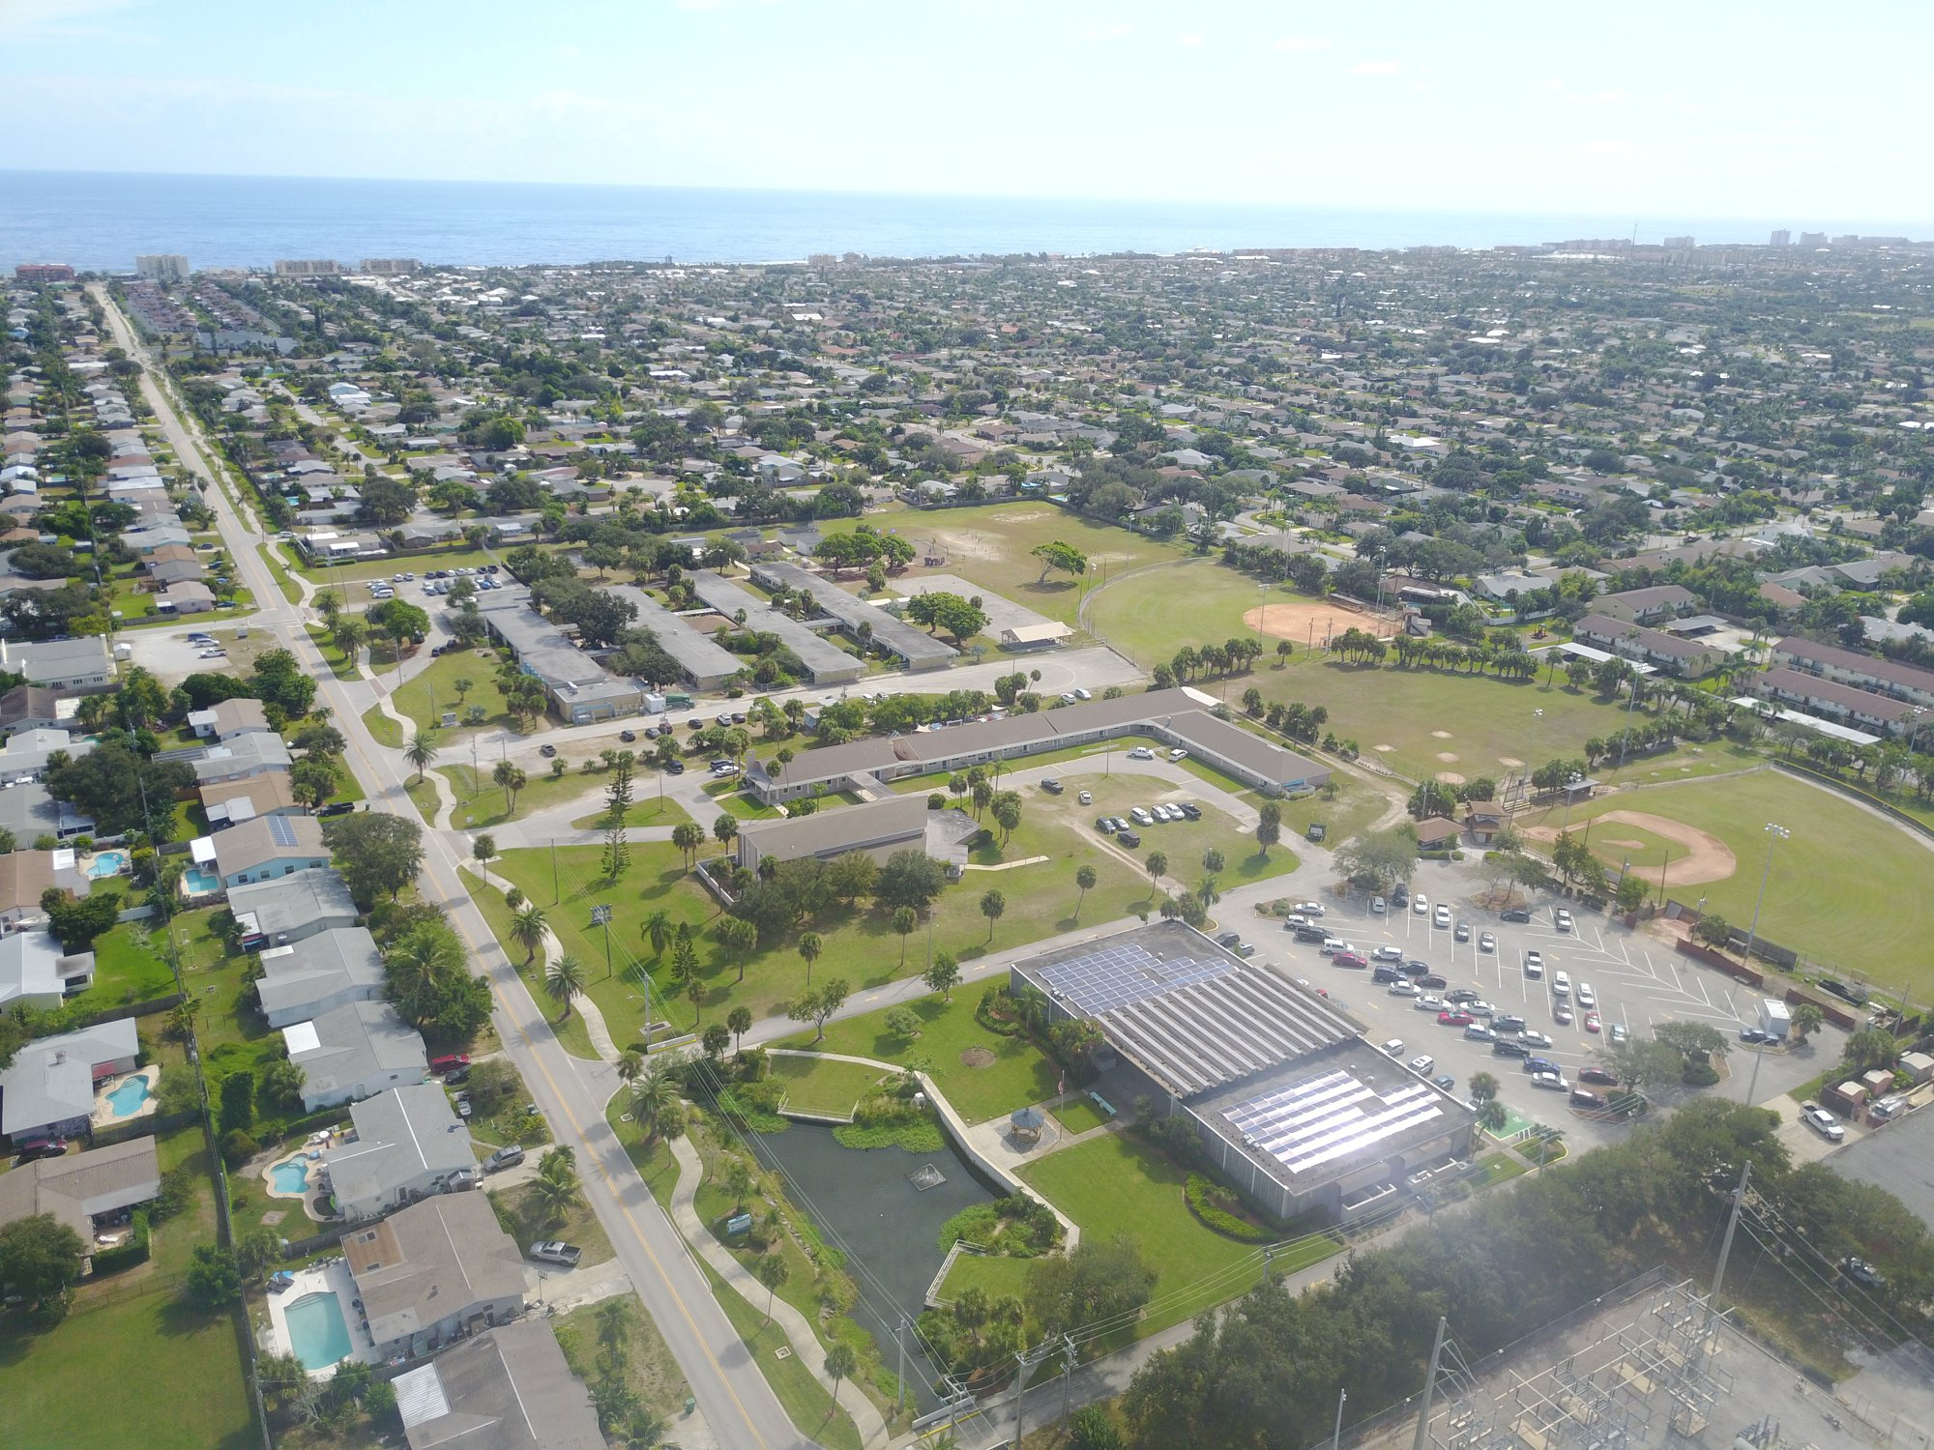

Partners
City of Satellite Beach, Florida
City of Orlando, Florida, Fleet and Facilities Management Division
Image Credit: City of Satellite Beach; dconvertini
Notes:
Speaker: We are partnered with the City of Satellite Beach, Florida, and the City of Orlando, Florida, Fleet and Facilities Management Division. Our project aims to develop a methodology for analyzing the solar potential of rooftops throughout the City of Satellite Beach. The city provided a high resolution Digital Surface Model, parcel data, and roof material data.
Image Credit: Alexis Miller, City of Satellite Beach, partner provided permission
"Orlando, Florida, USA" by dconvertini is licensed under CC BY-SA 2.0

Slide 4
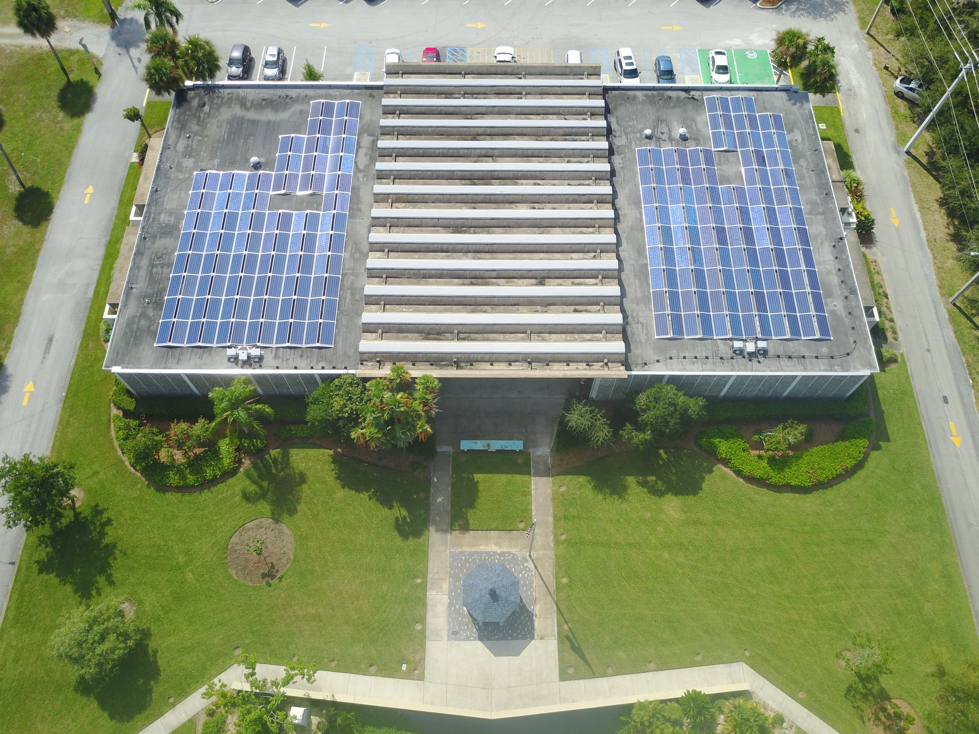
Community Goals
100% Renewable Energy by 2050 (City of Satellite Beach)
Find the most efficient way to implement rooftop PV panel
Understand the compounding effect of increasing energy expenditures and urban heat effects
Image Credit: City of Satellite Beach
Notes:
Satellite Beach seeks to achieve 100% renewable energy by 2050. All of this energy will come via solar as previous analysis has found wind energy to not be a viable option for Satellite Beach. The city seeks to find the most efficient way to install rooftop photovoltaic (PV) panels. The city of Satellite Beach is also interested in understanding the impact that urban heat has on energy expenditures, and to what degree energy expenditure is increased by higher tempertures from urban impervious surface throughout the city.
Image Credit: Alexis Miller of Satellite Beach, Florida, partner provided permission

Slide 5





Objectives
Evaluate the solar energy potential of rooftops in Satellite Beach, Florida, using LiDAR and NASA POWER data
Create LST and NDVI maps, showing pressures on energy consumption
Develop a reusable code-based tool for other cities' solar potential analysis
Image Credit: City of Satellite Beach
Notes:
Speaker: The main objectives of our project were to evaluate the solar potential of every rooftop within Satellite Beach, Florida, using NASA Prediction of Worldwide Energy Resources data as well as a Light Detection and Ranging digital surface model. We also strived to create land surface temperature and Normalized Difference Vegetation Index maps and displayed their impacts on energy consumption. Displaying the surface temperature of the land can show where hot spots are located. Buildings at these locations may need to use more energy such as air conditioning. NDVI displays vegetation. Locations with less vegetation usually have a higher LST which can force buildings to have a higher energy consumption. Finally, we developed a reusable code based tool for calculating solar potential analysis based on local inputs.
Image Credit: "Cropped Samsons Island", City of Satellite Beach, partner provided permission
PowerPoint Icons (Created by Team)

Slide 6
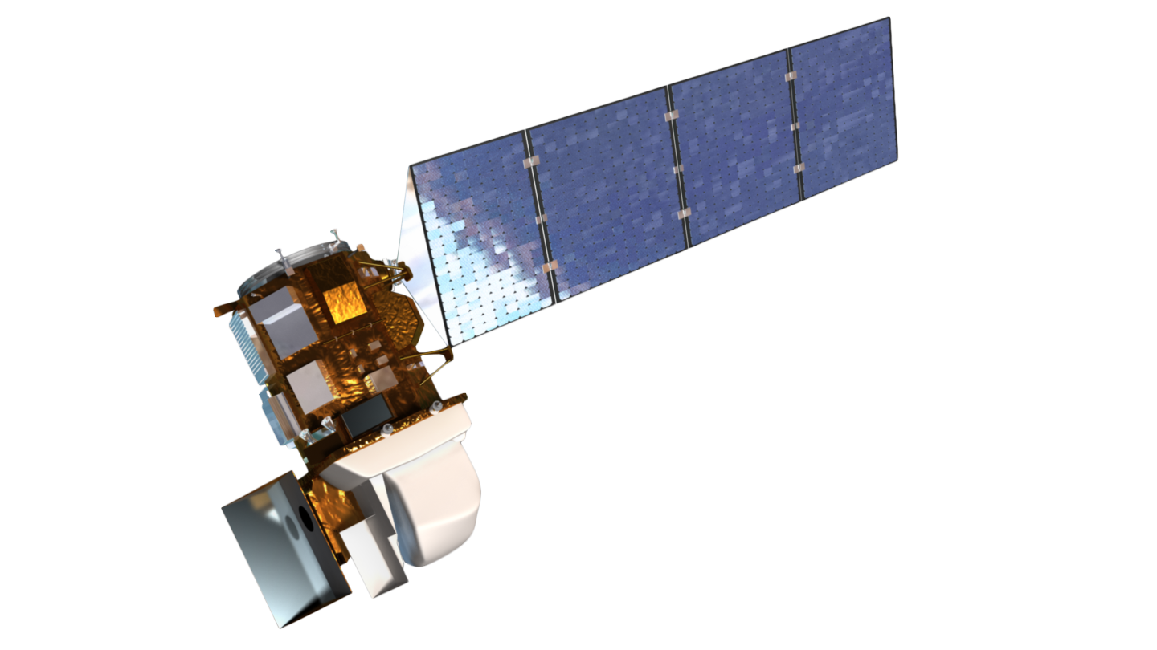

NASA Satellites and Sensors Used
Landsat 8 OLI/TIRS
(USGS)
NASA Prediction of Worldwide Energy Resources (NASA POWER)
Image Credit: USGS and NASA POWER
Notes:
Speaker: We used two NASA datasets that included Landsat 8 OLI/TIRS , and the NASA POWER dataset. The NASA POWER dataset yielded data on tilt solar irradiance, and a suite of climatological variables.
Image Credits:
USGS
NASA POWER

Slide 7
Methodology
Building Footprints
LiDAR DSM
NASA POWER
Slope / Aspect
Sun Position
Tilted Surface Irradiance
Roof Segments
Shading Analysis
Sun Exposure
Energy Potential by Building
Notes:
Speaker: Pre-processing included generating a 1-foot resolution digital surface model (DSM) from a USGS LiDAR point cloud and building footprints from the Microsoft US Building Footprints project. The DSM was used to drive slope, aspect, and hillshades for the entire study region. The slope and aspect outputs were used to process roof segments from the building footprints, and a tilt analysis derived from NASA POWER code resulted in altitude and azimuth values that were read into the hillshade analysis along with the DSM. The hillshade was combined with the slope and aspect in order to create sun exposure layers. Sun exposure was combined with the roof segments and irradiance (also derived from the tilt analysis) in order to derive energy potential at both the roof segment and rooftop/building levels.
Image Credit:
All other images created by Team
PowerPoint Icons (Created by Team)

Slide 8
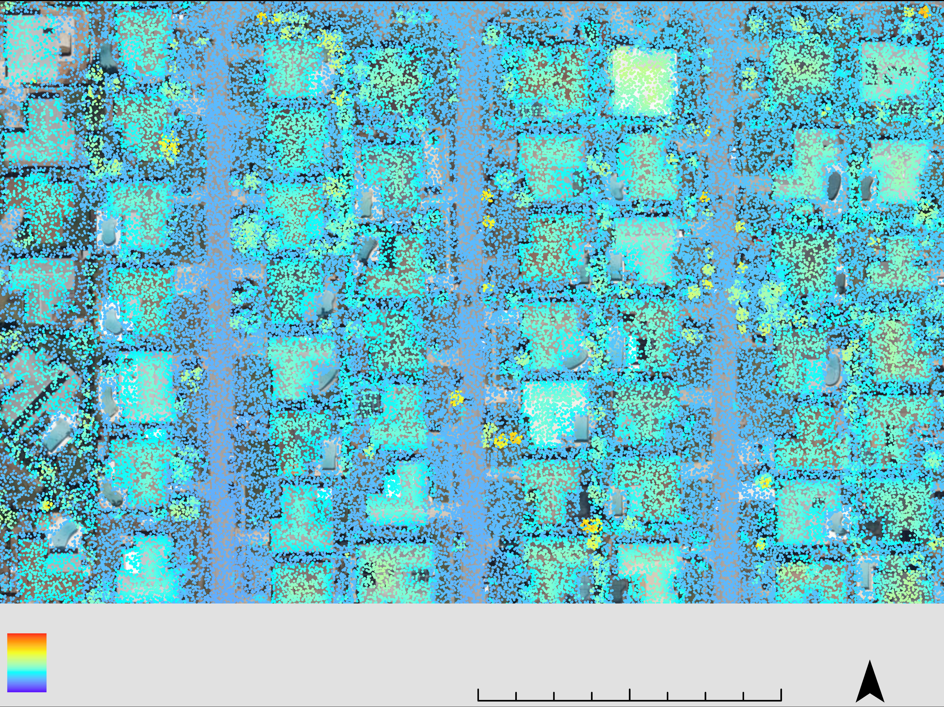
LiDAR Processing
Total LiDAR Points: 156,389,619
0.5 x 0.5 miles tiles
22 tiles
Point Density Range: 0.693 to 10.572 feet per point
Point Density Average ~ 0.80 feet per point
162.72 ft
-3.89 ft
0 150 300 ft
Notes:
Speaker: The LiDAR data for the project came from Woolpert Inc ©. The data was captured in 2019 and was obtained from Satellite Beach in point cloud format. There were a total of 22 relevant .las files that were stored in half mile squared tiles. There totaled to be 156,389, 619 LiDAR points with densities ranging from 0.693 to 10.572 feet per point, with the average being about 0.80 feet per point.
Image Credit:
ArcGIS Pro (Created by Team)

Slide 9
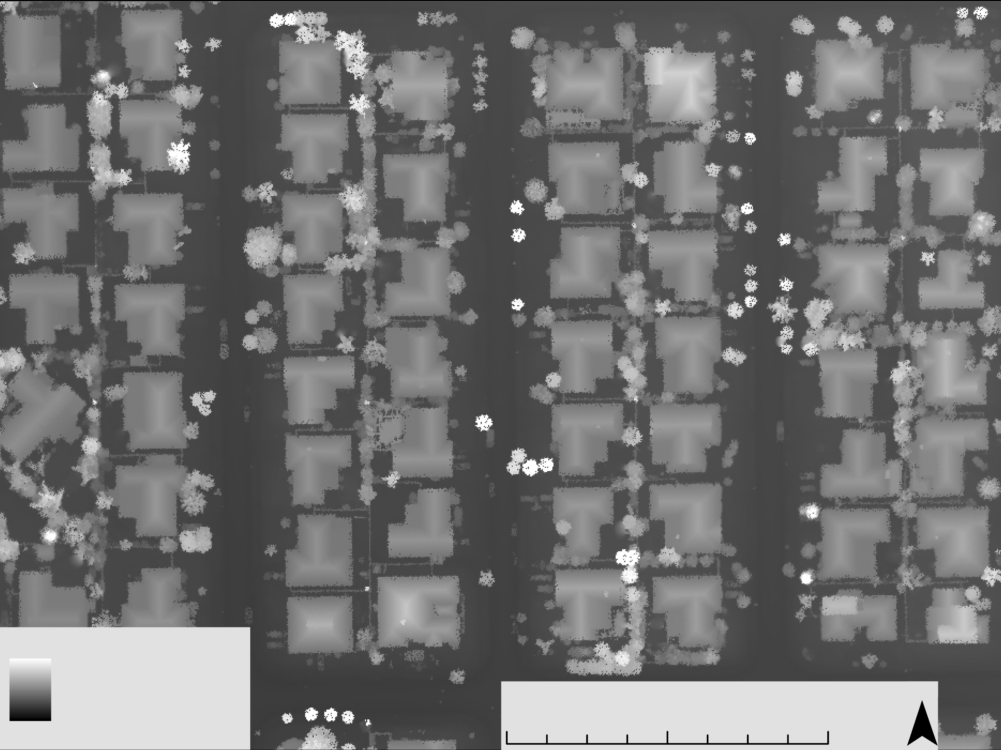
Digital Surface Model
150,015,000 pixels
1 square foot pixels
Minimum Value of negative 3.89 feet
Maximum Value of 162.72 feet
First-returns
"Noise" filtered out
162.72 ft
-3.89 ft
Elevation in Feet
0 150 300 ft
Notes:
Speaker: The LiDAR data was processed to generate a digital surface model or DSM. Compared to a digital terrain model which only shoes the surface characteristics, a digital surface model (DSM) utilizes the first return of the Lidar beam and maps out roof tops, trees and even powerlines at high enough resolutions. In the creation of the DSM we also filtered out LiDAR data that was considered "noise". We used a pixel size of 1 foot as our LiDAR point density was smaller than this, meaning there should be at least one LiDAR point per pixel on average. This resulted in 150,015,000 pixels with a minimum value of –3.89 feet and a maximum of 162.72 feet. This process enabled us to accurately measure roof tops as well as their geometric characteristics. A DSM is necessary for us to calculate shadowing affects on rooftops by surrounding features such as taller buildings and trees.
Image Credit:
ArcGIS Pro (Created by Team)

Slide 10





NASA POWER
Vertical
Maximum (60°)
Zenith
E
Altitude
Optimal (28°)
Horizonal
Solar Panel
Azimuth
N
S
Tilt Angle
Flat (0°)
W
Notes:
Speaker: After creating our DSM, the team focused on extracting solar irradiance data. NASA POWER derives top-of-atmosphere irradiance, atmospheric, and meteorological data via satellite in order to create 22-year climatological averages. A tilt analysis code provided by NASA POWER allowed us to calculate the azimuth, altitude, and tilted surface irradiance for solar panels. The former two parameters are required for modeling the position of the sun throughout the year in order to conduct a shading analysis. The latter parameter is required for modeling the amount of irradiance a solar panel may receive, as the angle at which the solar panel is installed will change the angle of incident solar radiation on the panel throughout the year.
Image Credit:
Created by Team
First and third images inspired by the Ohio Energy AZ Summer 2019 Project
PowerPoint Icons (Created by Team)

Slide 11
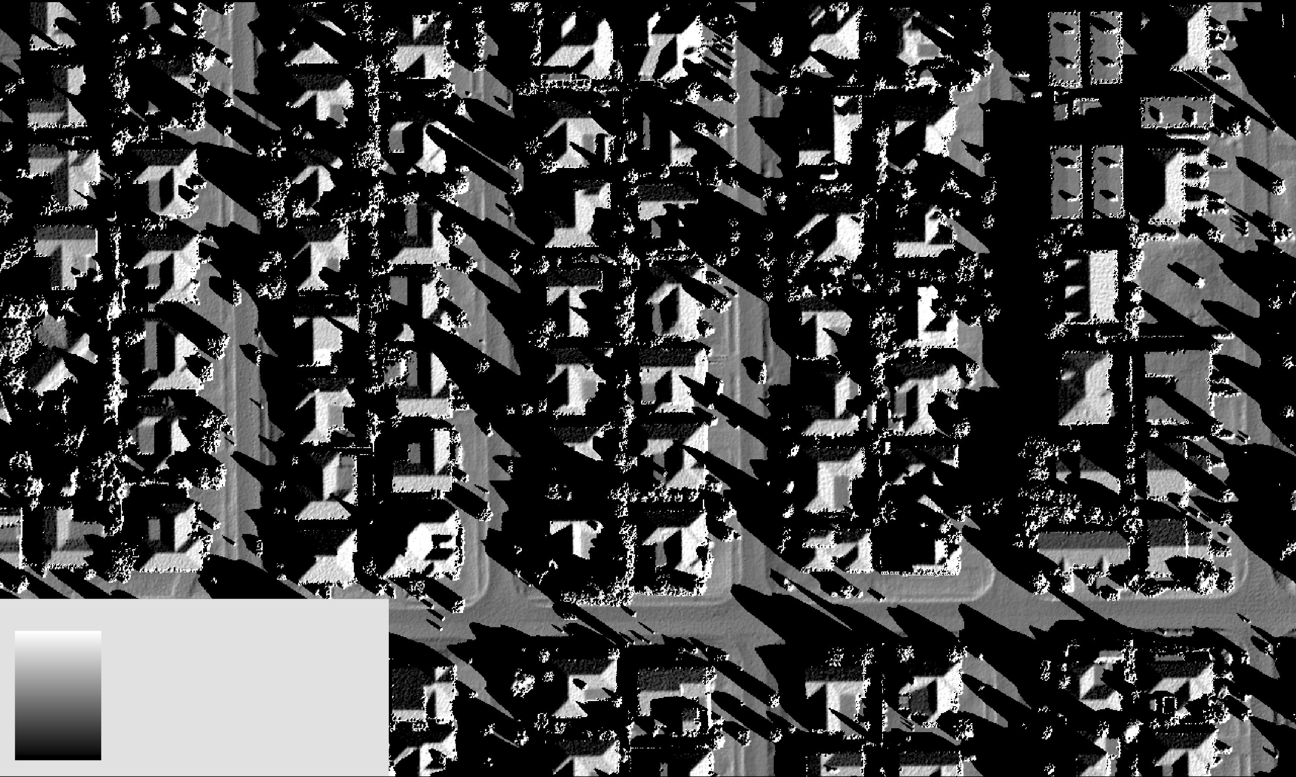
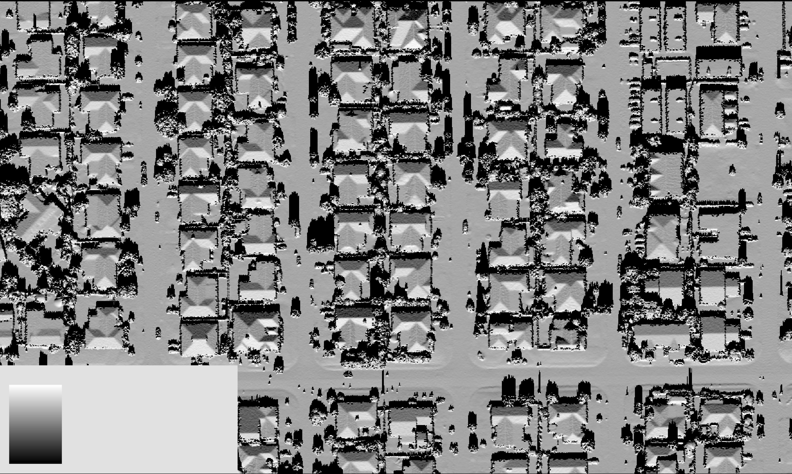
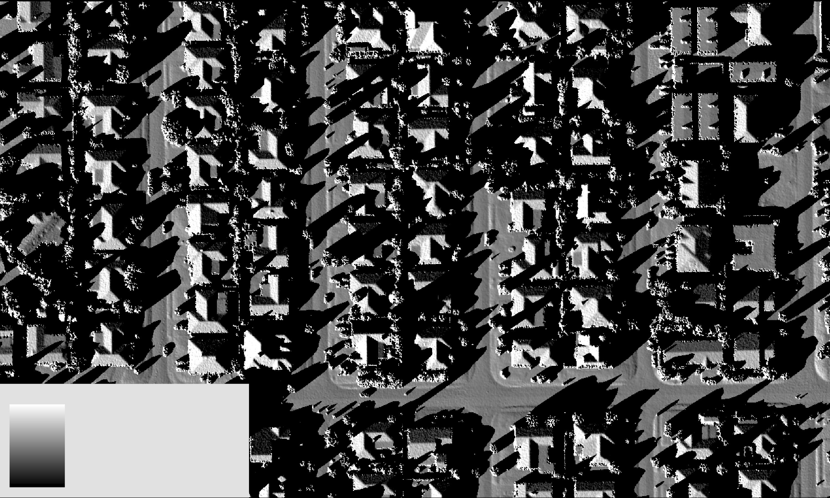
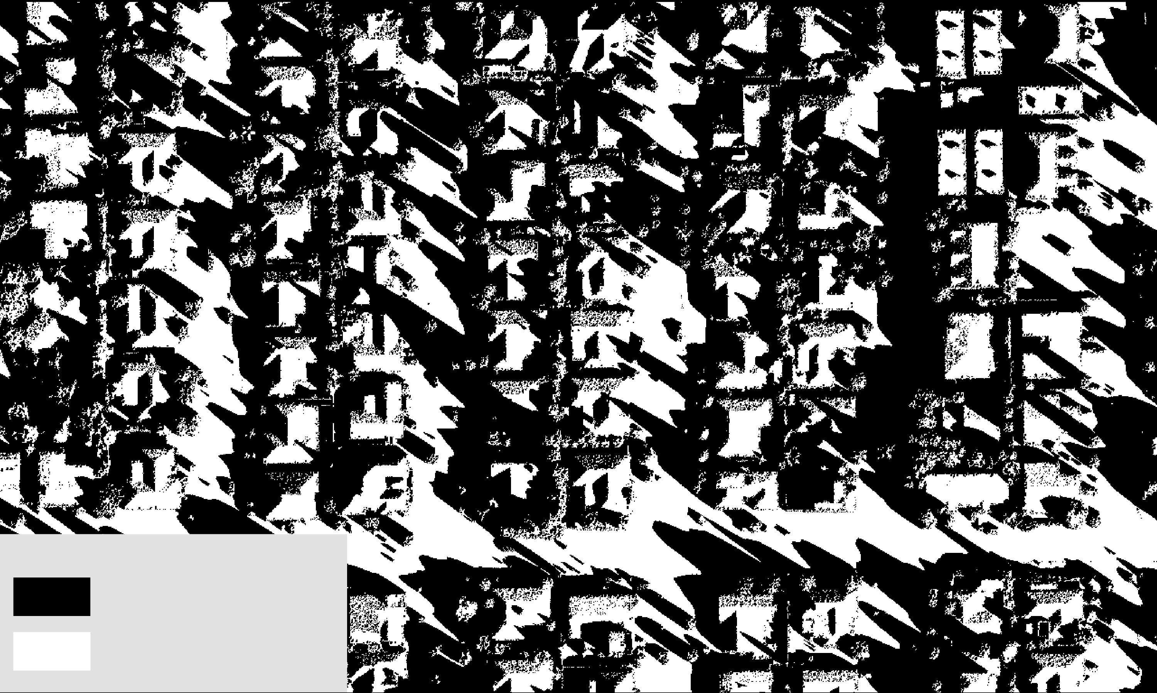
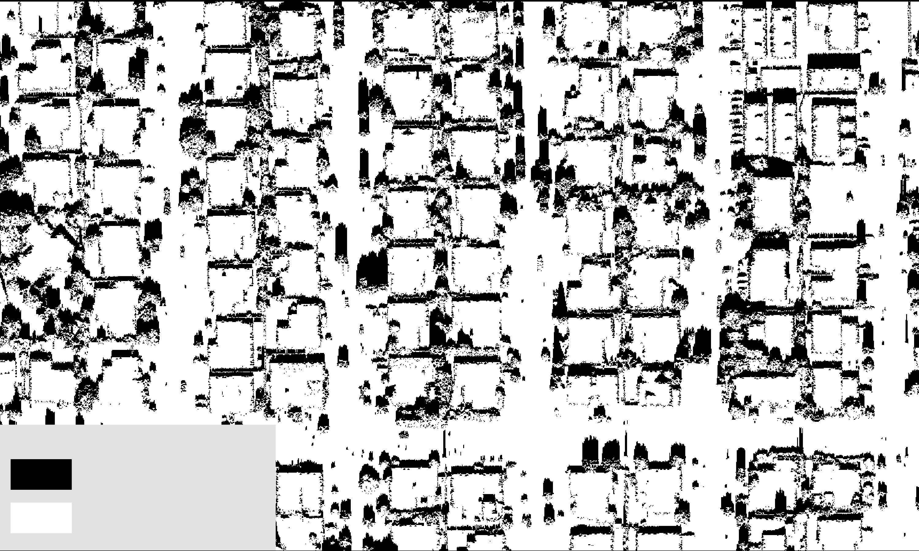
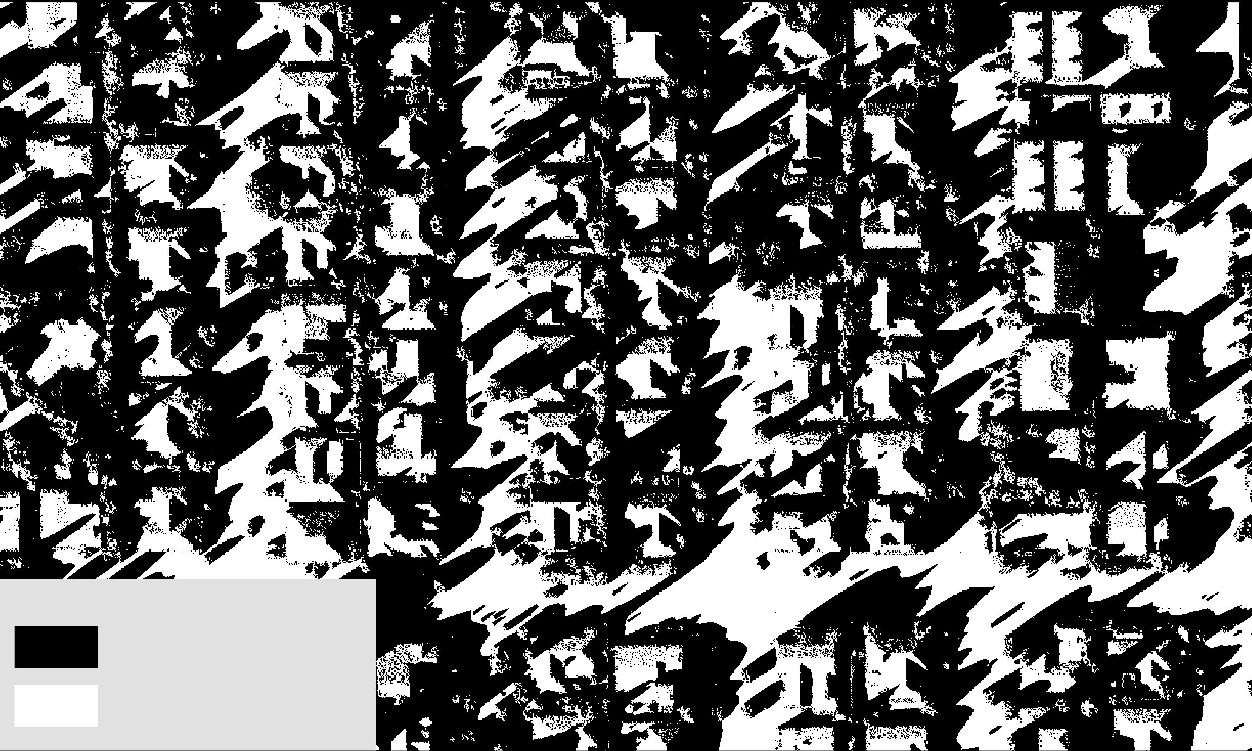
Hillshade
Light
Dark
Light
Dark
Light
Dark
Dark
Light
Dark
Light
Dark
Light
Notes:
In order to account for the affects of shading and shadows on PV potential, we used the Hillshade tool in ArcPro. This tool takes the altitude and azimuth of the Sun as an input, which are the height and angle of the sun, respectively. Every instance of time has a unique altitude and azimuth, everywhere in the world. Using the NASA POWER code, we extracted the azimuth and altitude for each daylight hour of the 15th day of the month, for one year to do our shading analysis. This resulted in 134 instances of Hillshade for a year. The top row on this slide indicates the original outputs of the Hillshade function by hour on January 15th, where 8am, on the left, has shadows angling northwest, while there is less shadowing at noon, and more shadowing facing northeast at 4pm. These outputs were then all reclassified to a binary of 0 or 1 where 0 represents a totally shadowed pixel, and 1 represents a pixel receiving direct sunlight. This is seen in the second for each hour where the shadowing effect appears more clearly. Unsurprisingly, most areas receive more solar irradiance during the middle of the day when the sun is highest.
Image Credit:
ArcGIS Pro (Created by Team)

Slide 12
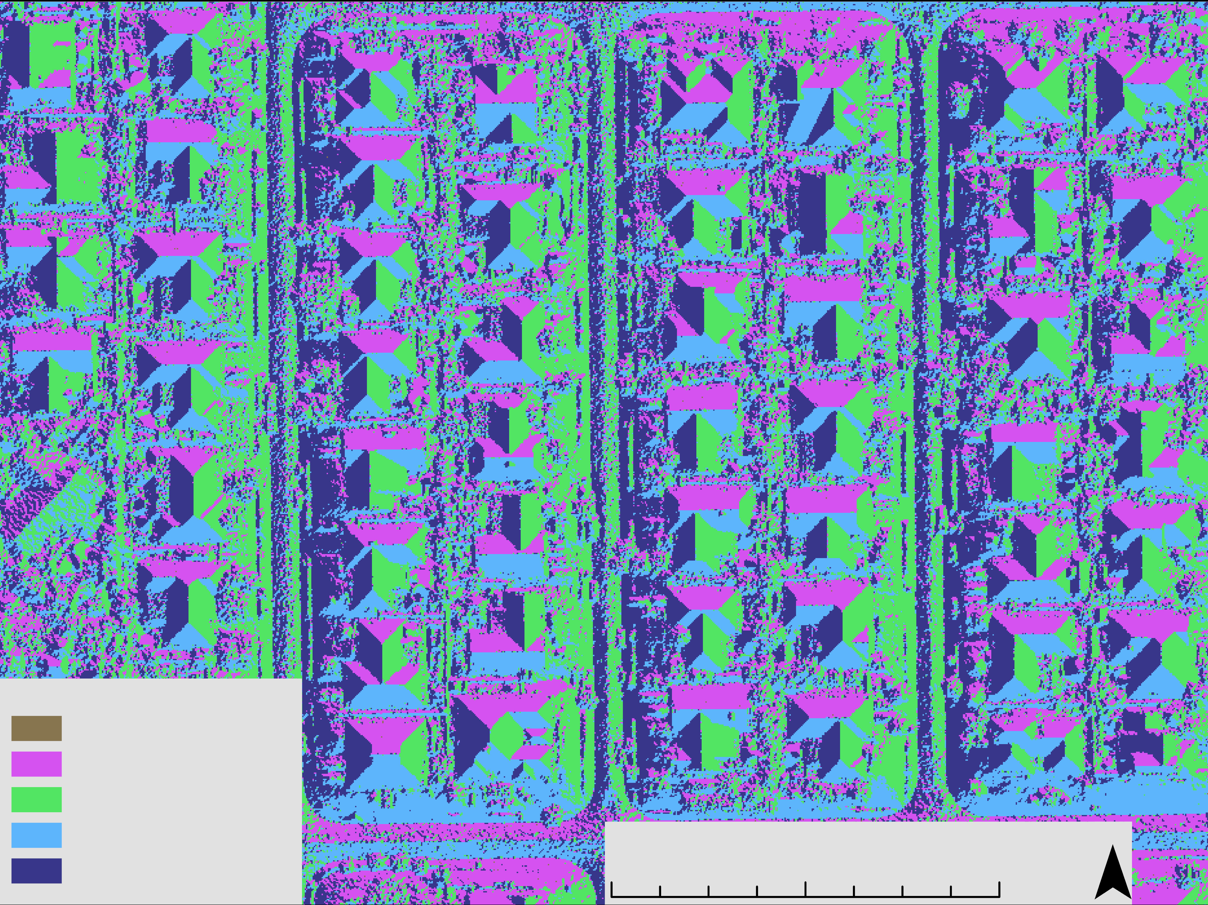

Aspect
Must have a slope to have an aspect, -1 is flat
Reclassified to cardinal directions centered on their midpoint
Majority Filter (x5) smooths pixels
N
E
Flat
North
South
East
West
W
E
S
0 150 300 ft
Notes:
Speaker: Aspect was one of the image derivatives generated from the DSM. We are interested in aspect because the direction that a roof faces influences how much solar irradiance that roof segment will receive. For example, in the Northern hemisphere solar panels are traditionally installed on South-facing roofs as they traditional get more solar irradiance. After running the Aspect tool in ArcPro, which returns values from –1 to 360 where –1 is flat, North is 0 degrees, and South is 180 degrees, we reclassified the data into 5 primary categories: the four cardinal directions and flat. We then ran this output through a majority filtering process five times to increase the smooothness of the aspects and reassign outlier pixels to their surrounding values.
Image Credit:
ArcGIS Pro (Created by Team)

Slide 13
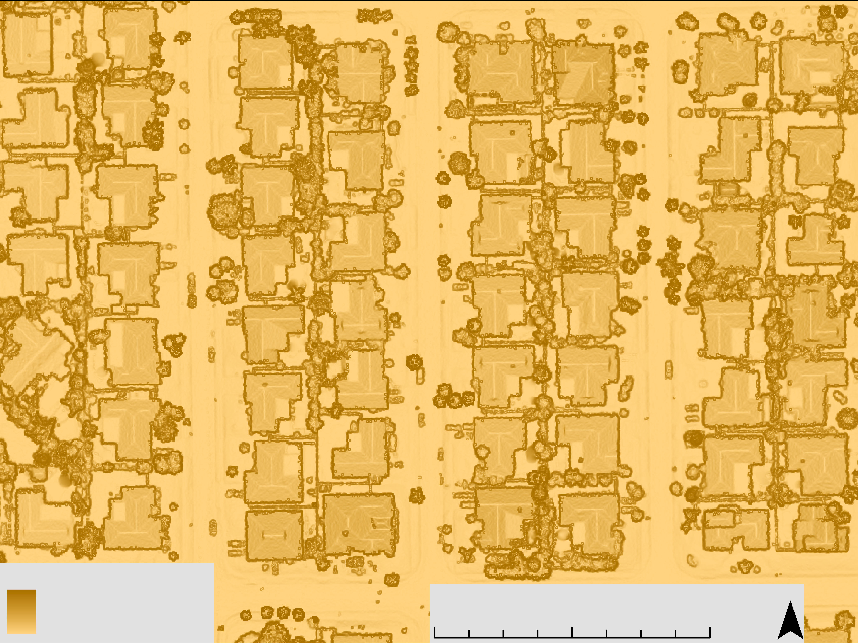
Slope
Slope of the pixels ranged from 0° to 90°
Average slope of 15.26°
Trees and roof edges have steep slopes
Roof segments visible
Slope affects PV potential
90° (vertical)
0 150 300 ft
0° (flat)
Notes:
Speaker: We also generated the slope from our DSM. Slope was categorized from 0-90°, with an average slope 15.26 degrees. This enabled us to see more clearly which roofs were more conducive to having solar panels installed and went in as a parameter for our sun exposure, and energy potential per building calculations as the tilt of the roof segment influences how much solar irradiance it receives at different times of the day, and year. The map on this slide indicates that trees and roof edges have high slopes. Roof segments also become visible because of the very low slopes at the top of the roof indicating a peak.
Image Credit:
ArcGIS Pro (Created by Team)

Slide 14
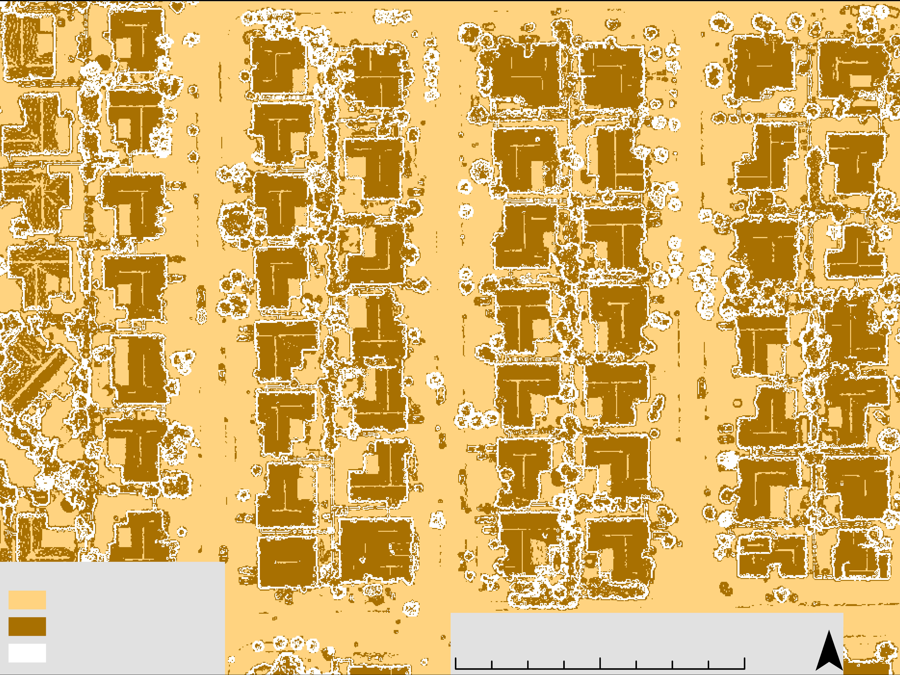
Slope Binary: "Flat" and Usable Slopes
Must have a slope less than 60° to be usable
Slopes under 10° are considered flat
Reclassified into "flat" and "usable slope"
Majority Filter (x1)
Unusable Slope(90°)
Usable Slope(60°)
Flat (<10°)
Sloped (10°-60°)
Unusable (>60°)
Flat (0°-10°)
Sloped (10°-60°)
Unusable (>60°)
"Flat" (10°)
0 150 300 ft
Flat (0°)
Notes:
Solar panelists often install on roof segments that have a tilt of 60 degrees or less, and also often install panels at the latitude of the area when the tilt is under 10 degrees. To account for these considerations, we reclassified the slope into a new "flat" category, which includes all pixels with values under 10 degrees, and a usable slope category for values 10 to 60, omitting any pixels with values greater than 60. Interestingly, this also helped us reduce the influence of vegetation and roof edges in our calculations as it often served as a buffer for the buildings usable slopes. We also performed a majority filter on this reclassification once to smooth out the data. The data was classified as –1 and 1 for flat and usable slopes, respectively.
Image Credit:
ArcGIS Pro (Created by Team)

Slide 15
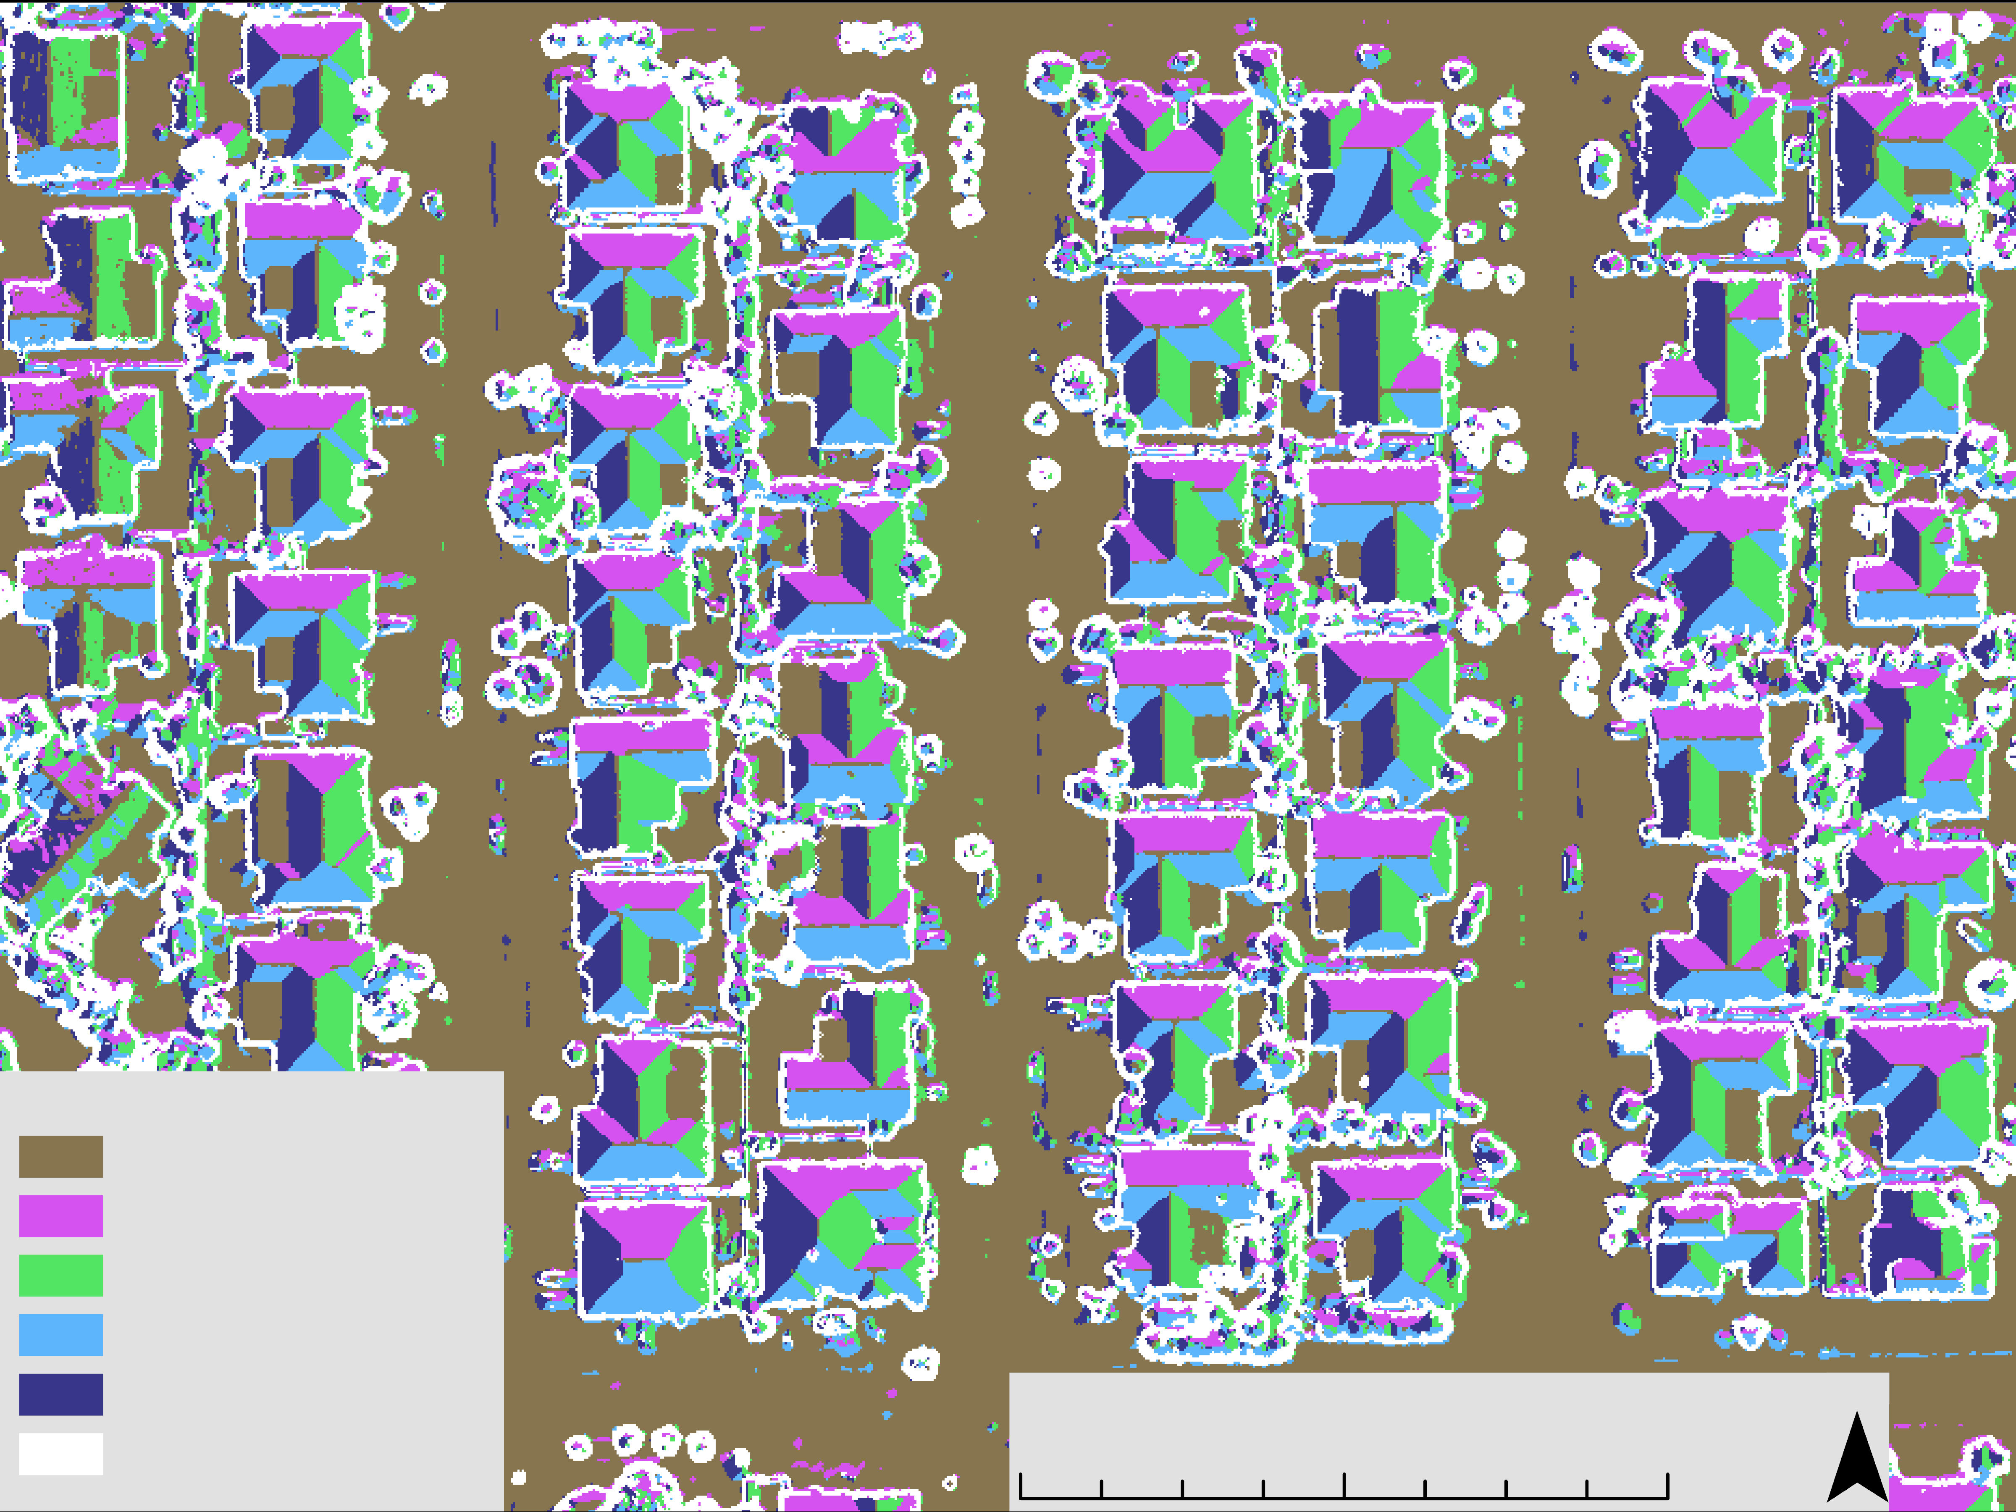
Aspect with Reclassified Flat
Raster Calculator: Slope Binary x Aspect
Reclassified to have all pixels with slopes under 10° to be "flat"
Majority Filter (x5) to smooth pixels
From flat pixels as 15.00% of all pixels to 68.19% of all pixels
Flat
North
East
South
West
No Data
0 150 300 ft
0 150 300 ft
Notes:
The original aspect file only included a "flat" designation for pixels that are truly flat and have no tilt at all. However, for our purposes anything under 10 degrees is considered flat. Therefore, we multiplied our slope binary outputs of –1 and 1 by our five aspect classification using the raster calculator function, and then reclassified as everything from –5 to 1 as "flat" as they are all pixels with less than 10 degrees. You can see that this clearly gives a flat designation to the road and several roof segments that did not exist in the original classification.
Image Credit:
ArcGIS Pro (Created by Team)

Slide 16
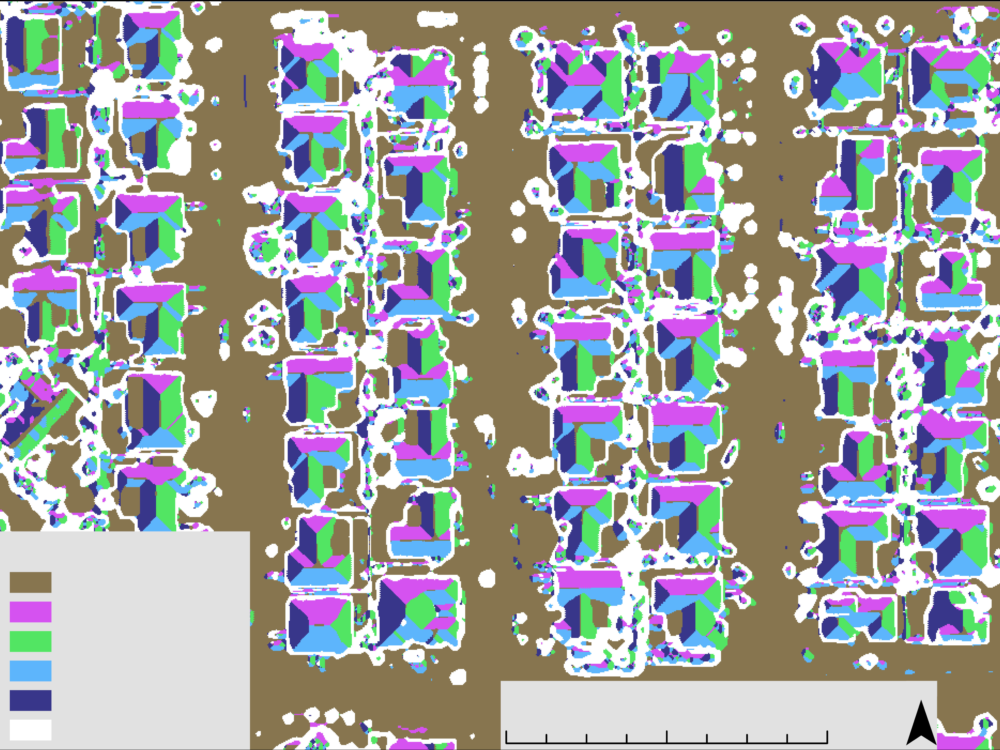
Majority Filter of Aspect with Reclassified Flat (x5)
Raster Calculator: Slope Binary x Aspect
Reclassified to have all pixels with slopes under 10° to be "flat"
Majority Filter (x5) to smooth pixels
From flat pixels as 15.00% of all pixels to 68.19% of all pixels
Flat
North
East
South
West
No Data
0 150 300 ft
Notes:
We then ran the Majority Filter five times to smooth the pixels and clean up the aspects. The output of this filtering process results in 68.19% of all of the pixels being "flat", compared to 15.00% of pixels in the output of the majority filter on the original aspect classification.
Image Credit:
ArcGIS Pro (Created by Team)

Slide 17
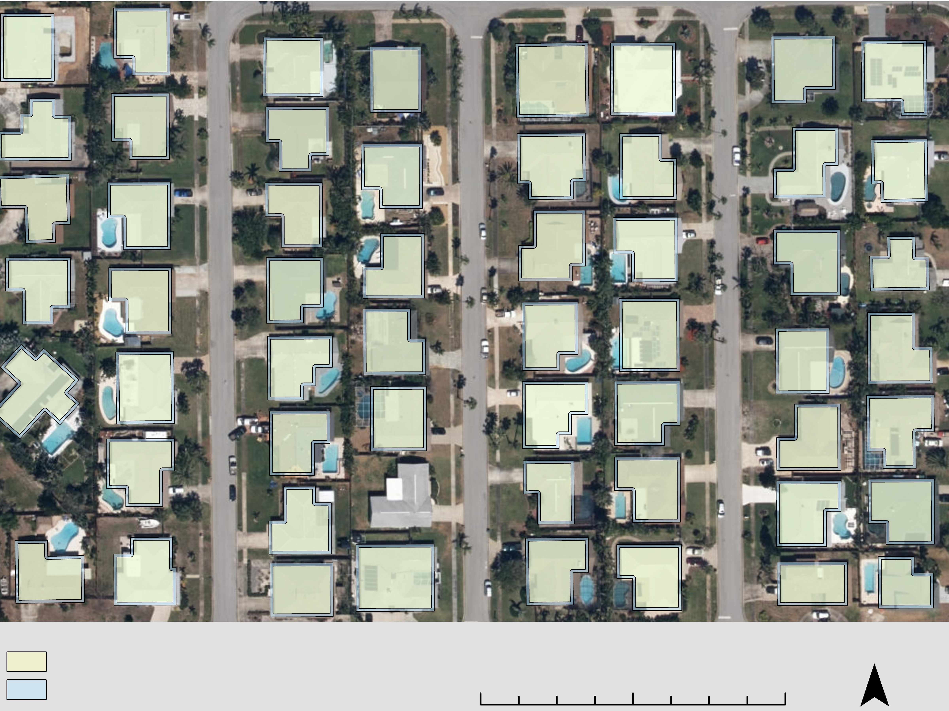
Buffered Building Footprints
Building Footprints from Microsoft for Florida
Clipped to municipal shapefile
Buffered by –3 feet to account for panel placement buffer
Does not perfectly match with DSM
3,931 buildings in the shapefiles
Buffered building footprint (-3 ft)
Building footprint
0 150 300 ft
Notes:
To derive we our PV potential by rooftop and roof segment, we used a Microsoft Building Footprint shapefile. There are limitations to this dataset, as it is missing some houses, that exist in our DSM. We buffered these building footprints by negative three feet, as solar panel installers typically do not install on the three feet nearest the edge of the roof. This map shows the original and buffered footprints. There are 3,931 buildings in Microsoft shapefile.
Image Credit:
ArcGIS Pro (Created by Team)

Slide 18
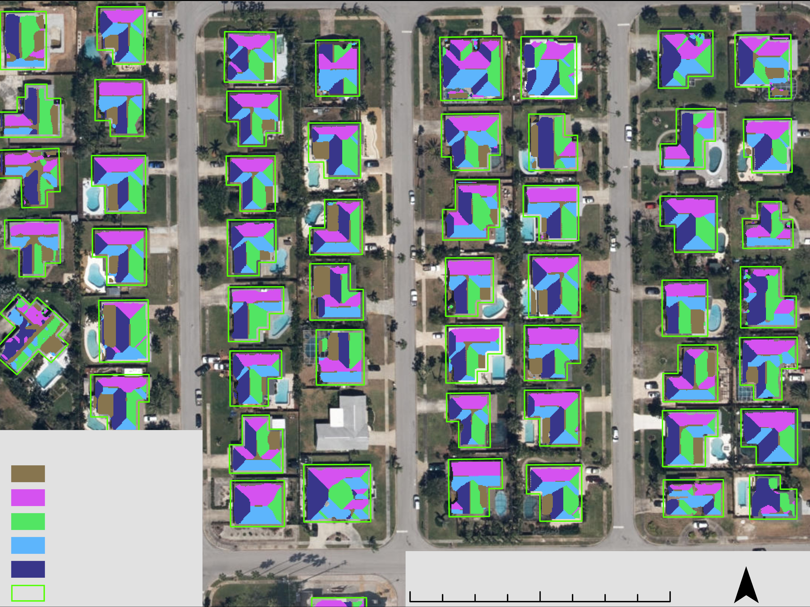
Aspects Extracted by Building Footprint
Extracted by Mask to the buffered building footprints
Unique values for aspect of 100, 200, 300, 400, 500
Reduced pixels viable pixels in dataset from 130,238,564 to 11,565,025, or by 91.12%
Flat
North
East
South
West
Footprints
0 150 300 ft
Notes:
We then extracted our aspect file with the flat classification to the buffered building footprints. In this map you can clearly see the segments of the roofs. This data was represented in categories of 100 to 500 and then a the pixel's slope value was added to using a raster calculator, giving each pixel a unique slope-aspect combined value. For exapmle, a value of 250 would represent a pixel that was facing north at an angle of 50 degrees while 520 would represent a pixel that was facing west and at tilt of 20 degrees. This data reduced the overall pixel count by 91.12% This dataset was later used to assign solar irradiance using the NASA POWER code.
Image Credit:
ArcGIS Pro (Created by Team)

Slide 19
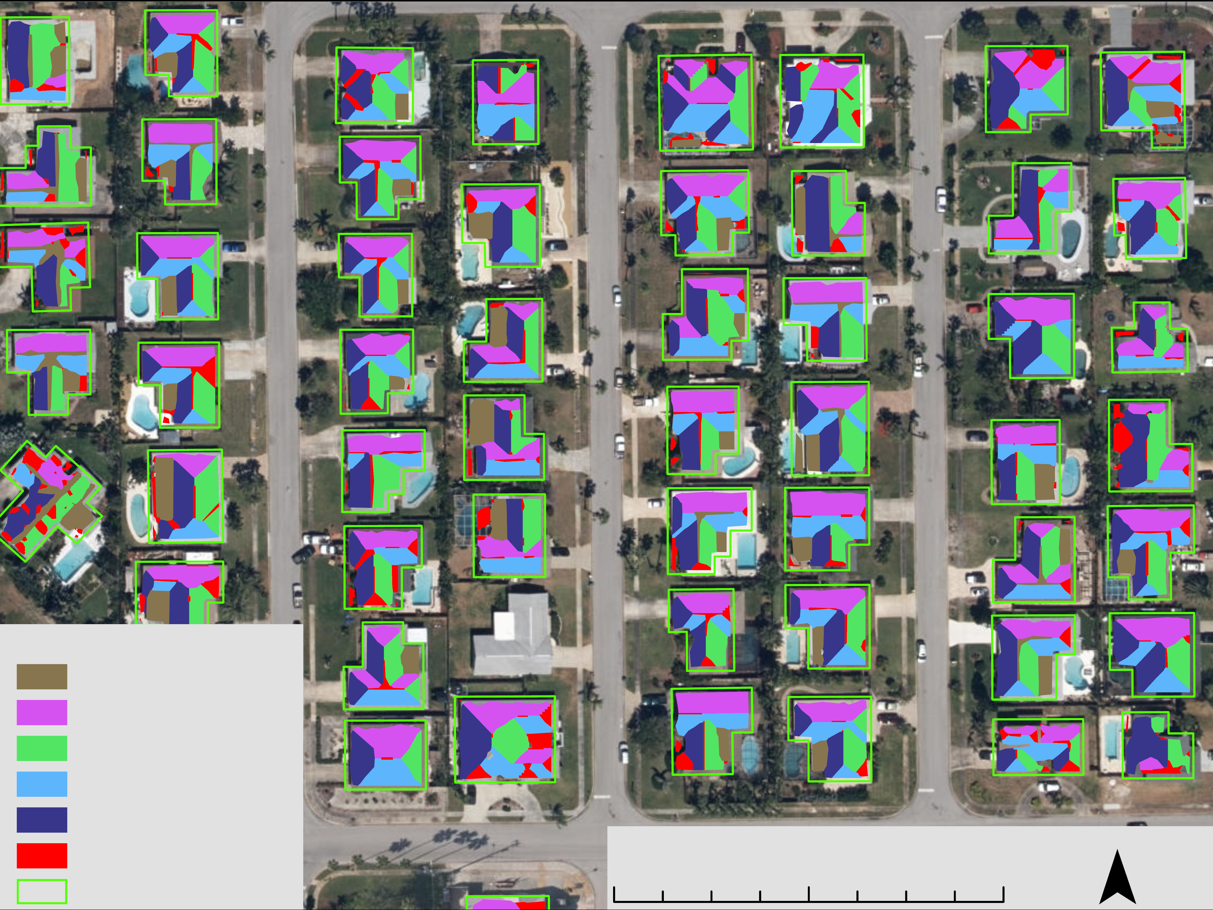
Aspect Polygons Greater than 100 sq ft
Polygons needed for roof segment PV potential calculation
Raster to Polygon
Filter out polygons under 100 square feet to get viable segments and reduce influence of pools, vegetation, and other noise
Flat
North
East
South
West
< 100 sq ft
Footprints
0 150 300 ft
Notes:
In order to later retrieve PV potential values by roof segment, we created roof segment polygons from the extracted raster file. Since there were some polygons that still did not represent roof segments due to a misalignment in the building footprints and the buildings as derived from the LiDAR data, we decided to exclude segments that were 100 square feet. This reduced the amount of pools or vegetation that was mistakenly classified as a roof.
Image Credit:
ArcGIS Pro (Created by Team)

Slide 20
Roof Geometry and Solar Energy
Sun exposure, slope and, aspect impact solar potential
Hourly hillshade displays which pixels are shaded and unshaded
Aspect and slope used to categorize segments
Variations accounted for by using the majority value of each roof
Solar irradiance -> PV potential (16%)
Slope / Aspect
Tilted Surface Irradiance
Majority Filter
Hillshade
Roof Segment Designation
Roof Segment Potential
Building ID
Building ID
Rooftop Designation
Rooftop Potential
Notes:
Speaker:
The derived raster file with unique slope and aspect values was then assigned solar irradiance values as calculated from our Hillshade analysis and NASA POWER code, returning a daily irradiance in KWh/m^2 per pixel. We then used the Zonal Statistics tool to derive the majority value of daily irradiance per each segment. This was then multiplied by the area of the segment to give an daily average solar irradiance per month. We then assumed at 16% efficiency and also included information about flat panel spacing which transformed our irradiance values into PV potential in KWh per day, for each roof segment.
IMAGE CREDITS: Created by Team
PowerPoint Icons (Created by Team)

Slide 21
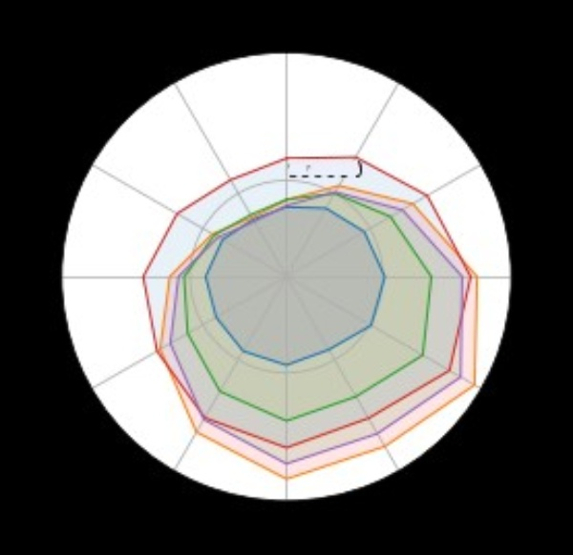
Results
Daily Energy Potential of Roof Segments (KWh)
Jan
Energy Potential peaks in May for all types of roofs (i.e., flat, North, South)
North-facing roofs produce the most solar potential of all roofs from April to August
South-facing roofs produce notably more energy during the winter
Dec
Feb
Flat
North
East
Nov
100000
Mar
South
50000
West
Oct
Apr
Sep
May
Aug
Jun
Jul
Notes:
Speaker: The annual cycle of energy potential was highest in late spring and early summer and may be due to greater cloud cover in later summer months. For most of the year, South-facing roofs (the red line) produced the highest PV potential, however from April to through August North-facing roofs produced the most PV potential. Energy potential peaks in May for all segments, making it the month with the highest PV potential, while December is the month with the lowest overall PV potential. South-facing roofs do notably better than all other aspects during the winter months.
Image Credit: Created by Team

Slide 22
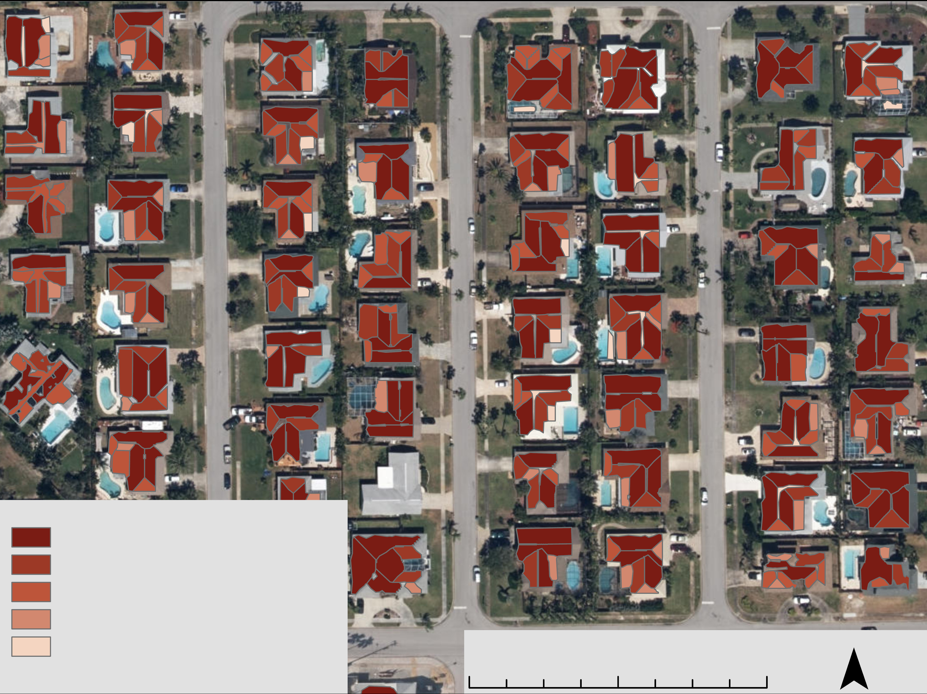
Daily PV Potential in KWh in May by Roof Segment
May produced the most PV potential of any month at 798,140 KWh per day
North-facing roof segments produced the plurality of PV potential at 25.40% and average of 40.59 KWh per day
Average potential of all segments was 33.26 KWh per day
Greater than 36.24
19.77 to 36.23
11.91 to 19.76
6.47 to 11.9
Less than 6.46
0 150 300 ft
Notes:
Speaker: May, the month with the highest daily PV potential, is shown here by roof segment. May produced the 798,140 KWh per day. North-facing roof segments produced the plurality of PV potential at 25.40% and an average 40.59 KWh per day. The average potential of all segments was 33.26 KWh per day.
Image Credit:
ArcGIS Pro (Created by Team)

Slide 23
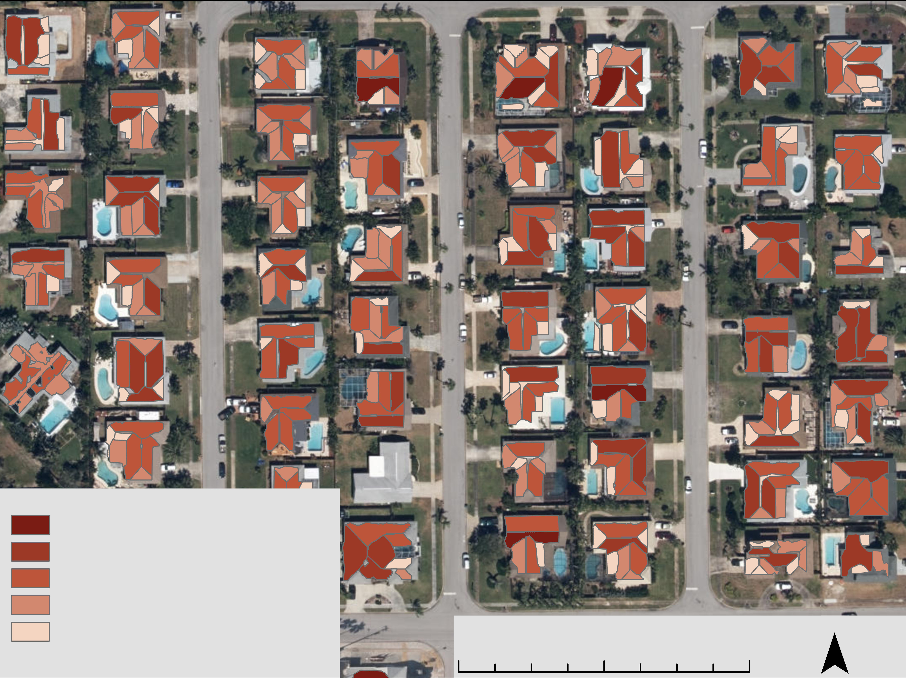
Daily PV Potential in KWh in December by Roof Segment
December produced the least PV potential of any month at 352,245 KWh per day (44.13% of May)
South-facing roof segments produced the plurality of PV potential at 29.61% and average of 22.17 KWh per day
Average potential of all segments was 14.69 KWh per day
Greater than 36.24
19.77 to 36.23
11.91 to 19.76
6.47 to 11.9
Less than 6.46
0 150 300 ft
Notes:
Speaker: December, the month with the lowest daily PV potential, is shown here by roof segment. December produced 352,245 KWh per day, which is only 44.13% of what May produced. South-facing roof segments produced the plurality of PV potential at 29.61% and an average 22.17 KWh per day. The average potential of all segments was 14.69 KWh per day. This data is displayed using the same classifications as the map for May.
Image Credit:
ArcGIS Pro (Created by Team)

Slide 24
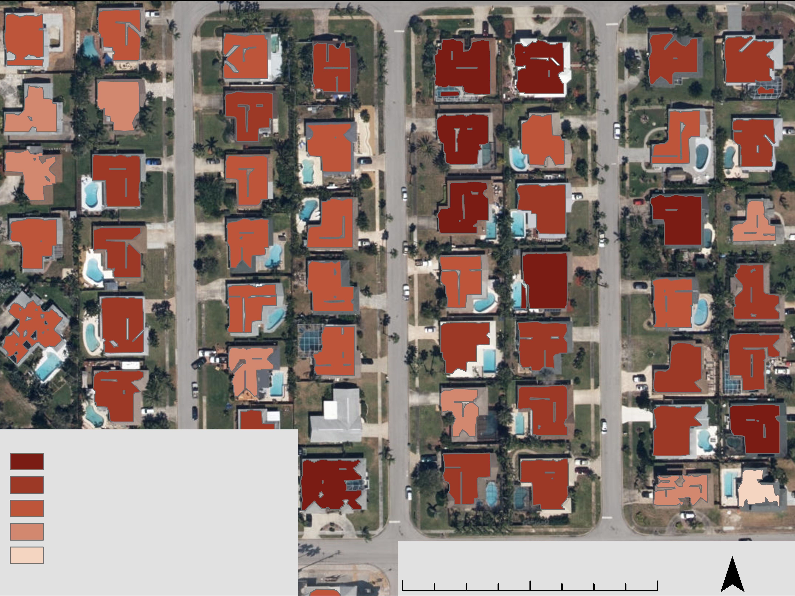
Annual PV Potential in KWh by Rooftop
Roof segments multiplied by days in month and summed to get annual rooftop potential
The total annual potential of rooftops is 212,172,448 KWh
Average annual potential 55,010 KWh
Greater than 67,770
54,250 to 64,769
46,742 to 54,250
35,744 to 46,741
Less than 35,743
0 150 300 ft
Notes:
Speaker: To create an annual PV potential, we multiplied each segment by the days in the month to get a monthly total potential and then summed those values to the year. The annual segment values were then summed to the rooftop. The total annual PV potential of rooftops in Satellite Beach is 212,172,448 KWh. The average annual potential is 55,010 KWh.
Image Credit:
ArcGIS Pro (Created by Team)

Slide 25
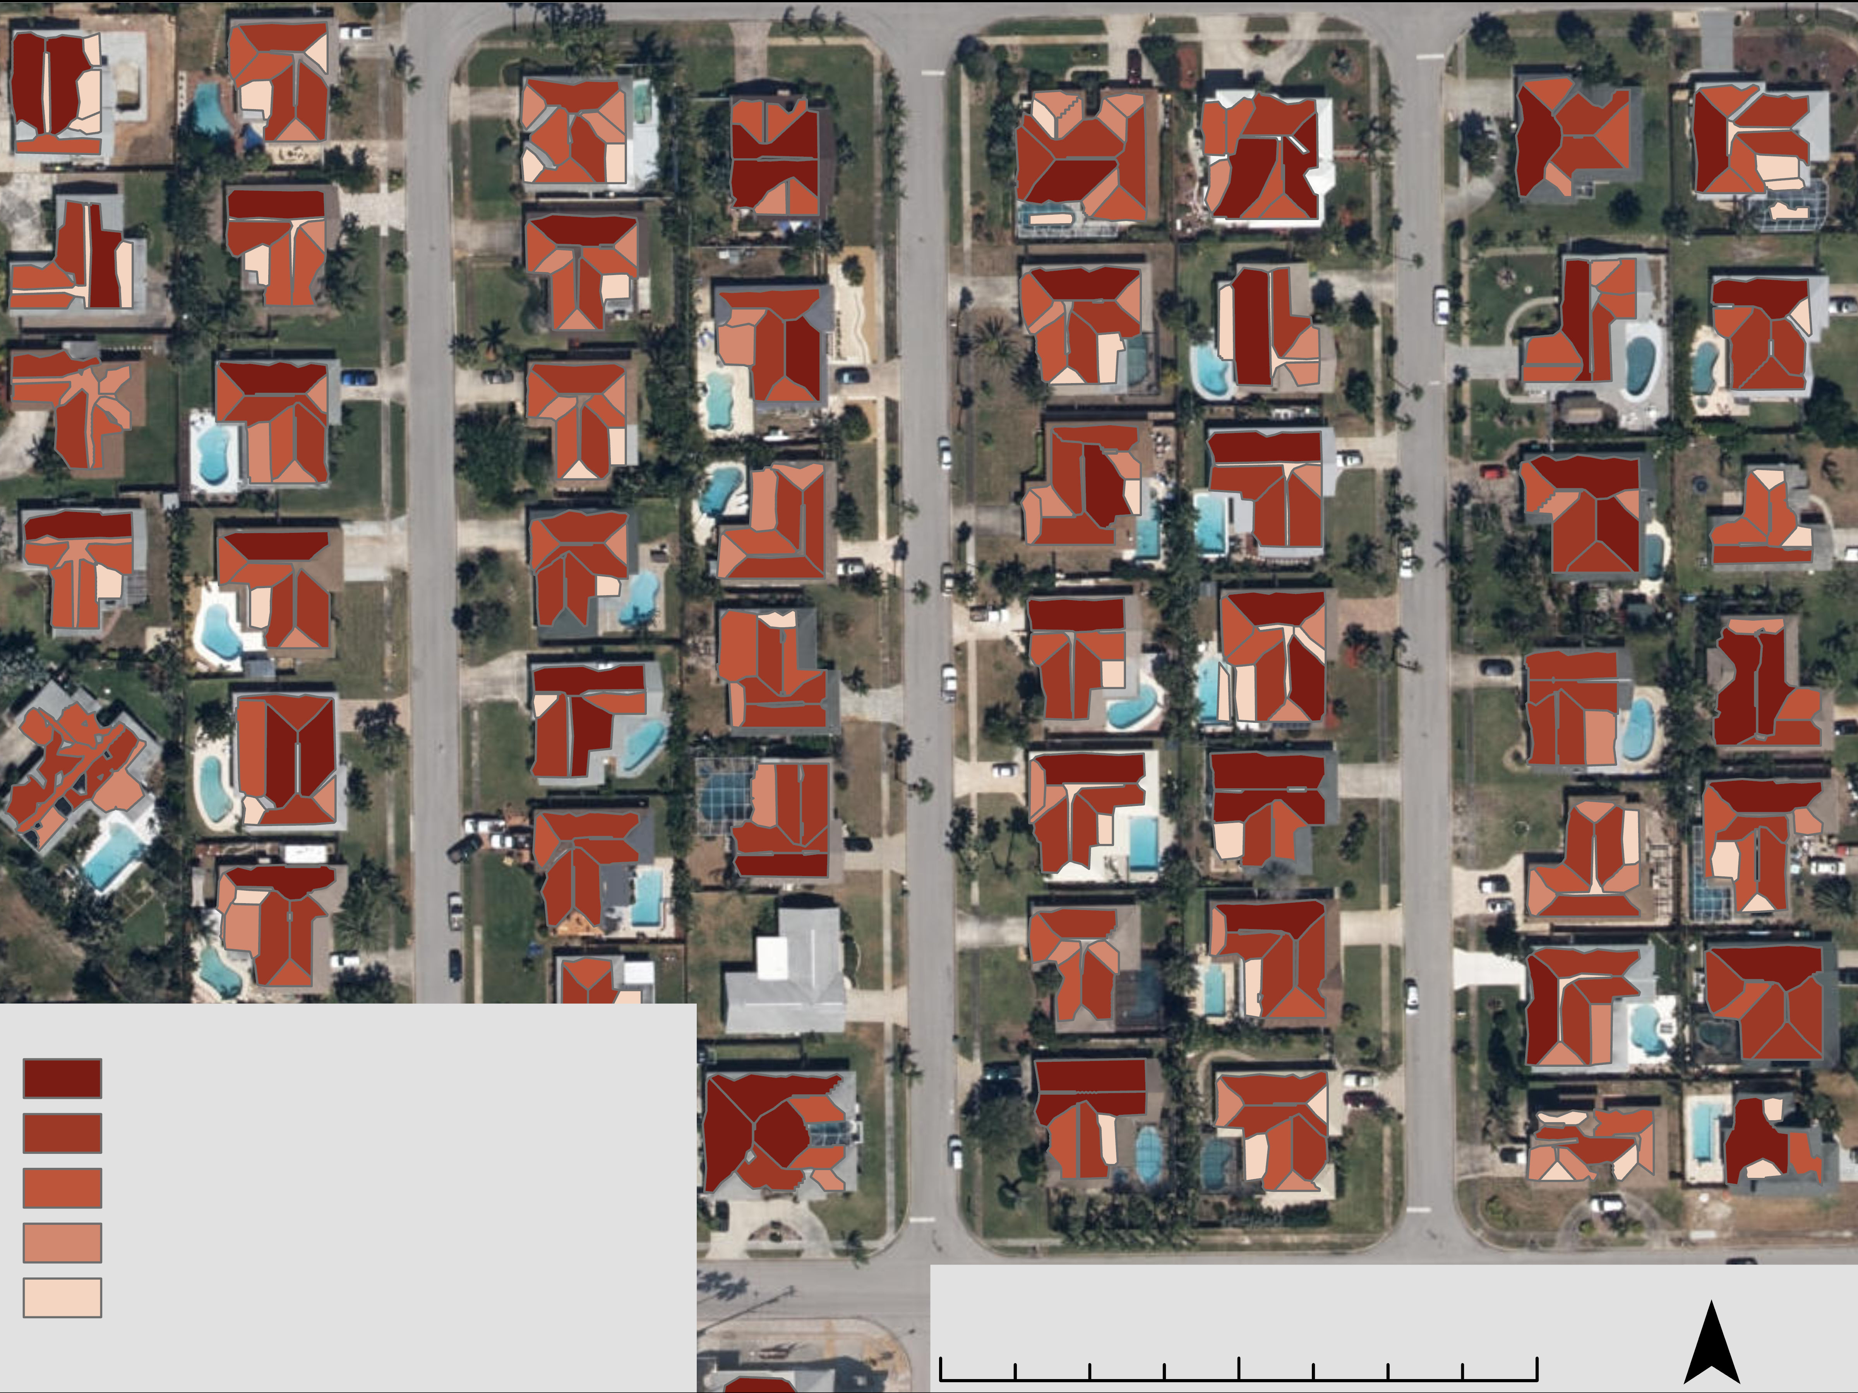
Annual PV Potential in KWh by Roof Segment
South-facing roof segments produced the plurality of PV potential annually with 51,755,072 KWh or 24.39% and the highest average of 11,000 KWh
Flat roof segments produced the least PV at 26,368,411 KWh or 12.43% and the lowest average of 5,396 KWh
Average potential of all segments was 8,848 KWh annually
Greater than 14,299
8,305 to 14,298
4,803 to 8,304
3,090 to 4,802
Less than 3,089
0 150 300 ft
Notes:
Speaker: At the annual potential by roof segment, we find that south-facing roof segments produce the pluarality of PV potential annually with 51,755,072 KWh or 24.39% of all PV potential and the highest average potential per segment as well at 11,000 KWh per year. Flat roof segments produced the least PV potential at 26,368,411 KWh or 12.4% and the lowest average at 5,396 KWh. This could potentially be due the spacing requirements for flat roofs which results in lower efficiencies. The average potential of all segments was 8,848 KWh per year.
Image Credit:
ArcGIS Pro (Created by Team)

Slide 26

Results: Annual Solar Production by Aspect
24.4%
23.2%
21.4%
18.5%
12.4%
S
N
W
E
F
Notes:
Speaker: This graphic displays the percentage of annual PV potential by roof segment. South-facing segments produce the most, followed closely by North which does indeed lead in Summer months. Flat segments fair the worst at only 12.4%
Image Credit: PowerPoint Icons used within figure (Created by Team)

Slide 27
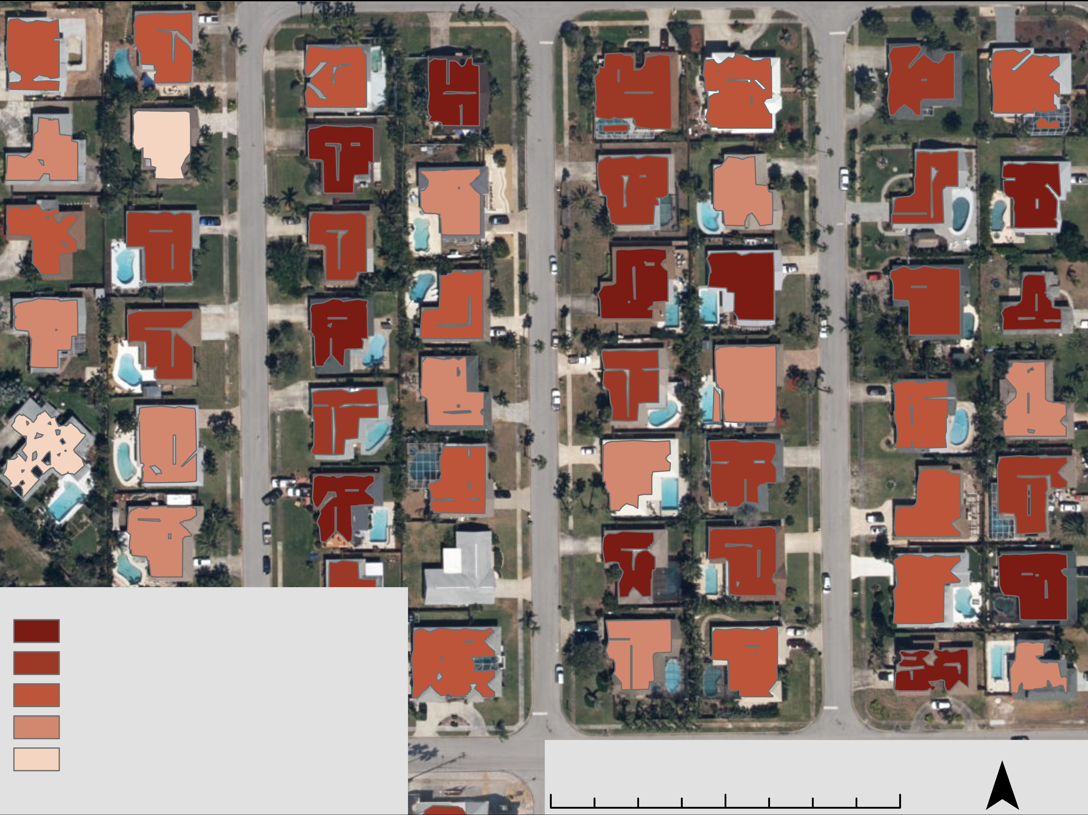
Annual PV Efficiency in KWh/m^2 by Rooftop
Rooftop annual PV potential normalized by area
Derives annual efficiency of rooftops
The average annual potential of rooftops 215.92 KWh/m^2
The median annual potential of rooftops is 225.40 KWh/m^2
Greater than 237.56
229.54 to 237.55
220.97 to 229.53
204.20 to 220.96
Less than 204.19
0 150 300 ft
Notes:
We also wanted to see how efficient rooftops where by the area the viable roof areas for solar panel placement. We normalized the annual PV potential of rooftops by the viable area of the roof to generate an efficiency rate of KWh per m^2. The average annual potential of rooftops was 215.902 KWh/m2 and the median was 225.40 KWh/m2. This could indicate that there are outliers on the low end of efficiency, likely due to shadowing effects.
Image Credit:
ArcGIS Pro (Created by Team)

Slide 28

Conclusions Orientation
Southern aspects produce the most energy
OVERALL
S
This is relevant for the positioning of solar panels.
Notes:
Satellite Beach Energy Potential Per Building
Speaker: In conclusion, we found that overall, south-facing aspects produced the most energy at an annual total of 51,755,072 KWh. It was the leading producer of PV potential for seven months of the year.
Image Credit: PowerPoint Icons within figure (Created by Team)

Slide 29
Conclusions Orientation
Northern aspects produce the most energy
APRIL TO AUGUST
from
N
and compete for leading aspect in September
Notes:
Satellite Beach Energy Potential Per Building
Speaker: This is interesting because solar panels are usually south facing. Having a north facing roof be the most productive segment is an idea that is often overlooked especially in summer months, where it was the highest producer of PV potential – from April through August. There is actually only about a 1% difference between North and South facing aspects for overall annual PV solar production.
Image Credit: PowerPoint Icons within figure (Created by Team)

Slide 30

Conclusions Time of Year
Rooftops in May produce the HIGHEST amounts of solar energy
212,172,448
kWh per year
Rooftops in December produce the LOWEST amounts of solar energy
Notes:
Satellite Beach Energy Potential Per Building
Speaker: Rooftops in May are the most efficient and therefore can potentially produce the highest amounts of energy. Rooftops in December are the least productive, producing around 44% of what rooftops do in May. Satellite Beach generates a total of 212,172,448 kWh per year.
Image Credit:
Created by Team
PowerPoint Icons within figure (Created by Team)

Slide 31

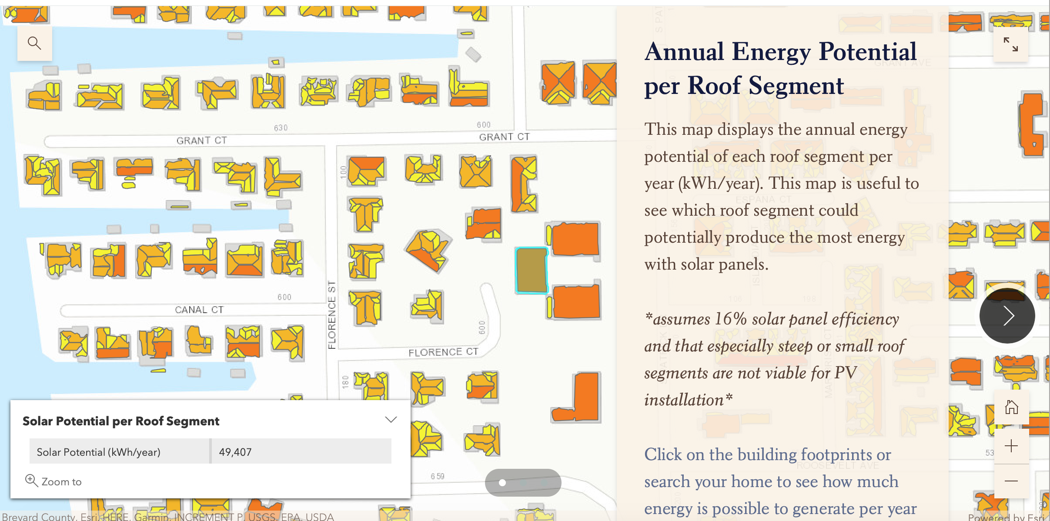
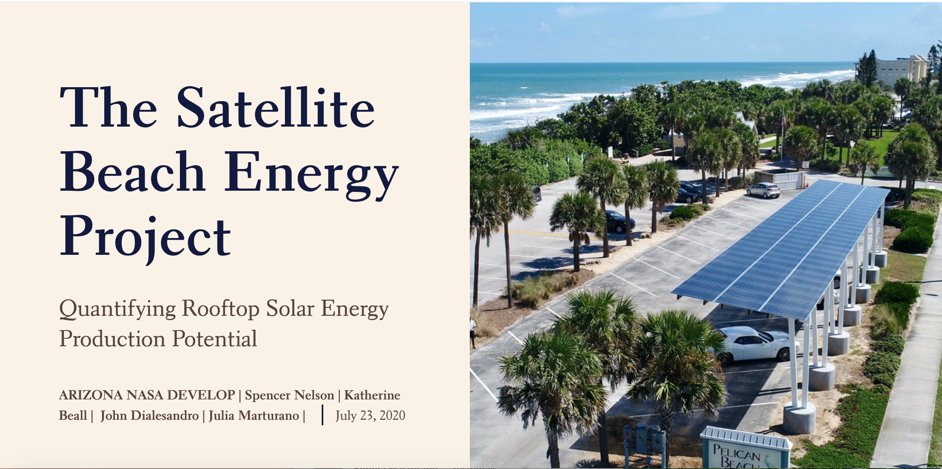
Conclusions Application
STORY MAP CREATION
Living space for new knowledge
Community connection to governmental initiatives
Image Credit: "PBP-SOLAR-3", City of Satellite Beach​
INTERACTIVE INTERFACE
Abstract code to concrete platform
Personalized information allows individualized decision making
Image Credits: Alexis Miller, City of Satellite Beach
Notes:
Speaker: Our team chose to create a StoryMap to act as a living space for the new knowledge we collected throughout the course of this 10 week project. We also made spreadsheets on solar potential by address. This will allow the community to better understand, and see in action how the City of Satellite Beach is striving to reach their goal of 100% clean energy by 2050. It's interactive interface will allow individuals to see their own solar situation and inform them how much they could contribute to their community's goals. It acts as the bridge that connects government initiatives to the community, to make it a unified effort.
::presentation will feature a AGOL StoryMap demo::
"PBP-SOLAR-3", City of Satellite Beach, Alexis Miller, partner provided permission
Image Credit: "StoryMap: The Satellite Beach Energy Project", Created by Team, https://storymaps.arcgis.com/stories/9e5e698888e54d7897178343394f8269
Image Credit: PowerPoint Icon

Slide 32
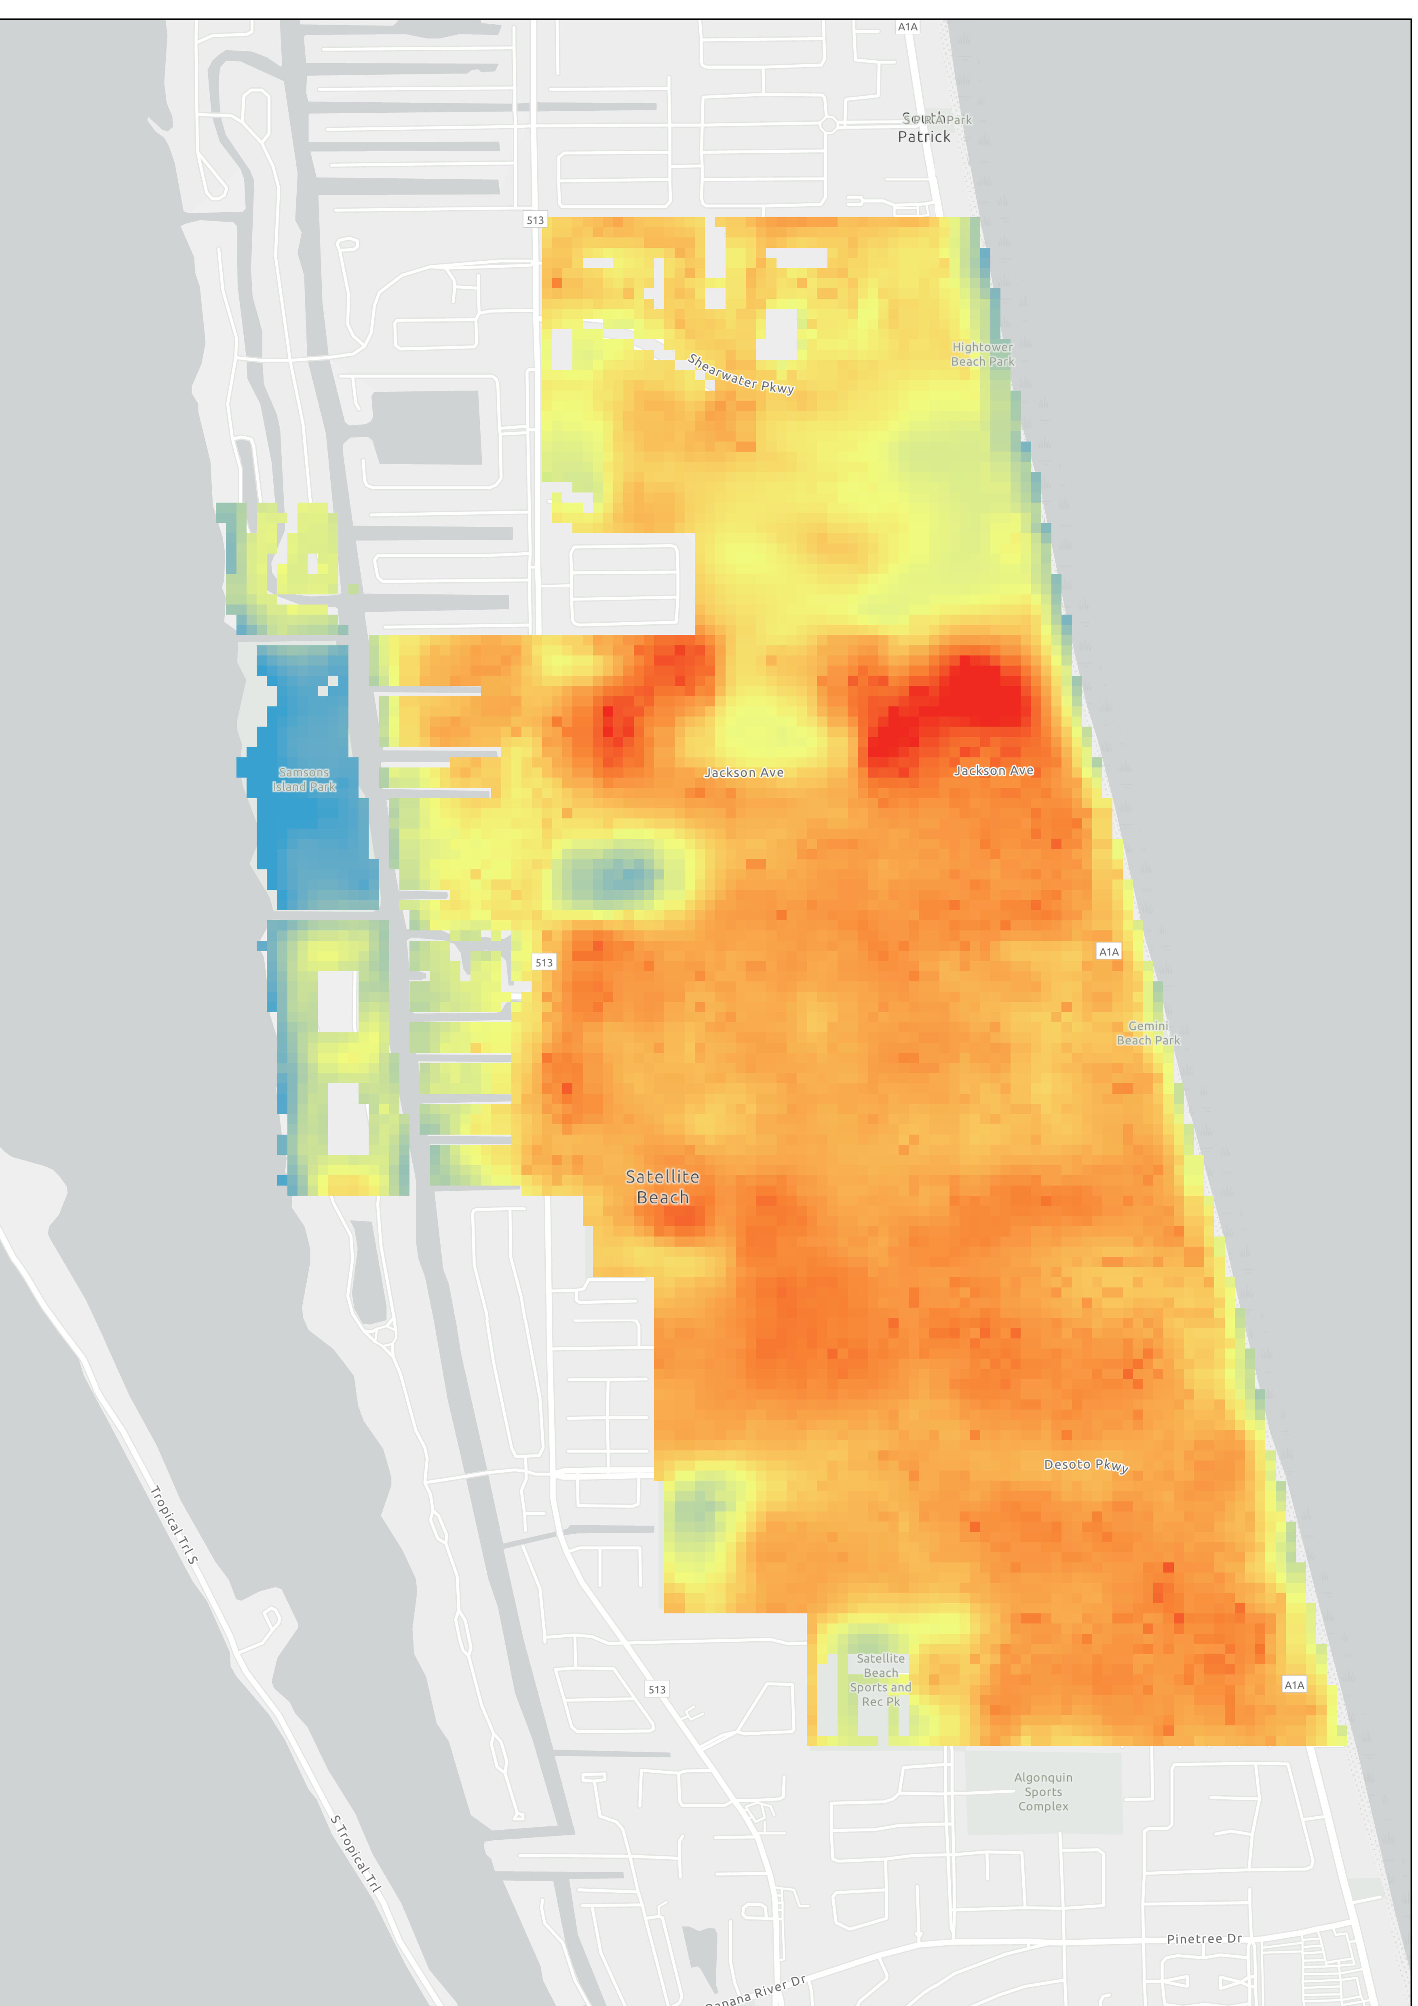
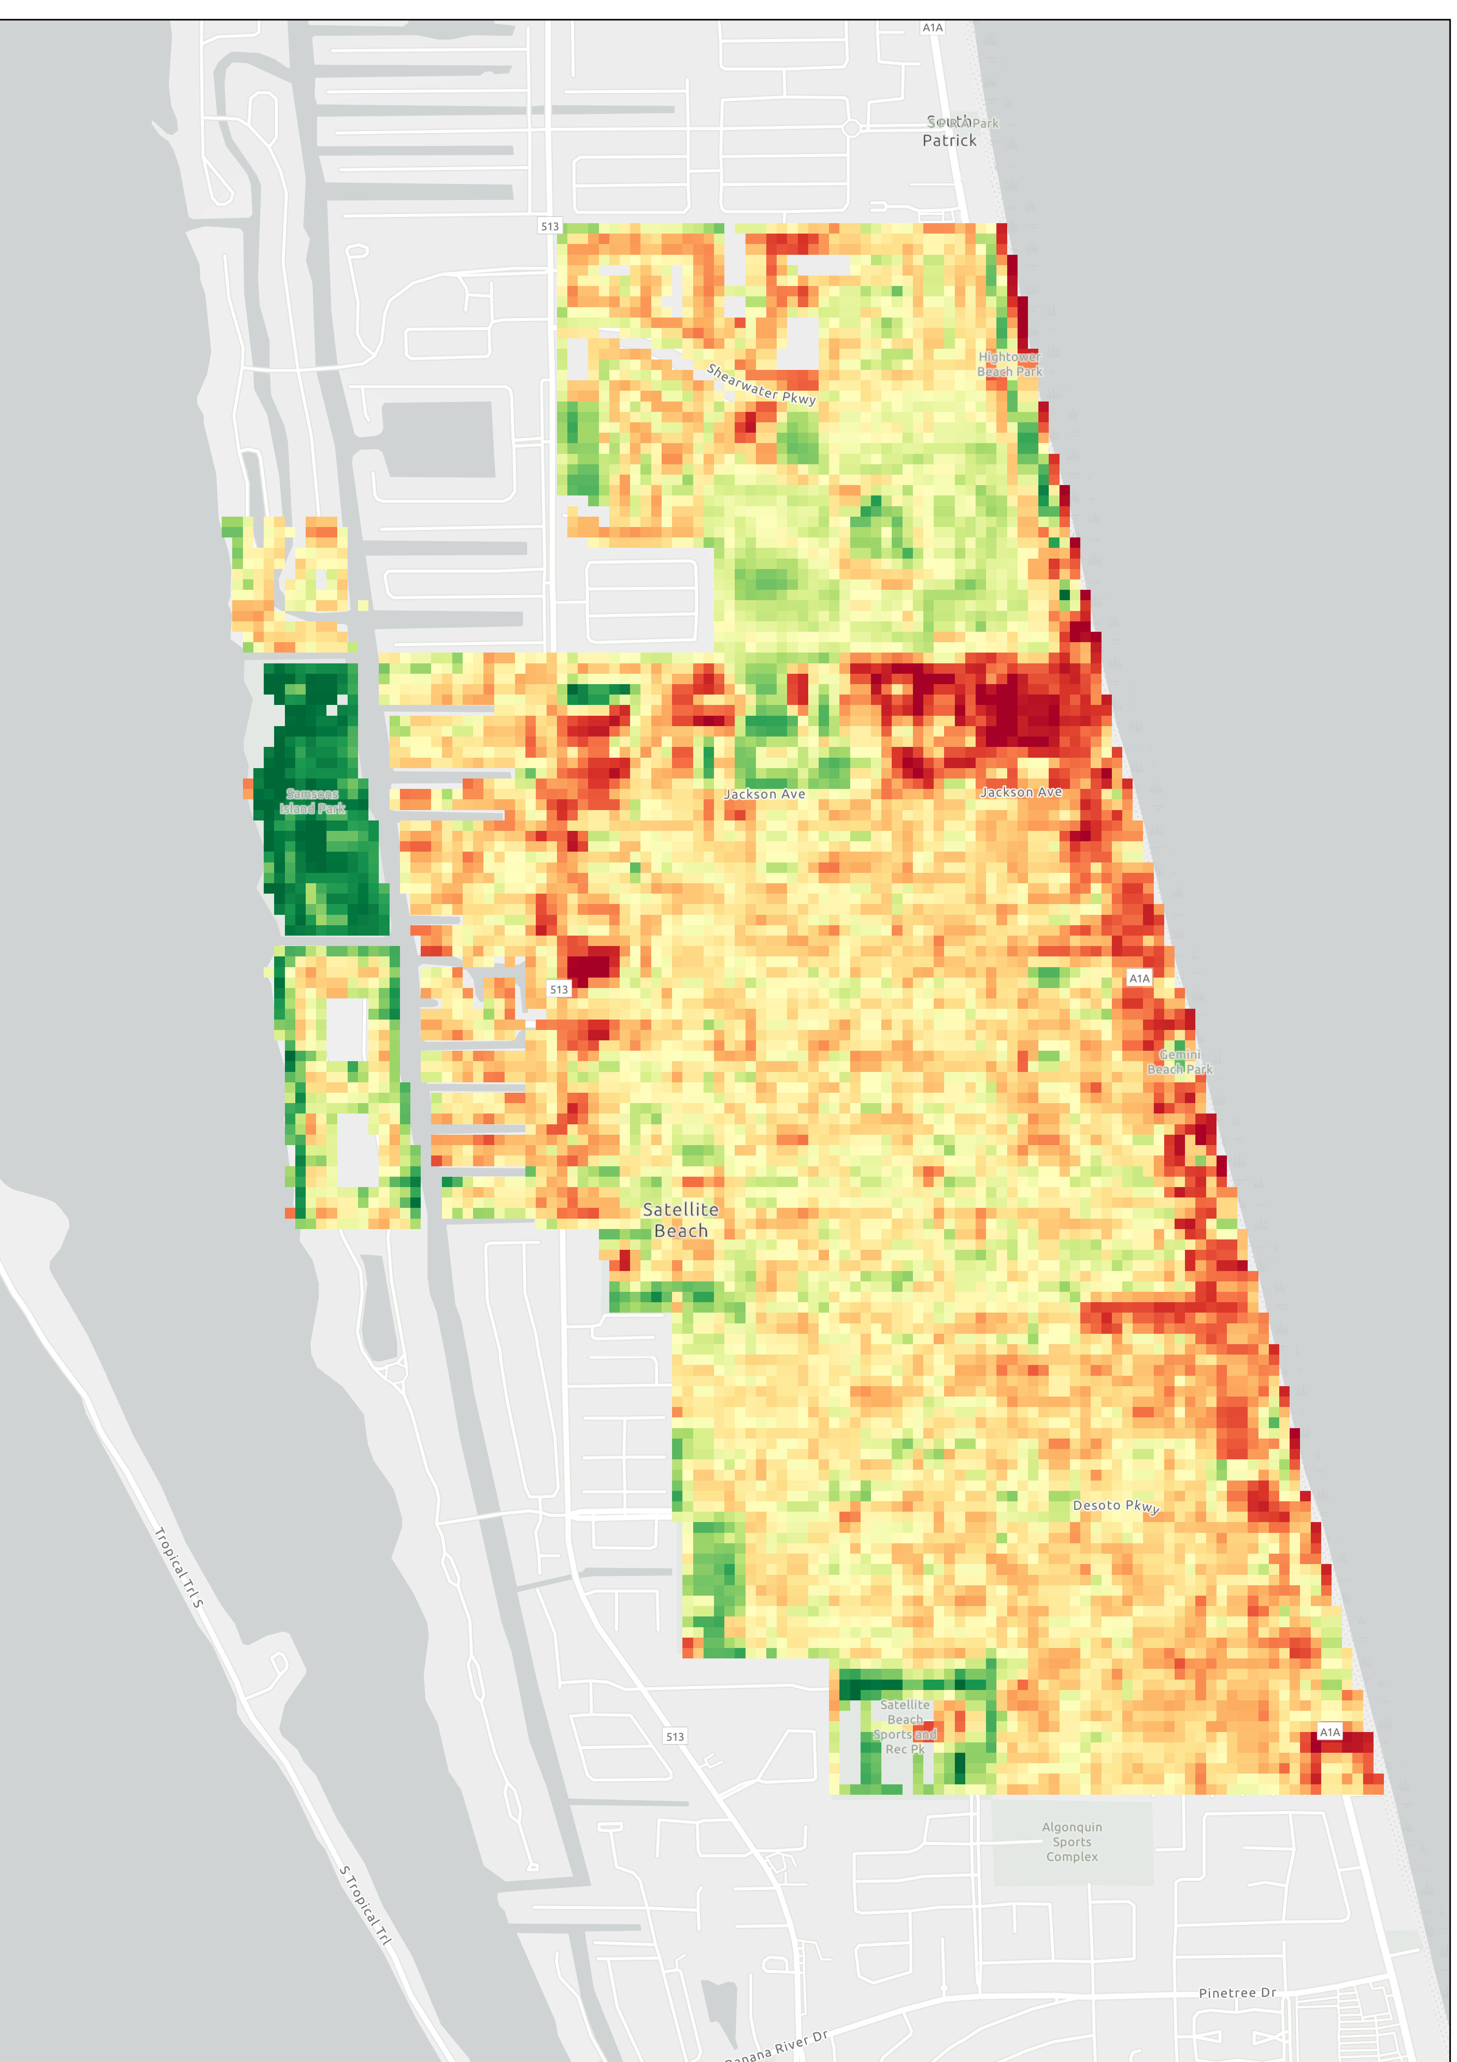


Urban Heat Island Indicators
LST 2015-2019
NDVI 2015-2019
Land Surface Temperature
High​
Landsat 8 OLI/TIRS (USGS)
High​
Low
Mi
Low​
Mi
0
2
0
2
Notes:
Speaker: To situate our research in a larger discussion of urban heat, we also mapped out the land surface temperature and NDVI for the Satellite Beach area using Landsat 8 OLI/TIRS. The highest LST readings were found in the areas that had the lowest NDVI readings or areas that were mostly void of vegetation. In regards to energy and solar panel, areas with a higher LST may use more energy. This is due to the possibility that buildings in these locations may have an increased need for air conditioning and could use solar panels to help offset that extra energy consumption. In that, PV panel placement in these areas may be beneficial. Mapping the LST and NDVI is preliminary analysis for a more robust statistical analysis to examine the relations between the energy expenditure and temperature and greenness.
Image Credit:
ArcGIS Pro (Created by Team)
USGS

Slide 33
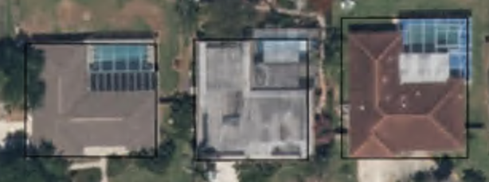
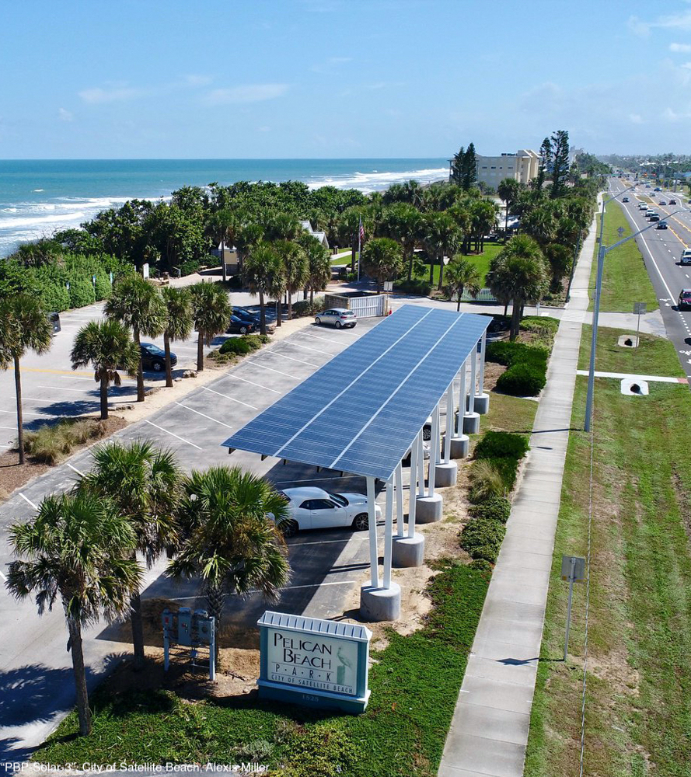
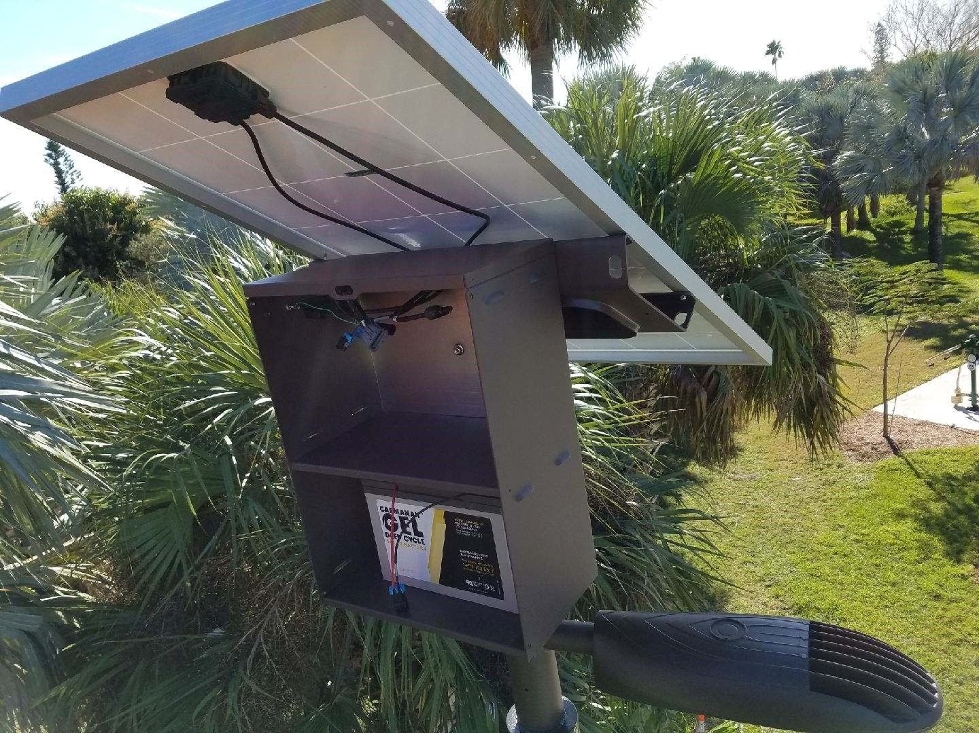
Conclusions Limitations and Future Work
Limitations
Future Work
Building footprints were imperfect
LiDAR data is a snapshot in time
  Does NOT account for new or destroyed homes
No data was collected in time to validate findings
Validate findings by gathering solar panel data on roofs with unique slopes and orientations
Image Credit: City of Satellite Beach
Notes:
Speaker: The limitations we encountered in this project include imperfect building footprints, LiDAR data not aligning with the present situation of the built environment, and not having the data to validate our findings. In the future, validating our work is extremely important to see how accurate our results are.
Image Credit:
"PBP-SOLAR-3" and "Battery Pack 1", City of Satellite Beach, partner provided permission
ArcGIS PRO, Created by Team
Image Credit: PowerPoint Icons within figure (Created by Team)

Slide 34
NASA DEVELOP:
Dr. Dave Hondula – Science Advisor, Arizona State University
Crystal Wespestad – Tempe Lead/Fellow
NASA POWER:
Dr. Paul Stackhouse Jr. – Senior Research Scientist and Principal Investigator
Bradley Macpherson – Geospatial and Technology Developer
City of Satellite Beach:
Alexis Miller – Project Manager
John Fergus – Volunteer
City of Orlando:
David Dunn– Manager, Fleet and Facilities Management Division
Ian LaHiff – Energy Project Manager, Fleet and Facilities Management Division
Solar Panel Experts:
Andy White – 3 Guys Solar
Ruslan Kudlai – General Manager, Tesla Energy

