Slide 1
ALASKA
Transportation & Infrastructure
Identifying Permafrost Subsidence Using NASA Earth Observations to Pinpoint Road & Infrastructure Vulnerability in Fairbanks, Alaska
Patrick Saylor, Marissa Dudek, Katie Lange, Joshua Green
California – JPL
Notes:
Project Lead introduces the project, and gives a brief background of themselves (university, prior experience with DEVELOP?), each team member then introduces themselves (in order of appearance on the slide) along with their background.
Hello and thank you for joining us. My name is Patrick Saylor, and I am the project lead for the Alaska Transportation and Infrastructure NASA DEVELOP project hosted at the California JPL (Jet Propulsion Lab). I will quickly introduce myself and my teammates before we get going!
<introduce self and teammates>

Slide 2
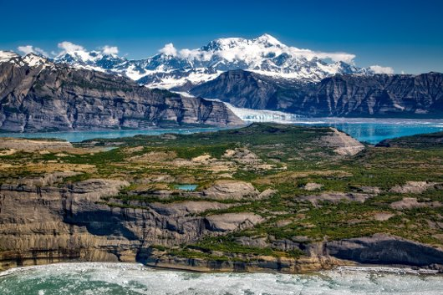
Overview
Background & Overview
  Community Concerns
  Current Monitoring Techniques
  Project Partners
  Project Objectives
  Study Area
  Satellites & Sensors
Methods
  Data Processing
  Cross-Platform Analysis
Results
  Conclusions
  Limitations & Errors
  Future Work
Acknowledgements
Credit: Pixabay
Notes:
For this presentation we are going to first step through some background information, including; permafrost deformation in Alaska, the community concerns of that deformation, the current monitoring techniques, as well as details about this project's partners and objectives, as well as the study area and study period. We are then going to discuss the methodology established in this project, including; what satellites and sensors were used, as well as how the data was processed and analyzed. Finally we are going to show our results, including; our conclusions, the limitations and possible errors of this project, and how this project can be expanded upon in the future.
------------------------------Image Information Below ------------------------------
- Image Credit: Pixabay, 2016
- Image Descr.: Body of Water in Between Mountains
- Image License: Pexels Creative Commons License
- Image Source: https://www.pexels.com/photo/adventure-alaska-beautiful-blue-sky-207049/

Slide 3
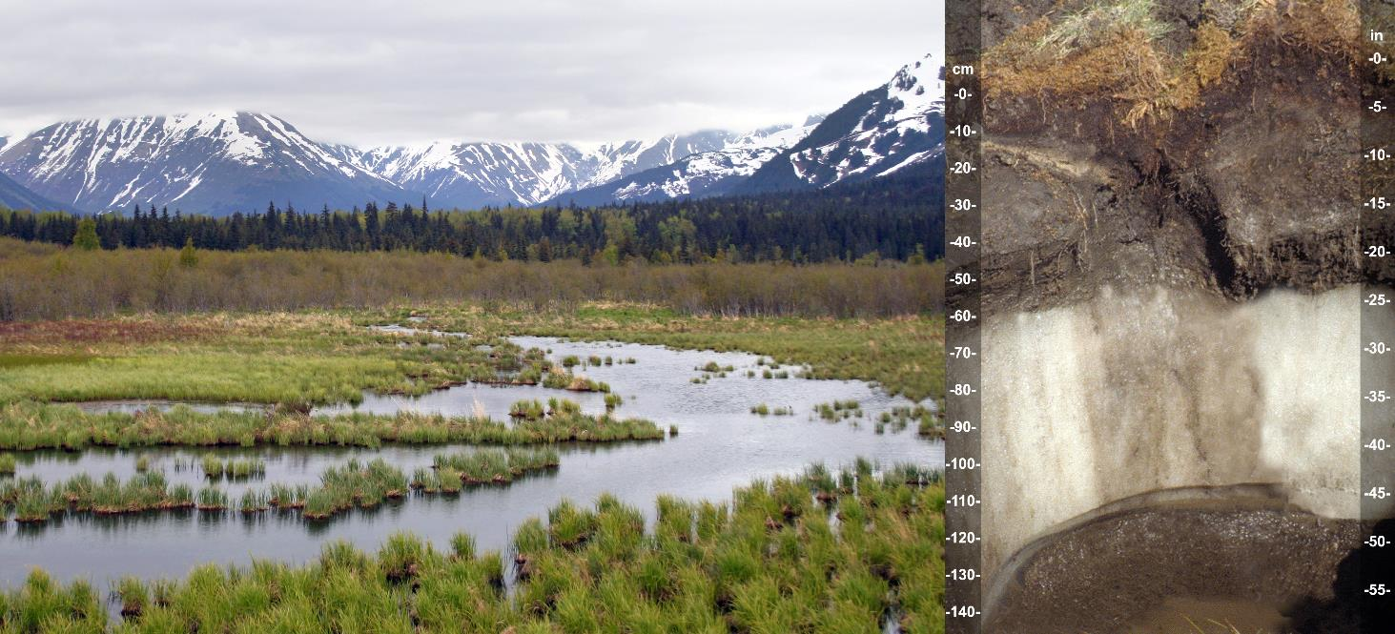
Background and Overview
PERMAFROST: Ground that remains frozen for 2+ years;
can be an inch to several miles deep beneath the Earth's surface.
Surface
Soil
Soil
Permafrost
Soil
Credit: John Kelley, USDA Natural Resources Conservation Service
Notes:
Permafrost is a dominant terrain feature in the Arctic region. Permafrost is a combination of soil and rock that has been continuously frozen for two or more years. In Alaska, permafrost can extend from a few centimeters to more than 650 meters beneath the Earth’s surface (NOAA-PMEL, 2020). This terrain feature is structurally important to the soil, as permafrost directly influences the basic geotechnical properties of the ground (Rachlewicz & Szczucinski, 2008).
------------------------------Image Information Below ------------------------------
- Image Credit: John Kelley, USDA Natural Resources Conservation Service
- Image Descr.: Photo by John A. Kelley, USDA Natural Resources Conservation Service If this photo is used in a publication, on a web site, or as part of any other project, please use the provided photo credit. This photo may not be used to infer or imply USDA-NRCS endorsement of any product, company, or position. Please do not distort or alter the images the photos portray
- Image License: Some rights reserved, credit given, image has been cropped from the original: Creative Commons License Attribution 2.0 Generic
- Image Source: https://www.flickr.com/photos/soilscience/5104761135/in/photostream/

Slide 4
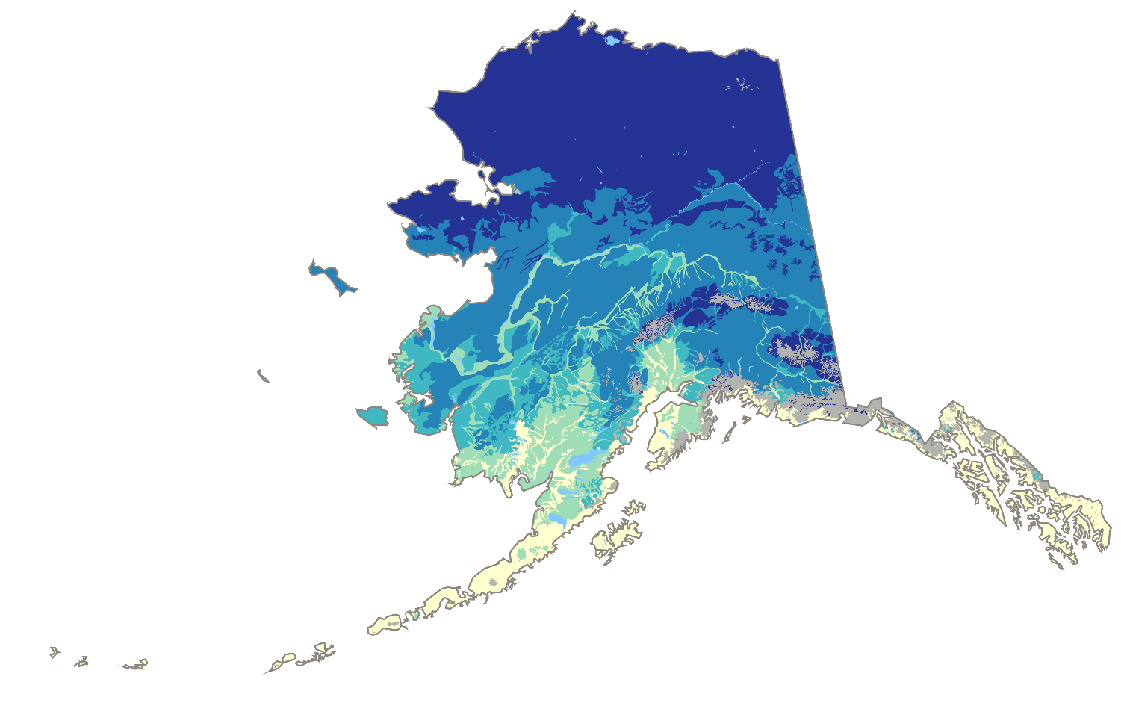
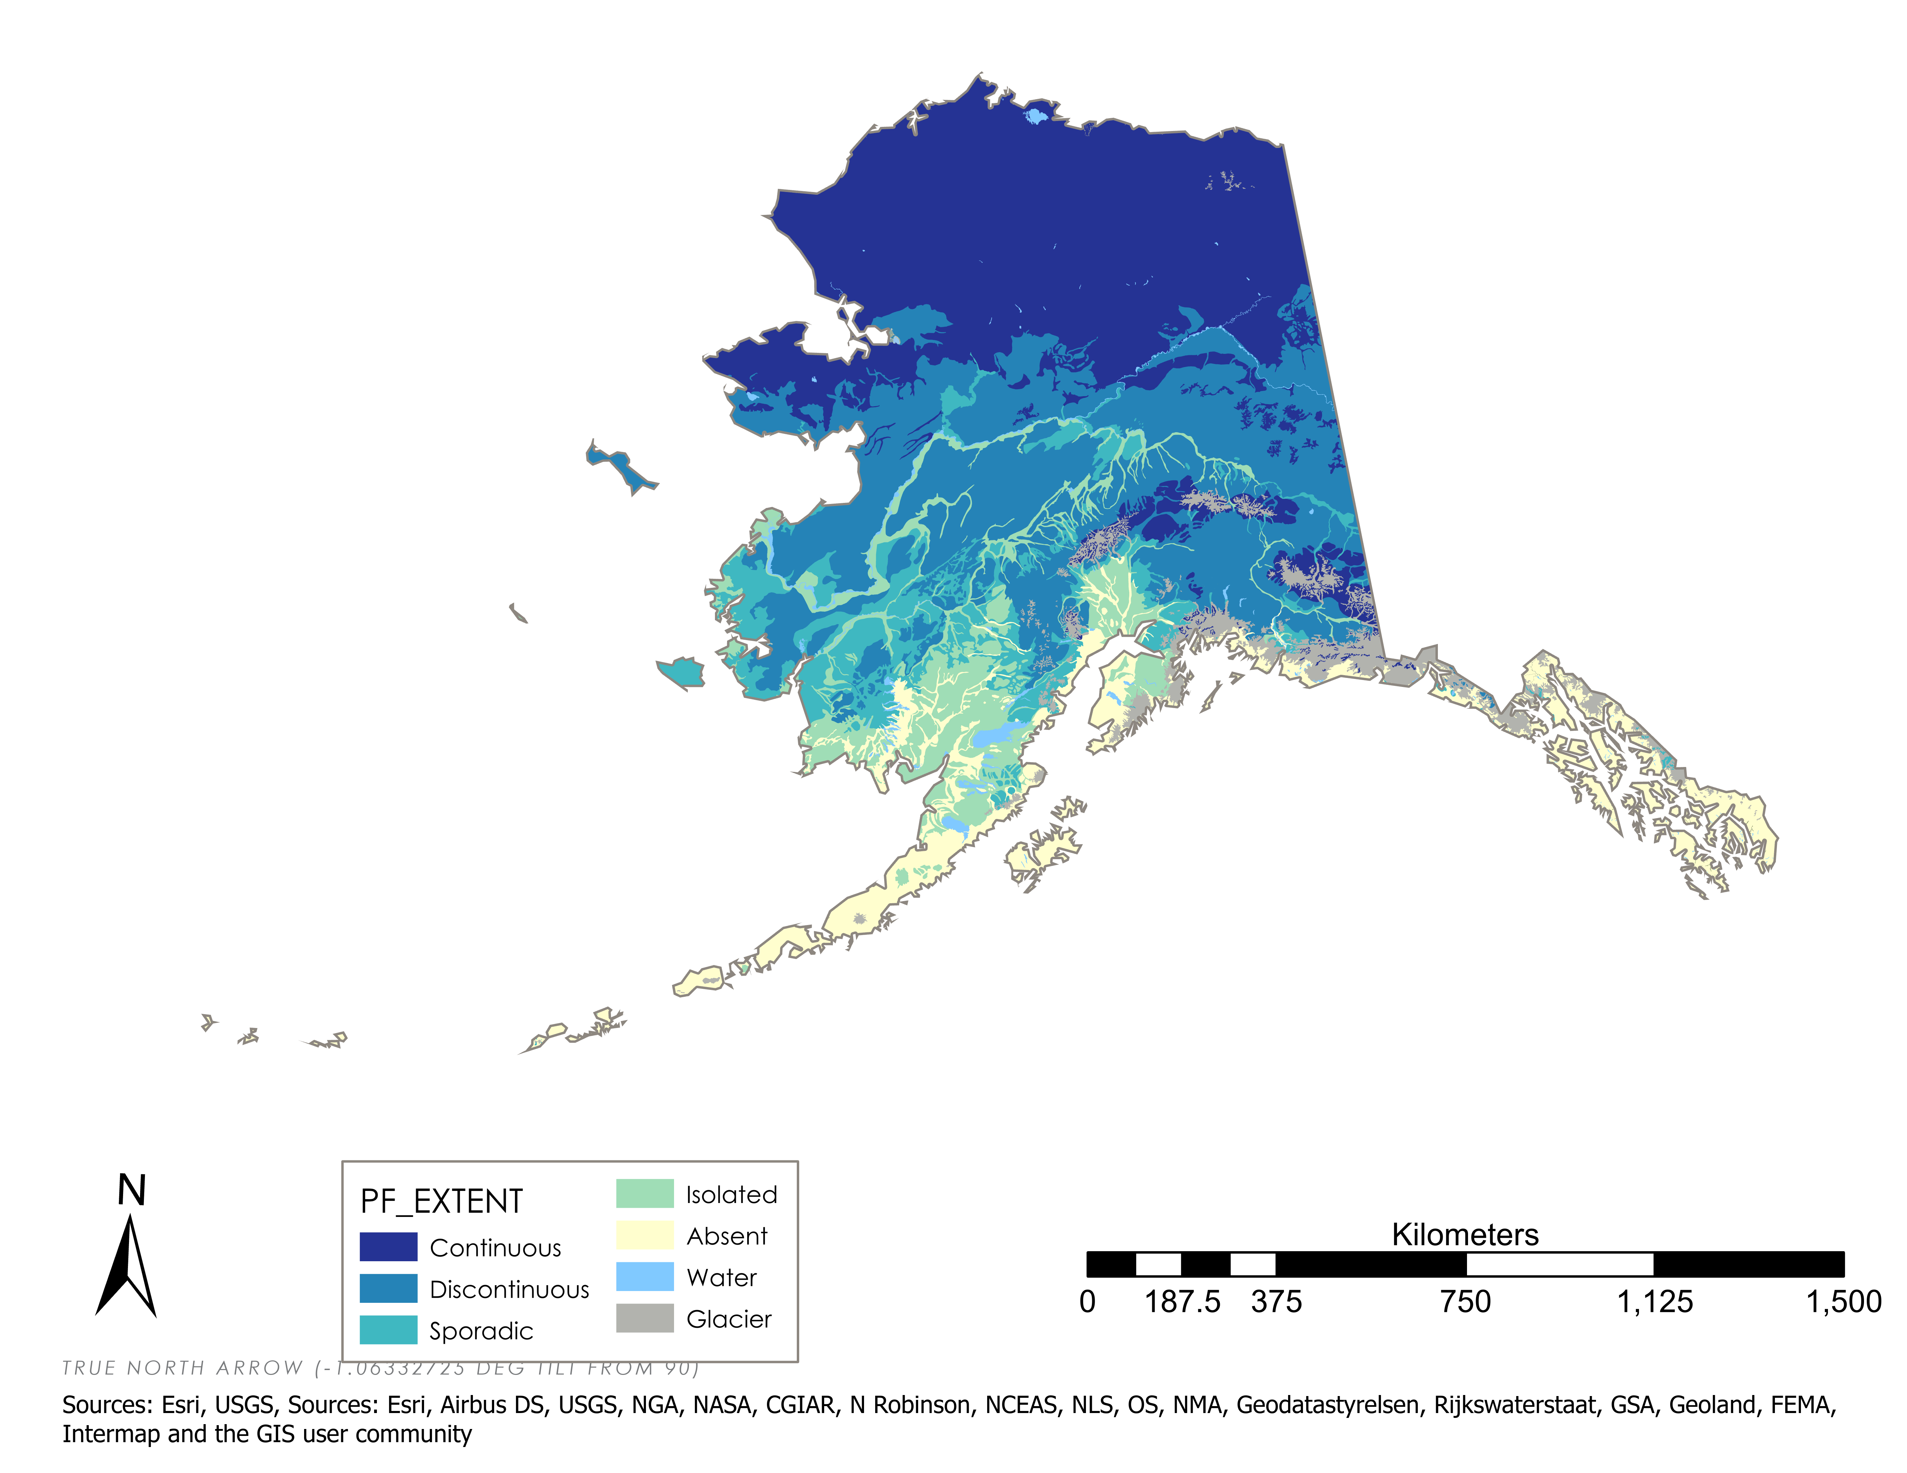
Background: Permafrost in Alaska
Barrow
PERMAFROST DISTRIBUTION (2008)
GLACIER
CONTINUOUS
Fairbanks
DISCONTINUOUS
SPORADIC
ISOLATED
ABSENT
LARGE WATERBODIES
Anchorage
Credit: UAF Institute of Northern Engineering; ADNR, DGGS; NASA DEVELOP
Notes:
"Permafrost is found beneath nearly 85% of Alaska. It is thickest and most extensive in arctic Alaska north of the Brooks Range, present virtually everywhere and extending as much as 2,000 feet below the surface of the Arctic Coastal Plain. Southward from the Brooks Range it becomes increasingly thinner and more discontinuous, broken by pockets of unfrozen ground known as taliks, until it becomes virtually absent in Southeast Alaska except for patches of high-elevation alpine permafrost." Recent climate warming has led to widespread permafrost thaw; resulting in land surface subsidence, sinking of ground surface elevation, and thermokarst formation (Strozzi et al., 2018)
------------------------------Image Information Below ------------------------------ (1)
- Image Credit: UAF Institute of Northern Engineering
- Image Descr.: Map showing 2008 permafrost distribution in Alaska. Percentages indicate how much of the ground surface is underlain by permafrost in each category. Source: Jorgenson and others, 2008.
- Image Source: http://catalog.northslopescience.org/catalog/entries/3587-permafrost-characteristics-of-alaska-2008-sha

Slide 5
Background: Permafrost Deformation
SEASONAL THAW: thaws a similar amount in summer and freezes in winter,
causing surface rebound
LONG-TERM THAW: thaws more in summer and freezes less in winter, causing surface subsidence
Surface
Surface
Surface
Soil
Surface
Soil
Surface
Soil
Surface
Soil
Soil
Surface
Soil
Soil
Surface
Permafrost
Permafrost
Baseline
Permafrost
Soil
Permafrost
Permafrost
Permafrost
Permafrost
Permafrost
Soil
Soil
Soil
Soil
Soil
Soil
Soil
Soil
Summer
Thaw
Winter Freeze
Summer
Thaw
Summer
Thaw
Winter Freeze
Summer
Thaw
Notes:
The uppermost section of a permafrost layer, or active layer, regularly thaws during the summer and re-freezes in the winter... allowing the surface to rebound after thawing; however, when thawing extends beyond the active layer, less of the thawed permafrost will re-freeze in the winter. This decrease in freezing, prompted by increasing temperatures, causes a positive feedback loop where surface subsidence and thermokarst formation increases across an area.
Long term permafrost thaw can cause the formation of thermokarst, which is an irregular land surface with depressions, hummocks, and lakes.
------------------------------Image Information Below ------------------------------
- Image Credit:
- Image Descr.:
- Image Source:

Slide 6
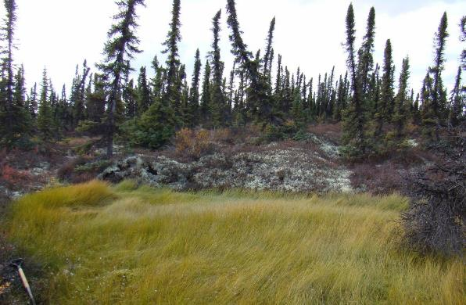
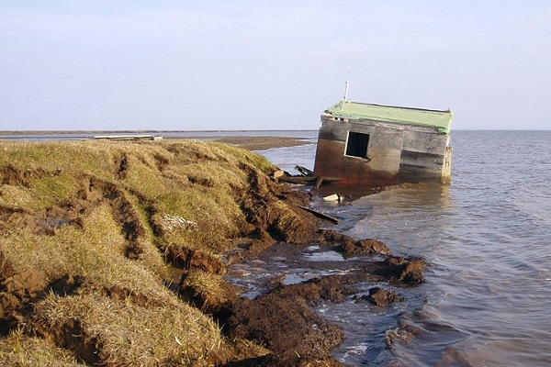
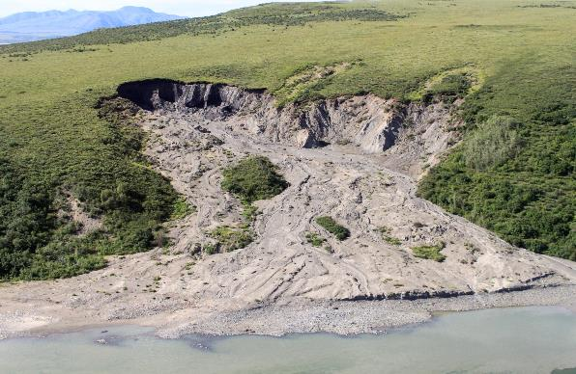
Community Concerns
Economic impacts
  Structural damage of private and public property
  Structural damage to infrastructure including roads, bridges, and oil & gas pipelines
Environmental impacts
  Slope instabilities; release of greenhouses from organic-rich soils
  Destabilization of critical infrastructure posing an environmental hazard (oil and gas pipeline spills, etc.)
Credit: United States Geological Survey
Credit: National Park Service
Notes:
"A major hazard of warming and thawing permafrost is that ground ice degrades, and the soil surface collapses. Fluctuations in temperature over the seasons also cause the ground to move as the upper layers freeze (ice lens formation) and thaw (loss of ice). Ice lenses may form under wet conditions as the ground freezes, especially in fine-grained soils such as silt or clay. Upon thawing, ground ice can cause an excess of liquid water that cannot be stored in the soil and needs to flow out of the soil as gravity consolidates the soil after thawing, leading to ground collapse." (DNR, DGGS: https://dggs.alaska.gov/hazards/permafrost.html)
In the United States, the presence of widespread permafrost results in classes of geologic hazards that are largely unique to Alaska. Permafrost is structurally important to the soils of Alaska, and its thawing causes landslides, ground subsidence, and erosion as well as lake disappearances, new lake development, and saltwater encroachment into aquifers and surface waters. Usteq, from the Yup'ik word meaning "surface caves in," is a catastrophic form of permafrost thaw collapse that occurs when frozen ground disintegrates under the compounding influences of thawing permafrost, flooding, and erosion." (DNR, DGGS: https://dggs.alaska.gov/hazards/permafrost.html)
------------------------------Image Information Below ------------------------------ (1)
- Image Credit: U.S. Geological Survey (image found from DNR, DGGS)
- Image Descr.: Thawing permafrost on various peatlands in Alaska. Permafrost thaw results in ground subsidence and inundation that kills black spruce and other understory plants living on the permafrost plateau. The black spruce forests found on permafrost plateaus are replaced with sedge- and moss-dominated bogs and fens, altering the ecosystem structure and function.
-License Info- Public Domain
- Image Source: https://www.usgs.gov/media/images/thawing-permafrost-alaska
------------------------------Image Information Below ------------------------------ (2)
- Image Credit: National Park Service, Climate Change Response
- Image Descr.: "Thawing permafrost: In Noatak National Preserve, Alaska, an exceptionally warm summer in 2004 triggered this 300m long slump associated with thawing permafrost."
-License Info: Creative Commons Attribution 2.0 Generic (CC BY 2.0)
- Image Source: https://www.flickr.com/photos/npsclimatechange/27759123542/in/photolist-7FhGfG-amE6xA-jb2CXK-amM7nc-phzBdW-g6nGDs-amBrA6-8M6eD2-5hgnb-g69PGF-E9d5wM-47fVhK-p1aJLF-8rT4E5-k6adda-k69qHK-k6ahZp-k6abF2-k69jLV-k69TGT-2cehbUt-k6bvjJ-g9D4ka-amE9y5-oHWi8B-p1r8vT-QuRerJ-k69BVp-p1aJHK-WGAcrS-Yg1EET-JhYLjj-RHKszq-2452x9o-23MFxnX-DGTkyx-XgKmrb-QqBmCZ-AFPZW5-BDmBsX

Slide 7
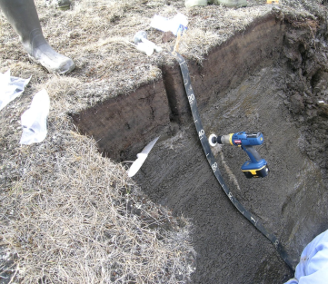
Current Monitoring Techniques
Ground-based geologic investigations
  Expensive and time consuming
  Remote permafrost thaw areas are logistically challenging to survey
  Permafrost thaw areas are often identified after damage is evident
Limited satellite data incorporation
  Project partners use some remote sensing techniques on a project-by-project basis
Credit: Thomas A. Douglas, U.S. Army Cold Regions Research and Engineering Laboratory
Notes:
Historically, surface deformation and infrastructure vulnerability from permafrost thaw has been quantified through ground-based surficial and subsurface geologic investigations. However, monitoring the impacts of permafrost thaw on infrastructure is largely limited as in situ observations are expensive and time consuming.
In addition, many areas affected by permafrost thaw are in remote areas or are logistically challenging to survey and frequently only identified after damage is evident. For these reasons, monitoring surface deformation via remotely sensed data has become an attractive approach for long term, comprehensive permafrost thaw identification. Currently, project partners use some satellite data in their decision making on a project by project basis. However, they are interested to gain more knowledge about detecting permafrost melt using radar methods.
------------------------------Image Information Below ------------------------------
Image Credit: Thomas A. Douglas, U.S. Army Cold Regions Research and Engineering Laboratory
Image Descr: The seasonally thawed “active layer” (dark brown surface soil) and underlying permafrost along a coastal bluff near Utqiaġvik, Alaska.
Image Source: Photo provided by project partner Tom Douglas, permission granted to use

Slide 8
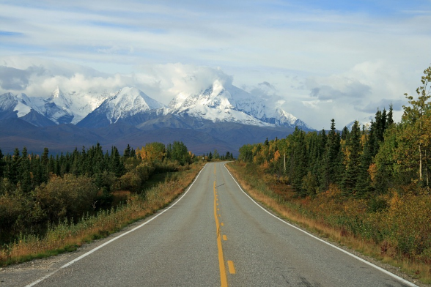
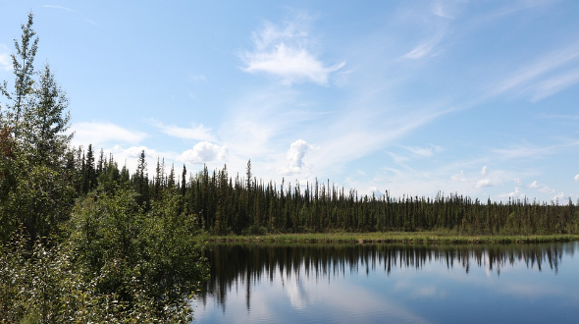
Project Partners
US Army Corps of Engineers, Cold Regions Research & Engineering Laboratory (CRREL)
Alaska Department of Transportation & Public Facilities (ADOT & PF)
Alaska Department of Natural Resources (ADNR)
Alaska Satellite Facility (ASF)
Credit: Pixabay
Credit: James Pack
Notes:
In this project, we partnered with the U.S. Army Corps of Engineers’ Cold Regions Research and Engineering Laboratory (CRREL), the Alaska Department of Transportation & Public Facilities (ADOT&PF), the Alaska Department of Natural Resources (ADNR), and support from the Alaska Satellite Facility (ASF).
------------------------------Image Information Below ------------------------------ (1)
- Image Credit: Username: 12019 - Pixabay, 2012
- Image Descr.: Road in Alaska
-License Info: Creative Commons Pixabay License
- Image Source: https://pixabay.com/photos/alaska-wilderness-mountain-forest-67164/
------------------------------Image Information Below ------------------------------ (2)
- Image Credit: JamesPack (JamesPackWriter), 2019
- Image Descr.: Lake near Fairbanks, AK
-License Info: Creative Commons Pixabay License
- Image Source: https://pixabay.com/photos/nature-outdoors-water-plant-tree-4969253/

Slide 9
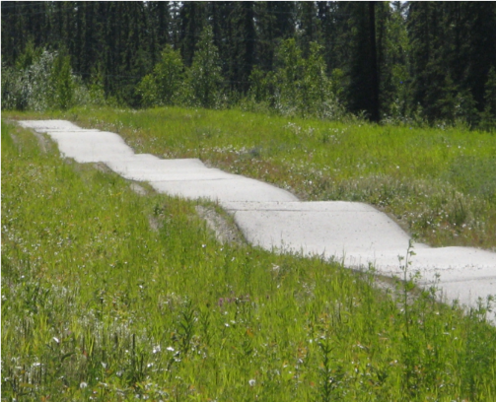
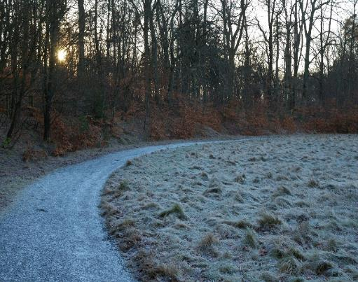
Project Objectives
DETECT permafrost subsidence and thermokarst formation
IDENTIFY road & infrastructure vulnerability
CREATE an InSAR processing module (PerMA)
EVALUATE the feasibility & accuracy of using InSAR to detect permafrost thaw
Credit from top to bottom: Thomas A. Douglas, U.S. Army Cold Regions Research and Engineering Laboratory; K.P. Marcin
Notes:
In order to assist partner decision making, the objectives of this study were to identify areas of permafrost subsidence and thermokarst formation posing risks to critical infrastructure, identify road and infrastructure vulnerability near permafrost thaw, create a tool to automate InSAR processing for future permafrost deformation maps, and develop and evaluate the feasibility and accuracy of using InSAR to detect permafrost thaw. Partners will be able to use the final products of this project to inform decision making concerning permafrost thaw and thermokarst formation near areas of critical infrastructure and build capacity to continue using InSAR in the future.
------------------------------Image Information Below ------------------------------ (1)
- Image Credit: Thomas A. Douglas, U.S. Army Cold Regions Research and Engineering Laboratory
- Image Descr.: A bicycle path in Fairbanks, Alaska exhibiting buckling from permafrost thaw. Photo taken July, 2008
- Image Source: Photo provided by project partner Tom Douglas, permission granted to use
------------------------------Image Information Below ------------------------------ (2)
- Image Credit: kpmarcin, 2014
- Image Descr.: N/A
-License Info: Creative Commons Pixabay License
- Image Source: https://pixabay.com/photos/frozen-ground-road-forest-nature-442177/

Slide 10
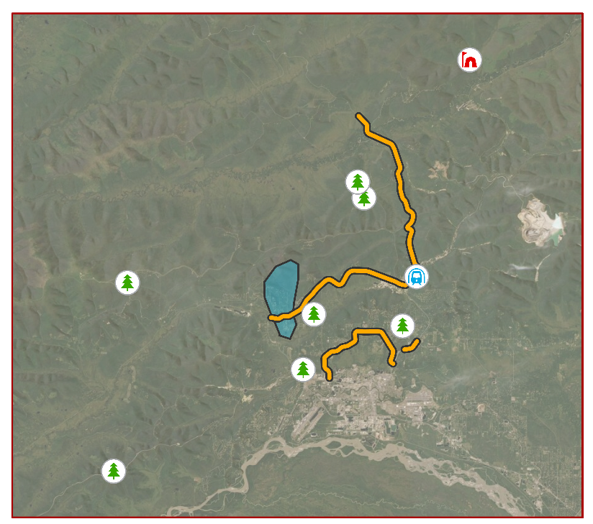
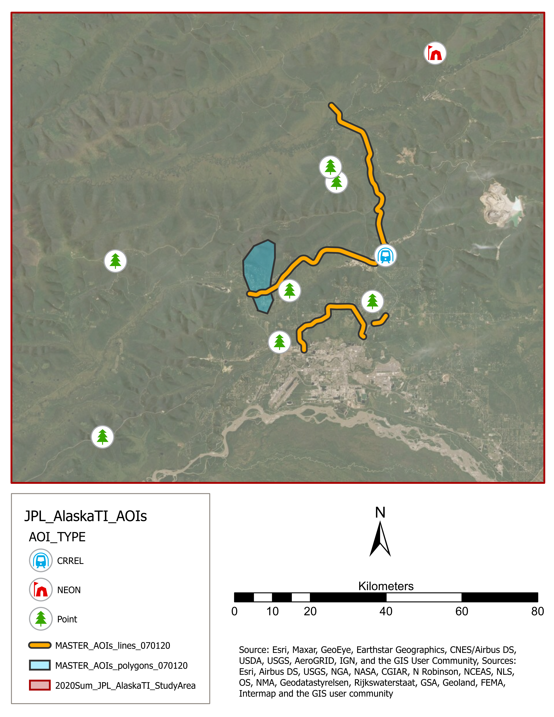
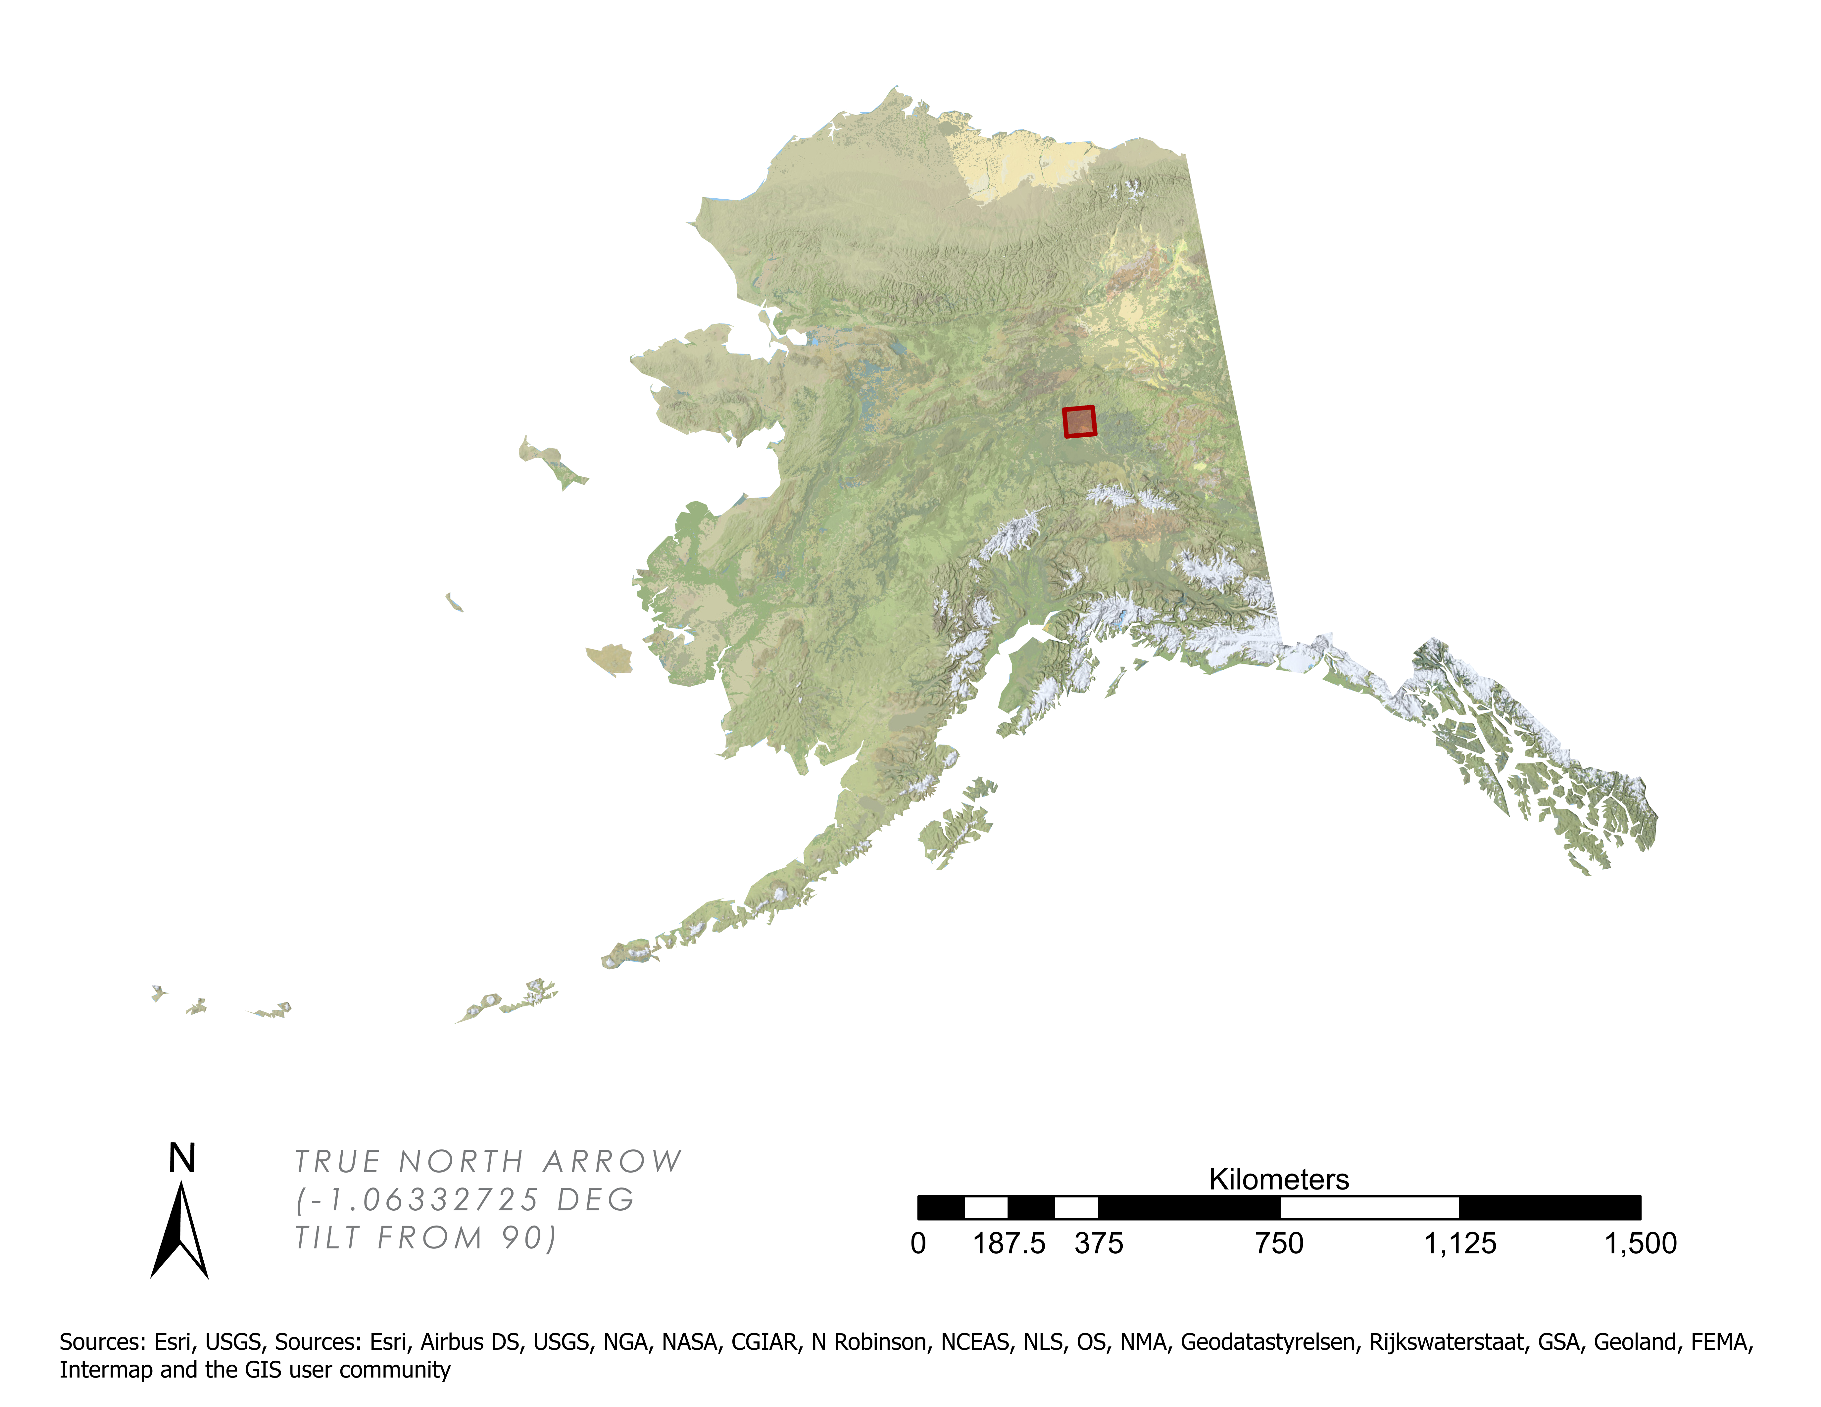
Study Area: Fairbanks, AK
Study Period: 2017 – 2020
Areas of Interest
Barrow
Caribou Creek Site
CRREL Site
NEON Site
Brooks Range
ADNR Site
Road
Fairbanks
ADNR Area
Study Area
Alaska
Range
Permafrost
Tunnel
Anchorage
Fairbanks
N
KILOMETERS
N
KILOMETERS
0
375
750
1,125
1,500
0
10
20
40
60
80
Credit (left): Esri, USGS
Credit (right): Esri, Airbus DS, USGS, NGA, NASA, CGIAR, N Robinson, NCEAS, NLS, OS, NMA, Geodatastylerelsen, Rijkswaterstaat, GSA, Geoland, FEMA, Intermap and the GIS user community
Notes:
The study area for this project was the Fairbanks area in central Alaska. Areas of Interest (AOIs) were designated by the project partners at beginning of the term. AOIs include the CRREL Permafrost Research Tunnel, the Caribou Creek NEON site, four major roadways (totaling ~80 miles), the O'Coinnor Creek watershed, and eight environmental locations (including known landslides and areas of thermokarst)
In this project, the Caribou Creek National Ecological Observatory Network (NEON) field site is being used as validation of deformation detection, as all there is repeat seasonal and annual remotely sensed data that can be used to evaluate its accuracy of permafrost detection.
------------------------------Image Information Below ------------------------------ (1)
- Image Credit: Esri, USGS
- Image Descr.: Alaska Statewide Context basemap (National Geographic)
- Image Source: Esri ArcGIS Pro
------------------------------Image Information Below ------------------------------ (2)
- Image Credit: Esri, Airbus DS, USGS, NGA, NASA, CGIAR, N Robinson, NCEAS, NLS, OS, NMA, Geodatastylerelsen, Rijkswaterstaat, GSA, Geoland, FEMA, Intermap and the GIS user community
- Image Descr.: Alaska Statewide Context basemap (Hillshade) *** Not visible in this map's scale ***
- Image Source: Esri ArcGIS Pro

Slide 11
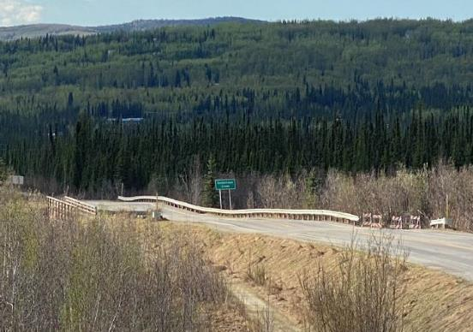
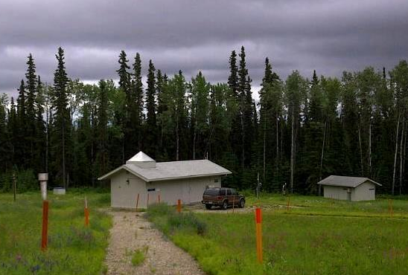
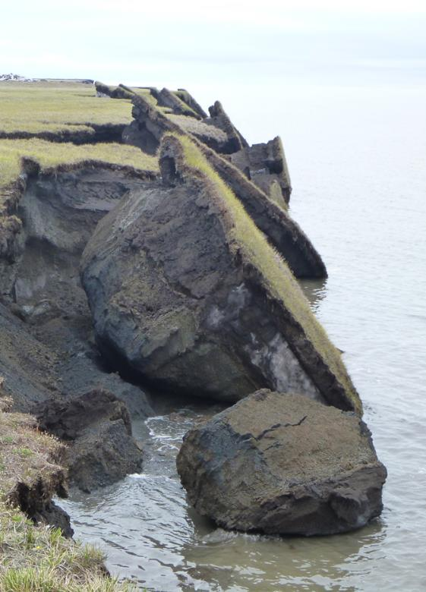
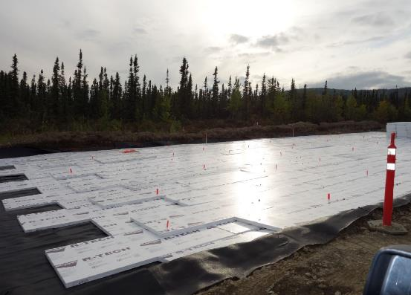
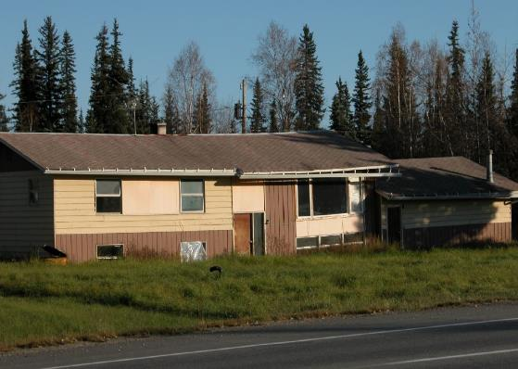
Study Area: Objectives
TRANSPORTATION
INFRASTRUCTURE
RESEARCH
Credit: T. Douglas (CRREL)
Credit from top to bottom: Jeffery Fox (USGS); Thomas A. Douglas, U.S. Army Cold Regions Research and Engineering Laboratory
Credit: United States Geological Survey
Notes:
Within Fairbanks, the project partners are interested in the effect of permafrost thaw on the local transportation, infrastructure, and research. Permafrost thaw is causing local roadways to subside and lose their structural integrity, and they are trying to combat this by implementing flexible foam into the construction of roadways. Permafrost thaw is also causing infrastructure to lose their structural integrity as the ground beneath building is sinking. The CRREL uses the Permafrost Research Tunnel to study permafrost characteristics. The area around the tunnel itself has also seen the formation of thermokarst.
------------------------------Image Information Below ------------------------------ (1)
- Image Credit: Jeffery Fox, United States Geological Survey
- Image Descr.: Crumbling blocks of permafrost along the Beaufort Coast
-License Info- Public Domain
- Image Source: https://www.usgs.gov/media/images/crumbling-blocks-permafrost-along-beaufort-coast
------------------------------Image Information Below ------------------------------ (2)
- Image Credit: United States Geological Survey
- Image Descr.: Magnetic observatory buildings at the College International Geophysical (CIGO) magnetic observatory, Fairbanks, AK.
-License Info- Public Domain
- Image Source: https://www.usgs.gov/media/images/college-geomagnetic-observatory-9
------------------------------Image Information Below ------------------------------ (3)
- Image Credit: Thomas A. Douglas, U.S. Army Cold Regions Research and Engineering Laboratory
- Image Descr.: "A residential home in Fairbanks, Alaska where permafrost thaw has affected the structure."
- Image Source: Photo provided by project partner Tom Douglas, permission granted to use
------------------------------Image Information Below ------------------------------ (4)
- Image Credit: T. Douglas, CRREL (May 2020)
- Image Descr.: "A roadway, guardrail, and bike path in Fairbanks, Alaska exhibiting buckling from permafrost thaw."
- Image Source: Photo provided by project partner Tom Douglas, permission granted to use
------------------------------Image Information Below ------------------------------ (5)
- Image Credit: T. Douglas, CRREL
- Image Descr.: "Using foam to limit permafrost thaw along a replacement road section in Fairbanks, Alaska."
- Image Source: Photo provided by project partner Tom Douglas, permission granted to use

Slide 12
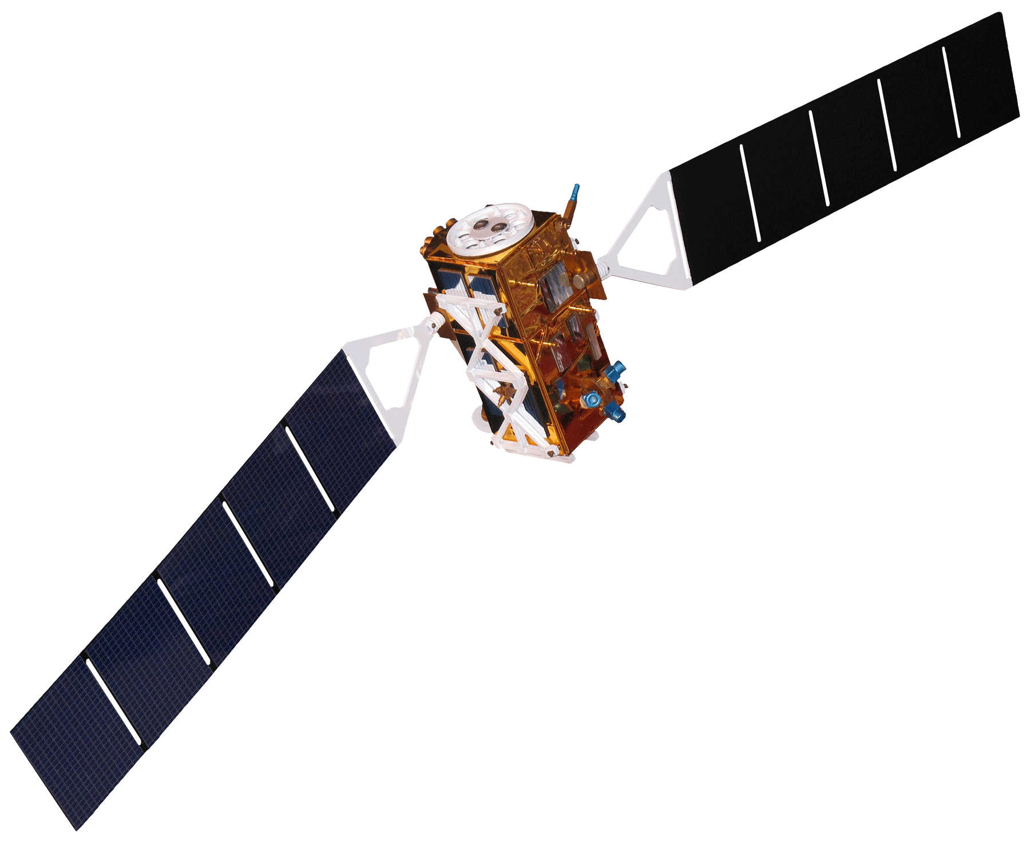
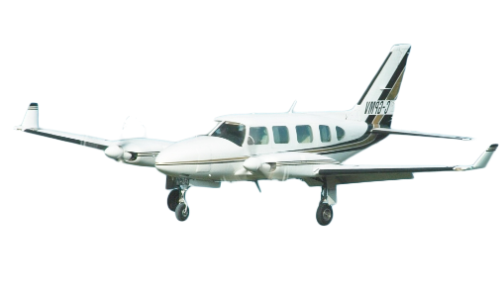
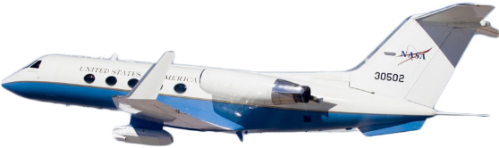
Satellites & Sensors
NASA Gulfstream III UAVSAR
Sentinel-1 C-SAR
Airborne LiDAR
Level-1 Single Look Complex Interferograms
L-Band Ground-Based Unwrapped Interferograms
Digital Elevation Model (DSM/DTM)
Credit: Rama, 2012
Credit: NASA Jet Propulsion Laboratory
Credit: John Davies, 2004
Notes:
The following Satellites and Sensors were used in this project:
1) Sentinel-1 C-SAR Level-1 Single Look Complex (SLC) product granules were accessed through the EarthData Portal. Sentinel-1 granules used in this project had an interferometric wide (IW) swath with vertical transmit and vertical receiver (VV) polarization.
2) The NASA Gulfstream III UAVSAR horizontal transmit and horizontal receiver (HH) ground range unwrapped interferogram, coherence, and the digital elevation models (DEMs) were directly downloaded from NASA Jet Propulsion Laboratory UAVSAR data portal.
3) The UAV LiDAR data, was acquired through the NEON data portal and the Alaska Data Elevation Portal. Additionally, UAV LiDAR coverage was sent to the team via online file transfer from the CRREL project partners.
------------------------------Image Information Below ------------------------------ (1)
- Image Credit: Rama (2012)
- Image Description: The C-SAR instrument on ESA's Sentinel-1 satellite is an active phased array antenna that provides polarized SAR imagery with a 5m resolution and 400 km swath, in all weather, day or night.
- Image Source: https://en.wikipedia.org/wiki/File:Sentinel_1-IMG_5874-white.jpg
-License Info: Wikimedia Commons and Creative Commons Attribution-Share Alike 2.0
------------------------------Image Information Below ------------------------------ (2)
- Image Credit: NASA Jet Propulsion Laboratory
- Image Description: Polarimetric L-Band SAR data was obtained from the JPL UAVSAR Program's Gulfstream III, a modified business jet equipped with SAR sensors specifically designed for differential interferometric measurements.
-License Info- Public Domain, images on public JPL websites may be used for any purpose without prior permission
- Image Source: https://uavsar.jpl.nasa.gov/education/what-is-uavsar.html
------------------------------Image Information Below ------------------------------ (3)
- Image Credit: John Davies- CYOW Airport Watch (2004)
- Image Description: UAV LiDAR surveys over Fairbanks commissioned by USGS were completed by Quantum Spatial using a Leica ALS70 system mounted to a Piper PA-31-350 aircraft.
-License Info- Permission is granted to copy, distribute, and/or modify this document under the terms of the GNU Free Documentation License
- Image Source: https://commons.wikimedia.org/wiki/File:Piper_PA-31-..._Navajo_...,_West_Capital_Aviation_AN0644817.jpg

Slide 13
Methods: Overview
Data Acquisition
& Processing
Validation & Comparison
Deformation Analysis
Sentinel-1
UAVSAR
Sentinel-1
Sentinel-1
UAVSAR Data
LiDAR
LiDAR Data
Notes:
Our Methodology is comprised of three major components: Data Acquisition, Cross-Platform Validation, and Seasonal Deformation Analysis. Data Acquisition consists of all the processing steps to acquire and process our three platforms: Sentinel-1, UAVSAR, and LiDAR. These datasets are then compared to one another for accuracy and to quantify the ability of Sentinel-1 to detect deformation. Finally, we perform timeseries and change detection analysis based solely on Sentinel-1 due to the spatio-temporal resolution provided.

Slide 14
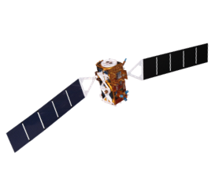
Methods: Sentinel-1 C-SAR Processing
HyP3
OpenSARLab
GIAnT
Create Interferograms
Pre-Processing
Time Series Analysis
Co-register of C-SAR SLC Stack
Computation of Interferograms
Topographic-related phase removal
Conduct Adaptive Phase Filtering & Multi-look
Undergo Phase Unwrapping
Terrain Geo-coding
Subset Areas of Interest
Cull Data According to Timeframe and Orbital Characteristics
Correct for Atmospheric
Noise Present in the Data
Create Ancillary Files and Functions
Reformat Interferograms
Run GIAnT
HyP3: Hybrid Pluggable Processing Pipeline
GIAnT: Generic InSAR Analysis Toolbox
Credit: Rama, 2012
Notes:
Sentinel-1 C-SAR data was accessed from the NASA Earthdata Portal in the .slc file format. Data was acquired from 2017 to present, spanning the months March to November at a 12-day interval, resulting in a total of <total images analyzed> images processed. Datafiles were then processed in ASF OpenSARLab as pairs with spatially and temporally co-registered granules to produce InSAR interferograms. The mechanics of interferogram production take place in the HyP3 computing environment. Here the ingested granule pair are spatially co-registered, computed into an interferogram, processed for topographic phase removal, processed for adaptive and multi-look phase filtering, phase unwrapped, and ultimately terrain geo-coded. The unwrapped interferograms are then pre-processed in OpenSARLab by subsetting the area of interest, verifying quality of data, culling data selection based on time frame and orbital characteristics, and finally reprojecting to a uniform UTM. The pre-processed interferograms are then put into the Generic InSAR Analysis Toolbox (GIAnT ) to create time series analysis of the interferograms.
------------------------------Image Information Below ------------------------------ (1)
- Image Credit: Rama (2012)
- Image Description: The C-SAR instrument on ESA's Sentinel-1 satellite is an active phased array antenna that provides polarized SAR imagery with a 5m resolution and 400 km swath, in all weather, day or night.
- Image Source: https://en.wikipedia.org/wiki/File:Sentinel_1-IMG_5874-white.jpg
-License Info: Wikimedia Commons and Creative Commons Attribution-Share Alike 2.0

Slide 15

Methods: UAVSAR Processing
JPL
Python & GIS
GIS
Data Acquisition
Pre-Processing
Data Analysis
Processing Mode: InSAR Pair
Type: L-Band
Polarization: HHHH
Build ENVI header (.HDR) file
Build Symbolic Image (.IMG) file
Convert Ground Range Deformation Products (.GRD) into TIFF Raster Datasets
Resample Raster Cell Size to Uniform Scale for Validation
Create Line of Sight Deformation Map Products through Raster Calculation
Deformation Analysis
Ground Range Multi-Looked Products (.GRD)
Interferogram
Unwrapped phase
Coherence
Amplitude 1 (range)
Amplitude 2 (azimuth)
DEM
Metadata file
Credit: NASA Jet Propulsion Laboratory
Notes:
- UAVSAR data was obtained through the NASA JPL UAVSAR data portal. Co-located granules with different collection dates were selected for processing as pairs to generate phase-differencing plots.
- The binary ground files were converted to raster (.geotiff) files using a python script
- The rasters were then taken into a GIS software to remove the no data values, calculate the line of sight deformation, and to conduct a deformation analysis
- To then proceed onto the cross-platform validation processing, the raster data was then upscaled to the same pixel size as the Sentinel-1 data as that dataset is a lower resolution.
------------------------------Image Information Below ------------------------------ (1)
- Image Credit: NASA Jet Propulsion Laboratory
- Image Description: Polarimetric L-Band SAR data was obtained from the JPL UAVSAR Program's Gulfstream III, a modified business jet equipped with SAR sensors specifically designed for differential interferometric measurements.
-License Info- Public Domain, images on public JPL websites may be used for any purpose without prior permission
- Image Source: https://uavsar.jpl.nasa.gov/education/what-is-uavsar.html

Slide 16
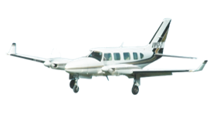
Methods: LiDAR Processing
USGS & NEON
GIS
Data Acquisition
Pre-Processing
Obtain Bare Earth Terrain DTM Products from Various Organizations, including:
United States Geological Survey
National Ecological Observatory Network
Cold Regions Research & Engineering Laboratory
NASA Arctic Boreal and Vulnerability Experiment
Georeference & Reproject Datasets
Mosaic Raster Datasets
Resample Raster Cell Size to Uniform Scale for Validation
Data Analysis
Create Deformation Maps
Conduct Time Series Analysis
Complete UAVSAR & C-SAR Validation
Credit: John Davies, 2004
Notes:
LiDAR coverage was acquired from multiple datasets, including the:
1) USGS - 2017 USGS LiDAR point cloud data and DTMs/DEMs over Fairbanks were obtained from the Alaska Elevation Portal.
2) NEON - https://data.neonscience.org/data-products/DP3.30024.001... Discrete LiDAR derived annual DTMs/DEMs from 2017 to 2019 at Alaska's five NSF NEON research stations were obtained from the NEON Data Portal.
3) CRREL - Pre-processed DTMs/DEMs from 2014 and 2016 were obtained through file transfer with the CRREL Permafrost Tunnel Research Facility.
4) NASA ABoVE – G-LiHT Portal
LiDAR DTM/DEM products were then georeferenced, mosaicked into rasters, and deformation maps were calculated from the difference of LiDARs collected of the same area from two different times. To then proceed onto the cross-platform validation processing, the raster data was then upscaled to the same pixel size as the Sentinel-1 data as that dataset is a lower resolution.
------------------------------Image Information Below ------------------------------ (1)
- Image Credit: John Davies- CYOW Airport Watch (2004)
- Image Description: UAV LiDAR surveys over Fairbanks commissioned by USGS were completed by Quantum Spatial using a Leica ALS70 system mounted to a Piper PA-31-350 aircraft.
-License Info- Permission is granted to copy, distribute, and/or modify this document under the terms of the GNU Free Documentation License
- Image Source: https://commons.wikimedia.org/wiki/File:Piper_PA-31-..._Navajo_...,_West_Capital_Aviation_AN0644817.jpg

Slide 17
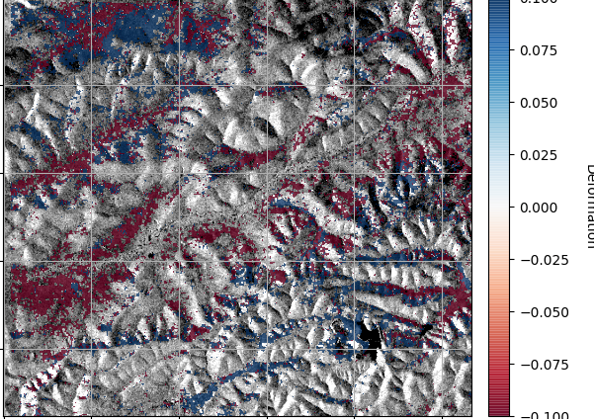
Methods: Deformation Analysis
Sentinel-1
2017 May-Sept Deformation Near Caribou Creek
.10
.10
Seasonal/Annual Deformation
Identify Areas of Consistent Change
Magnitude of Change
Spatial & Temporal Patterns
Basis for Risk Assessment
.05
Deformation (mm)
0.0
- .05
- .10
Notes:
Our methodology is intended to detect possible areas of deformation and later correlate them with proximity to critical infrastructure. In order to do this, we must first focus on assessing the deformation alone. To do so, we will evaluate the seasonal deformation by identifying areas of persistent change through time, the magnitude of these changes, spatiotemporal patterns that emerge, and ultimately use this as the basis for our risk assessment.
------------------------------Image Information Below ------------------------------
•Image Credit: DEVELOPer Katie Lange
•Image Source: Created by Katie Lange in OpenSARLab

Slide 18
Methods: Cross-Platform Analysis
Pairwise root mean square error
Pairwise difference in difference
Spatial correlation and covariance
UAVSAR
COMPARISON
LiDAR
UAVSAR
Root mean square error
Spatial Correlation
Quantify the accuracy of satellite data to detect surface subsidence as compared to airborne sensors
Sentinel-1
VALIDATION
LiDAR
Notes:
To assess the accuracy and validity of Sentinel-1 for detecting surface deformation, a pairwise comparison was employed across all three platforms. With this approach, we quantified the differences between each platform using a Pairwise RMSE, Difference in Difference, and Raster Quotient Ratio to determine the degree to which differences are detected across platforms. Note, in order to perform this analysis, both UAVSAR and LiDAR resolutions were downgraded to a common resolution of the Sentinel-1 platform in order to make direct raster comparisons. Sentinel-1 is ultimately the validation case, driven by its consistent spatio-temporal coverage over the study area, and the rest of the Arctic.
------------------------------Image Information Below ------------------------------ (1)
- Image Credit: Rama (2012)
- Image Description: The C-SAR instrument on ESA's Sentinel-1 satellite is an active phased array antenna that provides polarized SAR imagery with a 5m resolution and 400 km swath, in all weather, day or night.
- Image Source: https://en.wikipedia.org/wiki/File:Sentinel_1-IMG_5874-white.jpg
-License Info: Wikimedia Commons and Creative Commons Attribution-Share Alike 2.0
------------------------------Image Information Below ------------------------------ (2)
- Image Credit: NASA Jet Propulsion Laboratory
- Image Description: Polarimetric L-Band SAR data was obtained from the JPL UAVSAR Program's Gulfstream III, a modified business jet equipped with SAR sensors specifically designed for differential interferometric measurements.
-License Info- Public Domain, images on public JPL websites may be used for any purpose without prior permission
- Image Source: https://uavsar.jpl.nasa.gov/education/what-is-uavsar.html
------------------------------Image Information Below ------------------------------ (3)
- Image Credit: John Davies- CYOW Airport Watch (2004)
- Image Description: UAV LiDAR surveys over Fairbanks commissioned by USGS were completed by Quantum Spatial using a Leica ALS70 system mounted to a Piper PA-31-350 aircraft.
-License Info- Permission is granted to copy, distribute, and/or modify this document under the terms of the GNU Free Documentation License
- Image Source: https://commons.wikimedia.org/wiki/File:Piper_PA-31-..._Navajo_...,_West_Capital_Aviation_AN0644817.jpg

Slide 19
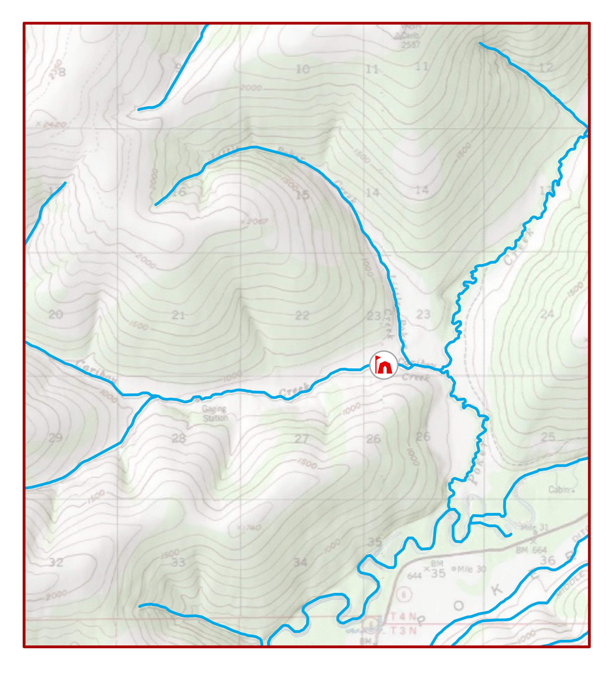
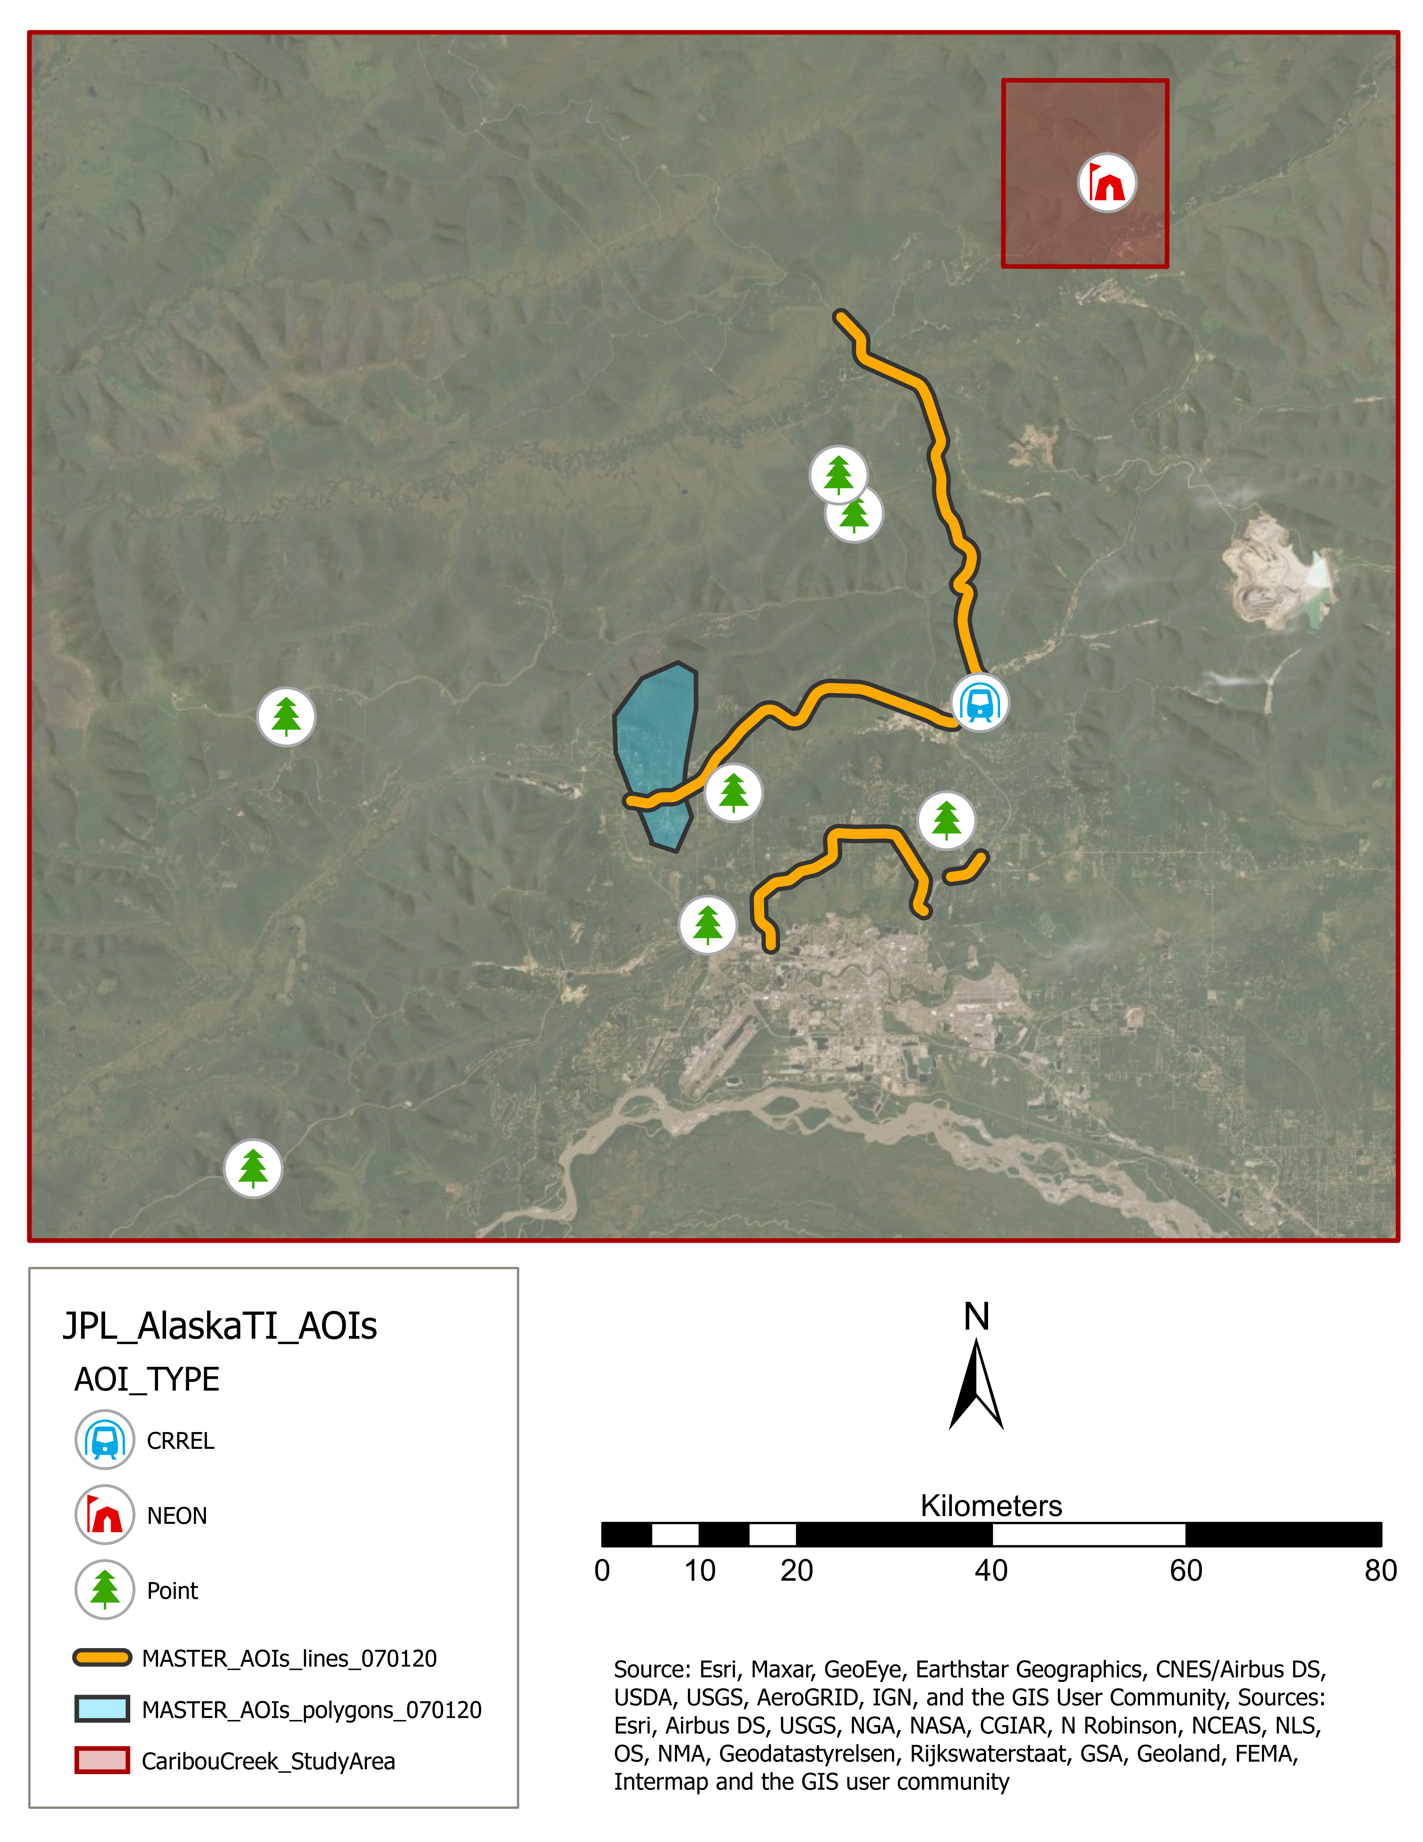
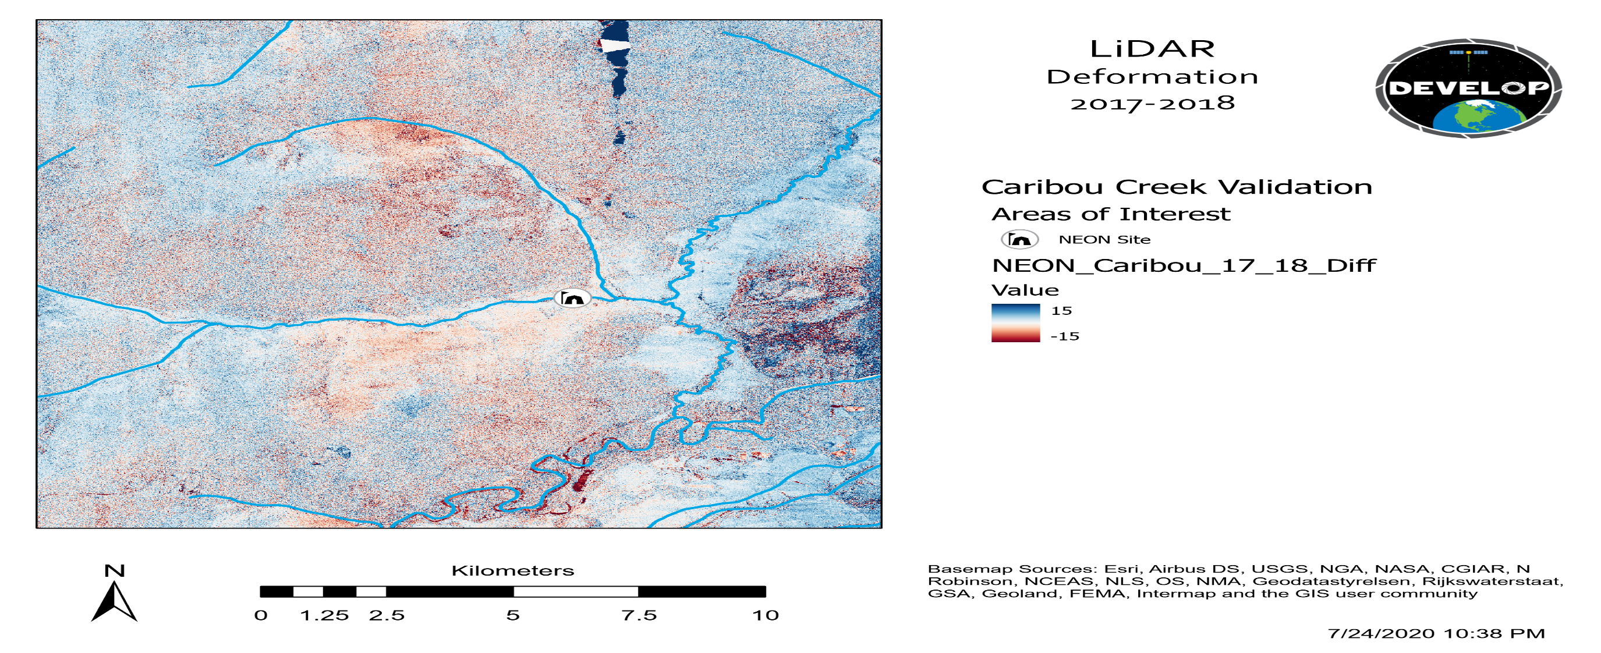
Results
Caribou Creek Study Area
1. Deformation Analysis
Areas of Interest
Sentinel-1
UAVSAR
LiDAR
CRREL Site
Fairbanks Study Area
NEON Site
ADNR Site
Poker Creek
Sentinel-1
UAVSAR
LiDAR
Road
ADNR Area
Sentinel-1
UAVSAR
LiDAR
Study Area
Caribou
Creek
NEON Site
2. Cross-Platform Analysis
Fairbanks
Sentinel-1
UAVSAR
LiDAR
River
KILOMETERS
N
Chatanika
Sentinel-1
UAVSAR
LiDAR
0
20
40
50
60
Sentinel-1
UAVSAR
LiDAR
KILOMETERS
0 km
5 km
10 km
Notes:
Results in the following slides will be presented first individually as stand-alone deformation analyses and then we will investigate cross-platform comparisons. Our initial analysis is focused on the caribou creek study area; a subset of the Fairbanks study area. This area was selected to allow for the greatest overlap in spatial and repeat temporal coverage.
------------------------------Image Information Below ---------------------------
- Image Credit: Esri, Airbus DS, USGS, NGA, NASA, CGIAR, N Robinson, NCEAS, NLS, OS, NMA, Geodatastylerelsen, Rijkswaterstaat, GSA, Geoland, FEMA, Intermap and the GIS user community
- Image Descr.: Alaska Statewide Context basemap (Hillshade) *** Not visible in this map's scale ***
- Image Source: Esri ArcGIS Pro

Slide 20
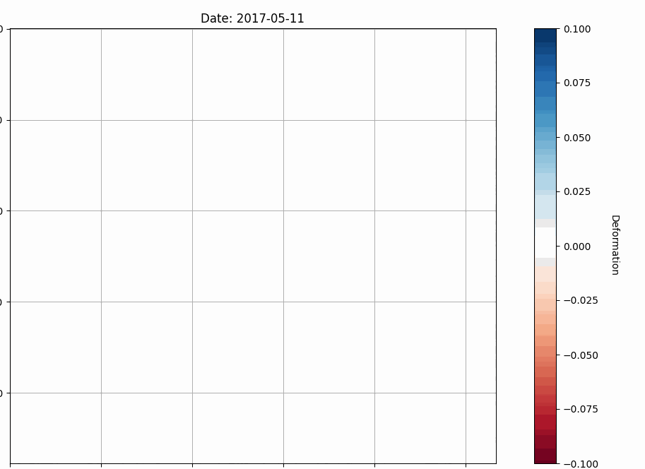
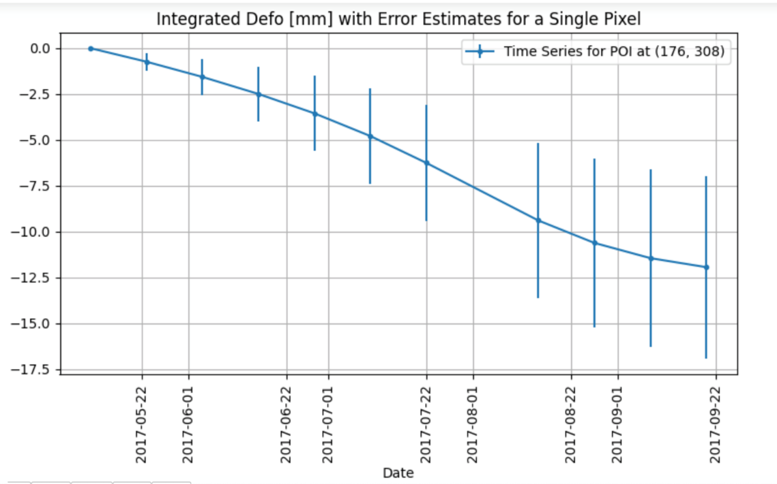
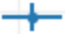
Results: Sentinel-1
Sentinel-1
UAVSAR
LiDAR
Caribou Creek
.10
Sentinel-1 Deformation (May-September 2017)
for a Single Pixel at Caribou Creek
.05
0.0
Time Series
-5.0
Deformation (mm)
0.0
Relative Deformation (mm)
-10.0
-15.0
-.05
5-22
6-22
7-22
8-22
9-22
Date
-.10
Notes:
The time series analysis created from Sentinel-1 2017 May to September shows a trend of deformation at the Caribou creek validation site. The graph shows a maximum deformation of -12 mm in late September. This trend was also observed in 2018 and 2019.
------------------------------Image Information Below ------------------------------
•Image Credit: DEVELOPer Katie Lange
•Image Source: Created by Katie Lange in OpenSARLab

Slide 21
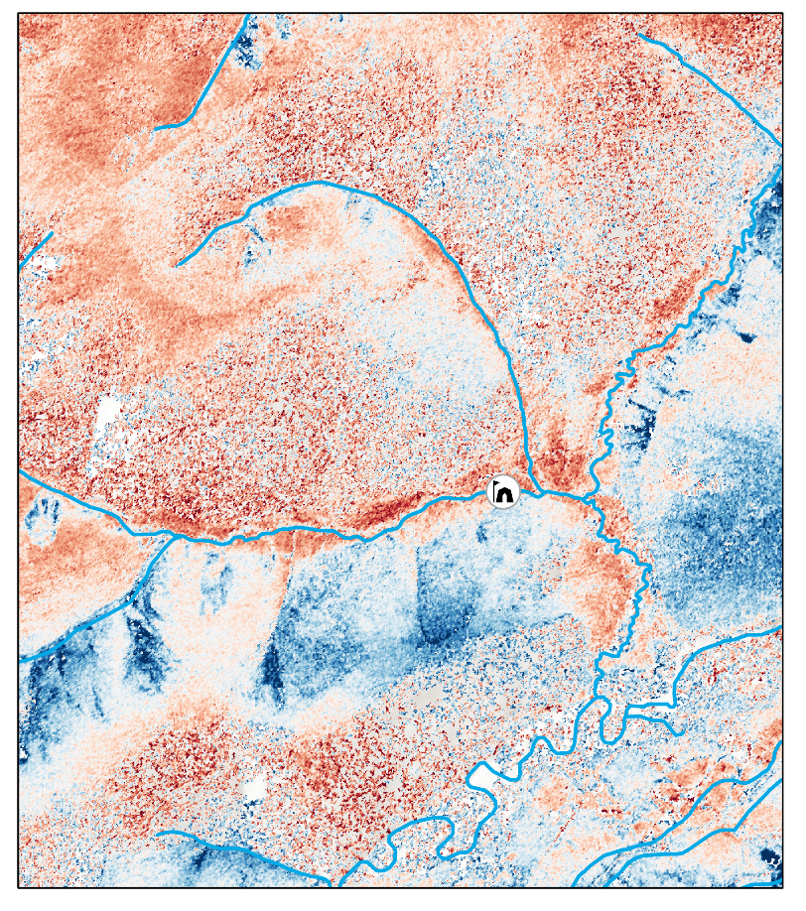
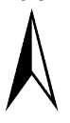
Results: UAVSAR
Sentinel-1
UAVSAR
LiDAR
Caribou Creek
N
UAVSAR Deformation 2017-2018
  Area surrounding Caribou Creek
  Notable deformation along slope angle gradients (riverbanks, steep hillsides)
  Terrain complexity adds to ‘speckling’ effect in pixel variability
UAVSAR Relative Deformation ('17-'18)
NEON Site
Deformation (mm)
150
-150
0 km
5 km
10 km
Notes:
UAVSAR Deformation is observed to occur along riverbanks and following terrain features. Deformation of up to 150 millimeters is observed in different areas across the study domain.
------------------------------Image Information Below ------------------------------
•Image Credit: NASA DEVELOP
•Image Source: No Basemap

Slide 22
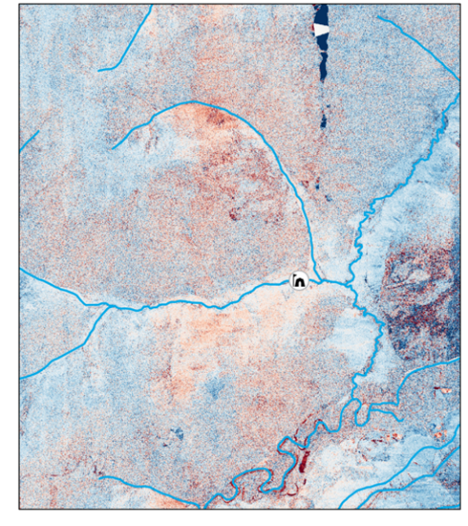
Results: LiDAR
Sentinel-1
UAVSAR
LiDAR
Caribou Creek
N
LiDAR Deformation 2017-2018
  Area Surrounding Caribou Creek
  Notable deformation occurring along riverbanks and in valleys
  Highest resolution dataset used for baseline validation
LiDAR Relative Deformation ('17-'18)
NEON Site
Deformation (mm)
150
-150
0 km
5 km
10 km
Notes:
The 2017 and 2018 LiDAR deformation map at 1m resolution shows deformation primarily occurring along rivers and in valleys. This map shows deformation surrounding the Caribou Creek.
------------------------------Image Information Below ------------------------------
•Image Credit: NASA DEVELOP
•Image Source: No Basemap

Slide 23

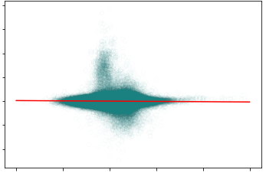

Results: Comparison
Sentinel-1
UAVSAR
LiDAR
Caribou Creek
LiDAR vs. UAVSAR
Root Mean Square Error
UAVSAR
LiDAR
N
N
8
6
RMSE = 13 mm
4
2
LiDAR (mm)
0
-2
-4
-10
-5
0
5
10
15
UAVSAR (mm)
0 km
5 km
10 km
0 km
5 km
10 km
Notes:
Cross-platform comparison of UAVSAR and baseline LiDAR dataset demonstrate at 13 mm root mean square error. Qualitatively, we observe similar spatial patterns in the seasonal deformation represented in both images. Note deformation is based on relative change over the course of the observed time period. Red indicates deformation.
------------------------------Image Information Below ------------------------------
•Image Credit: NASA DEVELOP
•Image Source: No Basemap

Slide 24
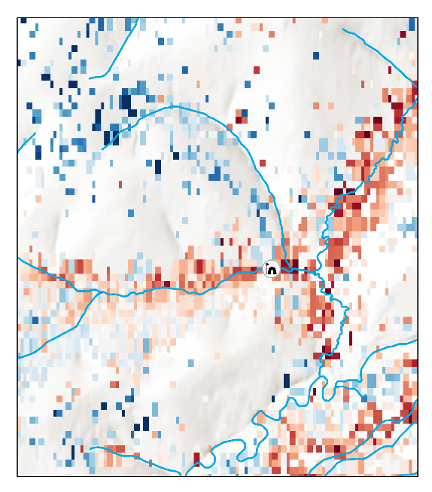
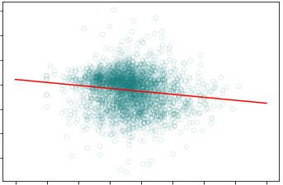
Results: Comparison
Sentinel-1
UAVSAR
LiDAR
Caribou Creek
LiDAR vs. Sentinel-1
Root Mean Square Error
Sentinel -1
LiDAR
N
N
50
RMSE = 21 mm
0
LiDAR (mm)
-50
-20
0
20
Sentinel-1(mm)
0 km
5 km
10 km
0 km
5 km
10 km
Notes:
The Sentinel-1 and LiDAR root mean square error was calculated to be 21 mm. LiDAR was resampled to match Sentinel-1 C-SAR resolution for direct comparison. The 80m pixel size of Sentinel-1 C-SAR and 1m pixel size of LiDAR introduces an uncertainty in their comparison. However, they visually show the same trend of deformation occurring in valleys and along riverbeds. Note that Red colors indicate deformation.
------------------------------Image Information Below ------------------------------
•Image Credit: NASA DEVELOP
•Image Source: No Basemap

Slide 25
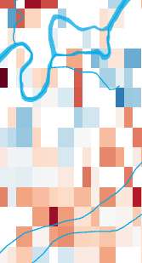
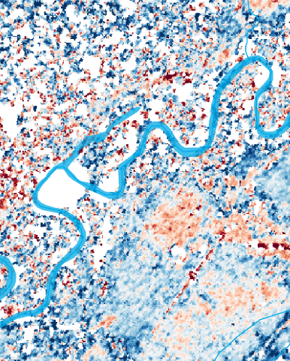
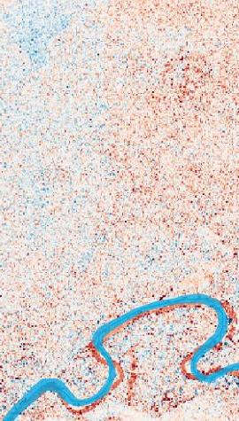
Results: Validation
Sentinel-1
UAVSAR
LiDAR
Notes:
In this slide you can see the resolution differences between platforms (from left to right: Sentinel-1, UAVSAR, LiDAR). High detail can be observed in LiDAR and UAVSAR while larger 80m resolution Sentinel-1 C-SAR data detects deformation but in less detail.
------------------------------Image Information Below ------------------------------
- Image Credit: Satellite Imagery Basemap
- Image Source: Esri, Maxar, GeoEye, Earthstar Geographics, CNES/Airbus, USDA, USGS, AeorGRID, IGN, and the GIS User Community

Slide 26
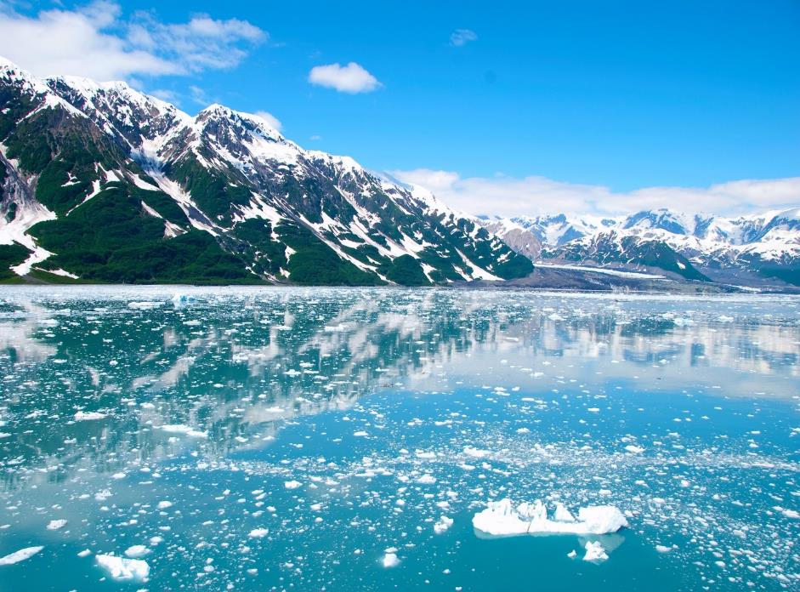
Conclusions
UAVSAR
  RMSE of 13mm compared to LiDAR
  Similar spatial patterns and magnitude of deformation compared to LIDAR
  Higher resolution imagery enables improved identification of deformation features
  Limited coverage of UAVSAR compared to Sentinel-1 C-SAR
Sentinel-1 C-SAR
  RMSE of 21mm compared to LiDAR
  80m resolution limits identification of deformation features
  UAVSAR and Lidar comparisons show:
- similar orders of magnitude deformation
similar spatial patterns of deformation
Smaller resolution of UAVSAR allows us to see slumping and deformation features
-RMSE of UAVSAR and LiDAR
LiDAR and Sentinel
RMSE
Credit: Jacqueline Schmid
Notes:
In this project, we found the UAVSAR and LiDAR Root Mean Square Error (RMSE) to be 13 mm. Similar spatial patterns and magnitude of deformation compared to LiDAR. The higher resolution of UAVSAR enables identification of deformation features. UAVSAR has the potential to accurately map permafrost thaw and subsequent surface deformation. However, limited temporal and spatial coverage of UAVSAR inhibits a comprehensive identification of permafrost thaw in the entire state of Alaska. Sentinel-1 C-SAR and LiDAR had a Root Mean Square Error (RMSE) of 22 mm. The 80m resolution limits identification of deformation features, however similar spatial patterns of deformation were observed.
------------------------------Image Information Below ------------------------------
- Image Credit: Jacqueline Schmid, 2015
- Image Description:
- Image Source: https://pixabay.com/photos/alaska-glacier-ice-mountains-810433/

Slide 27
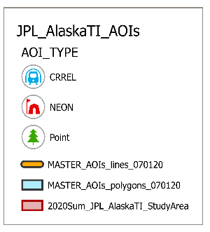



Conclusions
  Earth Observation
    Sentinel-1 C-SAR can be used to identify road & infrastructure vulnerability on a large scale
  Project Partners
    Can identify and prioritize areas experiencing the highest intensity of permafrost deformation
    The PerMA (Permafrost Measurement and Analysis) module can be used to automate processing and deformation detection of Sentinel-1, UAVSAR, and LiDAR
Areas of Interest
Caribou Creek Site
CRREL Site
NEON Site
ADNR Site
Road
ADNR Area
Study Area
Permafrost
Tunnel
Fairbanks
N
KILOMETERS
0
10
20
40
60
80
Credit (right): Esri, Airbus DS, USGS, NGA, NASA, CGIAR, N Robinson, NCEAS, NLS, OS, NMA, Geodatastylerelsen, Rijkswaterstaat, GSA, Geoland, FEMA, Intermap and the GIS user community
Notes:
Now that we have validated that Seninel-1 has similar spatial patterns of deformation as compared to the more "ground truth-ed" UAVSAR and LiDAR data in the Caribou Creek area, we expanded our analysis to the entirety of the Fairbanks study area. Our partners designated four roads of interest (totaling ~80 miles), the O'Coinnor Creek watershed, and eight environmental locations (including known landslides and areas of thermokarst). Using Sentinel-1 data is beneficial for analyzing such a large area because the airborne LiDAR and UAVSAR sensors are temporally and spatially limited across the study area. Sentinel-1 has 12 day repeat coverage so we can track seasonal and annual changes in the surface across the entire study area.
Project partners can now use the PerMA (Permafrost Measurement and Analysis) module to automate the of UAVSAR and LiDAR data, and deformation detection of Sentinel-1, UAVSAR, and LiDAR for future use.
------------------------------Image Information Below ------------------------------ (1)
- Image Credit: Esri, Airbus DS, USGS, NGA, NASA, CGIAR, N Robinson, NCEAS, NLS, OS, NMA, Geodatastylerelsen, Rijkswaterstaat, GSA, Geoland, FEMA, Intermap and the GIS user community
- Image Descr.: Alaska Statewide Context basemap (Hillshade) *** Not visible in this map's scale ***
- Image Source: Esri ArcGIS Pro

Slide 28
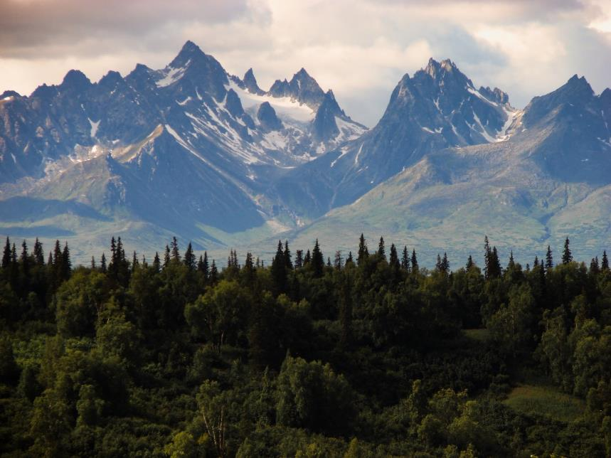
Limitations & Errors
LIMITATIONS
  Temporally & spatially sparse LiDAR
  Temporally & spatially sparse UAVSAR
  Unprocessed UAVSAR pairs
  Upscaling raster data to sentinel scale
ERRORS
  Decorrelation of UAVSAR coverage over water features and forests
  UAVSAR long range tilt in 2018 & 2019
  Relative deformation vs. absolute deformation
Credit: Skitterphoto
Notes:
This project was limited due to compromised LiDAR data in 2018, and the temporally and spatially sparse repeat coverage of LiDAR. Our validation area was reduced due to this limitation. This project was also limited due to upscaling UAVSAR and LiDAR to match Sentinel-1 resolution. Pixel values were grouped and averaged in this method; however, this step was necessary to validate across platforms. This project encountered an error in the 2018/2019 UAVSAR swath were there was a long-range tilt error. Additionally, coherence issues were observed in UAVSAR data over water features and forested land.
------------------------------Image Information Below ------------------------------
- Image Credit: Username: Skitterphoto (2015)
- Image Description: Green trees in Alaska
- Image Source: https://www.pexels.com/photo/wood-landscape-mountains-nature-792/

Slide 29
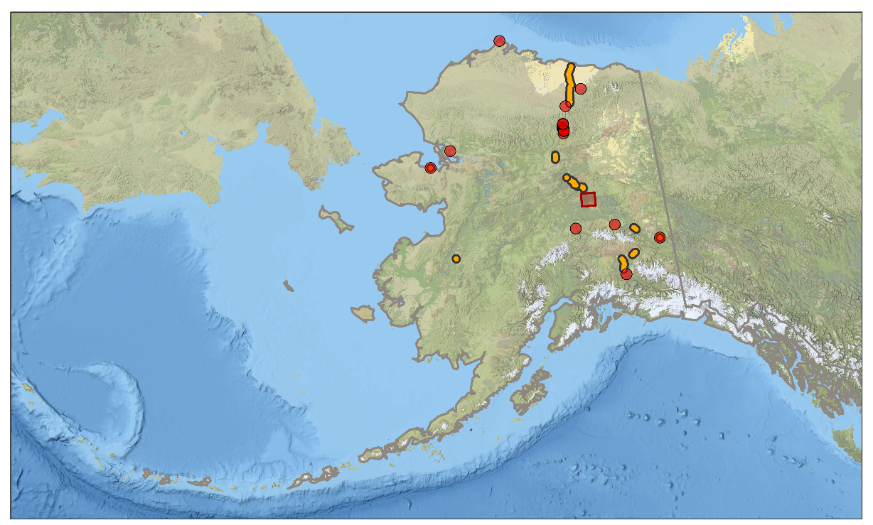
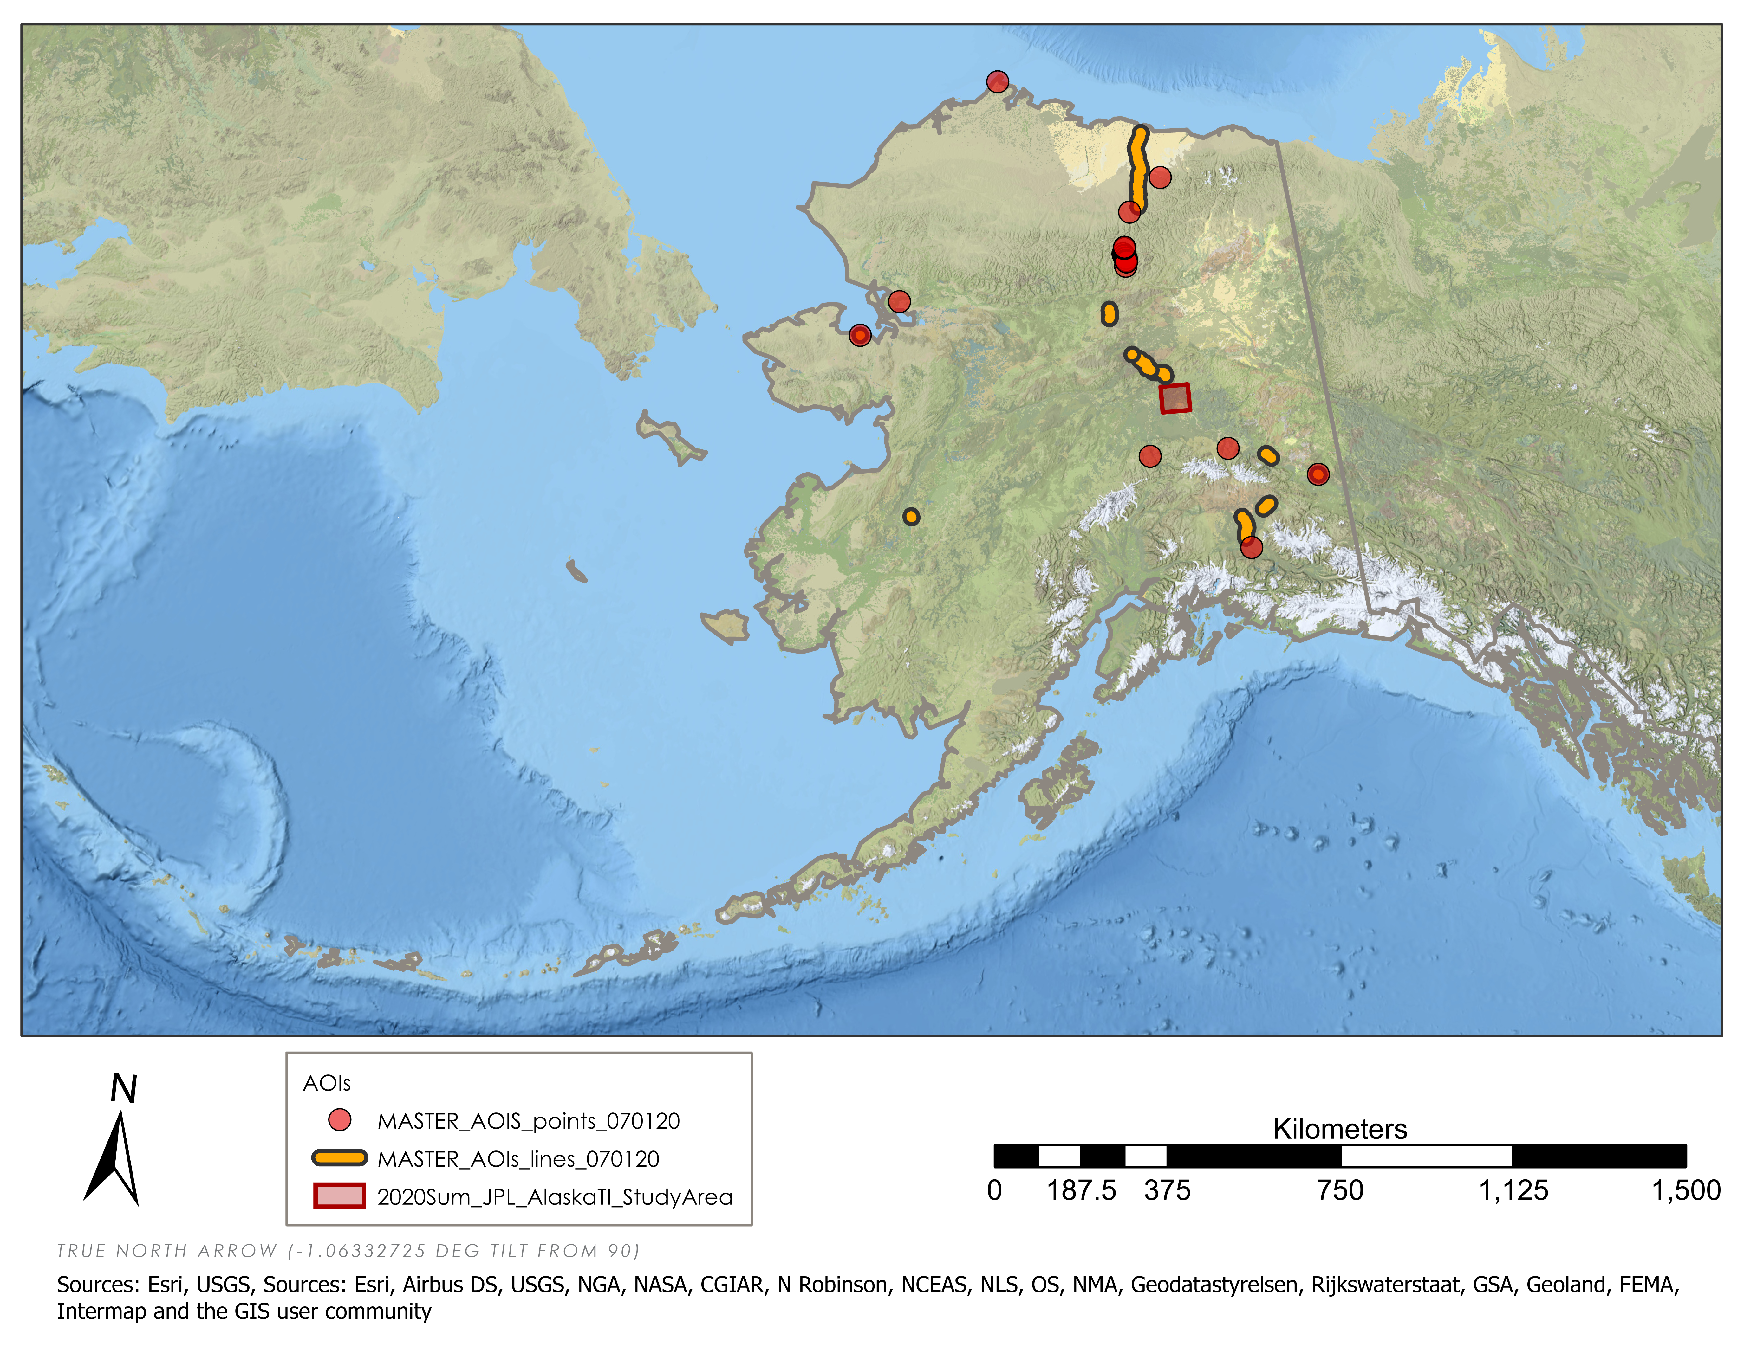
Future Work
EXPAND study to Areas Of Interest (AOI) beyond the Fairbanks region
FURTHER comparison with additional repeat LiDAR
EXPAND the automated InSAR, UAVSAR, LiDAR processing tool (PerMA)
STUDY the effect of underlying geology and soil on permafrost thaw
Barrow
Statewide Areas of Interest
Locations
Roads
Summer 2020 Study Area
Bering Sea
Gulf of Alaska
N
Kilometers
Credit: Esri, USGS
0
375
750
1,125
1,500
Notes:
This project may be expanded upon in the future by identifying areas of permafrost thaw and thermokarst formation outside of the Fairbanks area. Additionally, further comparison can be done with LiDAR with additional repeat pass data. Lastly, an automated InSAR processing tool could be created to streamline workflow and complete further analysis.
------------------------------Image Information Below -----------------------------------
- Image Credit: Esri, USGS
- Image Descr.: Alaska Statewide Context basemap (National Geographic)
- Image Source: Esri ArcGIS Pro

Slide 30
Advisors
Dr. Bruce Chapman (NASA Jet Propulsion Laboratory, California Institute of Technology)
Mr. Ben Holt (NASA Jet Propulsion Laboratory, California Institute of Technology)
Mr. Cecil Byles (NASA DEVELOP JPL Lead/Fellow)
Project Partners
Dr. Tom Douglas (US Army Corps of Engineers, Cold Regions Research and Engineering Laboratory)
Dr. Chris Hiemstra (US Army Corps of Engineers, Cold Regions Research and Engineering Laboratory)
Mr. Garrett Speeter (Alaska Department of Transportation & Public Facilities)
Dr. Ronald Daanen (Alaska Department of Natural Resources)
Dr. Franz Meyer (Alaska Satellite Facility)
Special Thanks
Alex Lewandowski (Alaska Satellite Facility)
Soumitra Sakhalkar (University of Alaska Fairbanks)
This material contains modified Copernicus Sentinel data (2017-2020), processed by ESA. UAVSAR data courtesy NASA/JPL-Caltech.
Notes:
We would like thank our science advisor at the NASA Jet Propulsion Laboratory (JPL) for their guidance during this term and for providing the Earth observation data required for this study; Dr. Bruce Chapman. Additionally, a special thank you goes to Dr. Franz Meyer, Alex Lewandowski, and Soumitra Sakhalkar with the Alaska Satellite Facility and the University of Anchorage for his guidance in the use of OpenSARLab and HyP3. We also thank JPL’s Benjamin Holt and NASA DEVELOP Fellow Cecil Byles for their support throughout this study.

