Slide 1
Utilizing Reinforcement Learning to Learn Safe Conflict Resolution
Brandon Waddell
Swee Balachandran
Tanner Slagel
César Muñoz

Slide 2
Outline
Introduction
Formulation
Results
Comparison
Lessons learned
Conclusions

Slide 3
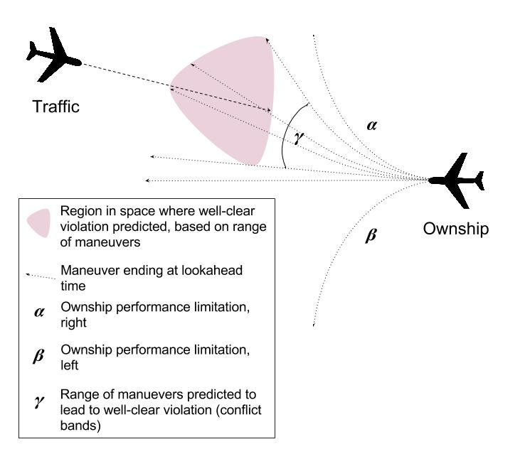
Problem Statement
Problem
  Intruder’s flight-plan could result in well clear violation
  Learn maneuvers to maintain separation
  Apply reinforcement learning
  Use DAIDALUS to ensure safe resolutions are learned
Resolve conflict
  Adjust heading
  Adjust speed
  Adjust altitude
  Adjust any combination of heading, speed, altitude
Return to mission after resolution
Notes:
Add picture to represent problem

Slide 4
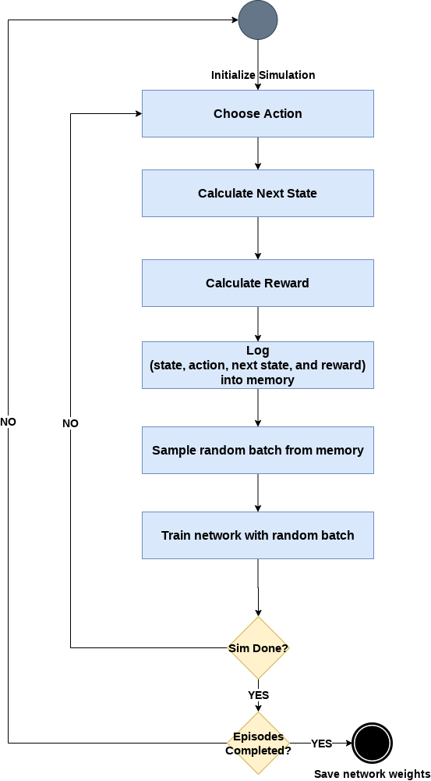
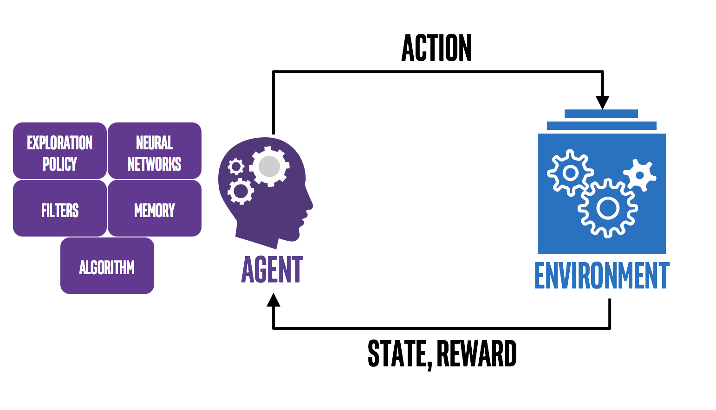
Reinforcement Learning
DQN Algorithm
Agent acts in an environment
Environment
  Returns new state to agent
  Rewards agent for action based on resulting state
Objective: Learn optimal action to maximize return for each state and action
Algorithm: Deep Q Learning (Q Iteration)
$$Q\left(s_{t},a_{t}\right)=Q\left(s_{t},a_{t}\right)+α(r_{t}+γ\max_{a}{Q\left(s_{t+1},a\right)})$$
image source: https://nervanasystems.github.io/coach
Notes:
Alpha learning rate
Gamma discount factor

Slide 5
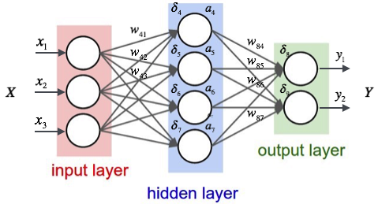
Controllers
Track controller
  Turn left (10 deg/s)
  Turn right (10 deg/s)
  Stay at current heading
Speed controller
  Accelerate (1 m/s)
  Decelerate (1 m/s)
  Keep current velocity
Altitude controller
  Ascend (1 m/s)
  Descend (1 m/s)
  Stay Level
Decision controller
  Use track controller
  Use speed controller
  Use altitude controller
DQN architecture:
Input layer, 2 hidden layers, output layer
Nodes per hidden layer: 150
Image source: https://medium.com/@raghavaggarwal0089/bi-lstm-bc3d68da8bd0
Notes:
Haven't decided if NN should be here or on previous slide

Slide 6

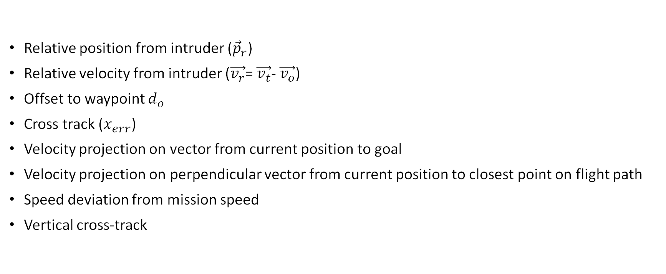




State Space
$${\vec{v}}_{t}$$
$${\vec{p}}_{r}$$
$${\vec{v}}_{o}$$
Relative position from intruder (${\vec{p}}_{r}$)
Relative velocity from intruder ($\vec{v_{r}}$= $\vec{v_{t}}$- $\vec{v_{o}}$)
Offset to waypoint $d_{o}$
Cross track ($x_{err}$)
Velocity projection on vector from current position to goal
Velocity projection on perpendicular vector from current position to closest point on flight path
Speed deviation from mission speed
Vertical cross-track
$$x_{err}$$
$$d_{o}$$
Notes:
Why can't I add formula to powerpoint

Slide 7
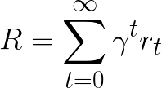
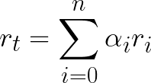

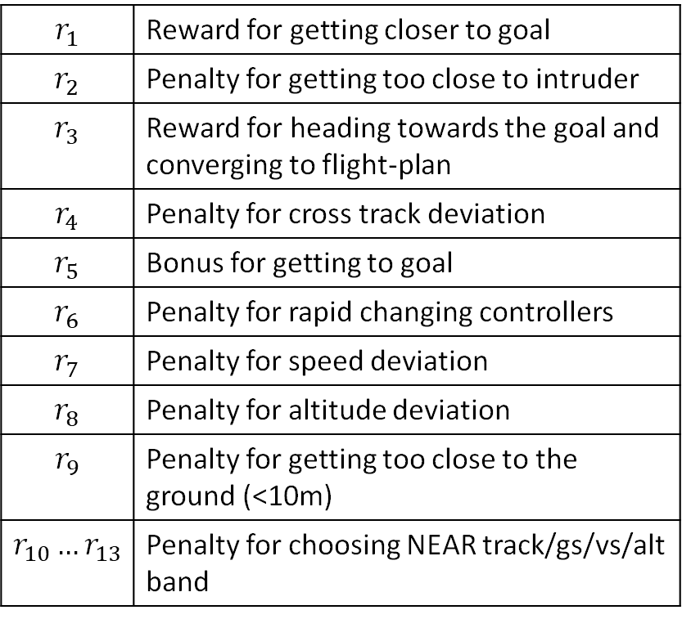

Reward Formulation
$$r_{1}$$ | Reward for getting closer to goal
$$r_{2}$$ | Penalty for getting too close to intruder
$$r_{3}$$ | Reward for heading towards the goal and converging to flight-plan
$$r_{4}$$ | Penalty for cross track deviation
$$r_{5}$$ | Bonus for getting to goal
$$r_{6}$$ | Penalty for rapid changing controllers
$$r_{7}$$ | Penalty for speed deviation
$$r_{8}$$ | Penalty for altitude deviation
$$r_{9}$$ | Penalty for getting too close to the ground (<10m)
$$r_{10}…r_{13}$$ | Penalty for choosing NEAR track/gs/vs/alt band
$$α_{i}>0$$
Reward
$$α_{i}<0$$
Penalty
DAIDALUS bands help determine this penalty

Slide 8
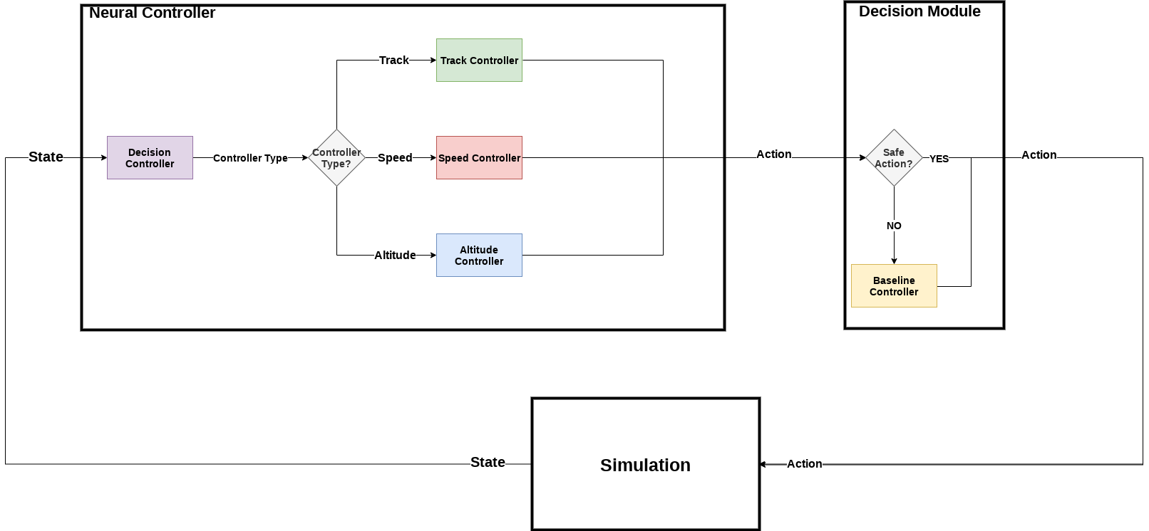
Simplex Architecture and Decision Controller

Slide 9
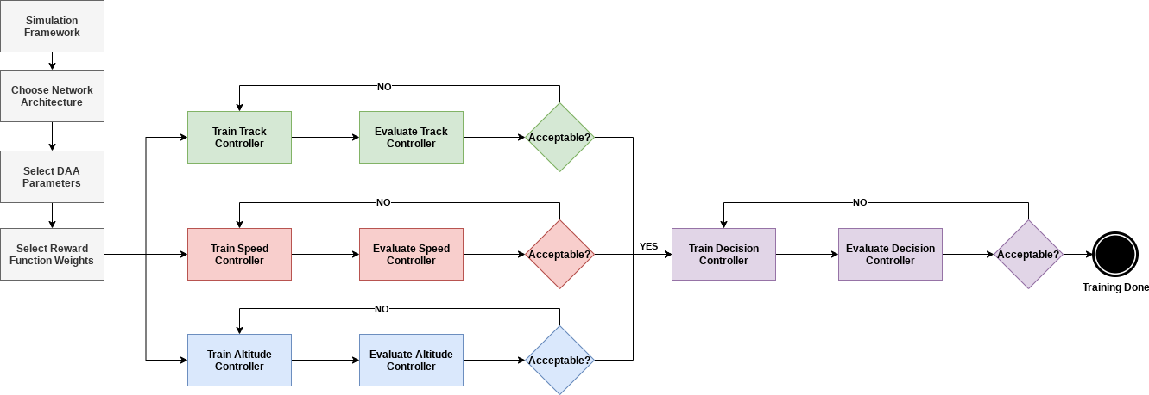
Training Pipeline

Slide 10
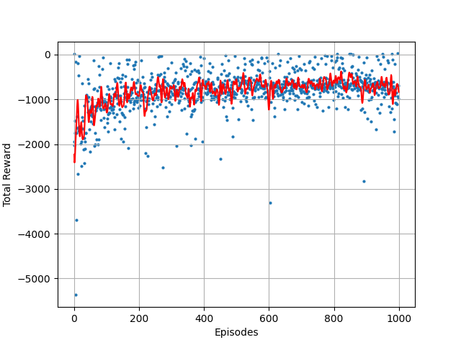
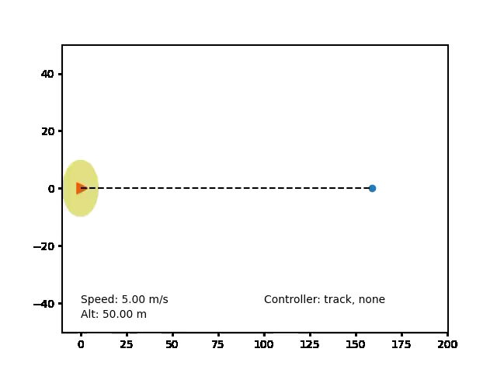
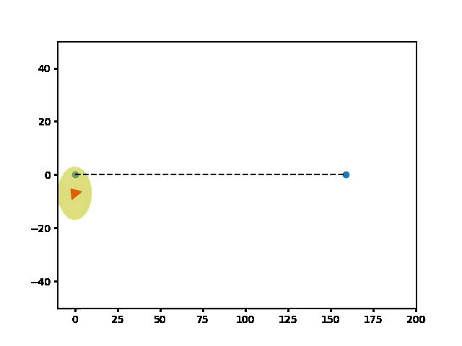

Training Progress
Pre-Training
Mid-Training
Post-Training (after 1000 episodes)

Slide 11

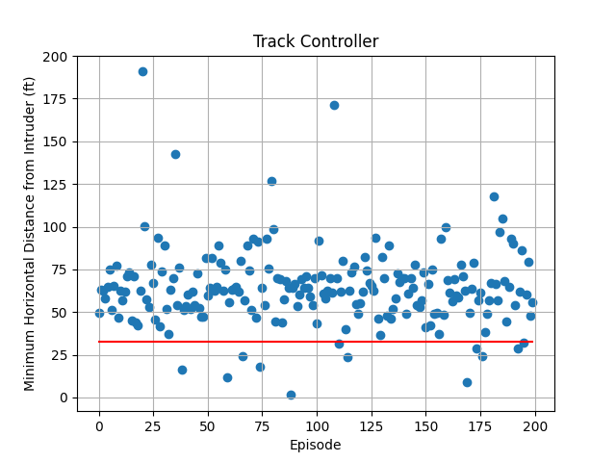
Results: Track Controller
Total training episodes: 3000
Well clear violation threshold: 30 ft
Well clear violations: 6.0%
Way-point reached: 79.5%
Notes:
Some points are close to the threshold, severity of loss of well clear
Even though there are 6.0% well clear violations, not all are severe. Roughly 50-60%, severity is less than 70%

Slide 12
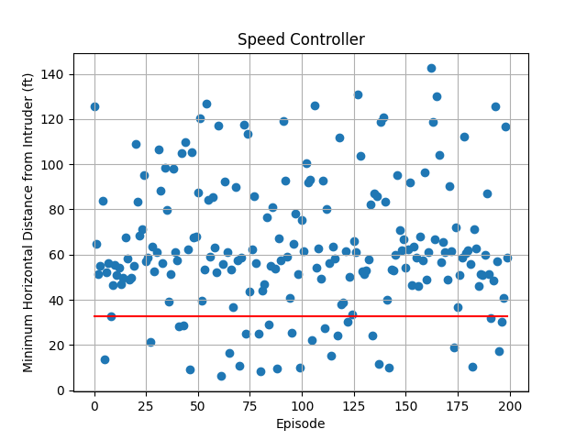
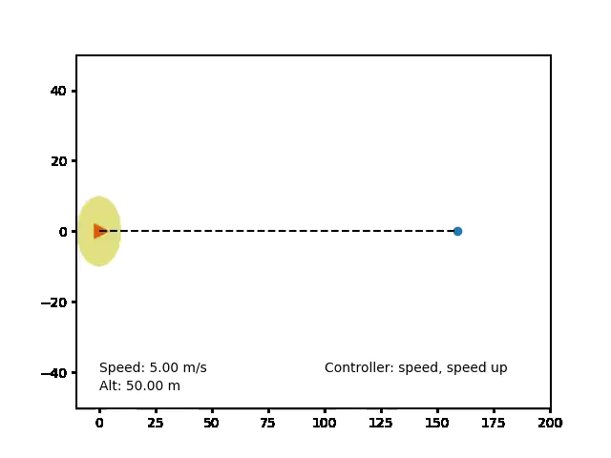
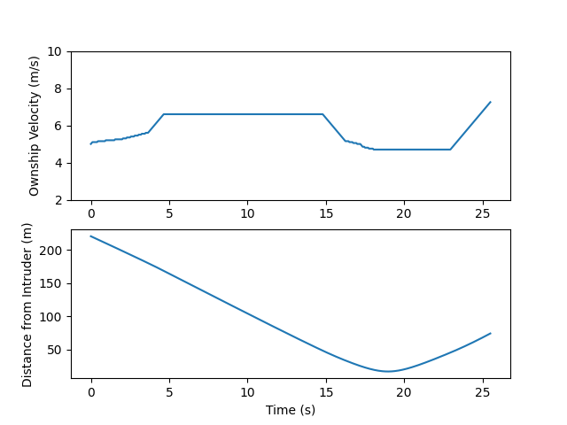
Results: Speed Controller
Total training episodes: 3000
Well clear violation threshold: 30 ft
Ownship velocity vs distance from intruder
Well clear violation: 14.5%
Way-point reached: 100%
Notes:
Talk about why well clear violations are higher

Slide 13
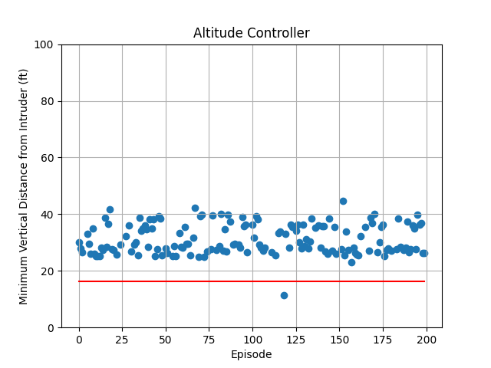
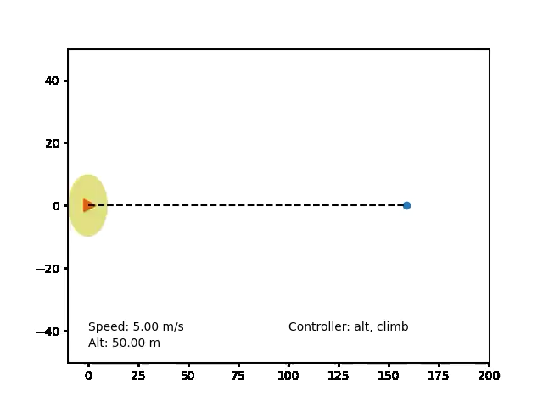
Results: Altitude Controller
Total training episodes: 3000
Well clear violation threshold
Well clear violation: 0.5%
Way-point reached: 76.5%

Slide 14
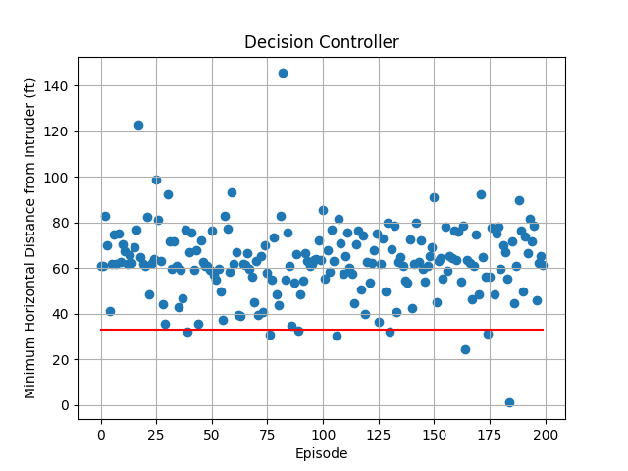

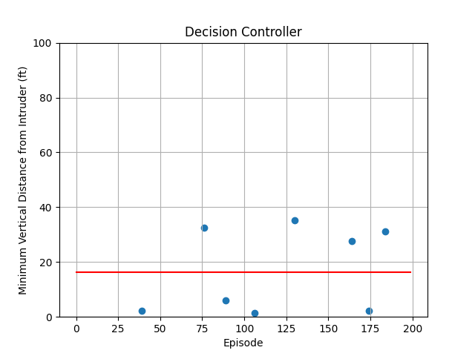
Results: Decision Controller
Total training episodes: 3000
Horizontal penetration of well clear
If horizontal penetration
  Calculate vertical penetration
Well Clear violation: 2.0%
Way-point reached: 72.0%

Slide 15
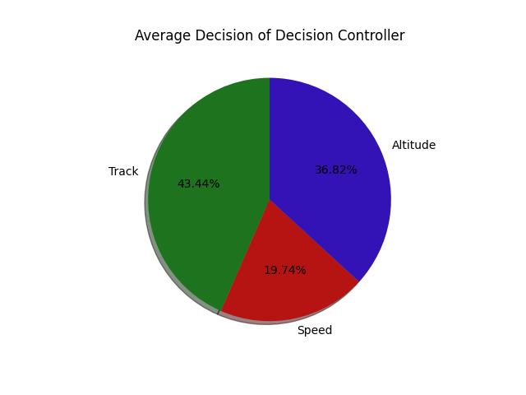
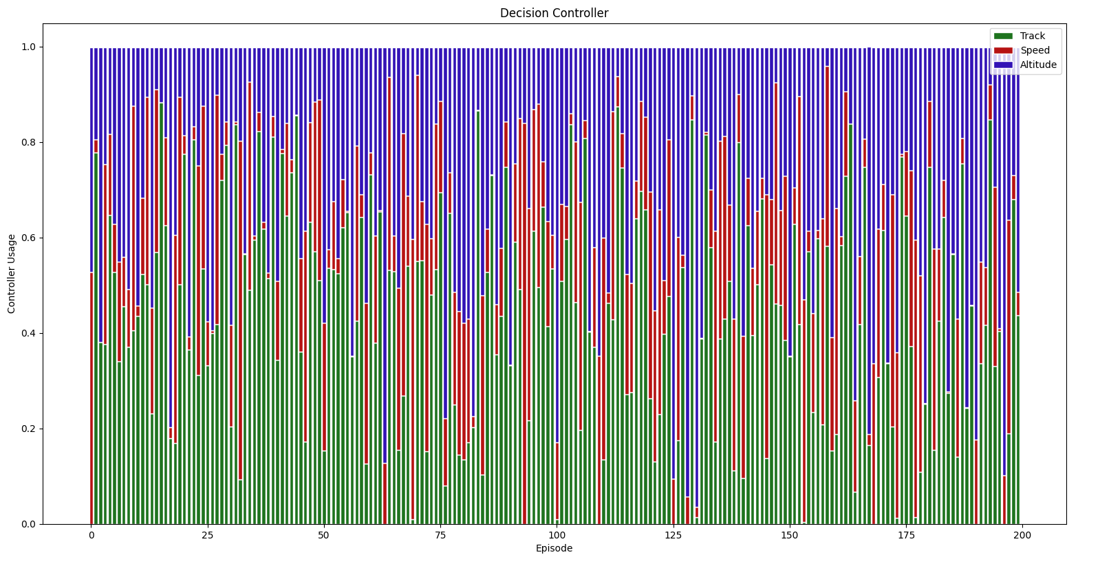
Controller Usage of Decision Controller
Track Controller: 43.44%
Speed Controller: 19.74%
Altitude Controller: 36.82%

Slide 16

Lessons Learned
  Emergent behavior
    Hard to encode algorithmically using logic
  Safe resolutions
    Used DAIDALUS bands as a supervisor to encourage learning of safe resolutions
    Individual controllers need to be trained sufficiently for the simplex architecture to be successful
  Takes several episodes (>5000 episodes) of learning.
    Time taken for 3000 episodes
      Track, speed and altitude: ~ 30 Hours
      Decision controller: ~40 Hours

Slide 17
Conclusion
Summary
  Use DQN and DAIDALUS to help learn safe resolution procedures
  Preliminary results indicate that you can use machine learning
Future work:
  Hyper parameter optimization
    Network architecture
    Learning rate
  Tune reward function and reward function weights
  Gaining confidence in the network outputs for deployment in flights
  Increase number of intruders in the airspace

