Slide 1
WEARABLE PROTECTIVE TECHNOLOGIES
Nicole A. Dugan
Mentors: Sheila A. Thibeault and Crystal D. Chamberlain
Summer 2020 NIFS Internship Program
August 7, 2020

Slide 2
OBJECTIVE | CHALLENGE
This is a continuation of my previous work in the spring to create new headgear designs that would protect astronauts on space missions from SPEs (solar particle events).
The design should accommodate enough radiation shielding to have an areal density of 2 g/cm2.
The design should cover the forehead and not create any gaps in protection between the hood and neckline of our protective garment.

Slide 3
APPROACH
This semester I focused on creating prototypes.
I started with the pattern that I created last semester based on our design constraints, and I made several changes as I went along.
The materials I used throughout this process were cotton twill and denim for the outer shell and lining and inexpensive moving blankets to simulate the radiation shielding material.
I made two prototypes with 3 layers of moving blankets in each (for the simulated radiation shielding).

Slide 4
RESULTS
Version (bold indicates prototype with simulated radiation shielding inserted) | Modifications | Comments
1 | Original pattern, no change | Could not accommodate more than 1 layer of moving blanket
2 | Added 1” strip to outside connecting seam, outside 1 ½” larger than lining | Very uncomfortable around the neck when shielding was inserted
3 | Lowered neckline 2” | Made neckline wider, but extra length on hood was unnecessary
4 | Hood shortened to original length, 5 ¼” added to center panel at neckline, which was then angled out from original center panel shape | Much better fit than previous prototypes, but shoulder drape idea is something I shall revisit later
5 | Shoulder drape taken off | Simplified version of design that would be easier to manufacture under current Stage 3 conditions

Slide 5
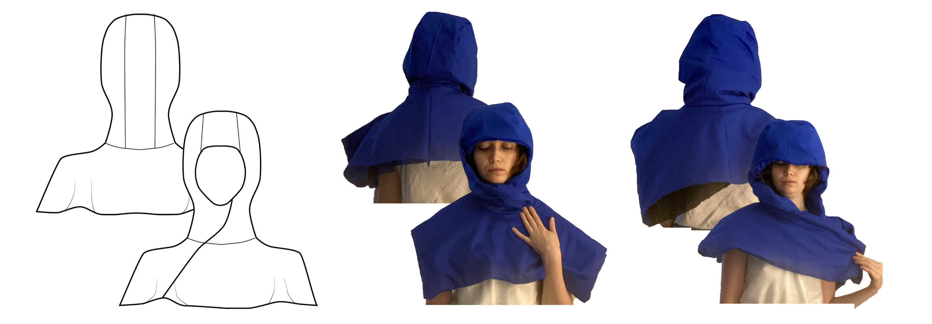
RESULTS
Front and back view of original design (tech flat)
Front and back of version 2 prototype without moving blankets
Front and back of version 2 prototype with moving blankets

Slide 6
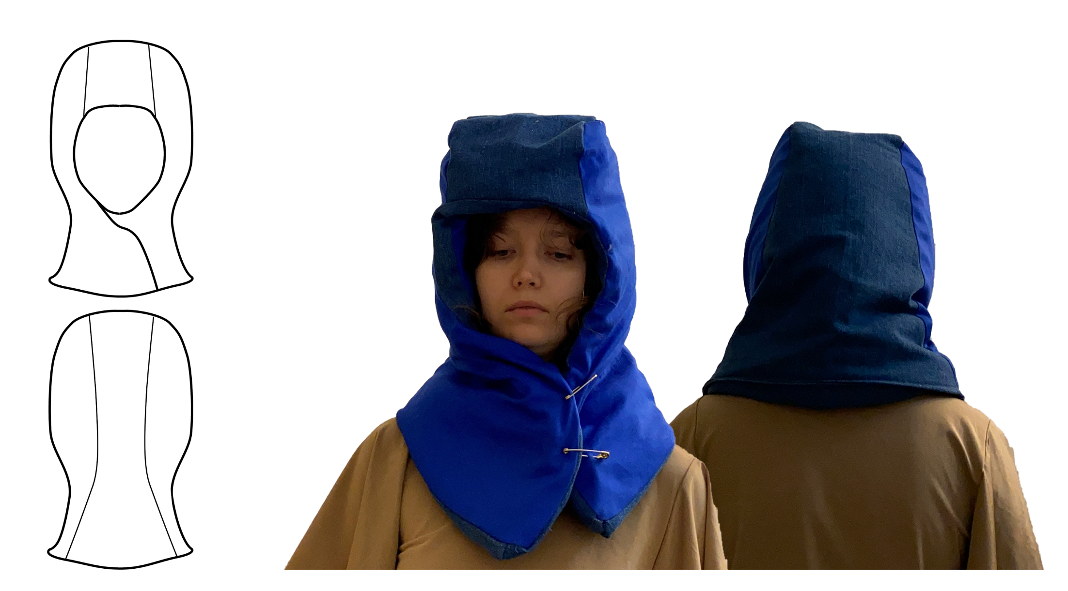
RESULTS
Front and back view of reshaped hood (tech flat)
Front and back of reshaped hood

Slide 7
SUMMARY | ANALYSIS | FUTURE WORK
I ran into more issues with incorporating radiation shielding into the prototypes than I expected.
Changing the angle of the center panel changed the fit of the hood completely.
Nothing is completely certain in these designs and concepts until the appropriate amount of radiation shielding is placed in a physical prototype.
The shoulder component of the headgear prototype is something I will return to for future work.

Slide 8
MASK EFFORT
I have been making masks since spring for Langley employees.
24 of my masks were delivered to Center.
They are Olson masks with fabric ties.

