Slide 1
Lightweight Regenerable CO₂-to-Power Conversion (RECOP) System for Safer Manned Missions
Bryson Clifford
Mentors: Dr. Yi Lin & Dr. John Connell
2020 Summer NIFS Research Symposium

Slide 2
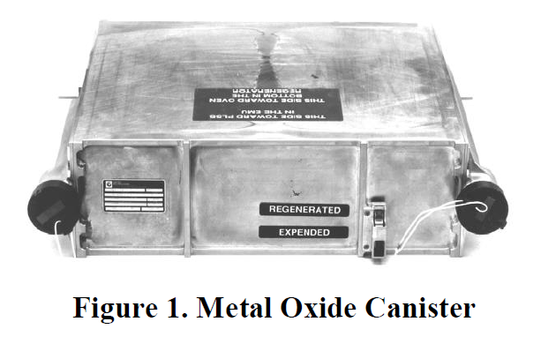
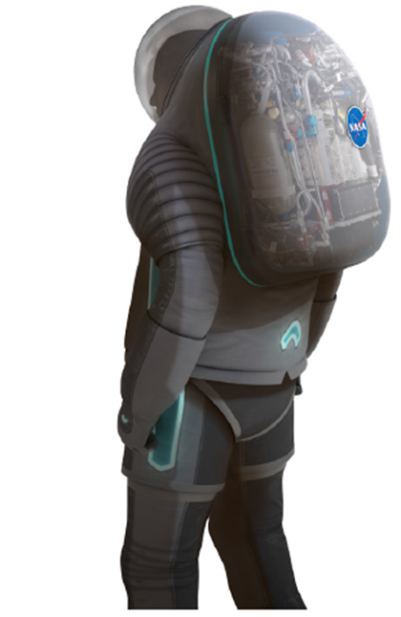
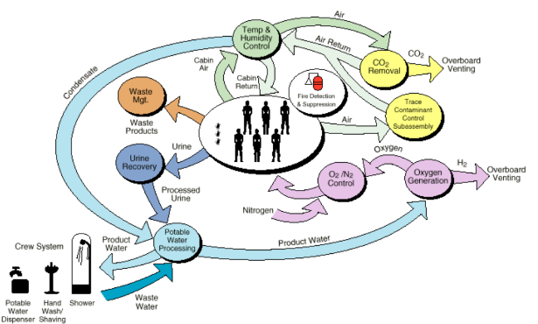
Challenge
NASA 2020 Technology Taxonomy: TX06 Human Health, Life Support and Habitation Systems
“Long-term, maintenance-free reliability to maintain ppCO₂ below 2 mmHg without significant impacts to resource requirements, such as power, and adsorber size and integration with CO₂ reduction equipment.”
International Space Station
PLSS
ECLSS
2
xEMU Suits

Slide 3
Challenge
Space Suit (for xEMU)
International Space Station (ISS)
Dimensions: 13.46” x 9.78” x 3.42”
Portable Life Support System (PLSS)
“MetOx” canisters (since 1998)
Rapid Cycle Amine (RCA) swing-bed technology (testing from 2006-present for xEMU)
Environmental Control & Life Support System (ECLSS)
CO₂ removal
Temperature & humidity control
Waste management
Urine recovery

Slide 4
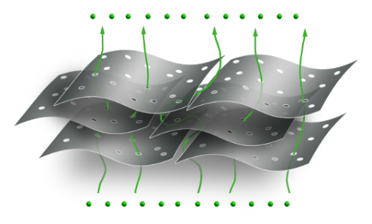
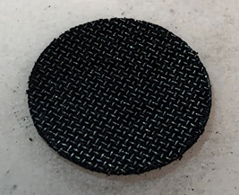
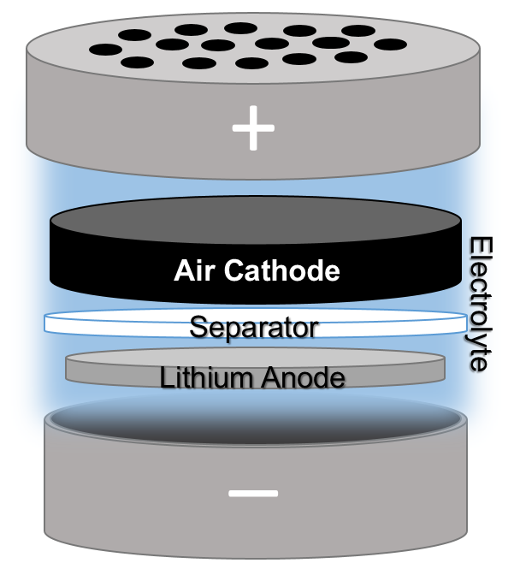
Project Objective
Regenerable CO₂-to-Power (RECOP) Project
Aim to selectively remove CO₂ from the air and and electrochemically generate power with reversible battery chemistry.
Holey graphene (hG)
(NASA patented advanced material)
Air Cathode (compressed hG + wire mesh current collector)
Li-CO₂ coin cell battery
Battery assembly

Slide 5
Fall 2019 Objective
Objectives: (a) system analysis on target application and (b) collect initial Li-CO₂ battery data.
(Theoretical) Values | Space Suit (per EVA*) | ISS (per day*)
CO₂ Generated (kg) | 0.700 | 22.950
Total Li Required (kg) | 0.146 | 4.830
Power Generated (W) | 199 | 2,160
Specific Energy (Wh/kg) | 2,016 (based on Li₂CO₃)
70 kWh Tesla battery uses 63 kg of Lithium Cobalt Oxide LiCoO₂: ~ 12 kg Li needed
* per day & per EVA notation does not apply to the amount of Li required for each application
https://www.quora.com/How-much-lithium-in-kg-is-used-in-an-electric-car

Slide 6
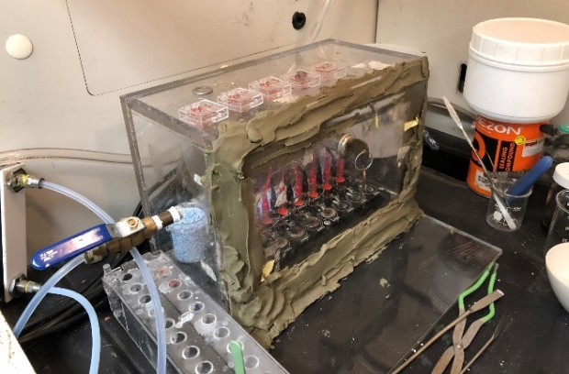
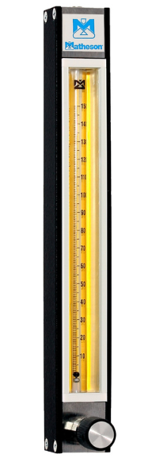
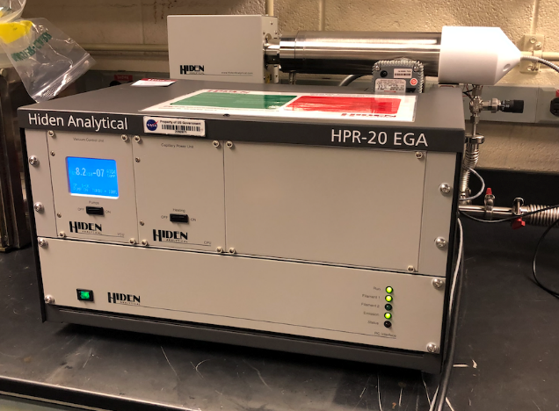
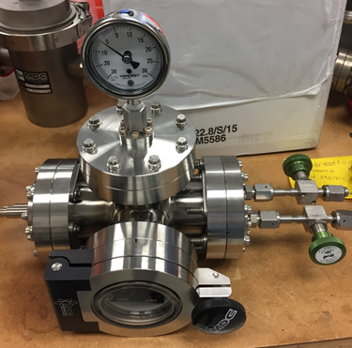
Spring 2020 Objective
Objective: Quantify and characterize the consumption and release of CO₂ during discharge and charge of Li-CO₂ batteries, respectively.
CO₂
O₂
Plastic purge chamber
Pure O₂ or CO₂ or mixed gas compositions
Hiden Analytical gas analyzer
Metal vacuum chamber

Slide 7
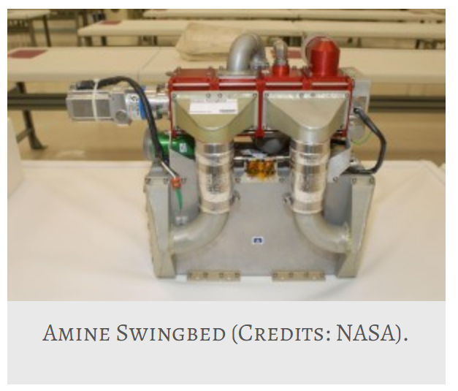
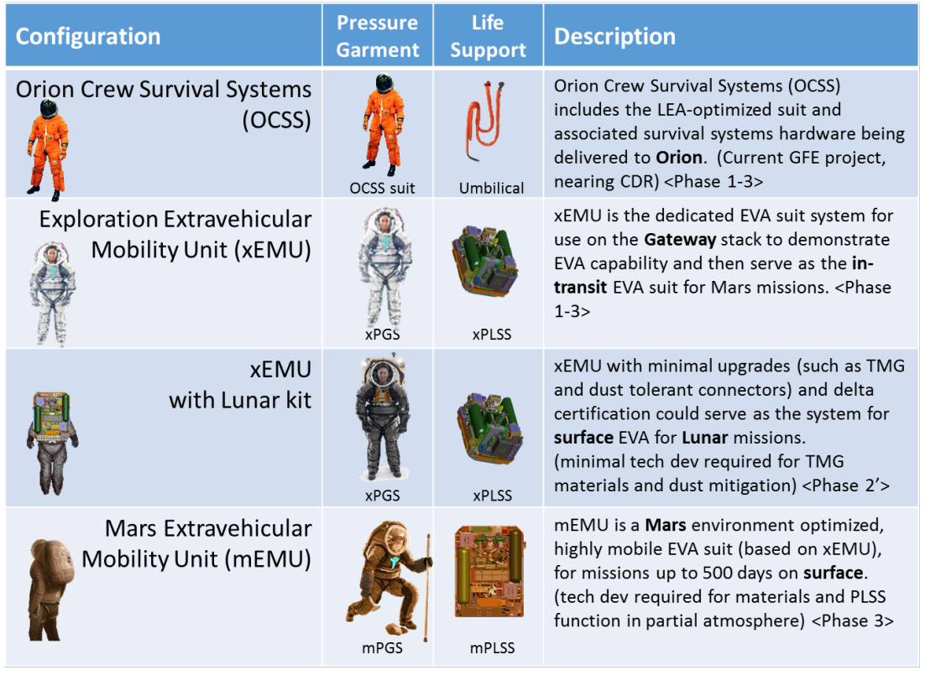
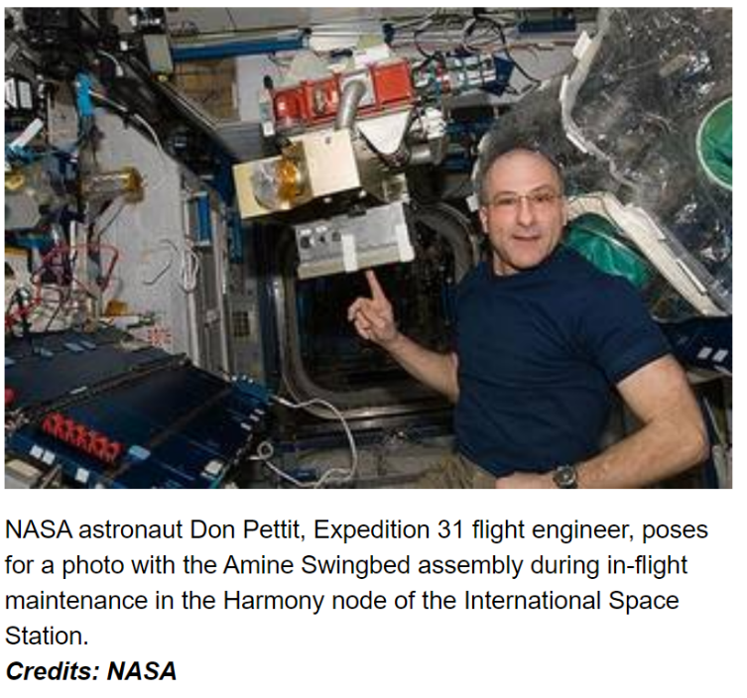
Summer 2020 (Virtual) Objective
Objectives: (a) initial drop-in replacement design of RECOP for target applications, (b) Li-CO₂ battery review article: Current Progress toward “Mars Air Batteries”, (c) support data processing and graph automation for experimental battery tests.
CAMRAS = CO₂ And Moisture Removal Amine Swingbed
ICES-2018-54 “Methodology for Extravehicular Activity (EVA) Technology Identification, Prioritization, and Maturation”

Slide 8
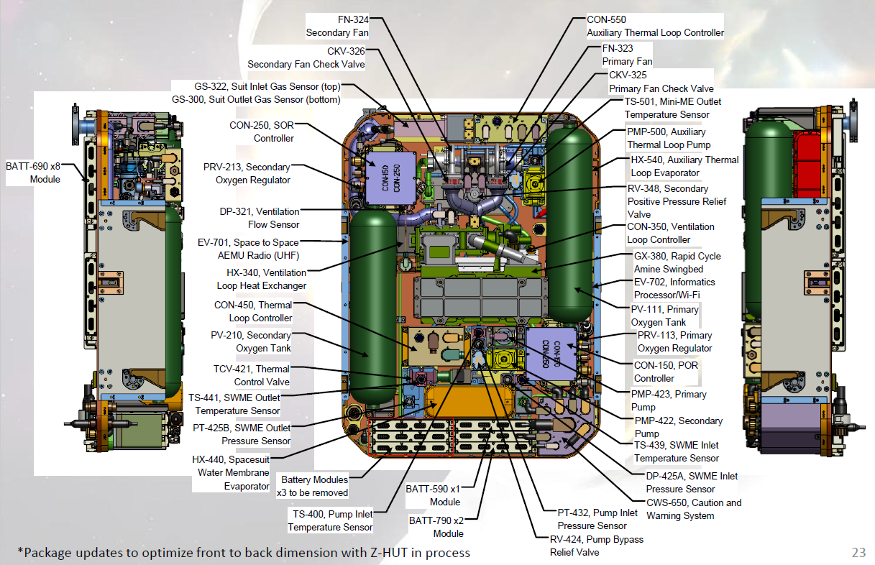
Results: Objective (a)
Rapid Cycle Amine Swingbed
Aim to draw direct comparison between:
RECOP and battery & RCA (xPLSS)
RECOP and CAMRAS (ISS)
Assess feasibility of RECOP as a dual drop-in replacement (CO₂ scrubber and power supply).
i.e. weight, active material mass, volume, power, voltage, etc.
Battery Packs
“Exploration Portable Life Support System (xPLSS)”, EVA Technology Workshop 2017, Colin Campbell, NASA\EC.

Slide 9
Results: Objective (b)
Current Progress toward “Mars Air Batteries”
Aim to compile a comprehensive Li-CO₂ summary, including:
History
Mechanism (discharge, charge, etc.)
Electrolyte
Air cathode (carbon, carbon-free, catalyst types – metal, metal-free, hybrid)
Flexible battery application
Influence of gas composition
Search criteria (present-2017):
Li-CO₂
Lithium-CO₂
Lithium-carbon dioxide
Li-carbon dioxide
90+ papers found, 50+ cited

Slide 10
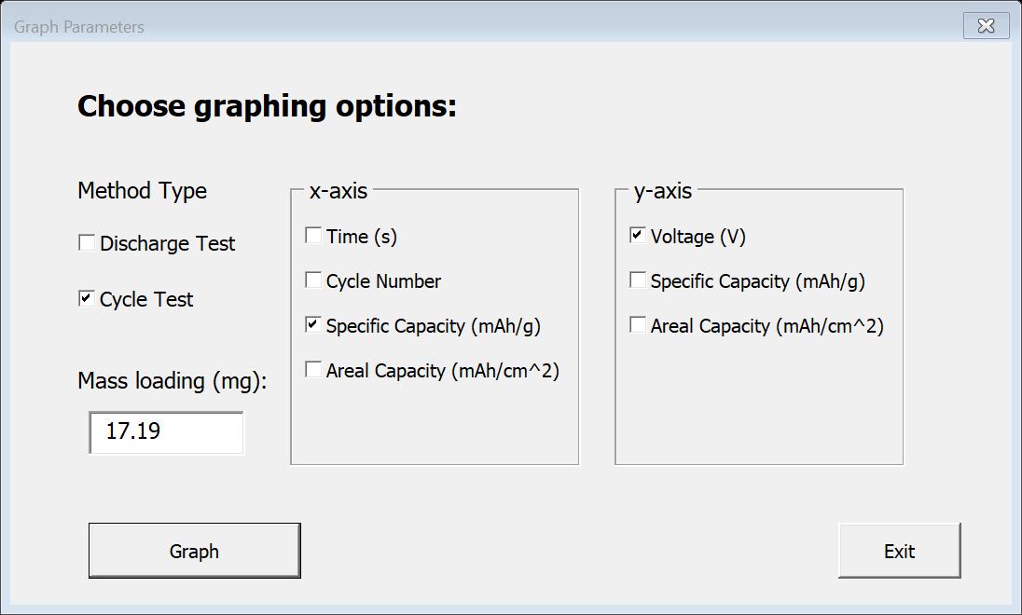
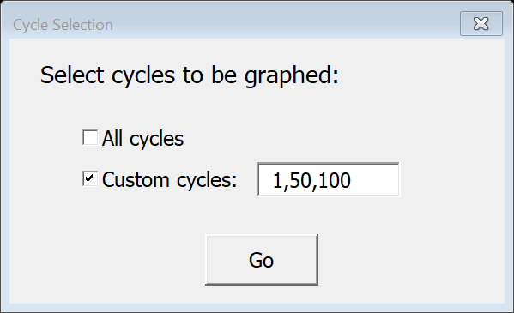
Results: Objective (c)
Aim to automate as much data processing as possible:
Discharge graphs
Cycle graphs
Able to sort and handle various exported report types

Slide 11
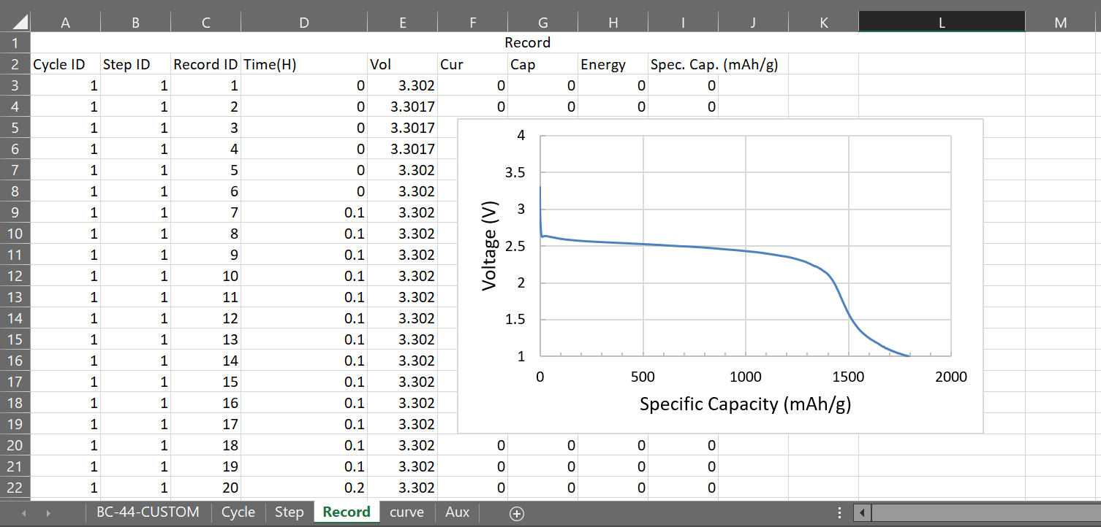
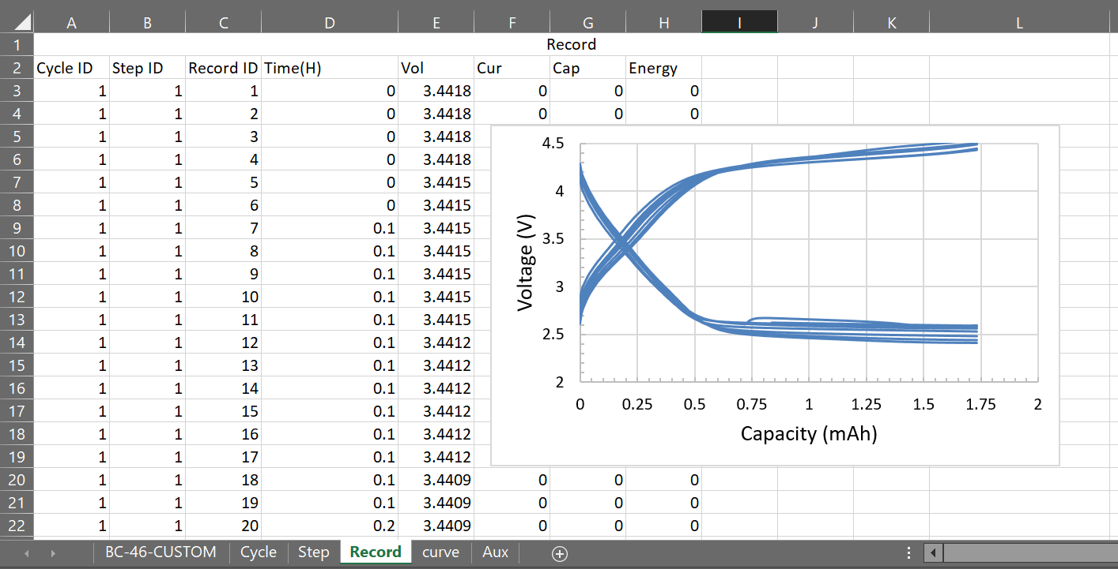
Results: Objective (c)
Macro pros:
Script can be used multiple times on same excel file
Graphs can be adjusted/edited post processing
Graph and data are sourced linked
Discharge graph sample:
Cycle graph sample:
Improve efficiency and ease of data evaluation for all parties.

Slide 12
Summary & Future Work
Stackoverflow.com
Automateexcel.com
Manually record macros to see code
Excel macro tips:
Drop-in RECOP design:
Continuous updates of xPLSS and CAMRAS specs for accurate theoretical design of RECOP.
RECOP testing under same trace contamination conditions as xEMU and ISS.
Continued (in-person) testing of hG-based Li-CO₂ batteries.

Slide 13
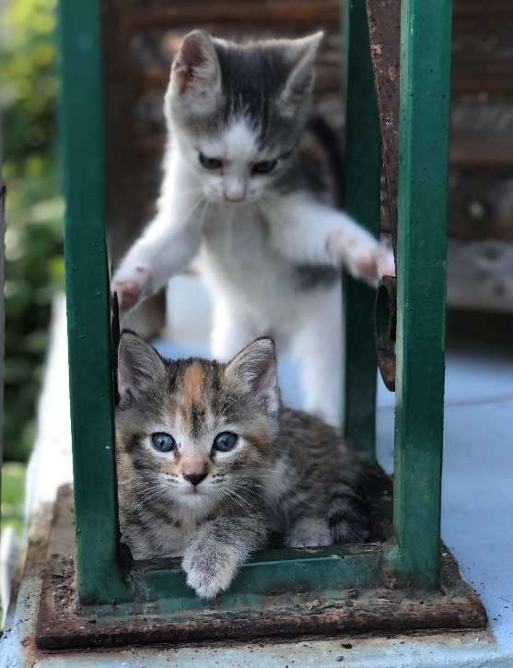
Acknowledgements
Colin Campbell (PLSS Team Lead)
Samuel Russell (PLSS Battery Expert)
Joel Alexa (vacuum chamber modifications)
April Rains, Brandon Walker, Christian Plaza-Rivera, and Liz Barrios (virtual lab mates!)
Universities Space Research Association (USRA)
NIFS Program Coordinators
AMPB Branch

