Slide 1


An Innovative Jump Start for MBSE Tooling
Habitat Architecture Library Challenge
NASA Tournament Lab Results

Slide 2
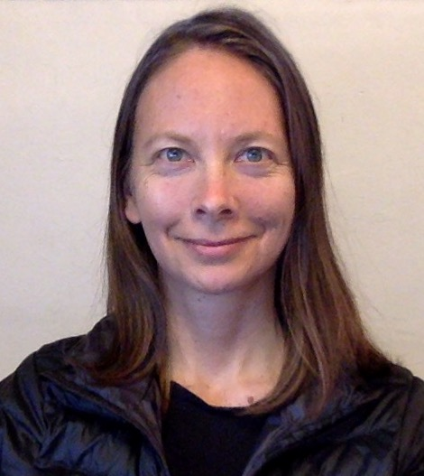
About the Presenter: Samantha Infeld
Title
  Systems Engineer, Analytical Mechanics Associates, Inc.
  NASA MBSE CoP Deputy Lead
  AMA MBSE Lead
Education
  B.S. in Aerospace Engineering, University of California, San Diego in 2000
  M.S. and Ph.D. in Aeronautics and Astronautics from Stanford University in 2002, 2006
NASA Experience
  14 years working concept development and concurrent engineering at JPL, Ames, and Langley, including co-founding JPL Phaeton early-career program, creating the LaRC Engineering Design Studio, systems engineering on CLARREO, MISSE-X, and the Ames Arcjet facility power supply modernization.
MBSE Experience
  For the past 10 years, Samantha has researched and developed appropriate MBSE capability for projects and concurrent engineering from requirements traceability to concept of operations to project management views.
  As a co-founder and now Deputy Lead for the NASA MBSE Community of Practice, Samantha has connected and organized the community of MBSE practitioners and established a strong online presence through the NASA Engineering Network (NEN).
Samantha Infeld (AMA/LaRC)
NASA MBSE CoP Deputy Lead

Slide 3
Contents
Context
NTL Challenge Information
NTL Challenge Results Summary
Proposed direct use of entries with examples from their models
Indirect benefits of running the challenge

Slide 4
What is MBSE?: The Knowledge Pyramid
Where does MBSE fit in?
  MBSE is a methodology that captures the Systems Engineering principles and formalizes the structure, behavior, and interaction these principles govern
  This methodology can then be implemented using methods, and tools to perform the methods, to realize the actual models.
  Methods include SysML-based frameworks such as libraries of common model elements.
Magic Draw, CORE, Innoslate
SysML-based frameworks and processes
Model-Based Systems Engineering
Systems Engineering
NASA
Methodology
Principles
Culture
Tools
Methods

Slide 5
Crowdsourcing for system model library ideas
Center of Excellence for Collaborative Innovation (CoECI)
  launched at the request of the White House Office of Science and Technology Policy
  available to government agencies
  uses open innovation, or “crowdsourcing”, to access the global public
  find ideas, concepts, designs, or solutions that meet a previously unmet need
  possibly resulting in significant advances in performance
NASA’s Center of Excellence for Collaborative Innovation (CoECI) runs the NASA Tournament Lab (NTL)
  NTL is the public brand

Slide 6
New kind of innovation, newer application
NASA has used open innovation in recent years for software development and new hardware technology, with promising results
NASA Engineering and Safety Center decided to sponsor a challenge as an additional avenue to advance NASA’s integration of MBSE.
This application is narrower than a function to perform with software or hardware.
We wanted innovation within the constraint of model-based systems engineering tools to ease starting burden through reusability and familiarity.
We picked a specific function - creating a space habitat architecture – to form a clear problem definition, make it easy to compare entries, and make it fun!
Would there would be as much participation or quality submissions with this more specialized topic and skill?

Slide 7
Challenge Definition
In early adoption of MBSE at NASA, mission architects were often starting from scratch to build model elements representing the functional and physical architecture of a system in SysML.
A common library will save system engineers a large amount of time, will allow project stakeholders to recognize common graphics and quickly understand the architecture options.
Challenge: create a library of modeled parts in a system modeling language (SysML) that can be easily used to create:
  space architecture representations
  their physical and functional decompositions

Slide 8
Challenge Promotion
The challenge was promoted internationally, especially through professional organizations and universities with a systems engineering focus.
It was open for 4 months, purposefully over the winter holiday break time to allow participants extra time outside of work or school.
The challenge was designed so that expertise in space hardware was not necessary but getting to play with models of space architecture could provide motivation to participate.

Slide 9
Challenge Entry Summary
https://www.assist2develop.com/blog/v4b4f423/nasa-challenge-winners
We did not receive as many entries as other broader outreach challenges, but the ones we received were thorough and high quality.
Solutions came from individuals and teams, students and professional consultants from the United States and Europe.
We learned a few lessons about how to engage with the public and what characteristics of a problem result in good crowdsourcing results.
The outreach challenge produced several useful ideas and modeled space elements now being folded into library building efforts to help Gateway and Artemis first, then generalized to all types of projects.
The NASA MBSE community of practice engaged several winners and runners-up to learn more about their new approaches.

Slide 10
Crowdsourcing for SE Methods
Promotion to the right organizations and advocates is key
  We had participation from flyers at conferences and personal recommendations
Keep the description concise and scope narrow
  The description had motivation and goals from several people and this muddied the water causing some confusion about what we actually wanted as entries [habitat system models vs libraries].
  Giving the content (space habitat subsystems, components, and functions) as an input so that contestants could focus on library design and functionality did work well.
Be available to communicate with the challenge organizer and contestants.
  It does take some time to be sure all the information is clear and available, and other questions are answered, but important for quality entries.
  Example: Several people were concerned about if they retained rights to use or publish their work – a motivating factor.

Slide 11
Proposed Direct Use of Challenge Entries
Alejandro Trujillo
PhD candidate at MIT, re-use in SE
Icon library package
Merge the Function and Component Libraries into the Gateway Library model to expand toward a NASA Function and Component Library
Nathan Vinarcik
University of Detroit Mercy student
Behavioral Analysis package toward an analysis library
Interface Blocks toward an interface library
JeanMarie Gauthier, PhD
R&D Engineer, Samares Engineering, Toulouse, France
Add to icon library
Use NASA profile elements
Jose Fernandez and team
professors from several universities, Spain and Germany
ISE&PPOOA method
Functional Flow patterns for library
Mohammad Chami
MBSE Consultant, Chami Consulting | MBSE Services
Variability stereotypes to support ISO standard 26550:2013
    Reference model for structure and processes
    Interrelationships between components

Slide 12
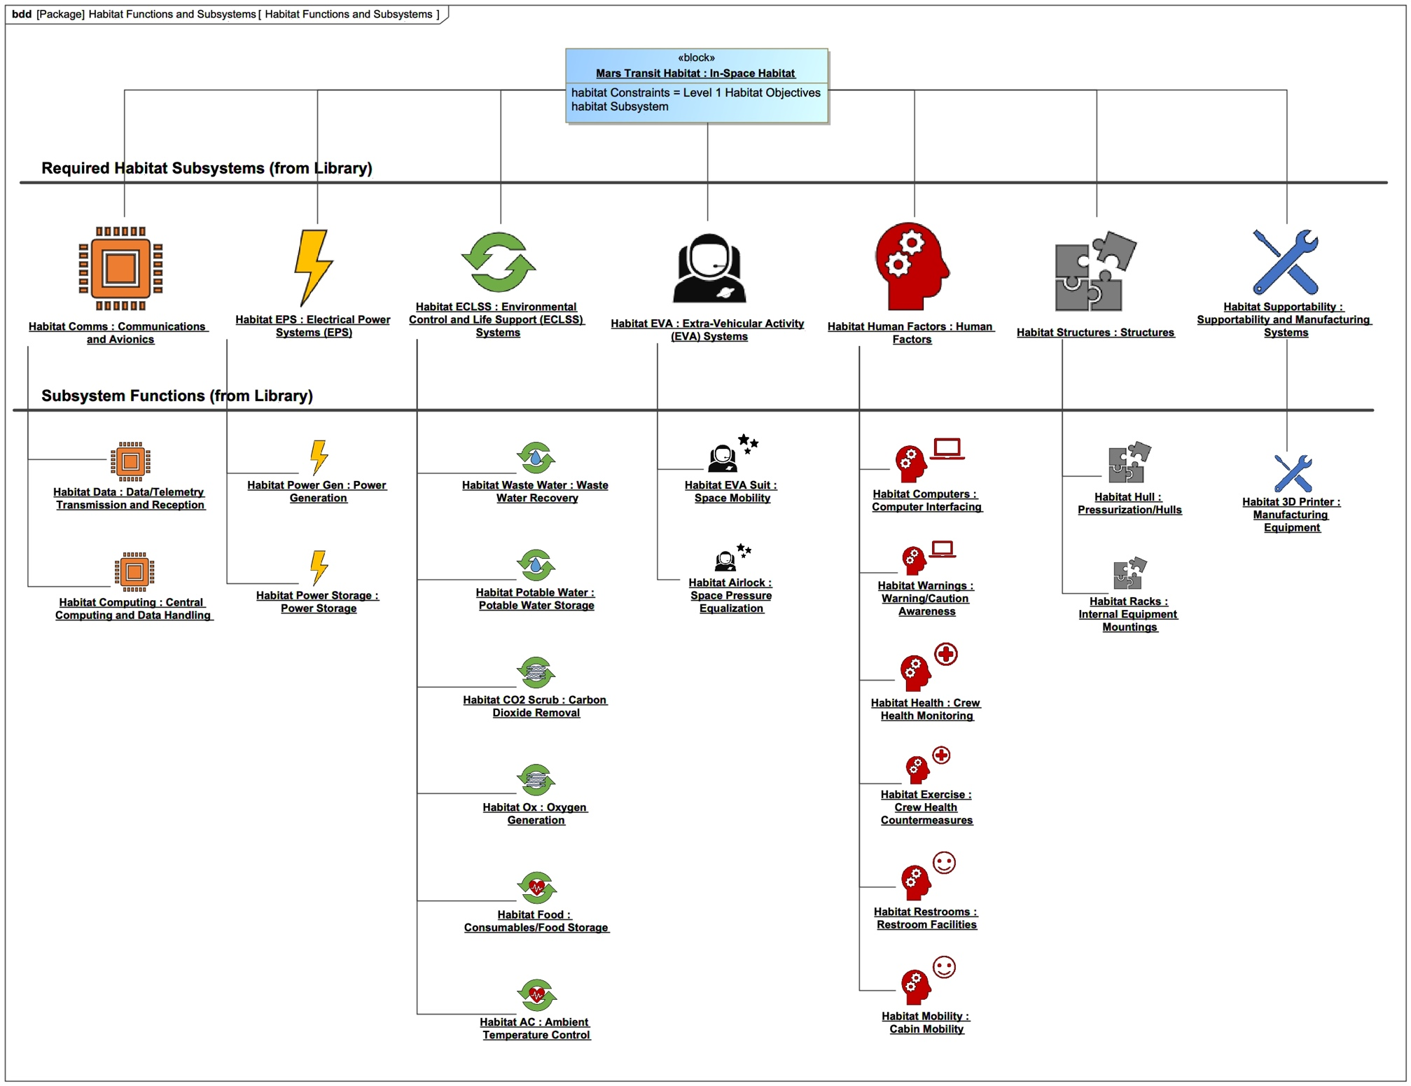
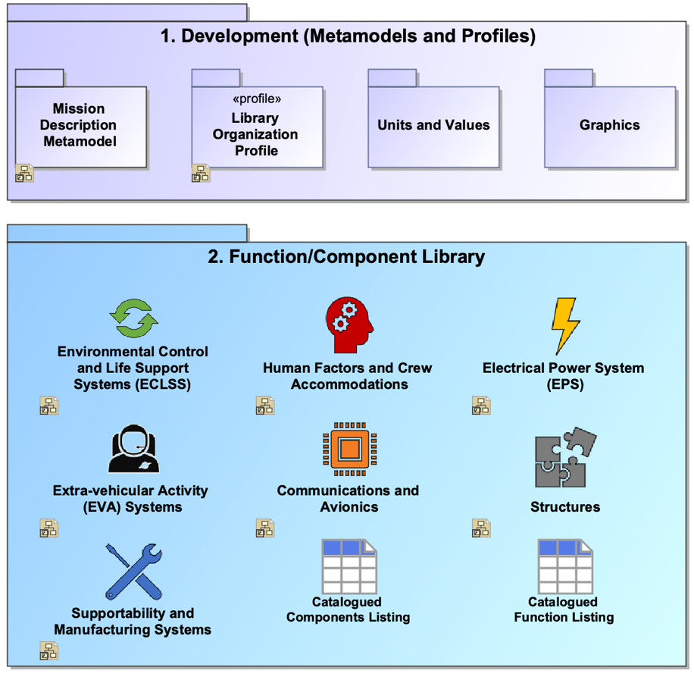
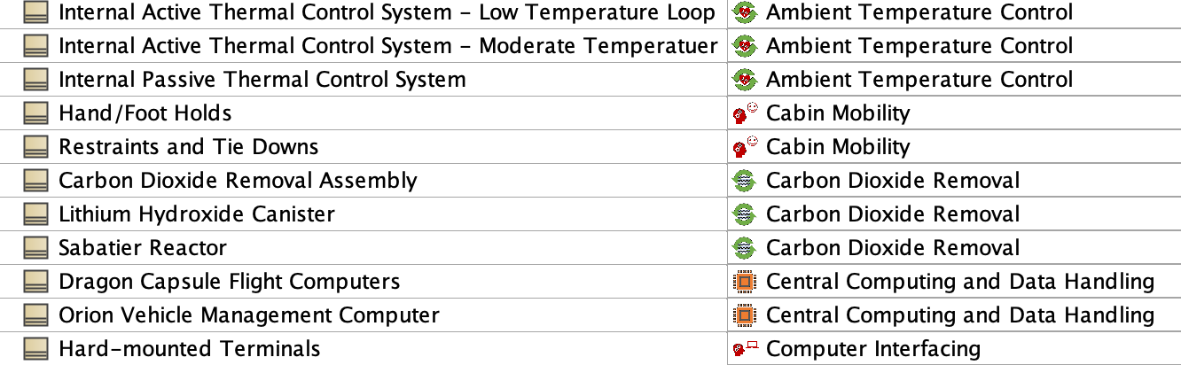
Icons, Functions, Component Libraries (A. Trujillo)
Icons are attached as image files as well as being used by packages, and blocks typed as functions or components. “Sub”icons for fast cognition
Library catalog graphically and in tables (where they can be easily sorted)

Slide 13
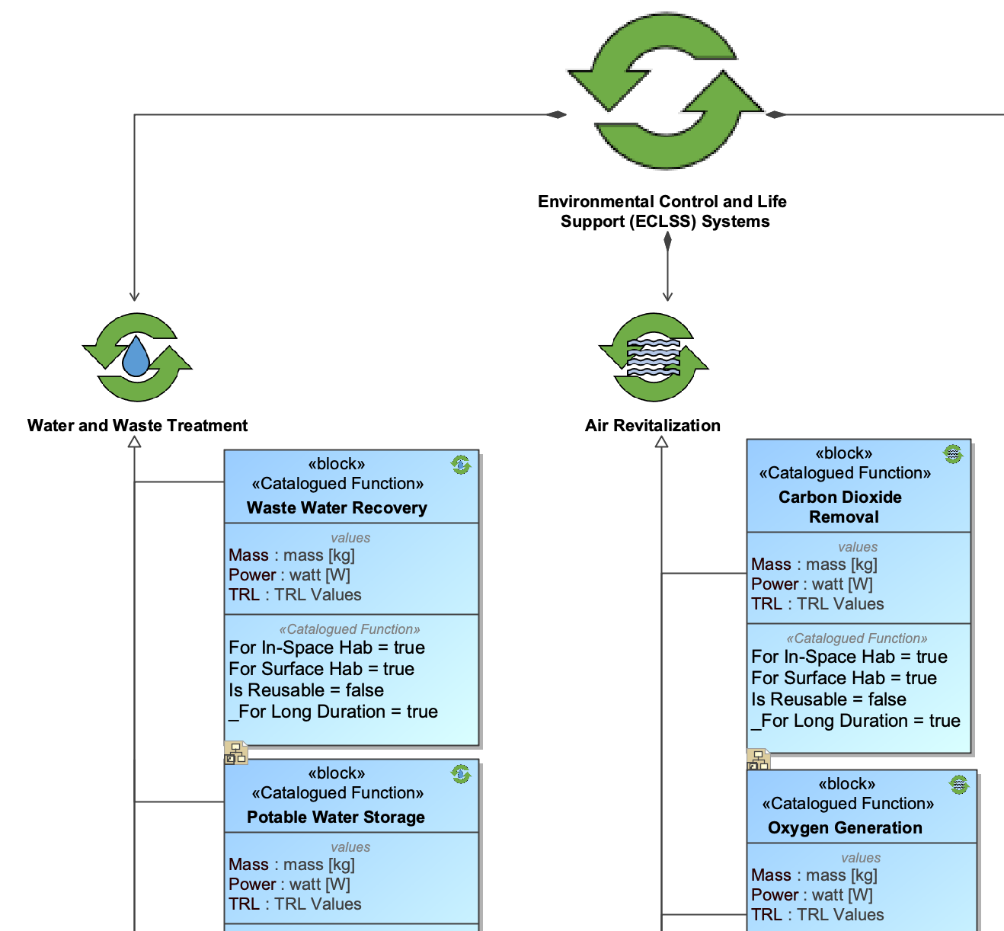
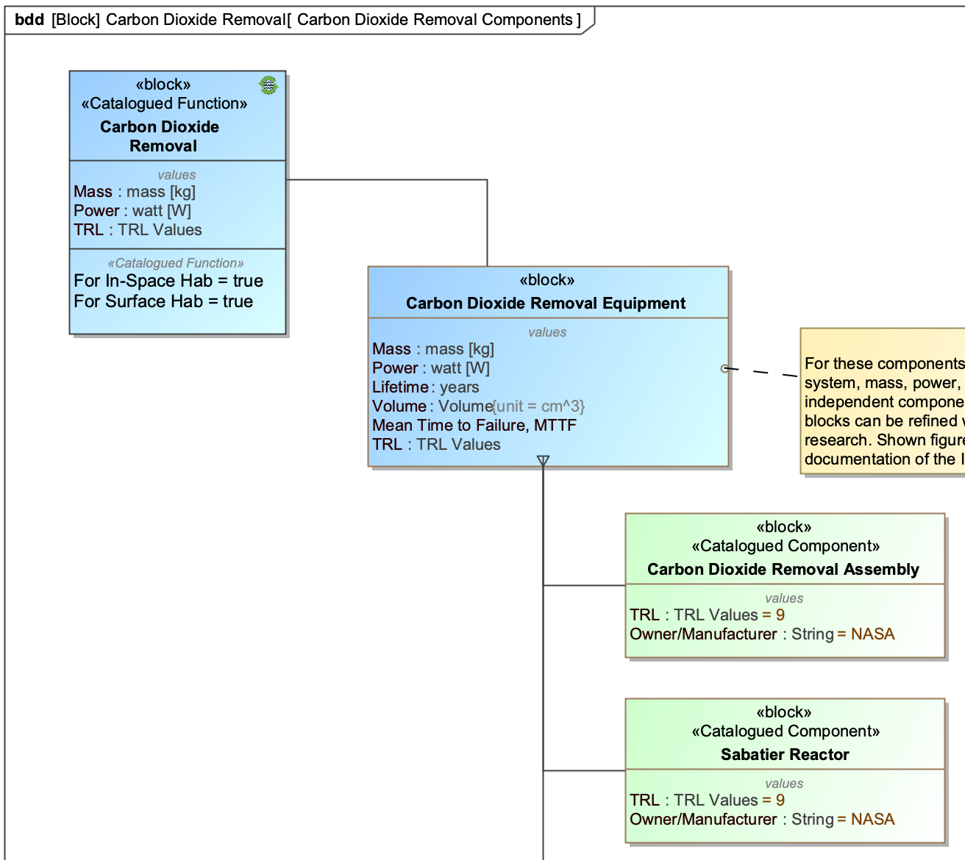
Icons, Functions, Component Libraries (A. Trujillo)
Blocks contain design attributes and library sorting attributes

Slide 14
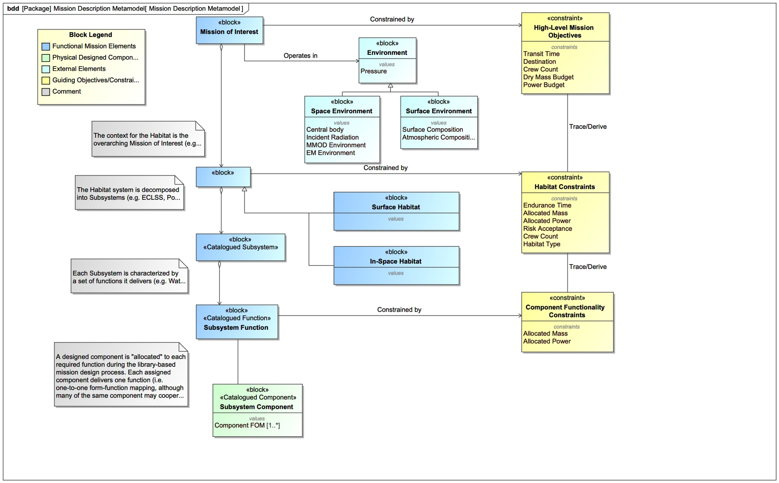
Icons, Functions, Component Libraries (A. Trujillo)
Metamodel for clear understanding of library organization and functionality and flexibility to adjust or expand libraries

Slide 15
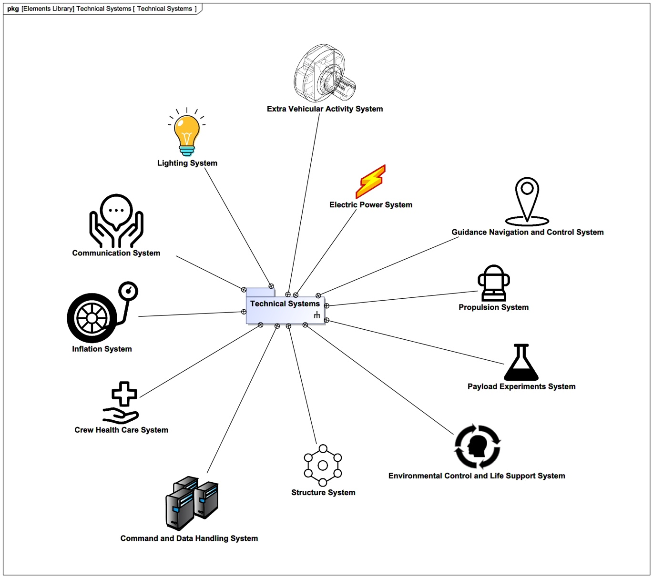
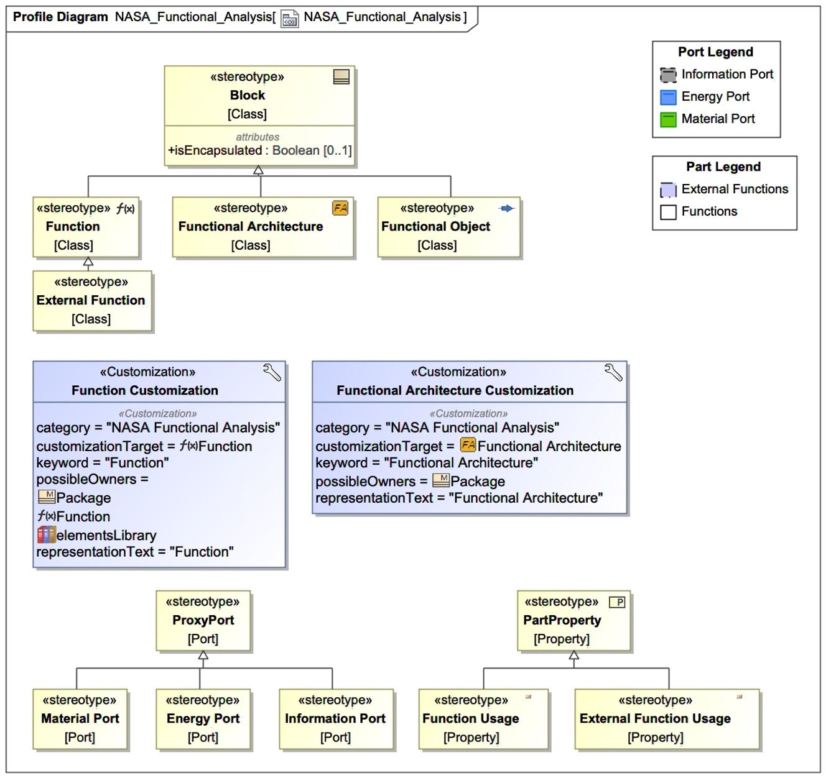
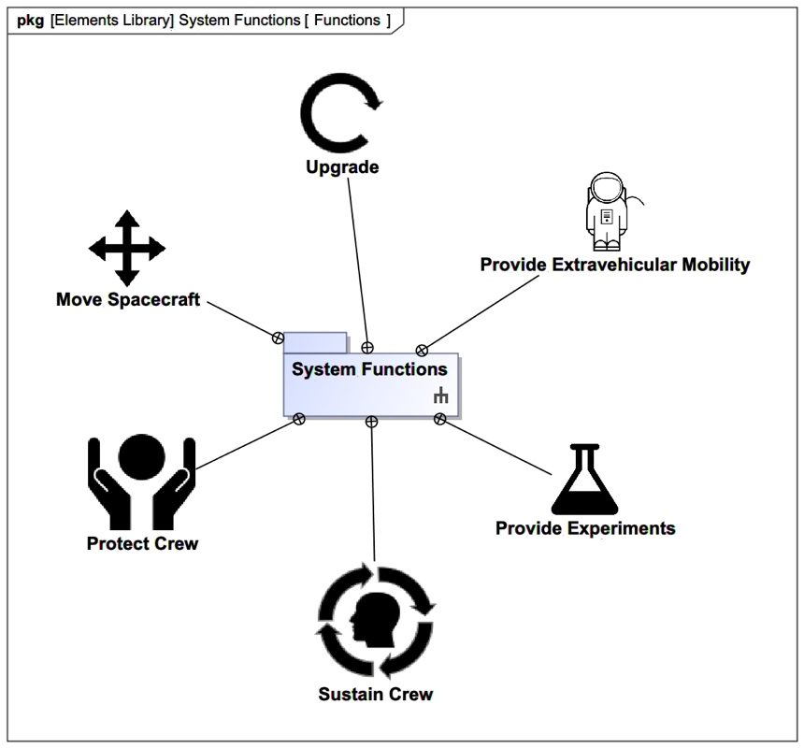
Icons and Integration with Profile (JM Gauthier)
Technical and Functions Libraries
Functional Analysis portion of Profile

Slide 16
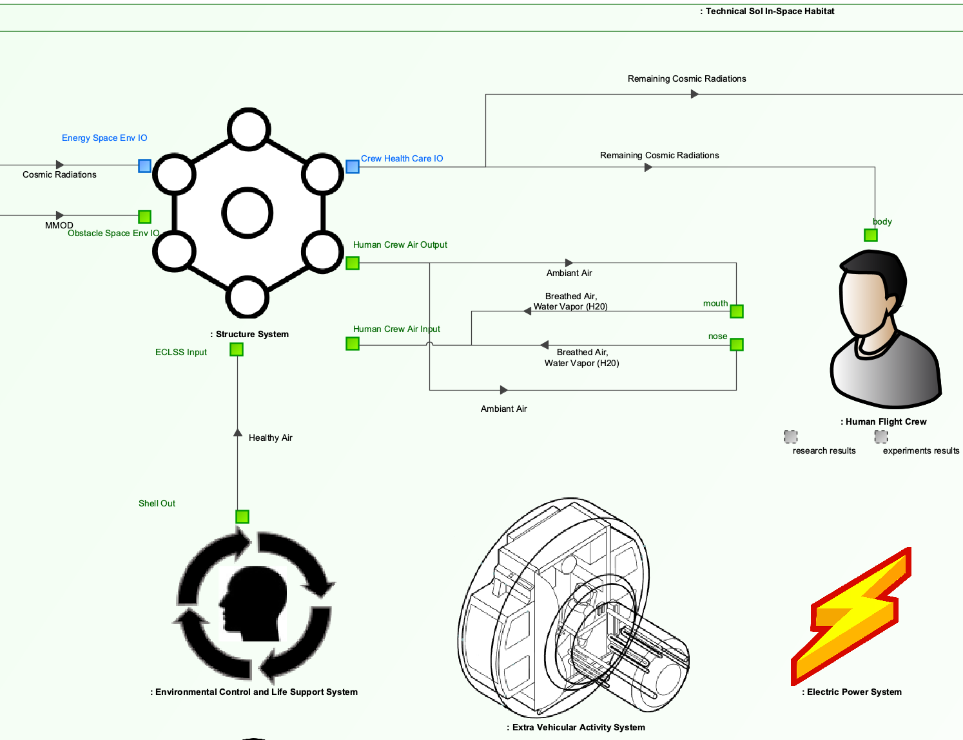
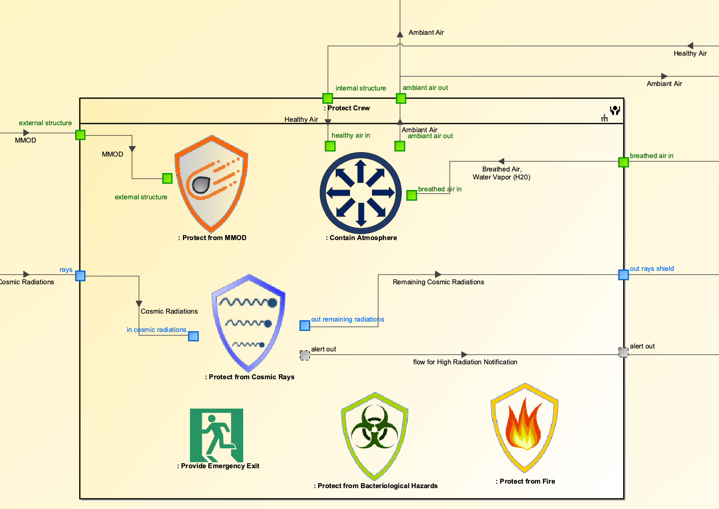
Icons and Integration with Profile (JM Gauthier)
Technical Architecture Use
Functional Architecture Use

Slide 17
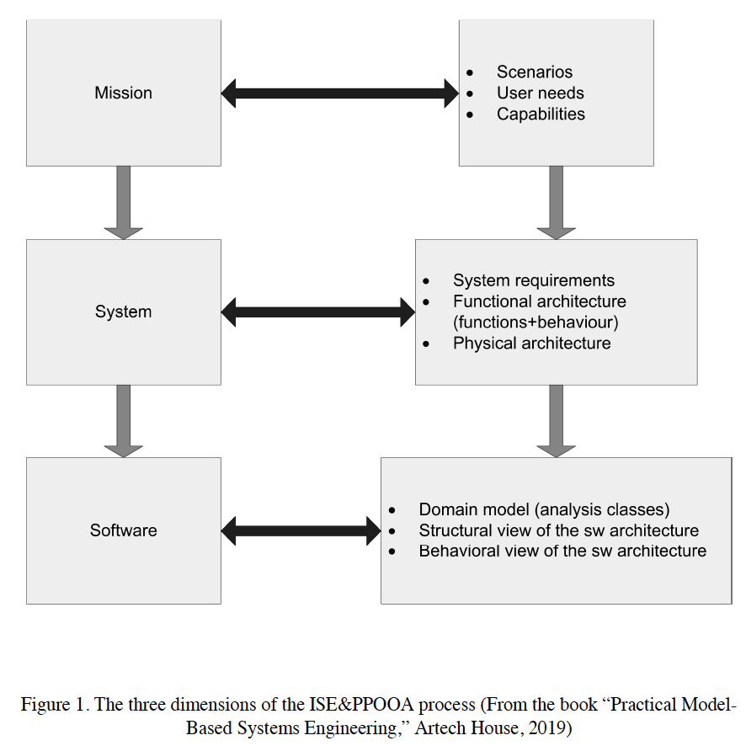
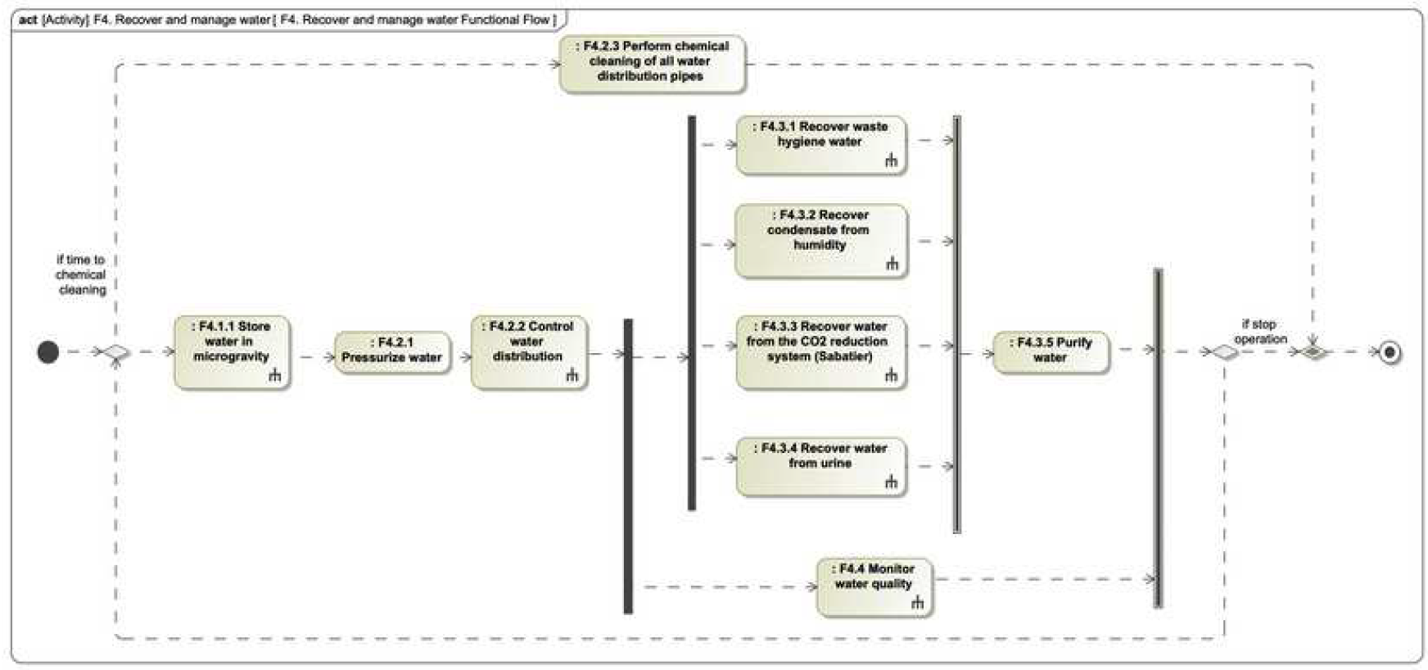
ISE&PPOOA, especially and functional flows
Integrated Systems Engineering and Processes Pipelines in Object Oriented Architectures
  Software intensive architecture focused on concurrency
The ISE&PPOOA method recommends that functional requirements are specified relying on the
functions outputs identified in the functional architecture. The detailed level functional system
requirements are presented in the lower level functions of the system. At least each function is
associated with one functional requirement and each functional requirement has one associated
function.

Slide 18
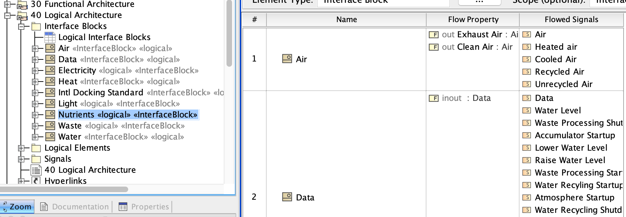
Behavioral Analysis and Interface Blocks (N. Vinarcik)

Slide 19
Domain vs Application Engineering (M. Chami)
Domain Engineering:
Where the variability is defined and analyzed.
Application Engineering:
Where the variability is configured to generate specific products.
Variability stereotype to specify use cases, extensible to technical and functional blocks

Slide 20
Indirect Benefits of the Challenge
Spurred discussion of libraries, profiles, meta-modeling, and model validation
Served as examples for those newer to MBSE, and thought-provoking to see different types of approaches for those more familiar with it
Engagement and visibility for NASA across systems engineering field and space industry
Visibility and connections to potential future workforce

