Slide 1
Machine Learning to Predict Composite Joint Performance from Process Parameters
Brennen Middleton
Mentor: Frank Palmieri
2020 Summer NIFS Research Symposium

Slide 2
Challenge
Bonded joints are a reliability concern due to unpredictable, unmeasurable strength
Aircraft manufacturers install >100,000 fasteners in each airframe for reliability, but at a tremendous cost
AERoBOND seeks to improve joint reliability using novel materials technology
  Modified epoxy resins applied to part (faying) surfaces during fabrication
  Characterization/process data collected from materials during development
  Process optimization challenging due to convoluted/complex process parameters
Notes:
Currently, some aircrafts are utilizing composites parts bonded with adhesives to achieve the high strength of customary materials, such as aluminum, while utilizing the advantage of low weight in composites
Adhesively bonded composites pose a reliability concern due to unpredictable and unmeasurable strength
100,000s of fasteners are added to improve this reliability, impacting the weight advantages of composites and increasing costs
AERoBOND is trying to improve the reliability of these composites by using a novel co-curing system, minimizing the use of adhesives and fasteners
However, process optimization for this project is currently challenging

Slide 3
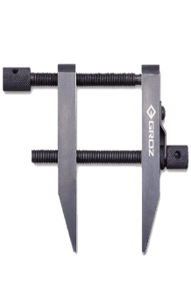
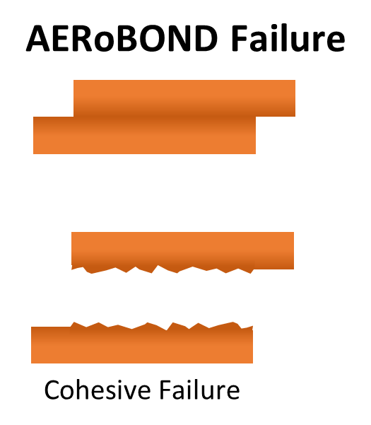
AERoBOND Process
Thermal Data
Composite Recipe
Joining Layer A
conventional materials (uncured)
Joining Layer A
Autoclave Run Log Data
Primary Cure
partially cured
surfaces
Infrared Spectral Data
cured laminate
Assembly with
partially cured interface
Joining Layer B
Autoclave Run Log Data
Secondary Cure
Ultrasound Data/Images
Co-cured structure
Mechanical Data
Notes:
This slide is just used to give an overview of the AERoBOND process and data collected in this process
The process begins with the fabrication of two uncured panels. These panels have an epoxy rich recipe, which is collected during the manufacturing process. Differential Scanning Calorimetry (DSC) data is collected from the joining layers of these panels.
The panels then undergo a primary cure cycle in an autoclave, which has predefined temperature, pressure, and time parameters inputted into the machine
These parameters are then collected during cure stage as autoclave run log data, and Fourier Transform Infrared Spectroscopy (FTIR) data is collected for the two joining layers, which are now partially cured
The panels are then assembled with a middle joining layer, called Joining layer B, which is hardener rich recipe that is noted
This assembly then undergoes a secondary cure, creating a completed co-cured structure. This results in a single composite with no visible interface.
Autoclave Run Log Data is taken from this stage, as well as C-Scan images of the composite structure
The completed composite then undergoes End-Notched Flexure testing, which is a mechanical test that tests the strength of these materials

Slide 4
Objective
Develop a machine learning (ML) algorithm to predict mechanical properties for a given set of processing conditions
  Prepare raw AERoBOND process data for ML
  Develop ML algorithm
  Create user interface and manual for other users
Stretch Goals
  Perform a parametric study to understand which parameters are important
  Identify AERoBOND processes likely to produce good joint properties before testing in the lab
Notes:
The objective of my project this summer was to develop a machine learning algorithm to predict the desired mechanical characteristics of these composites, given the input parameters of the composite
This algorithm will be used to conduct a parametric study to solve the optimization problem previously discussed and identify potential composite systems with desired mechanical and characterization properties

Slide 5
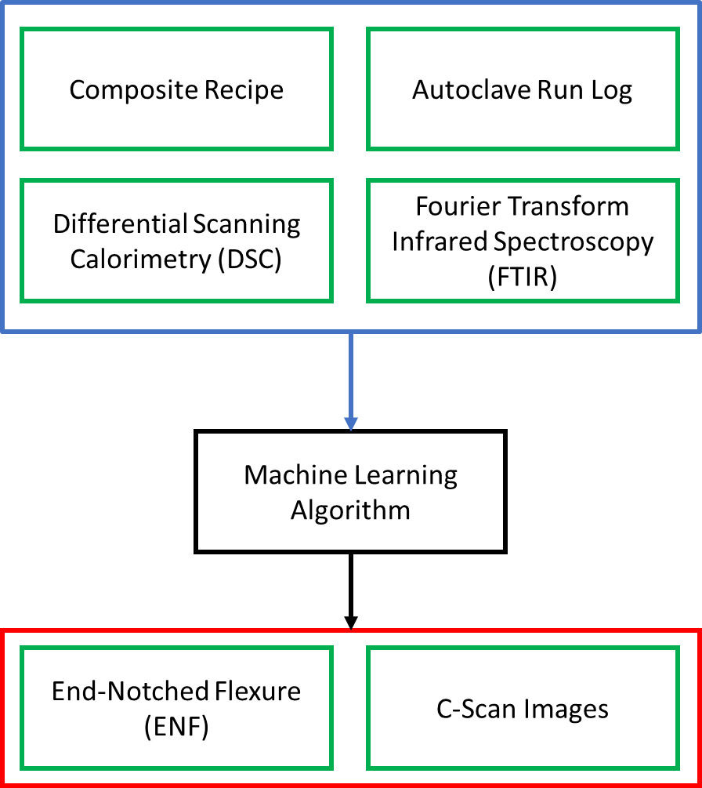
Approach
Application Phase
Training Phase
Input
Untested Parameters
Preparation of input data
  Based on advice from subject matter experts
Development of ML algorithm
  Random Forest Regression
Optimization of input parameters
Python was used to make the algorithm user friendly
Output
Optimized Output
Notes:
To successfully do this, the process has to undergo several steps
First, the data collected from the manufacturing and testing process has to be isolated, pulling the important information out of each file
Once preprocessing is completed, a ML algorithm has to be designed to analyze the data and give predictions for mechanical properties
The input parameters then have to be optimized after an output is achieved
To the left is a flow chart describing the ML process
The input values shown are used in the machine learning algorithm to create a model
A user prediction of the composite characteristics, called the prediction, is then loaded into the model
Output parameters are then created from this prediction and model that can be utilized to determine if the input is ideal
Just as a note, Python was used to create necessary scripts, as it is more user friendly. Many users have preferences for what language or application to use, but the utilization of python will be noted later in the presentation

Slide 6
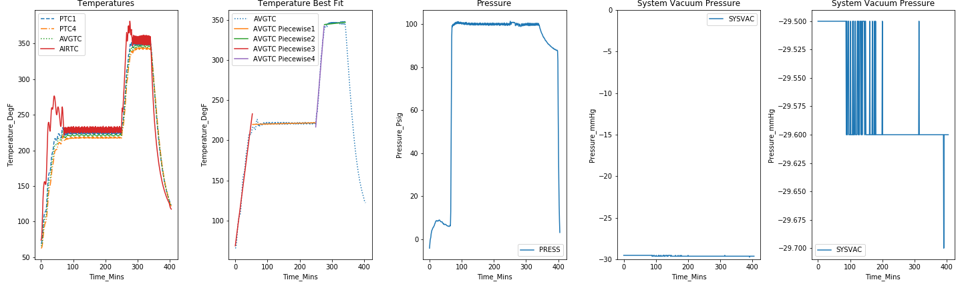
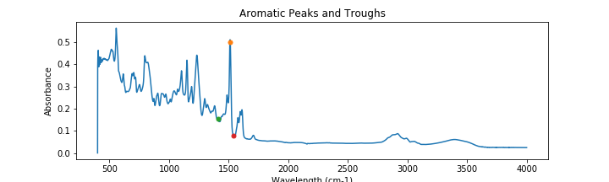
Preprocessing Results
Cure Cycle Data
FTIR Spectrum
Wavelength (cm⁻¹)
Notes:
Now we will move on to the preprocessing stage
The Autoclave Run Log data, shown at the top, and FTIR data, shown at the bottom, are used as examples to give clarity on what is occurring during this stage
For the autoclave data, piecewise functions were identified to correctly model the temperature ramping and holding of the primary and secondary cure cycles
The line equations and endpoints of each line were isolated for the ML algorithm
For the FTIR data, the desired peaks were isolated and an integration was performed to determine the area of the peak

Slide 7
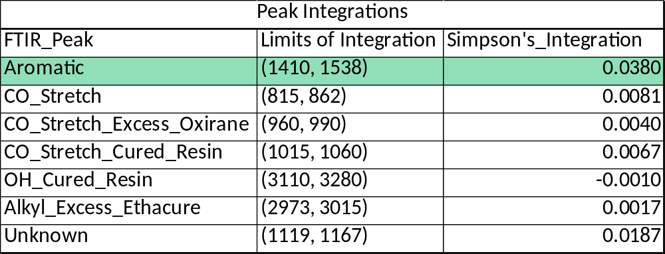
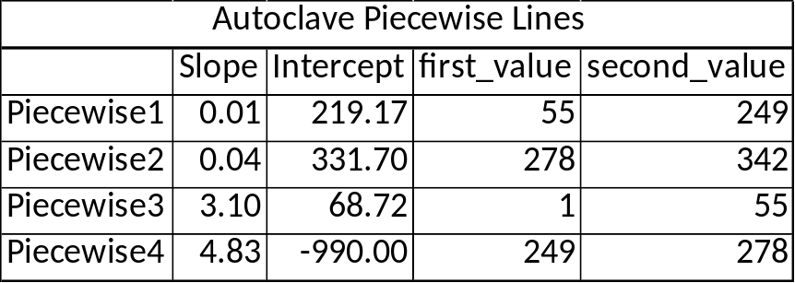
Preprocessing Results
There are 7 peaks associated with each FTIR scan
  Two scans for each experiment
Autoclave temperature data can be 2 or 4 piecewise lines
  Statistical analysis may be added
Composite recipe, DSC, and ENF are pulled from existing files
Notes:
The outputs of this processing is shown to the right, with the green highlighted cell in the FTIR table, referenced as ‘Peak Integrations’, referring to the specific peak shown on the previous slide
It should be noted that there are 7 desired peaks and a scan has been completed for each panel
Additionally, it was found that there are either 2 or 4 piecewise lines associated with each cure cycle for the autoclave data
Statistical analysis of these piecewise lines may be completed later and utilized for the ML algorithm instead of the raw data
The composite recipe, DSC data, and ENF data are not shown, as the process to isolate values from their raw data is not complicated. The values are pulled from existing files created from the machines utilized or data from testing analysis

Slide 8
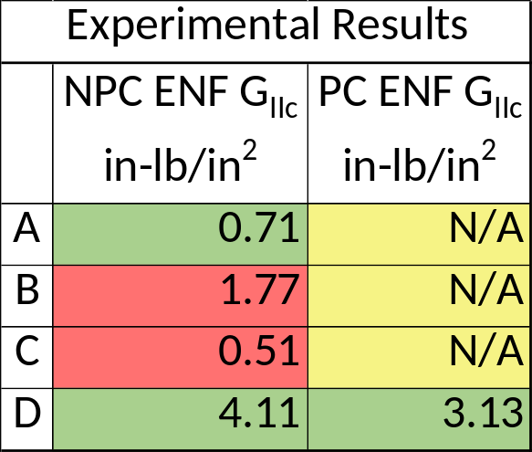
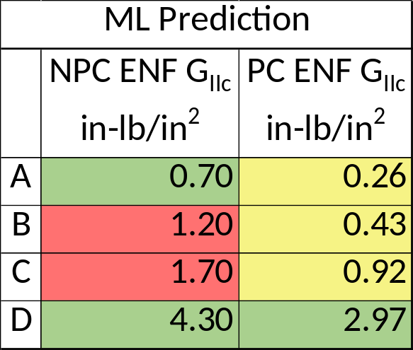

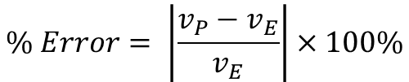
ML Results
Utilizes Random Forest Regression
  NPC ENF → Non-Precracked End-Notched Flexure
  PC ENF → Precracked End-Notched Flexure
This model had a score of 0.81
  R² value of 0.82
Errors are visible in this model
  Due to substitution of NAN values with a common number
  Utilize new model to forgo substitution and skip NAN values
$$\% Error= \left|\frac{v_{P}−v_{E}}{v_{E}}\right|×100\%$$
Notes:
Moving on the fun part is the ML algorithm
The model analyzed for the presentation utilized a Random Forest Regression, which creates decision trees to optimize outputs. However, other algorithms are currently being studied. Reasons for this will be shown later
The two tables shown to the top right are outputs from the ML algorithm, with the left table showing the test values given from the original experimental data, and the right table showing output values from internal predictions from the experimental data
The internal predictions are values the algorithm creates to determine it’s score, so no human intervention occurs during this stage
The table to the bottom right shows the percent error of these predictions, which the equation used for this calculation shown to the left
The green cells show values with a % error less than 10%, while the yellow cells show values with a % error greater than 10%.
The model had a score of 0.81, which is determined based on a mixture of values, such as the accuracy, reproducibility, and robustness of the predictions
The R2 is also given for this model, as it is more widely used in the scientific community at large
Even though a score of 0.81 seems relatively good, it can be see that the predictions produced are not ideal
The yellow cells highlight cells that contained NAN values, which means the cells did not have data
Due to the module used (sklearn) values had to be placed in these cells. These values add error to the model, so a new model is currently being tested to forgo the substitution

Slide 9
Analysis/Summary
AERoBOND seeks to make bonded composites with co-cure reliability
Completed preliminary ML algorithm with AERoBOND data
  Level of errors reasonable for first version
  Revised version under development during internship extension
Preliminary results indicate that ML algorithm can benefit the AERoBOND process development
A score of 0.81 can be improved
  Score of 0.90 is goal
  Tell model to skip NAN values
  Optimize input parameters
Notes:
In summary, AERoBOND is seeking to it create reliable composites with co-cure bonds
It should be noted that errors were expected, as this was the first instance of utilizing a ML algorithm for the data. A revised version is currently being tested during the internship extension.
Additionally, it has been determined that a score of at least 0.90 should be obtained, as the ML data shows that a score of 0.81 is not satisfactory for our specific project
This can be fixed by using a model that skips NAN values and optimizing the input parameters
Finally, the results shown that a ML algorithm can benefit the AERoBOND project and should be pursued

Slide 10
Next Steps/Outlook/Future Work
Revised model to score between 90% and 95%
Convert model to an executable for accessibility
Create a plan to allow others to update model with new data
Utilize model to guide optimization
  Reverse engineer the model to provide optimized input parameters
Notes:
The next steps for this model is to reach a score between 0.90 and 0.95
Additionally, we would like to convert the model into an executable file to allow accessibility
This is where I talked about python being more user friendly, as it is possible to convert the files created into a program that can be used by those not familiar with python or programing in general
The program should then be used to guide optimization in the lab and has the potential to be reversed engineered to provide input parameters from desired mechanical data
Finally, a plan should be created to allow others to update the model with new data obtained through testing

Slide 11
Acknowledgements
I would like to thank Tyler Hudson, Charles Liles, Lauren Abbot, Chang Woon Jang, Jin Ho Kang, Austin Smith, and Gabrielle Snyder
And the NASA Mississippi Space Grant Consortium for funding this internship

