Slide 1
LaRC Isolator Dynamics Research Lab
Internship Exit Presentation
By Brian Coulter

Slide 2
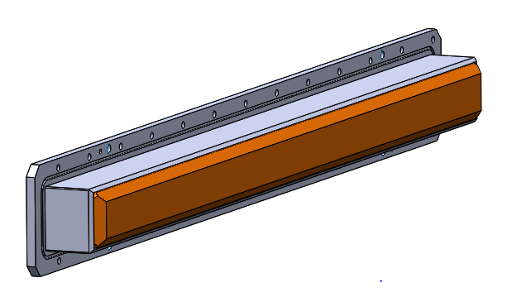
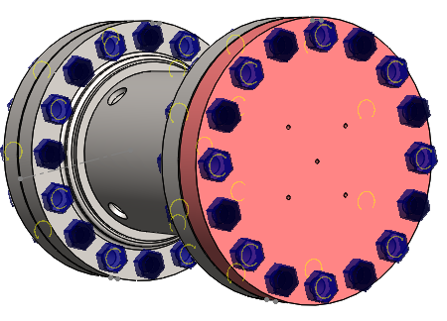
Overview and Purpose
Strategy
Two projects:
First is to design interchangeable wall inserts of varying topography for IDRL tunnel
Second is to perform Finite Element Analysis on plenum section for PIV insertion

Slide 3
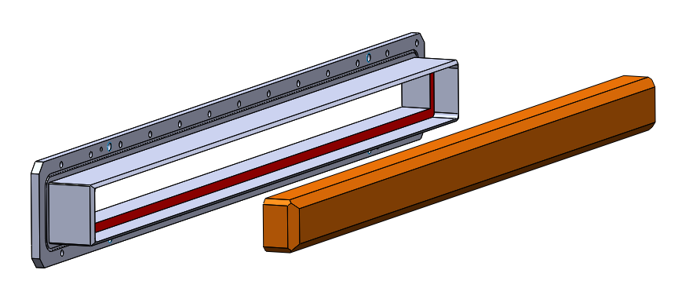
Wall Inserts
Existing Design

Slide 4
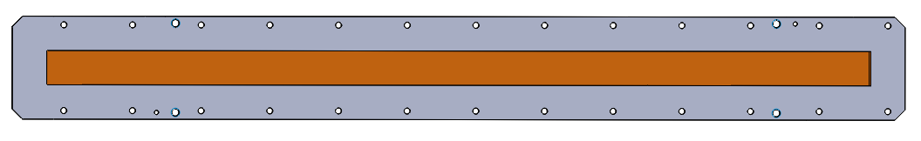
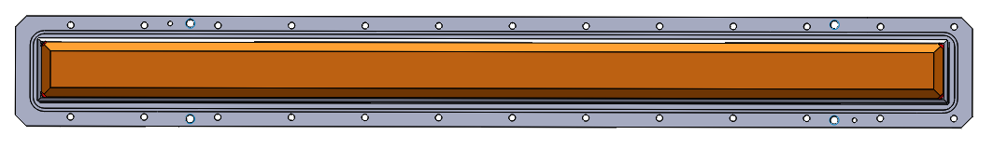
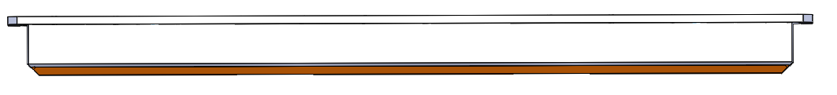
Wall Inserts
Existing DesignStrategy
Top View
Bottom View
Side View
Side View (Transparent Retainer)

Slide 5
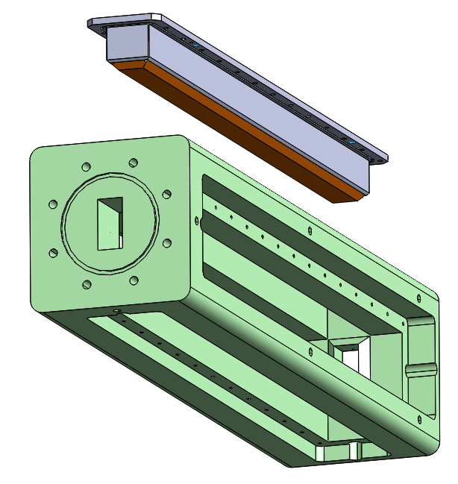
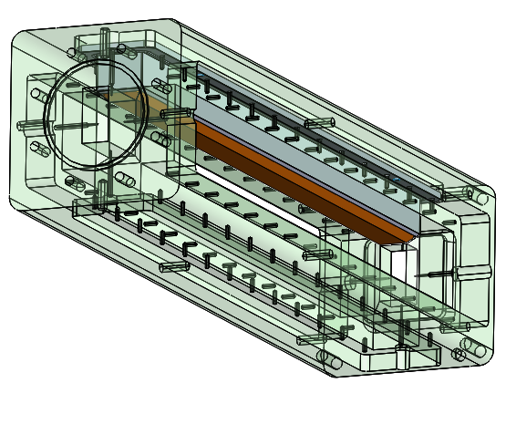
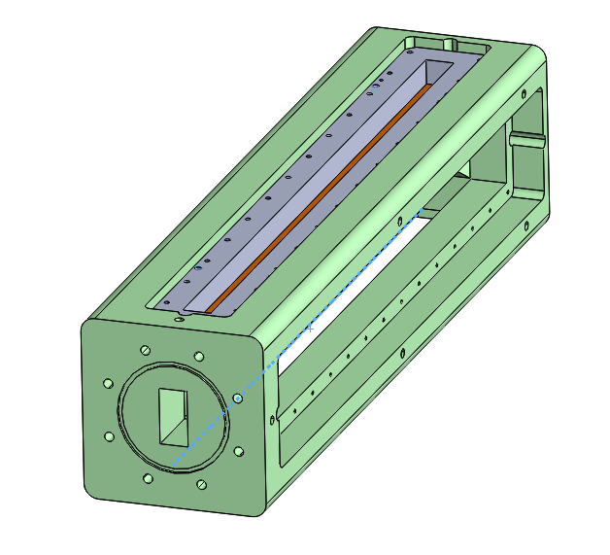
Wall Inserts
Existing Design

Slide 6
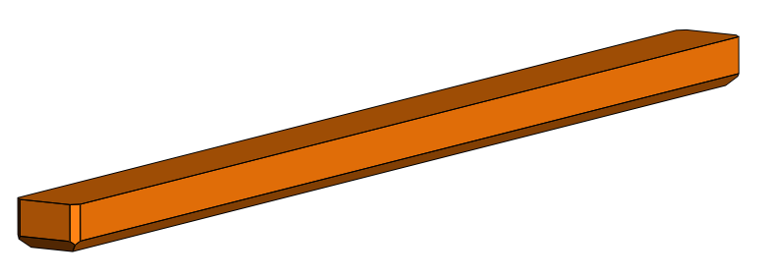
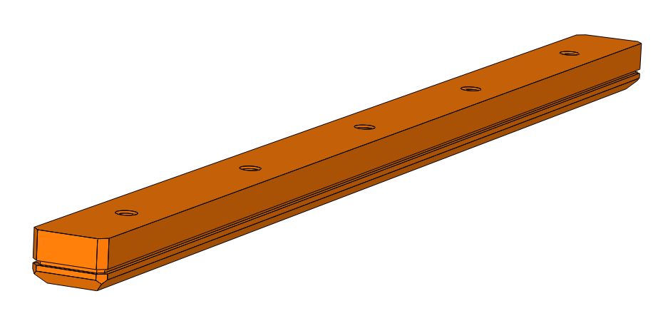
Wall Inserts
Wall Insert Comparison
Existing Wall Insert
Redesigned Wall Insert

Slide 7
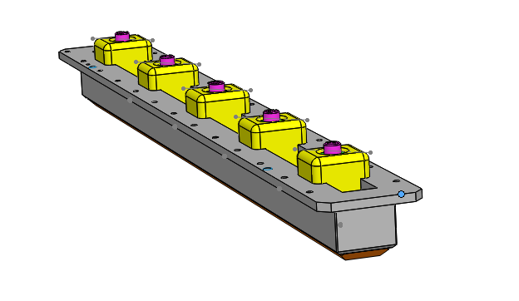
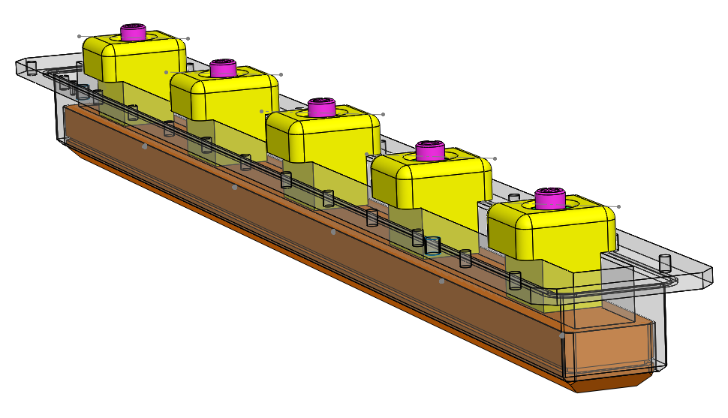
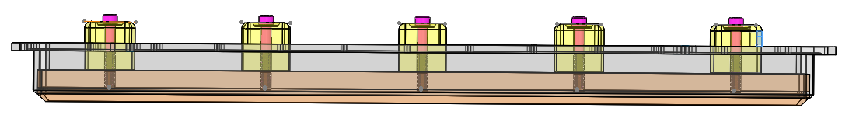
Wall Inserts
Alterations and Additions

Slide 8
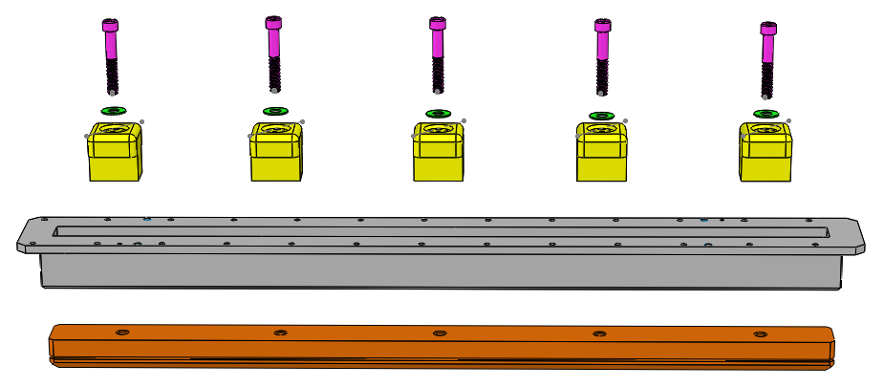
Wall Inserts
Alterations and Additions
Exploded View

Slide 9
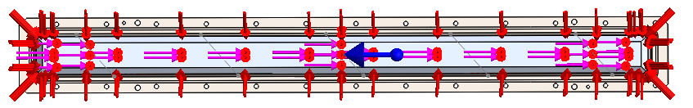
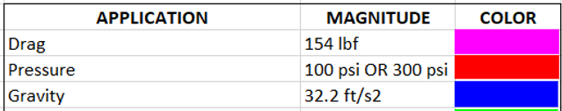
Wall Inserts
FEA Setup

Slide 10
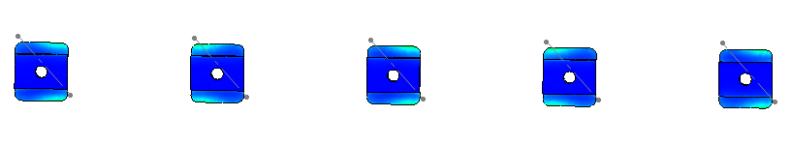
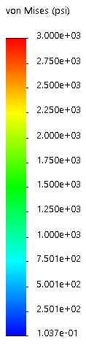
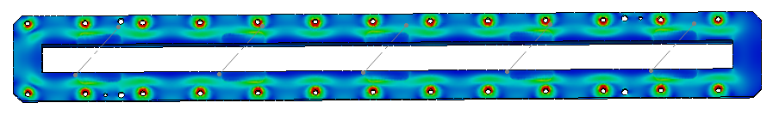
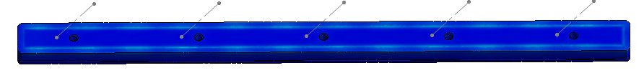

Wall Inserts
FEA Performance
100 PSI

Slide 11
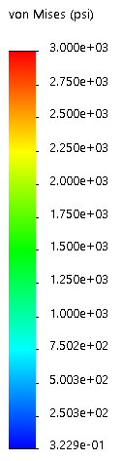
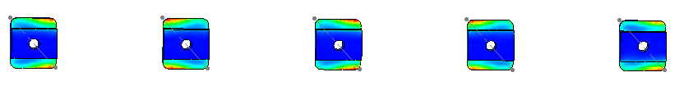
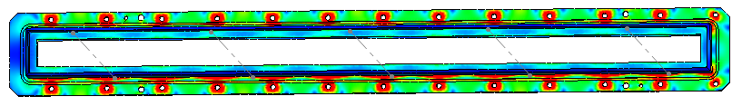

Wall Inserts
FEA Performance
300 PSI

Slide 12
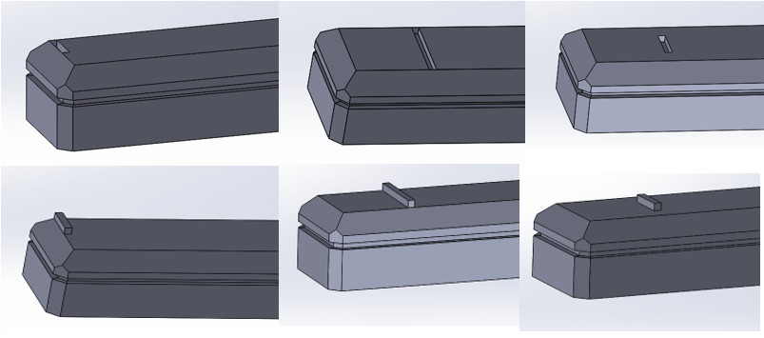
Wall Inserts
Design Variants

Slide 13
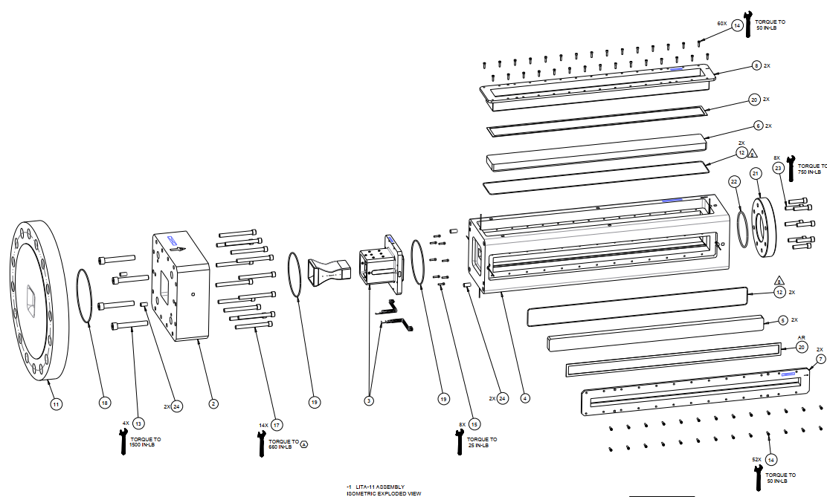
Plenum Modification
Existing Design and Proposed EditsStrategy

Slide 14
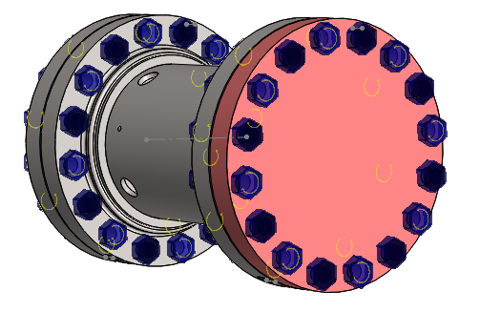
Plenum Modification
Existing Design and Proposed EditsStrategy
Existing Plenum Assembly
Modified Plenum Assembly

Slide 15
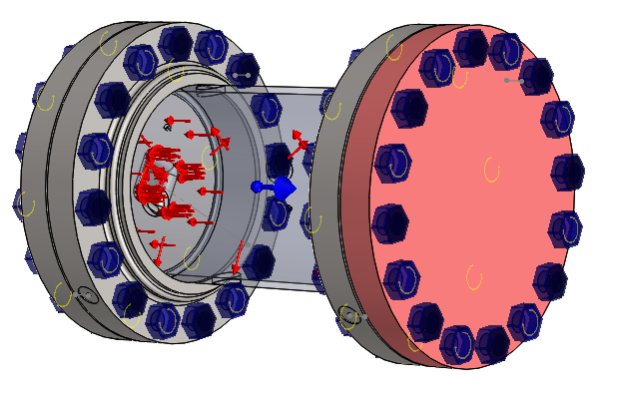

Plenum Modification
FEA Setup

Slide 16
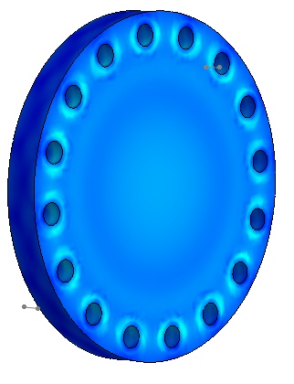
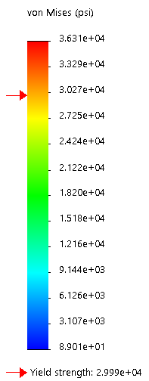
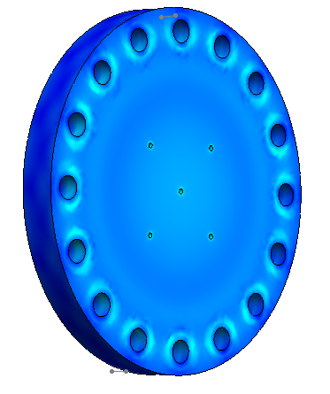
Plenum Modification
FEA Results: 300 PSI
Performance at 300 PSI
PostMod 300
PreMod 300

Slide 17
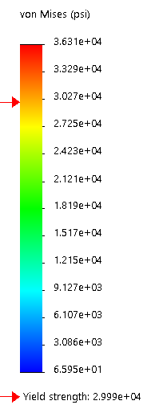
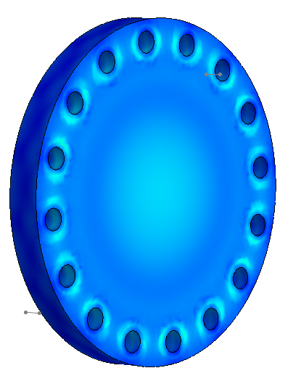
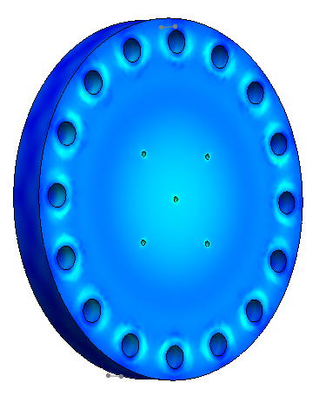
Plenum Modiication
FEA Results: 600 PSI
Performance at 600 PSI
PreMod 600
PostMod 600

Slide 18
Plenum Modification
Conclusions

Slide 19
Plenum Modification
Conclusions
Wall Inserts
Modifications Include
  Addition of O-ring
  Addition of threaded holes to wall insert
  Addition of retainer caps, screws, and washers to top of retainer assembly
FEA indicates that wall inserts should not be expected to yield or fail at either the 100 psi or 300 psi pressure points
FEA indicates that the retainer caps which were planned to be aluminum need to be manufactured from steel instead
Plenum Modifications
Five holes added to face of plenum flange
FEA indicates that though the modified flange experiences more stress than the unmodified flange, it stays within acceptable safety factor ranges
FEA indicates that the modified flange experiences no additional deformation at its center

Slide 20


