Slide 1


Aerosol Wind LIDAR Verification & Validation Data Set
Raina Hempley
John E Marketon
2020 Summer STEM Takes Flight Research Symposium

Slide 2
Challenge
What challenge or issue was your project focused on addressing?
  Providing an understood and known set of data for the verification and validation of a new instrument
  Converting DAPS data to the new system to be compared to the new data
What is the history of the challenge?
  No previous history of this challenge because this was not necessary in the development stage
What has been done to address that challenge in the past?
  It’s never been done before

Slide 3
Objective
Research project objective:
  To study the planetary boundary layer’s wind flow by obtaining 3 dimensional wind measurements.
My specific work objective :
  Transform a data set from the existing DAWN instrument and structure it to be compatible with the new Common Wind Platform acquisition and analysis software
  Provide a dataset for algorithm testing and verification.
Work ties in with the overarching project research objective via:
  Data verification of the new sensor’s output
  Conversion to advanced system/software/processors allows for optimal data evaluation/manipulation/calculations

Slide 4
Approach
What I did?
  Wrote code to converted the DAWN’s old DAPS data set into the new CWP SQL database
How I did it?
  Familiarization with versions of MATLAB and SQL code used and its limitations
  Used MATLAB to write code to automate the translation of the old data set into the new database
How it contributes to my research objectives?
This known and well understood data set provides a baseline for verifying, testing, and debugging the new CWP software being developed to handle the DAWN, Wind-SP, and AWP aerosol wind LIDAR instruments.

Slide 5
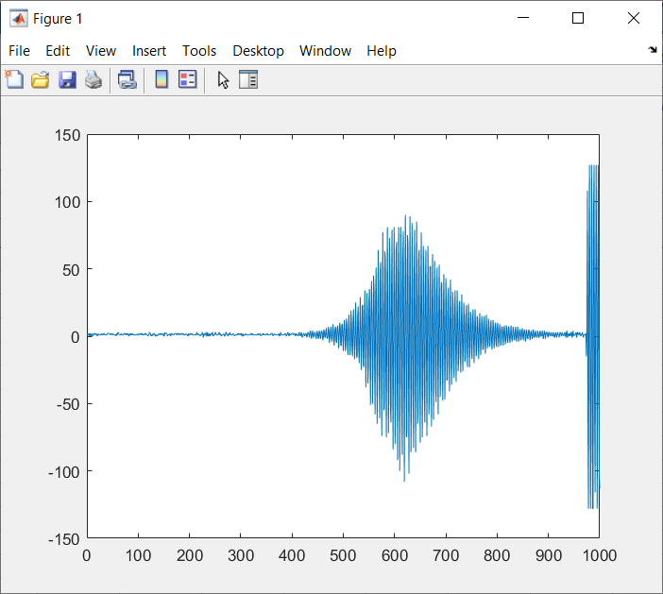
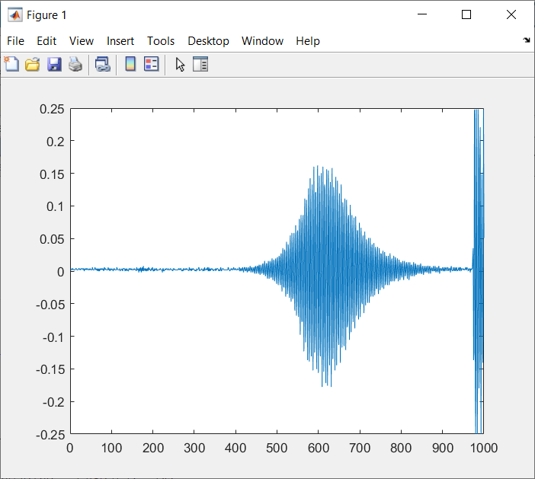
Results & Analysis
Result: Data conversion was successful but optimizing speed of conversion was tricky
Expected: no difference between the old data set and data set in SQL’s speed of conversion.

Slide 6
Summary
Summary: Discovered bottlenecks, Conversion is not quite the same
Project direction was unchanged with acknowledgement of bottlenecks

Slide 7
Next Steps/Outlook/Future Work
What would you do if you had 4 more weeks?
  I would develop the code to improve the current software
What would you do if you had 4 more months?
  I would work on collecting new datasets and help with the analysis
If I continued working on the team, I would most likely work on different sections of the code and eventually help with collecting new datasets, because of the finite nature of the task

Slide 8
Acknowledgements
Much appreciation for their evaluation, code reviews, encouragements, and professionalism:
  Seth Begay
  Zhaoyan Liu
  Connor Huffine
Special thanks for their guidance and dedication:
  John Marketon
  Shaw Lavanna
Grateful for their STEM stewardship through funding support: NASA’s Headquarters Earth Science Division(ESD) and Earth Science Technology Office(ESTO); Stem Takes Flight/ODU/NASA partnership

