Slide 2
Code TSM STAR Labs Facility, Capabilities, and Equipment
June 2020

Slide 3
Background
The Sensors & TPS Advanced Research (STAR) Labs at NASA Ames Research Center specializes in engineering, design, and fabrication of test articles from a variety of thermal protection materials (TPS) as well as sensors and instrumentation.
Test articles may be as simple as coupons for material characterization or as complex as space-flight articles with surface treatments and multiple sensors.
TPS materials possess unique challenges for fabrication due their material characteristics which may be anything from very abrasive, low density/high porosity, high density/low porosity, flexible, rigid, or any combination of the above.
TPS materials are highly sensitive to contamination from many sources such as machine coolants and oils, skin oils, and other chemicals so cutting and fabrication operations are processed dry, without any lubricants.

Slide 4
Background Continued
Safety is the primary goal of STAR Labs.
Industrial dust collectors capture airborne dust during cutting and fabrication operations to ensure a safe environment for personnel as well as a clean space for TPS related work.
Employees wear personal protective equipment (PPE) such as safety glasses or goggles, nitrile gloves, and smocks for their own protection as well as to maintain cleanliness of the TPS materials and instrumentation.
Depending on the TPS material in process, additional engineering controls or PPE may be used to ensure personnel safety.

Slide 5
Facilities
STAR Labs is located in building N242 at NASA Ames Research Center.
Facilities occupy approximately 5,600 ft² on the first floor and 4,900 ft² on the second floor.
Facilities are grouped by function, or material requirements, throughout 17 distinct lab spaces.
Outer building doors are unlocked and open during normal business hours.
Internal doors leading to all lab spaces remain locked and accessible only by key or cypher lock.
All lab spaces fall under ITAR controls.
Classified work is not performed within STAR Labs, however many projects fall under the designation of Sensitive But Unclassified (SBU).

Slide 6
Capabilities
Engineering design and test support.
Process development.
Design, build, and qualify instrumentation for flight projects.
Construction of instrumented ground test articles:
Arc Jet.
Shock & Vibration.
TPS Validation.
Material Characterization.
Inspection and evaluation support:
X-ray and CT.
Laser surface scanning.
Support development of reusable TPS
Coatings and Surface Treatments: TUFI, RCG, C9, CC2 (catalytic coating), HETC, and PCC.
Gap fillers.
Rigidized Surface Insulators: AETB, FRCI, and AIM.

Slide 7
Projects & Stakeholders
3 Dimensional Multifunctional Ablative TPS (3DMAT).
Adaptable, Deployable, Entry and Placement Technology (ADEPT).
Arcjet Calorimetry.
Asteroid Threat Assessment Project (ATAP).
Commercial Crew and Commercial Cargo.
Heatshield for Extreme Entry Environment Technology (HEEET).
Mars 2020.
Mars Energy Descent and Landing Instrument (MEDLI2).
Mars Sample Return (MSR).
Materials International Space Station Experiment (MISSE)
Orion Developmental Flight Instrumentation (DFI).
Orion Thermal Protection System (TPS).
Space Act Agreements and technology transfers with private industry: Blue Origin, Boeing, Lockheed, Sierra Nevada Corporation, SpaceX, Stratolaunch.
NOTE: Projects and stakeholders highlights only, not a comprehensive list.

Slide 8
Equipment
Manual fabrication equipment:
Mill, lathe, drill press, band saws, disc sanders, table saw.
CNC machines:
3-axis mills, 3-axis mills with 2-axis trunnions for 5-axis capability, 2-axis lathes with turret.
High temperature electric kilns/furnaces, vacuum hot-press, retort furnace, thermal vacuum chamber, quartz lamp bank, IR lamp, halogen lamp.
Laboratory fume hoods, spray booths, spray guns, air brushes, and drying ovens.
Jar roller mills, planetary mill, attritors, cold isostatic press.
X-ray, CT scan, scanning electron microscope (SEM).
3D printer, Laser scanner/digitizer, optical comparators, laboratory scales, assorted measuring/inspection devices, microscopes.
Thermocouple welders (Bead), laser thermocouple welder (Butt),
Electrodynamic shaker.
Ultrasonic cleaners.
CAD/CAM
NOTE: Equipment list covers highlights only, not a comprehensive list.

Slide 9
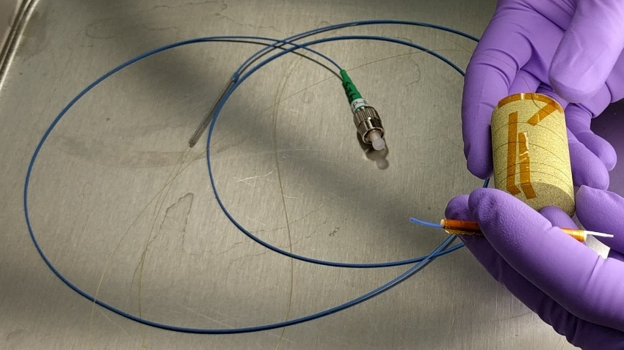
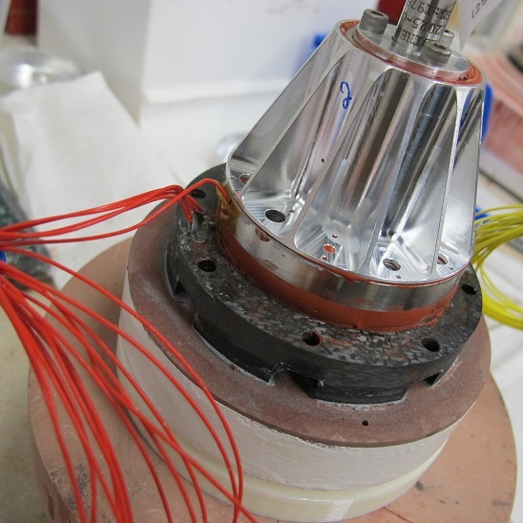
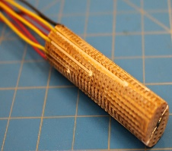
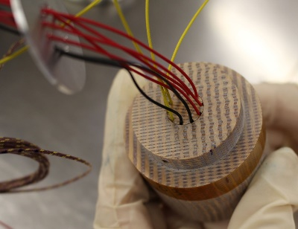
Gallery
Examples of articles produced by STAR Labs:

Slide 10
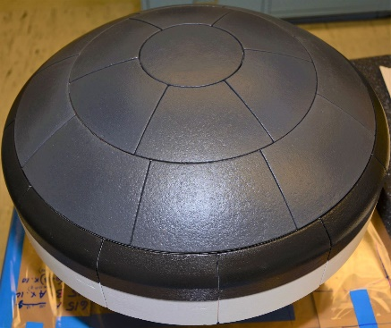
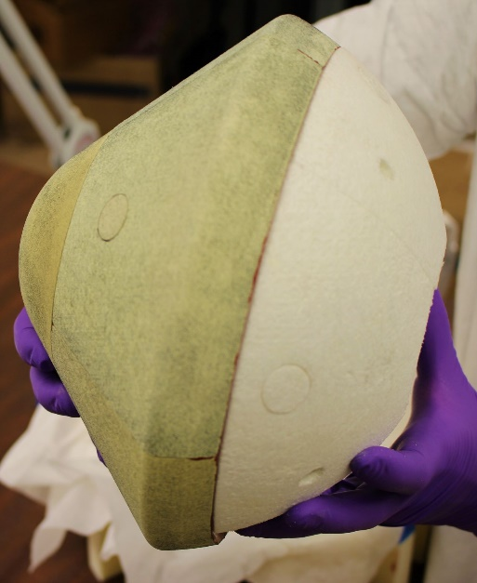
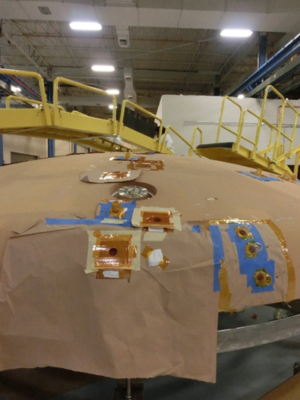
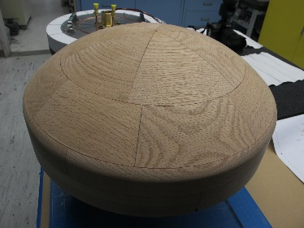
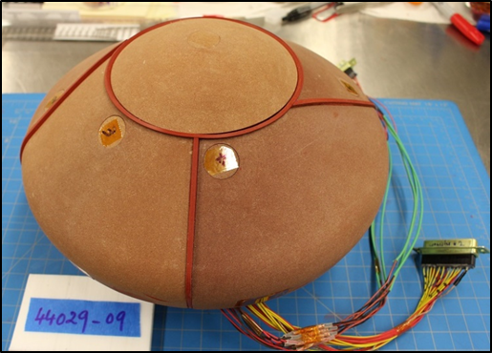
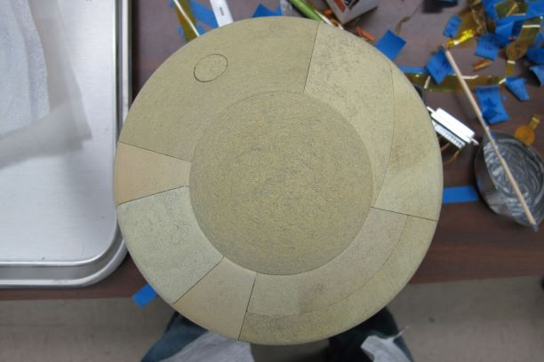
Gallery
Examples of articles produced by STAR Labs:

Slide 11
End

