Slide 1







Photo: Rainforest Rescue
SERVIR Amazonia
Overview and Highlights
Andrea Nicolau
NASA-SERVIR Regional Science Associate
Mekong

Slide 2
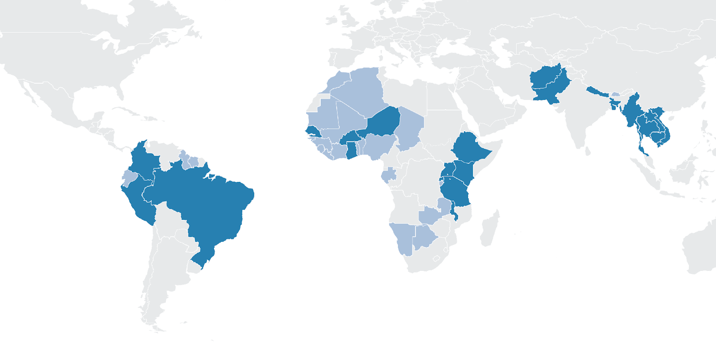

SERVIR SERVICES MEET NEEDS IN ASIA, Africa, and the Americas
SERVIR Science Coordination Office
NASA MSFC
SERVIR Hindu Kush Himalaya
ICIMOD
USAID Washington
NASA Headquarters
SERVIR Amazonia
CIAT
SERVIR Eastern & Southern Africa
RCMRD
SERVIR Mekong
ADPC
SERVIR West Africa
AGRHYMET
Focus Countries
Additional Reach

Slide 3
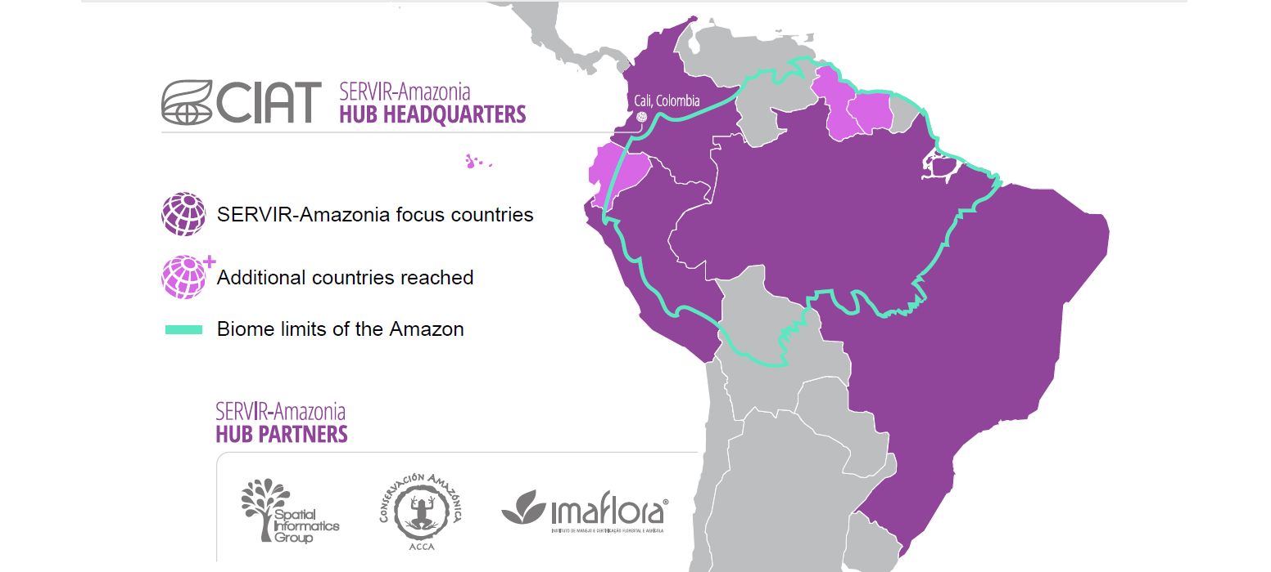
SERVIR AMAZONIA - FOCUS COUNTRIES

Slide 4
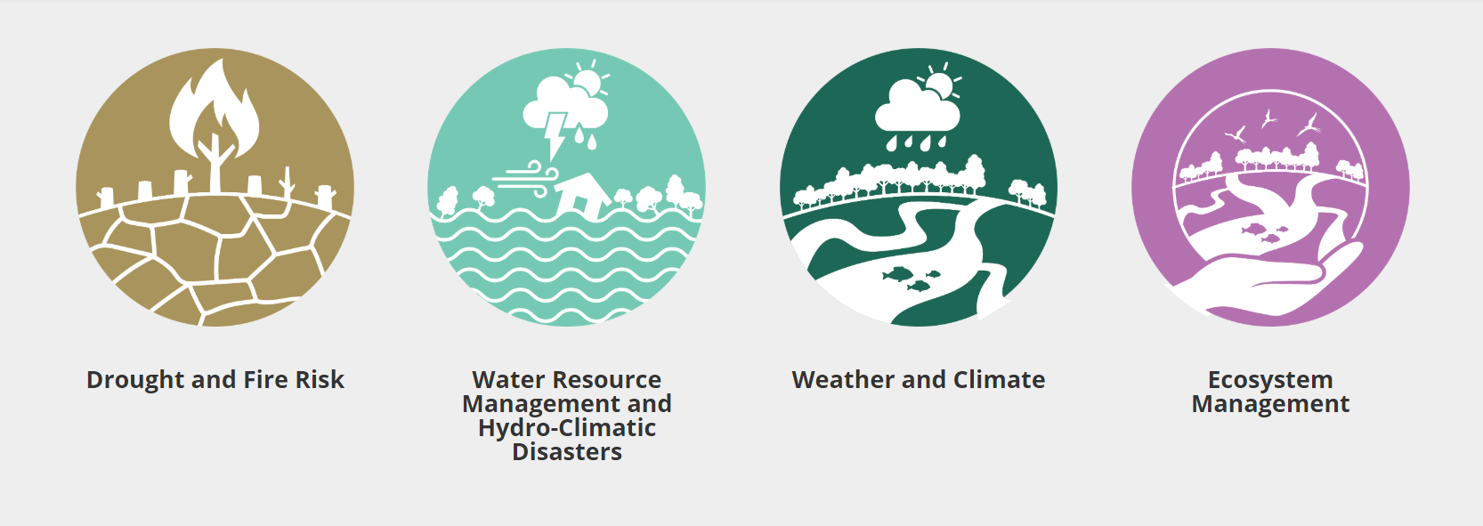
SERVICE AREAS

Slide 5
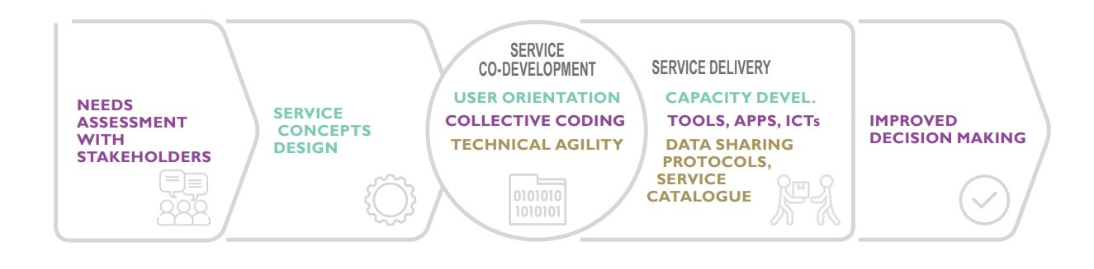
Service co-development

Slide 6

Services
Radar for detecting forest change
Monitoring & evaluation of mangroves in Guyana
Deforestation monitoring and reporting in Ecuador
Monitoring of gold mining in the Peruvian Amazon
Monitoring of gold mining in the Colombian Amazon
Forecasting seasonal to sub seasonal fire and agricultural risk from drought
Improving resilience and reducing risk of extreme hydrological events
Ecosystem services modeling in the Amazon’s forest-agriculture interface
Quantifying the effects of forest change on provisioning and regulating ecosystem services
Monitoring forest dynamics from space to enable sustainable livelihoods and biodiversity conservation in the Amazon (TerraBio)
Increase the protection of forests with traditional communities and indigenous peoples (Origins)
Amazon landscape and biodiversity Atlas

Slide 7

Social inclusion
Indigenous People
Most of the Amazon Basin is traditional territory of indigenous peoples now subject to enclosure for legal and illegal purposes
To ensure IPs know about, can access and benefit from SERVIR-Amazonia services, the Program engages representative IPOs, includes their needs, priorities in planning, training events.
The leading IPOs in the region already use GIS services that we help strengthen.

Slide 8
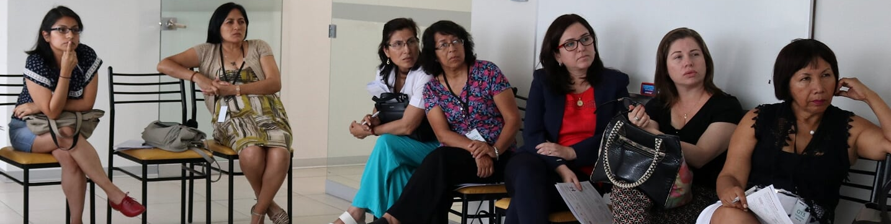
Social inclusion
Gender
Improving women’s leadership and creating an environment that provides opportunities to all, regardless of gender: Community of Practice
Integrating a gender lens in services
Increasing the use of remote sensing and GIS to address gender equity
Photo credit: SERVIR-Amazonia

Slide 9




Innovative science: 4 applied sciences teams
Naiara Pinto
Jet Propulsion Laboratory
Unlocking the Power of
Active Remote Sensing for Ecosystem Services Modeling in the Amazon’s
Forest-Agriculture Interface
Jim Nelson
Brigham Young University
Improving Resiliency and Reducing Risk of Extreme Hydrologic Events through Application of Earth Observations and In Situ Monitoring Information
Douglas Morton
Goddard Space Flight Center
Forecasting Seasonal to
Sub-Seasonal Fire and Agricultural Risk from Drought in Amazonia
Stephanie Spera
University of Richmond
Quantifying the Effects of Forest Cover Changes on Provisioning and Regulating Ecosystem Services in the Southwestern Amazon

Slide 10
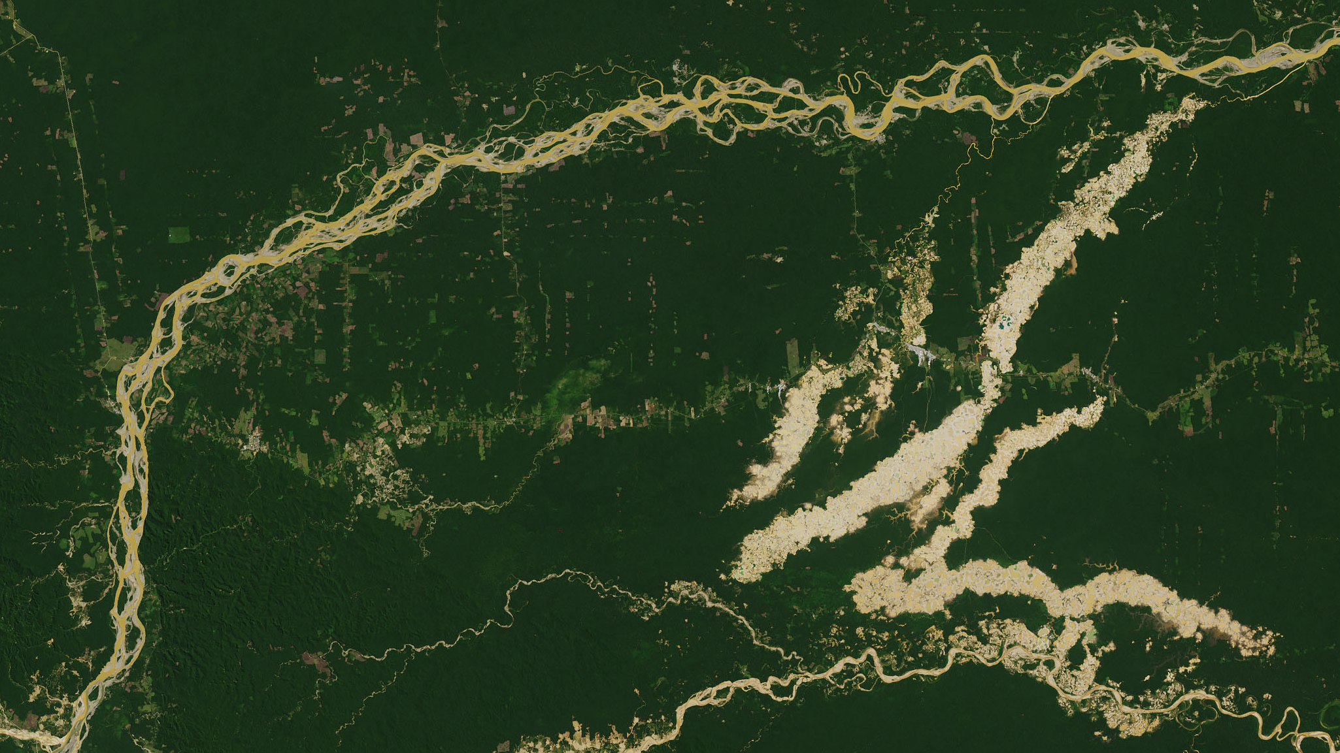
Monitoring of Gold Mining in the Peruvian Amazon
Source: The Nation, AP Photo / Rodrigo Abd
Notes:
Image Credit: Sally Ride EarthKAM http://images.earthkam.org/main.php?g2_view=core.DownloadItem&g2_itemId=1270164
Yungas Foothills

Slide 11
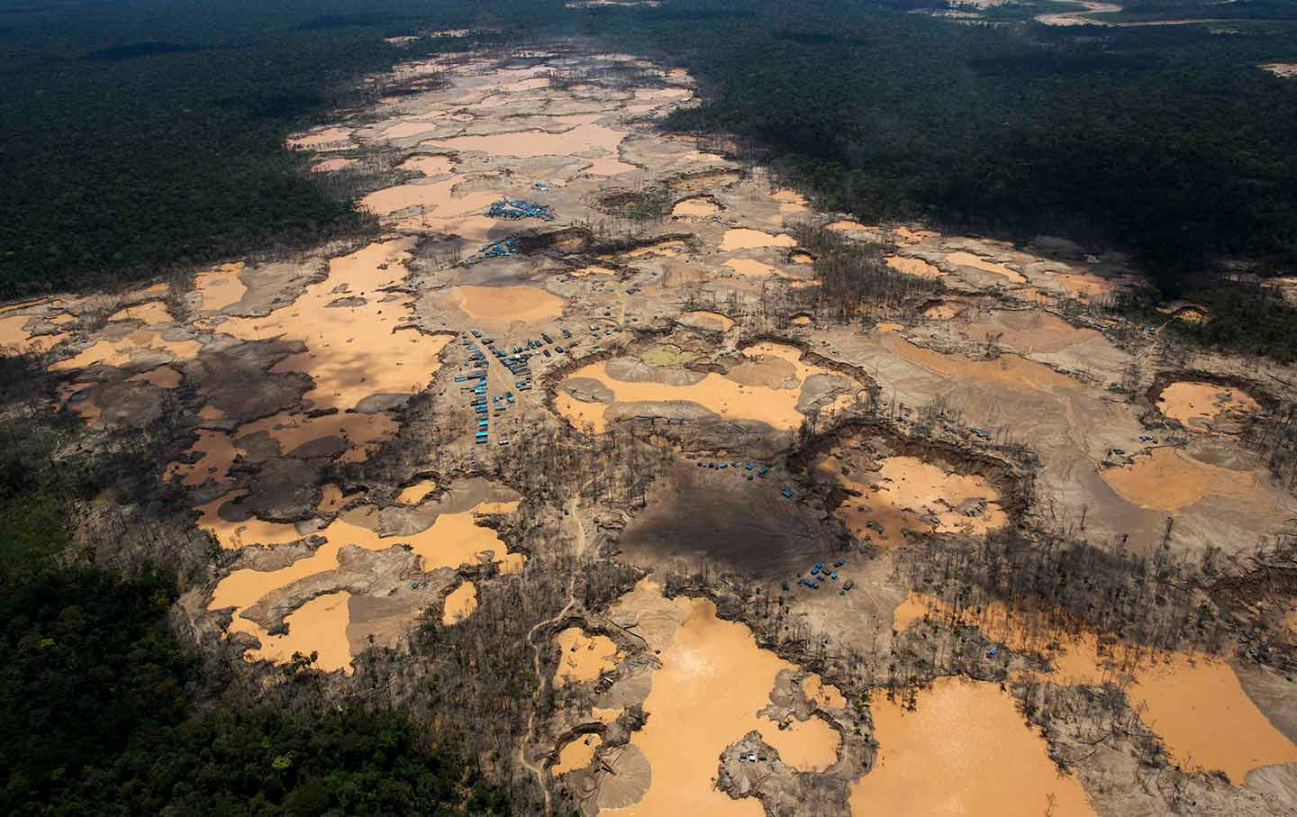



objectives
Produce near real time information about gold mining-related deforestation
Rapid identification of possible illegal mining fronts in priority areas
Differentiate the occurrence type (illegal, informal, formal) to better inform actions to authorities
Photo credit: The Nation

Slide 12
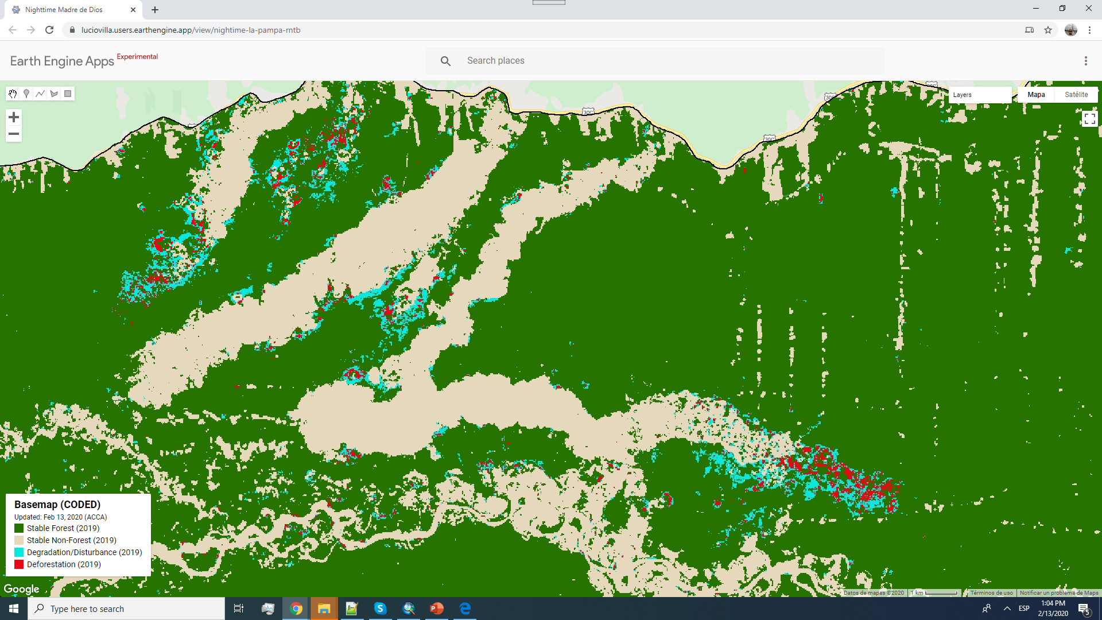
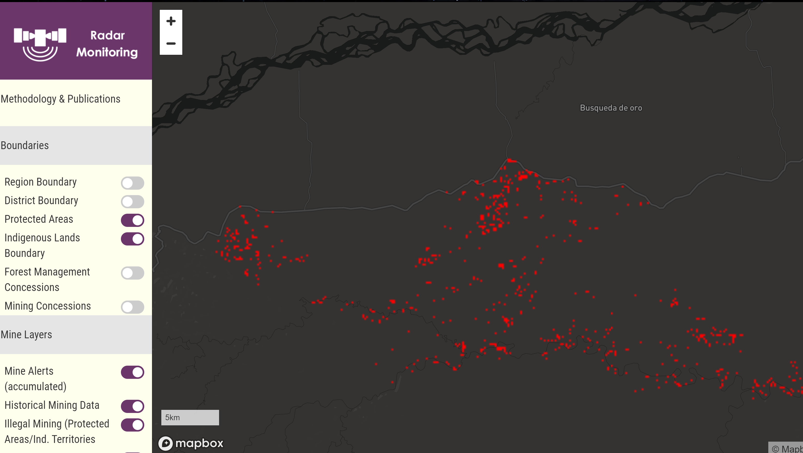
Web-app
ACCA works extensively with the Government of Peru to provide actionable data using methods that combine multiple remote sensing products, computing platforms such as Google Earth Engine, SAR and high-resolution data.
Change Detection
Alerts
Validation
APP
Base Layers

Slide 13
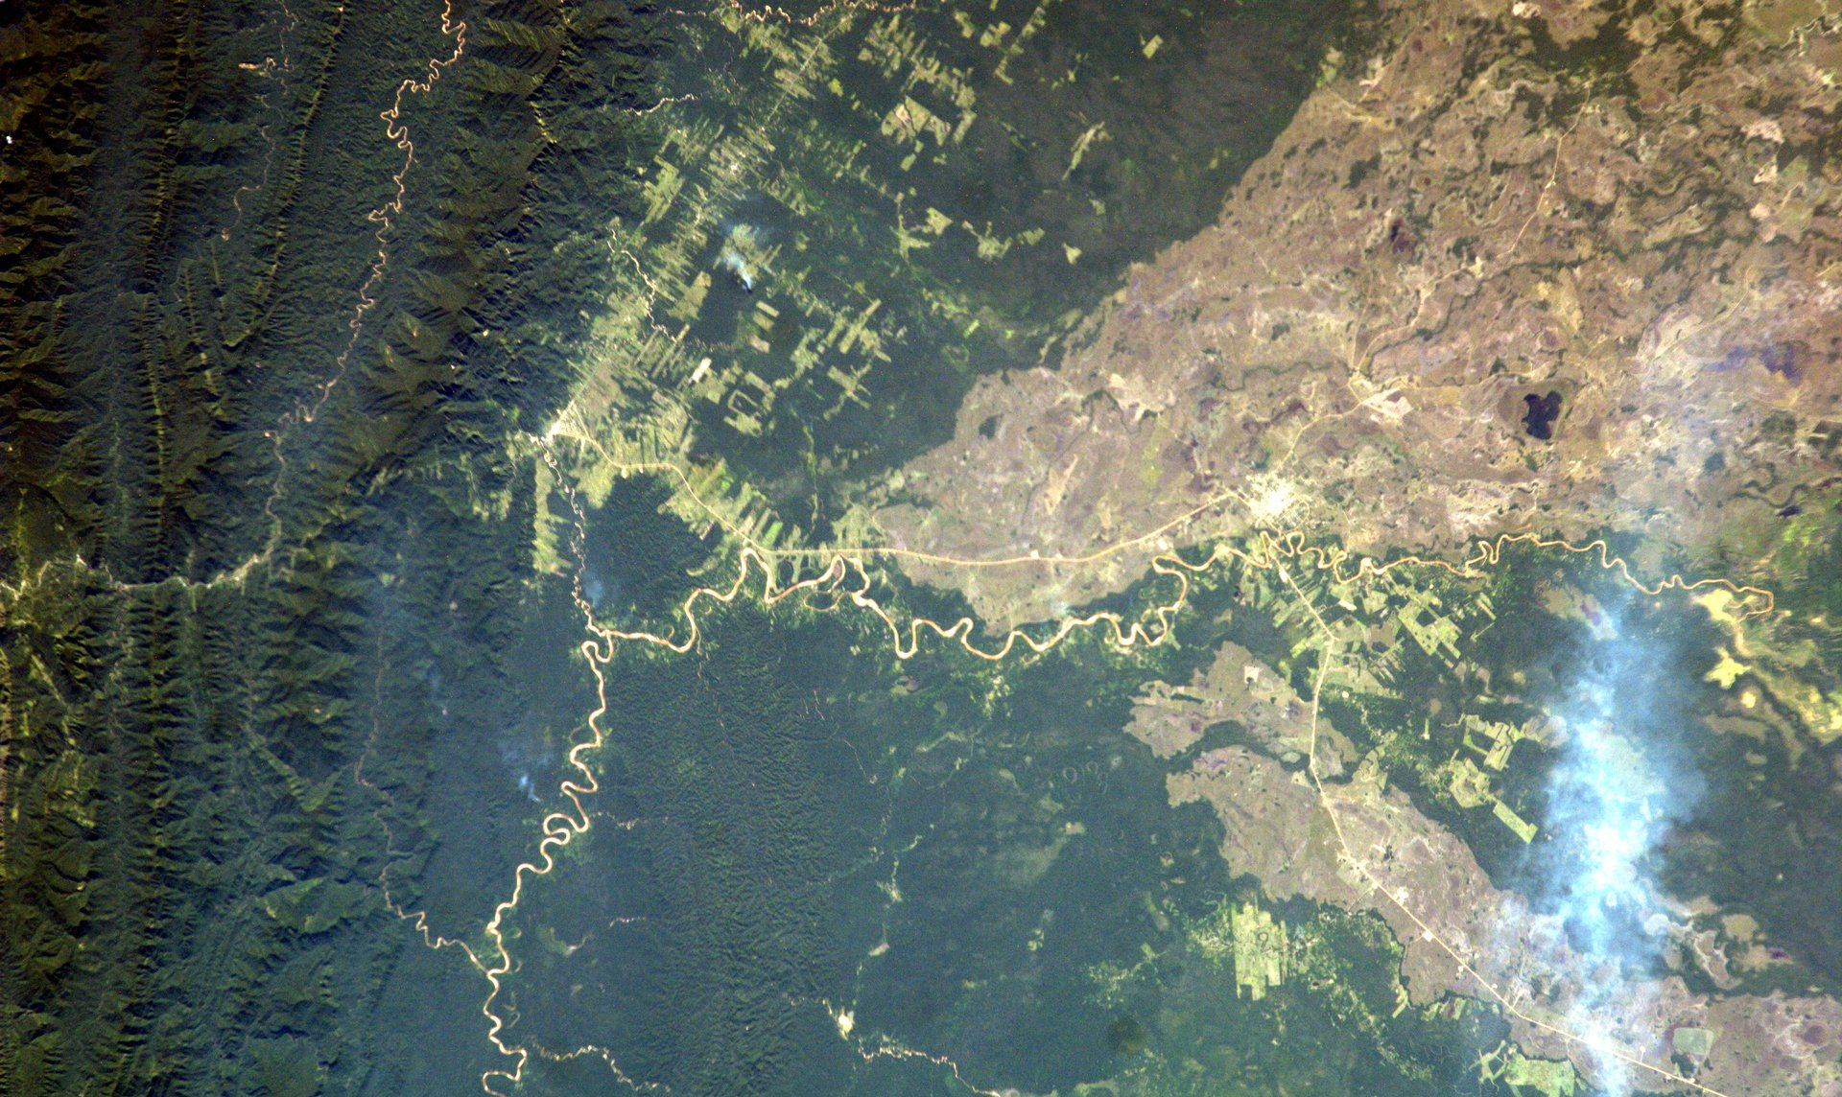
Deforestation Monitoring and Reporting in Ecuador
Notes:
Image Credit: Sally Ride EarthKAM http://images.earthkam.org/main.php?g2_view=core.DownloadItem&g2_itemId=1270164
Yungas Foothills

Slide 14
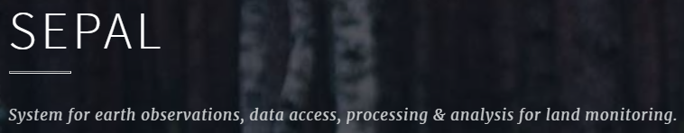
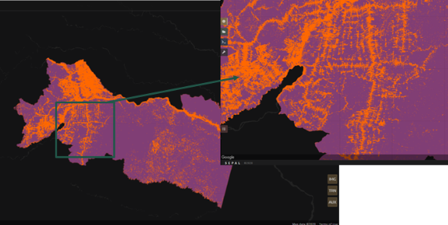

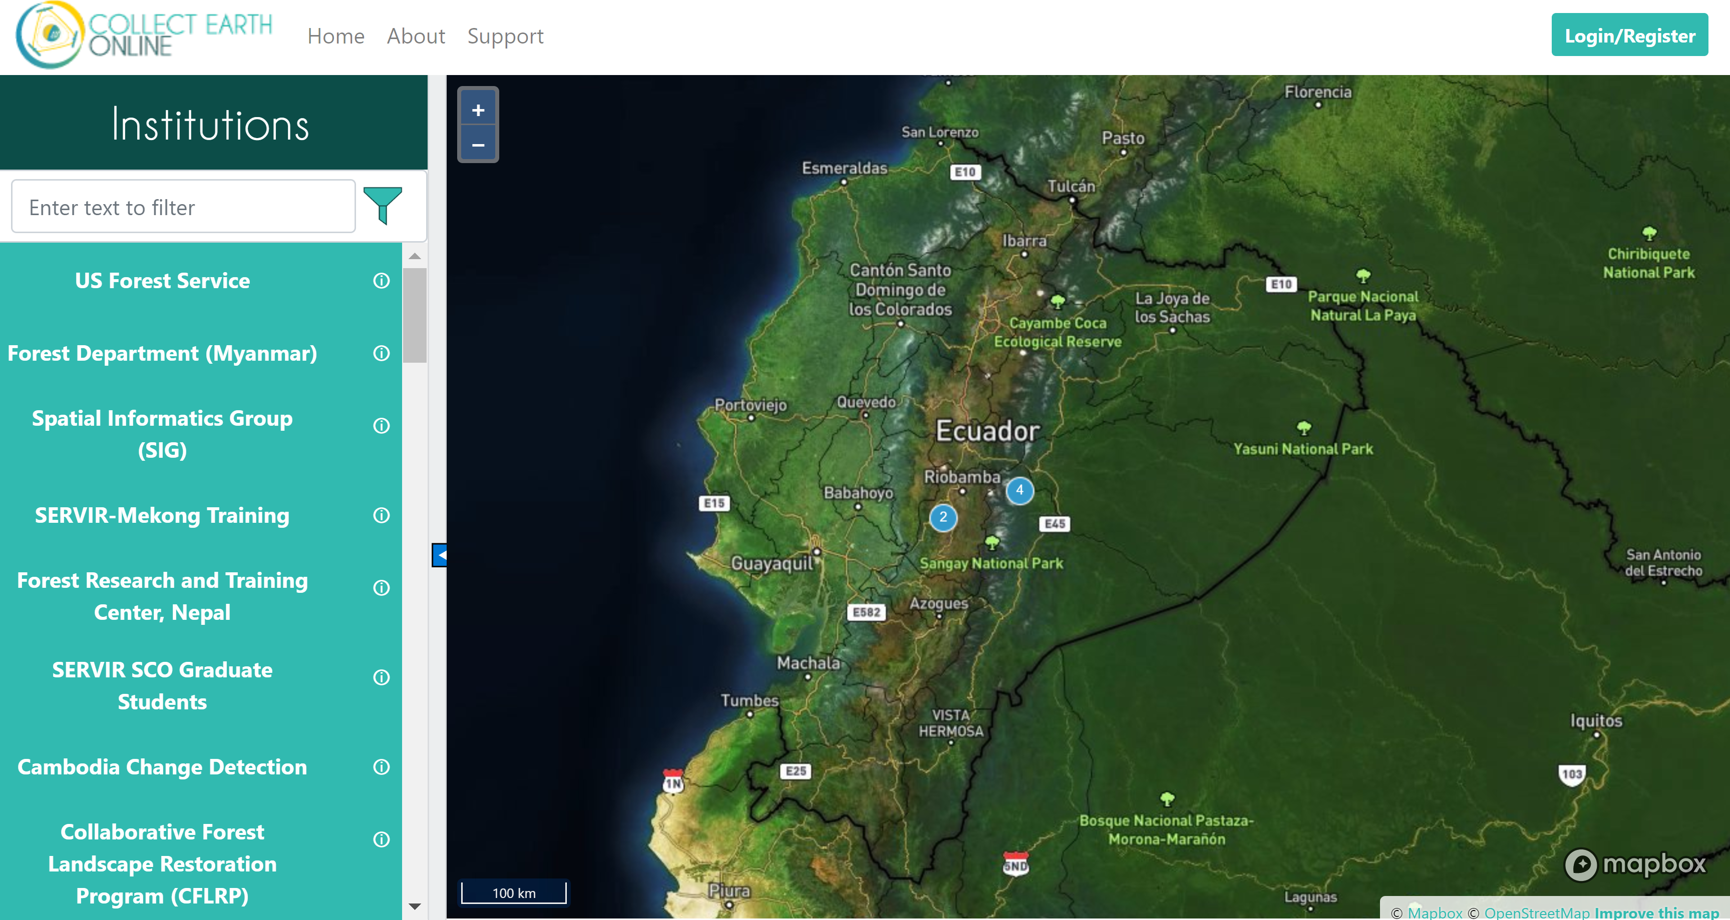



background
Ecuador has been engaging in national efforts to reduce carbon emissions from the forest sector, as an integral part of the National Action Plan for REDD+
SERVIR-Amazonia, in collaboration with FAO, is now contributing to Ecuador’s efforts to effectively reduce carbon emissions by implementing methodologies to reduce uncertainties in area estimation

Slide 15
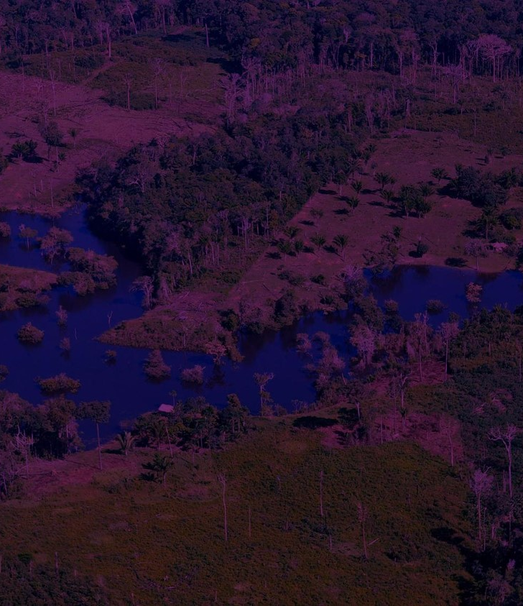

Thank You.
For further questions, please contact:
andrea.puzzinicolau@nasa.gov
africa.flores@nasa.gov – SERVIR Amazonia Regional Science Coordination Lead
www.servir.ciat.cgiar.org #SERVIRamazonia

