Slide 1
Visualization and 3d mesh generation for assemblerS range of motion
Jonah D. Vanke – Exit Presentation

Slide 2
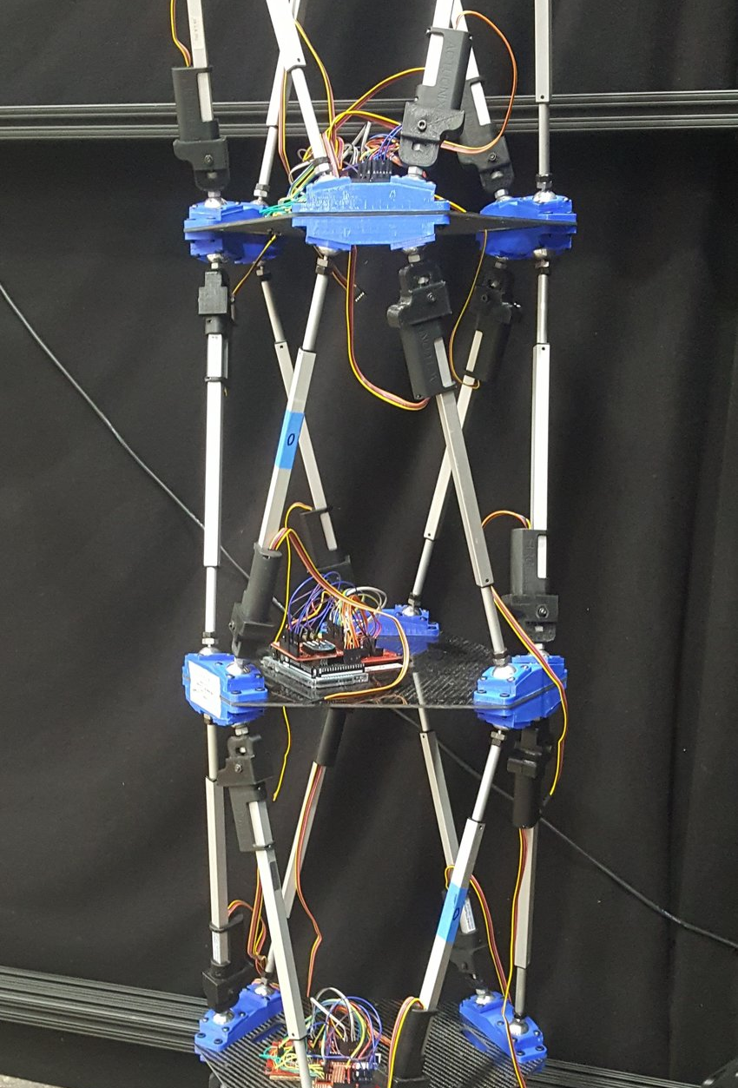
assemblers

Slide 3
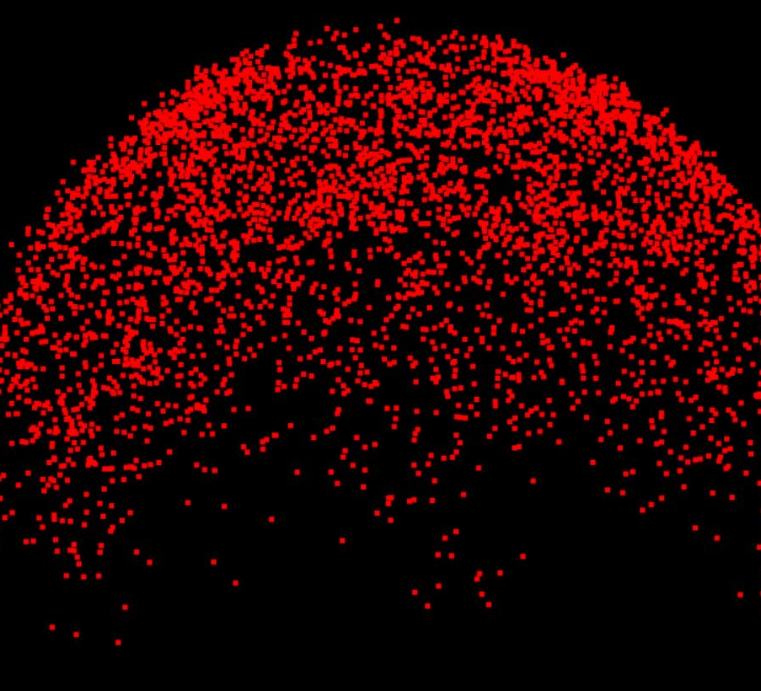
Assembler rom point clouds
Thousands of potential reaches generated randomly
Initially based on uniform distribution, later modified to include more extreme positions for multiple-SP stacks

Slide 4
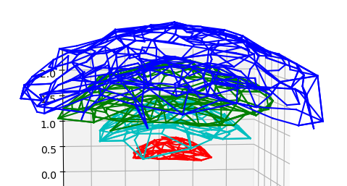
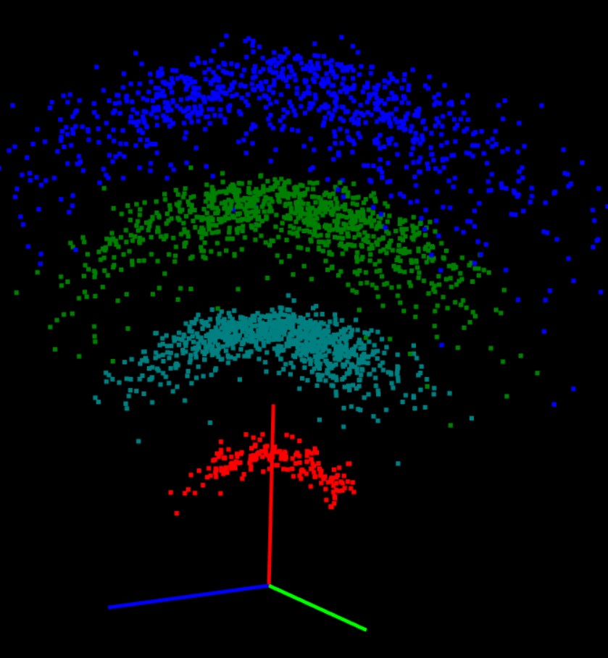
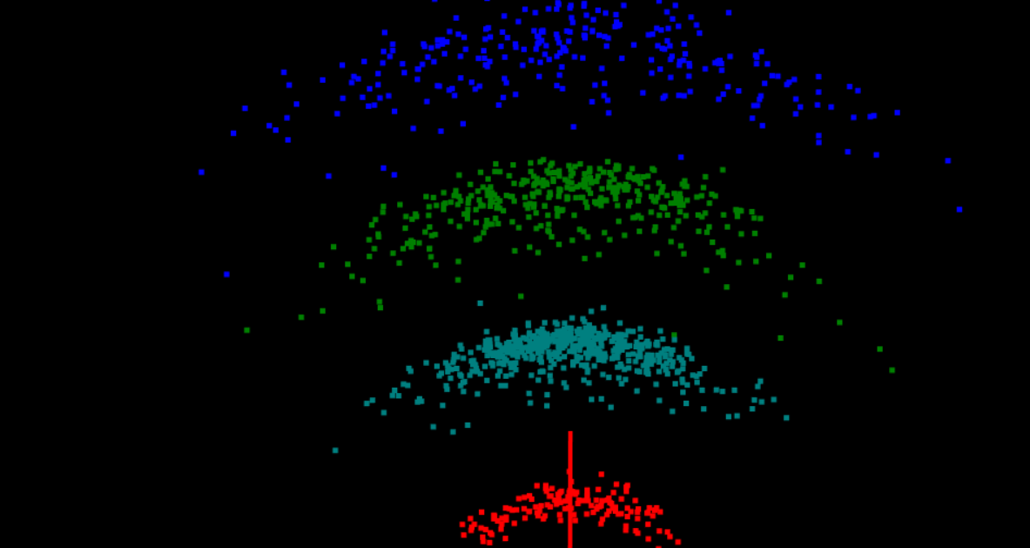

Slide 5
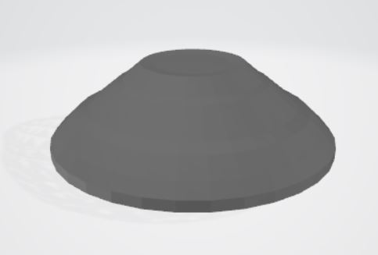
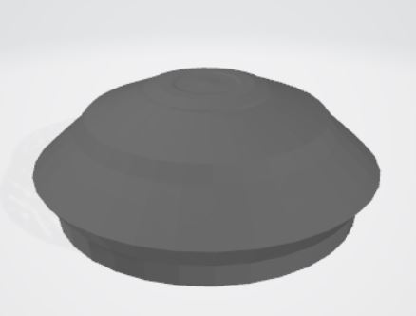
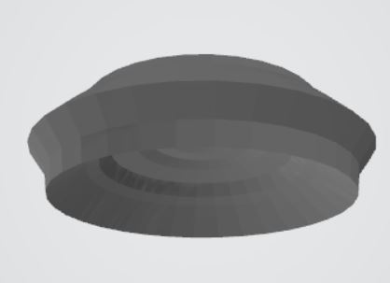
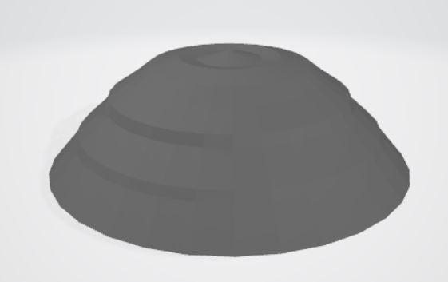
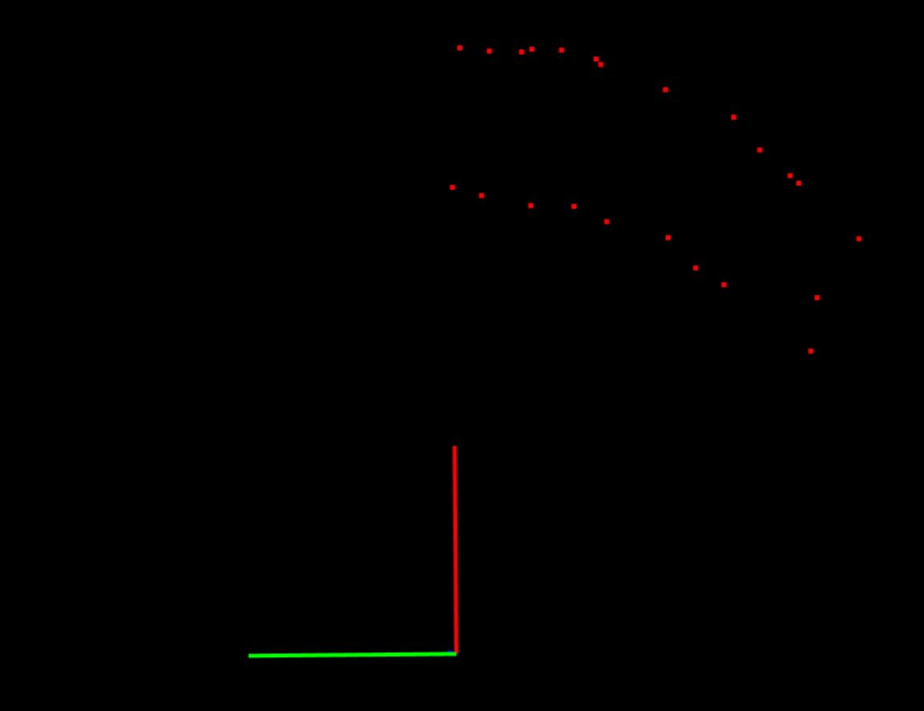
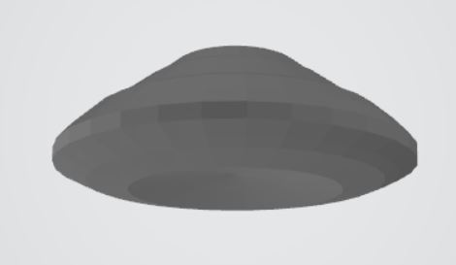
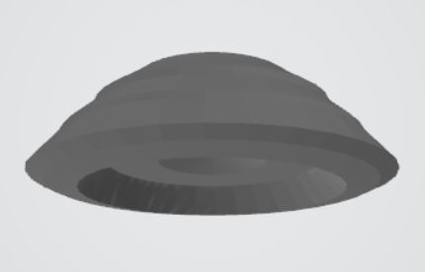
Rotation-based STL Generation
Files created using a 2-dimensional projection of a narrow 3-dimensional section of the point cloud revolved about the y-axis
Limited in capability due to asymmetry in true ASSEMBLER reach
A close approximation of initial non-extreme point clouds

Slide 6
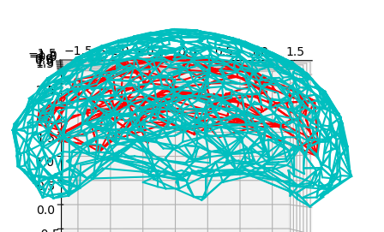
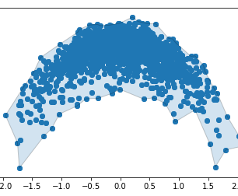
Alpha shapes
Bounding shapes for a set of points based on a circle or sphere of a given radius alpha
Used for generating a 2D edge to create rotation-based shells, and later for more representative STLs

Slide 7
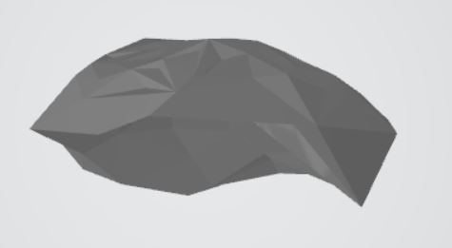
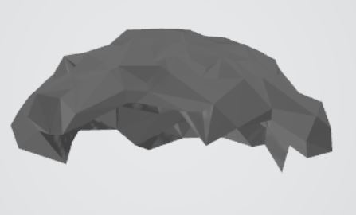
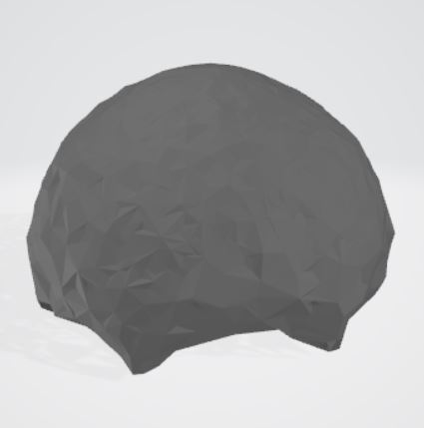
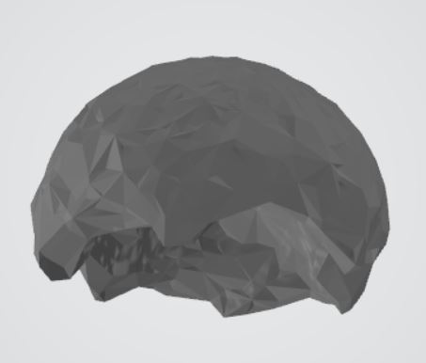
Alpha shape based stl generation
STL for 2-platform stack (uniformly random)
STL for 4-platform stack (uniformly random)
Used for more representative shells for initial, uniformly random point clouds
Also used to more accurately represent asymmetry of extreme reach
STL for 4-platform stack (extreme positions)

Slide 8
questions

