Slide 1

Delamination Depth Imaging for Quasi-static and Fatigue Load Testing Using Passive Thermography
Joseph N. Zalameda and William P. Winfree
NASA Langley Research Center
Hampton, VA 23681
QNDE Virtual Conference August 25-26, 2020

Slide 2
Outline
Introduction
Passive Thermography
  Single Stringer Panel Quasi-static Loading
    Imaging for Damage Growth with Ultrasonic and X-ray CT Comparisons
  Single Stringer Panel Fatigue (Cyclic) Loading
    Imaging for Damage Growth
Reduction of Thermal Data for Damage Depth
  Model Fit to the Thermal Data (Fatigue and Quasi-static Loading)
Conclusions

Slide 3
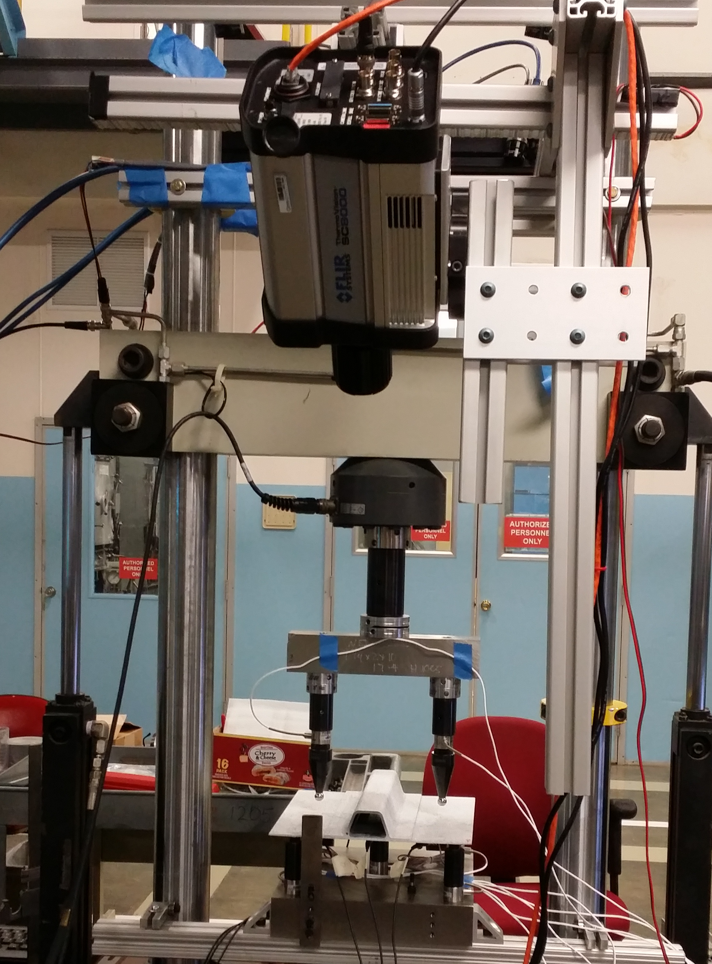
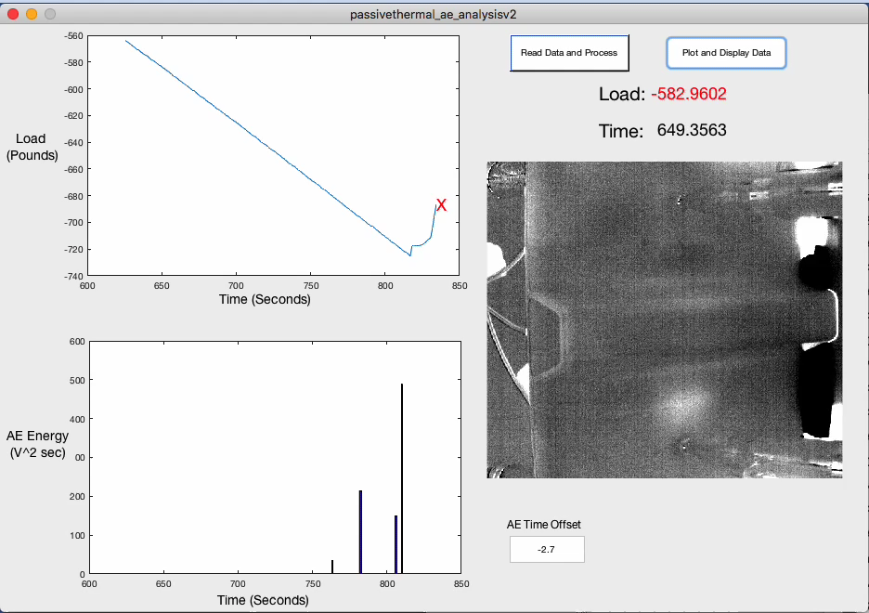
Single Stringer Panel Quasi-static Loading
IR Camera
Single Stringer Panel
Skin is 12 plies (0.22 cm thick), stiffener flange is woven composite 12 plies (0.24 cm thick), camera is synchronized to loading, 640 x 512 cooled InSb sensor, 25 mm Ge optics, and load is acquired for each frame, frame rate of camera is 80 -180Hz, applied load to over 1,000 pounds typically over 15 – 25 minutes.

Slide 4

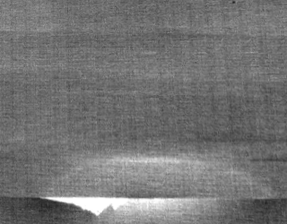
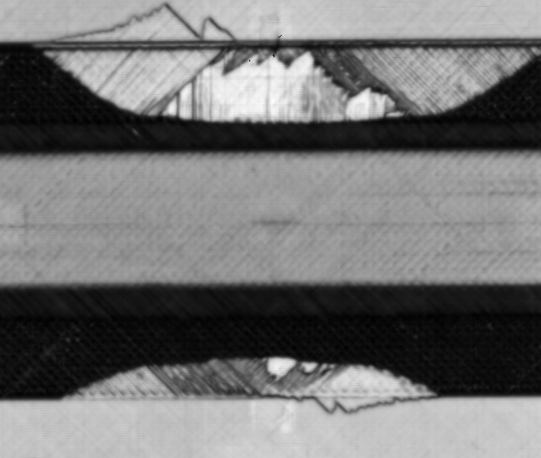
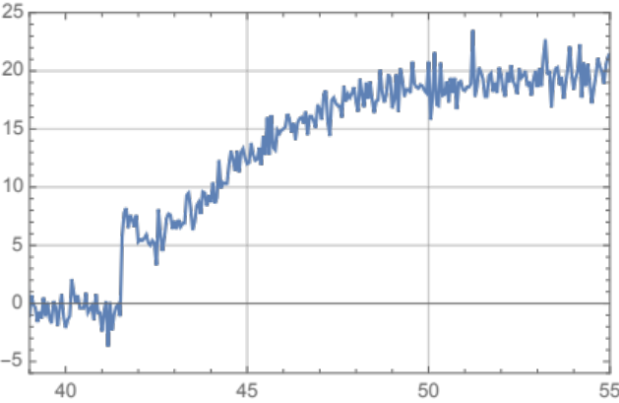
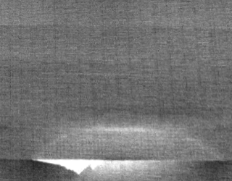
Single Stringer Panel Quasi-static Loading Thermal Responses
Next Image:
Elapsed Time = 0.056 seconds
Before Failure
Ultrasonic Inspection
7.6 cm
Instantaneous Heating
Single Pixel Plot
Instantaneous Heating Image
7.6 cm
Temperature (Counts)
Time (Seconds)

Slide 5
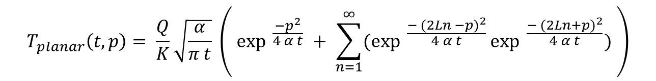
1-Dimensional Series Solution for a Planar Heat Source and Thermoelastic Heat Source
Infrared Camera
Winfree, W. P., Zalameda, J. N., and Michael R. Horne, “Simulations of Thermal Signatures of Damage Measured during Quasi-Static Loading of a Single Stringer Panel”, AIP Conference Proceedings 2102, 120007 (2019); https://doi.org/10.1063/1.5099849, Published Online: 08 May 2019.
Stiffener Flange
Thickness = L
T (t)
Heat Flux
depth = p
Heat Source
from Damage
at depth = l
Skin
$$T_{planar}\left(t, p\right)= \frac{Q}{K}\sqrt{\frac{α}{π t}} \left( {\exp{ }}^{\frac{−p^{2}}{4 α t}} + \sum_{n=1}^{∞}{({\exp{ }}^{\frac{− {(2Ln −p)}^{2}}{4 α t}}{\exp{ }}^{\frac{− {(2Ln+p)}^{2}}{4 α t}})} \right)$$
$${Instantaneous Respone : T}_{thermoelastic}\left(t\right)= \int_{0}^{l}{E_{0}\left(1 −\frac{2p}{l}\right)T_{planar}\left(t, p\right) dp}$$
$$Instantaneous Respone +Transient: T\left(t\right)=\int_{0}^{l}{E_{0}\left(1 −\frac{2p}{l}\right)T_{planar}\left(t, p\right) dp}+T_{planar}\left(t, L,l\right)$$
Notes:
The transient heating can be modeled with a simple 1-d thermal model

Slide 6
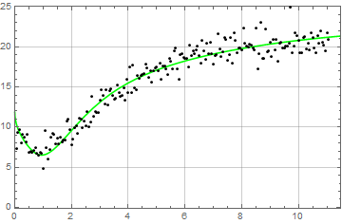
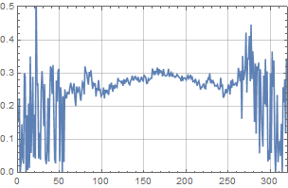
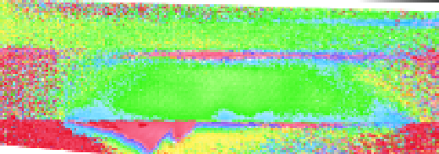
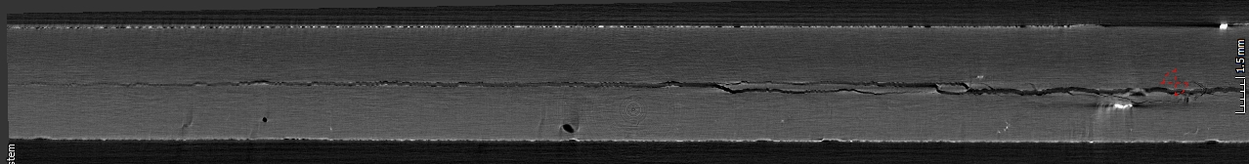

Model Fit to Data and Imaging of Damage Depth
Single Pixel Plot with Model Fit
Line Plot
0.4 cm
Thermal Thickness Image
Temperature (Counts)
Thickness (cm)
Data:
2.5 cm
Model:
0.0 cm
Position (pixels)
Time (Seconds)
Center of Crack
Position (pixels)
0.24 cm Depth
0.29 cm Depth
X-ray CT Cross Section Slice
Stiffener Flange Side
Skin Side
Crack at Multiple Interfaces
Notes:
The transient heating can be modeled with a simple 1-d thermal model

Slide 7
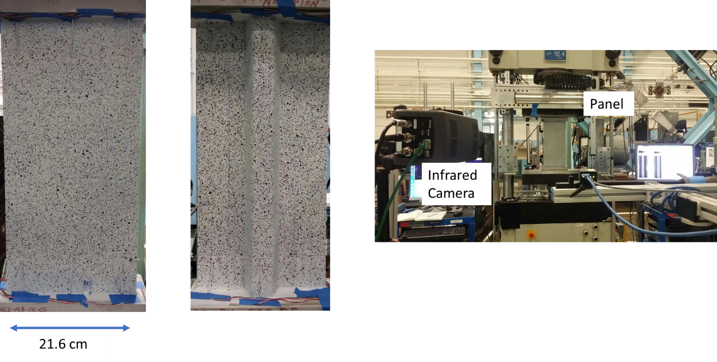
Single Stringer Panel with Fatigue Loading
Skin is 12 plies (0.22 cm thick), stiffener flange is woven composite 12 plies (0.24 cm thick), frequency of loading = 2 Hz, and maximum compressive load is -25,000 pounds, camera is synchronized to loading, 640 x 512 cooled InSb sensor, 25 mm Ge optics, and load is acquired for each frame.

Slide 8
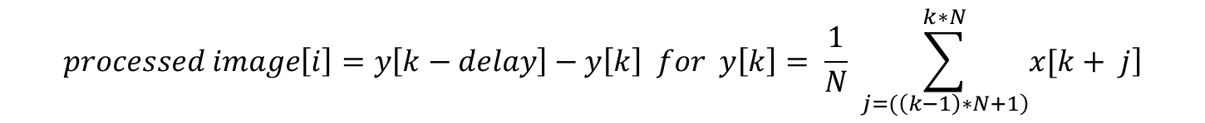
Data Processing for Rapid Growth Damage Response (Single Stringer)
$$processed image\left[i\right]=y\left[k−delay\right]−y\left[k\right] for y\left[k\right]= \frac{1}{N} \sum_{\left.j=(\left(k−1\right)∗N+1\right)}^{k∗N}{\left.x[k+ j\right]}$$
Frequency of loading = 2 Hz. Y[k] is the averaged thermal image, x[k + j] is the raw acquired thermal images (80 Hz), j is the acquired image number, k is the averaged image number, i is the processed image number, N = 40 is the number of boxcar averages, j is the acquired image number, delay = 25 is the offset subtracted averaged image.
Parameter for processing behaves as a simple notch filter.
Delay is sufficient to capture transient thermal response 12.5 seconds or less.
Notes:
Non periodic processing, is same but use 40 averaged images to filter out the periodic response (behaves as a simple notch filter), any signal at 2 Hz and its harmonics are removed, use longer delay subtraction of 25 averaged images.

Slide 9
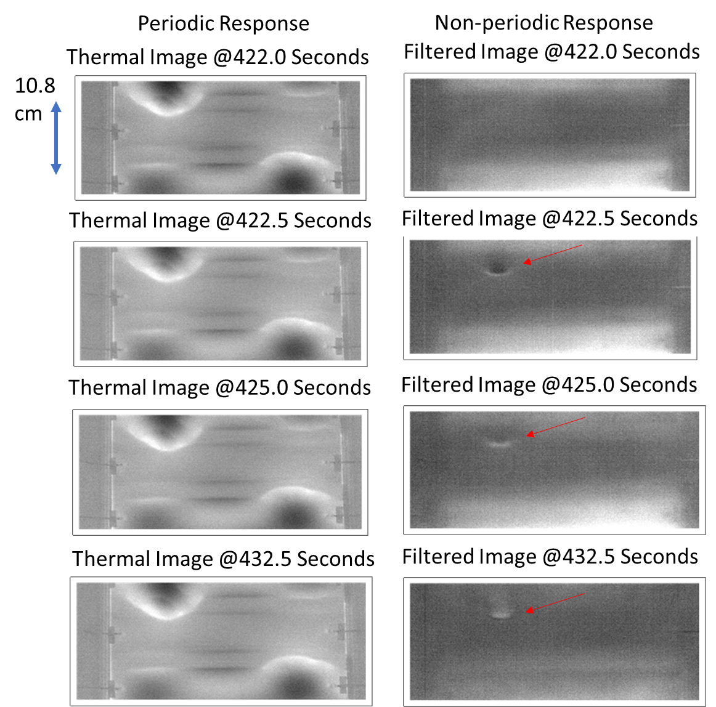
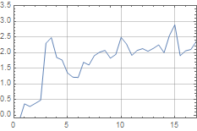
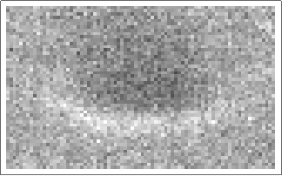
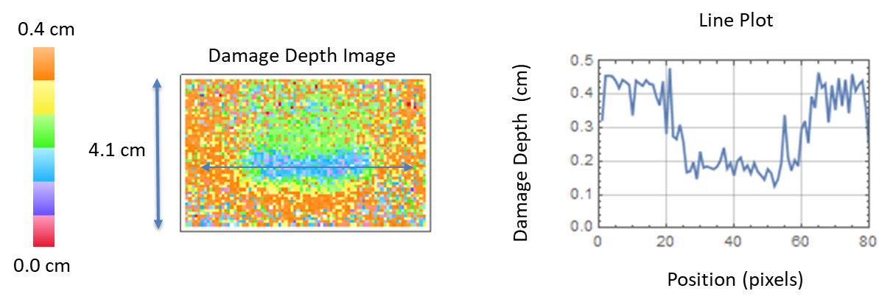
Comparison of Periodic to Rapid Growth Thermal Responses with Model Fit Results
Transient
Heating
Instantaneous Heating
Averaged Pixels Plot
Temperature (Counts)
4.1 cm
Time (Seconds)
Notes:
Single stringer panel, left is periodic response dominated by the TE heating, right is the non-periodic response with the 2 hz TE heating filtered out., see this rapid growth heating at 422.5 seconds and it stays for over 10 seconds.

Slide 10
Conclusions
Passive thermography has been shown to be an effective real time NDE technique for composite panels during quasi-static and fatigue loading.
Using notch filtering, the periodic response was removed and the non-periodic (rapid growth) thermal response was captured.
Rapid growth damage depth is determined using both the instantaneous and the transient thermal responses to reduced the thermal data to a defect depth image using the recently developed model.
Notes:
With passive thermography we can detect the location, size and depth of the rapid growth damage

