Slide 1
Lunar Excavation, Manufacturing, and Construction Challenge
Jul 31, 2020
Monsi Roman, Program Manager

Slide 2







NASA Prizes and Challenges
Centennial Challenges Program
NASA Tournament Lab
Space App
Citizen Science
NASA Education
NASA @ Work
NASA Solve

Slide 3

ABOUT US:
NASA’s first prize program
Established to conduct prize competitions in support of the Vision for Space Exploration and ongoing NASA programs
Inspired by Orteig Prize and Ansari X Prize, among others
Established (per NASA Prize Authority, 51 USC 20144): “to stimulate innovation in basic and applied research, technology development, and prototype demonstration that have the potential for application to the performance of the space and aeronautical activities of the Administration.”
  https://uscode.house.gov/view.xhtml?req=granuleid:USC-prelim-title51-section20144&num=0&edition=prelim
  First competition opened in 2005

Slide 4




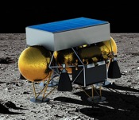
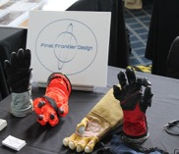
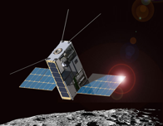
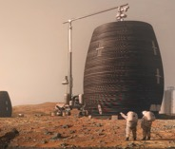
Since 2005 the NASA Centennial Challenges Program is Making Exciting Progress
19
Challenges
307
Teams
$10.33M
Awarded
42 States
24 Countries
Lunar Lander
Masten
Astronaut Glove
Final Frontier
Cube Quest
3 Payloads in Artemis-1; one team with ISS
3D Printed Habitat
AI Space Factory, Branch Tech, ICON, SEARCh+

Slide 5
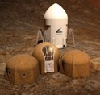
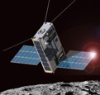





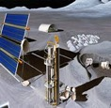
CURRENT CHALLENGES
3D-Printed Habitat
$3,150,000
Cube Quest
$5,000,000
Vascular Tissue
$500,000
CO₂ Conversion
$1,000,000
Space Robotics
$1,900,000
Lunar Nutrition
(Up to $3 M)
Lunar Power
(Up to $5 M)
Lunar Excavation, Manuf. & Construction
(Up to $5 M)
COMPLETED
ACTIVE
DEVELOPMENT

Slide 6

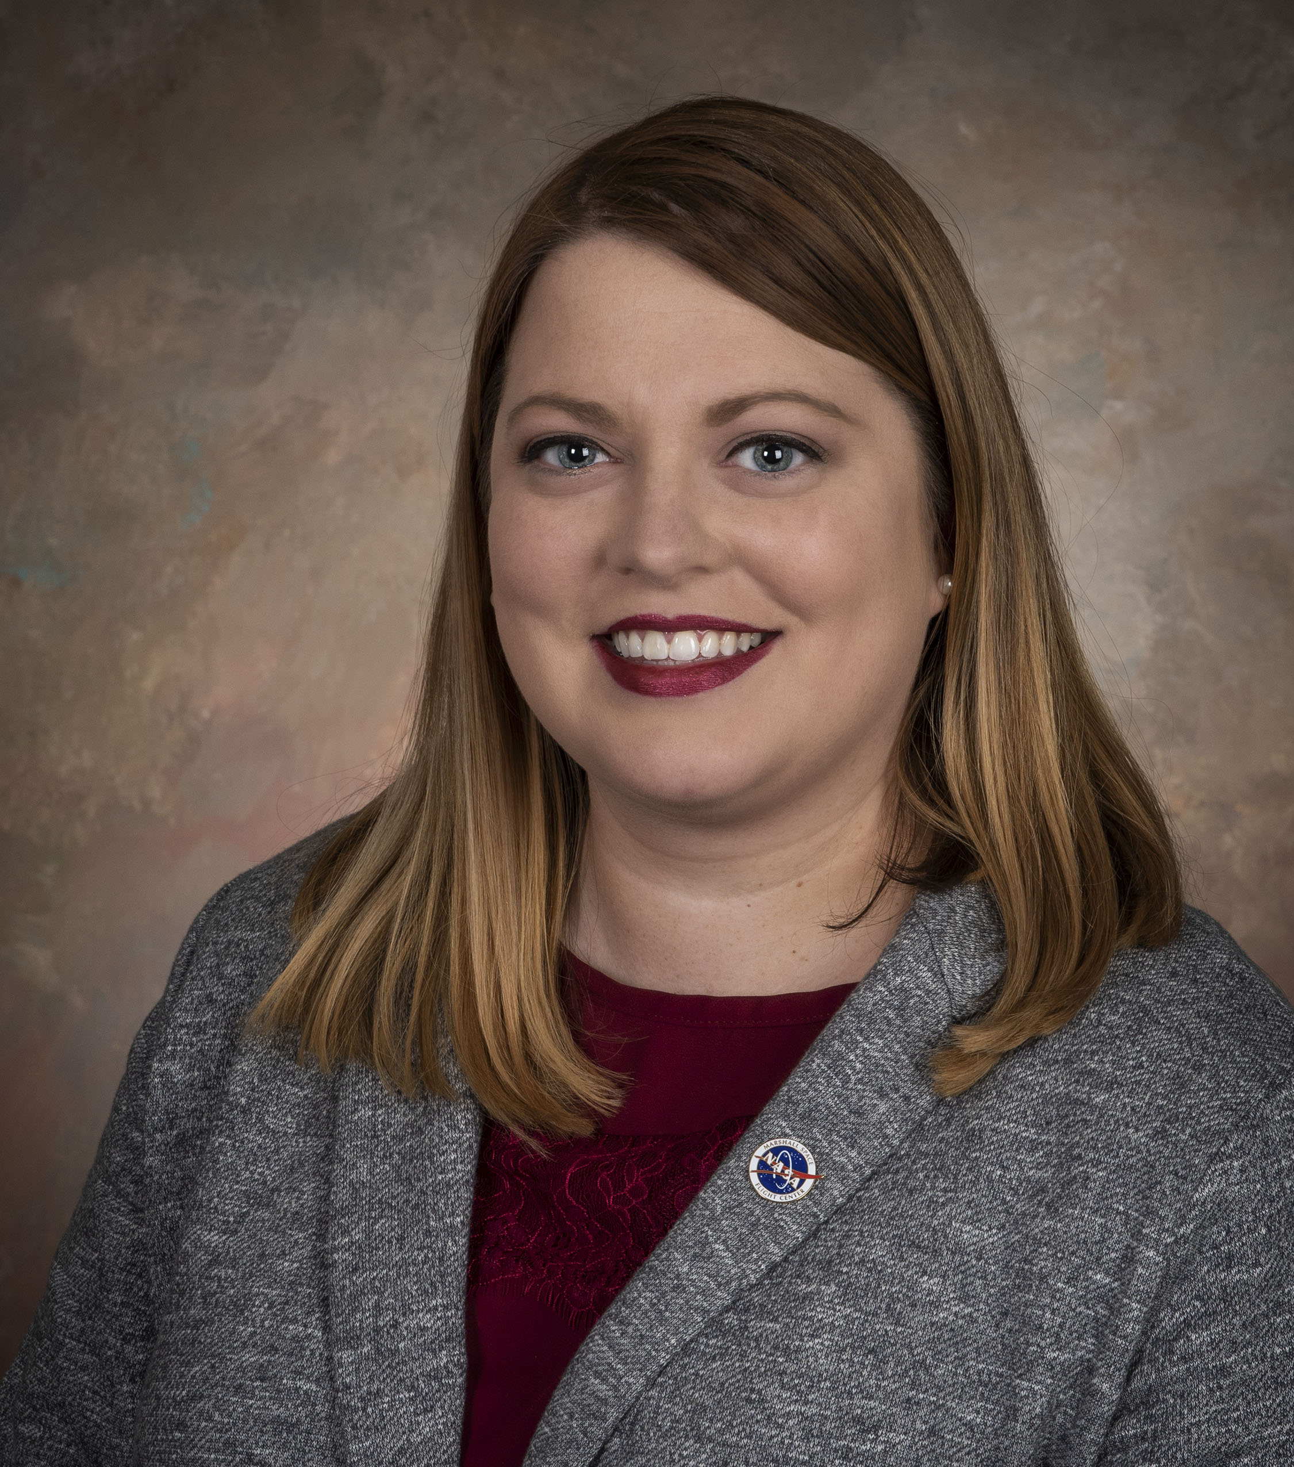




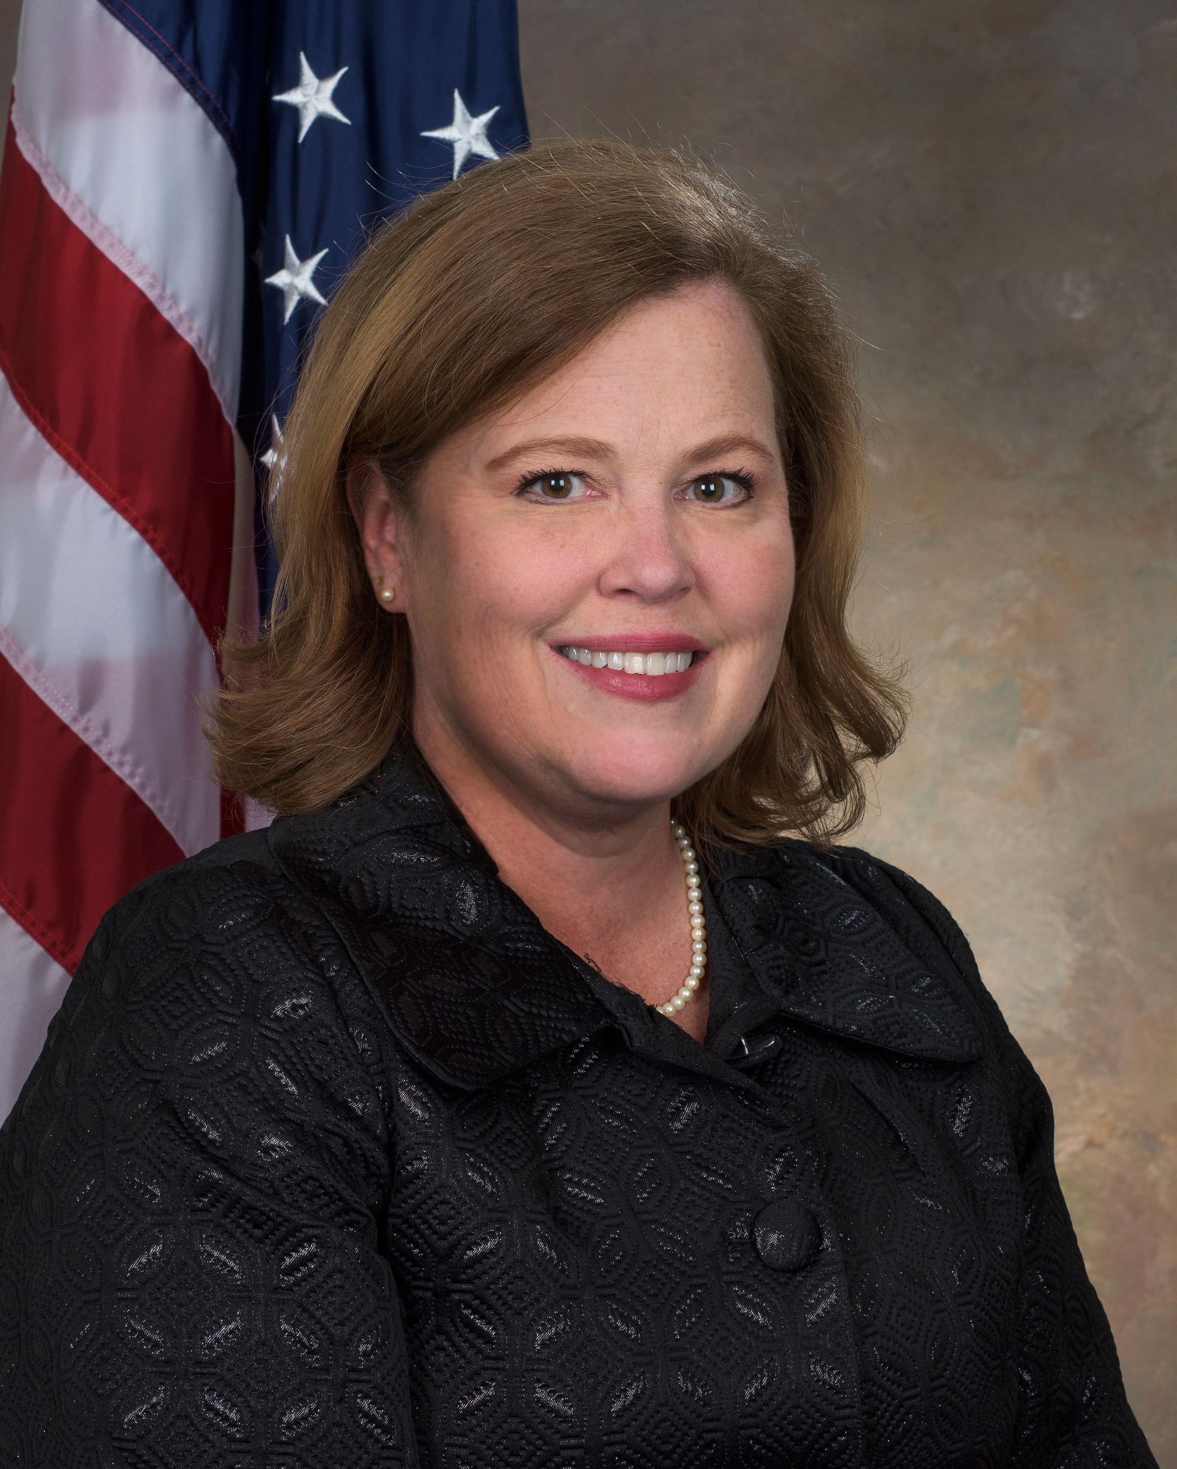
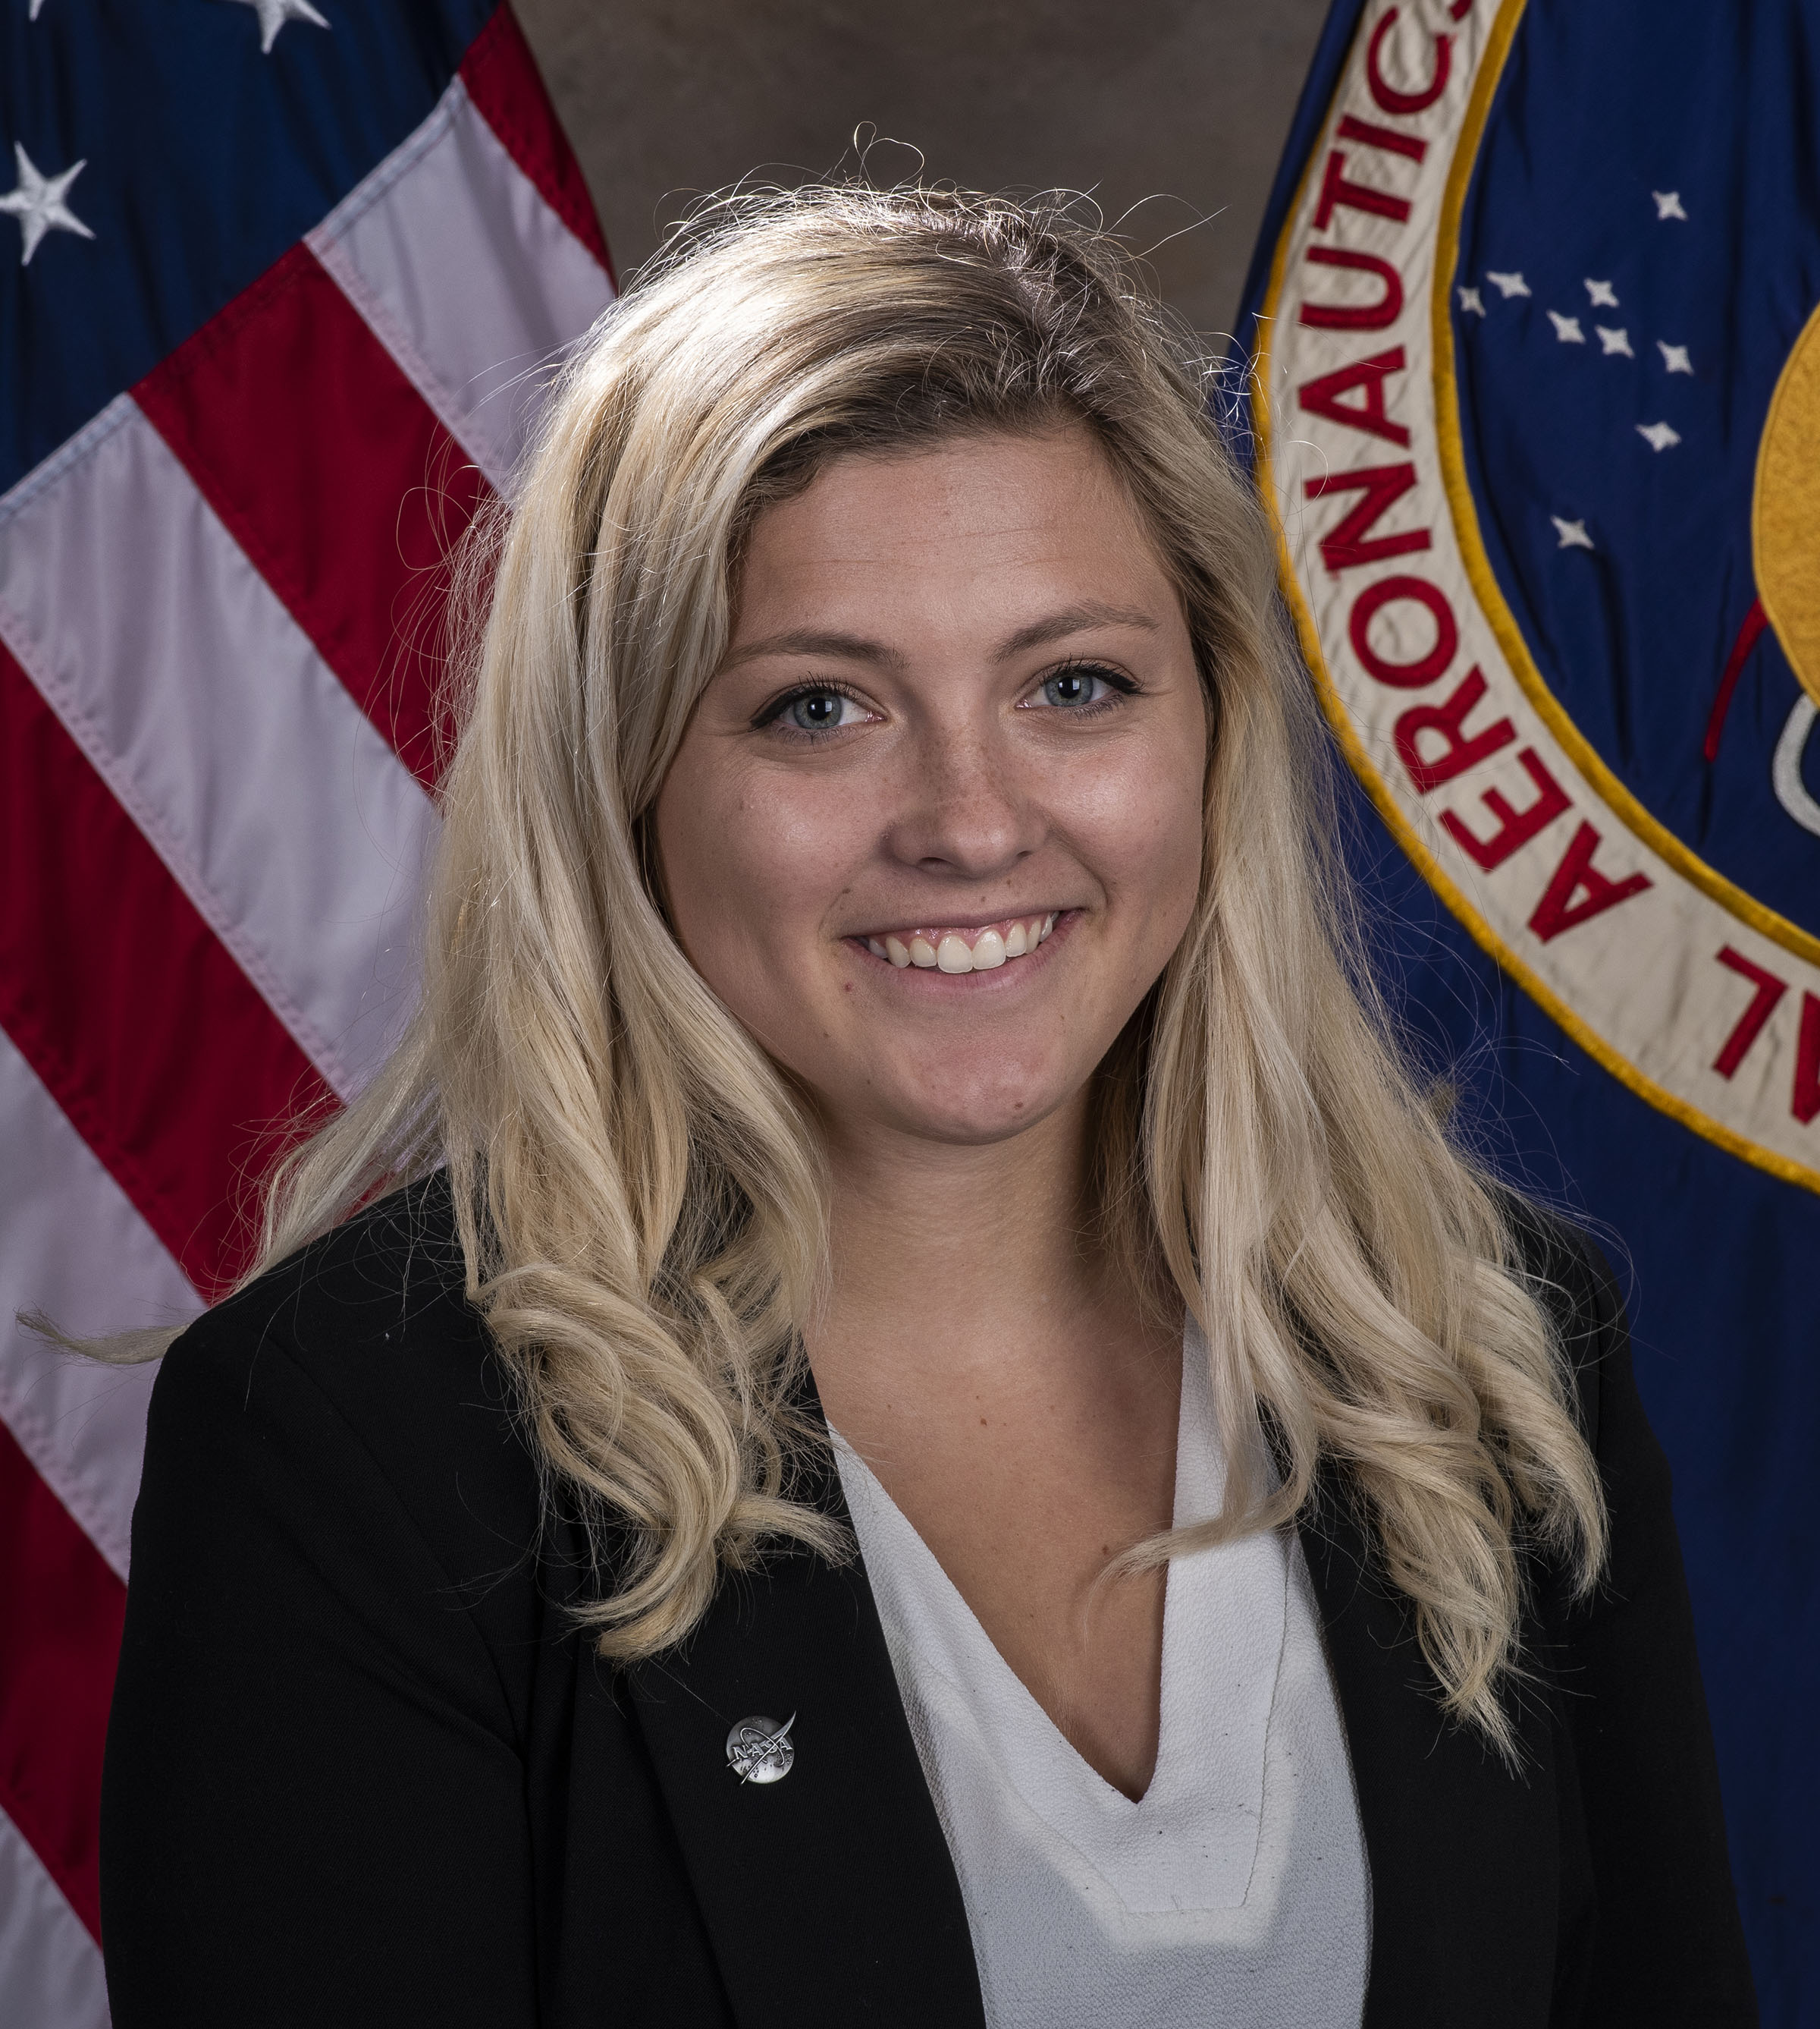




The NASA Team
 | Amy Kaminski STMD Program Executive for Prizes & Challenges
 | Monsi Roman CCP Program Manager
 | Denise Morris CCP Deputy Program Manager
 | Angela Herblet Data & Information Specialist III CCP Challenge Manager
 | Dawn Turner CCP Challenge Manager
 | Amanda Adams CCP Communication Integrator
 | Naveen Vetcha CCP Challenge Manager
 | Lane Stafford CCP Project Coordinator
 | Rosalind Cylar MSFC Legal Council
 | Chris Frangione Challenge Development Consultant
 | Jen Bravo Challenge Development Consultant
 | Alisa Ferguson Challenge Development Consultant

Slide 7








NASA CHALLENGE PTs AND SMEs:
 | John Vickers NASA Headquarters Principal Technologist
 | Jerry Sanders NASA Headquarters Principal Technologist
 | Mark Hilburger NASA Headquarters Principal Technologist
 | Mike Fiske Jacobs Space Exploration Group Subject Matter Expert
 | Tracie Prater Marshall Space Flight Center Subject Matter Expert
 | Kurt Leucht Kennedy Space Center Subject Matter Expert
 | Bob Moses Langley Research Center Subject Matter Expert
 | Eric Reiners Caterpillar Subject Matter Expert
 | Pete Carrato Challenge Development Consultant and Subject Matter Expert
 | Jennifer Edmunson Jacobs Space Exploration Group Subject Matter Expert
Lead NASA CENTERS – Marshall Space Flight Center and Kennedy Space Center

Slide 8
LUNAR EXCAVATION, MANUFACTURING, and CONSTRUCTION* CHALLENGE
TODAY
THE CHALLENGE…
*Placeholder name

Slide 9
OVERVIEW
GOAL
Develop autonomous icy regolith excavation technologies for near-term lunar missions that address key operational elements and environmental constraints
PRIZE PURSE
Up to $5M PRIZE PURSE
Phase 1 (Up to $0.5 M)
Phase 2 (Up to $4.5 M)

Slide 10
HISTORY OF FORMULATION
Meeting w/ PT and SMEs at MSFC to discuss needs and information needed for a workshop at MSFC
OCT-19
OCT-19 – JAN-20
FEB-20
MAR-20
APR-20
Challenge opportunities and technology gaps identified through interviews with NASA, OGAs, academia, and industry; Opportunity Analysis developed
Ideation workshop with NASA, OGAs, academia, and industry at MSFC/USSRC
Iterated with NASA Principal Technologist on competition concept, utilizing information gathered from workshop and interviews
DPMC Presentation to request ATP for Challenge Development
APR-20-Present
Working with PTs, SMEs and Consultants to develop the draft set of Rules

Slide 11
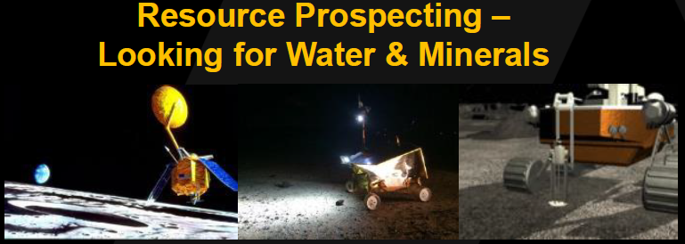
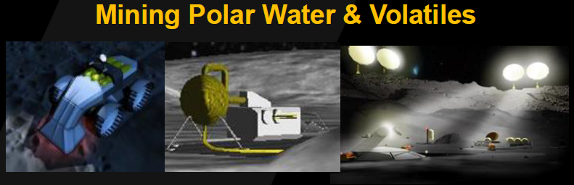
NASA is funding prospecting missions to further identify key lunar resources, but excavating those resources in extreme environments represent critical technology gaps
CHALLENGE WILL COMPLEMENT & SUPPORT NASA’S CURRENT WORK
The Lunar EMC Challenge will leverage lessons learned from previous challenges, and will address specific excavation scenarios with demonstration tests in scenarios closer to the lunar environment

Slide 12
INTERSECTION BETWEEN
TERRESTRIAL & LUNAR APPLICATIONS
An established market
Is optimized for earth applications
Is developing autonomous operations
Is evolving materials advancements
Offers multi-billion $ market opportunities
Consists of primarily conventionally-fueled systems
Terrestrial Mining Systems
Lunar Excavation Systems
An emerging market
Requires high energy density
Requires fully electric systems
Needs to address extreme environmental conditions
Requires low/no maintenance of machinery
Requires easy manufacture and replacement of high wear parts
Offers a novel niche market opportunity
Mutually-beneficial relationship
Leverage expertise of terrestrial mining for lunar excavation
Terrestrial mining can benefit from lunar advancements in autonomy, power systems & maintenance
Growth of commercial space market =
customers for mining systems

Slide 13
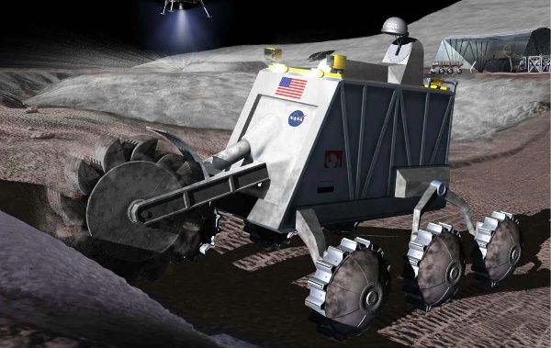
CHALLENGE SUMMARY
DURATION:
Challenge to open for registration November 2020
Duration of Challenge NTE 36 months
Open Registration: ~3 months
Phase 1: ~6 months
Phase 2: ~27 months
CHALLENGE GOALS:
Develop autonomous icy regolith excavation technologies for near-term lunar missions that address key operational elements and environmental constraints.
PRIZE PURSE:
$5 million total over up to 2 Phases
STRUCTURE:
Phase 1: Design
Track A: Design icy regolith simulant models
Track B: Design excavation architecture for one or more mission scenarios
Phase 2: Subscale Development
Track A: Develop lab-scale icy regolith simulants. End of the Track
Track B:
  Develop sub-scale hardware elements for excavating icy regolith in a given set of harsh lunar environmental conditions
  Develop full-scale hardware for excavating icy regolith

Slide 14
CHALLENGE TIMELINE
All Eligible Teams Advance
Top TBD Teams Proceed
OPEN CALL FOR REGISTRATION
Interested Teams will register and be screened for eligibility
Duration: 1 Month
Phase 1:
Track A: Teams submit icy regolith models
Track B: Teams submit excavation architecture models, simulations, videos
Duration: 6 Months
Phase 2:
Track A: Teams develop lab-scale icy regolith simulants. Track A ends
Track B: Teams develop sub-scale and full scale excavation hardware and systems demonstrations.
Duration: ~27 Months
Eligible Teams Advance
OPEN CALL FOR PHASE 2 REGISTRATION
Interested Teams will register and be screened for eligibility
Duration: 2 Months
14

Slide 15
CHALLENGE TIMELINE
Ideation Workshop (2/20/2020)
FEB 20
MAR 20
APR 20
MAY 20
JUN 20
JUL 20
AUG 20
SEP 20
OCT 20
NOV 20
MAY 21
JUN 21
NOV 23
Release RFP to solicit a challenge operation partner (3/24/2020)
DPMC Presentation & ATP Challenge Development (4/15/2020)
Challenge development meeting (5/11 - 5/12/2020)
Open the procurement for a challenge contractor
Select a challenge Contractor (7/6/2020)
Develop Official Rules, Team Documents, Evaluation Criteria, Communications Plan, and Finalize Prize Structure
DPMC Presentation & ATP Challenge Execution
Phase 1 opens for Registration
Phase 1 completion and awards
Phase 2 opens for Registration
Phase 3 completion and awards

Slide 16
Monsi Roman, Program Manager

