Slide 1
PACE Propulsion Subsystem Surge Analysis and Testing
Christopher Y. Mikhailovsky
Trident Vantage Systems
Jacob M. Stahl, Henry W. Mulkey
NASA Goddard Space Flight Center
2020 AIAA Propulsion & Energy Forum, 24-26 August 2020
This material is a work of the U.S. Government and is not subject to copyright protection in the United States.
Published by the American Institute of Aeronautics and Astronautics, Inc., with permission.

Slide 2
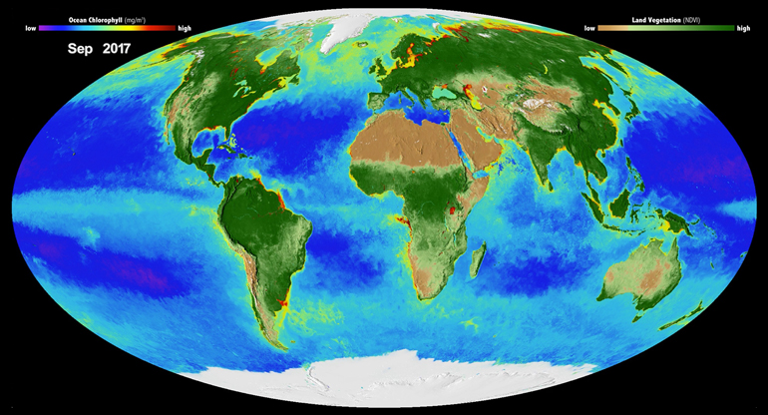
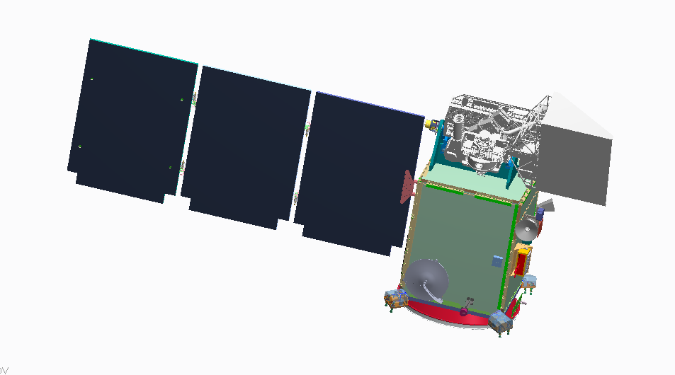
Plankton, Aerosol, Cloud, ocean Ecosystem (PACE)
PACE Science
New opportunities to monitor fisheries and respond to toxic algae blooms, and key ocean and atmosphere data for forecasting air quality and weather that will improve our understanding of Earth’s climate.
Mission Elements (Organization)
Science Team (NASA ESD)
Calibration (NASA ESD)
Ocean Color Instrument (GSFC)
Science Data Analysis (GSFC)
Spacecraft – (GSFC)
Polarimeters – (SRON, UMBC)
Launch services (LSP-SpaceX)
Mission Complement
HyperSpectral Scanner
Two Polarimeter Instruments
Spacecraft Earth Pointing Platform
OBPG Science Data Segment (SDS)
Vicarious Calibration System
Key Mission Parameters
98° inclination; ~676.5 km altitude
  Sun-Sync (1pm MLT AN),
  2 Day Global Coverage
Class C Mission
3 Year Mission & Controlled Reentry
10 Years Propellant
Observatory I&T - Ongoing
https://pace.gsfc.nasa.gov/

Slide 3
Surge Introduction
Surge Analysis is the computational determination of peak dynamic pressures at flight component locations in a propulsion subsystem.
Surge Testing is the experimental recreation of a propulsion subsystem in a laboratory environment which is followed by iterative testing to determine surge pressure effects at dead end locations.
Why attempt to gauge surge pressures?
The subsystem components being considered in both analysis and testing are sensitive to pressure spikes, and serve mission critical functions.

Slide 4
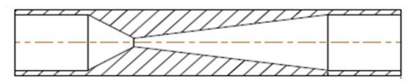
Background
How are surge pressure magnitudes controlled?
With the use of a venturi, or a cavitating orifice.
Where are the venturi positioned?
Depends on the feed system, they are traditionally placed upstream of the latching isolation valve, but can be additionally placed upstream of thruster valves.
How are venturi sized?
Sizing is meant to support propulsion subsystem mission optimization meaning meeting surge pressure mitigation requirements while minimizing the pressure drop across the orifice.
Venturi Cross Section

Slide 5
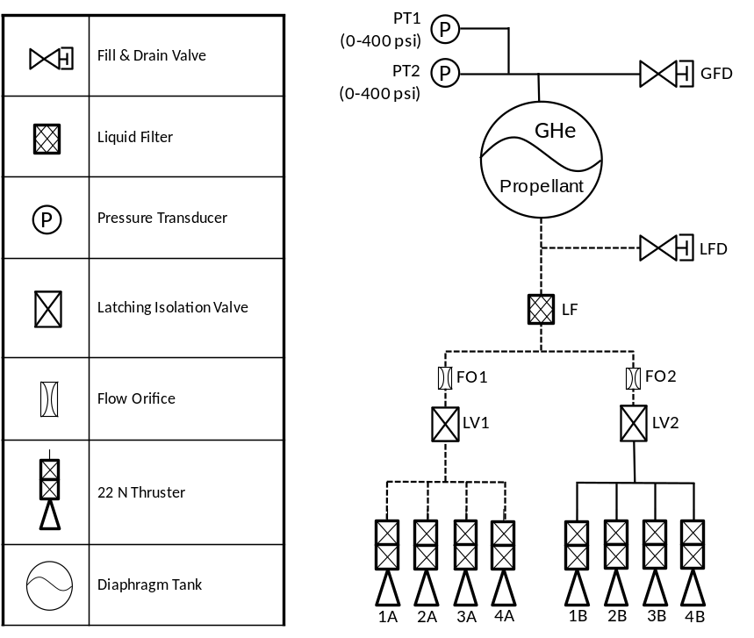
System Overview (1 of 2)
PACE Propulsion Subsystem
Monopropellant blowdown hydrazine architecture
Single Diaphragm Propellant Tank
Eight 22N Thrusters
MEOP: 400 PSIA at 50°C
Two different outside diameter tubing: 0.25” and 0.375”

Slide 6
System Overview (2 of 2)
“Critical” Components
Thrusters (1A – 4A)
Closed Redundant Latching Isolation Valve (LV2)
Liquid Fill and Drain Valve (LFD)
Not “Critical” Components
Gaseous Fill and Drain Valve (GFD)
Pressure Transducers (PT1 & PT2)

Slide 7
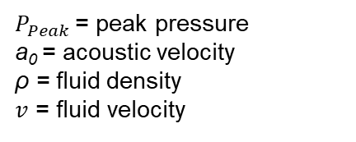

Cases Evaluated
Three Venturi Selection
Joukowsky Equation
Two Conditions Evaluated
Padded Pressure (45 psia of gHe)
Vacuum Scenario
Venturi Throat ID (in) | Downstream Pressure (psia) | Upstream Pressure (psig) | System Temperature (F) | Fluid Medium
0.048 | 0.14 | 385 (400 psia) | 68 | Water
0.052
0.055
0.048 | 45
0.052
0.055
$$P_{Peak}=ρav$$
$P_{Peak}$ = peak pressure
a₀ = acoustic velocity
ρ = fluid density
$v$ = fluid velocity
Component | Thruster | Liquid Fill and Drain Valve | Isolation Latch Valve
Proof Pressure | 1650 psi | 975 psi | 825 psi

Slide 8
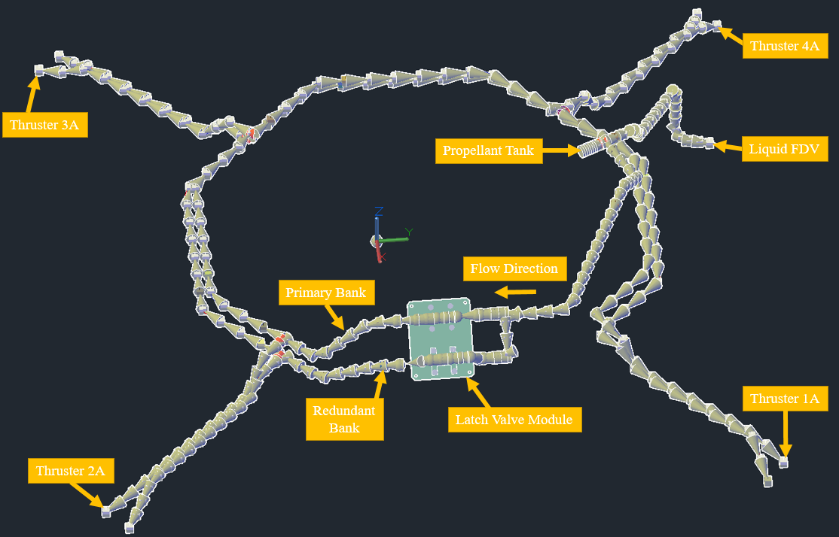
Surge Analytical Modeling (1 of 3)
Developed using C&R Technologies’ Thermal Desktop program using the internal FloCAD module
  Recreate 1:1 visualization model
  Define the feed system
  Assign parameters to subsystem

Slide 9
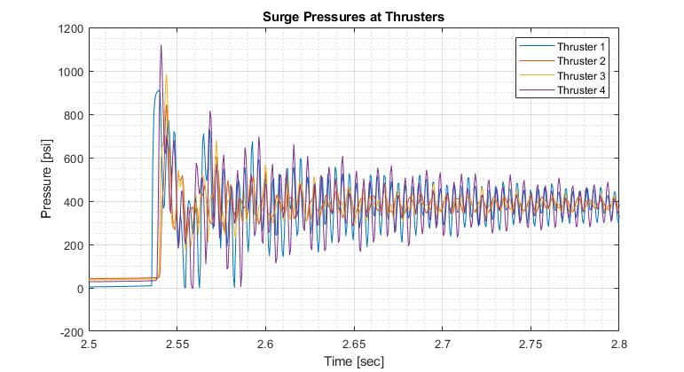
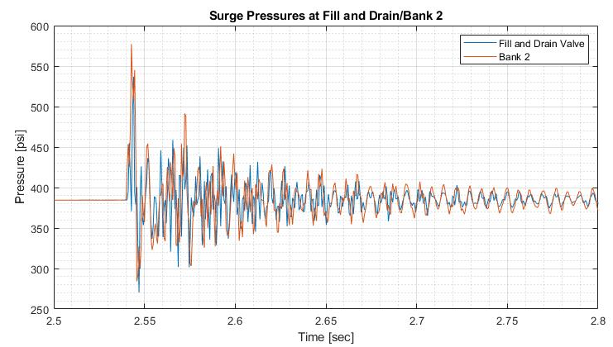
Surge Analytical Modeling (2 of 3)
The 0.048” venturi vacuum downstream MEOP upstream condition is evaluated. On the left is shown the surge pressures at the four thruster locations, on the right is shown the solution for the fill and drain valve and the latch valve for bank two.

Slide 10
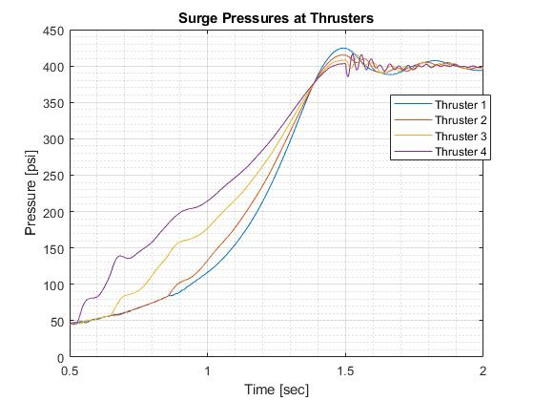
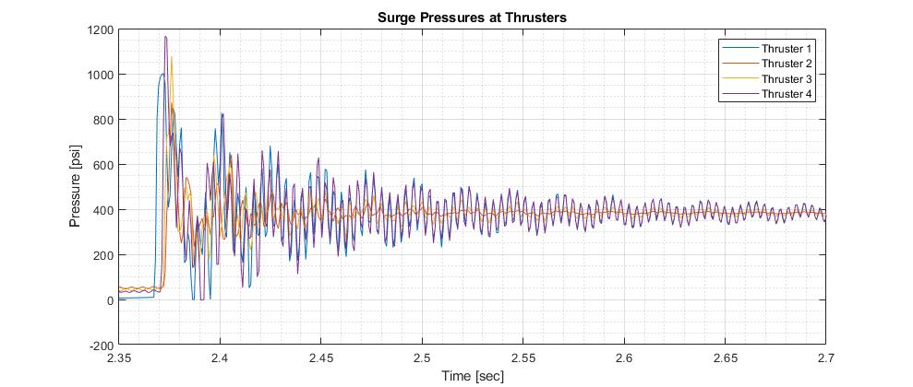
Surge Analytical Modeling (3 of 3)
The 0.052” venturi, vacuum downstream, MEOP upstream condition is evaluated, and its solution is plotted on the right. The gHe 45 psia padded downstream, MEOP upstream condition is shown on the left.

Slide 11
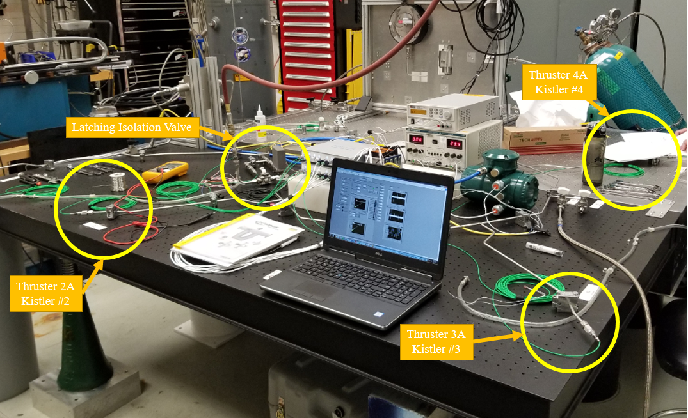
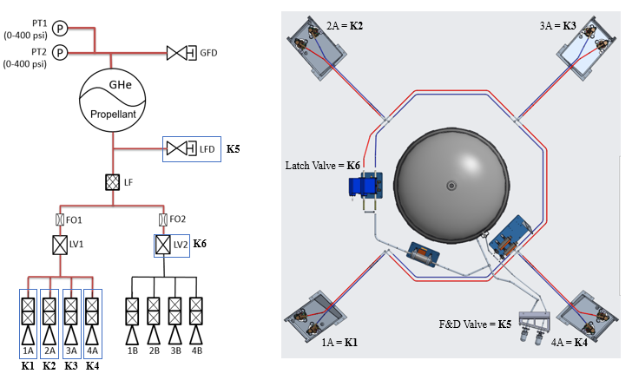
Surge Testing
The Surge Testing experimental test setup overview is shown below, along with the designation of the PACE propulsion subsystem Kistler Locations.

Slide 12
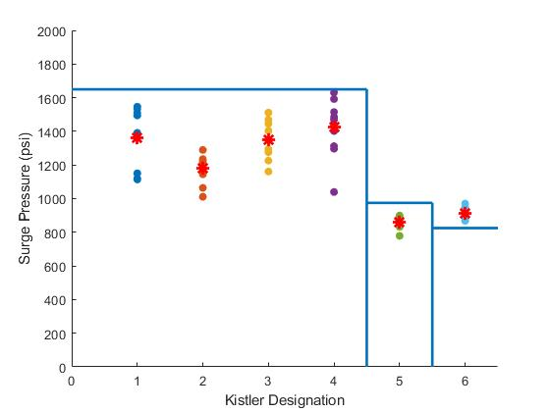
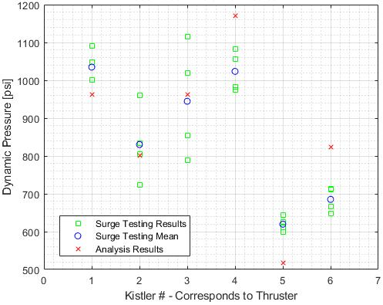
Comparison of Computational Model Against Testing (1 of 2)
The figure on the left shows a scaled for hydrazine empirical testing data summary for the 0.052” Venturi which was tested under a vacuum condition. The figure on the right shows the empirical versus analytical testing data for the same condition, unscaled for hydrazine.

Slide 13
Comparison of Computational Model Against Testing (2 of 2)
On the right is shown a comparison of the testing data against the analytical results. Although for some simulation cases a high sigma exists when compared against the analytical model, the peak pressure of a data set is of primary interest to sizing venturi.
Boundary Condition |  | MEOP, Vacuum Downstream |  |  |  | Analysis Result Sigma | Joukowsky Solutions
Venturi Size and Evaluation Point |  | Analysis Results (psi) | Testing Results (psi)
 |  |  | Average | Peak | Sigma
0.048” | Thruster 1A | 911 | 950.4 | 1055.0 | 67.4 | 0.58 σ | 758.2
 | Thruster 2A | 845 | 1059.7 | 1155.1 | 84.5 | 2.54 σ
 | Thruster 3A | 985 | 810.4 | 926.3 | 45.7 | -3.82 σ
 | Thruster 4A | 1120 | 998.4 | 1100.8 | 70.5 | -1.72 σ
 | F/D Valve | 536 | 744.0 | 792.8 | 54.7 | 3.8 σ
 | Latch Valve | 709 | 664.7 | 699.4 | 34.3 | -1.29 σ
0.052” | Thruster 1A | 1001 | 986.4 | 1120.5 | 113.3 | -0.13 σ | 867.8
 | Thruster 2A | 872 | 857.2 | 934.3 | 55.8 | -0.26 σ
 | Thruster 3A | 1078 | 976.9 | 1095.1 | 73.0 | -1.38 σ
 | Thruster 4A | 1167 | 1031.7 | 1181.2 | 112.5 | -1.2 σ
 | F/D Valve | 554 | 623.4 | 652.1 | 23.6 | 2.94 σ
 | Latch Valve | 727 | 663.4 | 703.2 | 22.5 | -2.83 σ
0.055” | Thruster 1A | 1062 | 1213.2 | 1744.5 | 54.8 | 2.76 σ | 968
 | Thruster 2A | 928 | 959.5 | 1388.8 | 28.7 | 1.1 σ
 | Thruster 3A | 1134 | 1090 | 1573.2 | 61.8 | -0.71 σ
 | Thruster 4A | 1300 | 1113.2 | 1732.9 | 102.5 | -1.82 σ
 | F/D Valve | 586 | 589.5 | 946.9 | 56.9 | 0.06 σ
 | Latch Valve | 625 | 652.7 | 969.9 | 30.1 | 0.92 σ

Slide 14
Conclusions
Analytical model created using Thermal Desktop’s FloCAD module proved to be a useful tool in generating preliminary expected surge pressure magnitudes for a given feed system, allowing for candidate venturi sizing.
  Provides GSFC with the capability of preliminarily sizing venturi for future missions without the need to go through surge testing campaigns.
Model allows preliminary identification of unexpected surge outcomes allowing for early recognition of noncompliance prior the start of testing.

