Slide 1
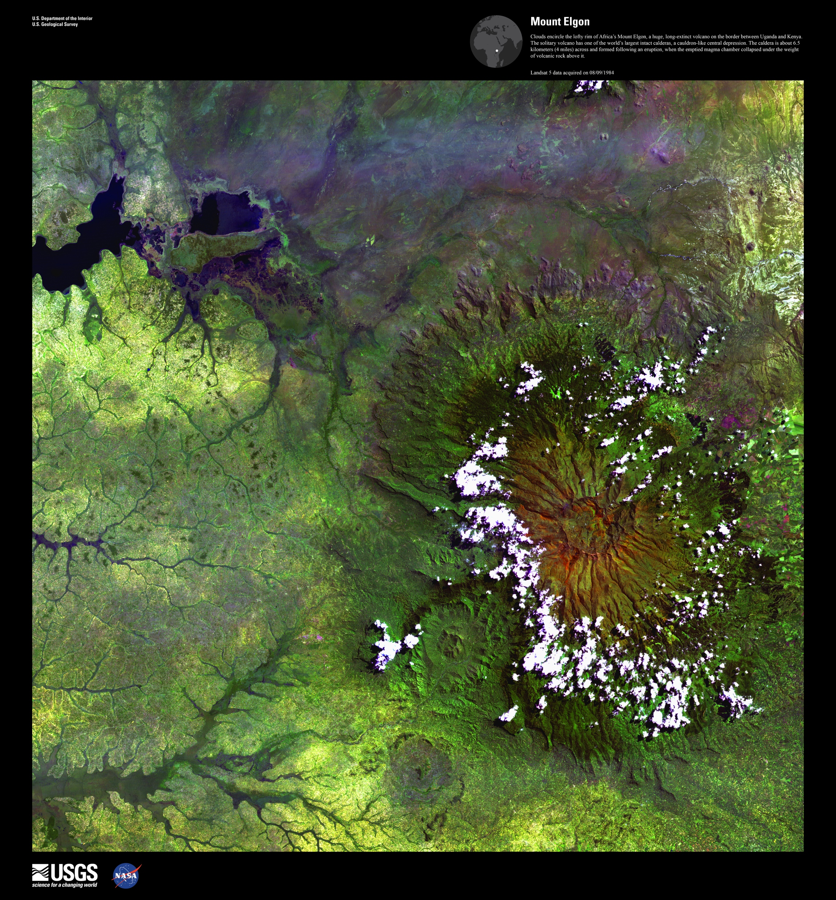
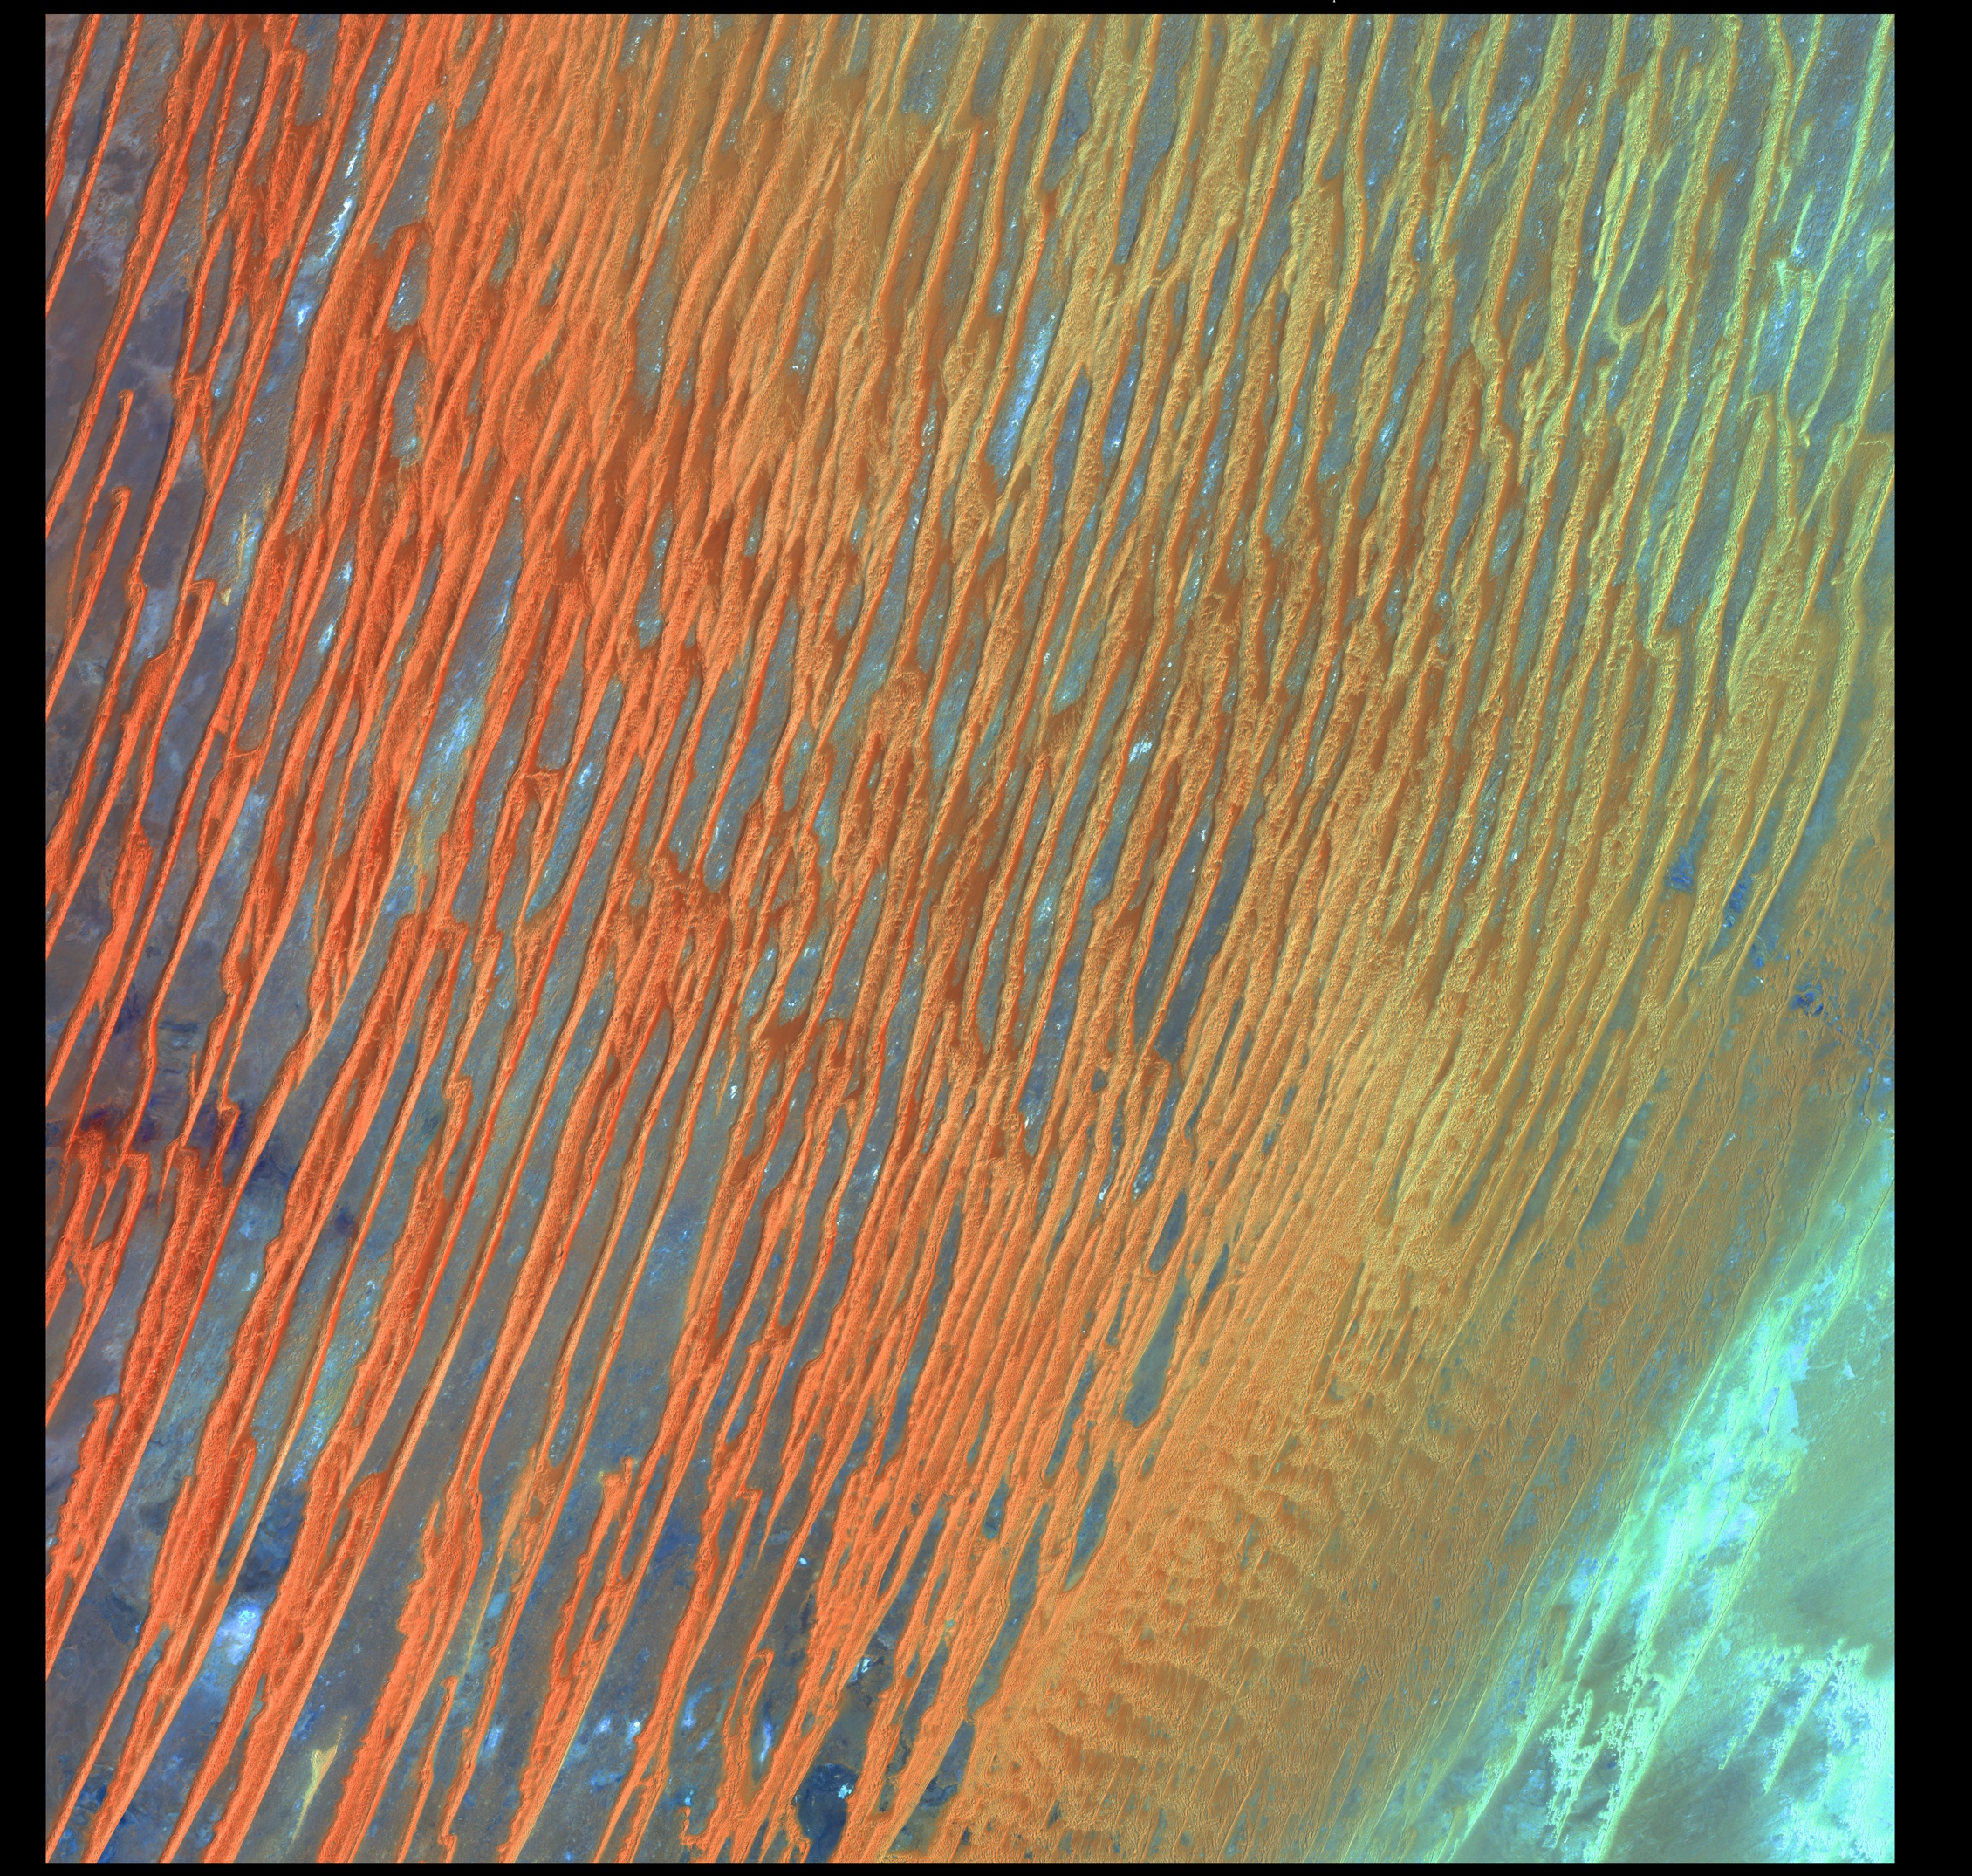
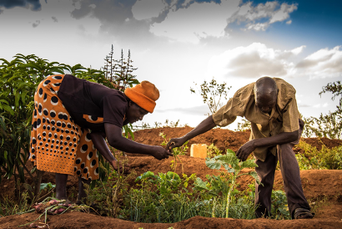


SERVIR Africa Overview & Locust Project Highlights
Emily Adams
Eastern and Southern Africa Science Coordination Lead & Gender Point of Contact

Slide 2
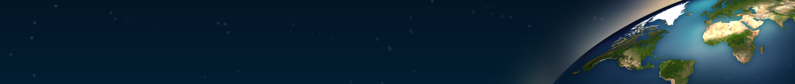


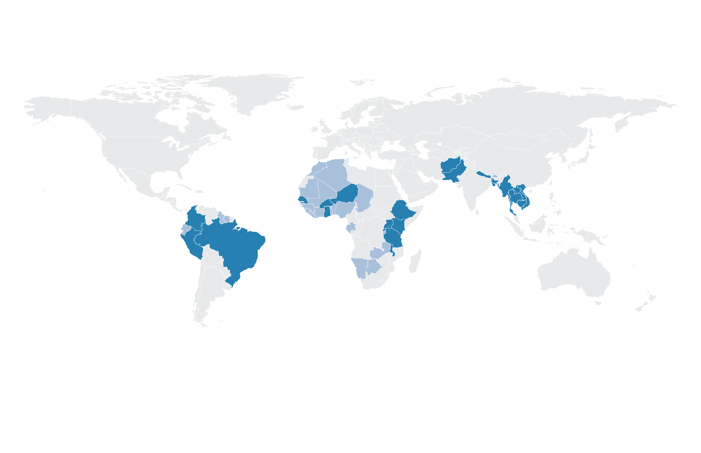




SERVIR Focuses on Asia, Africa, & the Americas
SERVIR Science Coordination Office
NASA MSFC
SERVIR Hindu Kush Himalaya
ICIMOD
USAID Washington
NASA Headquarters
SERVIR Amazonia
CIAT
SERVIR Eastern & Southern Africa
RCMRD
SERVIR Mekong
ADPC
SERVIR West Africa
AGRHYMET
Agriculture & Food Security
Land Use & Ecosystems
Focus Countries
Additional Reach
Water & Disasters
Weather & Climate
Notes:
Our approach involves connecting with regional institutions around the world to build their capacity. Here is a map of those hubs and the countries they work with. Our youngest hub, SERVIR Amazonia based out of CIAT in Cali Colombia, SERVIR West Africa based at AGRHYMET in Niamey, Niger, SERVIR Eastern and Southern Africa at RCMRD in Nairobi, Kenya, SERVIR Hindu Kush Himalaya at ICIMOD in Kathmandu, Nepal, and SERVIR Mekong at ADPC in Bangkok, Thailand.
Also shown here are our 4 application areas where we focus our services.
The regional and thematic expertise across the globe allows for knowledge sharing among hubs, allowing for replication and scaling of services when the needs arise

Slide 3

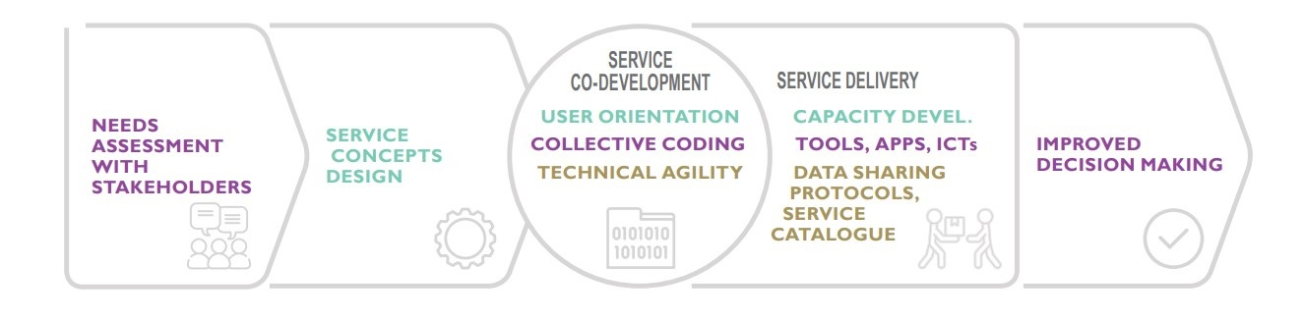

Slide 4

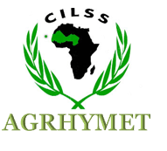


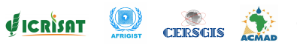

Services: SERVIR services meet needs in Africa
Drought monitoring and assessments
Frost monitoring
Streamflow and flood forecasting
Land cover mapping
Climate vulnerability, impacts, and assessment
Crop monitoring and area estimation
Surface water body mapping
Ground water monitoring and modeling
Charcoal production monitoring
Locust infestation monitoring
Monitoring of artisanal mining (Galamsey) in Ghana
Support for commune-level development planning in Burkina Faso
Niamey, Niger
Nairobi, Kenya

Slide 5
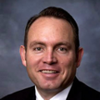






Bringing Innovative Science to West Africa: The Applied Sciences Team
Norm Jones
Brigham Young University
Geospatial Information Tools That Use Machine-Learning to Enable Sustainable Groundwater Management in West Africa
Jasmeet Judge
University of Florida
Linking deforestation, urbanization, and agricultural expansion for land use decisions in Ghana
Shrad Shukla
University of California, Santa Barbara
Integrating satellite observations and sub-seasonal climate forecasts to enhance agricultural and pastoral water-management decision-making using 21st century agro-pastoral water deficit predictions
Pontus Olofsson
Boston University
Supporting continuous monitoring and sample-based estimation of land change and forest degradation in West Africa

Slide 6
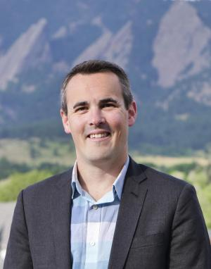
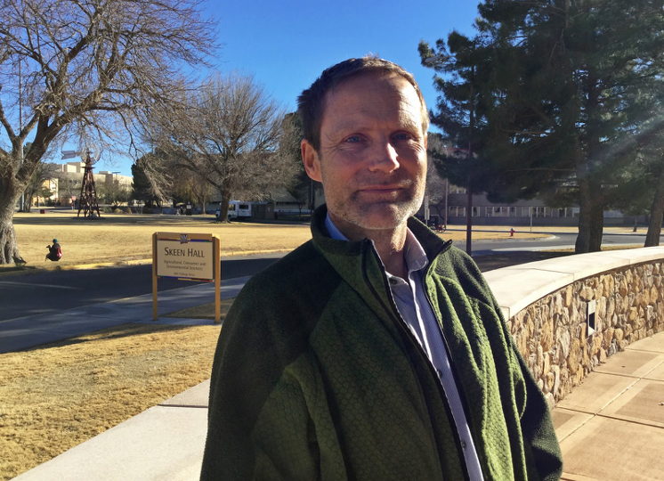
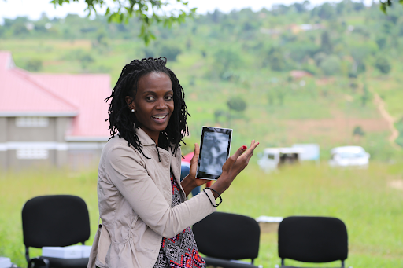

Bringing Innovative Science to E&SA Africa: The Applied Sciences Team
Evan Thomas
University of Colorado Boulder
In-situ data collection with remote sensing for machine learning parameter estimates and improved hydrologic models for flood, drought and agricultural yield forecasting
Niall Hanan
University of New Mexico
Range monitoring for decision support, pastoral livelihoods and food security in arid and semi-arid East and Southern Africa
Frank Davenport
University of California, Santa Barbara
Using Earth Observations and Statistical Models to Enhance Drought, Food Security, and Agricultural Outlooks in Eastern and Southern Africa
Catherine Nakalembe
University of Maryland / NASA Harvest
Earth Observation for National Agricultural Monitoring

Slide 7
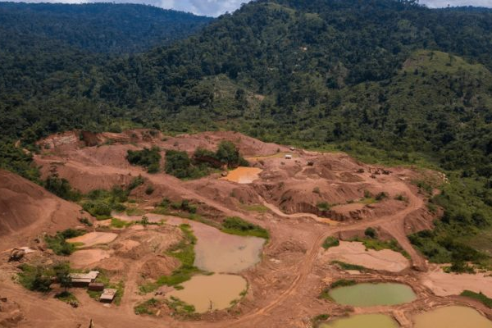


Services: Monitoring Illegal Mining (Galamsey) in Ghana
Galamsey driven deforestation doubled between 2015 and 2018 contributing to water pollution and land degradation
Mapping identified areas of illegal mining activities informs where monitoring and restoration interventions are needed
Photo credit: Jordi Perdigo
Notes:
Reference: https://servirglobal.net/Global/Articles/Article/2725/reducing-illegal-gold-mining-in-the-tropical-forests-of-ghana-and-peru-a-forthcoming-collaboration-across-the-atlantic
https://www.undispatch.com/how-satellite-data-can-fight-illegal-mining-in-ghana/
Illegal mining is a driver of freshwater pollution, deforestation and land degradation -

Slide 8
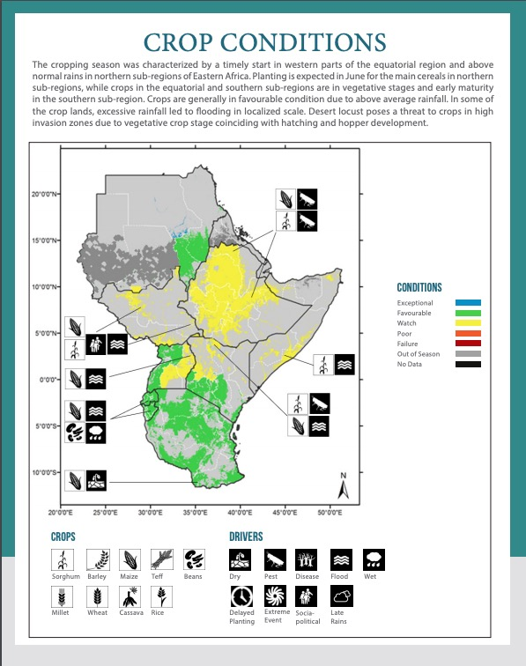
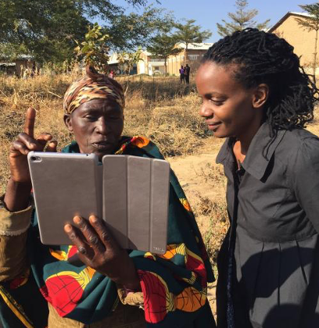

The Regional Cropland Assessment and Monitoring Service
AST Nakalembe supported the development of the regional and country crop conditions bulletins
Associated satellite derived crop masks and sampling framework reduced costs by 70% to the Kenya State Department of Agriculture, allowing for insurance protection to expand from 900 to 425,000 farmers.
In 2019, more than 12,000 farmers were compensated for crop losses
Photo Credit USAID
Photo Credit Catherine Nakalembe

Slide 9
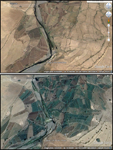
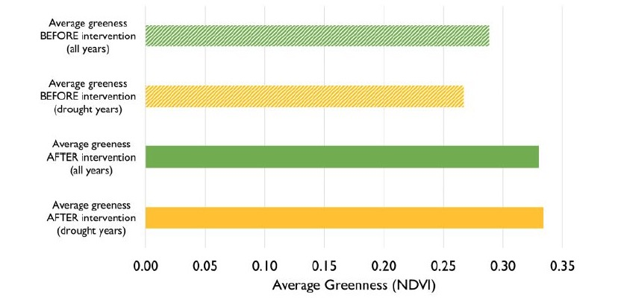
Assessing Landscape Scale Resilience Change
SERVIR analysis helps illustrate the benefit of water infrastructure programs implemented by USAID in Tigray, Ethiopia
2006
2019
Average greenness at project sites is higher than pre-intervention greenness
Increased water availability in drought years
Faster vegetation recovery at locations where water infrastructure exists
Water access improved during cropping seasons and allowed for a second cropping season in some cases
Methodology being scaled to support additional work in Ethiopia and efforts in Niger

Slide 10
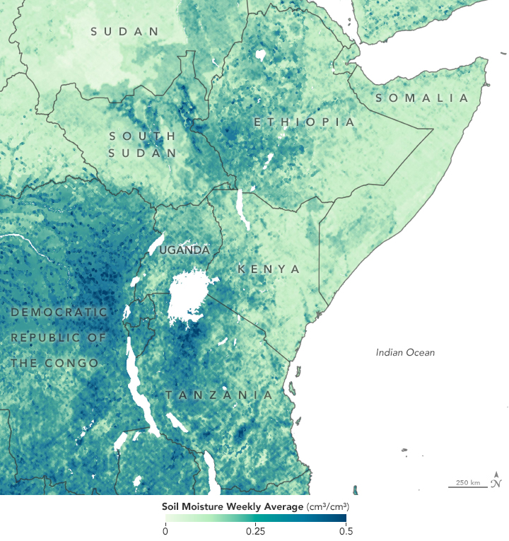
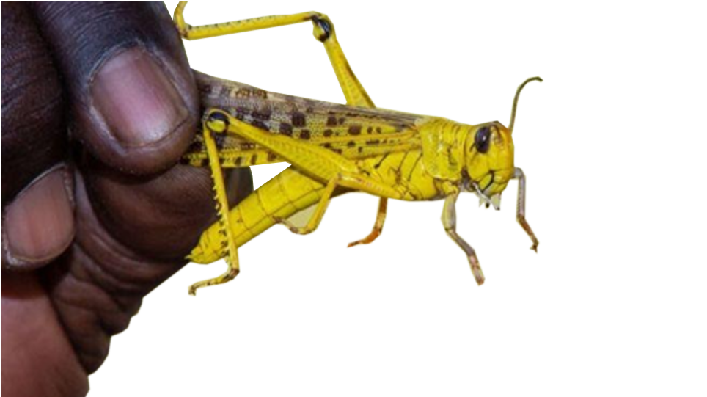
Improving Locust Monitoring and Modeling across Africa
In response to the recent unprecedented upsurge in Desert Locust activity in East Africa, SERVIR, in collaboration with NASA Harvest and Disasters, & FAO to map and model high-resolution soil moisture to identify areas at high risk for egg laying to target control measures
These methods were supported by work done with SERVIR West Africa
Notes:
coupling CYGNSS and SMAP soil moisture data
Locusts lay eggs in moist, sandy soils. Controlling locusts before they are airborne is critical.
Identifying areas affected by locusts to spot “optimal” conditions and help target control measures.

Slide 11
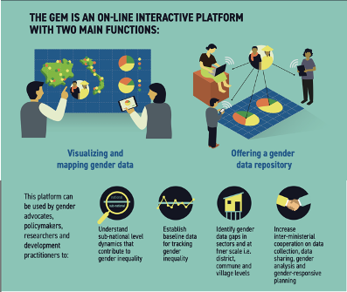
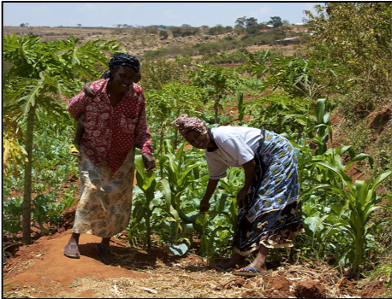

Gender Integration and Action
Building women leaders and gender champions in SERVIR
Empowering women and girls to explore STEM fields
Integrating gender considerations in service planning
Using remote sensing and GIS to address development issues that are inclusive of underrepresented groups

Slide 12
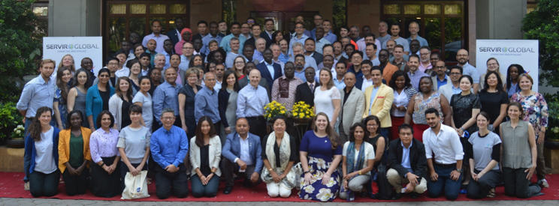
Thank You.
For further questions, please contact:
emily.c.adams@nasa.gov (SERVIR E&S Africa)
emil.cherrington@nasa.gov (SERVIR W. Africa)

