Slide 1
Advanced Structures and Materials Technology Integration for a Lunar Habitat
Lauren Bowling
Chris Wohl
2020 Summer NIFS Research Symposium

Slide 2
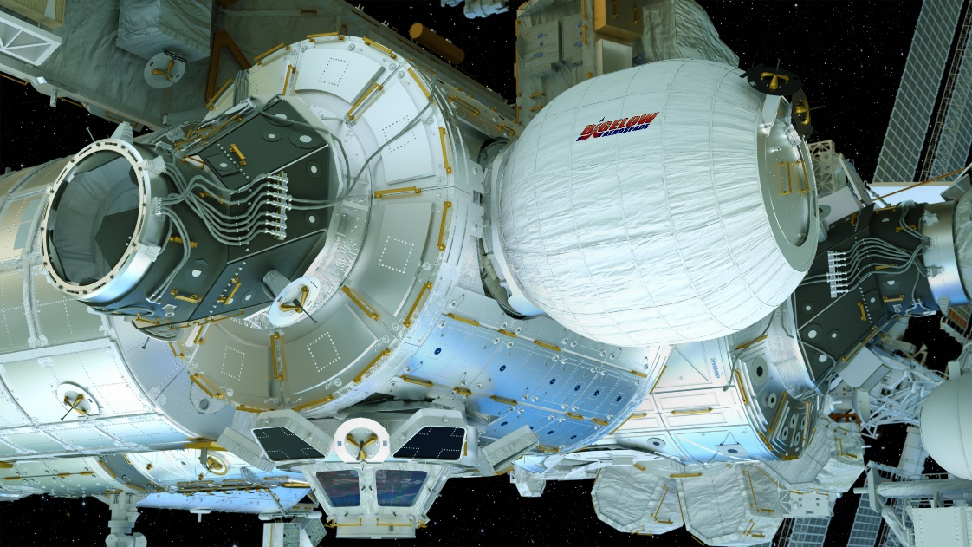
History of Inflatable Structures
Inflatable structures offer efficient mass to volume to strength ratios
2 inflatables have been in space
  Volga Airlock on Russian Voskhod 2
  Bigelow Expandable Activity Module (BEAM) on ISS since 2016
Many architectures have been designed for both lunar and Martian surfaces to include inflatables
[1]
Image Credit: NASA

Slide 3
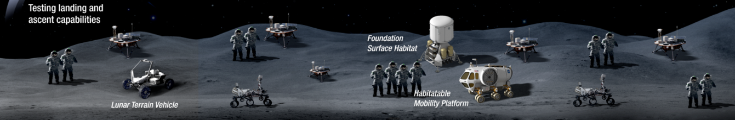
Need for a Lunar Habitat
Artemis Base Camp
  Habitable Mobility Platform
    Large, pressurized rover that supports long EVAs
  Lunar Terrain Vehicle
  Foundation Surface Habitat (FSH)
    4 member habitat for a 28-day surface stay
    2028
To be delivered via commercial lunar payload services (CLPS) or human landing system (HLS)
  Current max mass constraint of < 3,600 kg
[2]
Image Credit: NASA

Slide 4
Project Description and Approach
Help identify active LaRC research that could be used in an inflatable habitat
  Develop a timeline with mass constraints for habitat transportation
  +
  Produce a gap analysis for needed technology
  =
  Generate a habitat design
  Intensive literature studies on inflatable habitats
  Interviewed research groups at LaRC
  Compiled technologies into the “Bowling Habitat” architecture

Slide 5
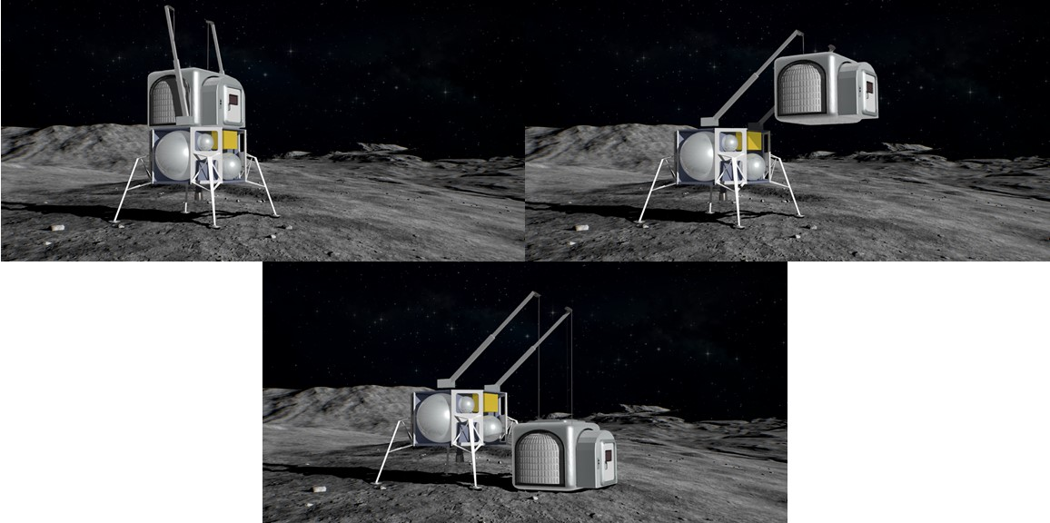
Results: The “Bowling Habitat” Un-Loading
Image Credit: Ronald Neale, NASA LaRC

Slide 6
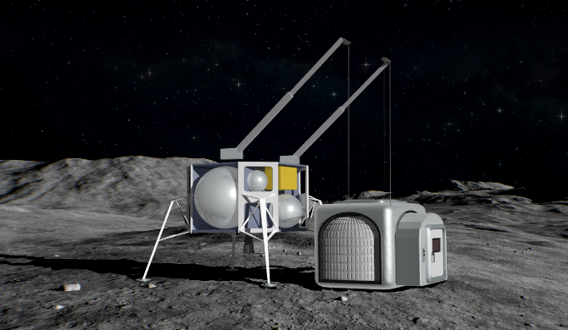
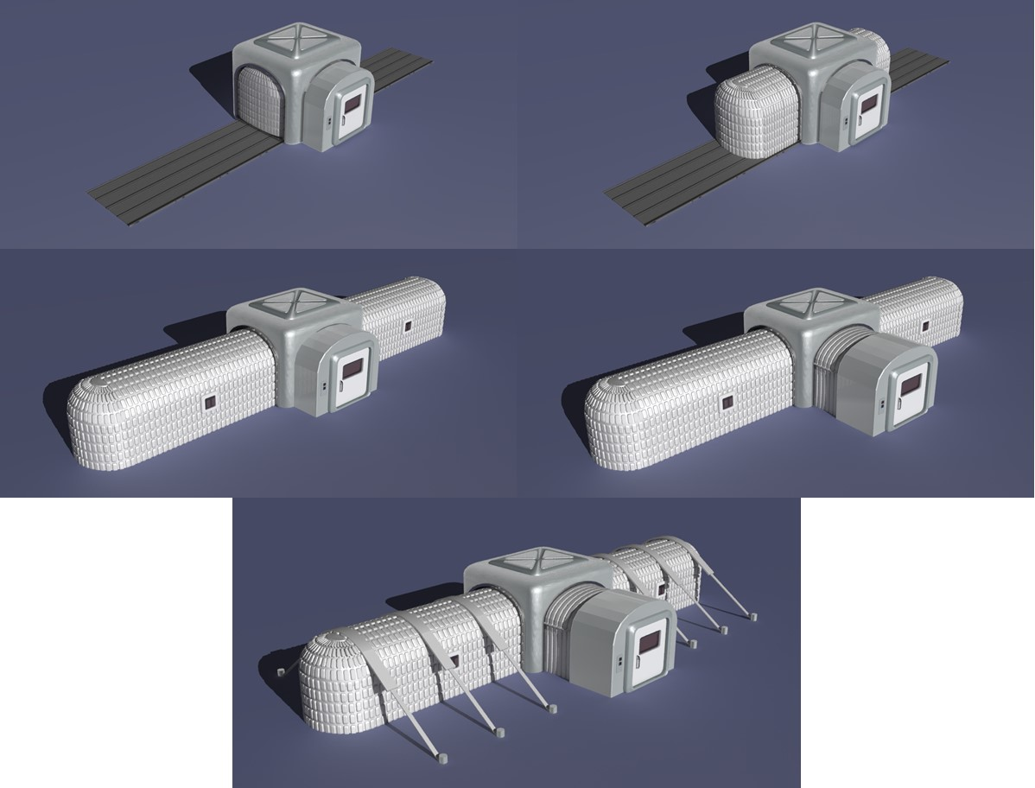
Results: The “Bowling Habitat” Deployment
InFLEX Fabric
Deployable Friction Barrier
(Jin Ho Kang and Keith Gordon)
“LEIA” Airlock
BNNT Guy Lines
(Cheol Park)
Image Credit: Ronald Neale, NASA LaRC

Slide 7
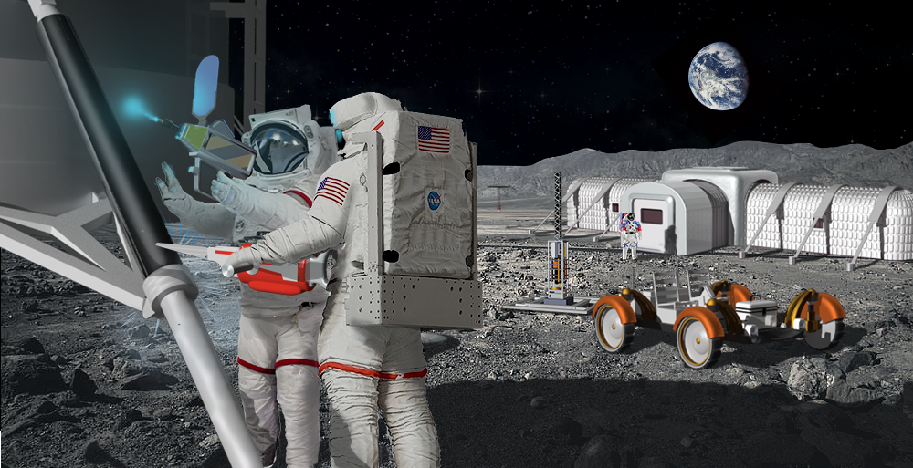
Results: The “Bowling Habitat” Landing Site
KRUSTY
(Marc Gibson)
Electron Beam Gun
(Karen Taminger)
Re-Purposable Composites
(Mia Siochi and Kris Wise)
Trusselator
(Brian Grimsley)
Image Credit: Ronald Neale, NASA LaRC

Slide 8
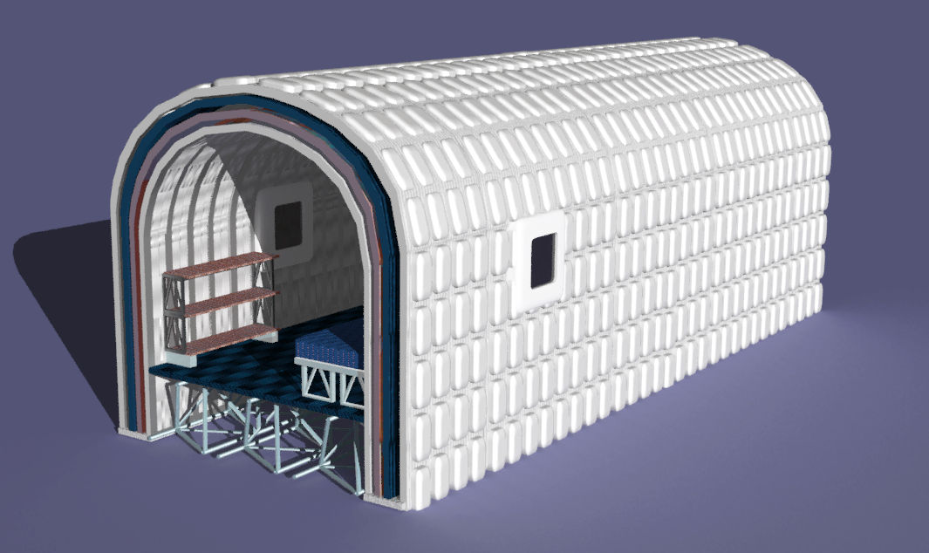
Results: The “Bowling Habitat” Interior
InFLEX Layering Scheme
Habitat Health Sensors
(Eric Madaras)
Ceramic Lunar Dust Coating
(Valerie Wiesner and Samuel Hocker)
Electron Beam Floor Boards
Trusselator Floor Joists
Image Credit: Ronald Neale, NASA LaRC

Slide 9
Implications and Future Work
“Bowling Habitat” is a modern suggestion for the FSH
  Beneficial to demonstrate the various technologies that could be used in the FSH
This project only addressed the structural needs of the habitat
  Did not address: hardware, monitoring, extra radiation protection, life-style needs, etc.
If I had:
  4 more weeks = interview more people, improve gap analysis paper
  4 more months = dive into gaps that were left unaddressed

Slide 10
Acknowledgements
Thank You:
  Bryce Horvath
  Ronald Neale
  NIFS Program Coordinators
  Michigan Space Grant Consortium
Questions?
SMEs:
  Brian Grimsley
  Mia Siochi
  Kris Wise
  Karen Taminger
  Eric Hoffman
  Richard Bird
  Wesley Tayon
  Jin Ho Kang
  Keith Gordon
  Haley Ketteler
  Alec Werner
  Sarah Gorski
  Valerie Wiesner
  Samuel Hocker
  Cheol Park
  Keith Arthur
  Jim Neilan
  John Cooper
  Sang Choi
  Matthew Simon
  Natalia Alexandrov
  Meghan Chandarana
  Tom Jones
  Pat Cosgrove

Slide 11
References
[1] Mahoney, “Bigelow Expandable Activity Module,” NASA. [Online]. Available: https://www.nasa.gov/content/bigelow-expandable-activity-module. [Accessed: 24-July-2020]
[2] Bartels, “NASA unveils plan for Artemis 'base camp' on the moon beyond 2024,” Space. [Online]. Available: https://www.space.com/nasa-plans-artemis-moon-base-beyond-2024.html. [Accessed: 24-July-2020]

