Slide 1

Optimizing Performance and Accuracy with LIFQWIK
Walker Knapp

Slide 2
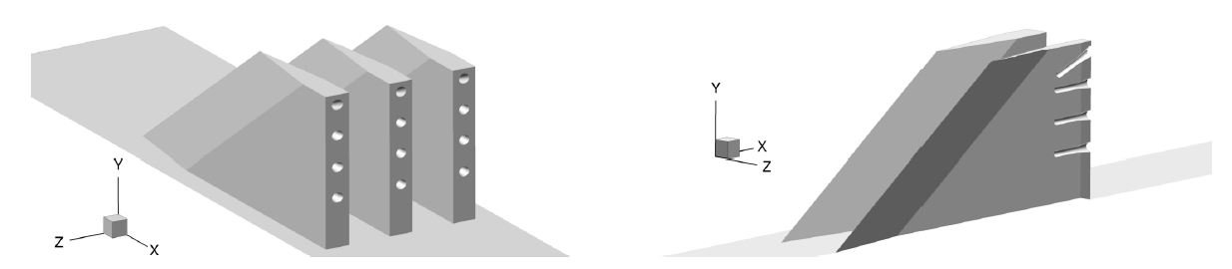
EIMP Experiments @ Langley
The Enhanced Injection and Mixing Project (EIMP) at the NASA Langley Research Center is investigating the physics of fuel injection for Mach > 8 flight.
Modeling high-speed fuel injection using Computational Fluid Dynamics software
Goals:
  Increase understanding of fundamental physics governing fuel-air mixing
  Develop strategies for improving fuel injector performance.

Slide 3
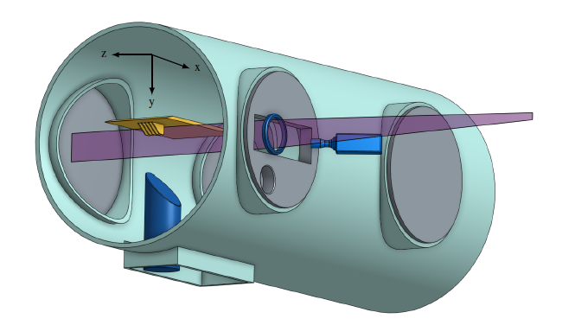
Planar Laser Induced Fluorescence
NO Planar Laser Induced Fluorescence (PLIF) is used to scan specific regions of fuel flow downstream from a strut injector.
To compare measured PLIF data with CFD results, a computational LIF model is applied to the results of CFD simulations to obtain similar PLIF images to measured data.
LIF models must be:
  Computationally efficient, to allow for rapid analysis of large CFD data sets
  Accurate enough to ensure that differences between measured PLIF data and computationally-generated PLIF images are due to errors in the CFD modeling

Slide 4
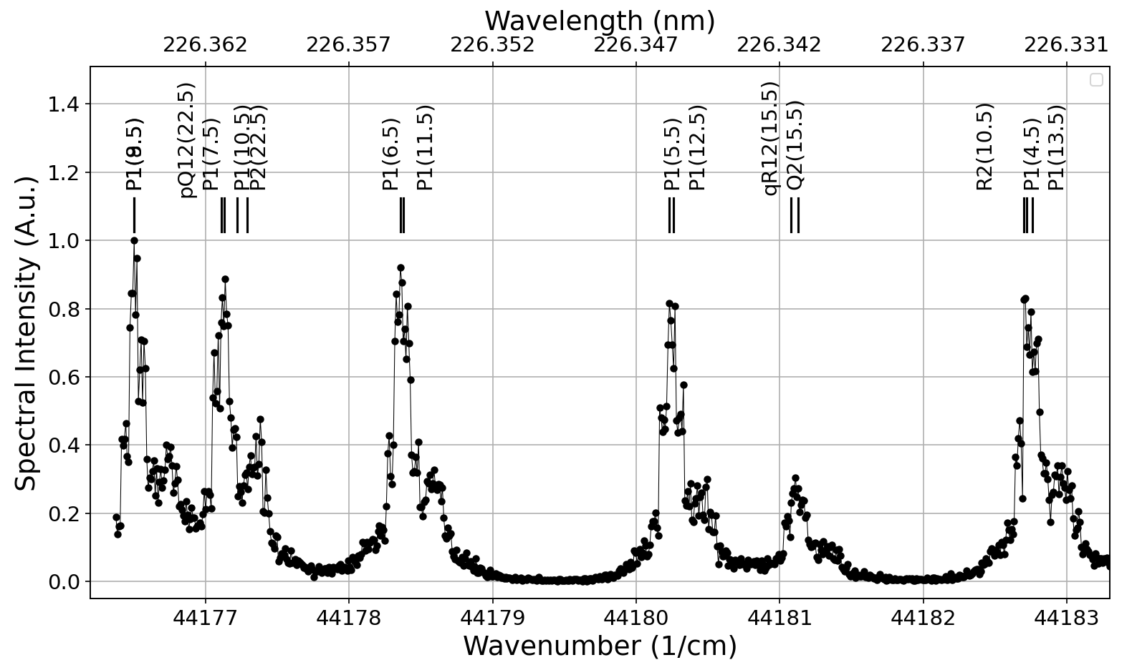
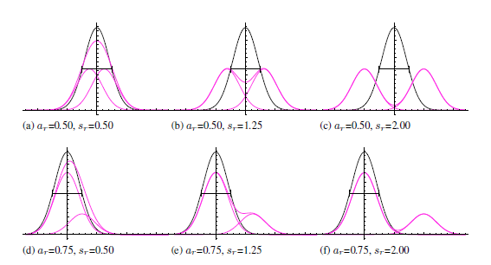
Experimental PLIF Measurements
The laser used to collect experimental spectra is observed to be double-peaked
Prior to 2018, no models could accurately predict the multiple peaks created by fluorescence data observed from these PLIF results

Slide 5
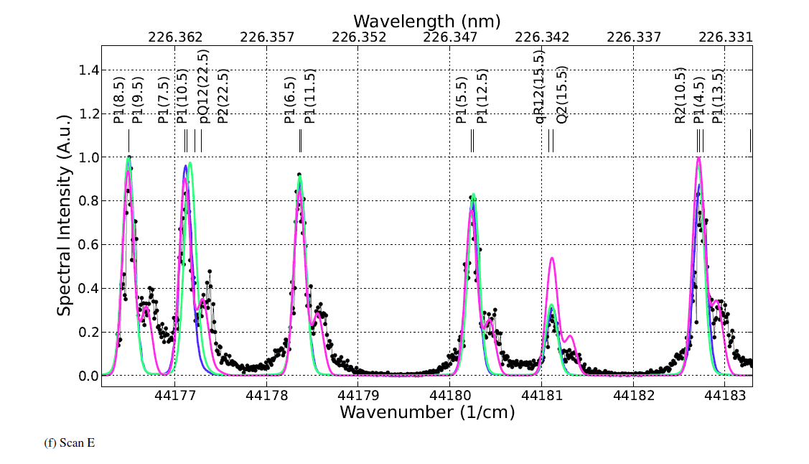
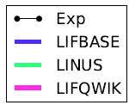
Previous PLIF Model Accuracy
LIFBASE and LINUS
  Commercial software that can very accurately capture the main primary laser peaks
LIFQWIK (2018)
  More accurately represents double-peak artifacts, but has other prominent inaccuracies (qR12(15.5))

Slide 6
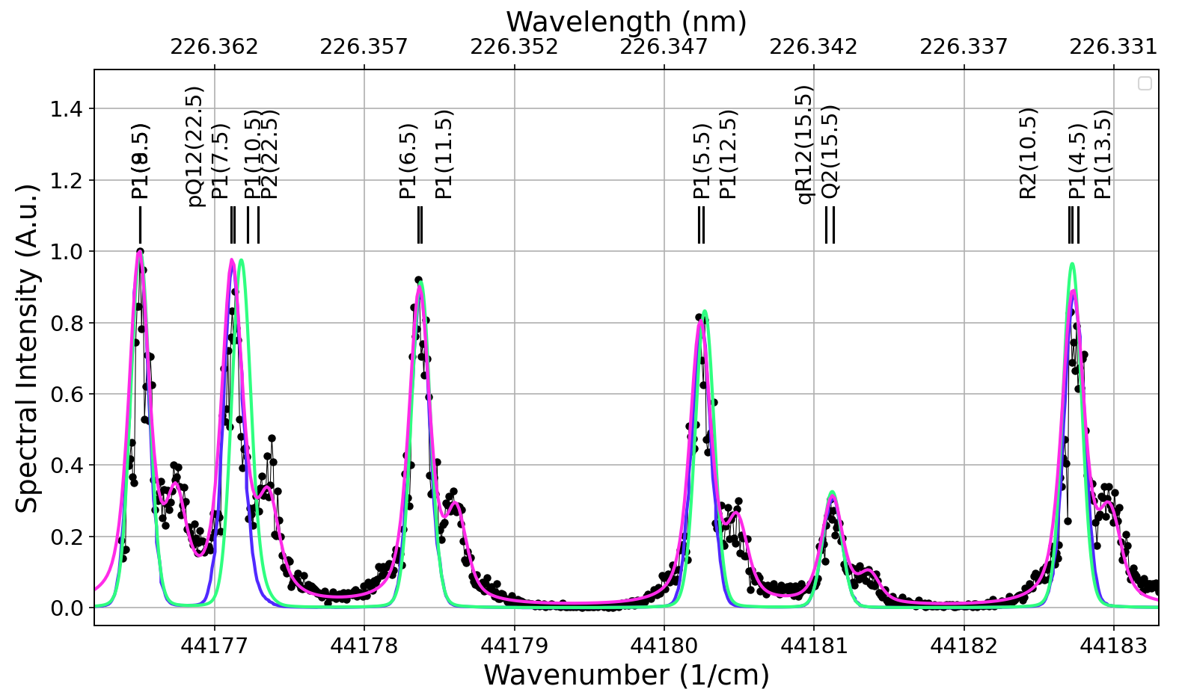
New LIFQWIK Model Accuracy
LIFQWIK (2020)
  Takes into account F1 and F2 spin-rotation split energy levels
  Much more accurately models laser artifacts and previously incorrect fluorescence lines

Slide 7
Former LIFQWIK Implementation
Written primarily in Fortran
  Had to recompile the program to switch parameters, lines, etc.
  Fortran tooling is antiquated and not well-maintained (i.e. F2PY)
Parallelization
  F
  Former implementation computes this sum in parallel on the CPU using OpenMP
Summed for each input band

Slide 8

CPU Parallelization of LIFQWIK
Computing Summation Term…
Computing Summation Term…
Accumulator
Main Program Thread
Computing Summation Term…
Main Program Thread
Computing Summation Term…
Computing Summation Term…
Run in series for each line of the desired spectrum

Slide 9
Vectorization of LIFQWIK
Input Wavenumbers
Summation Terms
Sum
[44175.46,
44175.4756513,
44175.49130261,
44175.50695391
...
44183.22304609,
44183.23869739,
44183.2543487,
44183.27 ]
[[3.43767107e-06 8.05100835e-06 ... 5.77171039e-06 6.27092496e-05],
[3.45269551e-06 8.10496568e-06 ... 5.80443243e-06 6.38959028e-05],
[3.46781868e-06 8.15946743e-06 ... 5.83743359e-06 6.51166193e-05],
[3.48304144e-06 8.21452094e-06 ... 5.87071706e-06 6.63727176e-05],
...
[5.99185330e-04 1.89630161e-05 ... 3.64124208e-05 4.81591913e-06],
[5.64098582e-04 1.87702393e-05 ... 3.59002380e-05 4.79118011e-06],
[5.32120181e-04 1.85803902e-05 ... 3.53988086e-05 4.76663126e-06],
[5.02882351e-04 1.83934097e-05 ... 3.49078329e-05 4.74227066e-06]]
[0.00509361
0.00523513
0.00538324
0.00553838
...
0.0111542
0.01051988
0.00994307
0.0094167 ]
$$S=C_{opt}E_{p}\frac{χ_{NO}P}{k_{B}T}φ(P,T,χ_{α})\sum_{i}{{(f_{B}\left(T, J\right)R_{f_{B}}\left(T,J\right)B_{12}\left(J\right)g(v_{0},v_{l},δv_{l},P,T,χ_{α},u_{||}))}_{i}}$$
$$S=C_{opt}E_{p}\frac{χ_{NO}P}{k_{B}T}φ(P,T,χ_{α})\sum_{i}{{(f_{B}\left(T, J\right)R_{f_{B}}\left(T,J\right)B_{12}\left(J\right)g(v_{0},v_{l},δv_{l},P,T,χ_{α},u_{||}))}_{i}}$$
$$S=C_{opt}E_{p}\frac{χ_{NO}P}{k_{B}T}φ(P,T,χ_{α})\sum_{i}{{(f_{B}\left(T, J\right)R_{f_{B}}\left(T,J\right)B_{12}\left(J\right)g(v_{0},v_{l},δv_{l},P,T,χ_{α},u_{||}))}_{i}}$$
$$S=C_{opt}E_{p}\frac{χ_{NO}P}{k_{B}T}φ(P,T,χ_{α})\sum_{i}{{(f_{B}\left(T, J\right)R_{f_{B}}\left(T,J\right)B_{12}\left(J\right)g(v_{0},v_{l},δv_{l},P,T,χ_{α},u_{||}))}_{i}}$$
Can represent almost all of LIFQWIK using vector math
Allows for an expanded instruction set and automatic parallelization using NumPy.

Slide 10
Tensorflow for GPU compute and optimization
The vectorized problem is perfect to run on GPUs
  Consistent arithmetic performed on a large set of data
Scales very well to being run using CUDA or OpenCL
  In the order of 2000-3000 compute cores to perform the math
Tensorflow allows for the easy translation of the NumPy vector math into code that can be run using one of these solutions
  NumPy matrices can be directly translated to TF “tensors”
Using Tensorflow lets us auto-differentiate the model

Slide 11
LIFQWIK Implementation Performance
4.343 milliseconds
10.598 milliseconds
222.16 milliseconds
1185 milliseconds
*CPU: TR 1950x, GPU: RTX 2070

Slide 12
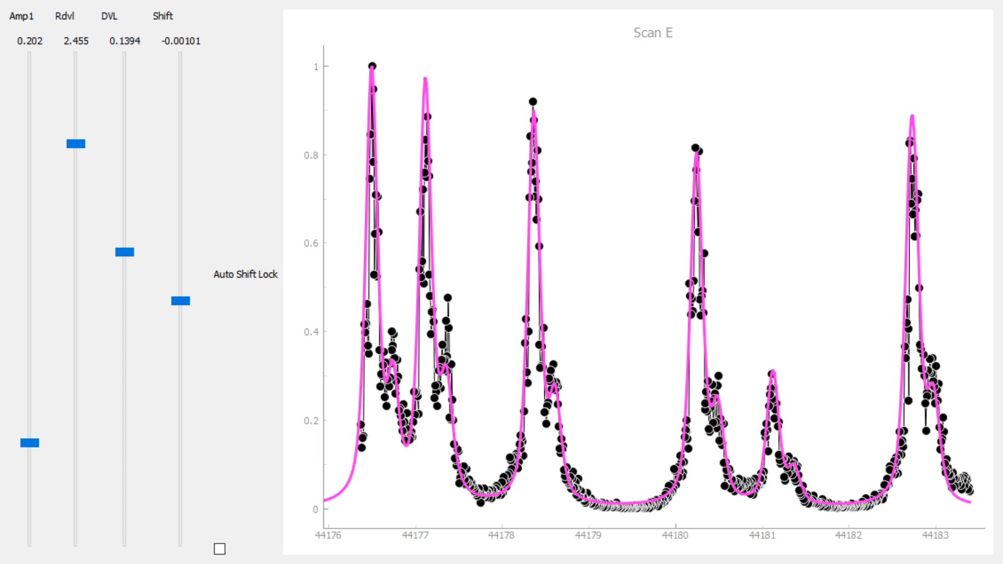
Interactive LIF Spectra
High performance allows for parameter fitting with a real-time preview:

Slide 13
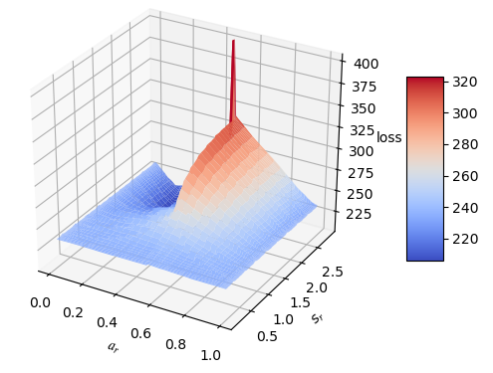
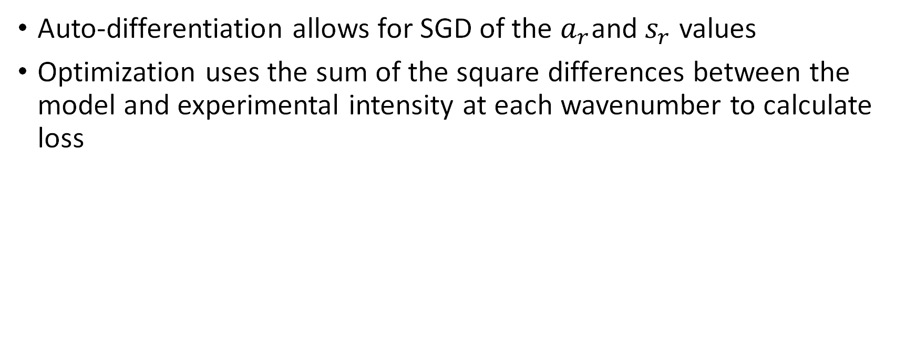
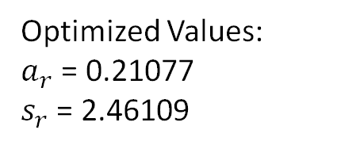
Machine Learning Parameter Fitting
Auto-differentiation allows for SGD of the $a_{r}$and $s_{r}$ values
Optimization uses the sum of the square differences between the model and experimental intensity at each wavenumber to calculate loss
Optimized Values:
$a_{r}$ = 0.21077
$s_{r}$ = 2.46109

Slide 14
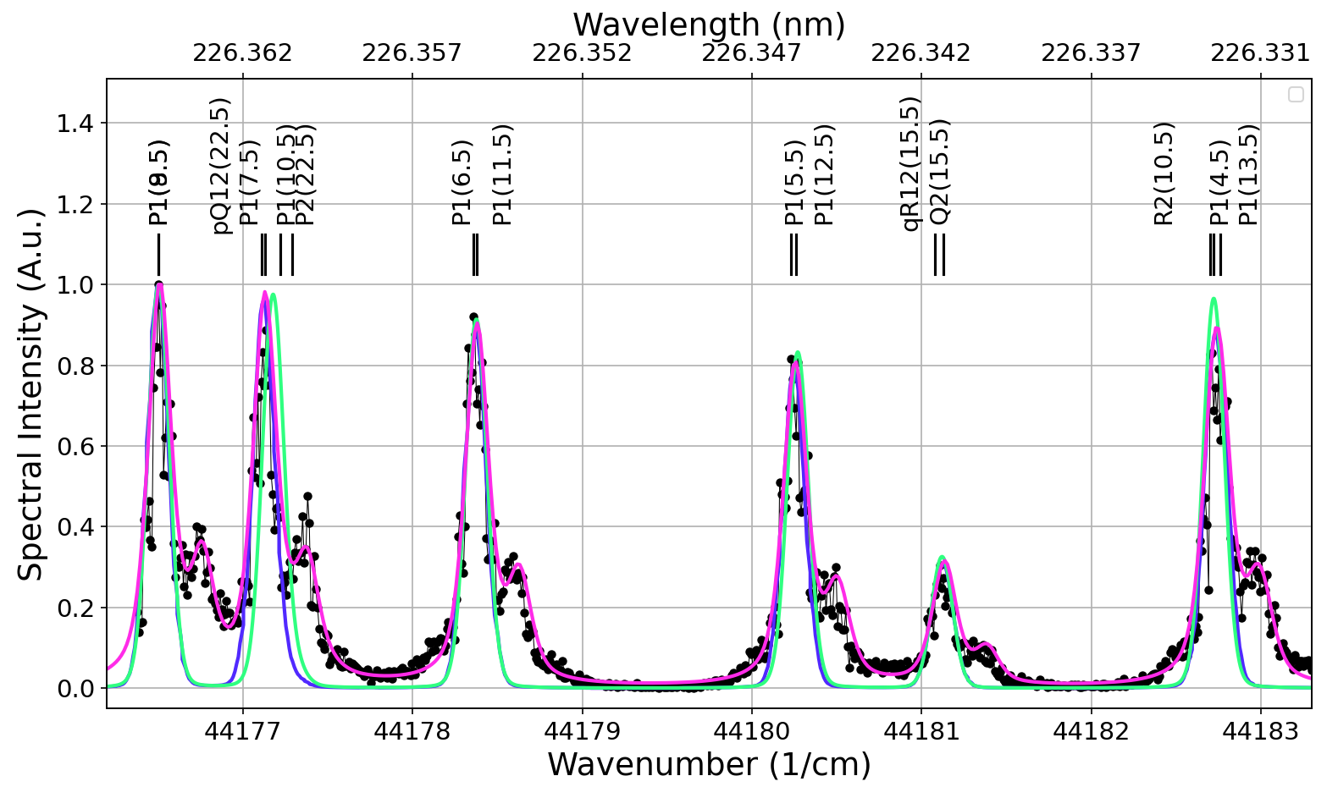
Scan E Before ML Optimization

Slide 15
Scan E After ML Optimization

Slide 16
Benefits of a Modular Python Interface
Easier and faster to further modify and create new models.
Compatibility with many tools and platforms
Automated usage of LIFBASE, and possibly LINUS in the future
Can be published to aid other scientific work involving PLIF simulation and measurement.
Relatively easy to call Python from other languages, i.e. Fortran

Slide 17
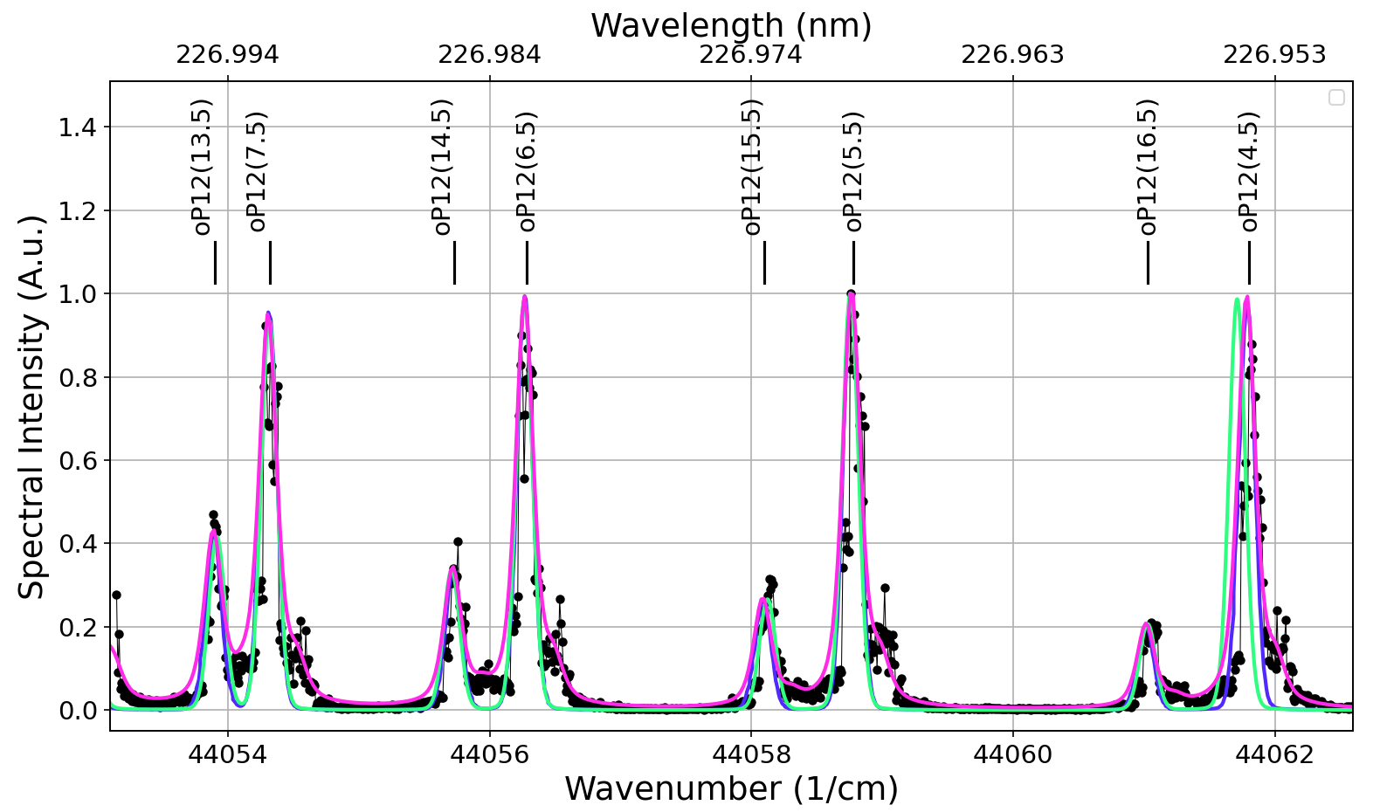
Results
Gas Cell - Scan A
1.45 kPa at 300 K

Slide 18
Results
Gas Cell - Scan B
1.45 kPa at 300 K

Slide 19
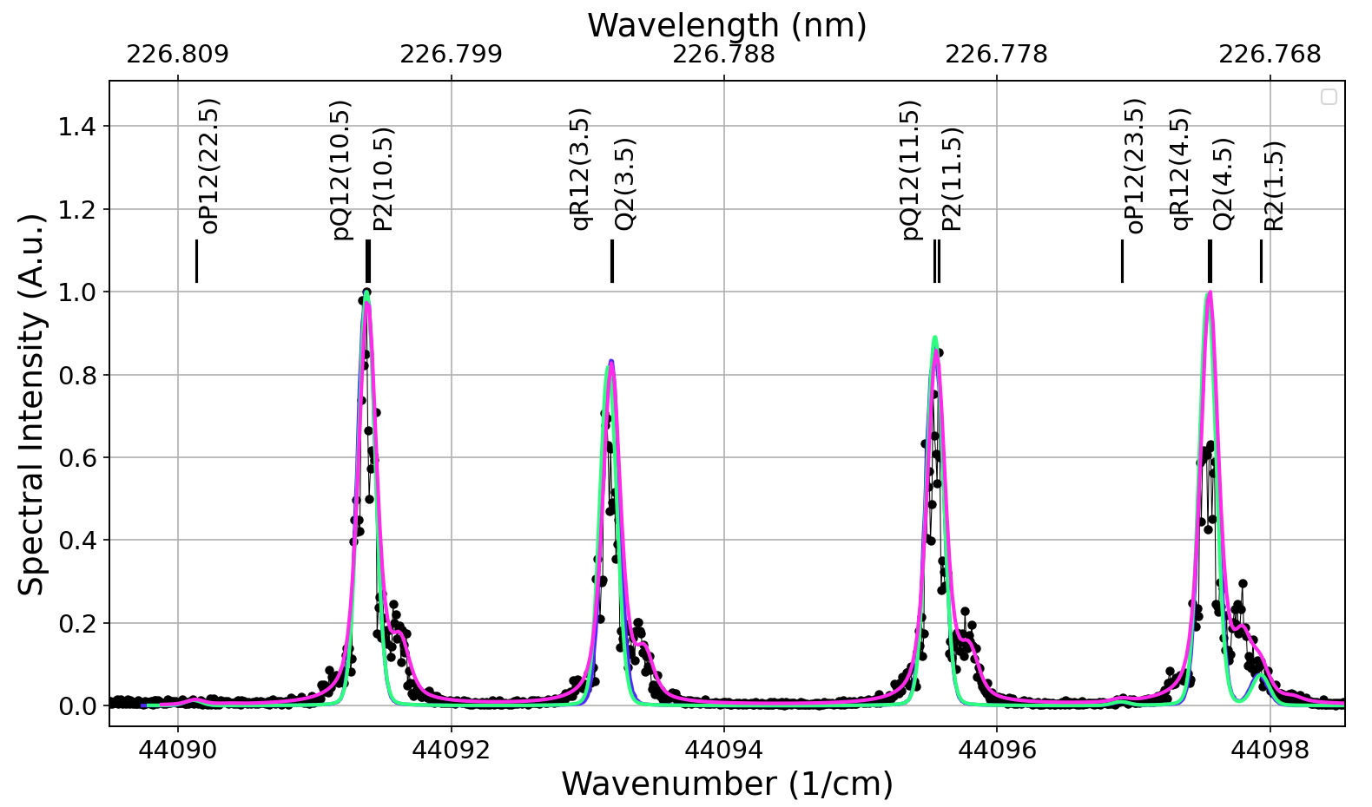
Results
Gas Cell - Scan C
1.45 kPa at 300 K

Slide 20
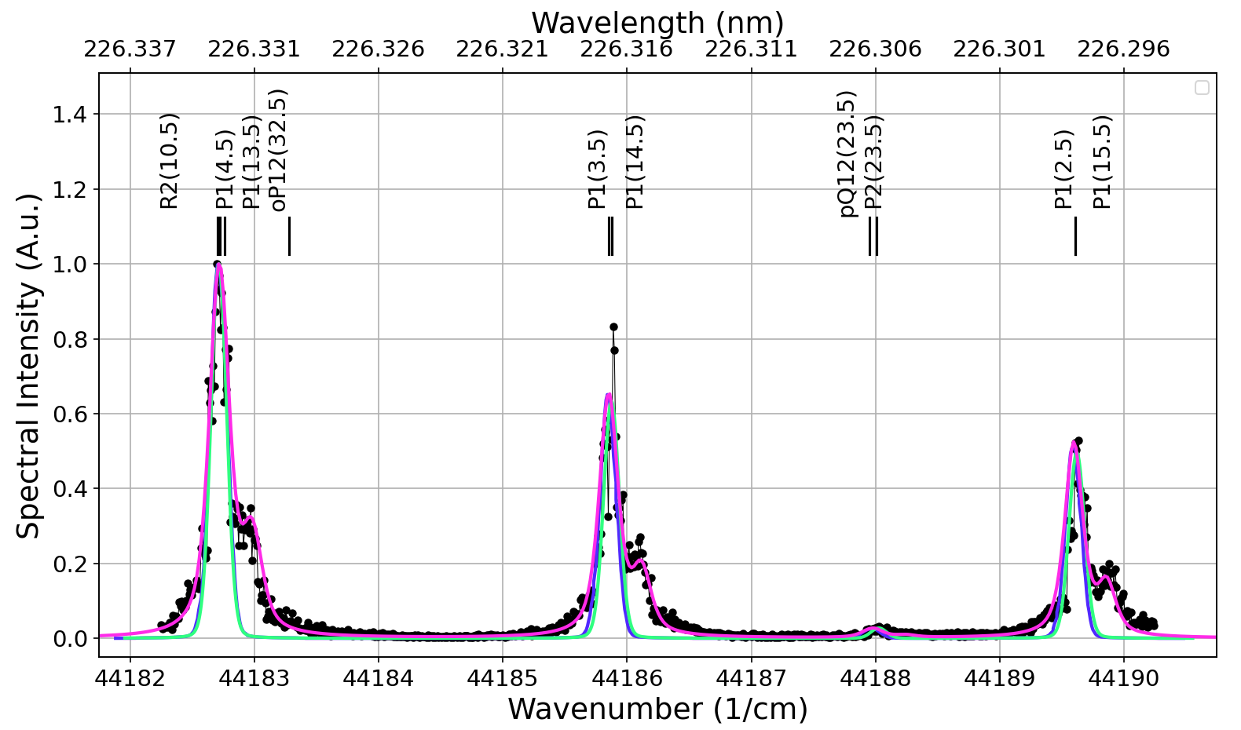
Results
Gas Cell - Scan F
2.21 kPa at 300 K

Slide 21
Contact Information
Walker Knapp
walkerknapp3@gmail.com
(703) 887 - 3070

