Slide 1



Two-step homogenization of thin-ply textile composite structures based on MSG and TexGen4SC
Xin Liu, The University of Texas at Arlington
Orzuri Rique, Wenbin Yu, Purdue University
Juan M Fernandez, Andrew Bergan, NASA Langley Research Center

Slide 2

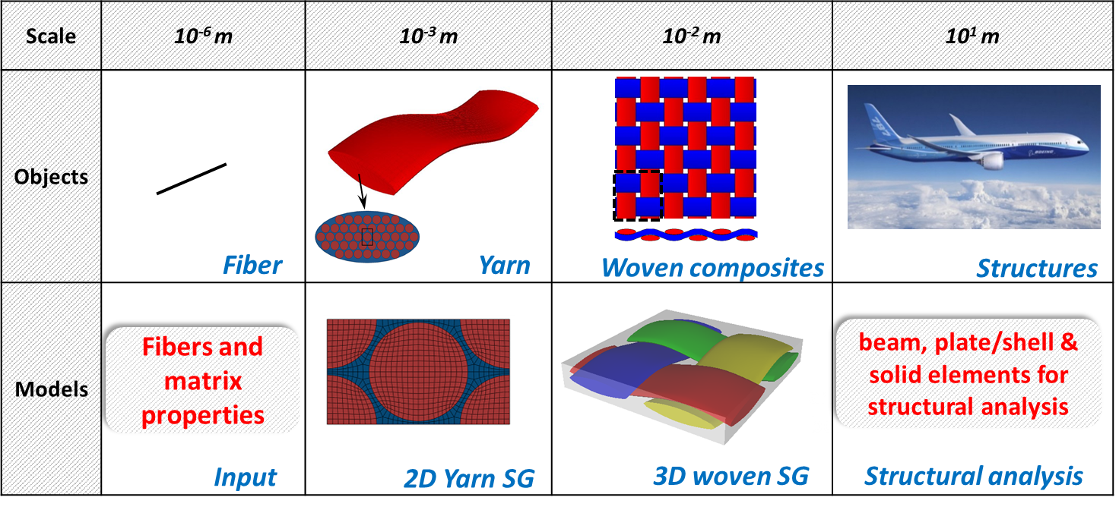
Multiscale modeling of textile composites

Slide 3
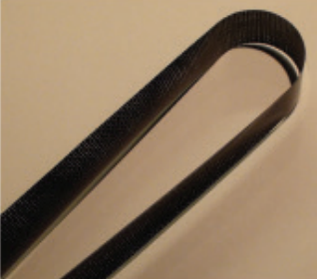
Viscoelastic homogenization of thin-ply composites
Challenges and motivation:
Viscoelastic properties of yarns cannot be measured.
PBCs in the thickness direction is not valid.
FEA-based RVE analysis requires additional efforts in coding.
FEA-based RVE analysis is mesh sensitive.
[1] Kawai Kwok and Sergio Pellegrino, AIAA Journal (2016).
Single-ply textile composites^{[1]}

Slide 4
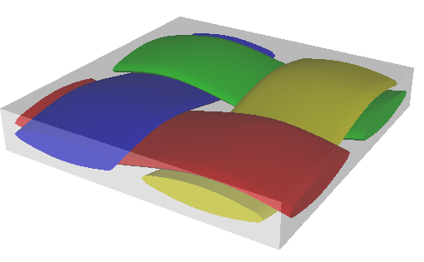
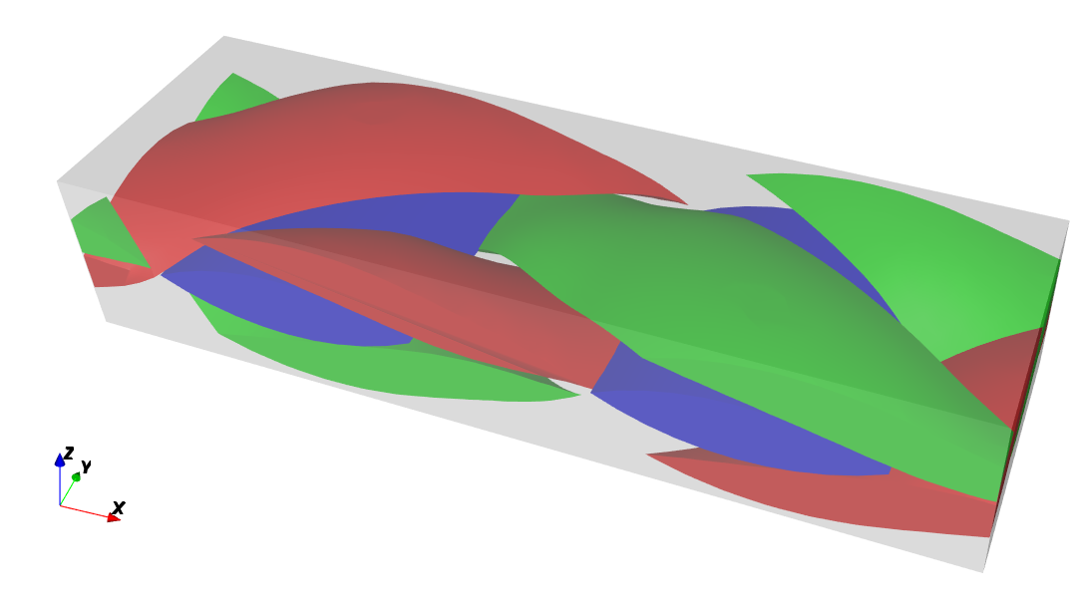
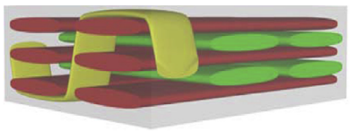
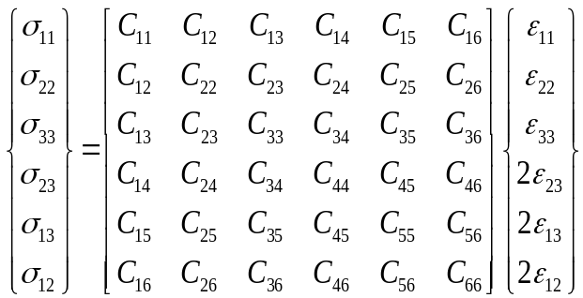
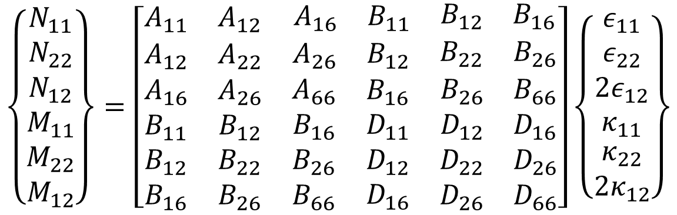
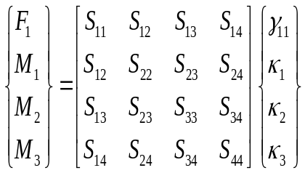
Mechanics of structure genome (MSG)
SG: Structure Gene (SG) is defined as the smallest mathematical building block of a structure which contains all the constitutive information needed for this structure (Yu, 2016).
MSG solid model
MSG plate model
MSG beam model

Slide 5





MSG viscoelastic analysis
Linear viscoelastic material:
Difference in transient strain energy:
The relaxation modulus tensor:
The instantaneous strain fields:
Effective viscoelastic properties are obtained from homogenization analysis at different time steps.

Slide 6
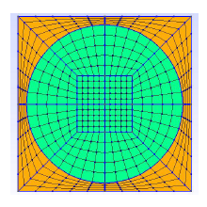
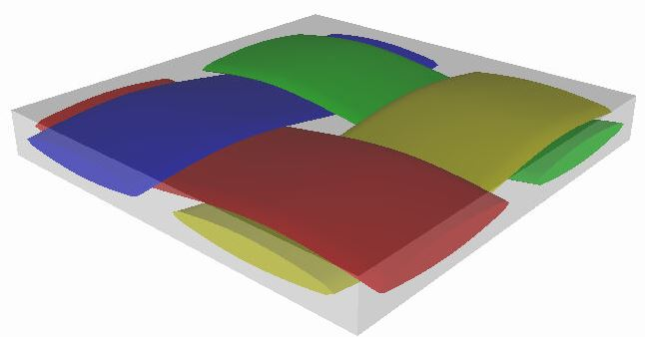
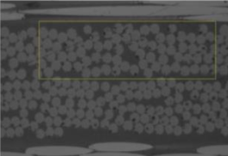
Two-step homogenization of thin-ply composites
Stress relaxation behavior:
Fibers: linear elastic; Matrix: linear viscoelastic (Prony series)
Yarn model (2D SG)
Textile model (3D SG)
Deployable boom structure
Homogenization
(MSG solid model)
Homogenization
(MSG plate model)

Slide 7
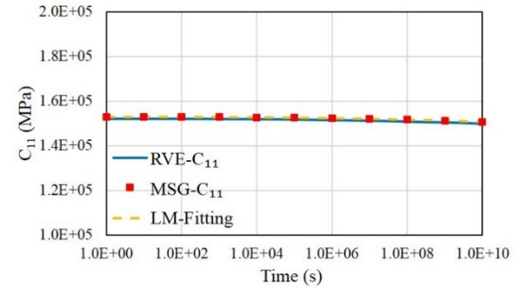
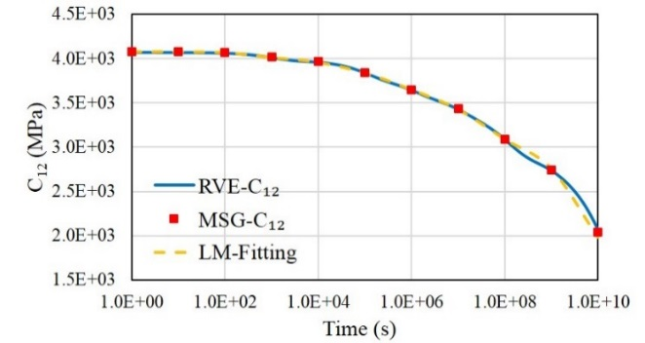
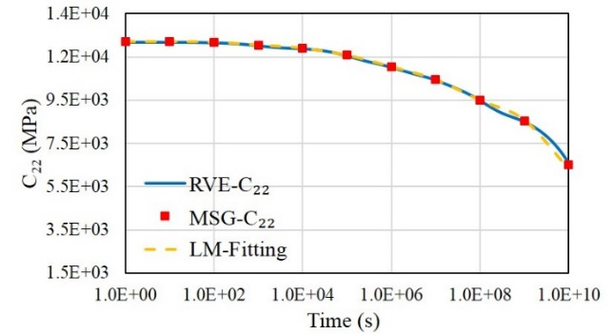
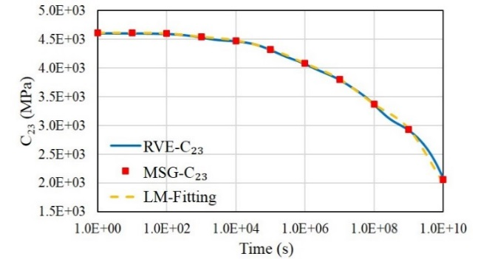
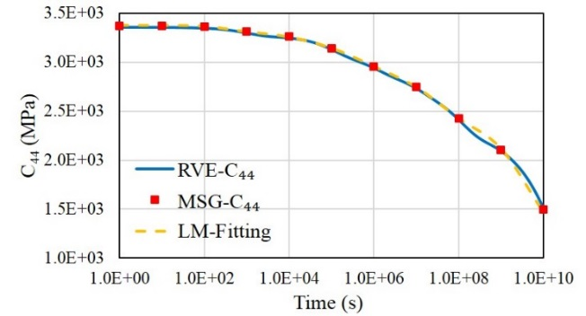
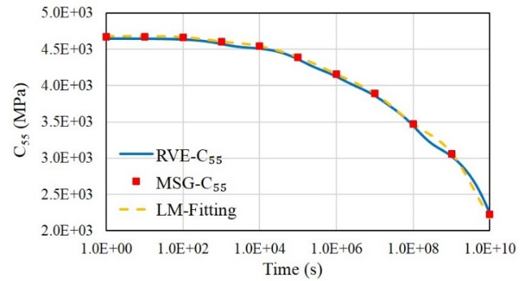
Microscale homogenization
MSG: 7.1s; RVE: 50s.

Slide 8
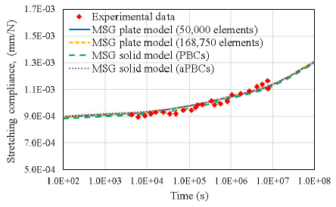
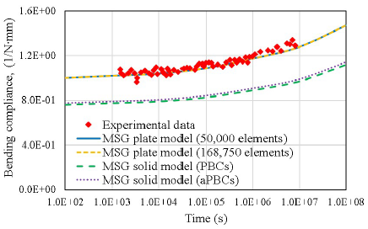
Mesoscale homogenization
Both yarns and matrix are linear viscoelastic materials.
Plate stiffness matrix is computed based on MSG plate model.
* Experimental data comes from Kawai Kwok and Sergio Pellegrino, AIAA Journal (2016).
Liu, X., et al., International Journal of Engineering Science, 2018.

Slide 9
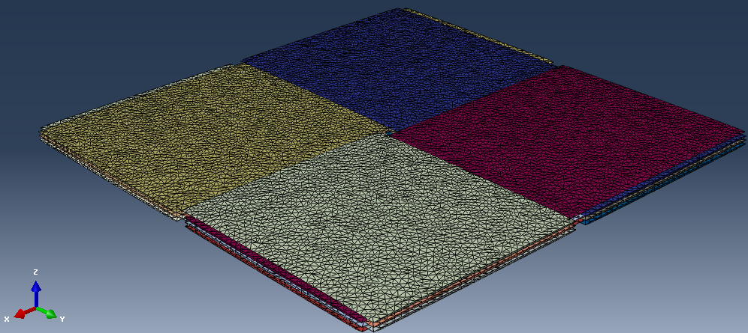
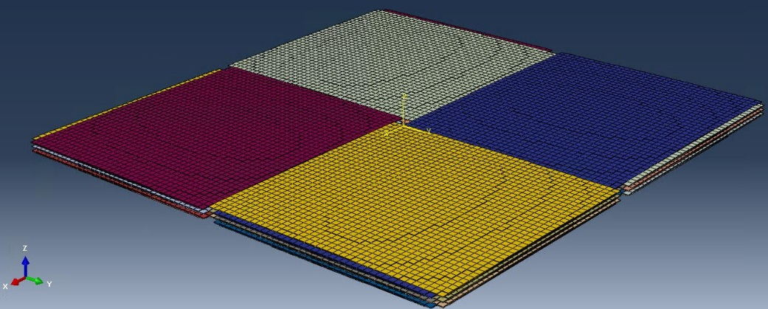
Mesoscale homogenization
(validation with Abaqus micromechanics plugin)
3-ply plain weave composites: C3D4 vs C3D8
C3D4 element
C3D8 element

Slide 10
Mesoscale homogenization
(validation with Abaqus micromechanics plugin)
Abaqus micromechanics
29 | 0.76 | 0
0.76 | 29 | 0
0 | 0 | 2.8
MSG plate model
27.2 | 0.83 | 0
0.83 | 27.2 | 0
0 | 0 | 1.8
C3D4
Abaqus micromechanics
27.4 | 0.82 | 0
0.82 | 27.4 | 0
0 | 0 | 1.89
MSG plate model
27.7 | 0.81 | 0
0.81 | 27.7 | 0
0 | 0 | 1.89
C3D8
MSG is less mesh sensitive.

Slide 11

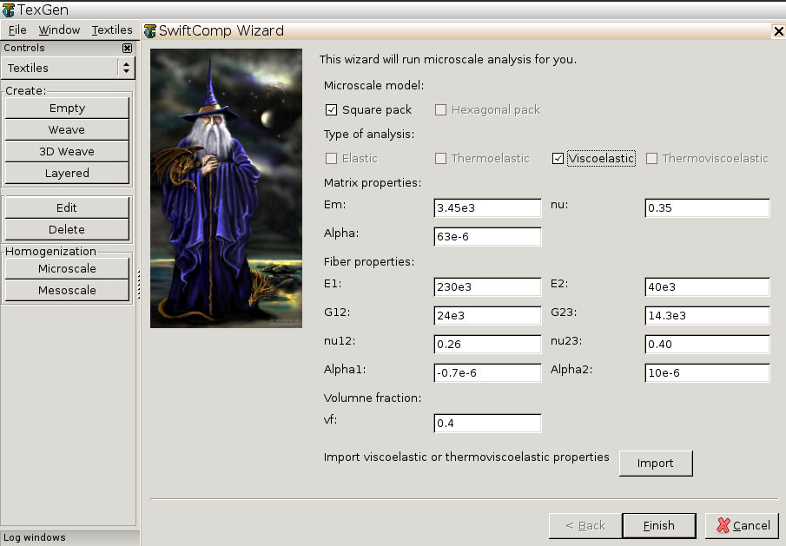
TexGen4SC
https://cdmhub.org/resources/texgen4sc
2
3
Two-step homogenization
Two micromechanical models
Viscoelastic and thermoelastic
Import file with properties
1
4

Slide 12
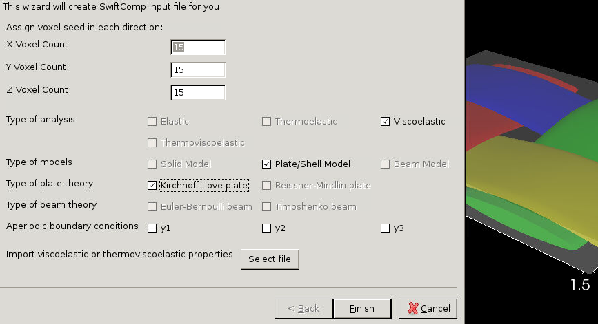
TexGen4SC
https://cdmhub.org/resources/texgen4sc
Viscoelastic and thermoelastic
Import file with properties
1
Demo
2

Slide 13
Thank you!
Xin Liu
xin.liu@uta.edu
Ph.D., Assistant Professor
The University of Texas at Arlington

