Slide 1
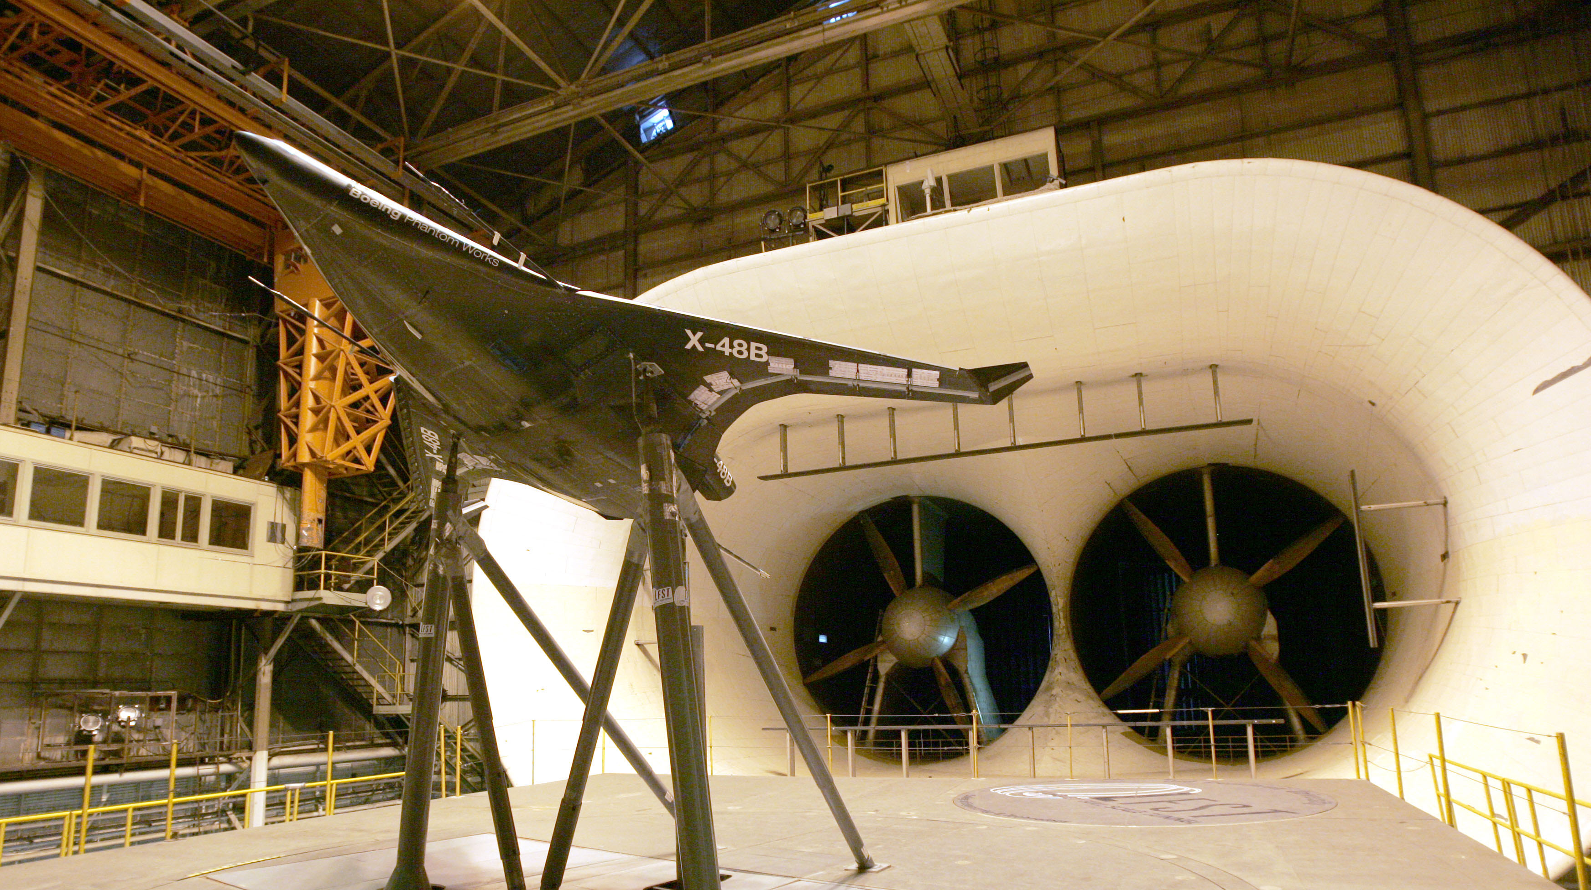

A Statistical Analysis of AMS Sensor Calibration Data
Cassandra Chang
August 5, 2020

Slide 2
Outline
Introduction to Angle Measuring Sensors
  Typical usage, calibration process
What’s the issue?
  Out of tolerance problems
Exploratory analysis
  AMS 12 calibrations
Simulations
  What happens in the wind tunnel vs calibration
Conclusions, Questions

Slide 3
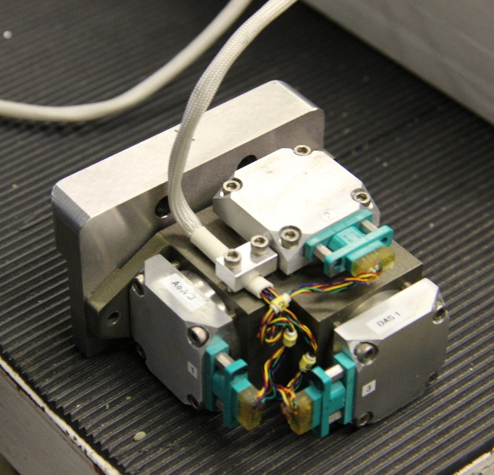
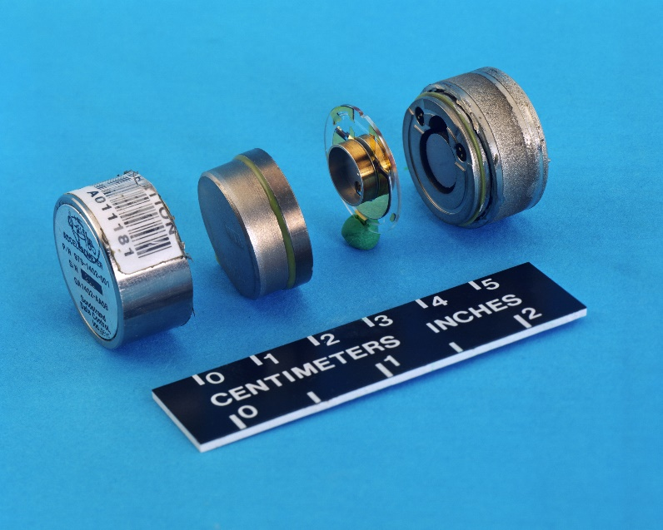
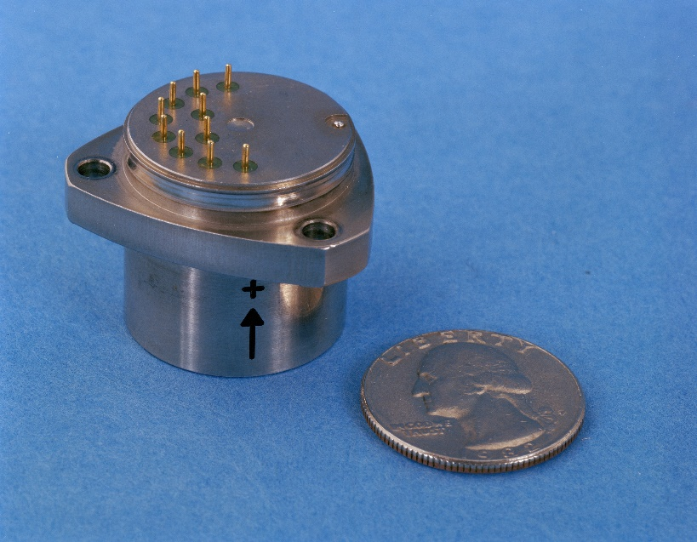
Introduction to Angle Measuring Sensors
3 axis Q-flex sensors
Measure angles for models in wind tunnel experiments
Focus on AMS 12 but generalizes to other AMS packages

Slide 4
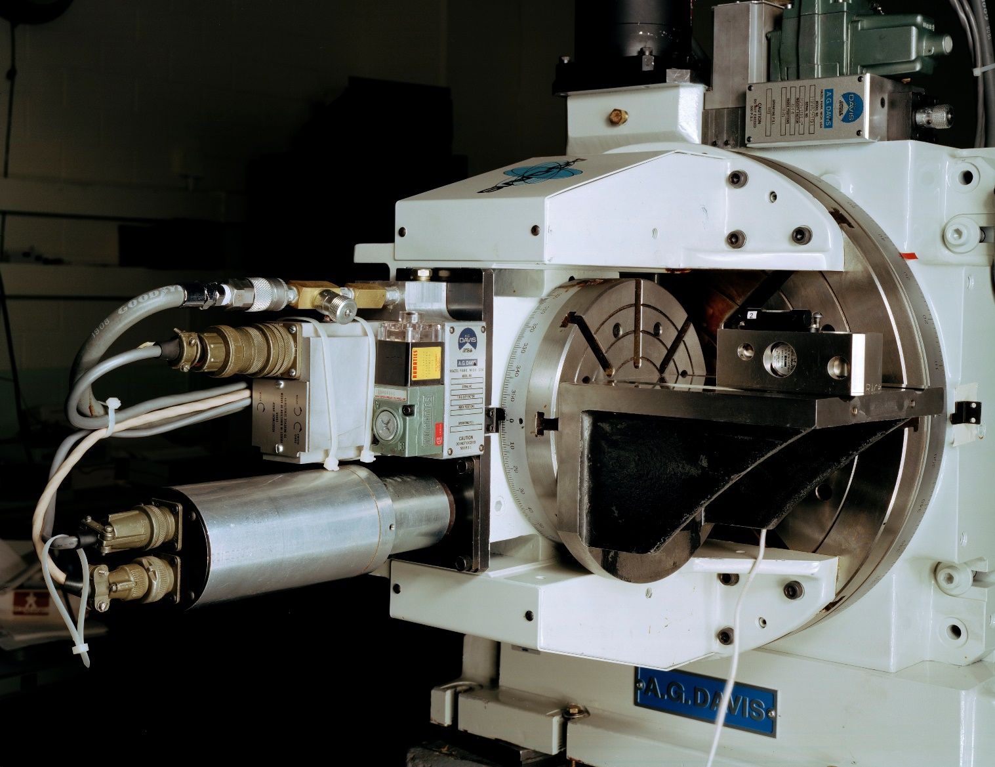
Calibration Process
Six-month intervals
Angles measured at set testing points
All test points determined by the A.G. Davis table

Slide 5
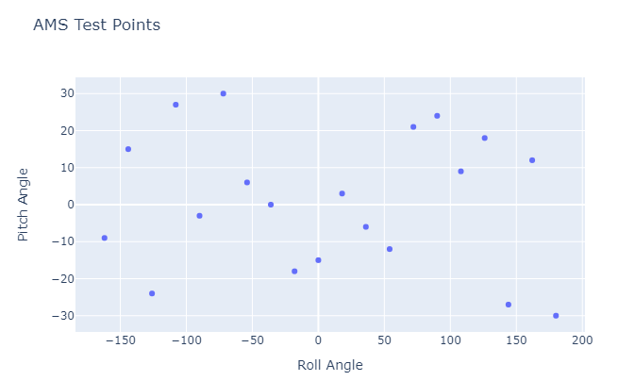
Notes:
Plane of test points – pitch and roll points are “arbitrarily” paired. No correlation in how these are distributed. Latin hypercube

Slide 6
So what’s the problem?
Notes:
Loss of trust in the calibration process – too many cals coming back OOT
Users have started to disregard the calibration results as it may result in redoing months of work
To their calibrated eye, it seems to be working fine

Slide 7
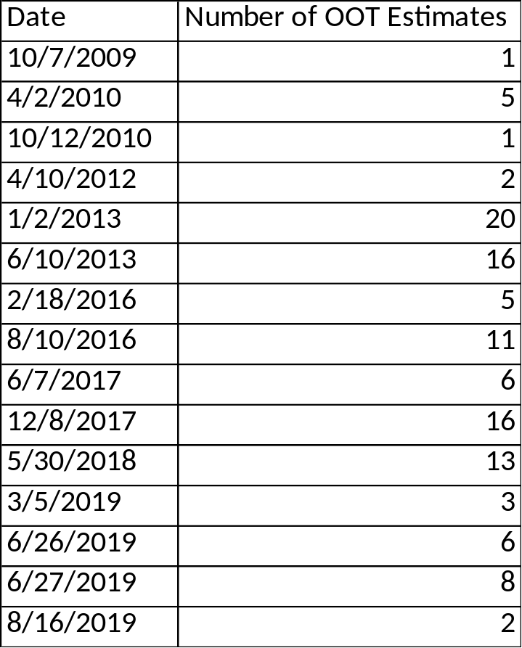
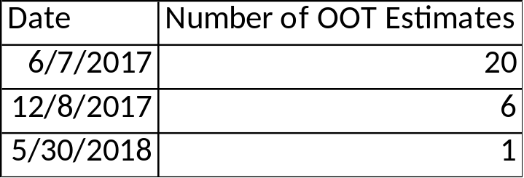
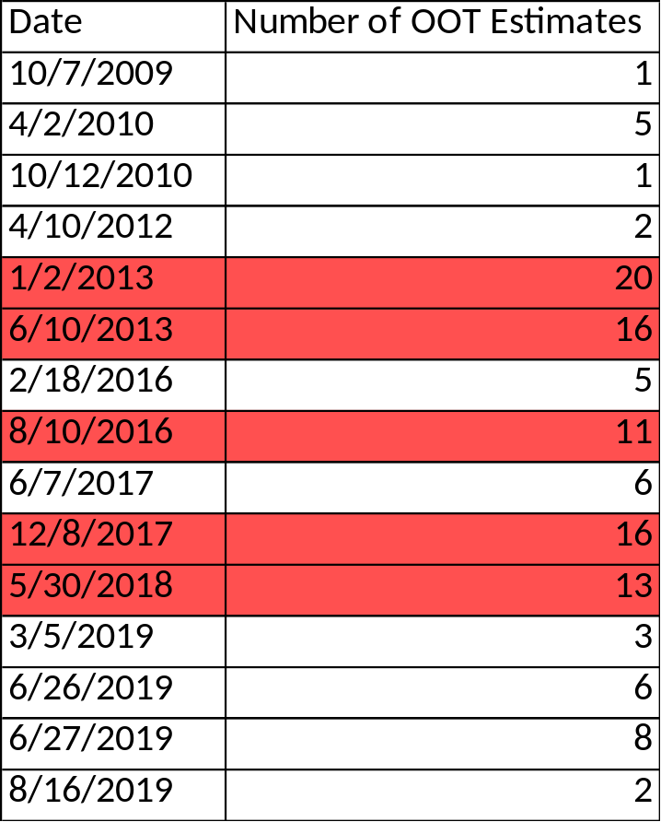
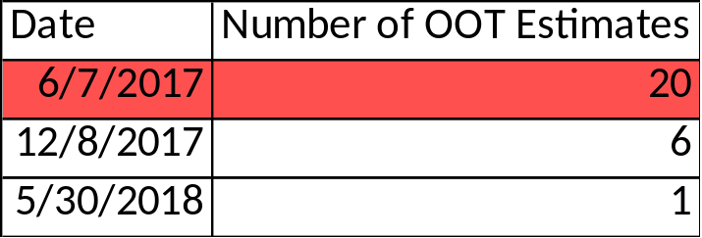
Out of tolerance calibrations
Pitch Deviations
15 (shown)/26 calibrations
Roll Deviations
3(shown)/26 calibrations
Notes:
Only the OOT cals are shown. Within these cals, we see how many of the measures (out of 20) are OOT.
Highlighted rows are ones with >10 OOT measures – maybe we need to look more closely at them. If these are the ones that are actually out of tol, then there really aren’t as many.

Slide 8
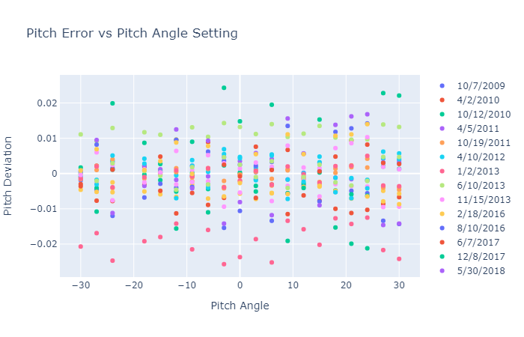

Slide 9
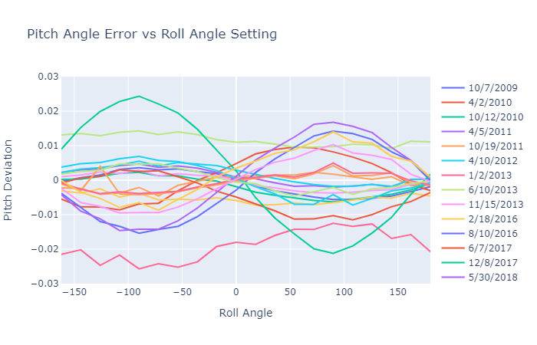
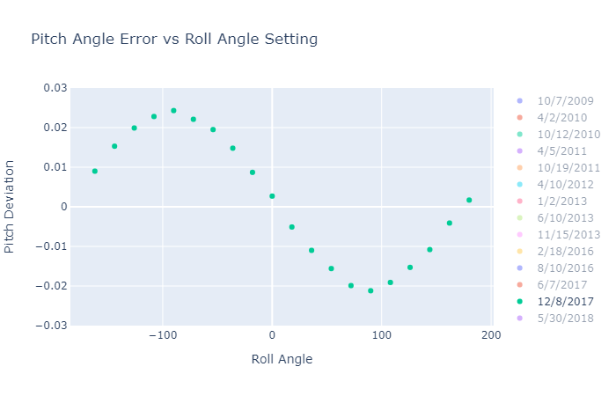
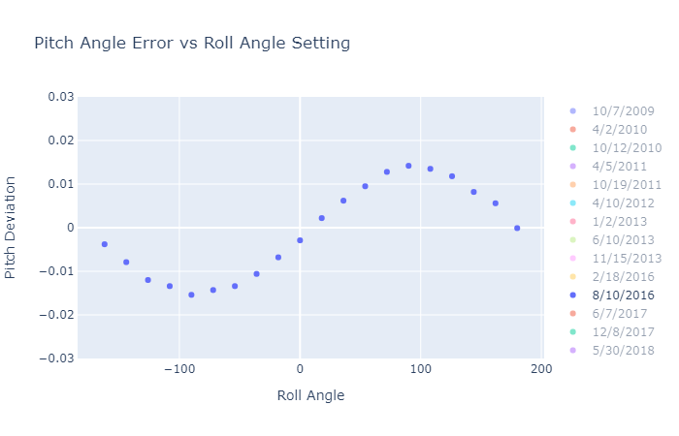

Slide 10
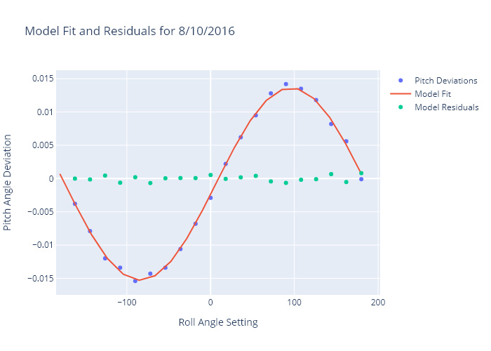
Notes:
Cubic model fit for F-test to show significance – if significant we can say that there is a structure that we need to remove
All models tested for AMS12 were significant to within alpha=0.05 (although they were all much lower than that)
Model residuals is pitch error after we remove this structure – looks random and they are actually all in tolerance

Slide 11
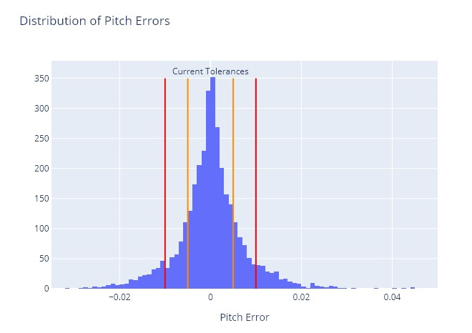
area in 0.005 tolerance: 64%
area in 0.01 tolerance: 85%

Slide 12
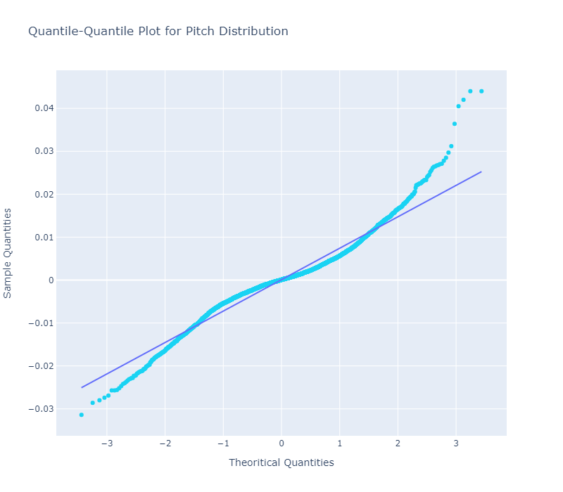
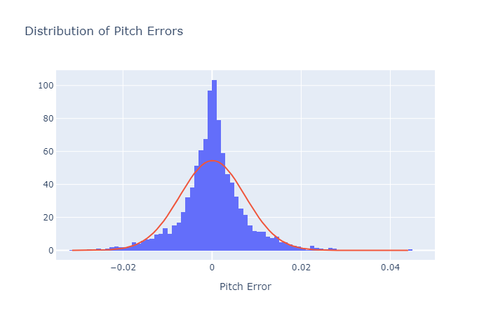
Distribution Fitting
Not normal! So what is it?
Top 3 fits (based on fitter and BIC):
  Generalized normal
  Weibull
  Laplace

Slide 13
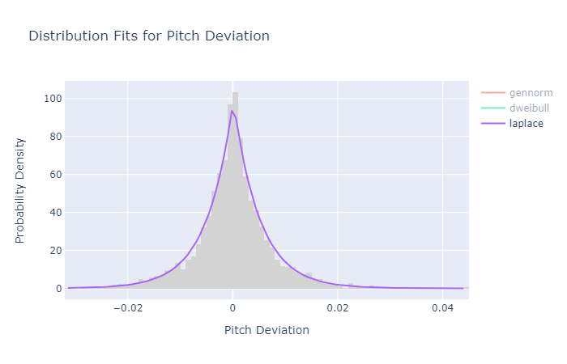
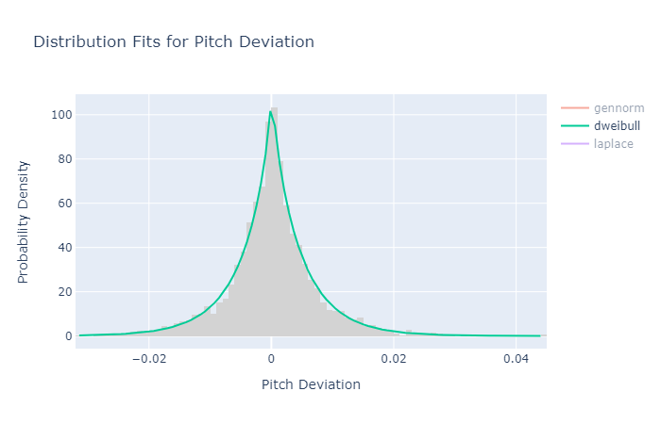
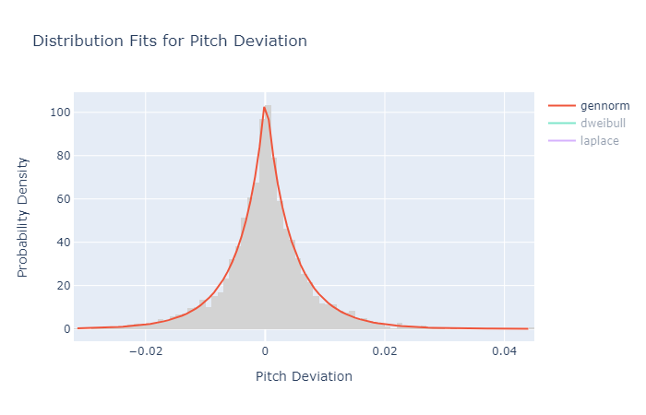
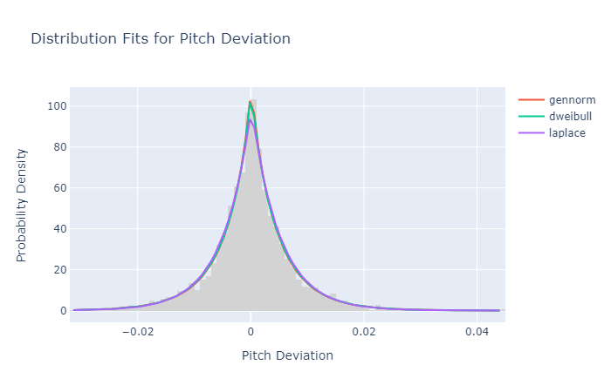

Slide 14
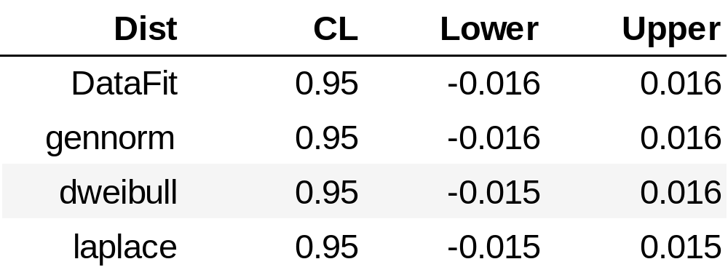
Distribution Fitting
Use Weibull because of applications in reliability engineering
Cross validation to verify this interval
Allows us to make probabilistic predictions

Slide 15
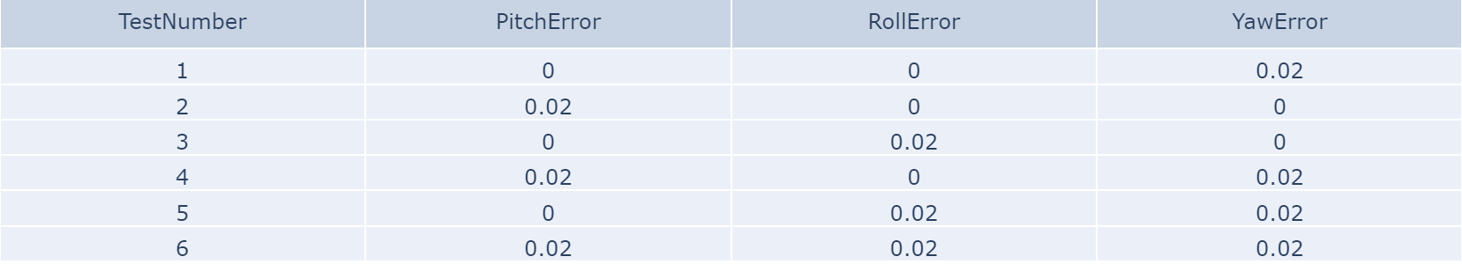
Simulations
Goal: simulate the AMS package readings and behaviors when:
  Given set perturbations in pitch, roll, and yaw
  Typically used in the wind tunnel to determine angle of attack

Slide 16
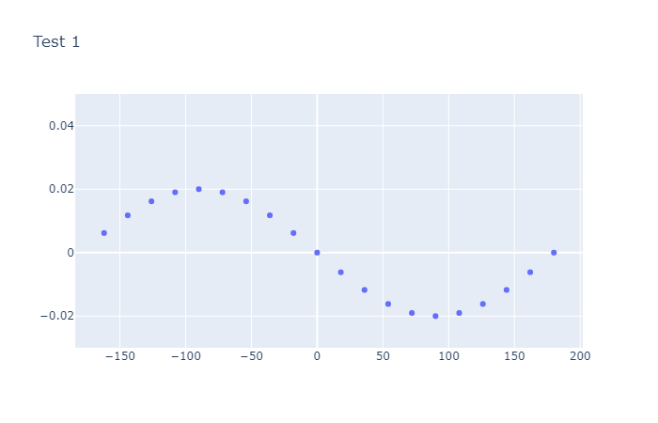
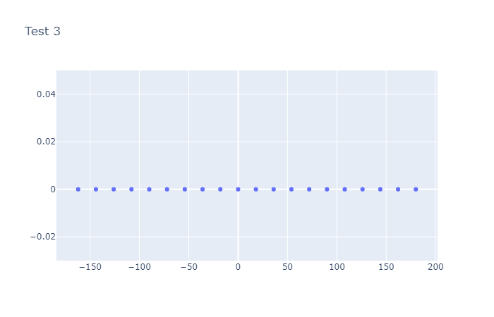
: Pitch Error = 0, Roll Error = 0 .02, Yaw Error = 0
: Pitch Error = 0, Roll Error = 0, Yaw Error = 0.02

Slide 17
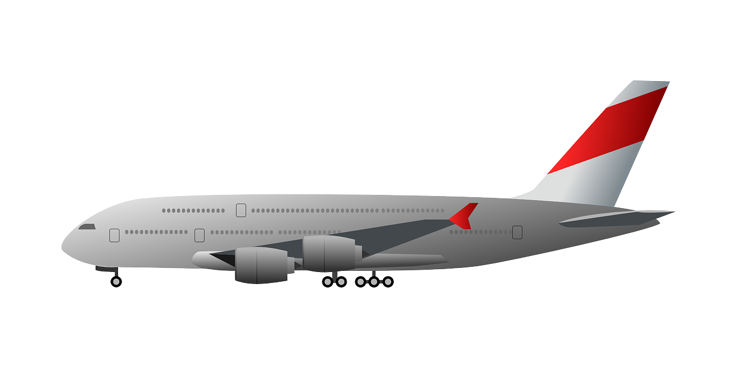
Simulations
Goal: simulate the AMS package readings and behaviors when:
  Given set perturbations in pitch, roll, and yaw
  Typically used in the wind tunnel to determine angle of attack

Slide 18
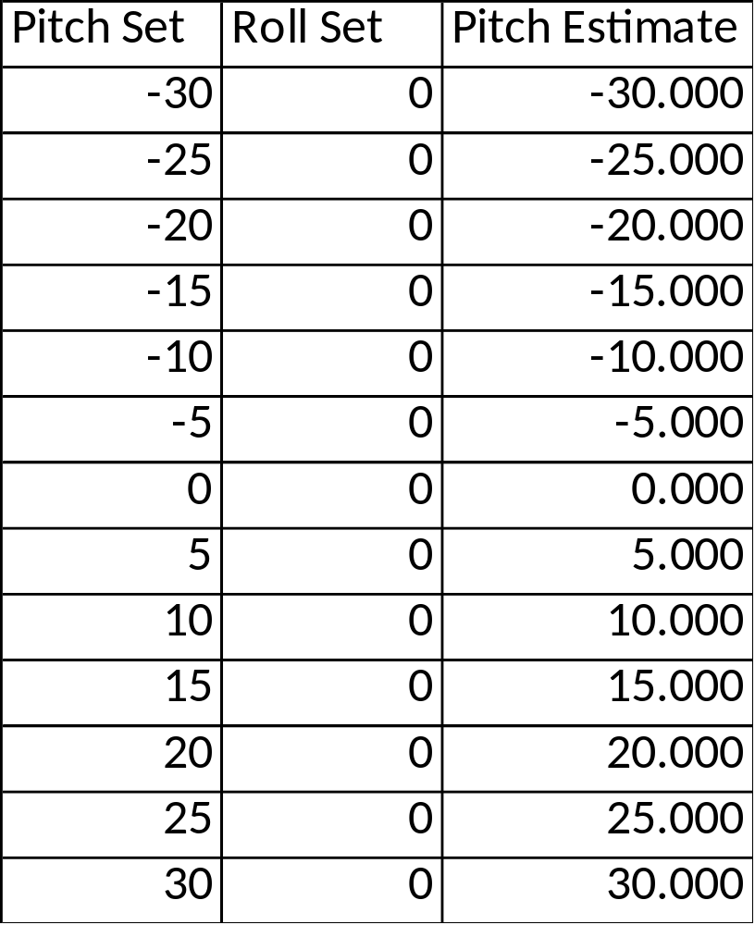

Yaw offset: 0.02

Slide 19
Conclusions
Disconnect between calibration process and actual usage
  Errors shown in calibration may not affect errors in practice
  Considered OOT on the table but still accurate in the wind tunnel
Future directions
  Test this in the lab instead of just running simulations
  Look more at roll error distributions and characteristics

Slide 20
Conclusions
Recommendations so far:
  Increase the tolerance levels to the 95% confidence interval in Weibull distribution
  Add onto the current calibration process – check performance when used in practice

Slide 21

Acknowledgements
Ken Toro and Pete Parker, mentors
Ciaran McCollum, intern
Shawn Britton
NASA Langley Internships Team

Slide 22
Questions?

