Slide 1
Planning for GEOS-IT
Amal El Akkraoui^{a,b}, Rob Lucchesi^{a,b}, Gary Partyka^{a,b} , Steven Pawsonª
ªGMAO, Earth Sciences Division, Sciences and Exploration Directorate, NASA GSFC, Greenbelt, MD
^{b}Science Systems and Applications, Inc., Lanham, MD
A presentation for discussion with the user community about an upgrade for GEOS-FPIT
July 16, 2020

Slide 2
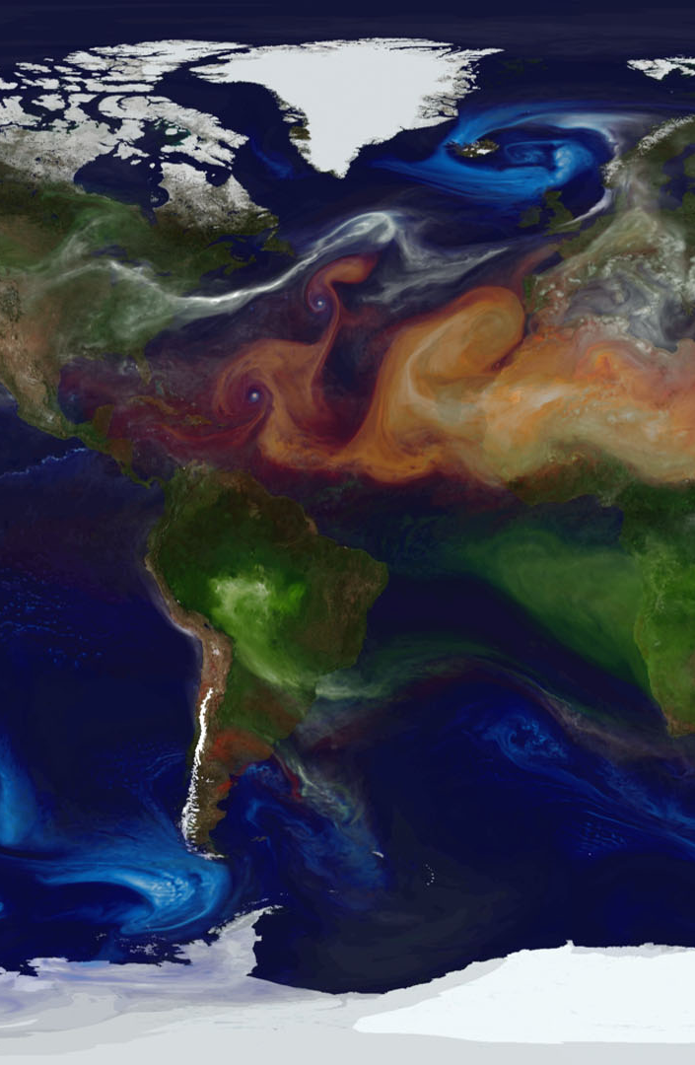
Plan for the Meeting
Overview of GMAO’s main GEOS systems and upgrade strategies
Technical details of GEOS-IT, the upgrade of GEOS-FPIT/RPIT
Logistical details: product generation and timelines
Data distribution: presentation by the DAAC
Input from representatives of each Instrument Team
Discussion

Slide 3
Summary of Major GMAO Products
GMAO’s current products that are documented both technically and through robust file specifications, well validated, and released to the broad community for research and applications
System | Focus | Customers/Applications
GEOS-FP “weather prediction” | Impacts of NASA observations on NWP: forefront resolution and complexity | NASA Field Missions (weather, aerosols) Multiple Agencies: NOAA/FAA; NOAA field stations; NRL
GEOS-CF “air quality” | Pioneering global system for atmospheric composition using multiple NASA assets | Health/Air Quality studies (via NASA Applied Sciences) Multiple agencies: NIH, Army, NOAA
GEOS-S2S “seasonal prediction” | Ensembles of coupled Earth System predictions, emphasizing NASA observations | National ensembles (NMME, SubX), drought/sea-ice prediction Multiple Agencies and international linkages
MERRA-2 “reanalysis” | Stable product for climate studies, emphasizing NASA data | Only current national reanalysis: USGCRP/NCA applications Interagency use: DoE, DoT, NOAA, …
GEOS-FPIT “mission support” | Stable, well validated, low-latency product for use by NASA instrument teams | More than 20 NASA Instrument Teams
GEOS-Nature Run “mission planning” | Complex Earth System simulations at fine resolution with obs. simulators | Planning for new space-based missions NOAA and broad community; DoE/Smithsonian; NSF

Slide 4
Proposed Transition from GEOS-FPIT to GEOS-IT
Commitment to NASA’s Earth Science Mission means GMAO wants to provide the best-possible products
GEOS-FPIT uses a ~2015-era version of the GEOS model and assimilation system
model enhancements lead to more realistic moisture, temperature, land surface, … analyses
older models become hard to maintain in modern computing environments
new observations typically cannot be assimilated in older systems
opportunity to use reprocessed versions of older operational observations (e.g., AMSU)
Planning to retain the 50-km resolution of GEOS-FPIT (time-to-completion and data volumes)
Continue use of the “3DVar” assimilation technique (HPC cost and data volumes)
Continue the “subscription only” access via the GES-DISC

Slide 5
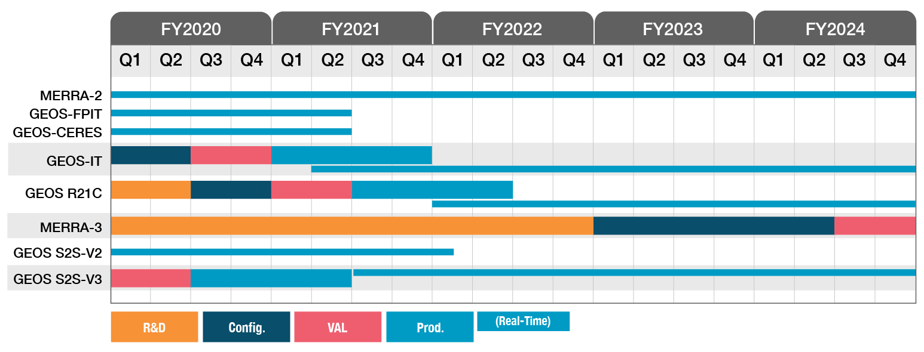
Timeline of GMAO Projects

Slide 6
~2015
~2020
~2025
GEOS-FP
GEOS-FP
Atmosphere
50km,L72
3D-Var
Near-real time NWP
Atmosphere
12.5km,L72
Hybrid 4DEnVar
Near-real time NWP
GEOS-FP
MERRA-3
Coupled Atmosphere-Ocean
Higher vertical resolution
JEDI-based DA
Multi-decade
MERRA-2
GEOS-FPIT
GEOS-IT
GEOS-R21C
Atmosphere
50km,L72
3DVar
1980-onwards
Atmosphere
50km,L72
3DVar
EOS-period
Atmosphere
50km,L72
3DVar
EOS to post-EOS period
Based on current GEOS-FP
Atmosphere
25km,L72
Hybrid 4DEnVar
EOS to post-EOS period

Slide 7
FPIT (GEOS-5.12.4)
Capability to process additional input observation types, such as METOP-B AMSUA, METOP-B IASI, METOP-B MHS, CRIS, SSMIS, and GOES sounder.
GEOS-5.13.0
GEOS-5.13.1
Hybrid 3D-Var data assimilation. Enhancement to the forecast model parameterization of surface drag
GEOS-5.16.5
GEOS-5.17.0
Hybrid 4D-EnVar DA.
Increase spatial resolution to 12.5km.
GEOS-5.21.0
Updated topography data set;
Retuning of the gravity-wave drag and turbulence parameterizations. Changes to the moist physics to improve the representation of intense precipitation events.
GEOS-5.22.0
FP (GEOS-5.25.1)

Slide 8
FPIT (GEOS-5.12.4)
Change to model physics (RRTMG longwave radiation + improved representation of cloud ice and liquid effective radii). Dynamical core update. All sky assimilation of GPM GMI radiances. Updated variational bias-correction scheme. Update to 4DIAU.
GEOS-5.13.0
GEOS-5.13.1
GEOS-5.16.5
Assimilation of radiances from Cris and ATMS from NOAA-20. Addition of total column ozone measurements from the OMPS nadir mapper instrument. NEXRAD velocity-azimuth display (VAD) winds disabled. Retuned Observation errors for all polar AMVs from MODIS and AVHRR. Update added to account for inter-channel correlations in the specification of the observation error matrix for AIRS and IASI hyper-spectral IR radiances.
GEOS-5.17.0
GEOS-5.21.0
GEOS-5.22.0
FP (GEOS-5.25.1)

Slide 9
FPIT (GEOS-5.12.4)
Deep convective parameterization (RAS) replaced with a combination of the Grell-Freitas scale-aware deep and congestus parameterization combined with the Park and Bretherton shallow convection scheme.
New RRTMG shortwave radiation scheme. Update to cloud liquid and ice radiative properties in the single-moment microphysics.
Catchment land model now includes updated hydrology features making GEOS systems consistent with operational GMAO production of SMAP Level 4 soil moisture products. This includes extensive updates of model BC (soil textures, vegetation phenology) and improved physical treatments of soil moisture diffusion and surface thermodynamics.
GEOS-5.13.0
GEOS-5.13.1
GEOS-5.16.5
GEOS-5.17.0
GEOS-5.21.0
GEOS-5.22.0
FP (GEOS-5.25.1)

Slide 10
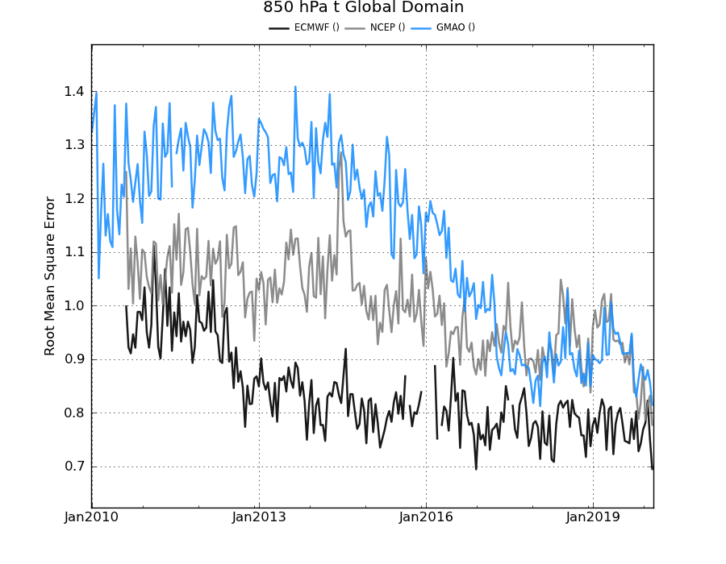
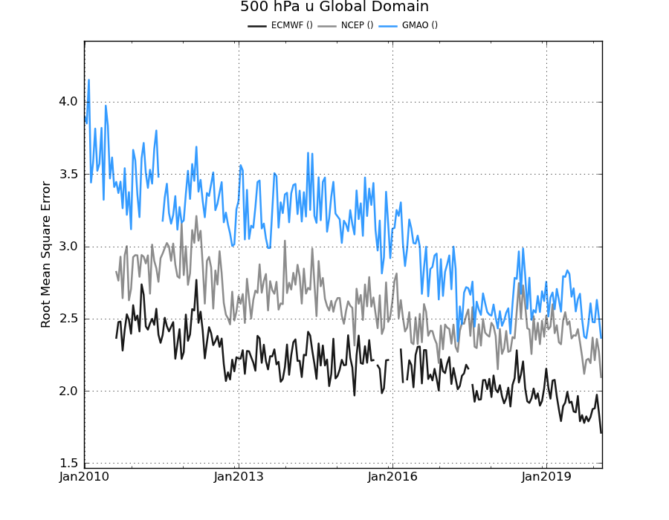
Impact on forecast skill
GEOS-FP
NCEP
ECMWF Ops
GEOS-FP
NCEP
ECMWF Ops
Time series of 48h forecast rms error for 850hPa temperature and 500hPa zonal wind

Slide 11
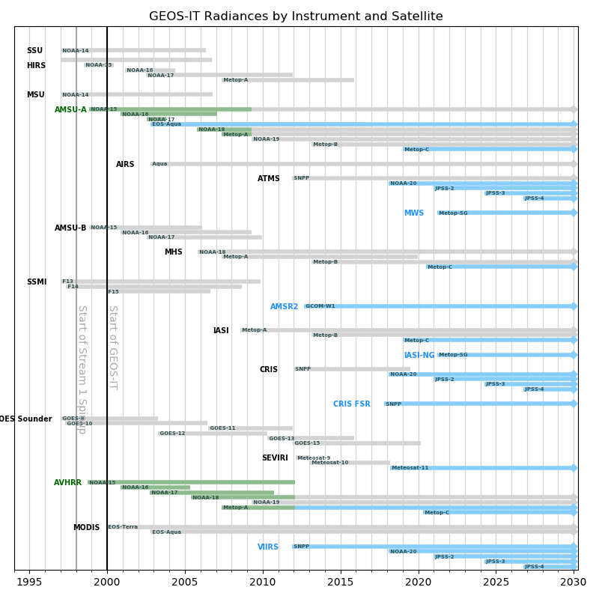
Observing system
Reprocessed
Used in FPIT
NEW

Slide 12
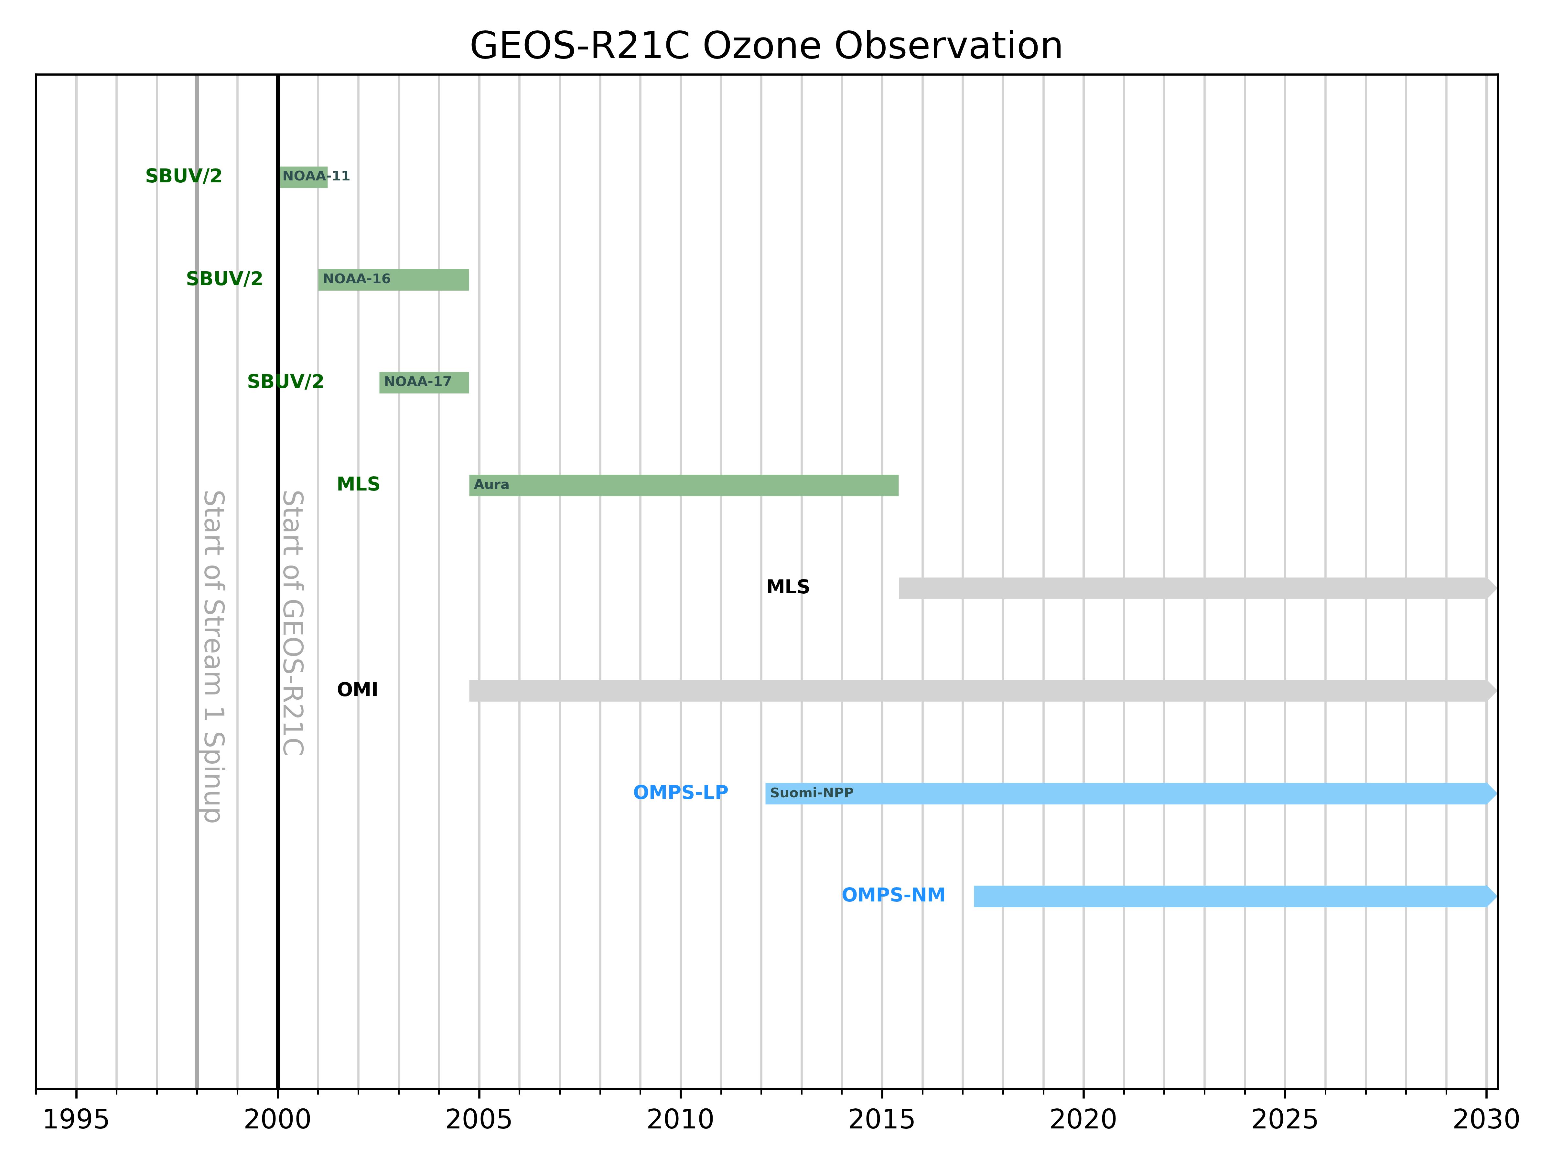
Ozone data

Slide 13
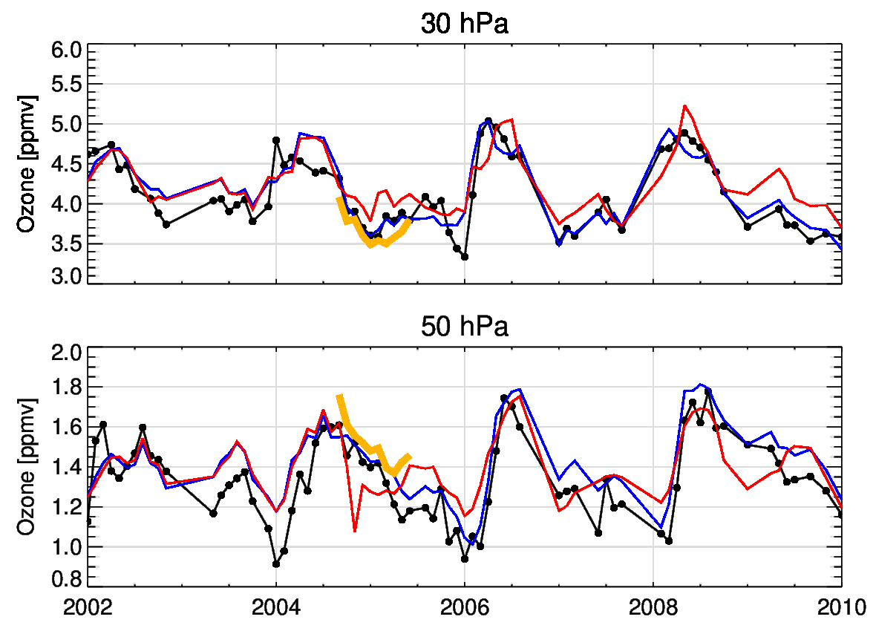
Nairobi sondes
MERRA-2
RPIT (SBUV)
SBUV test (new SBUV)
New version of SBUV ozone data: dynamical priors account for the QBO
Observation errors retuned
Test analysis in better agreement with ozonesondes and MERRA-2 than RPIT (“old” version of SBUV data)
Improvements of SBUV analysis:
MERRA (previous slide) → RPIT → new SBUV test
😔 😐 🙂
Downward propagation
SBUV period
MLS period
Monthly averaged data from ozonesondes and three analyses at Nairobi

Slide 14
Preliminary evaluation of T and Q:
“candidate” GEOS-IT system compared with current GEOS-FPIT system
Candidate system = 3dVar test with new SBUV/2 and no MLS
Current system = d5124_rpit_jan12 (GEOS-FPIT)

Slide 15
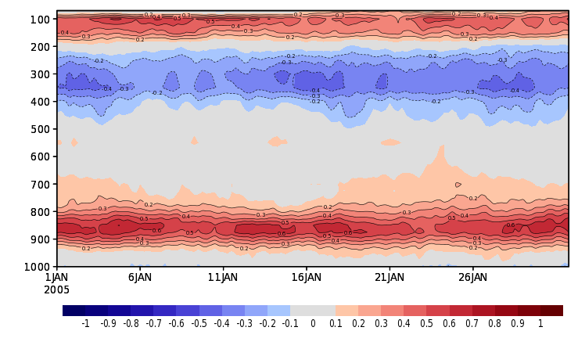
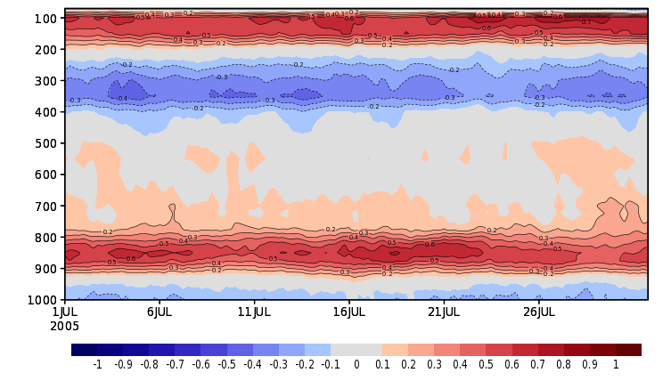
There are substantial differences in the global (60N,S) temperature
between the candidate-IT and the current GEOS-FPIT systems
Candidate minus current FP-IT TEMP; January 2005
Candidate minus current FP-IT TEMP; July 2005
How do these differences compare with ERA-5 Reanalysis temperatures?

Slide 16
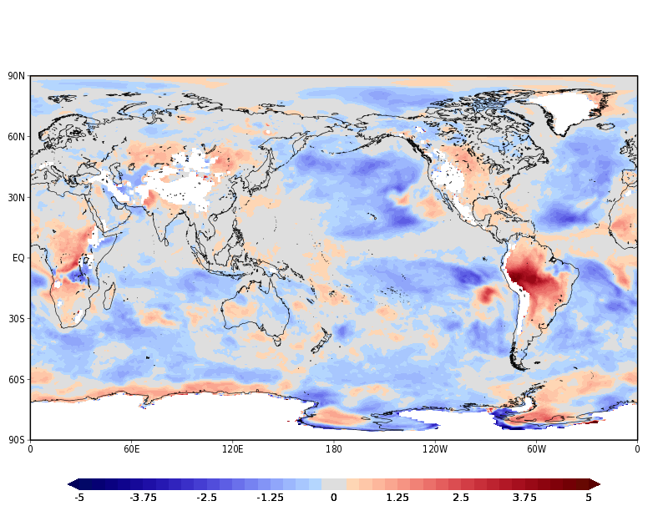
850T Closeness to ERA5
Blue = Candidate, Red = Current
Test minus current FP-IT TEMP; July 2005
Substantial improvement over most ocean surface, and some degradation over land (especially over South America)

Slide 17
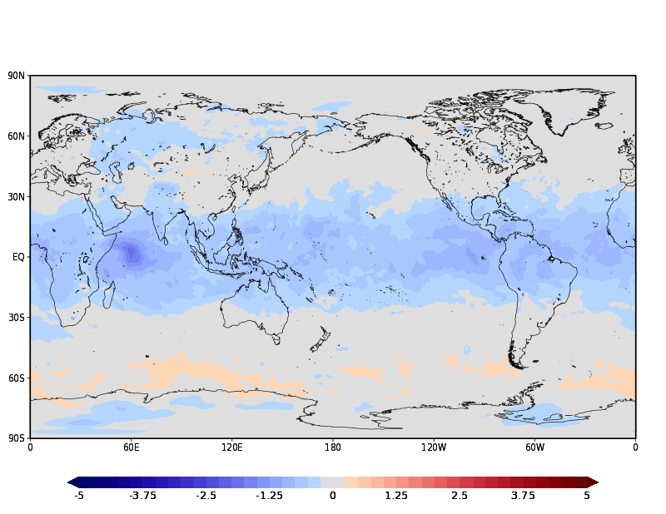
300T Closeness to ERA5
Blue = Candidate, Red = Current
Test minus current FP-IT TEMP; July 2005
Near-universal substantial improvement (except for a sliver of degradation along 60S)

Slide 18
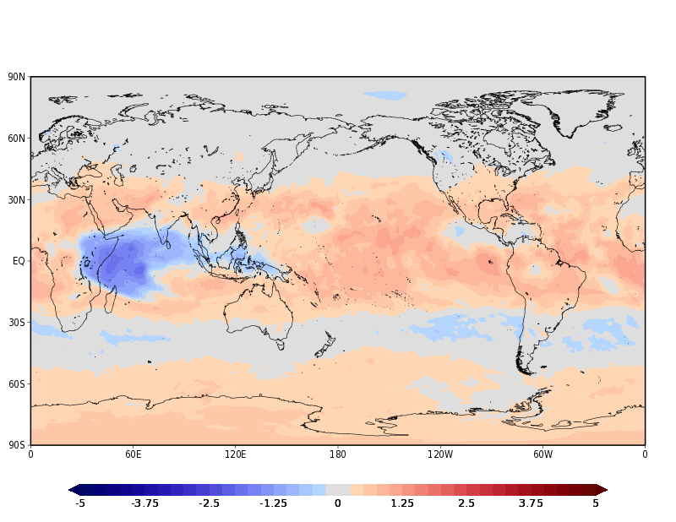
150T Closeness to ERA5
Blue = Candidate, Red = Current
Test minus current FP-IT TEMP; July 2005
Candidate system is warmer and further away from ERA-5. But compared with NCEP (not shown) the warmer 150mb temperatures in the candidate system are closer in candidate than in the current FP-IT

Slide 19
Summary
Proposed GEOS-IT:
Based on a recent GEOS-FP system (GEOS-5.25)
Retain the 50km horizontal resolution used in present GEOS-FPIT
Use a 3D-Var configuration for the assimilation
Updated observing system compared to GEOS-FPIT:
  reprocessed input data: AMSU-A , SBUV/2, AVHRR…
  new input data: Metop-C, NOAA-20, JPSS, including OMPS-NM and OMPS-NP
Not using all-sky radiances (microwave), GMI/TMI, or limb ozone (MLS, OMPS-LP)

Slide 21
GEOS-IT Data Collections
GEOS-FPIT file specification includes 30 collections plus the constant collection. Daily size is ~22 GB. Data resolution is not changing.
No change to the NetCDF-4 file format, except perhaps some metadata adjustment.
Filenames will change, but probably only the 2nd and 5th nodes: GEOS.fpit.asm.inst3_3d_asm_Np.GEOS5124.20101201_0000.V01.nc4
An updated file specification document will be released and posted on the GMAO products web page: https://gmao.gsfc.nasa.gov/GMAO_products/
Consideration will be given to dropping collections that are not being used.
21

Slide 22
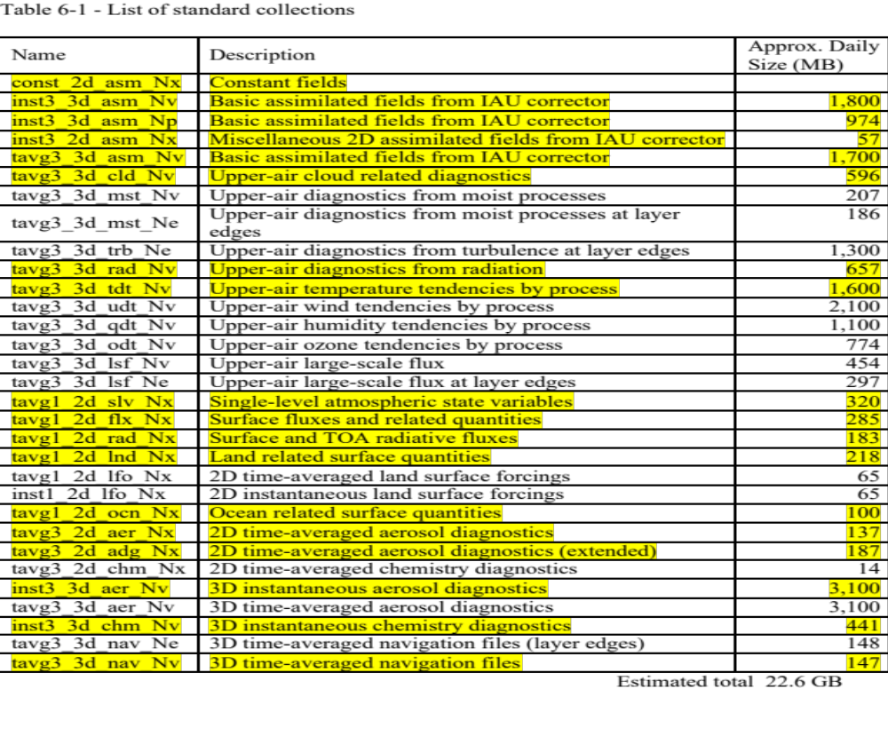
GEOS-IT Data Collections
22

Slide 23
GEOS-IT Production and Delivery
Products are delivered to end users by GES DISC.
These are assimilation products only. No forecast products for GEOS-IT.
In NRT mode, products generated 4X/day: 00 UTC (21-03); 06 UTC (03-09); 12 UTC (9-15); 18 UTC (15-21)
Delivery latency (to GES DISC): typically 1-16 hours after completion. Longer delays are possible.
Production will run with 3 parallel streams with starting dates TBD. The last stream will start in mid-2018. Estimate of production start is 2021 Q1.
Delivery of products to the GES DISC should begin in 2021 Q2.
At least 6 months of near real-time overlap before GEOS-FPIT stops production at the end of 2021.
23

Slide 24
GEOS-IT: Questions and Discussion
MLS
OMPS LP
CERES Flash Flux
CERES
Ocean Color
AMSR
GPROF
CESM/WACCM @ NCAR
MODIS Deep Blue
OMI
TES
GEDI
OCO-2/3
USGS Landsat
GEOCARB
CALIPSO
MPLNET
DSCOVER-EPIC
TCCON
24

