Slide 1
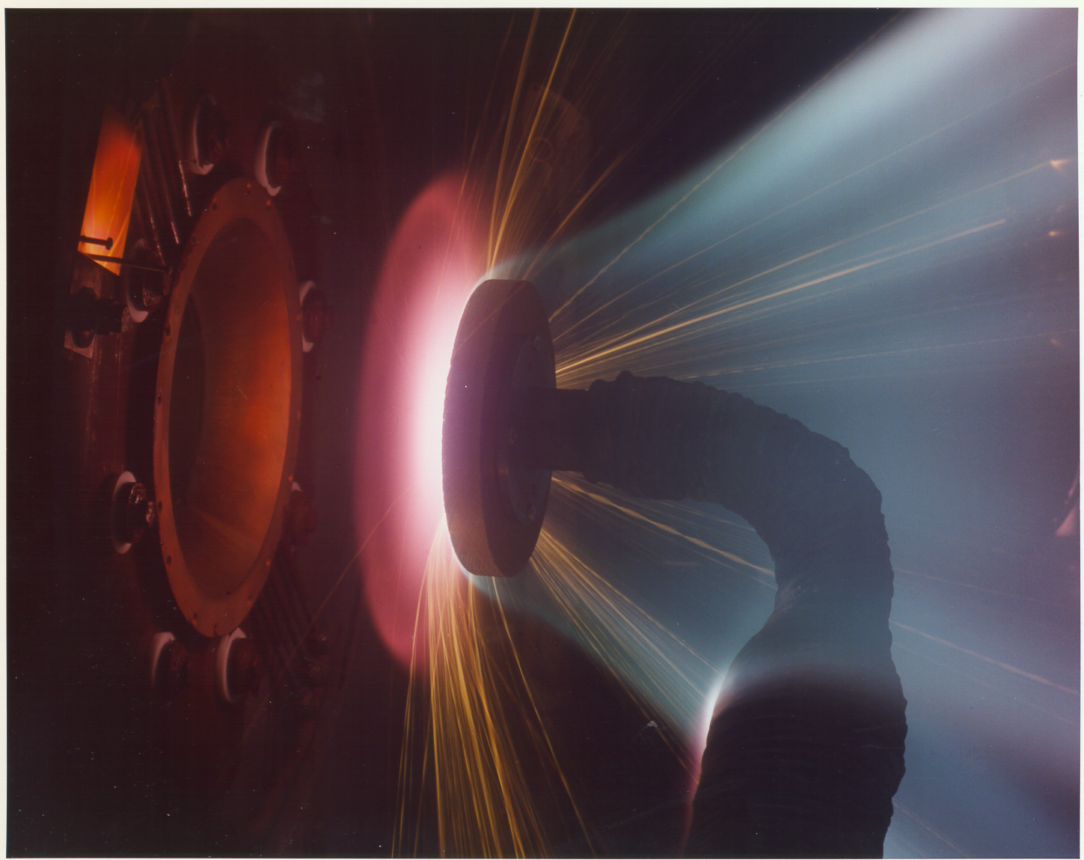
NASA Ames Thermophysics Facilities Overview
Scott Eddlemon
NASA Ames Research Center
September 2020

Slide 2
Our Mission:
Conduct safe and efficient operations of the high-enthalpy thermophysics facilities at ARC.
Support Agency and US Government missions by providing ground-based high enthalpy simulation services for DDT&E of thermal protection materials, aerothermodynamic design, and vehicle structures.
Develop and promote best practices for high enthalpy mission support and Research & Development.
The arc jet complex is NASA’s sole production-class capability for high enthalpy testing.
Our customers include any NASA mission requiring a heat shield, commercial spacecraft developers, and DoD.

Slide 3
Facility Organization Overview
Exploration Technology Directorate
Rupak Biswas
Entry Systems and Technology
Division
David Hash
Thermophysics Facilities Branch
Scott Eddlemon
ATOM Contract Support
Aerothermodynamics Branch
Jeff Hill
Thermal Protection Materials Branch
Mairead Stackpoole
Arc Jet Operations
Peter Race
Range Operations
Chuck Cornelison
Entry Systems and Vehicle Development Branch
Kerry Zarchi
EAST Operations
Mark McGlaughlin

Slide 4
Energy and Time Domains for Hypervelocity Heating Phenomena
Gas chemistry
Fluid dynamics
Thermal soak
GASDYNAMIC
FLOWFIELD DEFINITION
MATERIAL RESPONSE
30,000
KINETICS
ABLATION
AERODYNAMICS
THERMO-
60 MJ/kg
STRUCTURAL
SHOCK TUBES
50
BALLISTIC RANGES
ARC JETS
20,000
40
Stagnation Enthalpy (Btu/lb)
ARC JETS
30
REAL GAS EFFECTS
10,000
20
10
0
τ
Chem
1
τ
Chem
τ
Chem
<
1
τ
>
τ
<
1
τ
<
Flow
Flow
Flow
10
-6
10
-5
10
-4
10
-3
10
-2
10
-1
1
10
10
2
10
3
10
4
(1
μ
sec)
(1 msec)
Test Time (sec)

Slide 5
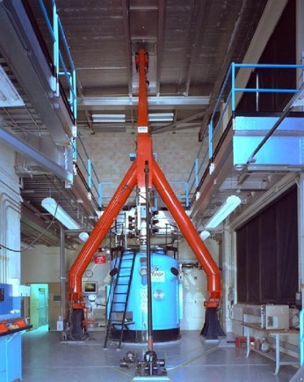
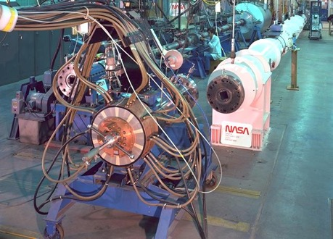
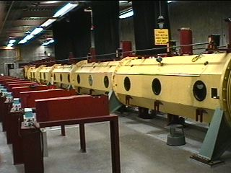
Ballistic Range Complex
Ames Vertical Gun Range
Impact Physics & Cratering
Electric Arc Shock Tube
Aerothermodynamics
Hypervelocity Free-Flight Aerodynamic Facility
Aero & Aerothermodynamics
Simulates gasdynamics of atmospheric entry. Entry simulation up to 8 km/s is achieved by launching models from high-speed guns into flight tubes containing pre-mixed atmospheric simulants of arbitrary composition and pressure.
Simulates the effects of radiation and ionization during planetary entries by launching isolated shock waves through atmospheric simulation cell. The driven section of the facility is supplied by a 1.25 [MJ] capacitor storage system.
Simulates planetary impact cratering phenomena. The facility utilizes various model launching guns that can achieve impact velocities up to 8 km/sec.

Slide 6
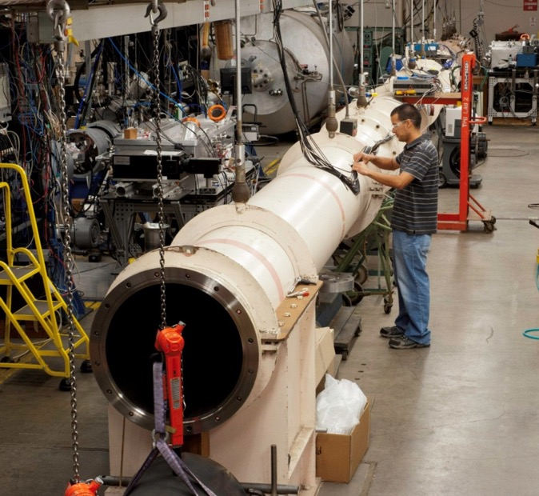
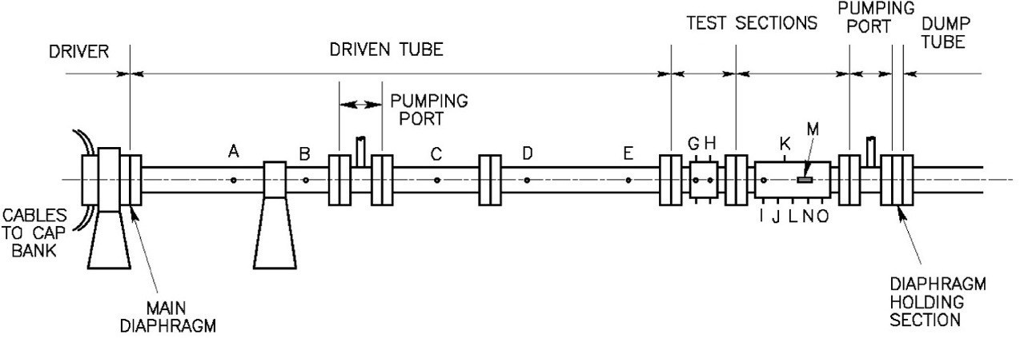
Electric Arc Shock Tube (EAST)
EAST generates high velocity shock waves for the study of optical radiation and ionization entry phenomena. The facility uses test gas mixtures that mimic the atmospheres of various planets.
Developed in the mid 1960s; operational in early 1970s
4 inch/24 inch dia. driven tube
Unique capabilities
  Shock speed range (up to 46 km/s)
  Driven gas composition
  Optical instrumentation
Gas kinetics, radiation, ionization studies

Slide 7
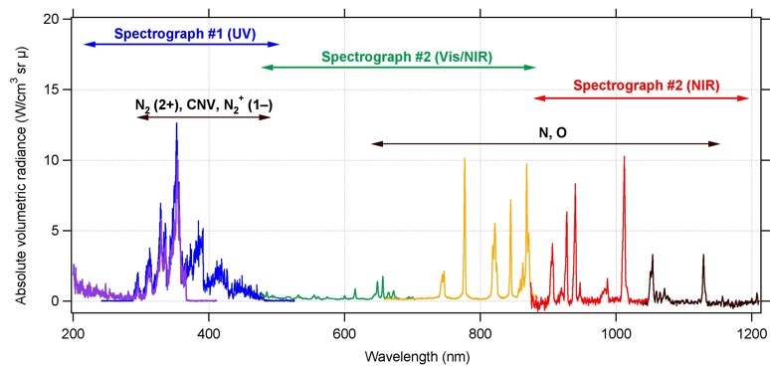
Electric Arc Shock Tube (EAST)
Reproduces shock speed, gas composition, pressure
Clean shock with no material surface interference
Facility characteristics:
  Versatile shock tube used to generate shock-heated gas conditions experienced by planetary entry vehicles
  High power electric arc driver
  4” dia. Aluminum driven tube/ 24” steel driven tube
  Oil-free high vacuum pumps to minimize test gas contamination
Research projects
  Test programs to investigate shock layer radiation and its potential contribution to planetary entry vehicle heat transfer
    Earth: Orion lunar return
    Mars: Aerocapture
    Titan: Huygens entry; aerocapture
Facility capabilities and instrumentation
  Shock speeds from 3 km/s to 46 km/s
  Gas kinetics, radiation, and ionization studies
  Imaging spectroscopy instrumentation for spatial and spectral measurements of shock layer radiation from the near infrared through the vacuum ultraviolet
  High-resolution shock speed measurement instrumentation
Air radiation: 10 km/s, 0.1 torr
Facility WWW Site:
http://thermo-physics.arc.nasa.gov
Notes:
4

Slide 8
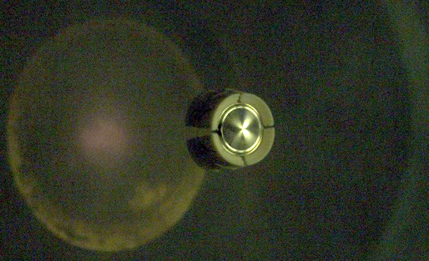
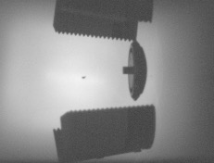
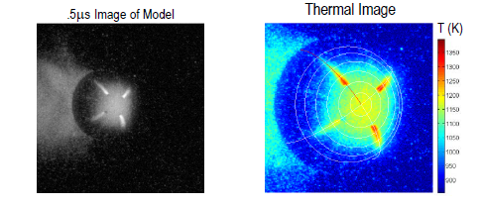
Hypersonic Free Flight Facility
Sealed, Variable Pressure Flight Tube
Variable Launch Velocities
Model and Sabot Exiting Gun
PERFORMANCE SUMMARY:
Light-gas Guns .28, .50, 1.00 and 1.50 caliber
Powder Guns 20, 25, 44, and 61 mm
Velocity 0.2 to 8 km/sec
Max. Reynolds Number 2 x 10⁶ 1/ft
Model Acceleration 1.5 x 10⁶ g
Model Mass 0.005 to 0.1 kg
Test Gas Air, N₂, CO₂, arbitrary
Pressure/Temperature 0.03 - 760 torr/Ambient
Sabot Separation Aerodynamic
TEST SECTION DIMENSIONS:
Length 75 ft. (22.8 m)
Diameter 3.5 ft. (1.1 m)
Sabot Separation
Flight Shadowgraph

Slide 9
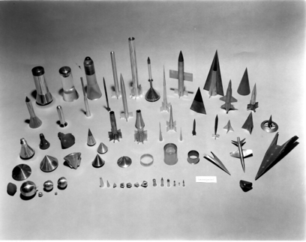
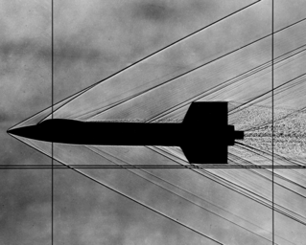
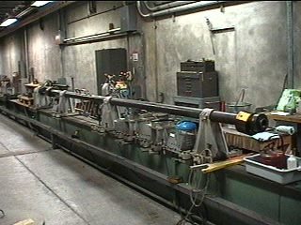
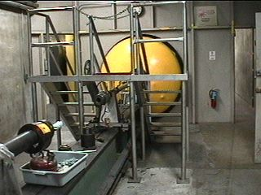
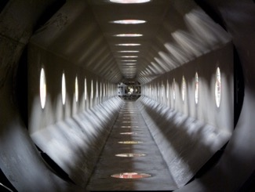
Hypervelocity Free-Flight Aerodynamic Facility
HFFAF Data Gathering Systems:
Trajectory & Aerodynamic Coefficients:
  Type: Focused shadowgraph (film-based)
  Light Source: Spark gap (capacitive discharge)
  Shuttering: Kerr cell (electro-optical), 40 ns exposure
  Model Detection: Photomultiplier-tube/halogen light sheet
Aeroballistic Models
Shadowgraph Image
Model Launching Gun
(Light-Gas & Powder)
Sabot Separation
Tank
Test Section
(Shadowgraph Stations)
Test Section
(Interior)

Slide 10
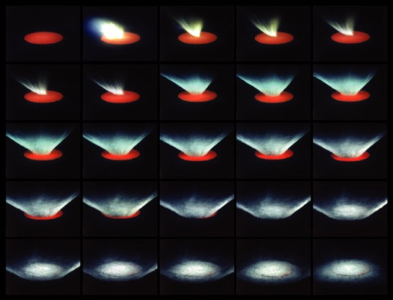
Ames Vertical Gun Range (AVGR)
PRIMARY SPONSOR: SMD, Planetary Geology and Geophysics (PGG)
STATUS: Operational (Commissioned 1966)
LOCATION: N-204A
PERFORMANCE SUMMARY:
Projectile speed 0.5 to 8.0 km/sec
Projectile size 2mm to 7.6 mm
Projectile geometry sphere, cylinder, irregular shapes
Projectile composition metallic, plastic, glass, mineral
Test section environment variable (Air, CO2, etc.)
Test section pressure 0.04 to 760 torr
Test section temperature Ambient
TEST CHAMBER DIMENSIONS:
Diameter 2.5 m
Height 2.5 m
Volume 14 m³
Ejecta Dispersion Analysis and Capture
The AVGR simulates the physics and mechanics of planetary impact cratering phenomena. The facility utilizes various model-launching guns that can achieve impact velocities up to 8 km/sec. The angle of elevation of the gun with respect to the horizontal plane can be varied in 15° increments from 0° to 90°, thus permitting oblique angles of impact with respect to the gravitational vector. The large impact chamber can accommodate sizable targets and allows for testing at sub-atmospheric pressures and in gases other than air. Primary instrumentation consists of a diverse suite of state-of-the-art, high-speed imaging systems (i.e. pairs of Phantom V10, V12 and Shimadzu cameras) that can record the cratering processes with tremendous detail. In addition, spectroscopy and other forms of instrumentation can be accommodated.

Slide 11
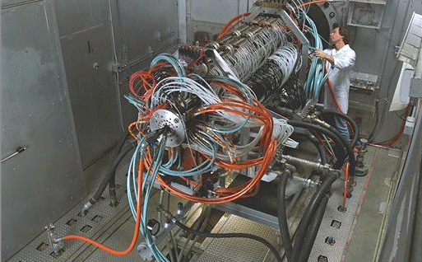
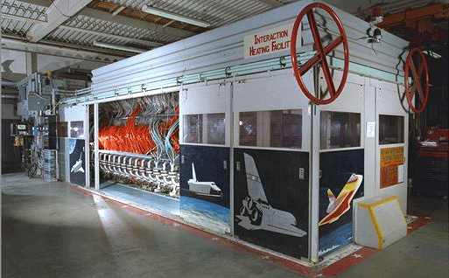
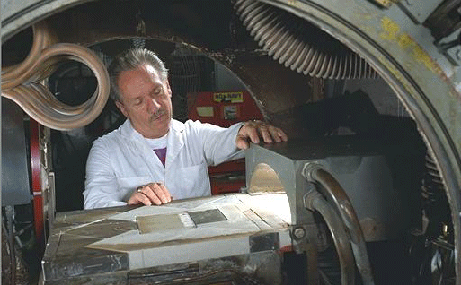
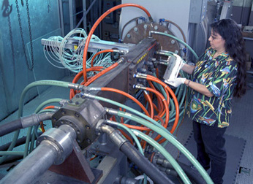
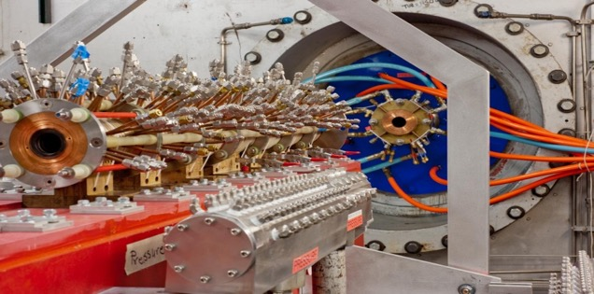
NASA Ames Arc Jet Facilities
Ames AHF/20
Ames IHF/60
Ames PTF/20
Ames TFD/20
Ames TP3/10 (former JSC TP1/10)
IRVE-3 Calibration Model in TP-2
Unique national capability, essential for developing, qualifying, and sustaining any vehicle program with atmospheric entry phase

Slide 12


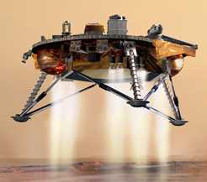
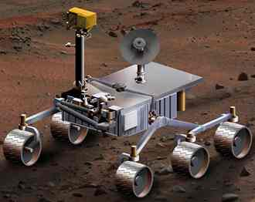
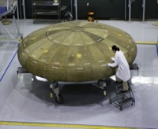
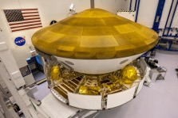

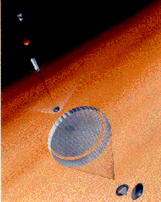
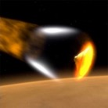
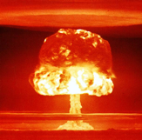
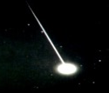
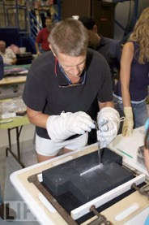
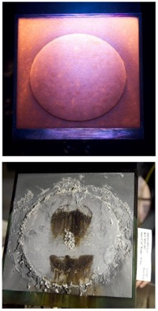
Rationale for Arc Jet Testing: TPS DDT&E, TRL 1-9
Long duration, controllable, reproducible ground test platform for simulating hypersonic entry environments
Flight Qualification/Sustaining Engineering: qualify/certify/validate suitability for flight of TPS materials and processes for National Programs; support updates to manufacturing processes
TPS R&D: provide critical data for the development of thermal protection system (TPS) materials and techniques
APOLLO
SPACE SHUTTLE
PHOENIX
MSL
Mars 2020
MSL
Orion
GALILEO
STARDUST
MARS PATHFINDER
MER
DoD
Space Operations/Contingencies: Support TPS damage assessment and repair technique verification

Slide 13
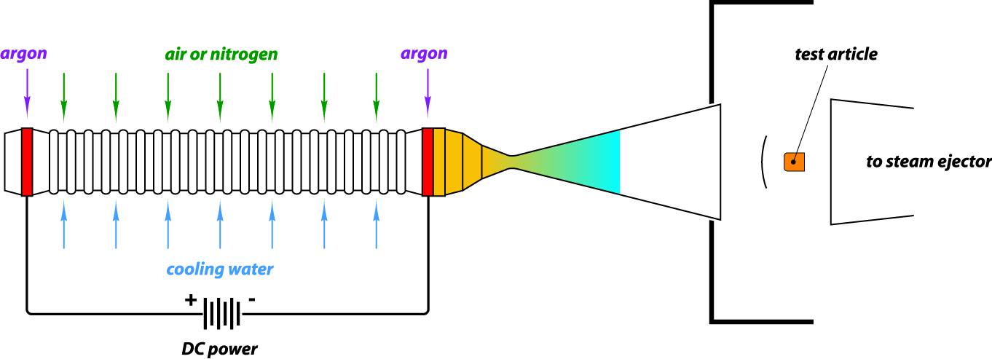
Arc Jet Schematic
Objectives:
  Simulate entry heating in a ground-test facility with flight-like chemical, physical, shock flow phenomena, for duration comparable to flight heating pulse
  Provide test data to verify thermal protection concepts, materials, and system designs before flight; support continuing engineering during operations
Gas Temp.
> 12000 F
High Energy Flow
Mach 4- 12 at exit
10-45 MJ/kg
Vacuum Test Chamber
Simulates altitudes 30 – 60 km
Method: Heat a test gas (air) to plasma temperatures with an electric arc, then accelerate to hypersonic velocity and direct onto a stationary test article

Slide 14
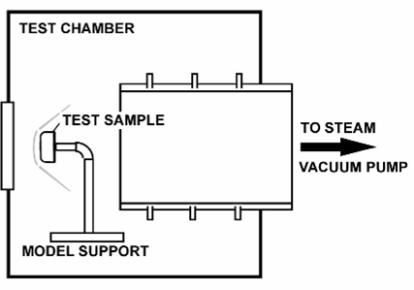
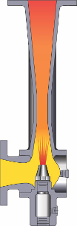
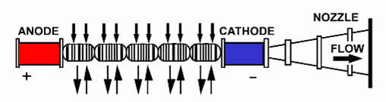
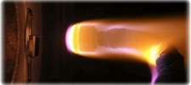

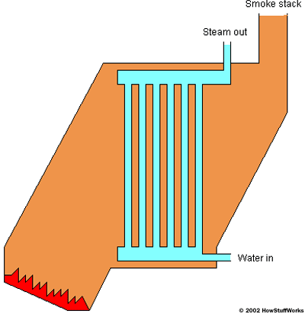
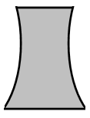
Arc Jet Facility Components
EACH ARC JET LEG IS SUPPORTED BY COMMON FACILITY INFRASTRUCTURE
EJECTOR/
CONDENSER
COMPRESSED AIR SUPPLY
TEST LEG
ARC JET
HEATER CORE
COOLING WATER
CONTROLS, ENGINEERING, DATA ACQUISITION
COOLING PUMPS
STEAM PLANT
DC POWER SUPPLY

Slide 15
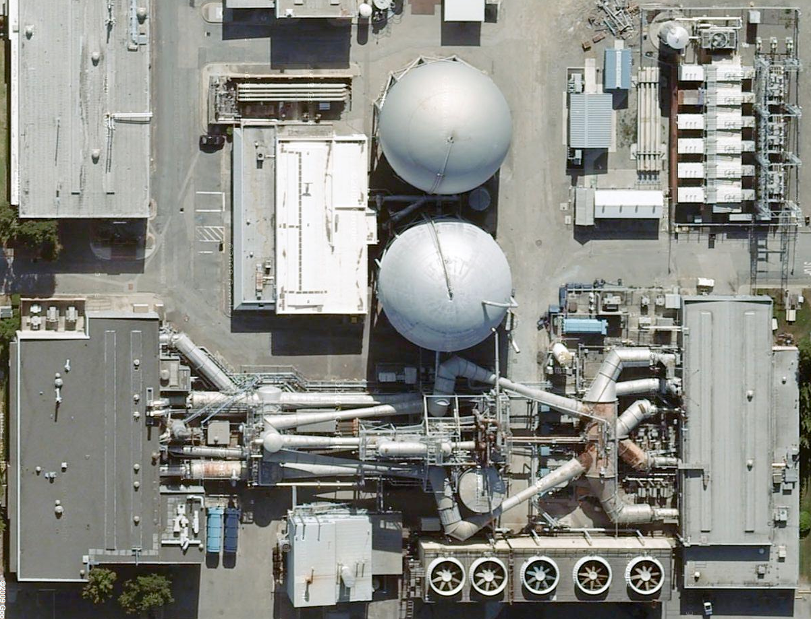
Ames operates four active test legs supported by a common utility and service infrastructure
  Maximum power 150 MW; 75 MW continuous service
  Arc heaters rated up to 60 MW
  Air, N2 test gases; Ar shield for segmented heaters
  1 Torr cabin pressure at 5 lb/s gas flow; 80 micron blank-off
  400 test runs per year; 1000+ models
  Compliant with all current environmental regulations
Key: IOC/ Completed Refurb/ Approved Refurb
150 MW Power Supply
1975/2008/2014
Pollution Control
2011
DI Cooling
2007
SPARE
Ejector-Condenser System
1961/2010
SPARE
SPARE
Controls/Chambers/Exhausters
1975/2009
TFD/20
High Pressure Systems
1961/2007
IHF/60
LEAF-Lite
AHF/20
TP3/10
PTF/20
Steam Boiler
1946/2010/2011/2013
SVS Cooling
2009
Five year average availability > 90%

Slide 16
Arc Jet Modernization
Arc Jet Complex Risk Statement: In the absence of sustainment funding for aging Arc Jet Complex infrastructure there is an unmanaged likelihood that a failure will disable the capability for up to 24 months, thereby leading to critical and costly delays in verifying and validating entry thermal protection for planned crewed, robotic, and commercial missions.
The Arc Jet Modernization Program is a suite of technical assessments and work packages in response to this risk. The Program office is managed by NASA HQ SETMO (Space Environments Testing Management Office).
The Arc Jet Modernization Project is the implementation mechanism for Program goals and objectives, including coordination between Program functions and Operations. The Project office is managed by Ames Research Center.
Arc Jet Capability Funding ($M) | FY20 | FY21 | FY22 | FY23 | FY24 | FY25 | FY26 | Total
Arc Jet Modernization | $13.0 | $15.4 | $15.4 | $15.4 | $15.4 | $15.4 | $15.40 | $105.4
Arc Jet Operations | $9.0 | $9.0 | $9.0 | $9.0 | $9.0 | $9.0 | $9.0 | $63.0
16

Slide 17
Initial Work Packages for Arc Jet Modernization
Work Package
Steam Vacuum System (SVS) Controls Consolidation Moves controls from old boiler house to new boiler plant Estimated Cost - $3.3 M
Enhanced HV Electrical Monitoring Adds sensors to monitor health of critical electrical distribution components that serve 20/150 MW systems Estimated Cost - $0.8 M
Data Acquisition and Control System Site-wide upgrade and modernization of controls. Adds SCADA class system to reduce Human-in-the-Loop CONOPS Estimated Cost – Range up to $5 M
Test Gas Controls Modernizes Air/Argon gas injection system that serves (including service for TP-3 Heater) Estimated Cost – Range up to $9.5 M with Power Controls Integration
Model Insertion System (AHF) Replaces multi-arm and single article system Estimated Cost - $4.5 M
Safety Ventilation (All Test Legs, North and South) Adds improved test chamber ventilation and post-run test article handling system/improvements for CONOPS. Estimated Cost - $TBD M

Slide 18
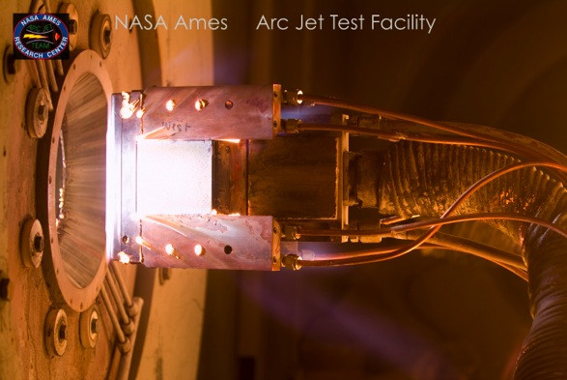
Summary
TSF facilities are unique high-energy platforms for simulation of important chemical physics phenomena associated with hypervelocity atmospheric entry. We operate these facilities for government and commercial customers.
The facilities operate at high energy densities and at high pressures.
Most of our equipment is unique and of advanced age.
Safe, efficient operation is our top priority.

