Slide 1




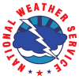


Operational Transition of Gridded NUCAPS to NOAA NWS and Emerging Applications
Emily Berndt¹, Kris White³, Nadia Smith², and Rebekah Esmaili²
Contributions from Erika Duran⁴, Kevin Fuell⁴, Frank LaFontaine⁵, Jeff Szkodzinski², and Roger Allen⁵
¹NASA MSFC, ²Science and Technology Corporation, ³NWS Huntsville,
⁴University of Alabama in Huntsville, ⁵Jacobs

Slide 2
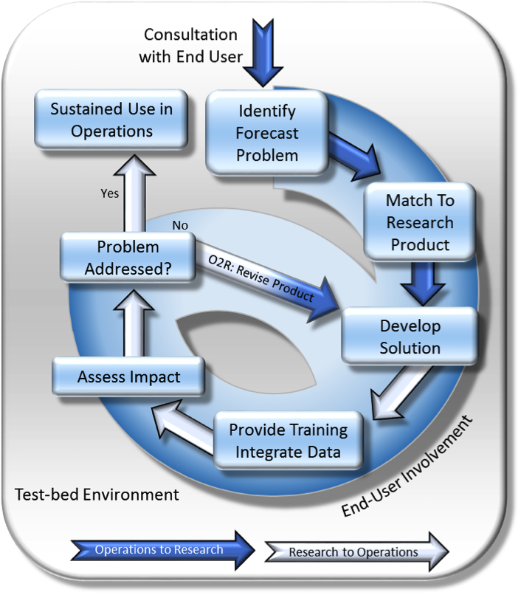
SPoRT Mission
The Short-term Prediction Research and Transition Center was established in 2002 for transitioning unique satellite observations and research capabilities to end users to improve short term forecasting and decision support
Introduce experimental products to end users through a Research to Operations / Operations to Research Paradigm
Concept has been used to successfully transition a variety of satellite datasets to operational users for 15+ years
https://weather.msfc.nasa.gov/sport/
https://nasasport.wordpress.com
Twitter @NASA_SPoRT
Facebook NASA SPoRT Center

Slide 3
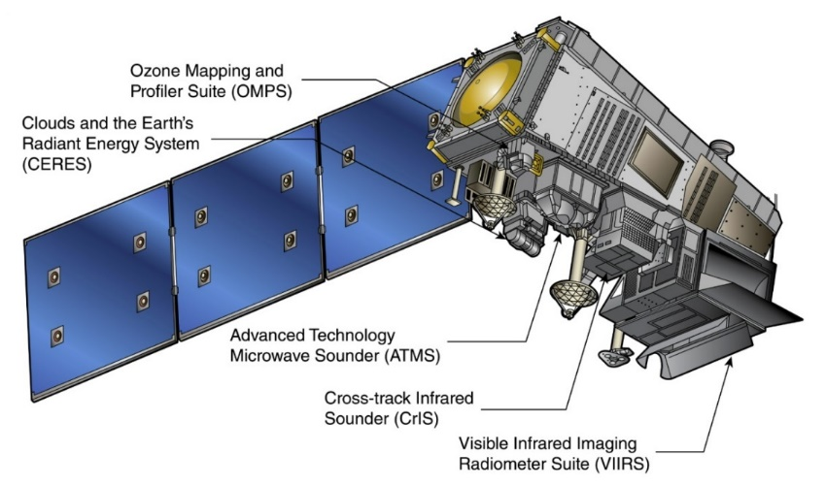
Hyperspectral Infrared Sounders
Onboard Suomi/NPP and NOAA-20
CrIS – Cross Track Infrared Sounder (1305 Channels)
ATMS – Advanced Technology Microwave Sounder (22 Channels)
Overpasses between standard radiosonde launches
Passes over East Coast: 05z/17z
The Plains: 07z/19z
West Coast: 11z/23z
Alaska: Multiple
NUCAPS, NOAA Unique Combined Atmospheric Processing System, is the algorithm for CrIS/ATMS soundings
Measure temperature and water vapor with height as well as ozone, other trace gases, and cloud information (e. g. cloud top fraction, cloud top pressure)
Most accurate in the upper-levels under clear conditions
Infrared and microwave measurements are paired to allow for measurements in partly cloudy regions
Measurements are degraded in regions of thick clouds and precipitation

Slide 4
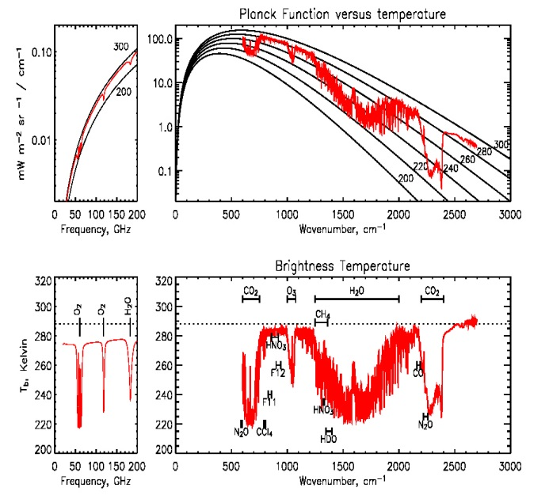
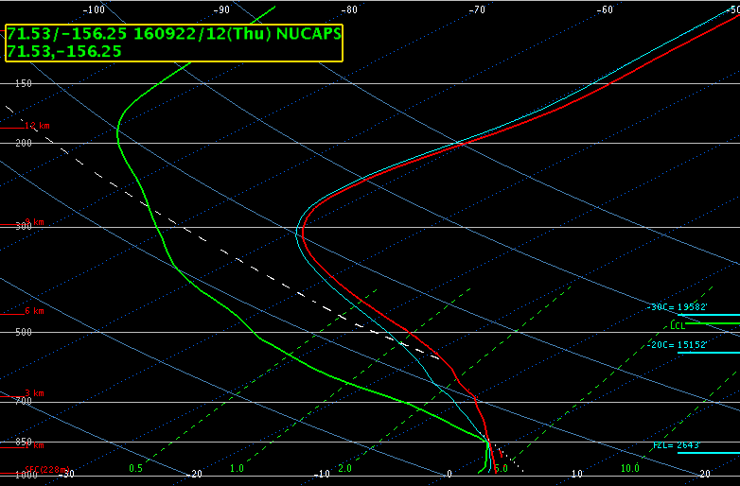
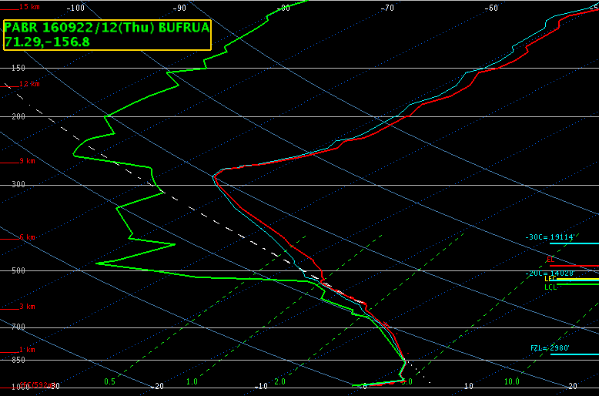
How is a NUCAPS Sounding Retrieved?
Which CrIS channels are used? 399 of them
24 for surface temperature
87 for atmospheric temperature
62 for water vapor
Adjacent Channels are not used
Channels chosen are predominantly sensitive to one gas only
Initial profile statistically derived from MW (ATMS) and full IR measurement (all channels of CrIS)
Perform cloud clearing to remove cloud signal from IR radiance
Produce final IR+MW NUCAPS soundings at 100 layers
MW-only NUCAPS soundings available operationally but not in AWIPS yet
CrIS and ATMS can resolve:
4-6 layers of water vapor
6-10 layers of temperature
Physical retrieval using both MW and a subset of cloud-cleared IR channels. This involves
Error checking, diagnostic tests, iteration
Sequential retrieval of T, q, CO, O3, CH4, etc.
Quality flags
NUCAPS Sounding
Radiosonde

Slide 5
Successful Retrievals
Cloud Clearing succeeds when NUCAPS footprint has cloud variability;
i.e. when the CrIS footprints have variable cloud fractions
NUCAPS retrieves soundings if there is a radiative pathway past clouds
NUCAPS footprint
CrIS footprint
✓
✓
✓
The clear-sky radiative pathway PAST clouds can be determined using a cluster of 3x3 CrIS footprints with variable cloud fractions.
NUCAPS soundings are successfully retrieved from clear-sky or cloud-cleared radiance measurements.
✓
✓
✓

Slide 6
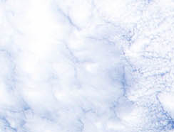
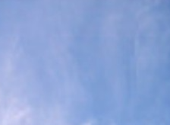
Failed Retrievals
Cloud Clearing FAILS when NUCAPS footprint is uniformly cloudy;
i.e. when each CrIS footprint has the same cloud fraction
NUCAPS cannot retrieve soundings if there is no radiative pathway past clouds
NUCAPS footprint
CrIS footprint
✘
✘
✘
NUCAPS soundings CANNOT be retrieved from cloudy measurements of the radiative the pathway through clouds.
This is why optical thickness (cirrus versus stratocumulus) is irrelevant to NUCAPS.
✘
✘
✘

Slide 7
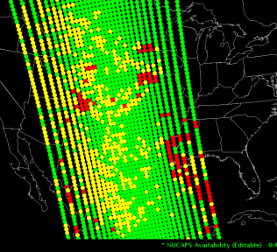
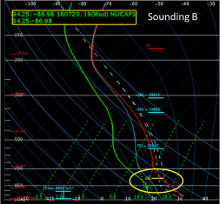
Soundings in NWS Operations
Since 2014 S-NPP CrIS/ATMS NUCAPS Soundings have been operationally available to all National Weather Service forecasters through the Advanced Weather Interactive Processing System (AWIPS) as Skew-T plots
NUCAPS Soundings have been valuable:
Where conventional observations lack
Between radiosonde launches
Have been demonstrated as valuable for:
Assessing the pre-convective environment
Cold Air Aloft aviation hazard
The JPSS Sounding Initiative collaborated to develop the capability to visualize the data in plan view or cross section to maximize the benefits of NUCAPS data in AWIPS
NUCAPS Sounding locations in AWIPS
Images by Kris White (NWS HUN/SPoRT)
NUCAPS
Sounding
in AWIPS

Slide 8
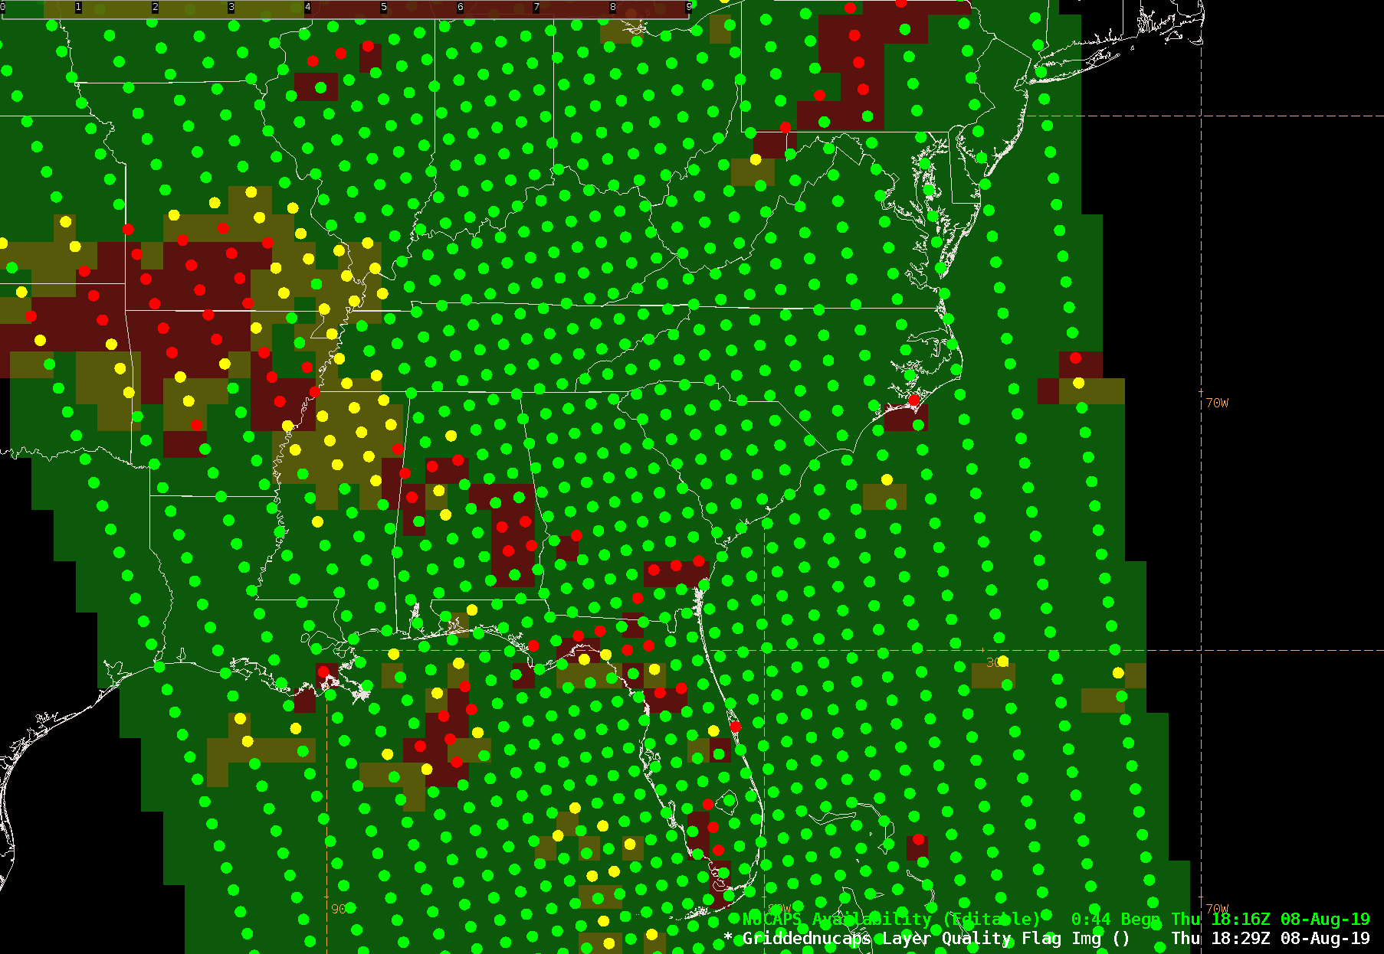
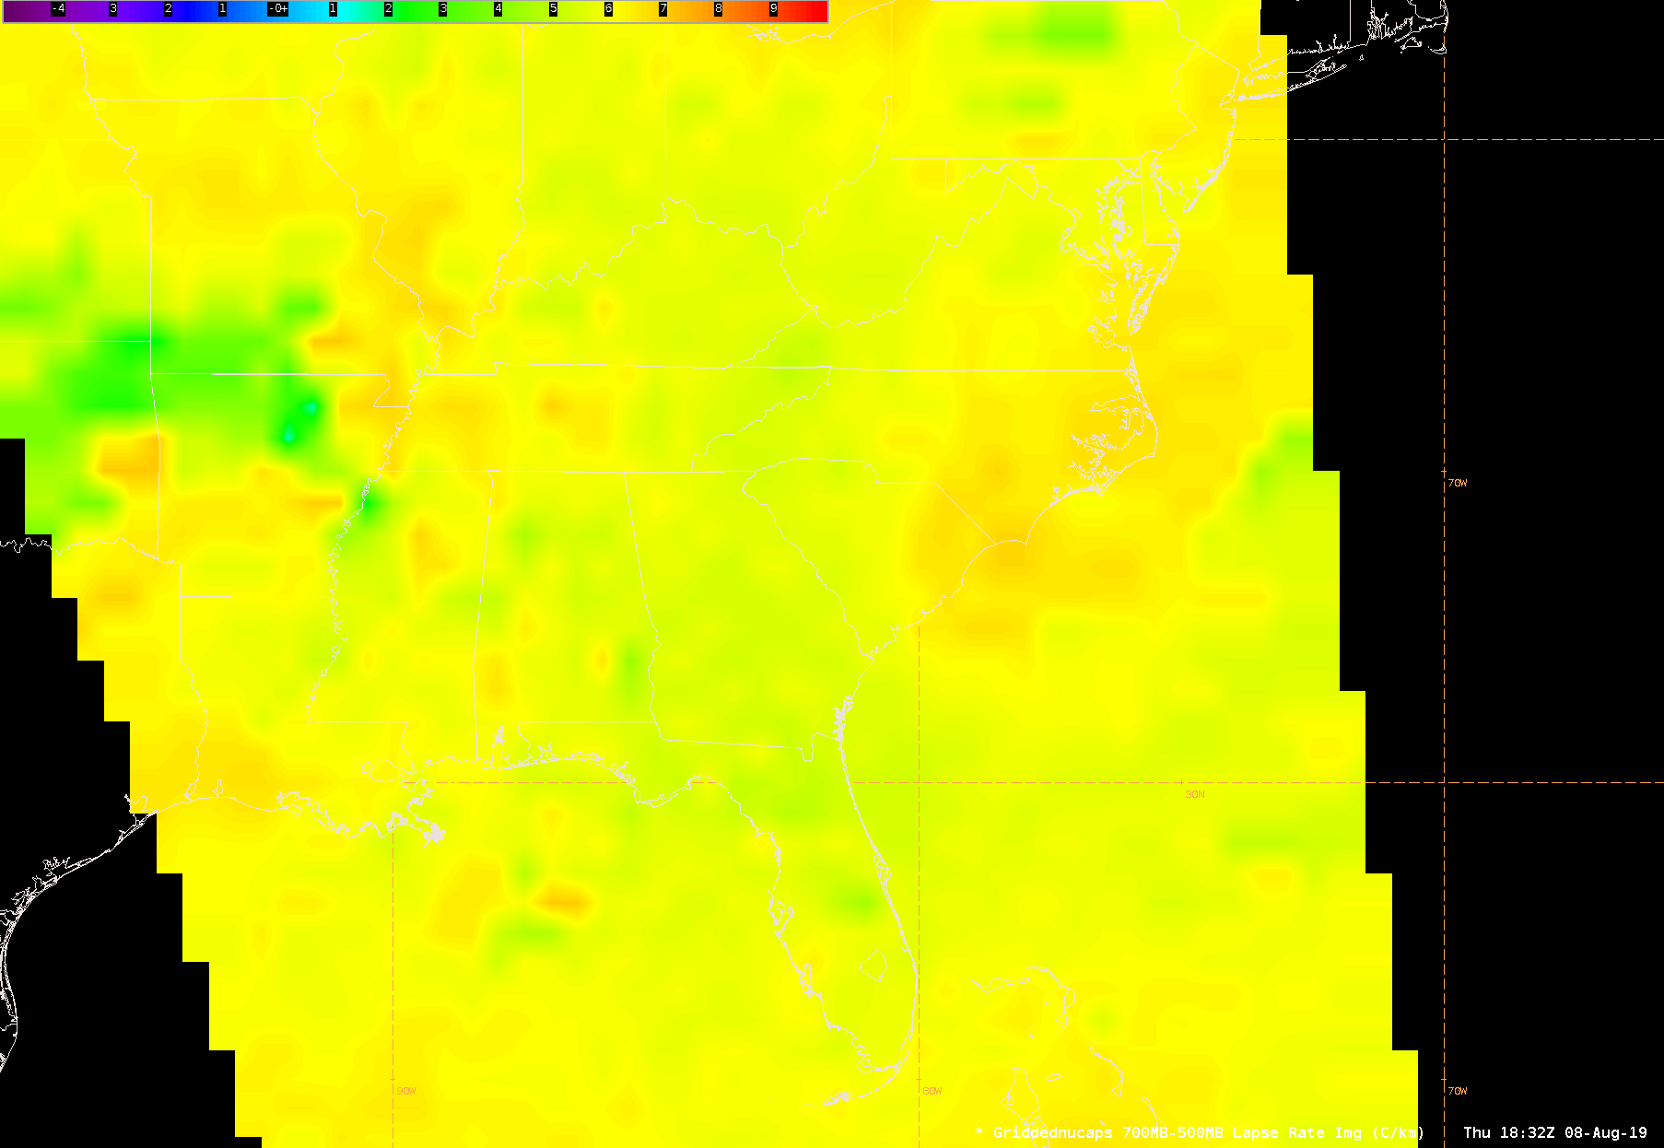
Gridded Soundings in NWS Operations
An experimental gridding process was developed in 2015/2016 and introduced to NWS forecasters in a testbed environment
The JPSS Sounding Initiative partnered with the Meteorological Development Lab to develop the gridding capability within AWIPS
Operational NWS-wide release was 3 Sept. 2019
Minimal interpolation in the gridding process
Temperature, moisture, and derived fields are available for display
Transformation (i.e. gridding) of point soundings to plan view & cross section displays

Slide 9
Quality Flags
https://weather.msfc.nasa.gov/nucaps/qg/NUCAPS-QF-quick-guide.pdf

Slide 10
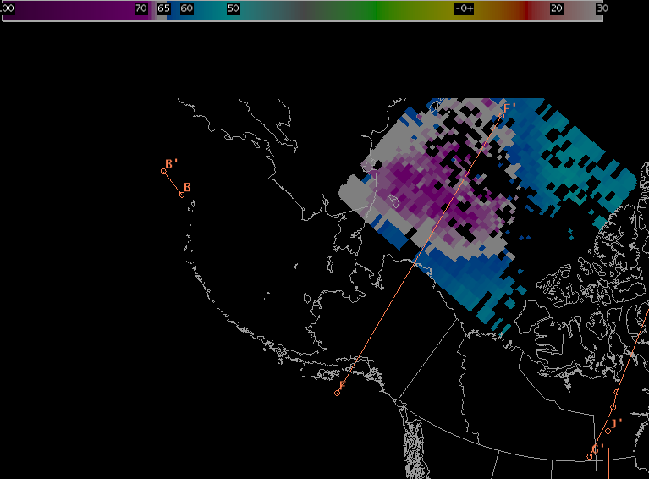
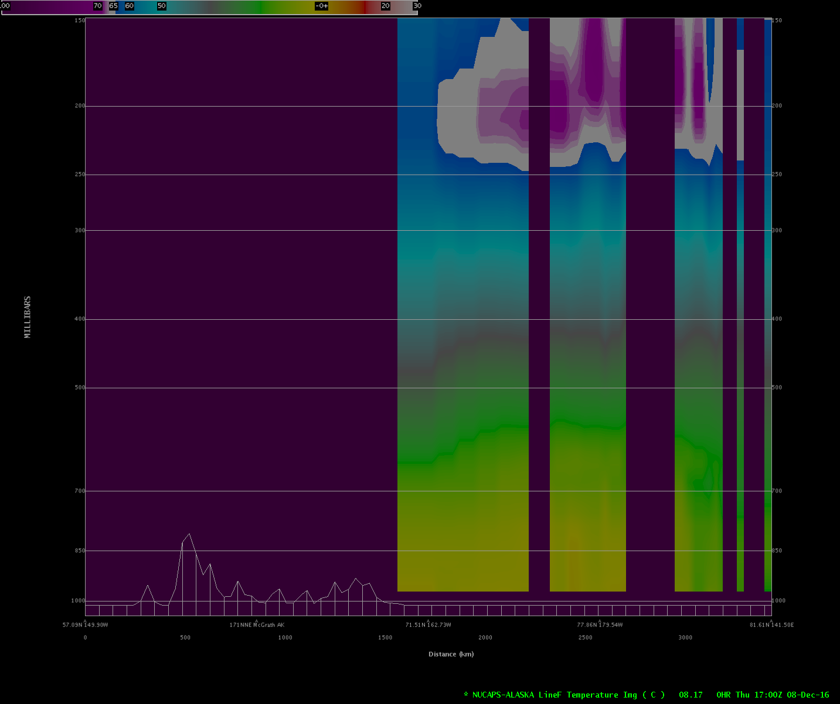
Cold Air Aloft
Gridded NUCAPS was initially developed to address Cold Air Aloft
Cold Air Aloft (≤ -65°C) events can freeze airliner fuel and regularly occur at flight levels in the arctic
The Anchorage Center Weather Service Unit (CWSU) provides Meteorological Impact Statements (MIS) to Air Traffic Controllers to direct flights around the 3D air features
In data sparse Alaska, forecasters have relied on analysis and model fields and limited radiosonde observations to guess the 3D extent of the Cold Air Aloft
Gridded NUCAPS
8 Dec 2016
1700 UTC
Horizontal extent of
Cold Air Aloft
at 212 mb
Vertical
extent of
Cold Air Aloft
250 to 150 mb
NUCAPS Soundings and Gridded products have been operationally adopted into the Anchorage CWSU operations
Weaver et al. (2019)

Slide 11
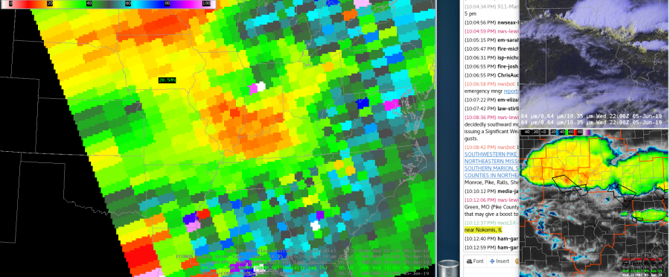
Pre-convective Environment
Gridded NUCAPS was first demonstrated at the Hazardous Weather Testbed in 2016
The goal was to test the utility of Gridded NUCAPS for analyzing the pre-convective environment
Testing at HWT solidified the value of Gridded NUCAPS:
To assess thermodynamic spatial gradients/patterns
As another observation tool to increase situational awareness
Gridded NUCAPS 400-200 mb Relative Humidity
18 UTC 05 June 2019
IR and RGB imagery showing outflow coming out of the storms in the eastern LSX area not firing up additional storms. NUCAPS 400-200 mb RH product shows quite a bit of drier air that the line is pushing into. More moisture is west of the MO/IL line, so that part of the line may have a better chance to maintain themselves/develop new cores ahead of the line along that outflow. ~ HWT Forecaster 2019

Slide 12
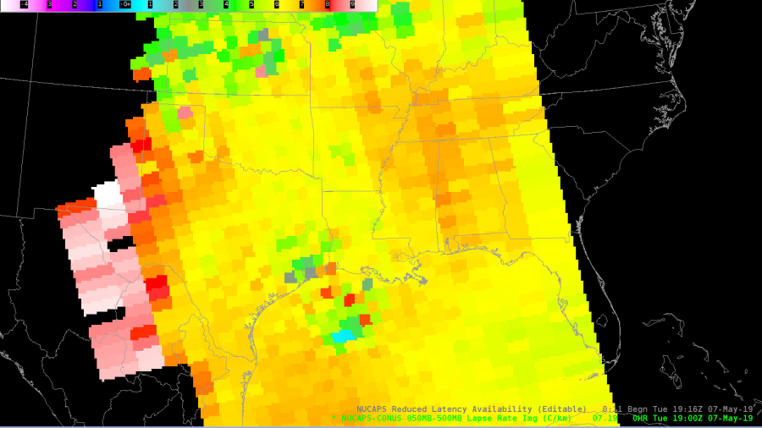
Gridded Soundings
Forecaster feedback led to product improvements and best practices
View the data on standard pressure levels
Leverage AWIPS derived parameters
The value of spatial gradients in mid-level fields
AWIPS procedures and recommended fields to analyze
Easy to access menu
Best practices to address data quality and gaps
As an operational forecaster, I like to compare model output, real-time obs, and any additional derived data. This image from the NUCAPES H85-H5 Lapse Rate can potentially help boost one’s confidence in particular synoptic situations. For example, suppose you were expecting a dryline to emerge east across W Texas, but guidance indicated otherwise and sfc METARS were unavailable, using the NUCAPS Lapse Rate products can help determine the location of the dryline (for this particular setup). In this image, values reflect the drier air advancing east leading to steeper lapse rates. ~ HWT Forecaster 2019

Slide 13
Emerging Applications
Fire Weather and the identification of the Low Level Thermal Ridge and assessment of the Haines Index
Stratospheric air intrusions and cyclogenesis by assessing ozone-derived fields
Turbulence potential by assessing upper level lapse rates
Assessing the Tropical Cyclone Diurnal Cycle and changes in the Tropical Cyclone Environment
Diagnosing the breadth and extent of the Saharan Air Layer with precipitable water, temperature, moisture, and ozone fields
Assessing the rain/snow transition by analyzing low level lapse rates, dew point depression, near surface temperature
Any assessment of the thermodynamic environment in clear to partly cloudy conditions
Check out Examples on CIMSS Satellite Blog

Slide 14
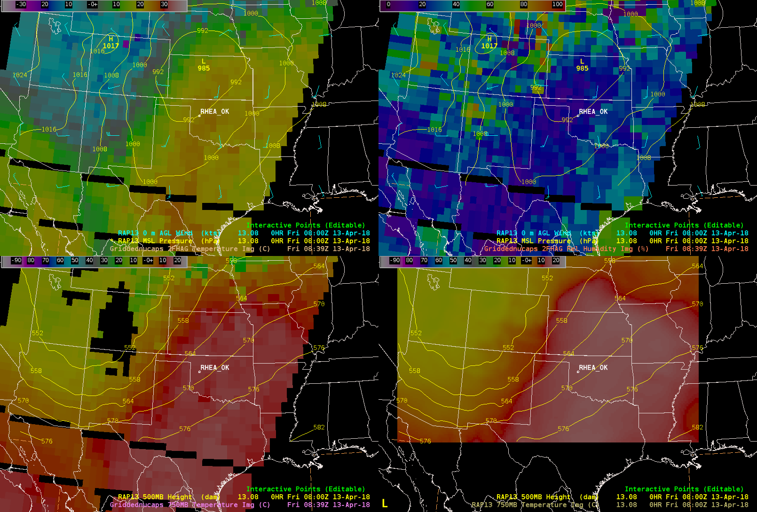
Fire Weather
Rhea, OK fire started on April 12, 2018 which burned approximately 400,000 acres
Combined with model data, NUCAPS can be used to diagnose warm, dry conditions
Identification of a Low Level Thermal Ridge (see training)
Gridded NUCAPS surface temperatures
RAP wind barbs & MSL pressure
Gridded NUCAPS surface relative humidity
RAP wind barbs & MSL pressure
Gridded NUCAPS 750 mb temperature
RAP 500 mb heights
RAP 750 mb temperature and
500 mb heights

Slide 15
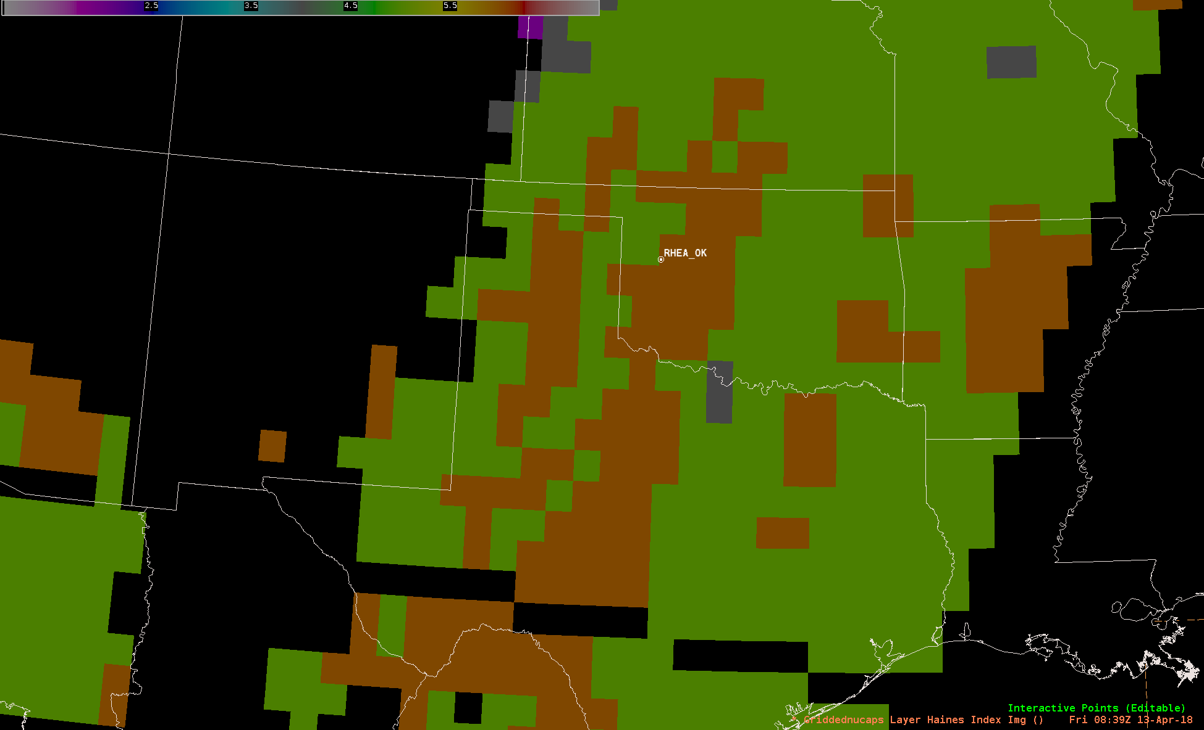
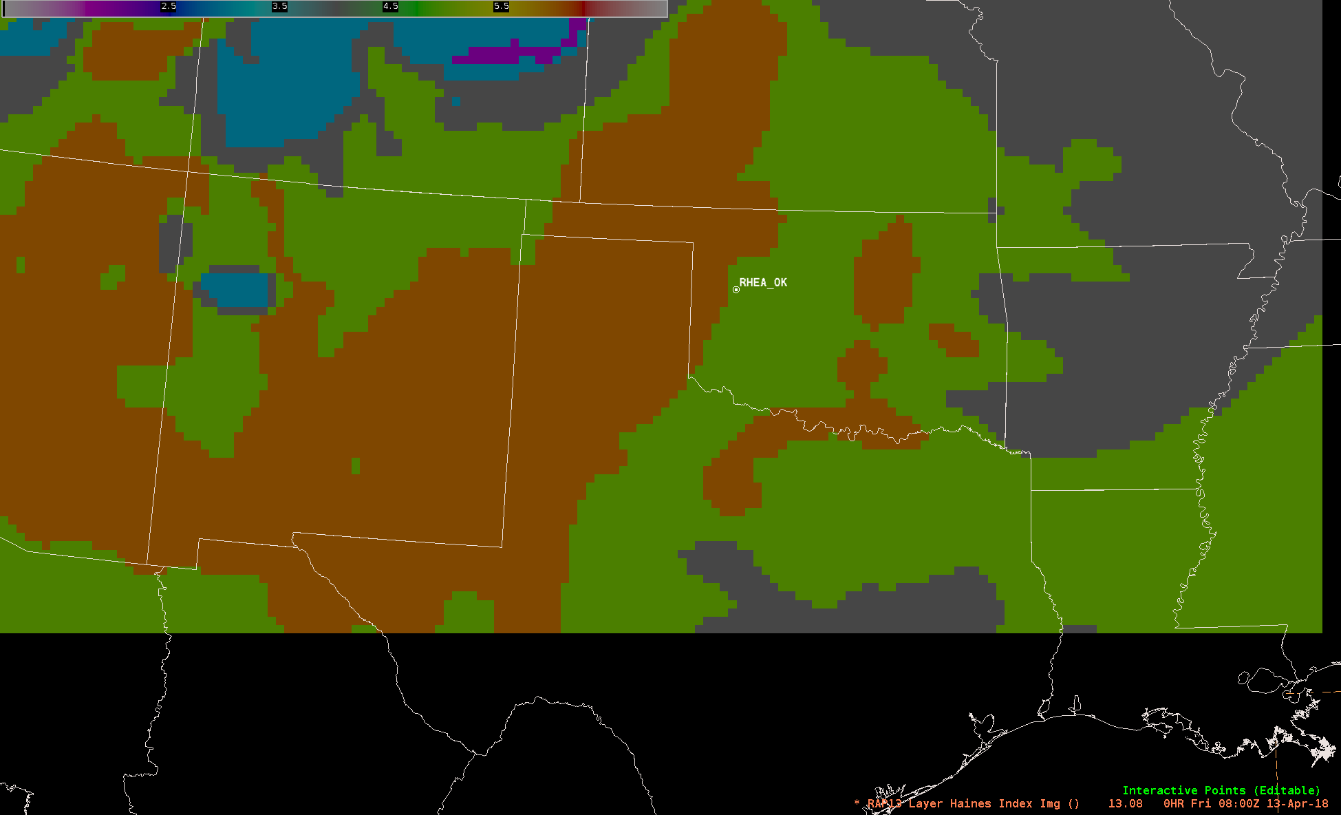
Fire Weather
Haines Index can be calculated in AWIPS
The levels used to calculate the parameter can be adjusted
NUCAPS region of high potential fire growth (orange) shifted to the east compared to RAP
Haines Index from Gridded NUCAPS calculated from 850mb to 700mb
0839 UTC 13 April 18
Haines index from RAP model data calculated from 850mb to 700mb
0800 UTC 13 April 2018
NUCAPS is model-independent observational data set that can be used to diagnose the potential for fire growth between model runs and to identify gradients not captured in the model

Slide 16
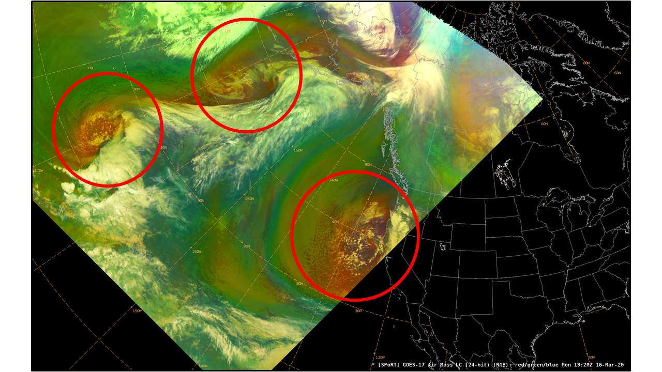
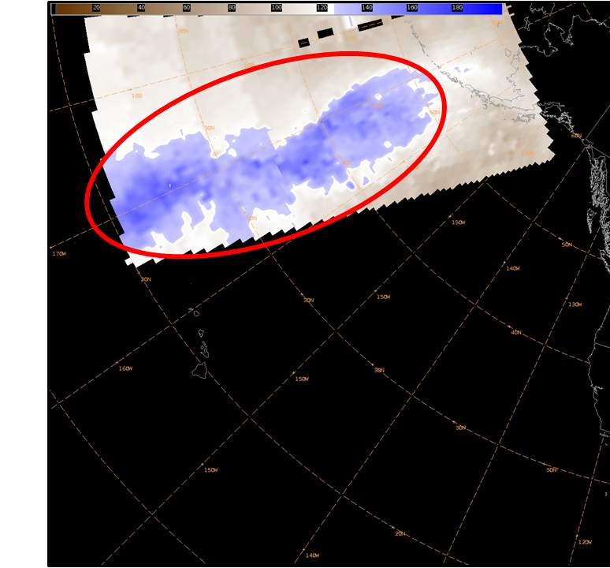
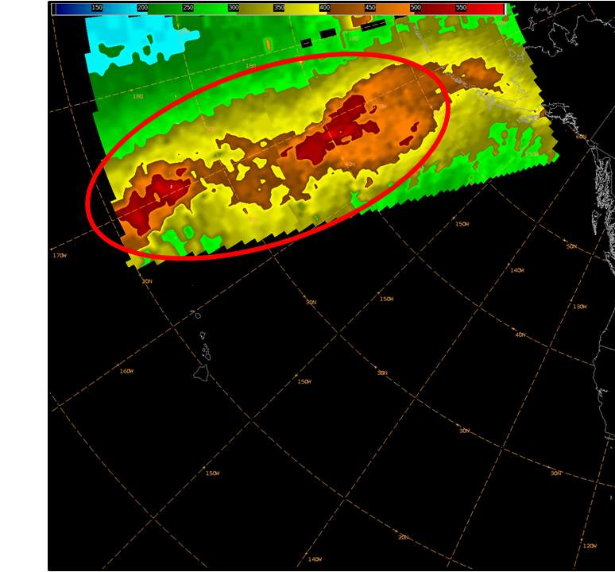
Cyclogenesis
Ozone-derived fields have been demonstrated in Ocean Prediction Center operations
Ozone is a tracer for stratospheric air to assess the potential for tropopause folding
Assess trends in cyclogenesis
Anticipate associated hazards such as high winds/waves
16 March 2020 Air Mass RGB
16 March 2020 Gridded NUCAPS Ozone Anomaly
16 March 2020 Gridded NUCAPS Tropopause Level

Slide 17
Tropical Cyclone Environment
Tropical cyclone radial anomalies show differences in thermodynamic fields in both the near-storm and surrounding environment
For each overpass
soundings are sorted into 100 km radial bins centered on the TC, out to 800 km
A daily mean sounding is calculated for each radial bin
The daily mean profile is subtracted from each sounding within each radial bin to yield a temperature or moisture anomaly
Anomalies are converted to local time and composited every 4 hours
Vertical radial anomalies demonstrate patterns such as the tropical cyclone diurnal cycle
Plan view radial anomalies demonstrate gradients in temperature or moisture, capturing features such as dry air intrusions
2020 Hurricane Season NUCAPS Radial Anomalies

Slide 18
Summary
NUCAPS Soundings were operationally transitioned to NWS operations in 2014
Through the Hazardous Weather Testbed Spring Experiment the JPSS Sounding Initiative has had the opportunity to introduce Hyperspectral Infrared Sounder Retrievals (S-NPP, NOAA-20, MetOp-A/B) to NWS forecasters
Products have been tailored to meet the needs of the operational environment
As a result of consistent user interaction and feedback, Gridded NUCAPS has been transitioned to operations but is still undergoing active development
New applications include fire weather, cyclogenesis, turbulence, assessing the tropical cyclone environment but encompass any assessment of thermodynamic fields in clear to partly cloud conditions
Much of this work is the result of operations to research feedback
This presentation represents work funded by the NOAA Joint Polar Satellite System Proving Ground/Risk Reduction Program, directed by Dr. Mitch Goldberg and This work was supported by the NASA Research and Analysis Program as part of the Short-Term Prediction Research and Transition Center (SPoRT) project at the Marshall Space Flight Center.

Slide 19
More Information
Data Access
NOAA-20 soundings available via the SBN
S-NPP and MetOp can be requested from SPoRT and delivered via the LDM
Modified NUCAPS Soundings can be requested from CIRA
Gridded NUCAPS VLab page
Help/Troubleshooting
Product descriptions
Training
Color tables
To Join the NUCAPS User Group contact Kris White (kris.white@noaa.gov) or Chauncy Schultz (chauncy.schultz@noaa.gov)

Slide 20
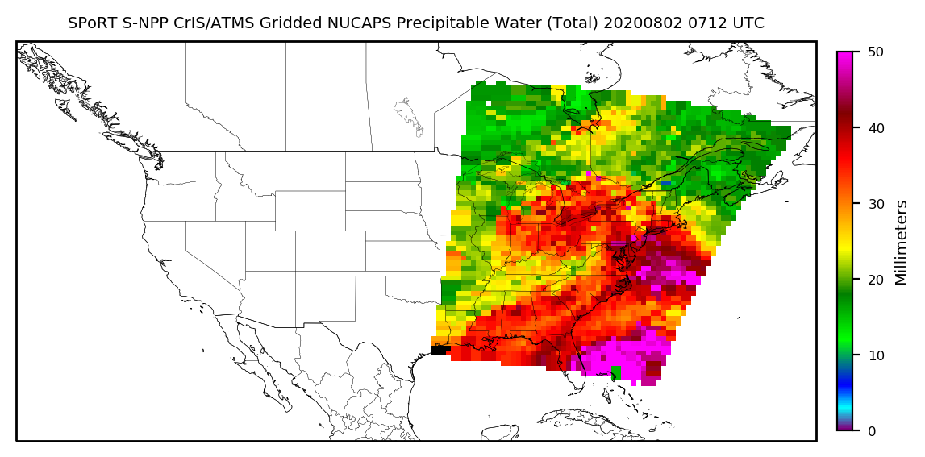
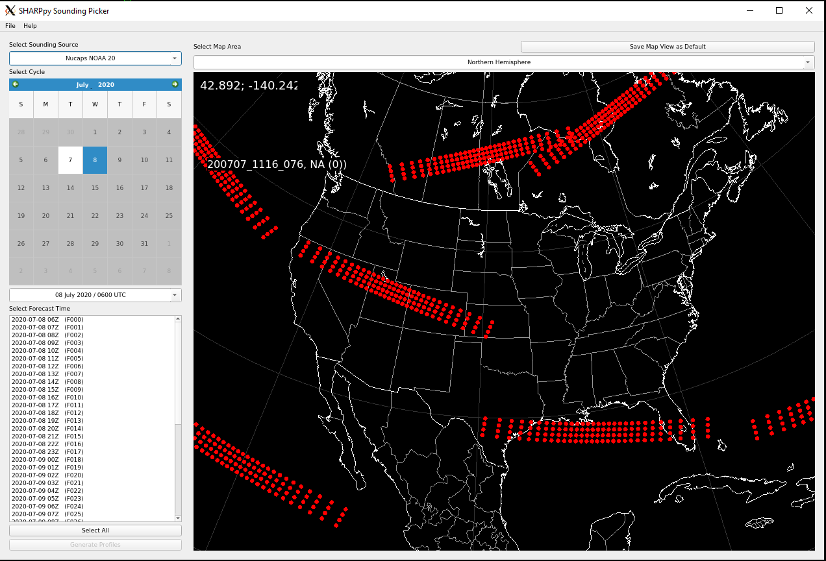
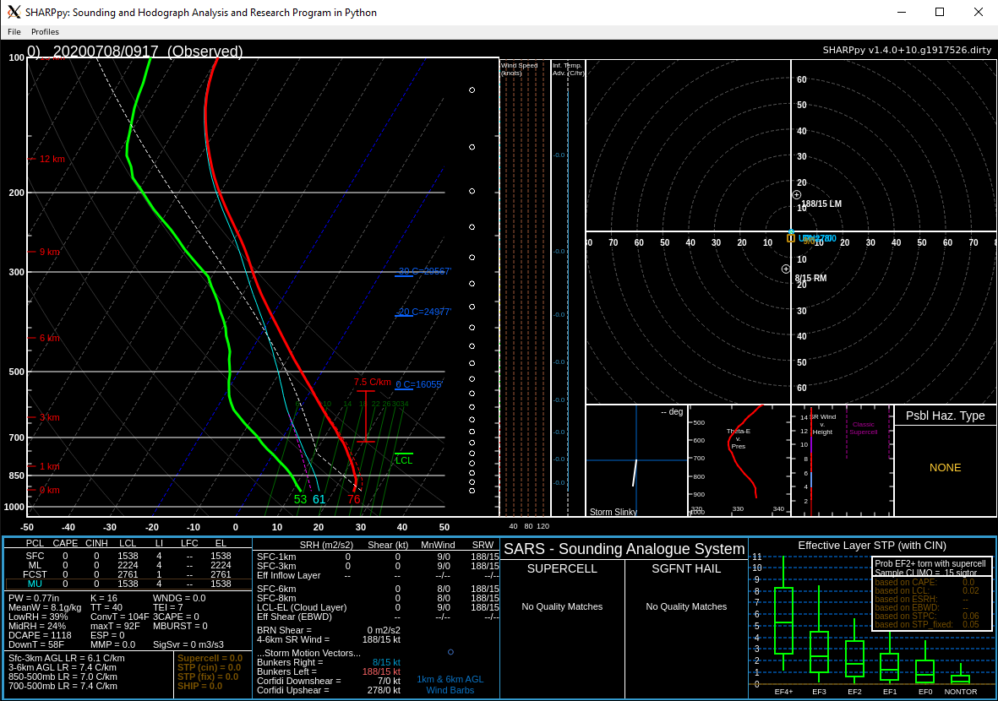
Non-AWIPS Visualizations
Web-site with multiple domains
Global
Alaska
CONUS
Caribbean
RealEarth and McIDAS-V formats under development
SHARPpy
Prototype developed to display S-NPP and NOAA-20
Developing real-time processing for formatted files

Slide 21
Helpful Links
SPoRT/STC NUCAPS Informational page
Gridded NUCAPS VLab page
Alaska VAWS Seminar: How NUCAPS and gridded NUCAPS can help you
COMET Module: GOES-R/JPSS Case Exercise: Products & Capabilities for Assessing Convective Initiation
VISIT Training
Advanced Satellite Sounding
Foundational Course for JPSS
NUCAPS Soundings Quick Guide
Gridded NUCAPS Quick Guide
Gridded NUCAPS Quick Brief
OSPO NUCAPS Information
OSPO Skew-T Viewer
Useful names and emails
Emily Berndt
(emily.b.Berndt@nasa.gov)
Jack Dostalek
(jack.Dostalek@colostate.edu)
Rebekah Esmaili
(rebekah@stcnet.com)
Scott Lindstrom
(scott.Lindstrom@noaa.gov)

