Slide 1
Hypersonic Technology
Anton Scholten
Mentor: Robert Baurle
LaRC-D306
08/05/2020

Slide 2
Outline
Boundary conditions in VULCAN-CFD
Automatic differentiation
Boundary conditions to check
What/how to debug
Debug script/code
Shell script outline
Fortran code outline
Sample output
State of the boundary conditions
Other things learned
Other ideas explored
Acknowledgements

Slide 3
Boundary conditions in VULCAN-CFD
Implicit BC originally hand coded: fast calculations
But: prone to human error while coding the Jacobians
Operator overloaded (using automatic differentiation) later added
But: expensive to compute (recursive, matrices instead of scalars…)
Flux and BC Jacobians: we focus on the later
VULCAN was first made for calorically perfect gas, then a thermally perfect path was added.
Thus two versions for each BC exist, but remain very similar
VULCAN is nondimensional

Slide 4
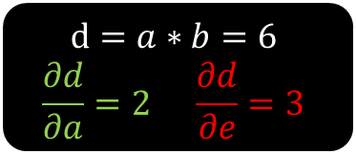
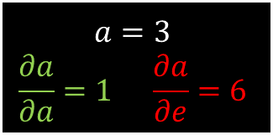
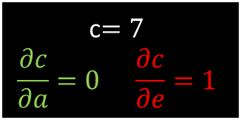
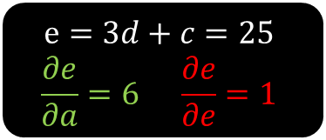
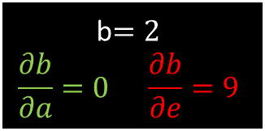
Automatic differentiation
$$e=3d+c=25$$
$$\frac{∂e}{∂a}=6 \frac{∂e}{∂e}=1$$
Variables and their partials wrt other variables are together (in matrices, or as fields)
Forward mode differentiation: how one input affects every node
Reverse: how every node affects one output (“backpropagation”)
Computational graph
Forward (left) and backward (right) propagation
$$\frac{∂e}{∂d}=3$$
$$d=a∗b=6$$
$$\frac{∂d}{∂a}=2 \frac{∂d}{∂e}=3$$
$$\frac{∂e}{∂c}=1$$
$$\frac{∂d}{∂a}=2$$
$$\frac{∂d}{∂b}=3$$
$$a=3$$
$$\frac{∂a}{∂a}=1 \frac{∂a}{∂e}=6$$
b$=2$
$$\frac{∂b}{∂a}=0 \frac{∂b}{∂e}=9$$
c$=7$
$$\frac{∂c}{∂a}=0 \frac{∂c}{∂e}=1$$
$$ex: \frac{∂d}{∂a}=\frac{∂a}{∂a}b+a \frac{∂b}{∂a}=1∙2+3∙0$$

Slide 5
Operator Overloading
Let’s take the scalar multiplication function, say:
$mult\left(a,b\right)=a∗b$
Now let’s “overwrite” it to handle partials (using the chain rule):
$ddt_mult\%f=a\%f∗b\%f$
$ddt_mult\%d=a\%f∗b\%d+a\%d∗b\%f$
We do need to introduce a new “derived” data type which has two fields:
$\%f$: function value, scalar
$\%d$ : derivatives, vector [ partials of the variable with our selected primitive variables ($ρ, u.v, w, P$ or $T$, turbulence vars, … ) ]
We do need to make sure to handle cases where $a$ or $b$ is a constant !

Slide 6
Boundary conditions to check
Input file string : code variable
MF_T0_IN : ibcsmfi
LWBLOW : ibclwb
P0_T0_IN : ibcsbi, ibcsub
PRESS_OUT : ibcsbo, ibcsmfo, ibcmof
SYMM : ibcsym, ibcslp, ibceul
AWALL : ibcnsa, ibcawm
IWALL : ibcnsi, ibcnst, ibcnsr, ibctcw, ibctcwp, ibciwm, ibccwm, ibcswmm, ibcpwm
BCCHRF : Ibcchrf (inflow and outflow)
( Subsonic Mass Flux Inflow )
( SUBsonic inflow/outflow )
( EULer slip wall )
( 1D Conduction Wall Matching )

Slide 7
What/how to debug
VULCAN runs with an input file where we can specify how Jacobians are evaluated (manual vs automatic)
Changing the input file does not require re-compilation
The Jacobian is just a matrix so we compare the entries
Need to make sure to match the equations (ex: laminar vs turbulent, different number of species)
Get values out of VULCAN by writing to a file
Compare them

Slide 8
Debug script/code
Shell script (tcsh, C shell derivative) handles everything, just execute using command line. Takes ~5 min to run all BCs.
Does require a few changes to the source code:
Manual Jacobians in IMPLICIT_GEN_MOD.F
Operator Overloaded Jacobians in OP_OL_MOD.FT
Both have CP and TP sections
Can pick which input file to run and comparison to do:
Only manual Jacobians, comparing CP vs TP
Compare manual vs automatic, CP vs TP
Compare manual vs automatic, CP separate from TP

Slide 9
Shell script outline
Select options (run one case or all, comparison type)
Compile the Fortran code used to compare values (shell scripting had various drawbacks: loading the data into variables, looping,..)
For BC (1 to 9)
Calorically and thermally perfect
Laminar and turbulent
Add “USE HAND CODED IMPLICIT BCS” to input file (using Stream EDitor)
Run VULCAN and rename the output generated (this solution seemed easier than passing arguments to VULCAN)
Remove the added line
Run again to get operator overloaded values (and rename output)
End loop
End loop
Run Fortran code to compare the output files (pass it the option selected as input so it knows what we want to compare)
Change VULCAN source code to comment in/out the next BC of interest (we have to be careful if it is the last one since we need to uncomment the first BC then)
Recompile VULCAN
Switch input files so they have the proper BC in them (I could have used SED to do this)
End loop

Slide 10
Fortran code outline
Get the given input when the code was called
Three loops to read all the files into variables (cp/tp, laminar/turbulent, manual/automatic Jacobians)
Write to output file:
Laminar:
Dimensional primitive variables
CP:IGEN | CP:OPOL | TP:IGEN | TP:OPOL | CP:IGEN==CP:OPOL | (CP:OPOL-CP:IGEN)/CP:OPOL | etc… (Boolean to know if they match, then relative error to know if we have rounding errors (e-16) or worse Depending on the option given, we might only compare some of the values)
Again for conservatives (these usually match if the above does)
Again for Turbulent
+2 Additional equations to check (which adds 2 rows and columns to the Jacobian)

Slide 11
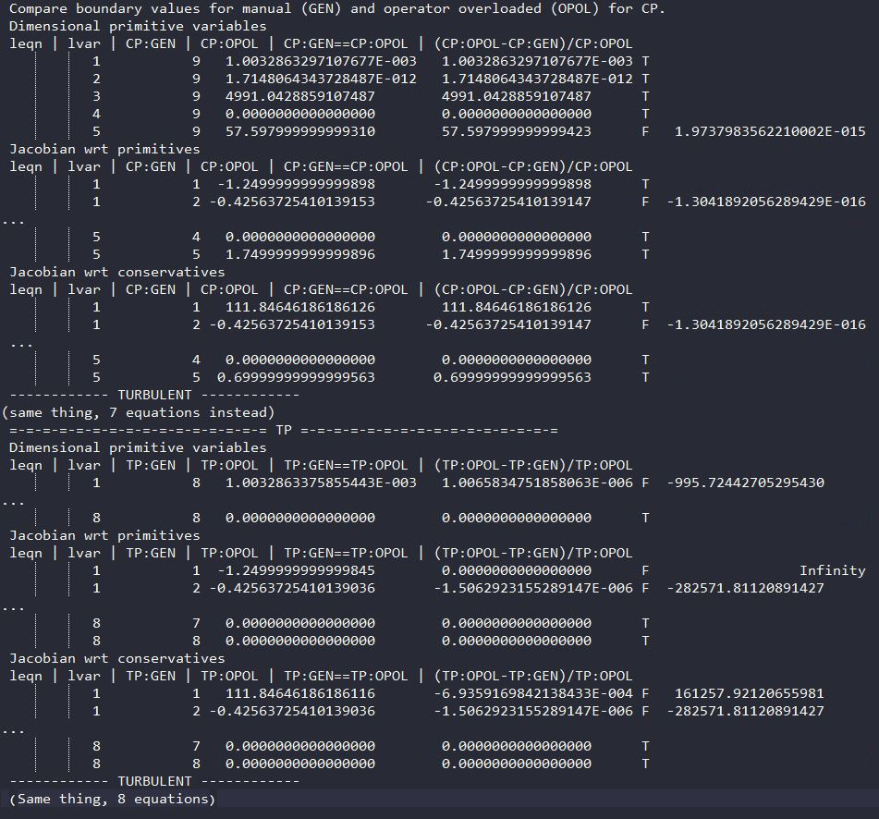
Sample output
1
2
1) Matching values
2) Don’t match but small error
3) Don’t match
4) Don’t match and division by 0 so we have Infinity
3
4

Slide 12
State of the boundary conditions
Gas | Calorically perfect |  |  |  |  |  | Thermally perfect
Flow | Laminar |  |  | Turbulent |  |  | Laminar | Turbulent
 | Var. | Prim. | Cons. | Var. | Prim. | Cons. | Cons. | Cons.
ibcsmfi | o | o | o | o | o | o | x | x
ibclwb | o | o | o | o | o | o | x | x
ibcsbi | o | o | o | o | o | o | x | x
ibcsbo | o | o | o | o | o | o | o | o
ibcsym | o | o | o | o | o | o | o | o
ibcnsa | o | o | o | o | o | o | o | o
ibcnsi | o | o | o | o | o | o | o | o
Ibcchrf (inflow) | o | o | o | o | o | o | x | x
Ibcchrf (outflow) | o | mom. | mom. | o | mom. | mom. | x | x
O : values match
X : values do not match
Var. : Dimensional primitive variables
Prim. : Jacobian wrt primitives
Cons. : Jacobian wrt conservatives
TP: we cannot compare variables wrt primitives because manual Jacobians use pressure while operator overloaded use temperature
mom. : issues with momentum equations

Slide 13
Other things learned
SSH and connecting to K clusters at LaRC
sftp for file transfer
PBSPro for batch system to submit jobs
Pointwise mesh generation software
Generated a few meshes but haven’t made one that can run in VULCAN yet
Tcsh is weird
Switch/case statements didn’t appear to work so I resorted to if/else
… else statements didn’t appear to work either so I only used if
Couldn’t use variables as for loop limits

Slide 14
Other ideas explored
Multiple VULCAN directories
Making changes to the source code would become complicated
Single input file
Would work with sed to edit the file but I originally used completely different input files for each BC
Make code only report the wrong values in a list (small/medium/large errors)
Makes it harder to see error patterns, or if both manual and operator overloaded gives wrong values (ex: a no-slip wall having velocity)
Make the script less intrusive
Place a unique string in the source code and then sed the boundary condition if()
Issues might arise if we need to get the values from different places in the code
Comparing speed between automatic and manual Jacobians
Lots of different functions involved, I wasn’t sure where to start and stop

Slide 15
Acknowledgements
Thanks to Robert Baurle for mentoring me and helping me throughout the internship by giving me explanations about VULCAN, or fixing the numerous issues I had.
Thanks to the internship coordinators for making the internship happen despite the world situation.

