Slide 1
August 11, 2020
Guidance Modifications & Enhancement for Space Launch System Block-1 in Support of ARTEMIS I and Beyond
Matt Hawkins/JSEG/MSFC/EV42
Naeem Ahmad/NASA/MSFC/EV42

Slide 2
Introduction
NASA’s Space Launch System (SLS) is the launch vehicle that will be taking Crew back to the Moon
Guidance algorithms largely based on heritage Shuttle algorithms
Process and algorithm improvements have been identified based on extensive testing and simulation
Five major updates detailed in this presentation

Slide 3
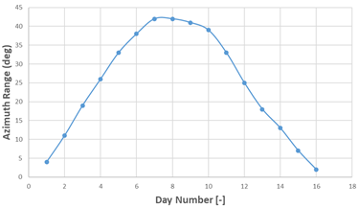
Launch window updates cover expanded GR&A
Right Ascension of the Ascending Node (RAAN) and Inclination targeting uses polynomials
Problem: Updated Ground Rules and Assumptions (GR&A) significantly expanded launch windows

Slide 4
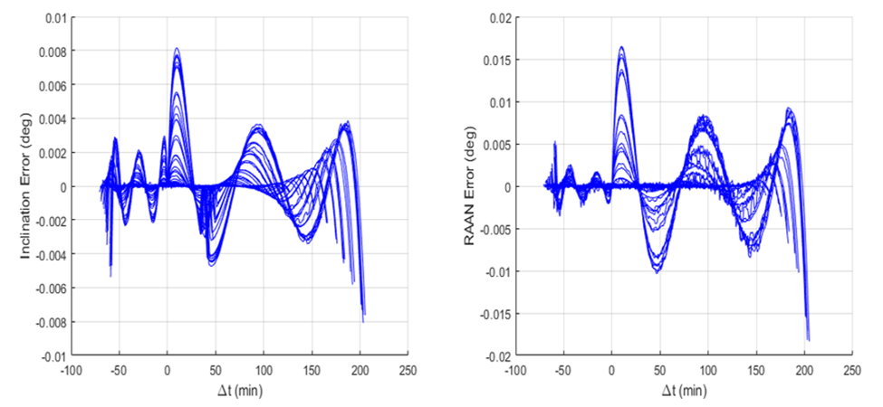
Launch window updates cover expanded GR&A
Solution:
1) Daily reference point inputs
2) Increase polynomial order

Slide 5
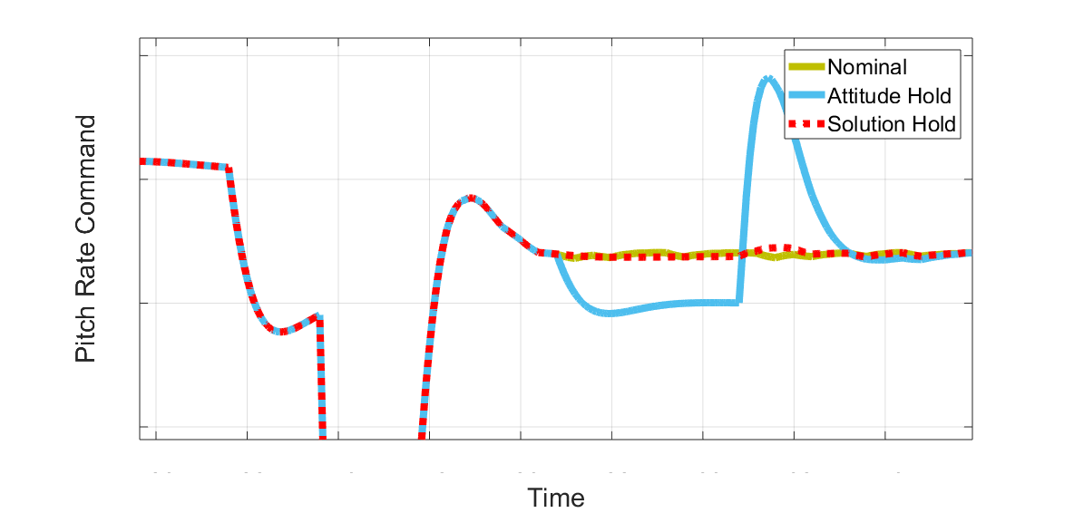
PEG solution hold covers anomalies
Options if Powered Explicit Guidance (PEG) algorithm loses convergence:
1) Attitude hold
2) Use last good PEG solution
Old Baseline
Attitude Hold
Solution Hold

Slide 6
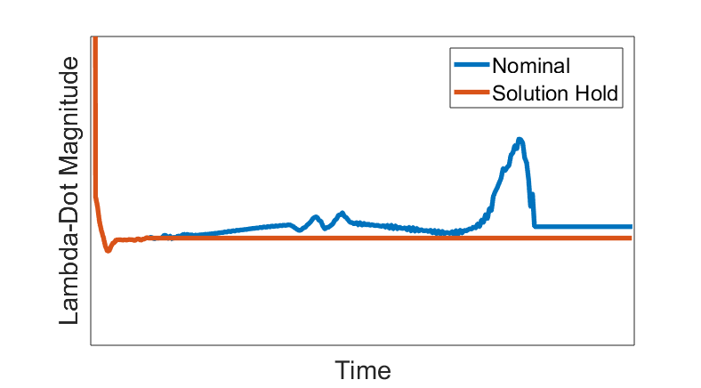
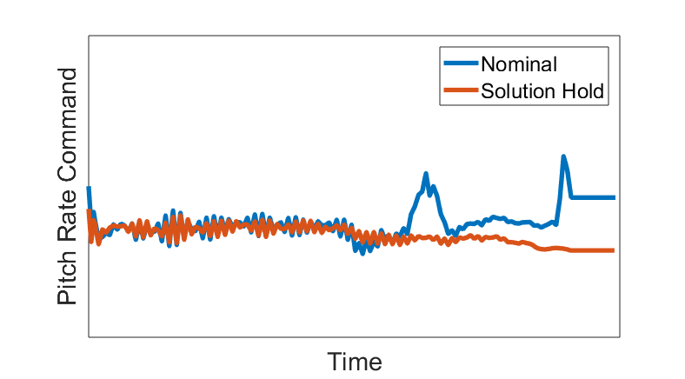
PEG solution hold covers anomalies
Solution hold performs admirably
Test case: nominal flight with solution hold after LAS jettison

Slide 7
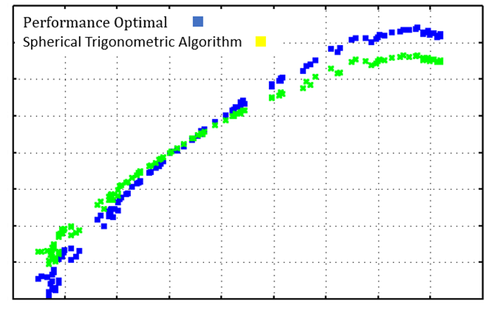
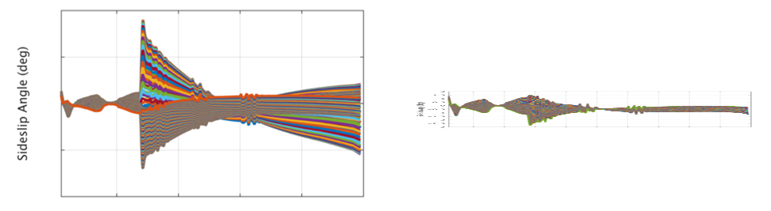
Spherical trigonometry calculations replace brute force method
BS Yaw adjustments reduce loads and reduce run times

Slide 8
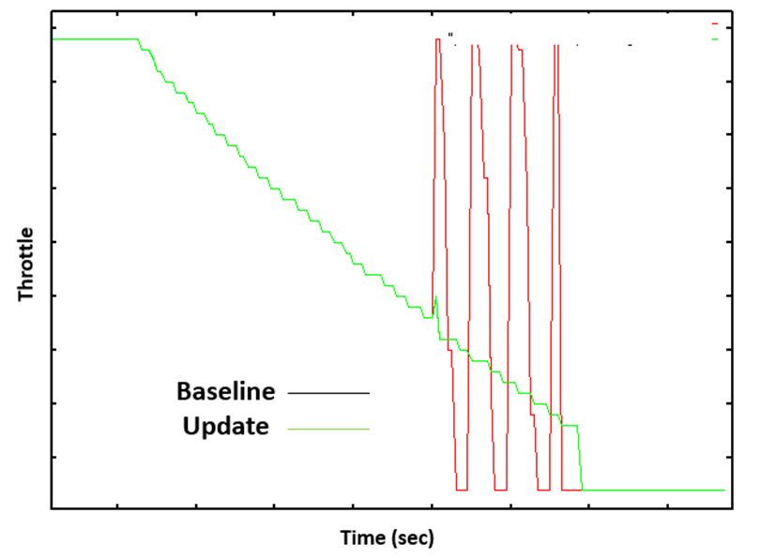
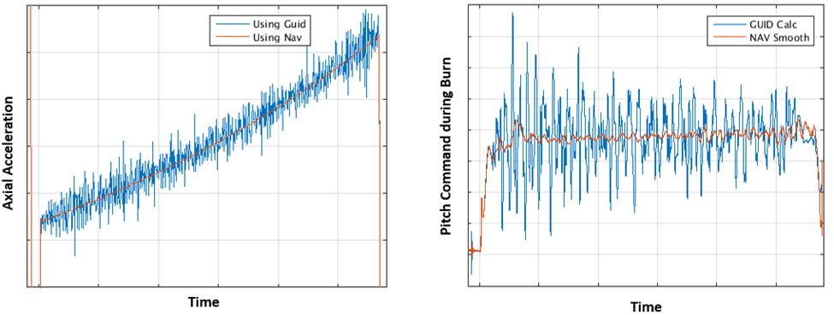
Navigated acceleration is robust against hardware anomalies
Shuttle heritage code includes finite differencing for acceleration
Navigated values are robust against hardware anomalies
Artemis I
type
mission
B1B
type mission

Slide 9
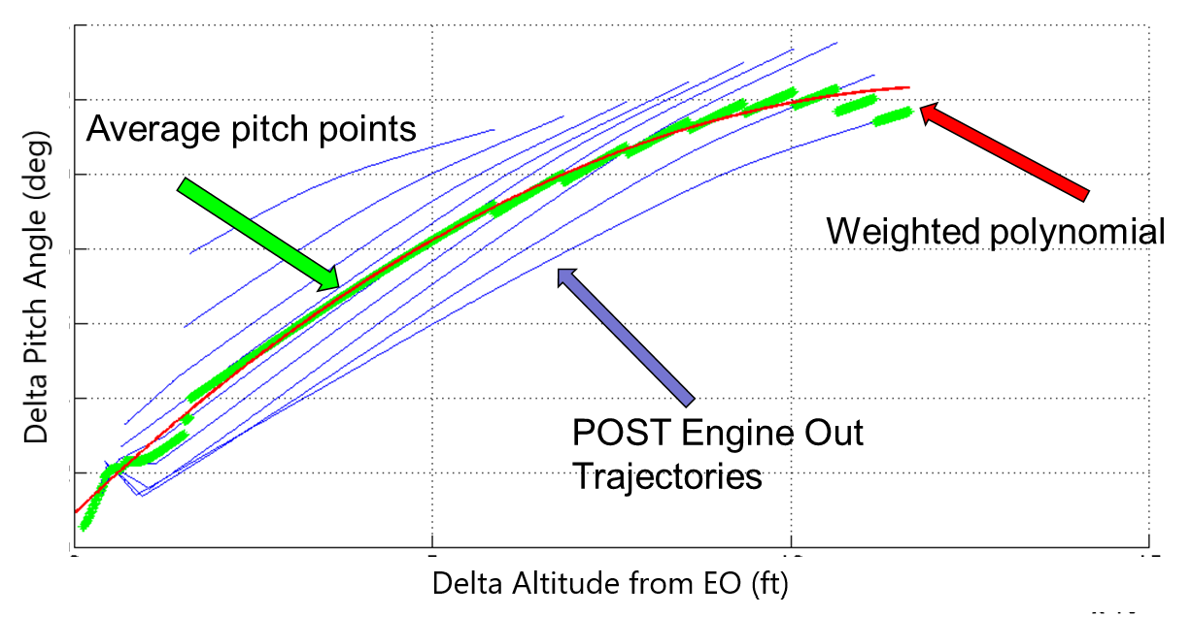
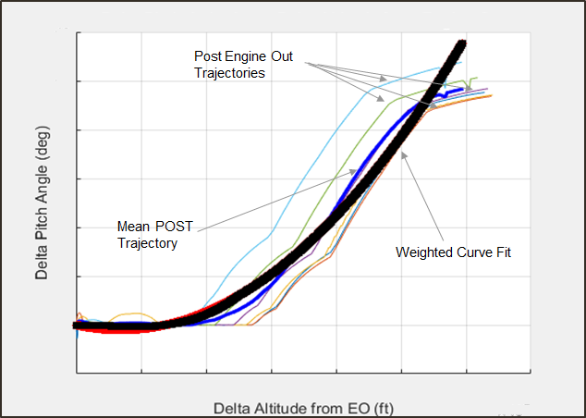
Updated Engine Out methodology maximizes performance
SLS plans to respond to loss of a core engine (Engine Out)
As techniques matured, 3DOF and 6DOF designs diverged
Early design cycle
Recent
(FRAC-0)
cycle

Slide 10
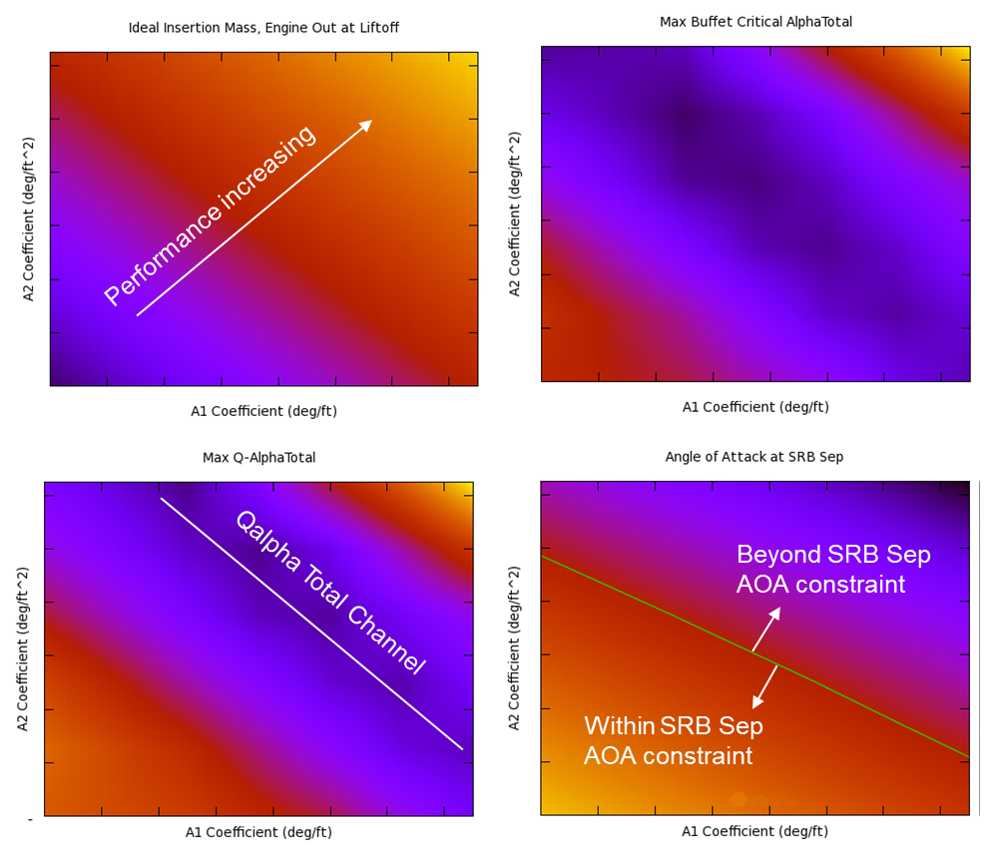
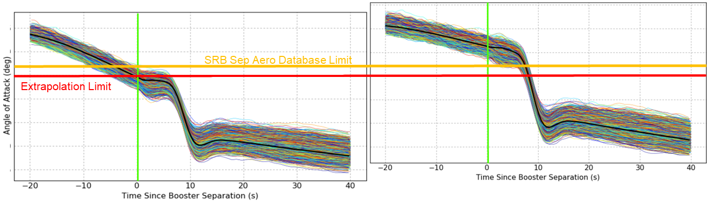
Updated Engine Out methodology maximizes performance
New 6DOF method based on macroscopic trajectory effects
See companion paper for overall EO design (AAS 20-589)
Insertion Mass
Peak α-total
Peak Q-α-total
α at SRB sep
Early Design
Refined Design

Slide 11

Informed by extensive testing and simulation, guidance is more robust against many off-nominal conditions

