Slide 1
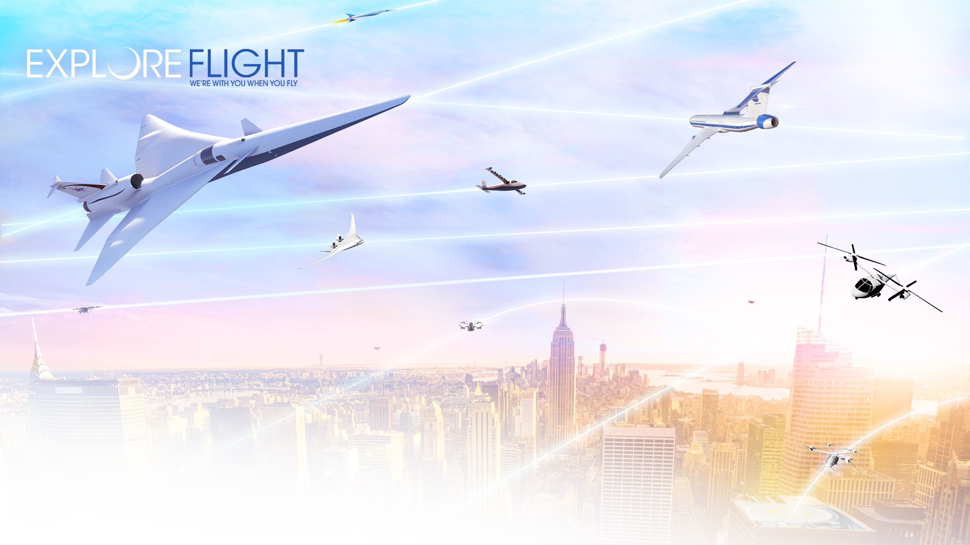

National Aeronautics and Space Administration
Workshop to Support Implementation of NOAA’s Unmanned Systems Strategy
Parimal Kopardekar, PhD
NASA Aeronautics Research Institute
August 4, 2020
www.nasa.gov

Slide 2
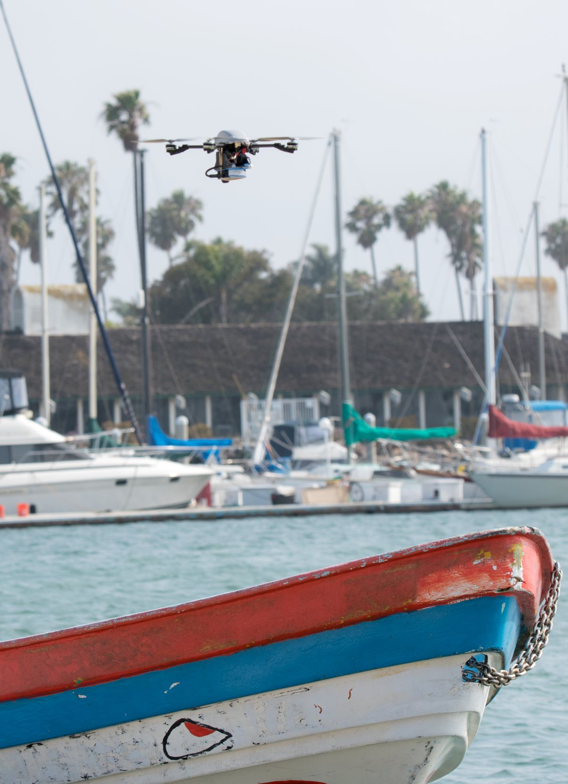
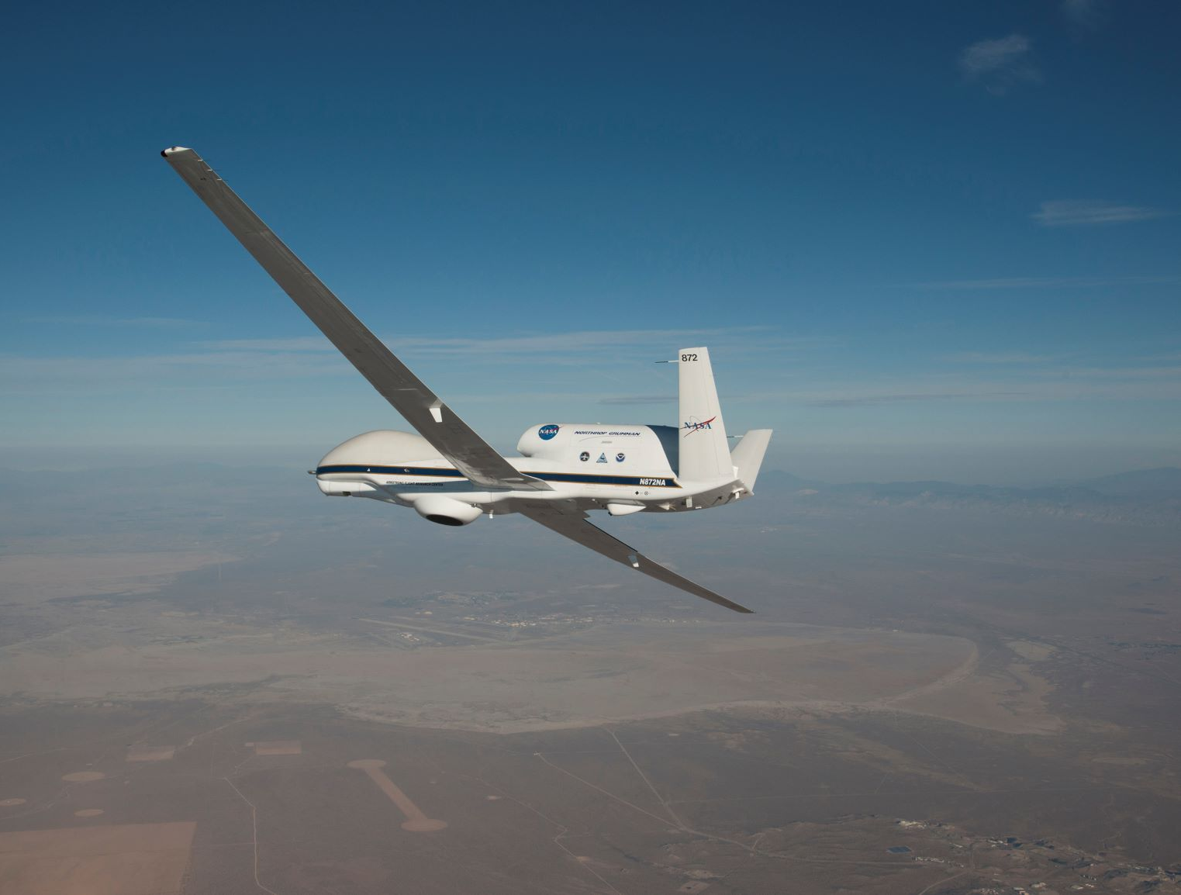
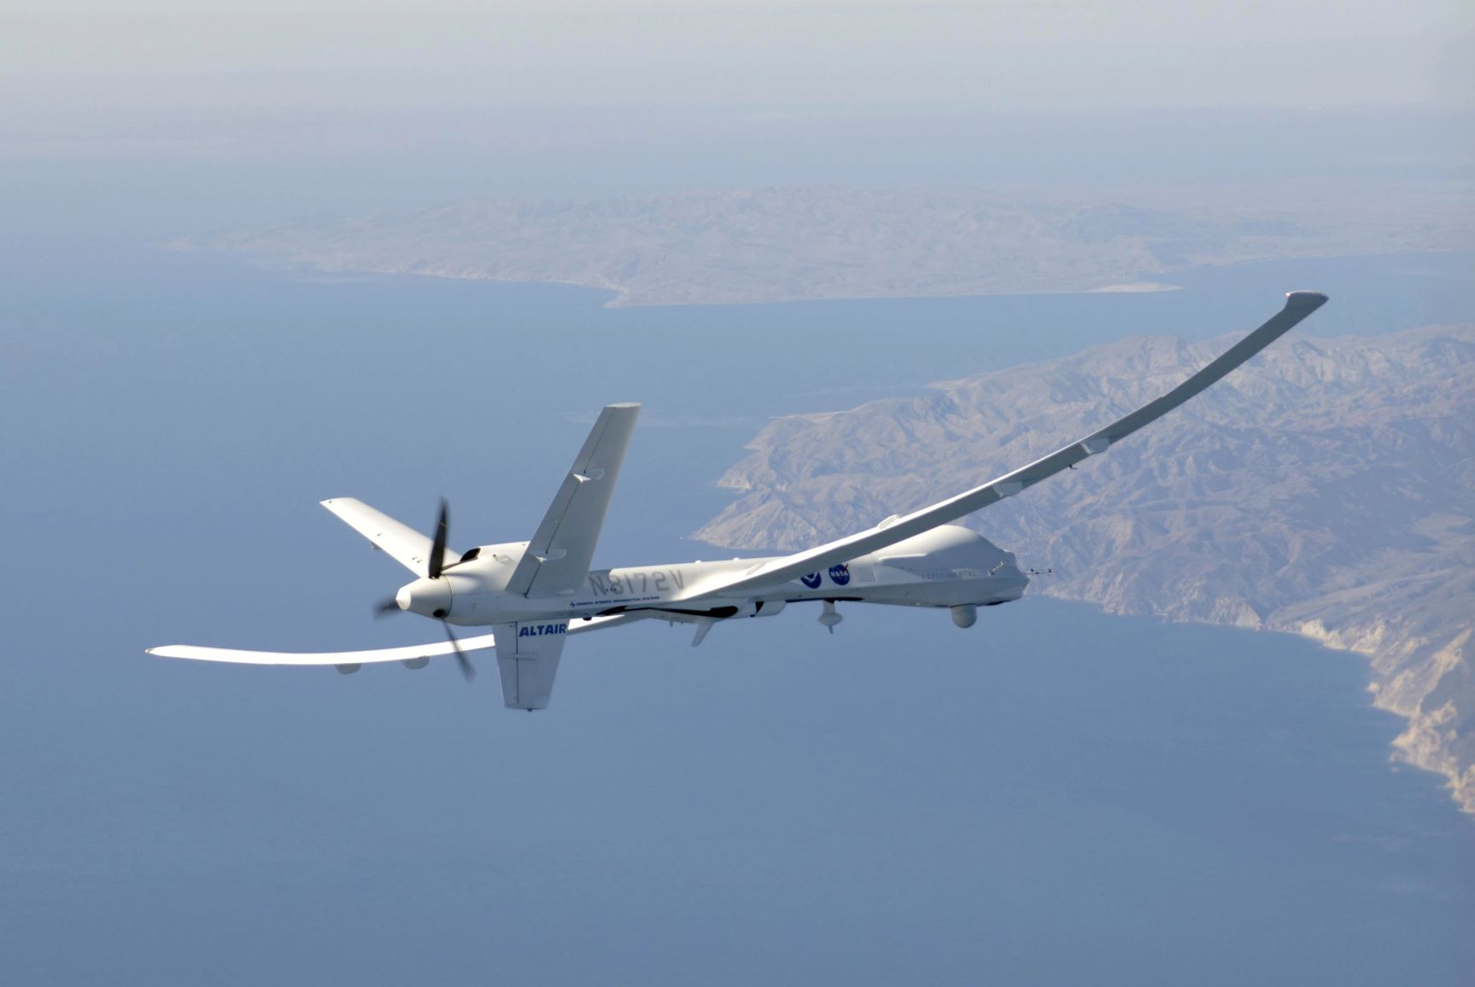
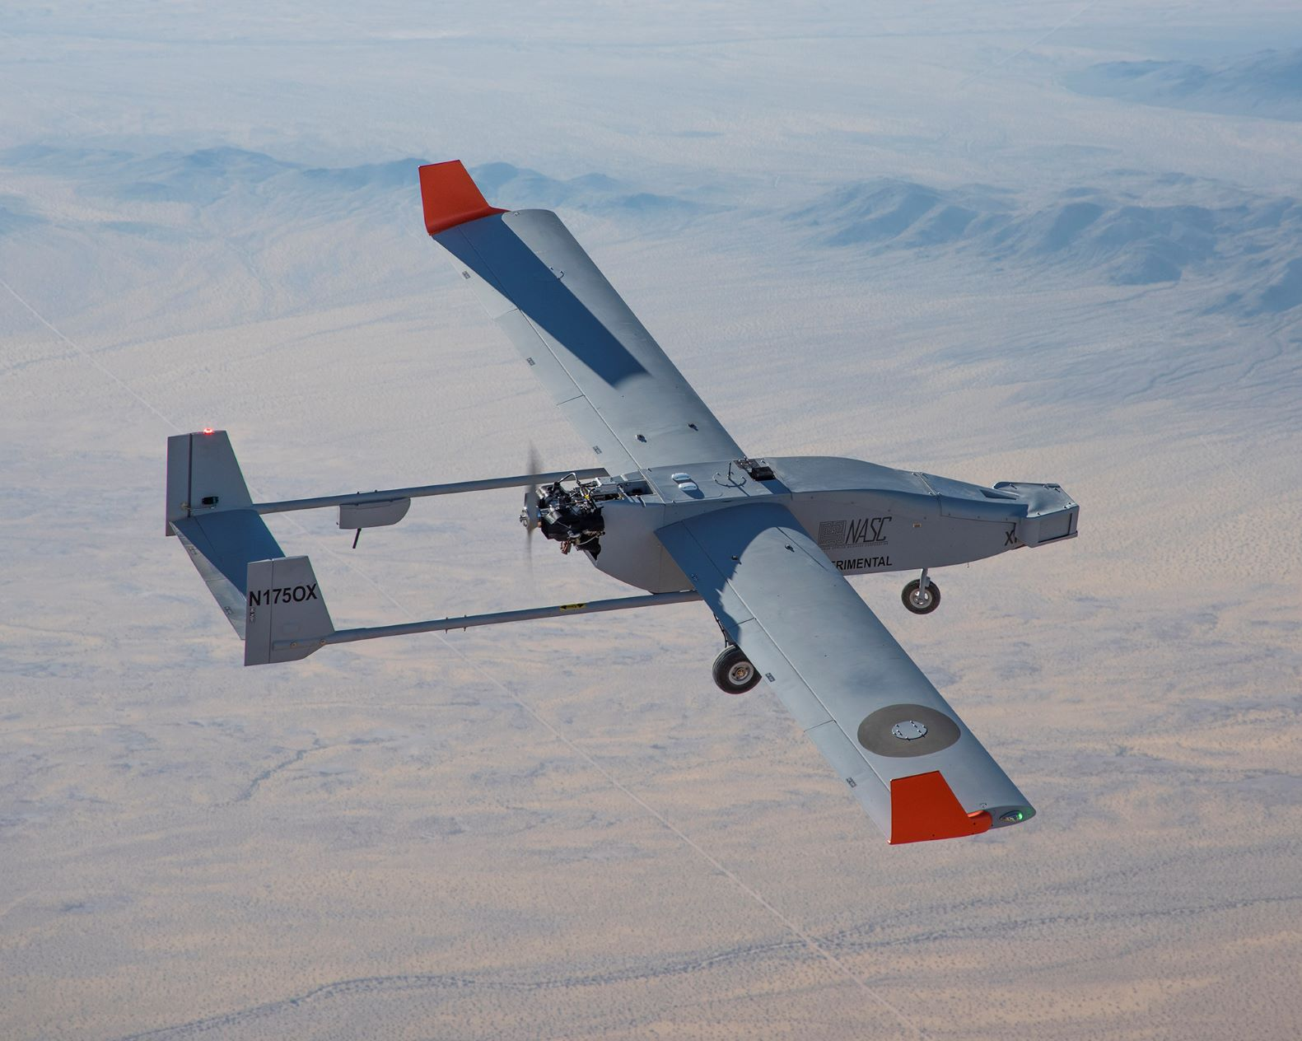
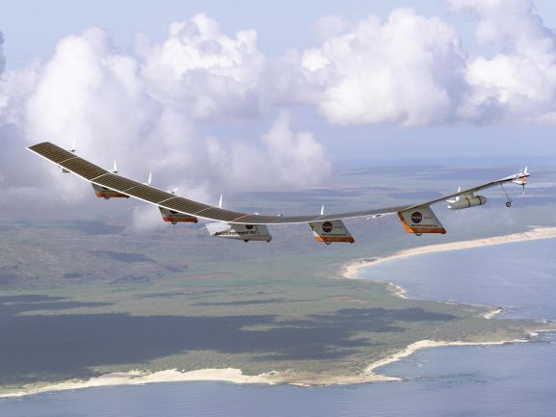
Research to Operations

Slide 3
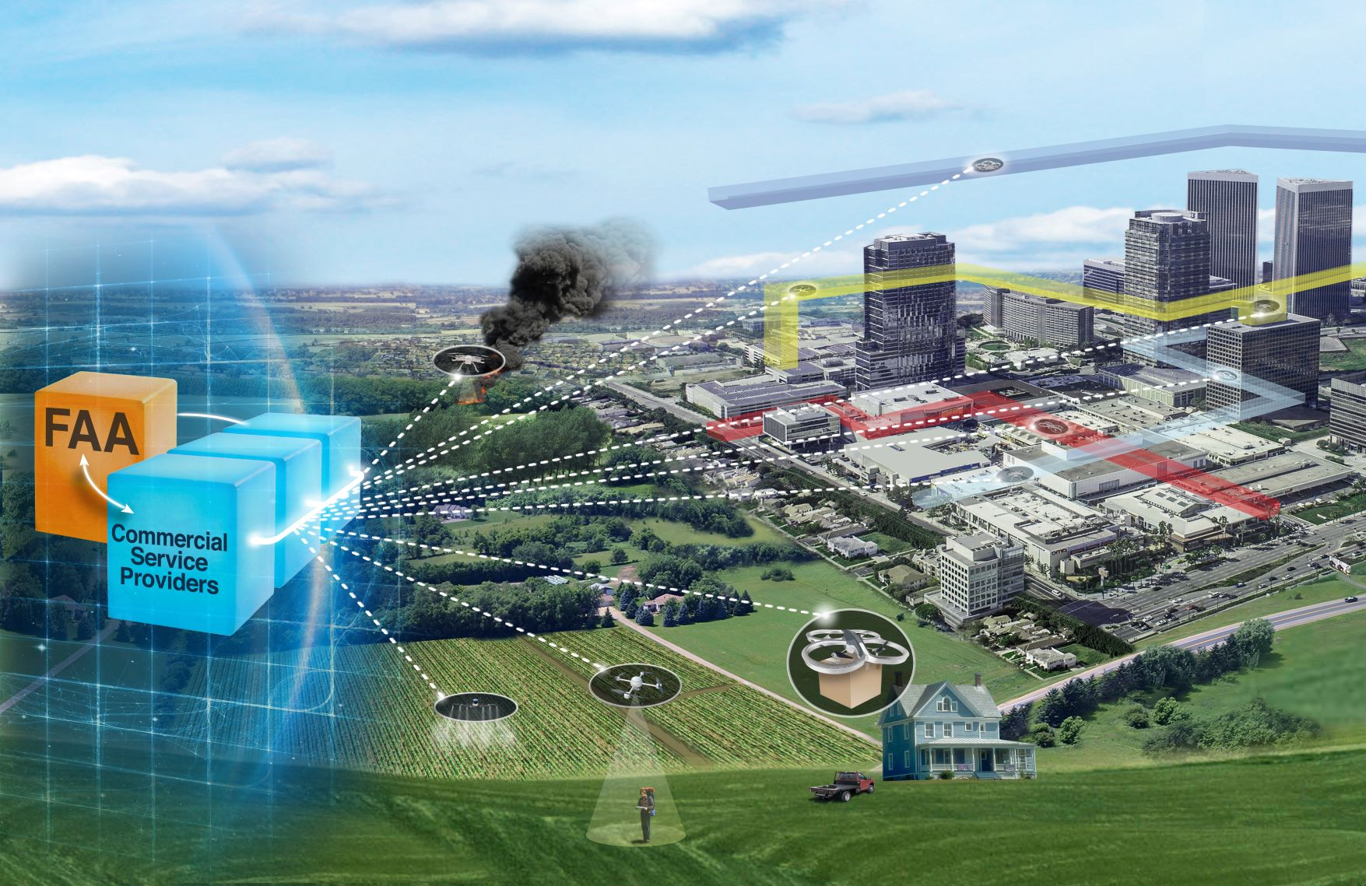
UTM:
Unmanned Aircraft Systems Traffic Management
Scaled operations without burdening current air traffic system
Service-oriented architecture
Cooperative
Digital
Intent-sharing
Third-party services
Managed by exception

Slide 4
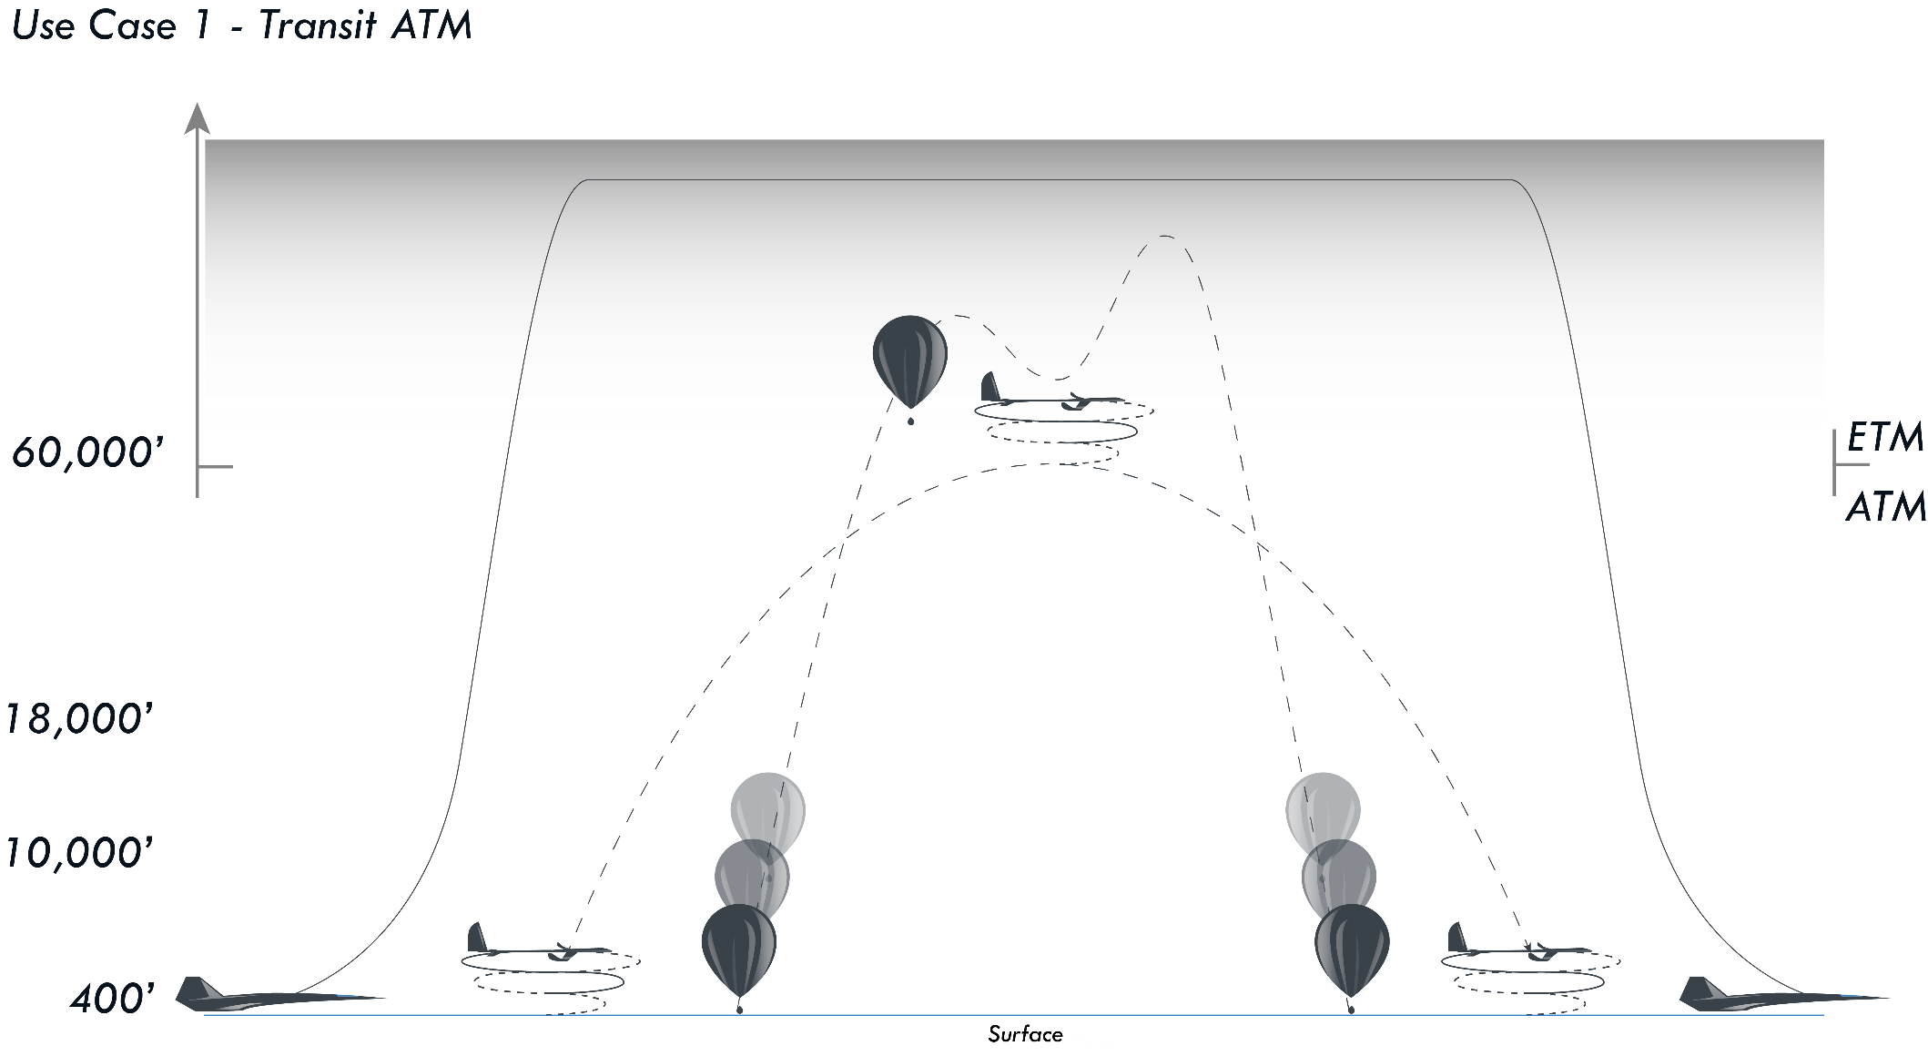
Upper E Traffic Management (ETM)

Slide 5
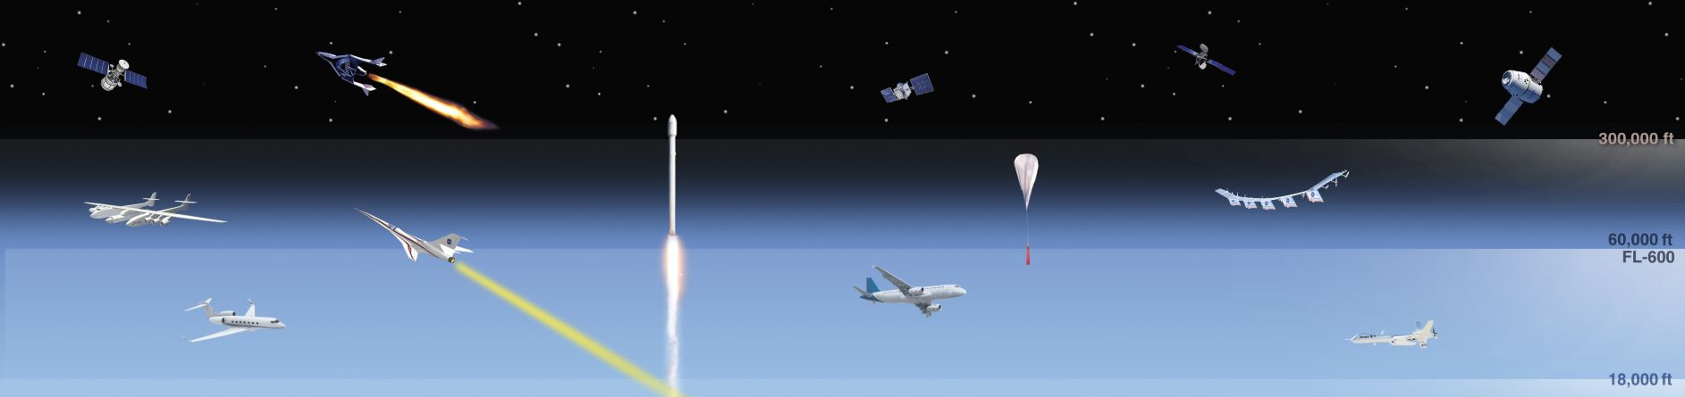
Upper E Traffic Management (ETM)
Separation methodologies may include:
Cooperative Separation
Provided Separation

