Slide 1




Additive Manufacture of C103 for In-Space Propulsion
Omar Mireles, Omar Rodriguez, Sara Rengifo, Pat Salvail.
NASA Marshall Space Flight Center
Youping Gao
Castheon Inc.
Noah Philips
ATI Specialty Alloys
JANNAF Additive Manufacturing for Propulsion Applications TIM
14 September 2020

Slide 2

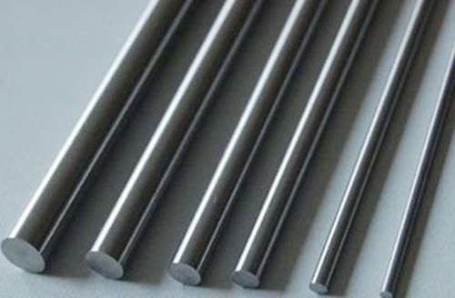
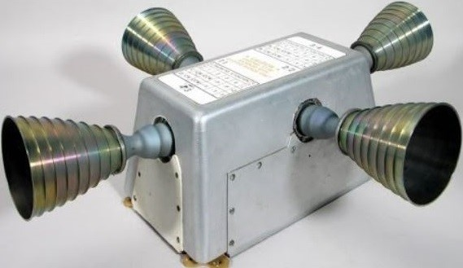
Background
Traditional Manufacture Constraints
  C103 commercial bar stock Ø_{max} = 102 mm (4 in).
  Larger sizes unable to meet ASTM B655.
  Significantly limits design options.
  High buy-to-fly ratio (20:1 to 50:1).
Objectives
  Investigate C103 (Nb10Hf1Ti) AM and post-processing for improved design flexibility, properties, cost, & availability.
Tasks
  Produce, characterize, and supply C103 powder (ATI).
  AM Parameter development & design rules (Castheon & MSFC).
  Metallography (Castheon & MSFC).
  Vacuum stress relief, wire-EDM, and HIP (MSFC).
  Tensile tests: RT (MSFC) and high temp (PSU & Westmoreland).
C103 bar stock.
Apollo CSM RSC using C103.

Slide 3
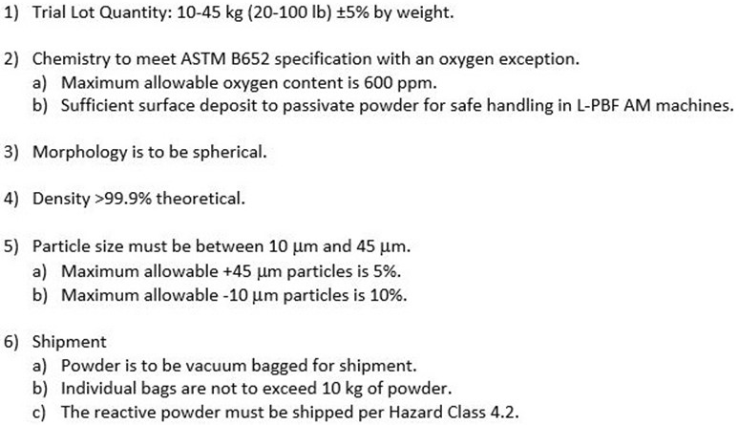
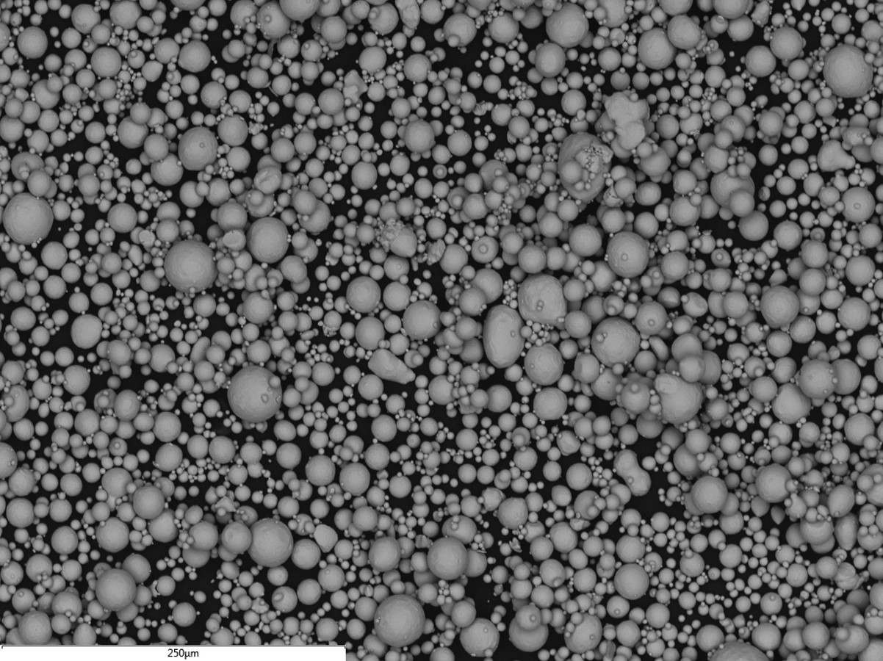
Feedstock Development
MSFC provided powder requirement specification
ATI developed the atomization process
Powder provided to Castheon and MSFC
  L-PBF grade C103 powder is reactive.
  Shipped as metal powder hazard class 4.2.
Powder Characterization
  Particle Size Distribution (PSD): D10 = 12.6 µm, D50 = 33.8 µm, D90 = 49.1 µm.
  Morphology: median circularity of 0.98 (highly spherical).
  Density: > 99.9 %TD
  Chemistry: met ASTM B625 except oxygen (600 ppm max - passivation).
L-PBF AM C103 Powder Requirements
SEM micrograph of L-PBF AM C103 gas atomized powder.

Slide 4
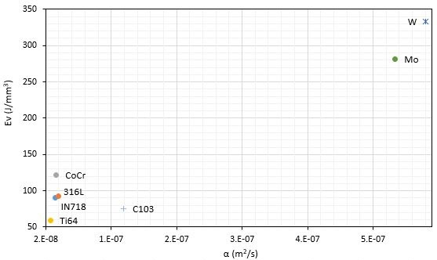
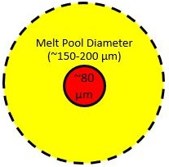
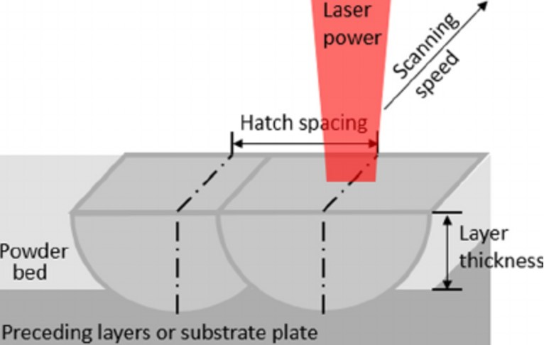
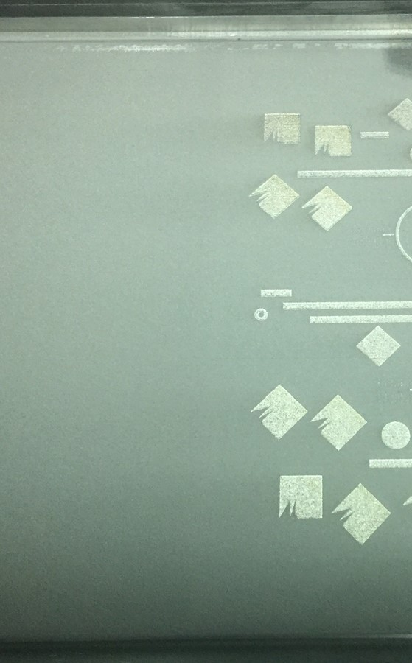
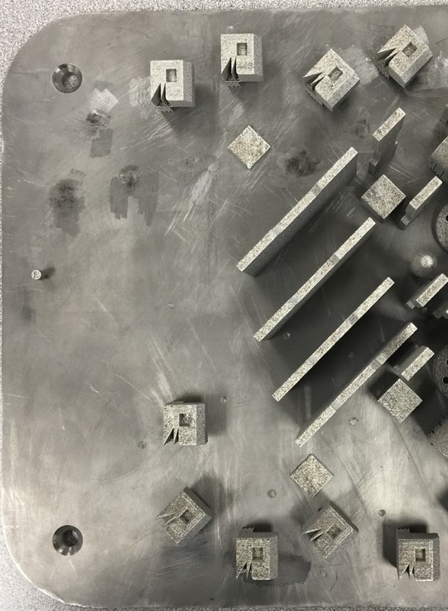
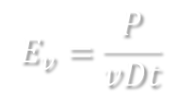

L-PBF Parameter Development
Parameters Development
  Energy density predictions & experimental iterations.
  GE Concept Laser M2: Ø_{l} = 80 µm (Castheon)
  EOS M100: Ø_{l} = 40 µm (MSFC)
  E_{v} = Volumetric Energy Density (J/mm³)
  P = Laser Power (W)
  V = Laser Speed (mm/s)
  D = Hatch spacing (mm)
  t = Layer thickness (mm)
Powder Performance
  Uniform distribution and good flow.
  Must be kept dry and under argon.
Print Behavior
  Max unsupported overhang surface: 40-45°.
  Thermal distortion: low to moderate (i.e. IN625).
(XY)
$$E_{v}=\frac{P}{vDt}$$
$$∅_{mp}=1.8 to 2.5 x ∅_{l}$$
L-PBF laser focus and melt pool.
(XZ)
Thermal diffusivity and L-PBF energy density map.
L-PBF hatch spacing.
C103 printed by Castheon on a Concept Laser M2.

Slide 5
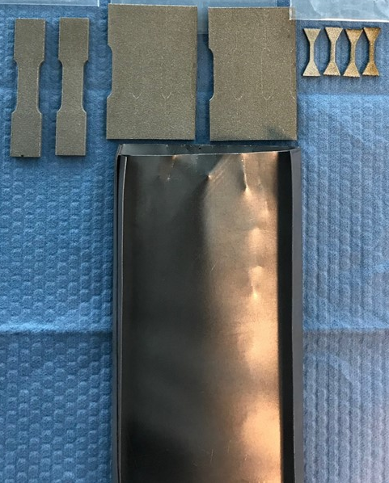
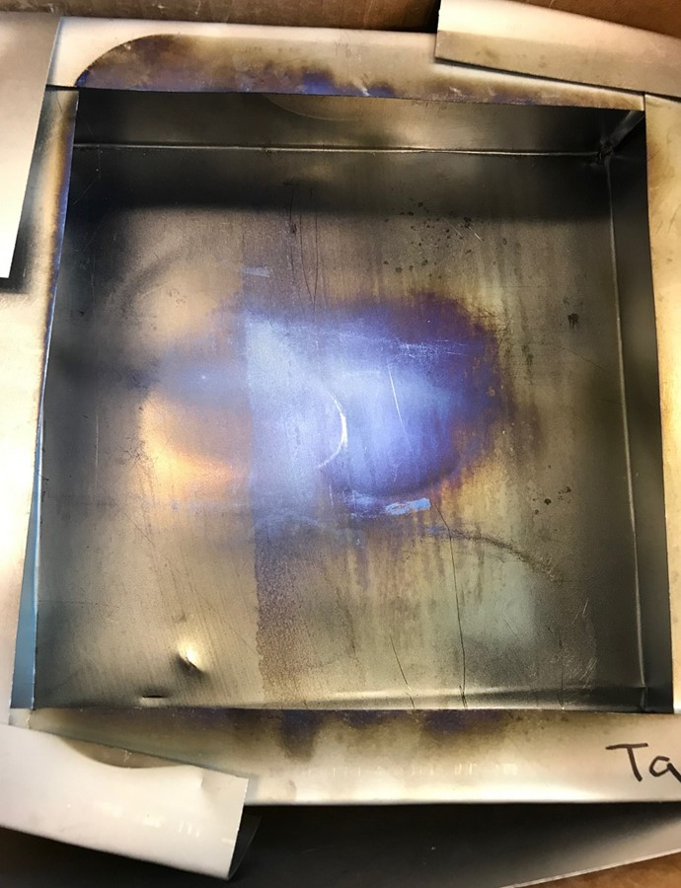
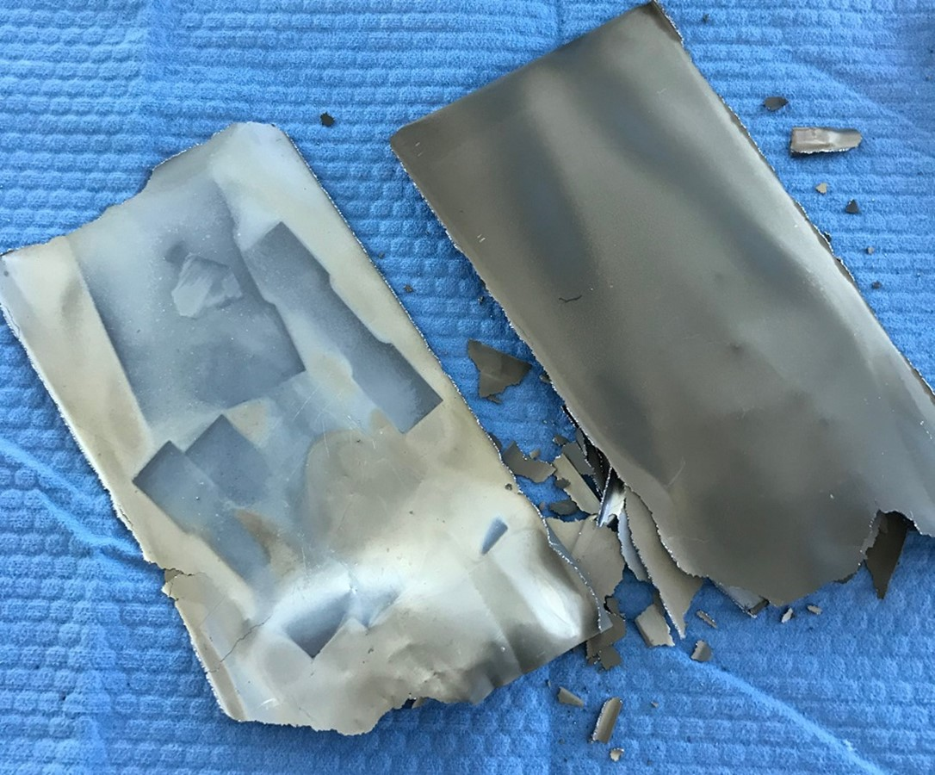
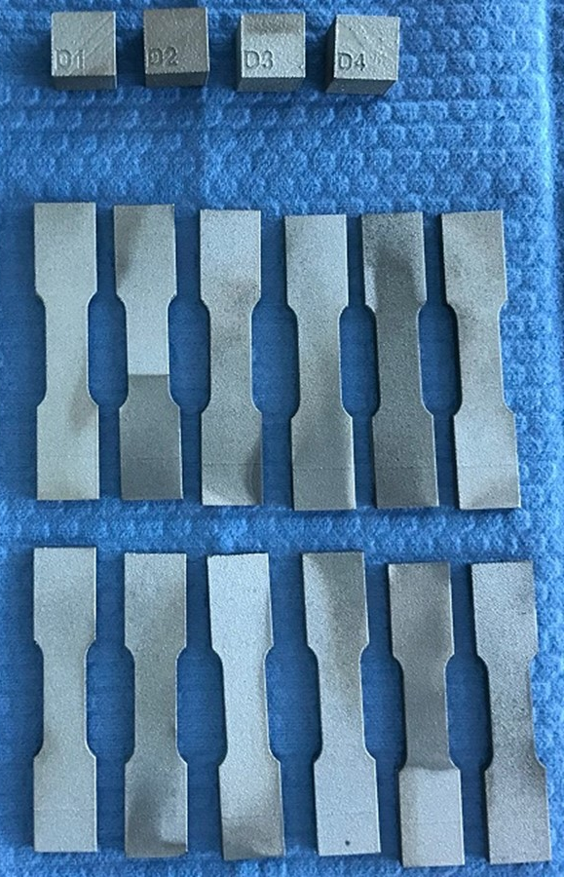
Heat Treatment
Stress Relief (SR)
  1100 °C
  Vacuum of 10⁻⁴ torr
  1 hr
  Ta wrap and clean furnaces required.
Hot Isostatic Press (HIP) ^{[1]}
  1593 °C
  103.4 MPa argon
  3 hrs
  Ta wrap and clean furnaces required
Chemistry
  LECO
Specimens & Ta wrap (pre-SR).
Build plate Ta wrap (post-SR).
Condition | O (ppm) | N (ppm) | H (ppm)
Powder | 441 | 26 | 4
As-built | TBD | TBD | TBD
SR+HIP | 1070 | 150 | 5
Post-HIP Ta wrap brittle from C & O.
Specimens post-SR & HIP.
[1] Wadsworth, J., Roberts C.A., and Rennhack, E.H., “Creep Behaviour of Hot Isostatically Pressed Niobium Alloy Powder Compacts,” Journal of Materials Science, Vol. 17, 1982, pg. 2539-2546.

Slide 6
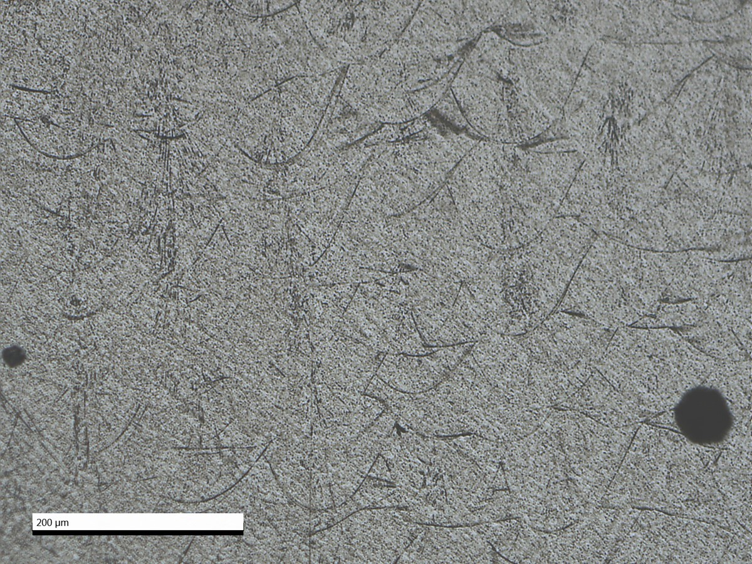
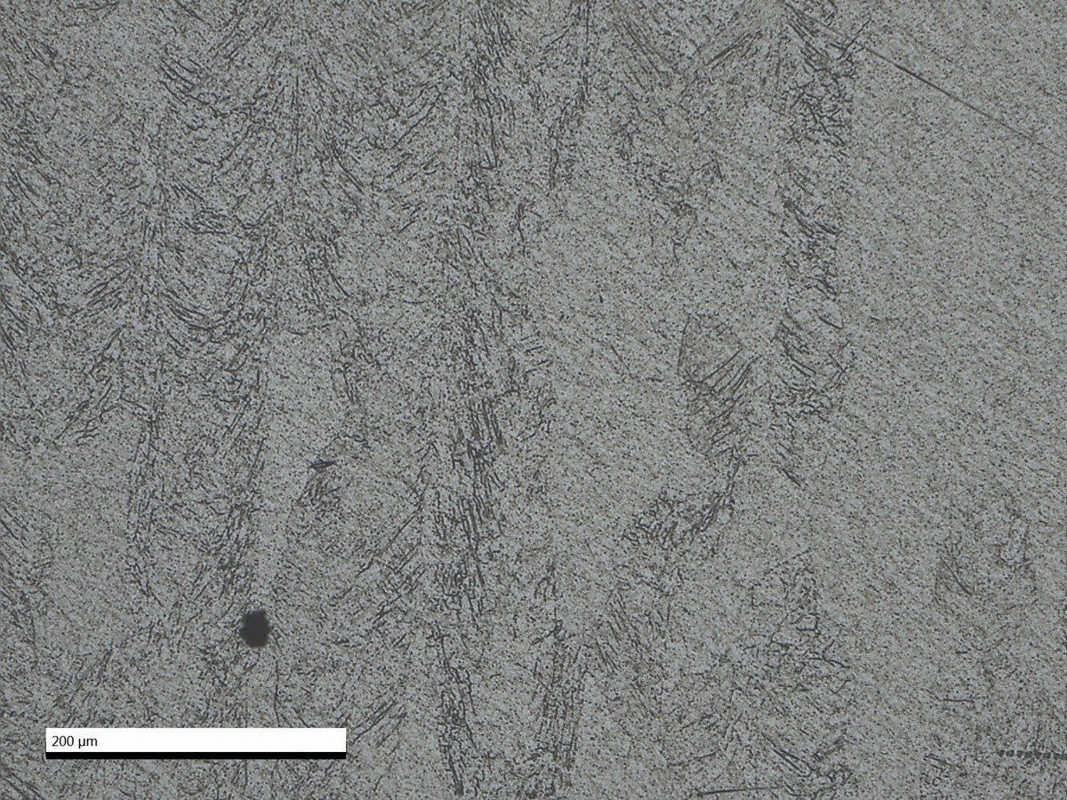
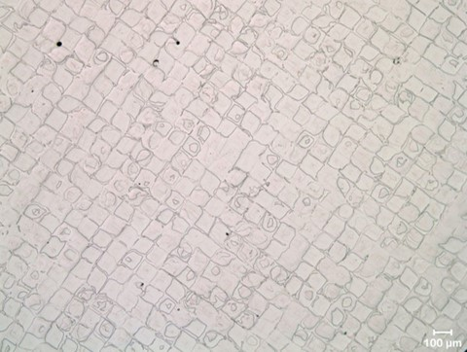
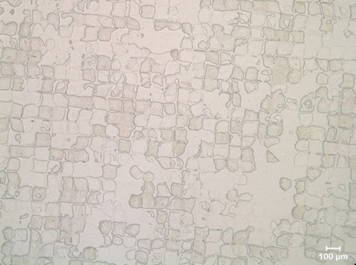
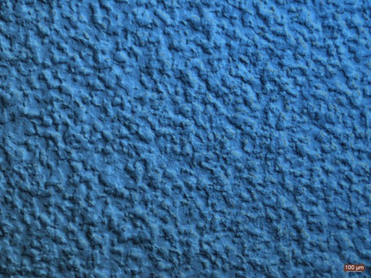
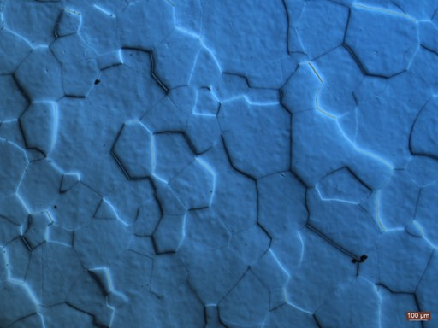
Microstructure
Density
  As-built: 99.986 %RD.
  SR+HIP: 99.993 %RD.
Optical micrograph: as-built (500x, XZ), 99.986 %RD
Optical micrograph: SR+HIP (500x, XZ), 99.993 %RD.
Optical micrograph: as-built, etch (500x, XY).
Optical: SR+HIP, etch (500x, XY). Partially converted.
Polarized optical micrograph of wrought C103 (L) as-received, (R) heat treated. Courtesy Castheon.

Slide 7
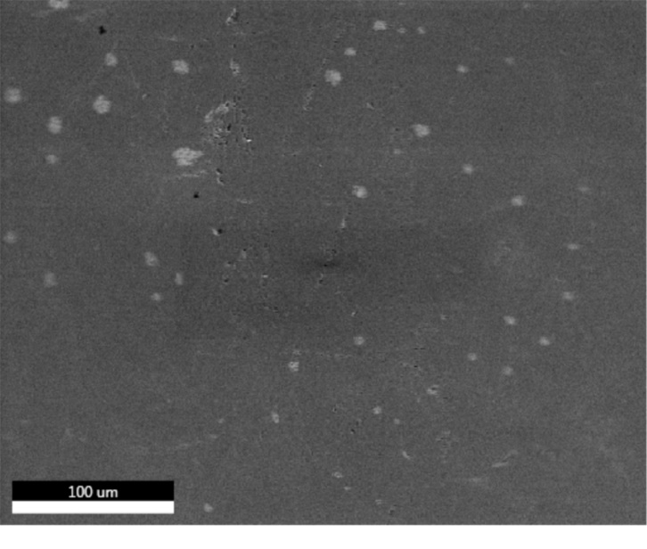
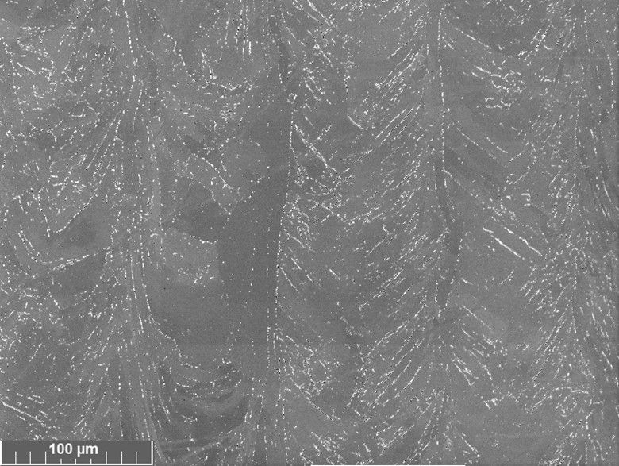
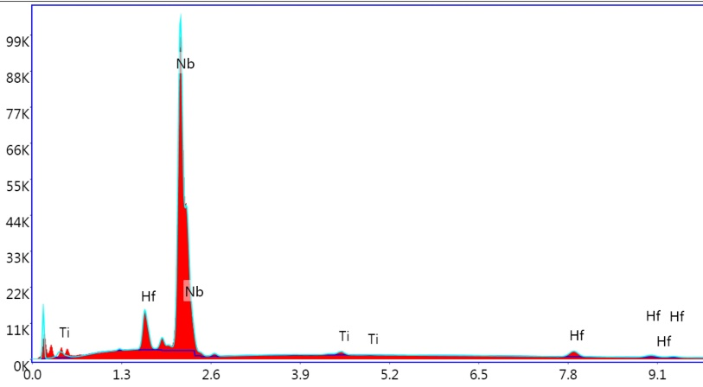
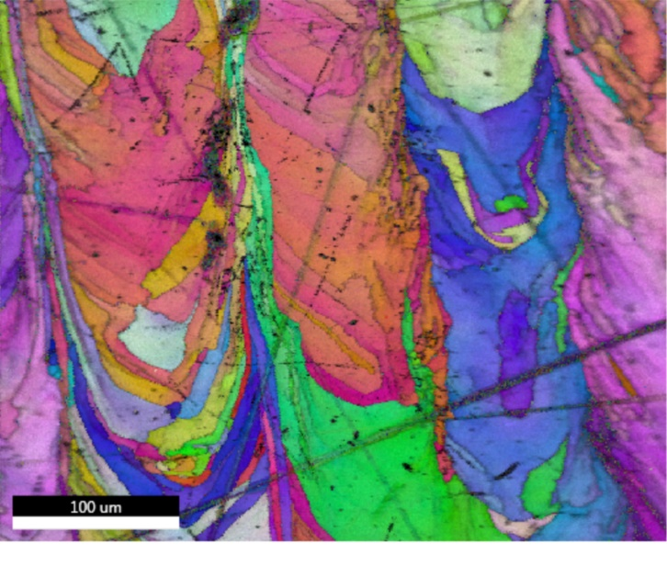
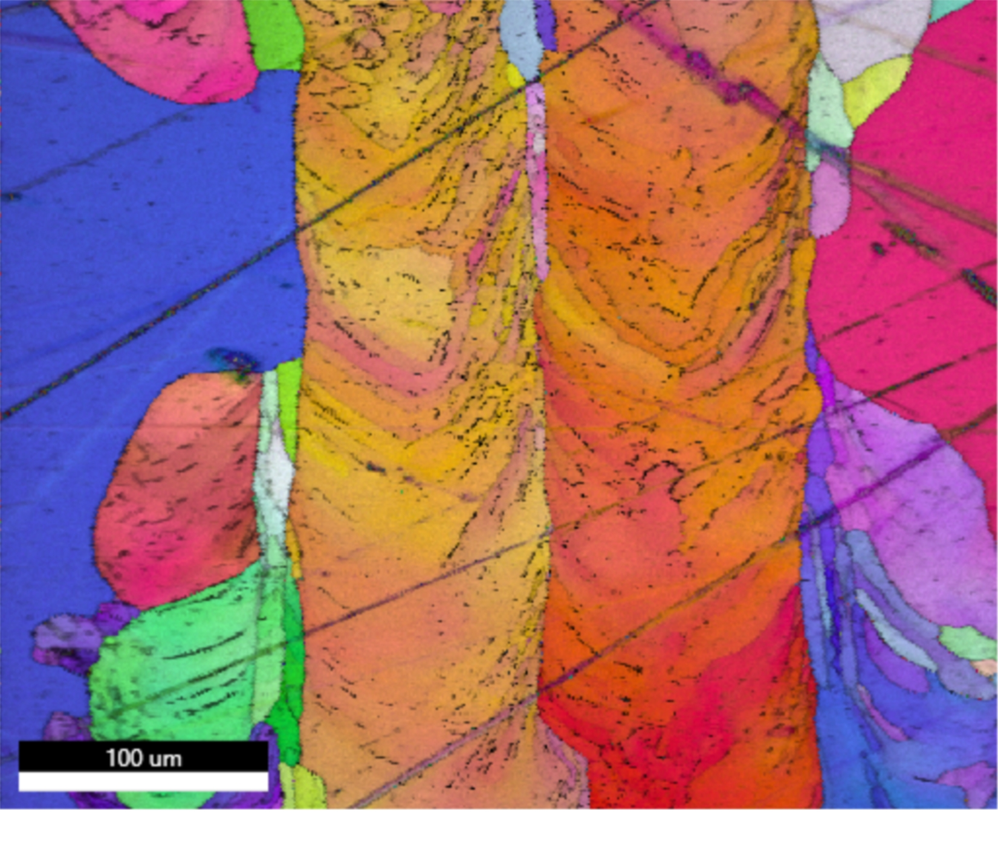
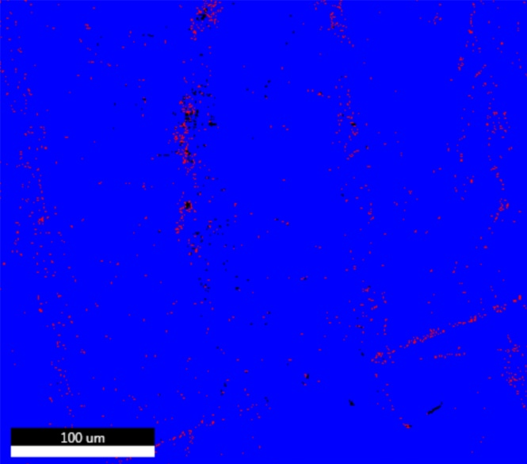
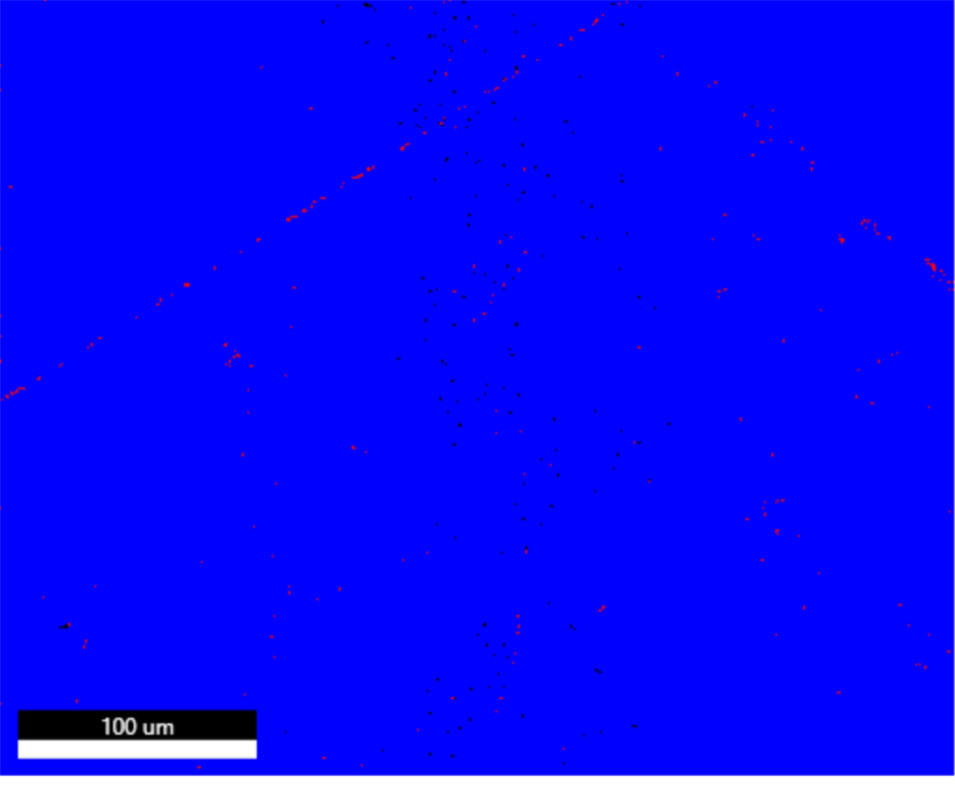
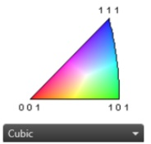
Microstructure
SEM micrograph: as-built (XZ, 500x).
SEM micrograph: SR+HIP (XZ, 500x).
EDS spectra constituents Nb, Hf, & Ti peaks. Trace quantities of Mg.
EBSD Inverse Pole Figure (IPF+IQ) showing grain orientation and size of as-built (left) and SR+HIP (right).
Phase Image: As-built (left) showing 99% BCC (blue), 1% FCC (red). SR+HIP (right) showing nearly 100% BCC.

Slide 8
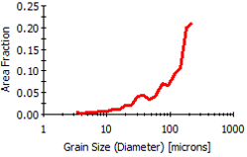
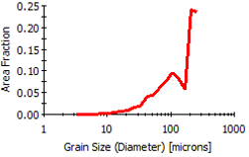
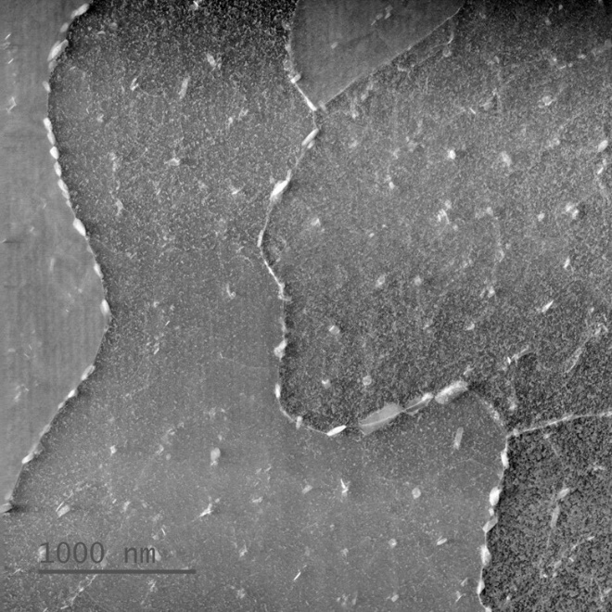
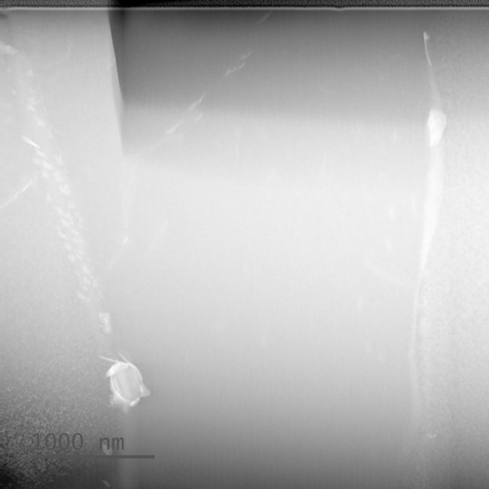
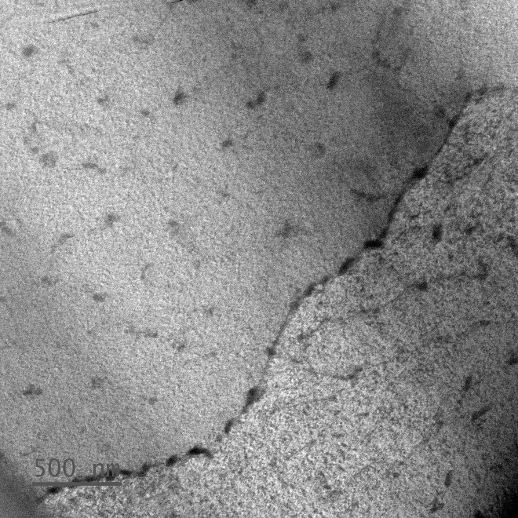
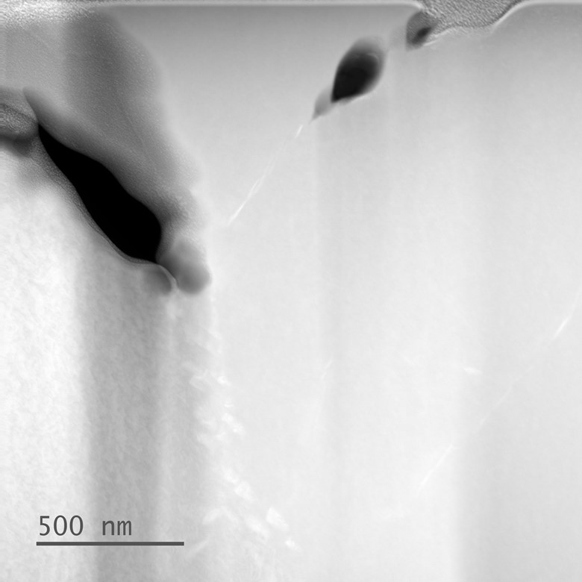
Microstructure
Grain size distribution of as-built (left) and SR+HIP (right)
TEM micrograph showing as-built (left) and SR+HIP (right) HfO₂ precipitate distribution.
TEM micrograph as-built (left) showing precipitates and pores. SR+HIP (right) show far less intra-granular precipitates, larger pores, and precipitates concentrated along grain boundaries.

Slide 9
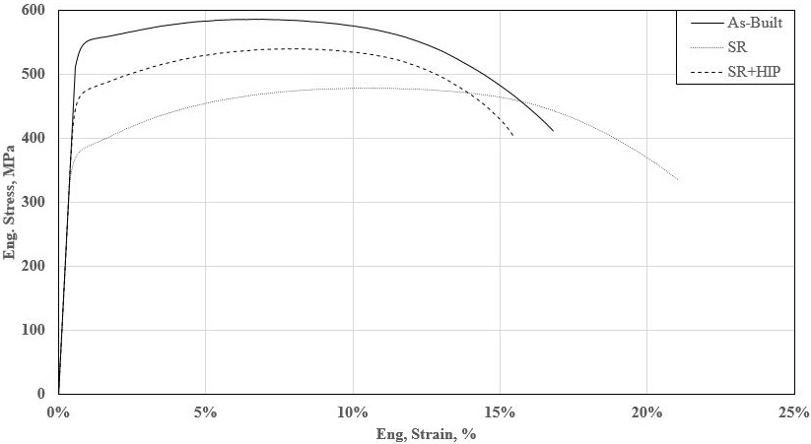
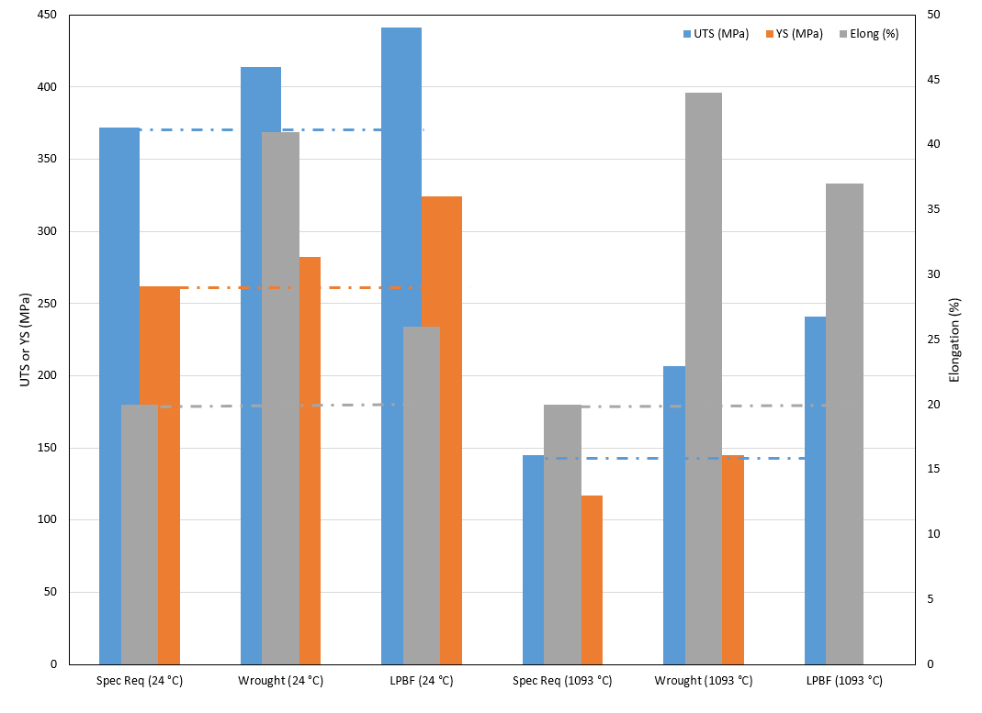
Mechanical Properties
Test Matrix.
AM C103 stress-strain curves vs. material condition. Specimens printed in the vertical (Z) direction.
C103 ambient and elevated temperature mechanical property comparison. Possible that fine distributed oxides from the L-PBF acts as a strengthener and stabilizer.
Angle (°) | Sa (µm)
0 | 12.9
45 | 8.1
90 | 10.5
Condition | YS_{avg} (MPa) | UTS_{avg} (MPa) | ε_{avg} (%)
As-Built (Z) | 560.43 ± 1.47 | 410.94 ± 0.12 | 16.67 ± 0.2
SR (Z) | 410.5 ± 0.28 | 334.9 ± 1.02 | 20.79 ± 0.4
SR+HIP (Z) | 452.46 ± 60.35 | 326.03 ± 106 | 18.88 ± 4.83
Condition | Hardness (HRB)
As-built | 93
SR+HIP | 83
AM C103 Room Temperature Tensile Properties in the Z direction.
AM C103 hardness.
AM C103 as-built surface roughness

Slide 10
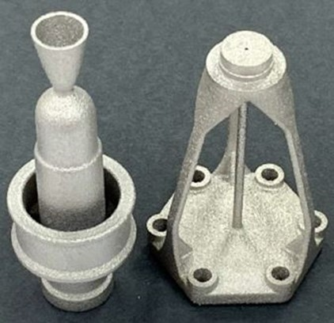
Advantages of AM C103
Overcoming Traditional Manufacture Constraints
  Bar stock Ø_{max} = 102 mm (4 in) or experiences micro-segregation (fails ASTM B655).
  AM fast solidification rate prevents micro-segregation.
  AM small grain sizes & dispersed oxides improves UTS, YS, elongation, hardness.
  AM greatly increases design flexibility and eliminates bar stock size limitations.
Feedstock Cost Reduction
  Wrought min order of 45 kg (100 lb) with variation in $/mass.
  95-98% machined away (20:1-50:1 buy-to-fly) = Few $k for part and several $10k waste.
  AM powder is ~33% more expensive than wrought feedstock.
  AM waste ~10% (1.1:1) = Few $k for part and few $0.1k waste.
  Order of magnitude cost reduction.
  AM minimizes machining to interface surfaces (C103 can be difficult to machine).
  Surface finish improvements already available via chemical etch, Micro-Tek, and electro-polish.
Industry Implications
  Commercial and government space now intend to use AM C103 (previously avoided).
  RCS thruster, upper-stage propulsion components, and hypersonics can now leverage AM C103.
AM C103 MSFC Green Propulsion Thruster and Stand-off.

Slide 11
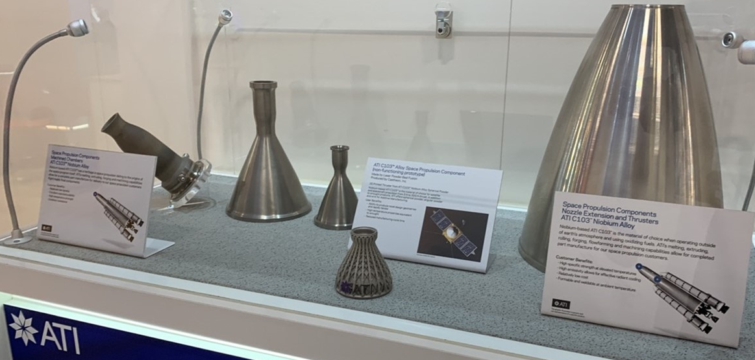
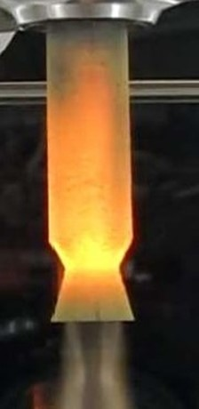
Conclusions
Conclusions
  L-PBF AM of C103 proven feasible.
  AM greatly increases design flexibility.
  L-PBF C103 small grain size improves UTS and YS compared to wrought.
  TRL increased from 3 to 5.
  L-PBF C103 produced at an order of magnitude cost reduction.
Recommendations for future work
  Expanded powder supply chain to drive down cost.
  Determine powder re-use cycles and recondition methods.
  Evaluate surface finish modification impact on the deposition process of protective silicide coatings (R512E) onto AM C103 substrates.
  A test campaign for green propulsion, RSC, or in-space propulsion is required to drive TRL and flight adoption.
Examples of L-PBF and EBAM C103 components.
AM C103 Hot Fire Test

Slide 12
Acknowledgements
The authors would like to thank Marvin Barnes, Daniel Cavender, and Craig Wood of NASA MSFC; Sanghamitra Deb, Richard Martens, and Gregory Thompson of the University of Alabama Central Analytical Facility; Bill Wood and Graham Tewksbury of PSU; and Jeff Powell of Westmoreland.
This project was funded under NASA Cooperative Agreement Notice #80MSFC18N0001.
The opinions expressed in this presentation are those of the author and do not necessary reflect the views of NASA or any NASA Project.

Slide 13
