Slide 1
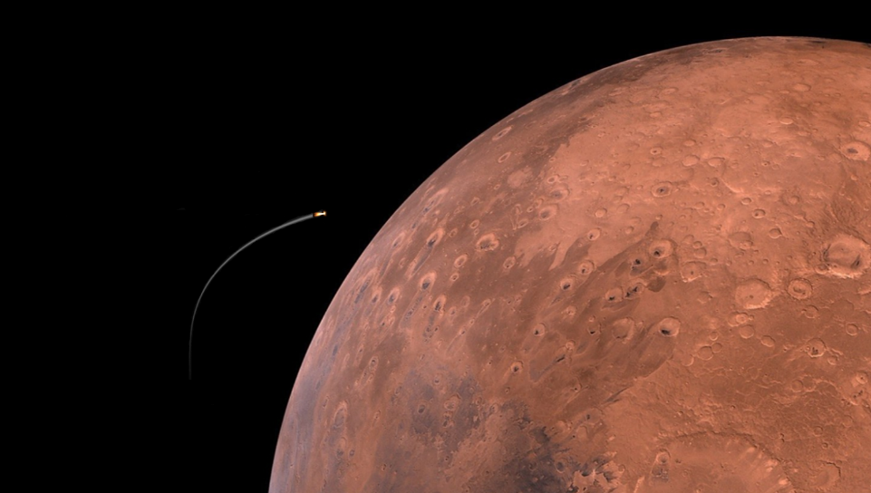
Emerging Technologies for Mars Exploration: Mars Ascent Vehicle
Darius Yaghoubi
AIAA Next Gen Technical Symposium
September 4, 2020

Slide 2
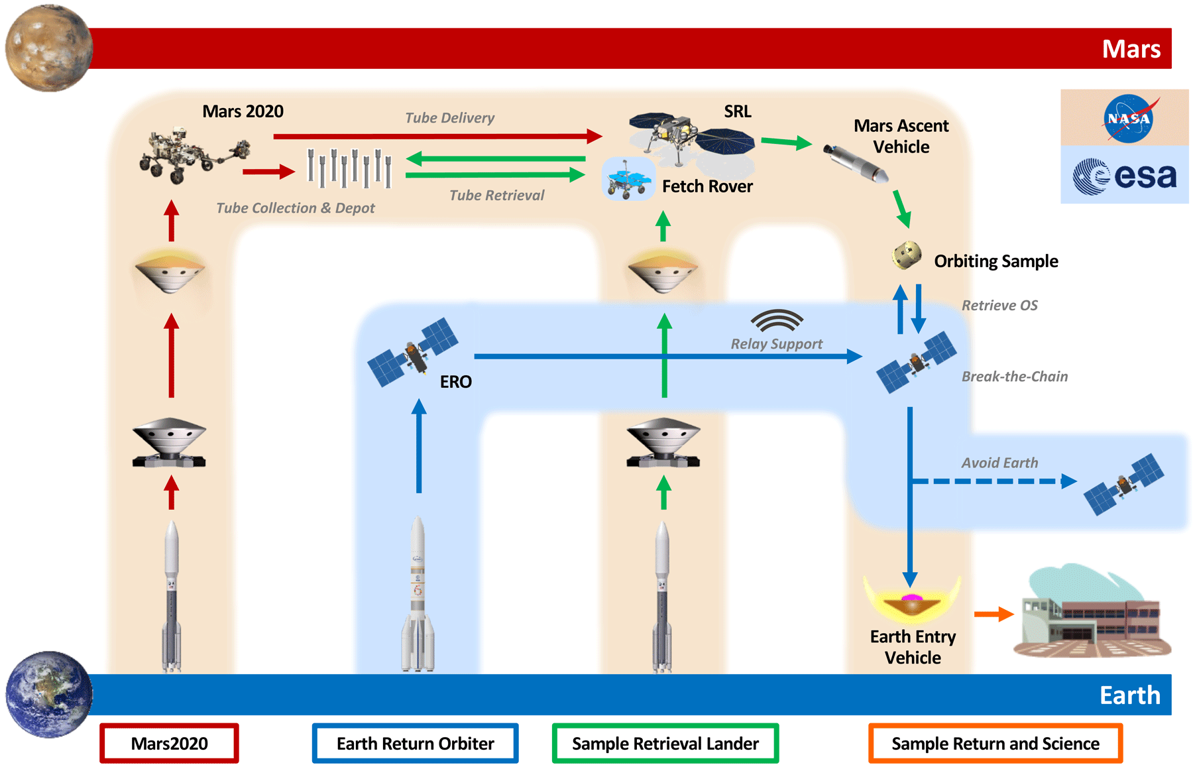
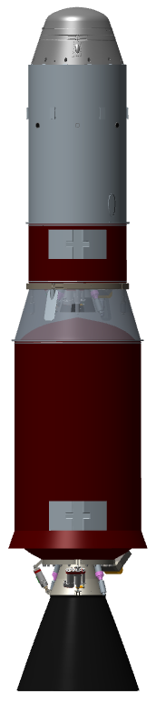
What is MAV? How does it fit into the Mars Sample Return Architecture?
MAV
Pre-decisional. Subject to change. For planning and discussion purposes only.

Slide 3
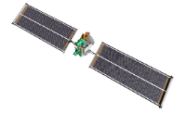









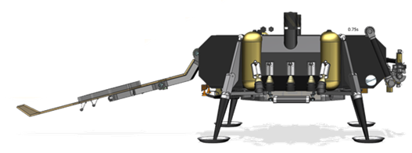

MAV Ascent Mission Operations
3
2nd Burn to Burnout
2nd stage SRM 2 burn
Periapsis raise
SRM 2 burnout
5
OS Payload Delivery
Orient vehicle for OS release
MAV transmit final IMU state
MAV enable telemetry beacon
4
3rd Burn to Cut-off
Post-2nd burnout transients wait*
2nd stage OTT burn
OTT cut-off
OS/ERO Capture
6
2
Coast
Depart sensible atmosphere
Orient vehicle for 1st stage and MPA fairing separation
Separate 1st stage and MPA fairing
Reorient vehicle prior to burn 2
Activate TVC 2
Primary Mission: Launch ~0.5kg of Mars into a circular orbit of 343km @ 27º inclination
1
Launch and 1st Burn to Burnout
VECTOR launch*
1st stage SRM 1 burn
Max Q at ~T+20-50s
SRM 1 burnout
1st Burn
Coast
2nd Burn
3rd Burn (*incl. trans. wait)
Prep for OS Separation
Loiter
~60 – 80s
~390 – 530s
~20 – 30s
~0 – 130s
~Minutes
~Days
*Conceptual elements shown. Not to scale.

Slide 4
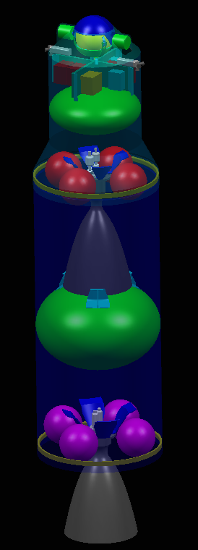
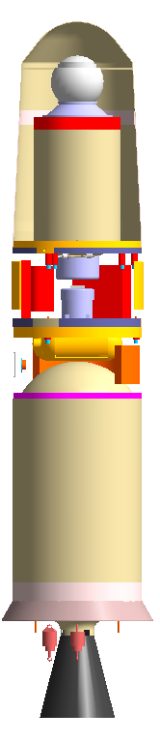


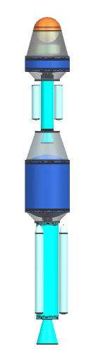

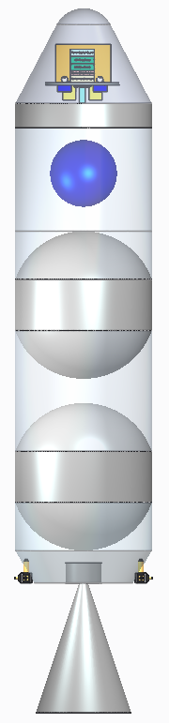
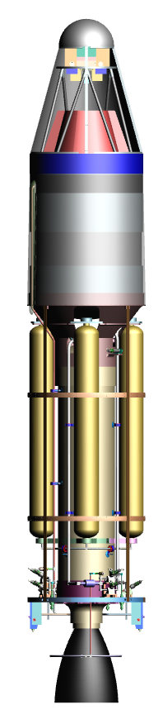

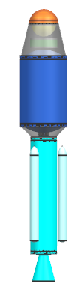
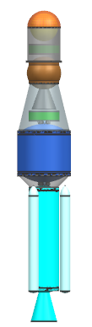
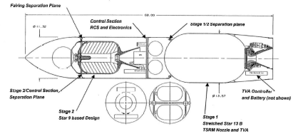




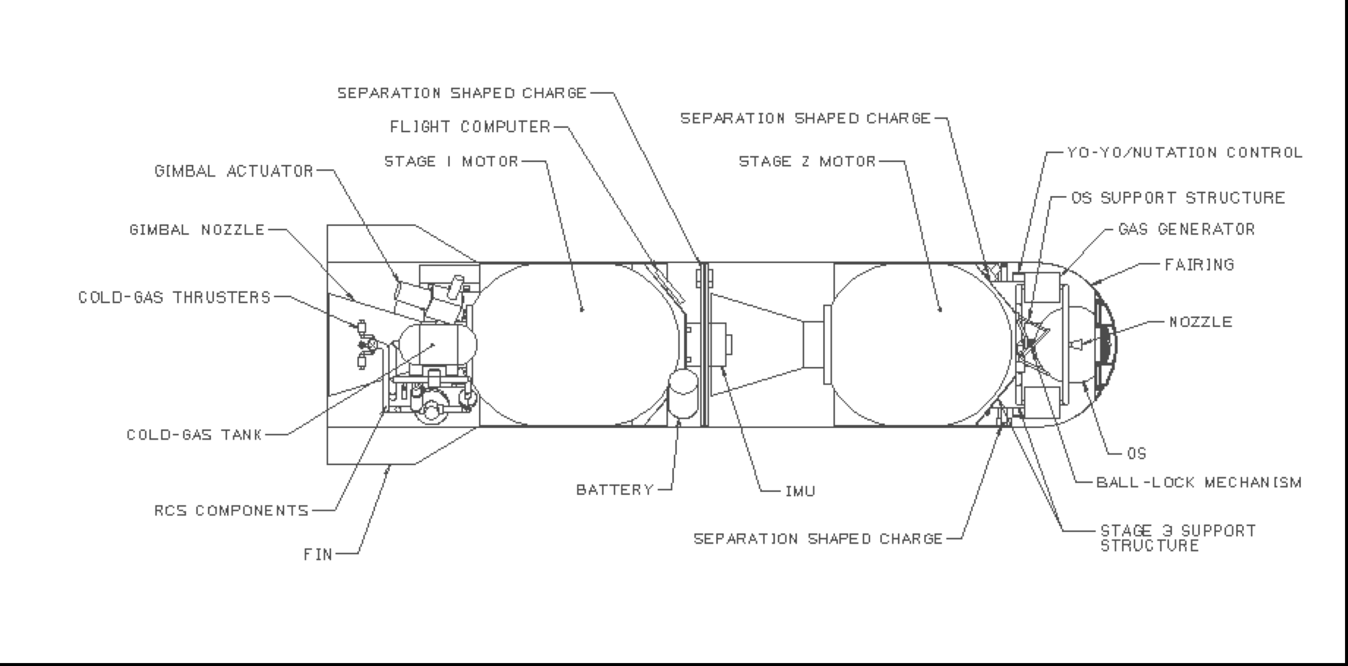
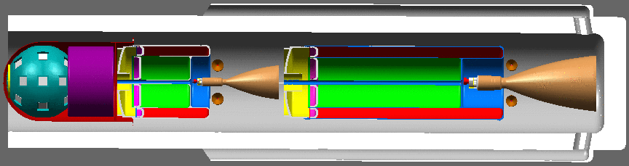
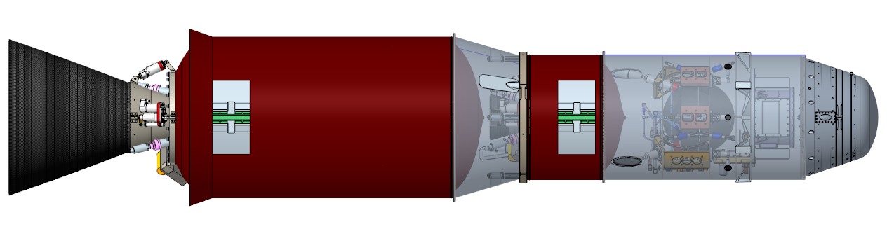
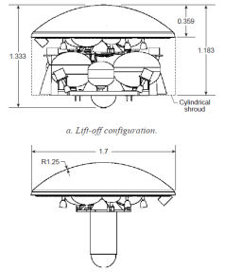
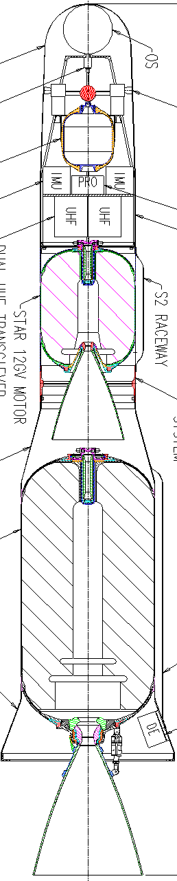
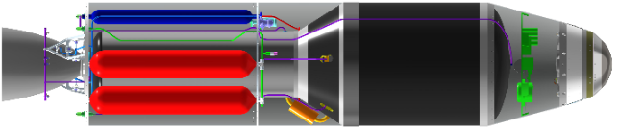
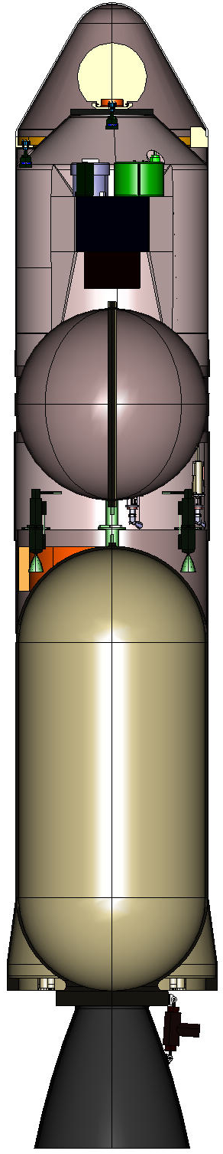
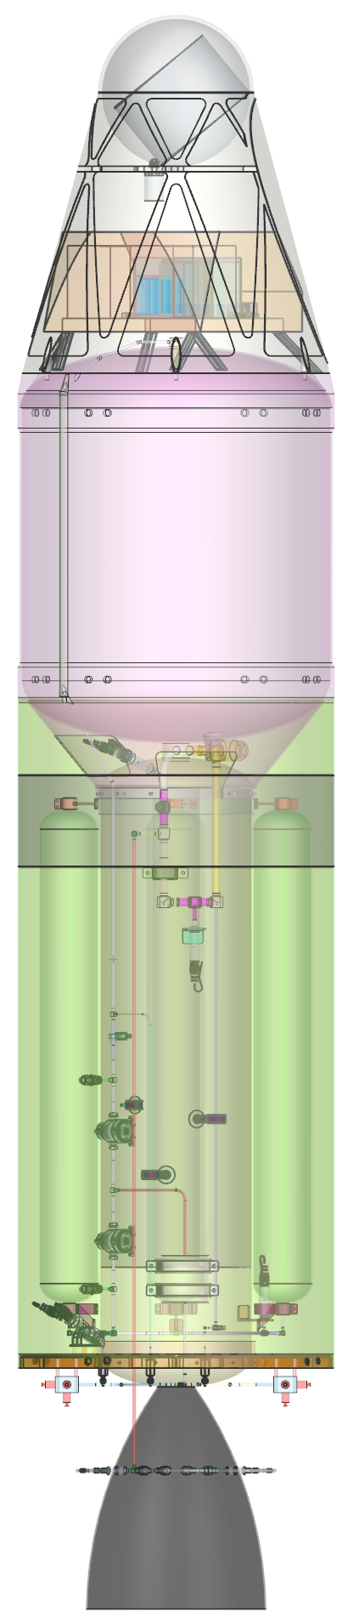
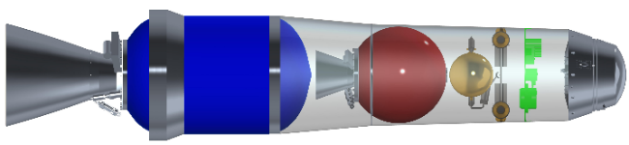

MAV History
Preliminary concepts for a Mars Ascent Vehicle were examined to varying levels of configuration and fidelity as far back as the 1970s.
Current concept has evolved over the past ~25 years with multiple studies, each with independent assumptions on key mission parameters.
Most MAV concepts developed by JPL up until recent iterations, being developed by MSFC.
Current MAV study began in 2017 as part of the Mars Sample Return Campaign, initially visualized with a hybrid propulsion system.
MSFC Ownership
Baseline SSGG Concept, 6/2020
Images not to scale

Slide 5
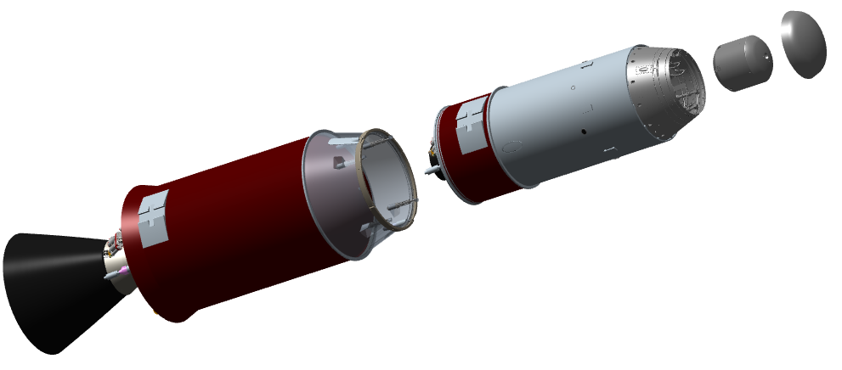
MAV Physical Architecture
Mars Ascent System (MAS) consists of:
Mars Ascent Vehicle (MAV)
  Two-stage (guided, guided) solid motor vehicle
  Pyrotechnic stage separation
  Electrical-mechanical Thrust Vector Control (TVC)
  Monopropellant Reaction Control System (RCS) with orbital trim capability
MAV Payload Assembly (MPA)
  Ejectable fairing
  Orbital Sample (OS)
Approximately 3m long, 60cm wide
OS
MPA
Fairing
MPA
2nd Stage
1st Stage

Slide 6
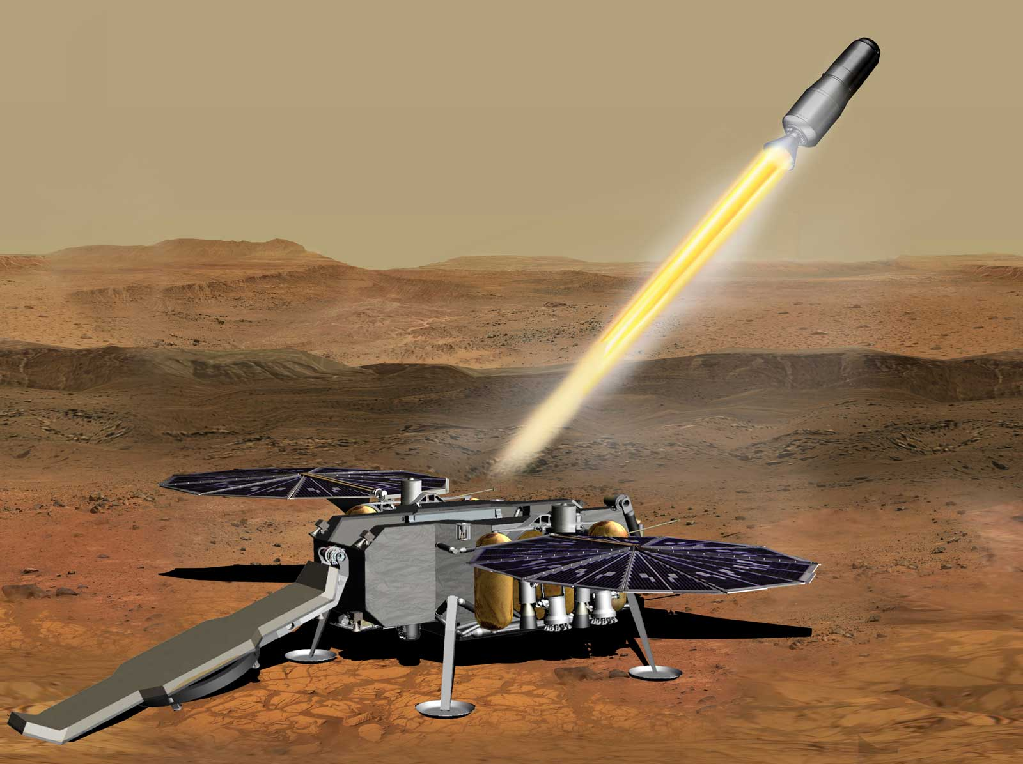
MAV: A system built on unique design constraints
Never done before
MAV is a payload before its mission begins
Orbit window
Martian environment
  Remote
  Temperature
  Atmosphere
  Radiation
  Dust
Images are pre-decisional and subject to change. For planning and discussion purposes only.

Slide 7
MAV Overall Design
Forward Structure
RCS Propellant Tank
Electromechanically Actuated TVC
Lander Attach Points
RCS
MPA
Separation System
Avionics
Aft Aero Ramp
Orbital Trim Thrusters
First Stage SRM
Second Stage SRM

Slide 8
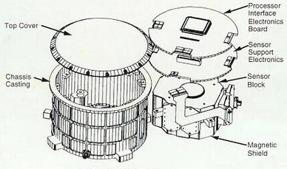
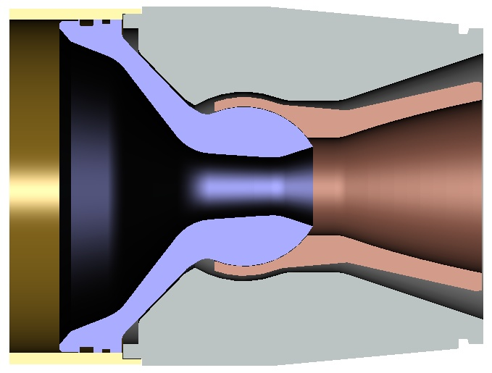
Emerging Technologies, Innovations, and Challenges
Not pictured: Cabling and umbilical options
Beacon functionality
IMU options
SRMs withstanding extreme temperature gradients
Separation system capable of handling lateral loads
Hydrazine RCS propellant must not freeze
VECTOR launch mechanism attach points
Orbital Trim Thrusters
TVC Supersonic Splitline*
Pre-decisional. Subject to change. For planning and discussion purposes only.
*Image Credit: http://up-ship.com/blog/wp-content/uploads/2016/05/ssslnozzle.jpg

Slide 9
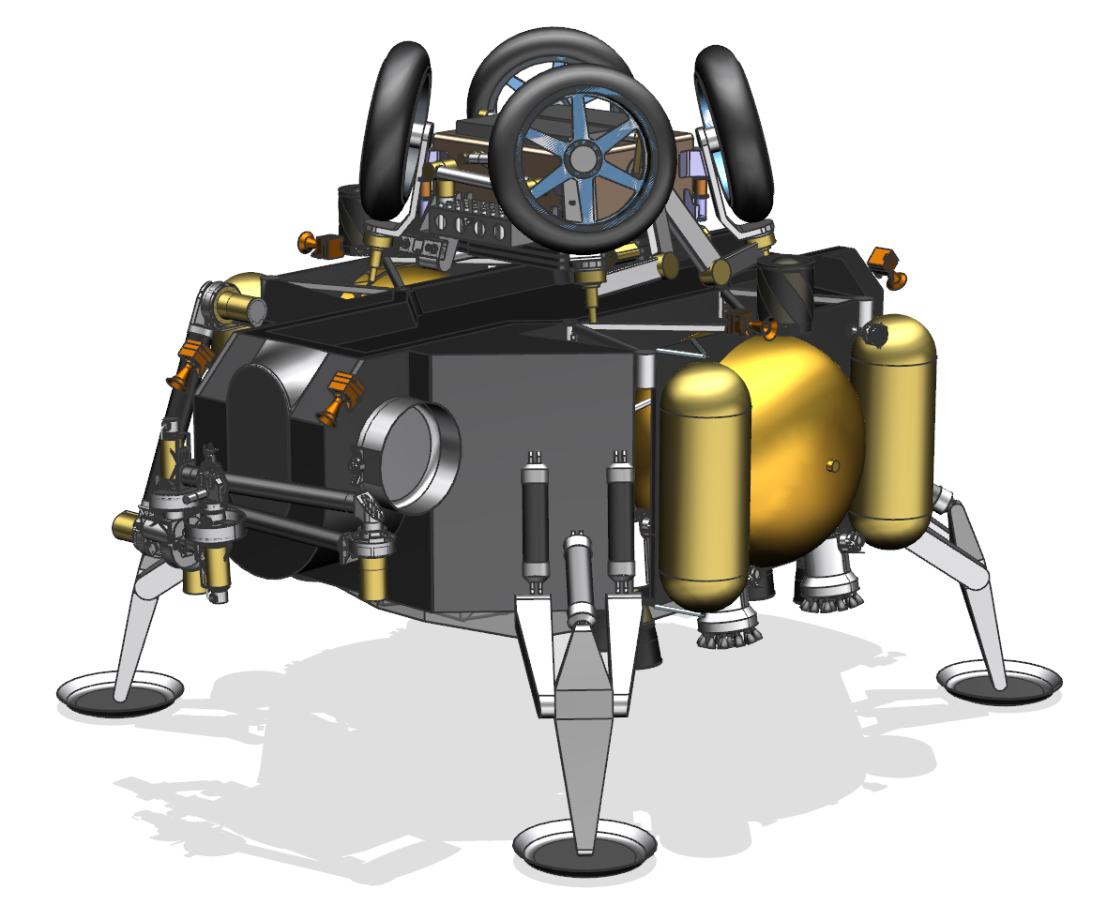
MAV-SRL Interface
SFR, stowed (JPL)
SRL, post-EDL

Slide 10
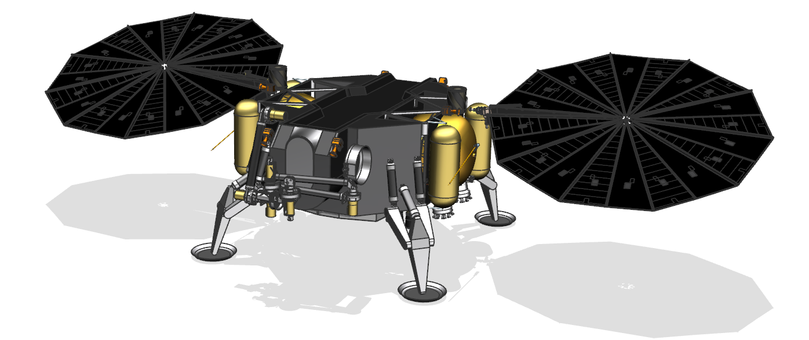
MAV-SRL Interface
Sample Transfer Arm (ESA)
SRL, Surface Operations

Slide 11
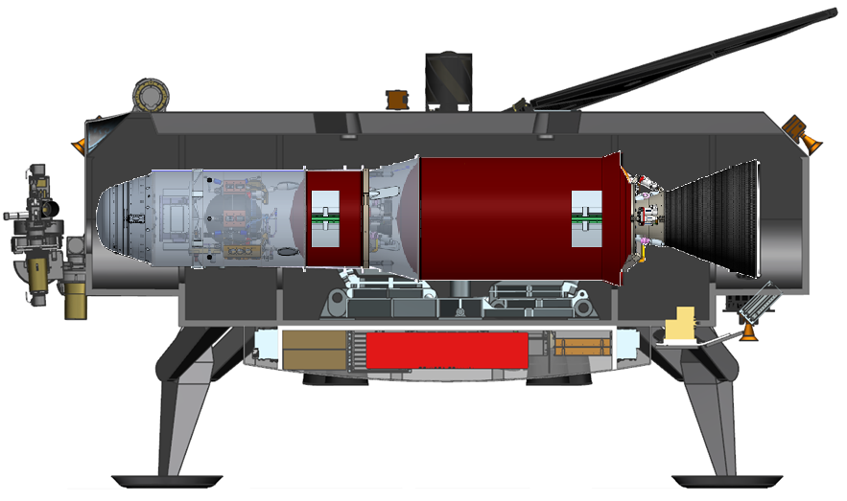
MAV-SRL Interface
SFR Deployment Mechanism
Sample Transfer Arm (ESA)
SRL Cross-section, MAV Stowed

Slide 12
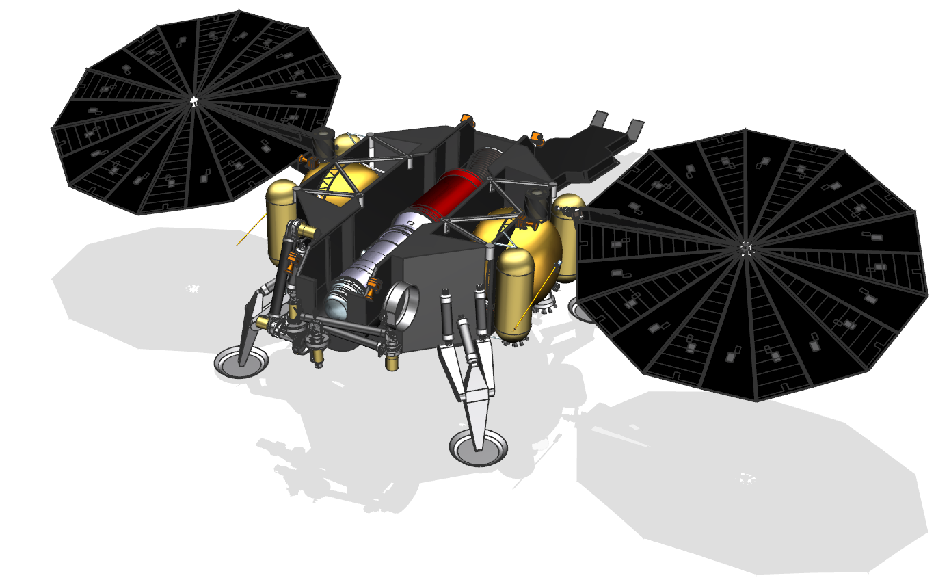
MAV-SRL Interface
SRL, Pre-Launch

Slide 13
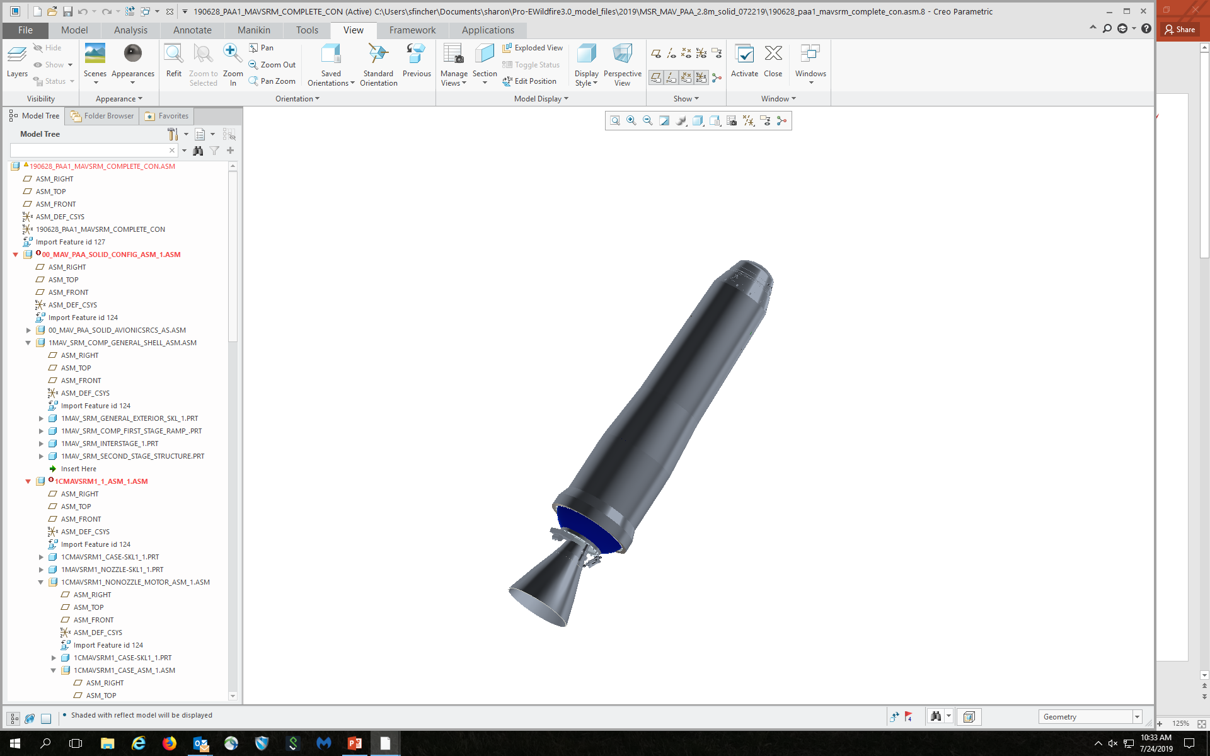


SRL and MAV: VECTOR Launch Mechanism
Launch rail system originally assumed. This presented issues with EDL loads and dust.
Vertically Ejected, Controlled Tip-Off Rate (VECTOR) adopted to mitigate issues.
0.37g accel field, no substantial atmosphere or dynamic environments. Two bodies are similar in mass (2:1).
yeet

Slide 14
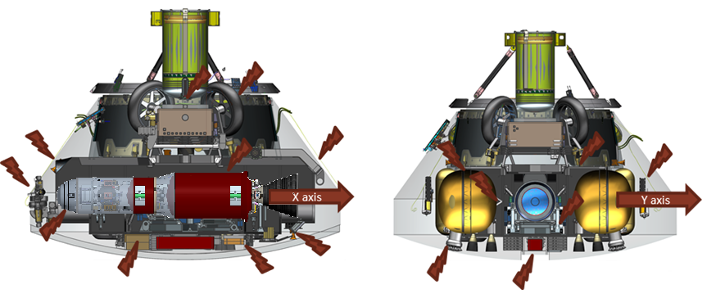
Preliminary Concept: SSGU
Initial constraints from SRL level were overly ambitious with regard to mass and volume.
A number of volumetric “pinch points” exist within aeroshell.
Heritage missions (MSL) saw mass growth up to 60% due to increases in rover size.
Current baseline enclosed SRL design does not have enough margin to accommodate growth of this kind.

Slide 15
How can we reduce mass/volume?
Recognize all opportunities and minimize threats?
  Will reduce mass but not significantly
  Likely will not affect volume
Redesign motors?
  Higher Isp would mean less propellant
  Higher efficiency nozzles = higher Isp
  We are already at about as efficient as we can get…
New propulsion system all together?
  It would reduce the mass, volume reduction maybe
  Already had a number of full-fledged analysis cycles that showed moving away from solid propulsion is just too risky
Redistribute mass: Utilize gear ratio between dry mass and propellant to place as much mass from the second stage onto the first stage as possible.

Slide 16
Guided-Guided vs Guided-Unguided Hardware Architecture
Legend:
MPA Fairing
MPA/OS
Static Nozzle
TVC Nozzle
Avionics
RCS
Spin & Despin
SSGG
SSGU

Slide 17

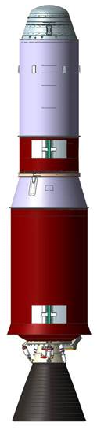
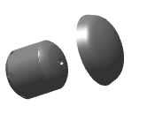
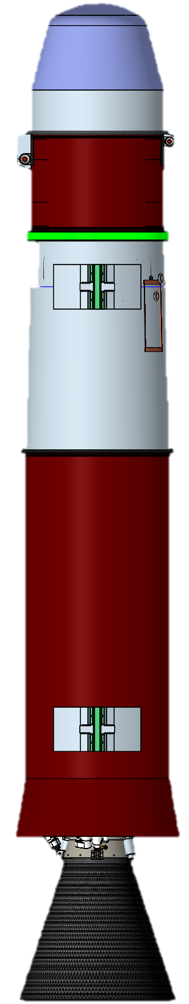
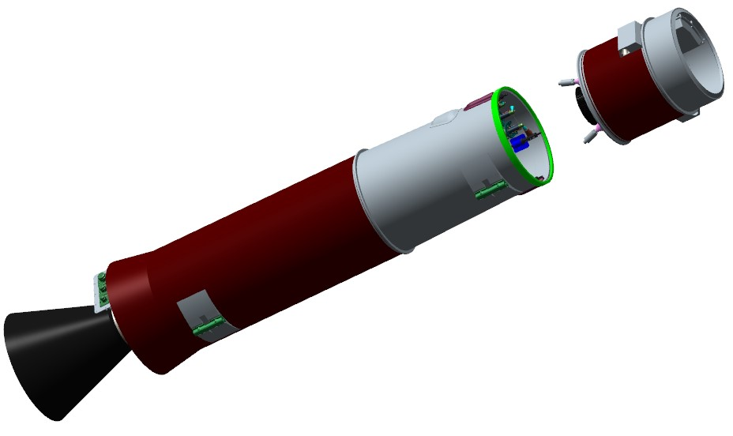
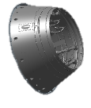
Preliminary SSGU Architecture
SSGU Mars Ascent System (MAS) consists of:
Mars Ascent Vehicle (MAV)
  Two-stage (guided, unguided) solid motor vehicle
  Pyrotechnic stage separation
  Electrical-mechanical Thrust Vector Control (TVC) on 1st stage
  2x Spin Motors and 2x De-spin motors on 2nd stage, enabling spin stabilization
  Monopropellant Reaction Control System (RCS)
MAV Payload Assembly (MPA)
  Ejectable fairing
  Orbital Sample (OS)
Approximately 2.8m long, 50cm wide
MPA
Fairing
OS
MPA
2nd Stage
1st Stage

Slide 18


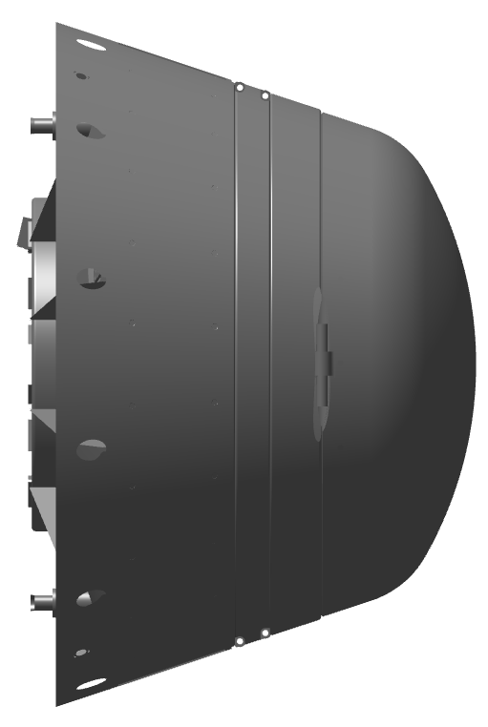

How Does SSGU Work?
3
Spin-Ups and Staging
Use RCS to conduct low-speed spin
Conduct angular momentum correction
Separate 1st stage
Hi-speed spin motor burn
5
OS Payload Delivery
MAV 2nd stage-commanded OS release
MAV 2nd stage-enabled beacon telemetering
4
2nd Stage Burn to Burnout and Spin-Down
2nd stage SRM 2 burn to burnout
Post-2nd burnout transients wait
De-spin motor burn
OS/ERO Capture
6
2
Coast and MPA Fairing Separation
Depart sensible atmosphere
Orient vehicle for MPA fairing separation
Separate MPA fairing
Reorient vehicle back to flight vector
1
Launch and 1st Stage Burn to Burnout
VECTOR launch*
1st stage SRM 1 burn
Max Q
SRM 1 burnout
*Vertical Egress, Controlled Tip-Off Rate
(VECTOR) SRL MAV-launch mechanism
1st Burn
Coast, Spin-Up, and Staging
2nd Burn and Spin-Down
OS Release
Loiter
~65 – 85s
~340 – 430s
~35s
~ TBD [Minutes]
~Days
*Conceptual elements shown. Not to scale.

Slide 19
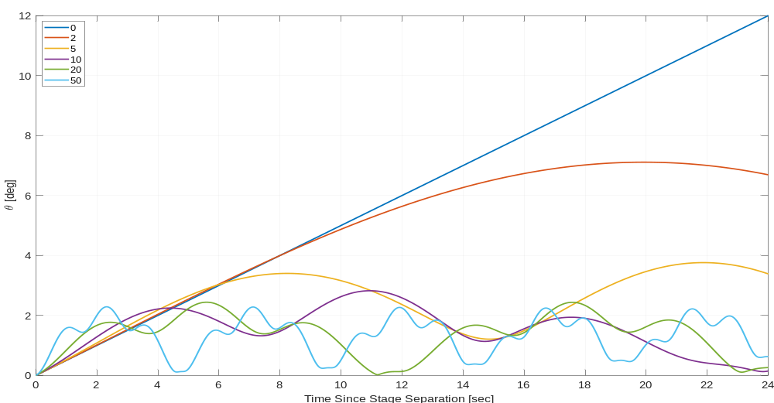
Effect of S1 Spin on Initial Angular Error
The separation impacts a non-trivial tip off rate (~0.5 deg/s)
For SSGG, this is trivially corrected with the RCS system prior to S2 ignition
For SSGU, there is no sensing or control for effect and it becomes part of the dispersions
0 rpm
2 rpm
→ Spinning the first stage a little bit (5-10rpm) using S1 RCS system and choosing ignition time based on nutation behavior controls initial angular error
5 rpm
20 rpm
50 rpm
10 rpm

Slide 20
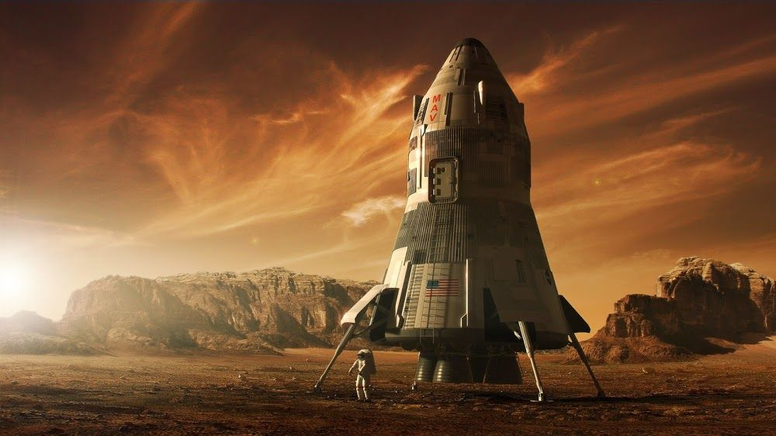
Looking to the future…
Perseverance: July 2020
MAV Launch, Earth: July 2026
MAV Arrival, Mars: 2028
MAV Launch, Mars: 2029
Martian Samples
Returned to Earth: 2031
- Crewed Mars Mission: Late 2030s?
Image Credit: Steve Burg, https://www.artstation.com/artwork/nyaLr

