Slide 1


Passive Thermal Coating Observatory Operating in Low-Earth Orbit (PATCOOL)
Kevin Bauer
NASA Launch Services Program
TFAWS Passive Thermal Paper Session
Presented By
Kevin Bauer
Thermal & Fluids Analysis Workshop
TFAWS 2020
August 18-20, 2020
Virtual Conference

Slide 2
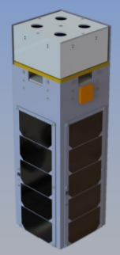
Agenda
Background
Mission Objectives
Thermal Design
Modeling Approach
Thermal Desktop Model
Temperature Predictions

Slide 3
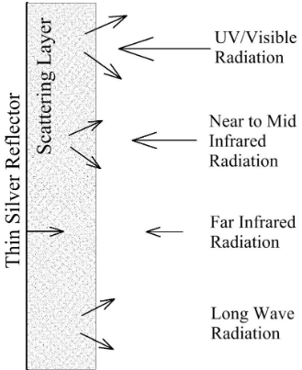
Background
Ideal thermal control coating (TCC) designed for 1 astronomical unit (AU) from the sun and far away from any IR sources first suggested in 1961 by Hibbard
State-of-the-art includes white paints and second surface mirrors
Reflecting most of the suns irradiance while permitting far-IR emission
Scattering white pressed powder with a metallic backing developed at Kennedy Space Center (KSC)
Long-term exploration to the moon, mars, and beyond
Enabling technology advancement for cryogenic fluid storage or even superconductors
[1] Hibbard R. R., “Equilibrium Temperatures of Ideal Spectrally Selective Surfaces,” Solar Energy, Vol. 5, No. 4, Oct. 1961, pp. 129–132.
Notes:
Hibbard R. R., “Equilibrium Temperatures of Ideal Spectrally Selective Surfaces,” Solar Energy, Vol. 5, No. 4, Oct. 1961, pp. 129–132.
White paints are scattering particles held together by a binder (alpha 9% epsilon 90%) second surface mirrors transparent to the suns radiation but not IR with a metallic reflector (alpha 9% epsilon 91%)
White paint absorbs 15% solar spectrum TCC absorbs .2%
Proposed coating, low absorption high emittance
In accordance with space policy directives

Slide 4
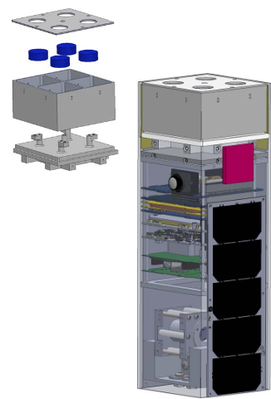
Mission Objectives
PATCOOL will serve as a performance test for a TCC developed at KSC
  Comparison to current state-of-the-art thermal control coating AZ-93 white paint
  Incorporate redundancies to reduce uncertainty
Ascertain how close to cryogenic temperatures can the samples reach in a low earth orbit
  Minimize environmental sources to solar radiation
  Collect a significant temperature delta between coatings
Thermal Desktop model validation
  Use of empirical data to improve model fidelity
  How accurate are TCC optical properties?
Notes:
Model validation with initial temperature decay after 1800sec as well as orbit oscillation effect
TRL (3-4) from lab testing TRL (5-6) with cubesat mission

Slide 5
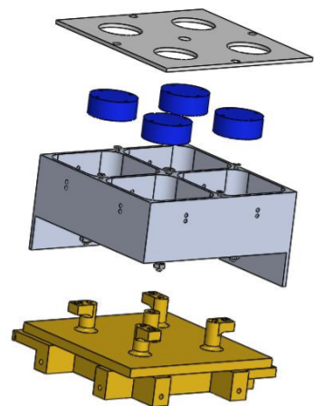
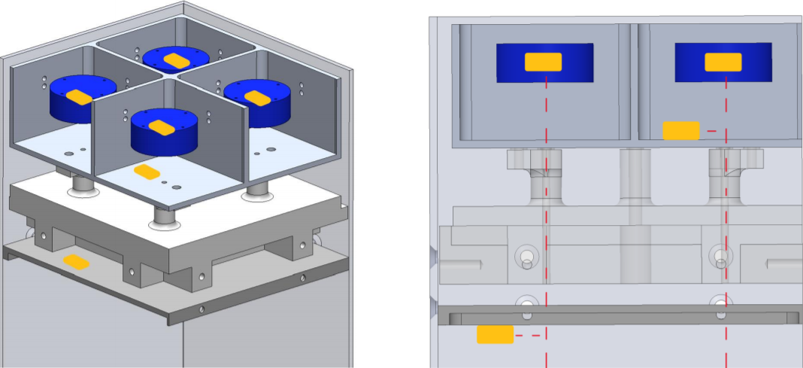
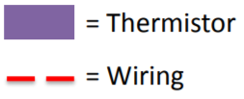
Thermal Design
Thermal control coating samples
  Four aluminum 7075 disks
    - Promote uniformity and isolate coating contribution
  Two coated with AZ-93
  Two coated with a thermal control coating developed at KSC
Sample housing
  Shield samples from earth albedo and IR planetshine
    - Housing cover top coated in AZ-93 bottom with reflective coating
  Kevlar strings (diam. = .36mm)
  Reflective surfaces
3U CubeSat
  Zenith pointing towards the sun
  Sample housing adaptor
    - 3D printed Ultem 1000
  Avionics thermal barrier
    - Reflective coating
Notes:
Redundancies in temperature measurements and samples
Thermally isolate samples from cubesat

Slide 6
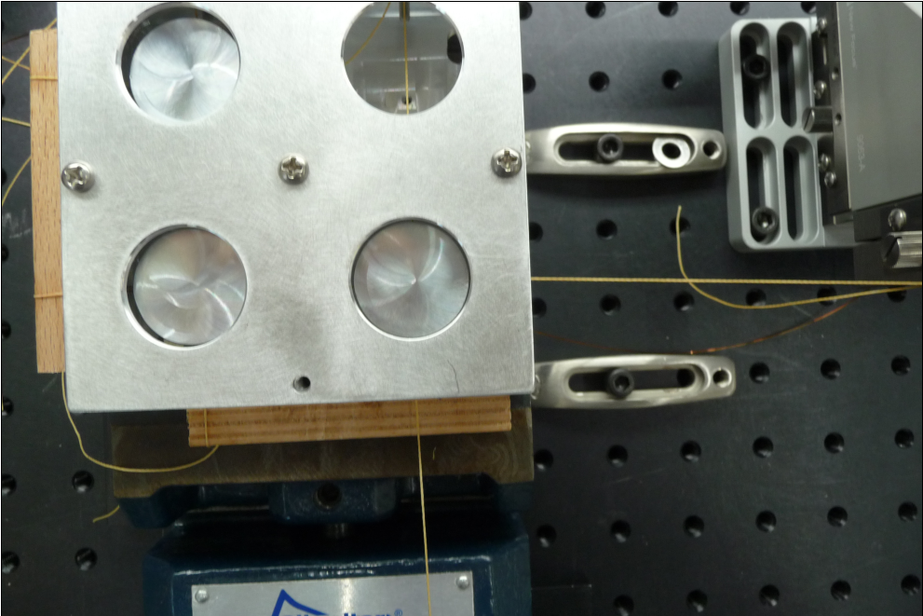
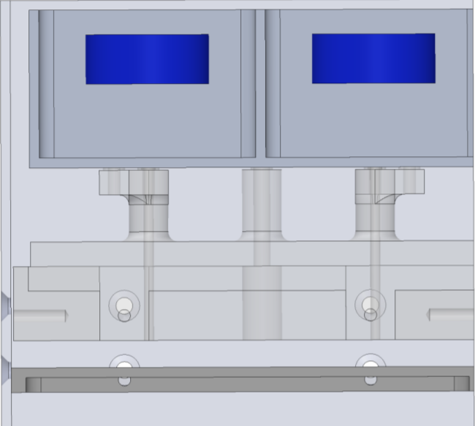
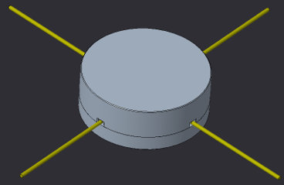
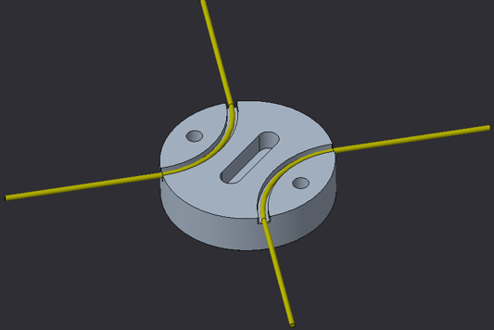
Thermal Design
Sample and Cover Alignment
MLI
AZ-93
Kevlar strings
AZ-93
(reflective coating on all surrounding faces)
(reflective coating on all surrounding faces)
Ultem Housing adaptor
Aluminum Samples
Thermal barrier (reflective coating)
Thermal Protection
Notes:
20 mm (.7874”) housing cover opening
25.4 mm (1”) sample diameter
3.175 mm (.125”) spacing between sample and housing cover

Slide 7
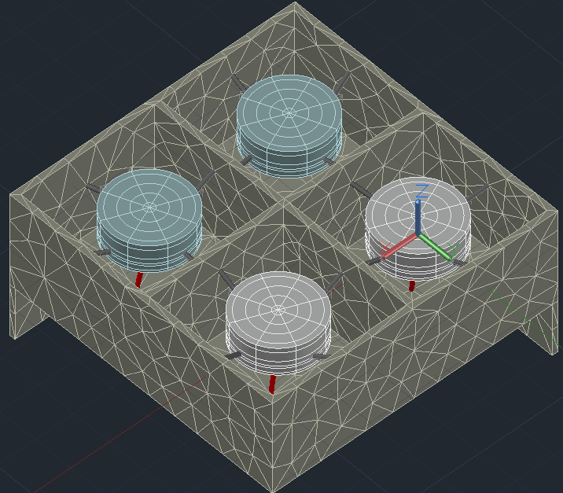
Modeling Approach
International Space Station used for low-earth orbit parameters
Environment conditions assumed from [2],[3]
Sample fidelity
Case | Solar Constant (W/m2) | Albedo | IR planetshine (W/m2)
Hot | 1414 | 0.36 | 255.522
Nominal | 1367 | 0.28 | 242.903
Cold | 1322 | 0.22 | 230.285
[2] Anderson, B. J., C. G. Justus, and G. W. Batts. "Guidelines for the selection of near-earth thermal environment parameters for spacecraft design." (2001).
[3] Gilmore, David G., and Mel Bello. Satellite thermal control handbook. Vol. 1. EI Segundo, CA: Aerospace Corporation Press, 1994.
Notes:
- ISS orbit period 5560 sec
Samples discretized 9 in angular direction, 5 in radial direction and 3 in height
Kevlar dia. .36mm (.014”)
TC 4 lead wire configuration (dia. = .127mm)(.005”)

Slide 8
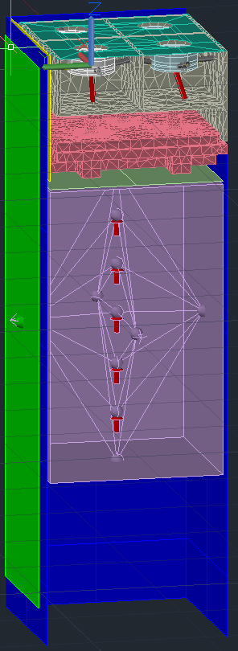
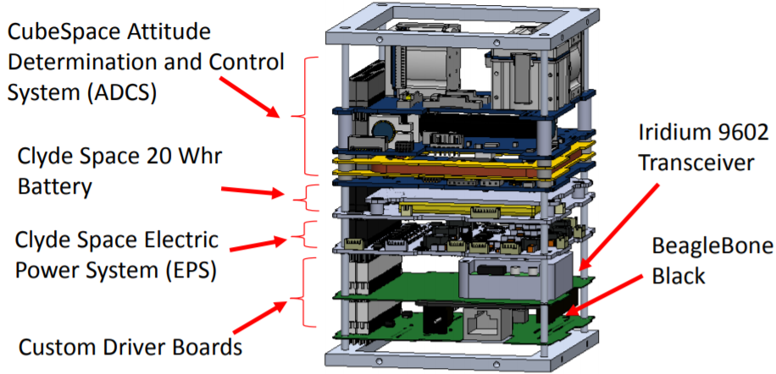
Modeling Approach
Avionics
  ADCS (.825 W)
  Battery (.1 W)
  BeagleBone (1.05 W)
  EPS (.2 W)
  Tranceiver (.175 W)
Notes:
Anderson, B. J., C. G. Justus, and G. W. Batts. "Guidelines for the selection of near-earth thermal environment parameters for spacecraft design." (2001).

Slide 9
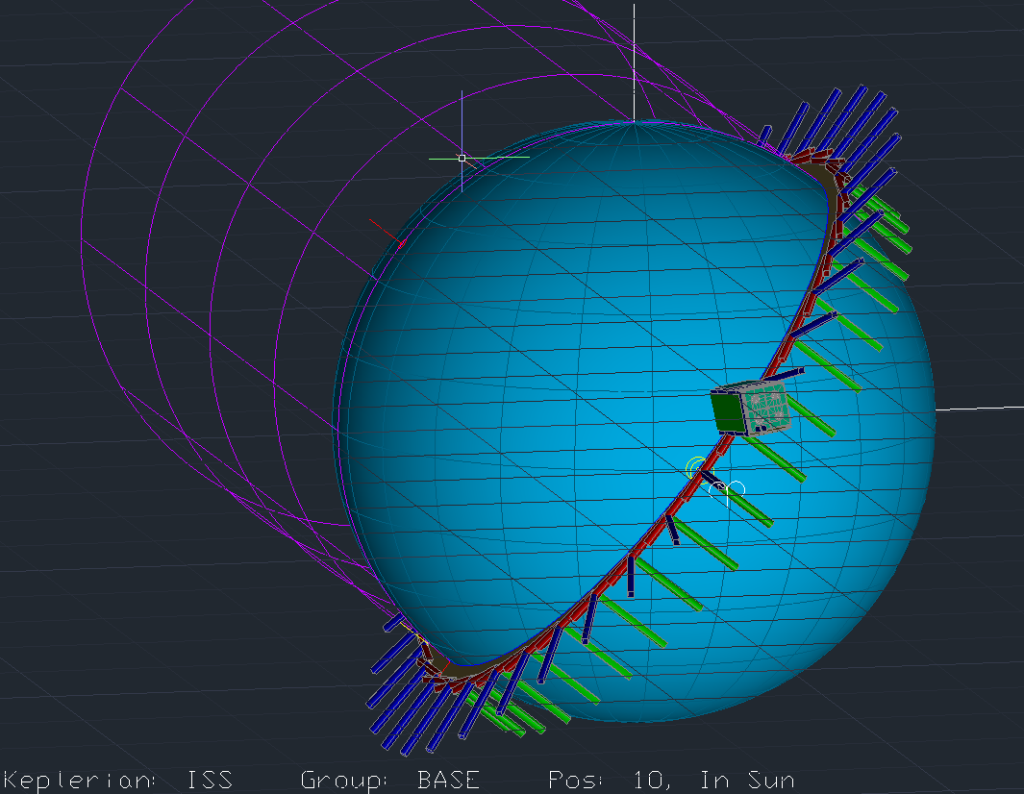
Thermal Desktop Model

Slide 10
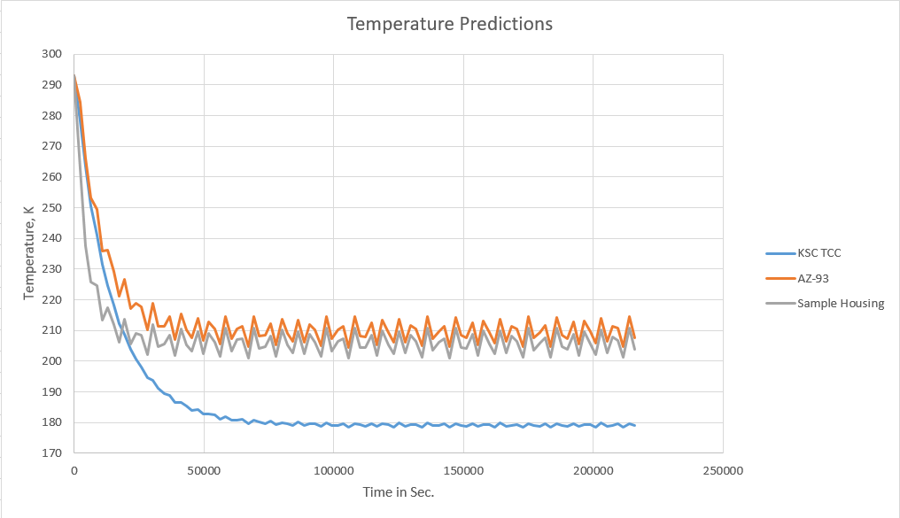
Temperature Predictions

Slide 11
Future Work
Post processing
  Use of subroutines for an overall energy balance on samples
Model Validation through empirical data
  Lab testing only accounts for simulated solar radiation

Slide 12
Questions?
Thank you for your time and this opportunity!

Slide 13


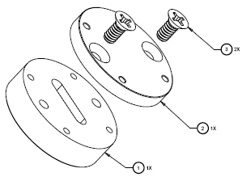
Backup Slides

