Slide 1
Galaxy Clusters
Dr. Steven Ehlert
NASA Marshall Space Flight Center
Notes:
Hello everyone and thank you for listening to my talk. My name is Dr. Steven Ehlert, and I am an X-ray Astronomer at NASA’s Marshall Space Flight Center. I work with many different X-ray astronomy missions in different stages of development. While they all have different specialties and specific missions, they all observe some of the most spectacular, extreme, and sometimes violent objects in the Universe. The subject of today’s talk is going to be one of those extreme object classes called galaxy clusters. I did my PhD thesis on X-ray observations of galaxy clusters primarily using data from an X-ray telescope called Chandra. It is named after the astrophysicist Subrahmanyan Chandrasekhar, who made a tremendous number of contributions to our understanding of stars, gas, and galaxies in the Universe. His most famous work was developing a model for the structure of white dwarf stars that predicted a fundamental limit to their mass – 1.4 times the Solar mass, known as the Chandrasekhar limit. Many galaxy clusters are part of the Science Olympiad materials for this year, and I will try and describe some of these objects in detail. In particular, I will try and emphasize just how big these objects are. A unfortunate side effect of working with big astronomical objects all day is that you become sort of numb to the sheer scale of what you are observing. At the same time, I will also try to weave in other topics that you are very likely to encounter in competition, so I hope you have been studying up. So what are galaxy clusters, and why would anyone observe them in X-rays?

Slide 2
Galaxy Clusters are the largest bound structures in the Universe.
Notes:
The main property of galaxy clusters is that they are the largest gravitationally bound structures in the Universe. As the name suggests, galaxy clusters host many (typically hundreds or thousands) of galaxies all orbiting a common center, not all that different from many planets orbiting around the Sun. Here you can see a Hubble image of a galaxy cluster at optical wavelengths. I will be spending most of this talk discussing the composition of these clusters, as the galaxies only compose a tiny fraction of the total mass in these systems. At the end of this talk I will describe how these different components interact with one another in ways that help astronomers such as myself learn more about the Universe. So I have already stated that galaxy clusters are the biggest – just how big are they?

Slide 3
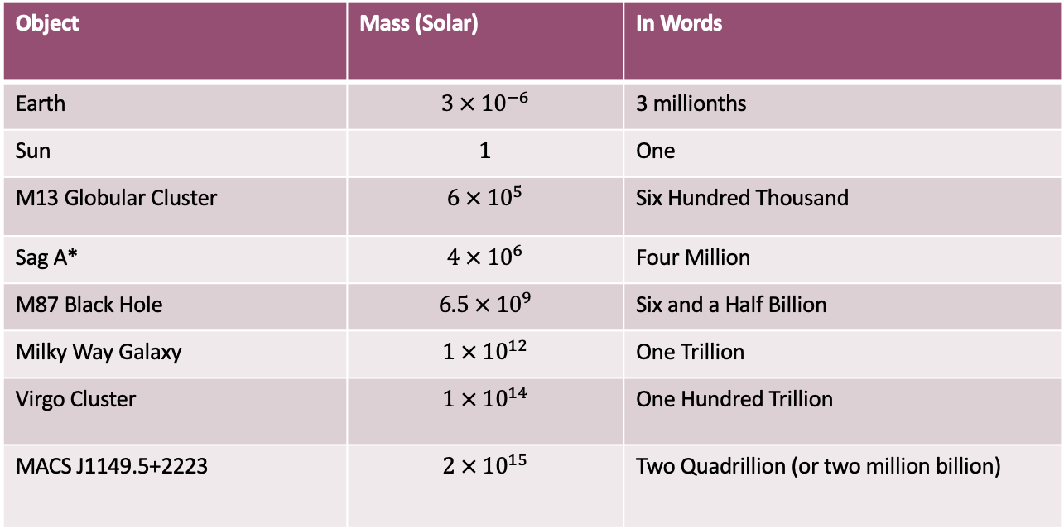
Just how large are galaxy clusters?
Object | Mass (Solar) | In Words
Earth | $$3 × {10}^{−6}$$ | 3 millionths
Sun | $$1$$ | One
M13 Globular Cluster | $$6 × {10}^{5}$$ | Six Hundred Thousand
Sag A* | $$4 × {10}^{6}$$ | Four Million
M87 Black Hole | $$6.5 × {10}^{9}$$ | Six and a Half Billion
Milky Way Galaxy | $$1 × {10}^{12}$$ | One Trillion
Virgo Cluster | $$1 × {10}^{14}$$ | One Hundred Trillion
MACS J1149.5+2223 | $$2 × {10}^{15}$$ | Two Quadrillion (or two million billion)
Notes:
I have a few comparisons to other objects big and small here. All masses here are relative to the Sun, which is generally the unit we use for astronomical objects. A globular cluster of stars such as M13 comes in around 600,000 solar masses, while supermassive black holes at the center of galaxies come in between 1 million and 10 billion solar masses. Galaxies tend to come in at around 1 trillion solar masses. but cluster masses are typically around 100 trillion to a few quadrillion solar masses. I have deliberately written the numbers out so that the scientific notation doesn’t hide their astounding size quite so much. So how do objects that are so large form in the first place?

Slide 4
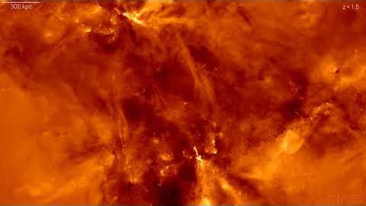
Galaxy Clusters form through continuous mergers of galaxies and ambient gas into larger scale structures
Notes:
The answer is from the bottom up. Stars and star clusters form first in the early Universe, which then merge with one another to form galaxies. Galaxies in particularly dense locations in the early Universe all merge even further to form clusters of galaxies. This video shows you a simulation of a galaxy cluster forming from a simulation known as Illustris TNG. The colors here denote the speed of the gas until about halfway through the video it switches to a gray scale that traces starlight. You can also see the clock in the top right corner of the video using a number called the redshift. I won’t be discussing the details of redshift in this talk, but I will give a few numbers to help scale things. Larger redshifts means further back in time, with a redshift of 3 corresponding to about 11 billion years ago and a redshift of 1 corresponding to about 6 billion years ago. The Universe itself 13.7 billion years old. At the end of this video you can see the single cluster that has formed through multiple mergers over billions of years.

Slide 5
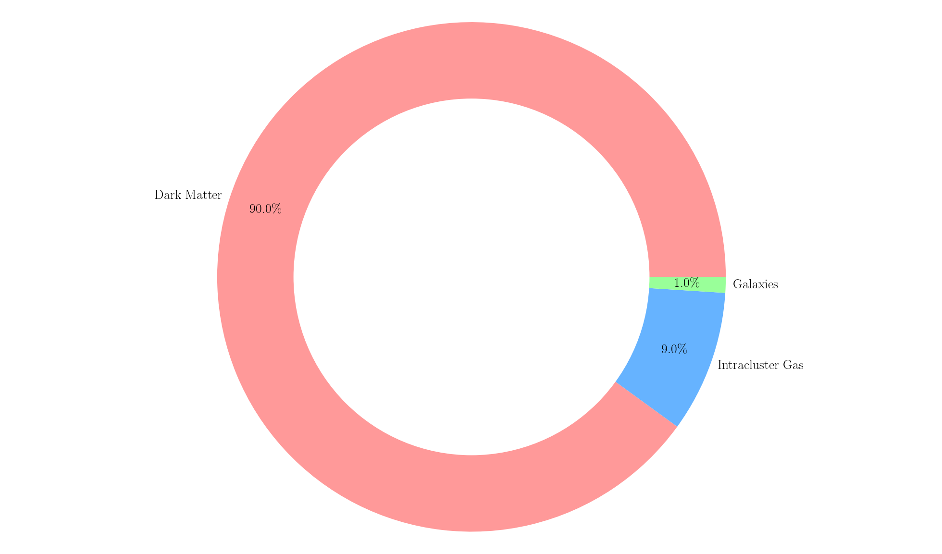
The vast majority of a galaxy cluster’s mass budget is dark matter, a particle or collection of particles that is fundamentally different than ordinary matter
Notes:
As I stated before, galaxy clusters are far more than simply galaxies. In fact, only about 1% of the total galaxy cluster mass is concentrated within the galaxies. A factor of 8-10 more mass is hosted within diffuse intracluster gas sourrounding the galaxies. The vast majority of the mass in a galaxy cluster, however, is in a mysterious but ubiquitous form of matter known as dark matter. We don’t know much about dark matter, but all the evidence suggests it is a form of matter that differs from ordinary matter at the most fundamental level. I will discuss dark matter in a little more detail later. All three of these constituent components interact with one another in very interesting and powerful ways in a galaxy cluster, and these interactions have provided scientists with incredibly useful insights into galaxy evolution, the properties of dark matter, the physics as to how structure forms in the Universe, and even constraints on the large scale properties of the Universe itself. But for this talk I will focus on what we know about these three components and at the end describe a few ways as to how galaxy clusters teach us about a wide range of physics in the Universe.

Slide 6
Intracluster Medium
Notes:
I will start with the diffuse gas residing in the cluster, historically called the Intracluster Medium or ICM. What do we know about it in general?

Slide 7
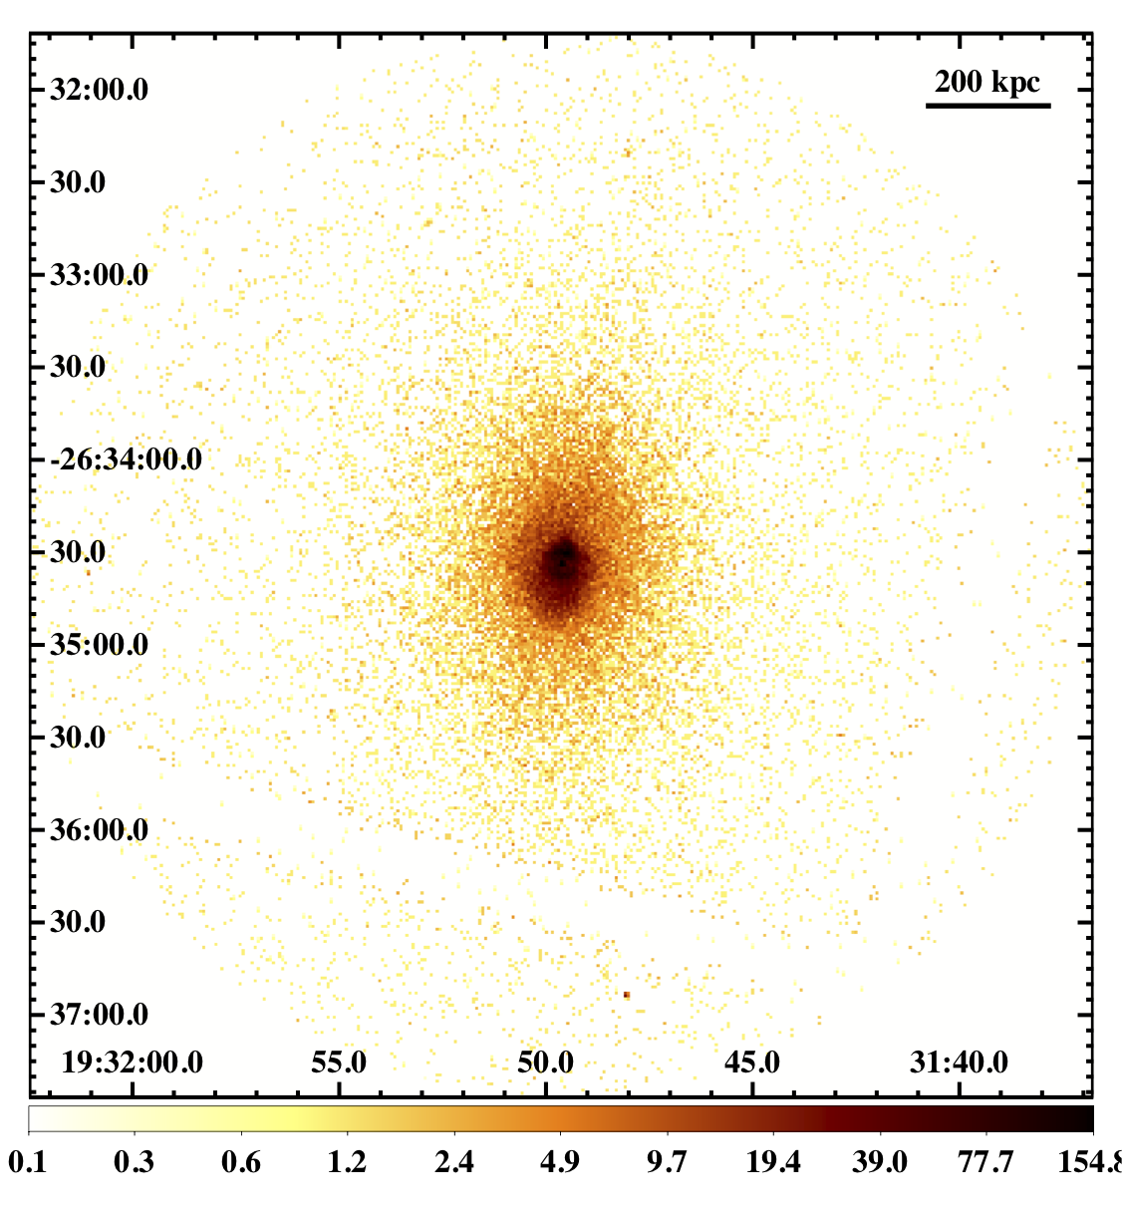
The Intracluster Medium (ICM) is a hot, diffuse plasma residing throughout the cluster’s sphere of influence.
The hot temperature of the ICM means that it shines brightly in X-rays.
Notes:
The Intracluster Medium is ubiquitously observed in X-ray observations of galaxy clusters. Here is a Chandra X-ray image of a galaxy cluster called MACS J1931.8-2634 that shows the positions of X-rays photons detected around the cluster center (the dark brown region). This is from a research paper I wrote about 10 years ago. You can see from the grid that this cluster is located at RA 19 hours 31 minutes and 50 seconds and DEC -26 degrees 34 minutes 30 seconds. I should also point out the scale of this image: the black line in the top right corner corresponds to approximately 650 thousand light years at the distance of this cluster. Remember that 1 pc is about 3.26 light years. So we can see X-rays spanning more than a million light years from top to bottom. So what else do we know about the ICM?

Slide 8
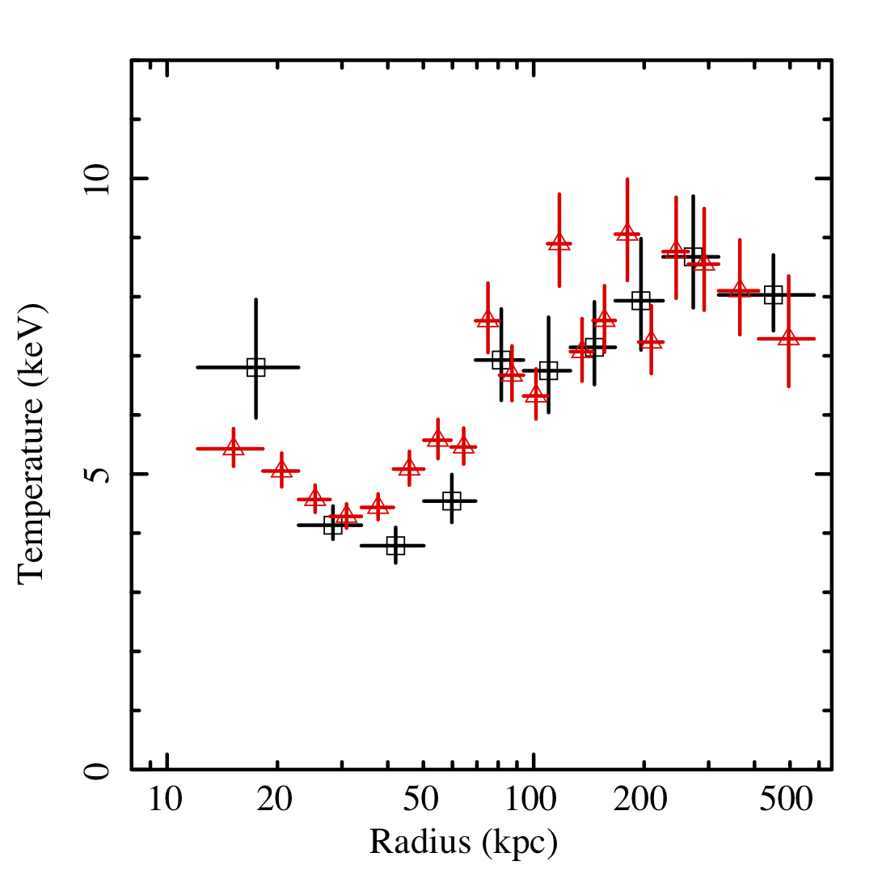
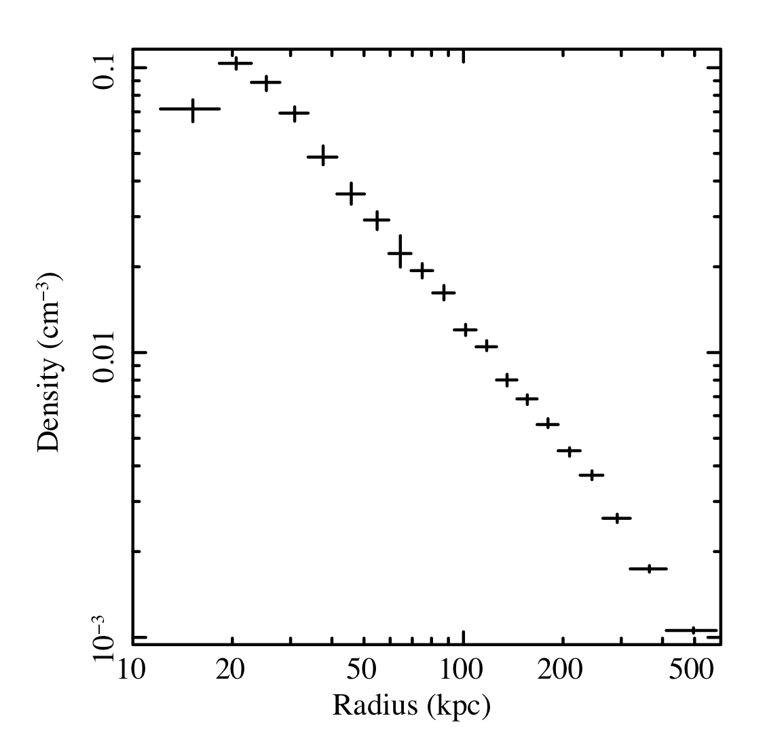
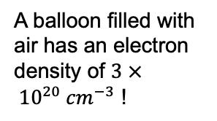
Modern X-ray observatories allow measurements of the ICM’s temperature and density structure to be made.
A balloon filled with air has an electron density of $3 × {10}^{20} {cm}^{−3}$ !
1 keV = 11 million degrees K!
Notes:
We can figure out many of the thermodynamic properties of the ICM using these same X-ray observational data. An X-ray telescope such as Chandra measures not only the positions of the X-rays that arrive but also the energy of each individual X-ray that arrives. By counting the number of X-rays observed at individual energies we can create a spectrum and estimate the temperature of the gas. The total number of X-rays (and subsequently the total energy emitted) we observe scales with density **2 * temperature **(1/2). Here you can see the results of some of this spectral fitting on the cluster from the previous slide. The temperature and density were calculated in concentric annuli around the cluster center for this plot, with the size of the annulus given by the horizontal error bar. The vertical error bar provides the uncertainty on the measurements.
Notice that the temperatures here are in a useful unit for X-ray astronomy that has units of energy instead of K. Also note that the temperature of this gas ranges from 3-10 keV in this units, which corresponds to temperatures of 30-110 million degrees. This is hotter than the core of the Sun. The densities of the ICM are exceedingly low, with just 0.1 electrons per cubic centimeter at the center of a cluster. For comparison, a standard balloon will have something like 10**20 electrons per cubic centimeter, so denser by a factor of a billion trillion. Even the highest quality vacuums on Earth have electron densities a million times higher than this. With these two numbers, we can also calculate the pressure of the gas – remember the ideal gas law says PV = nRT, and this can be rearranged to state P = n/V * constant * T, exactly the two variables that we have here. The characteristic energy of any photon coming from any thermal source can be estimated as kT, where k is a number known as the Boltzmann constant that has a value of 1.38e-23 J/K.
You’ll notice that, unlike the Sun, the center of the cluster is actually COOLER than the outer regions. There is a good reason for this – remember how the energy emission goes as density**2 * T^1/2? Well the total thermal energy scales as density * T. So when you divide those energy / energy emission, you get a time scale that depends on density^-1 * T^1/2. So the densest regions cool off the fastest, with only a weaker dependence on temperature.

Slide 9
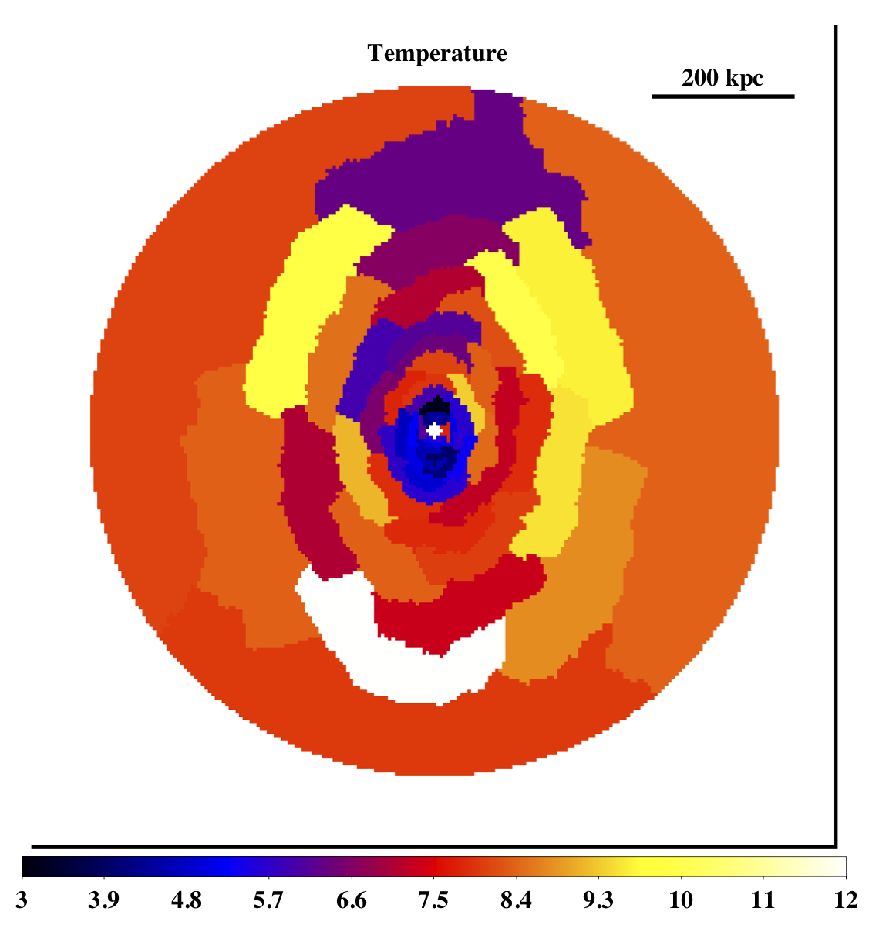
The hot temperature of the ICM means that it shines brightly in X-rays (0.5 – 8 keV). Modern X-ray observatories enable us to map the temperature and density structure of the ICM.
Notes:
In fact, an X-ray observatory like Chandra can give us more information than just the average profile. We can observe substructures in the ICM based on its temperature and density measurements. Here is the temperature map of the cluster MACS 1931, where the color of each region corresponds to its measured temperature. You can see a very clear spiral of low temperature gas that arises from a past merger event. By observing the gas in enough details we can therefore learn a great deal as to how these very massive structures formed and what that history implies for how these structures will evolve in the future.

Slide 10
Galaxies in Clusters
Notes:
So with that, I will now move onto the galaxies in clusters. What do we know about them? Are galaxies in clusters unique compared to isolated (or field) galaxies? The short answer is yes. To see that, lets first look briefly at how galaxies are classified and then back to our original cluster image.

Slide 11
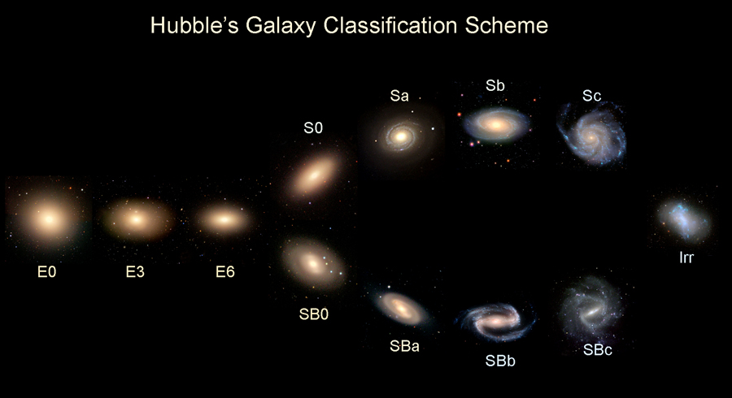
Interaction histories of galaxies with their environment greatly influence their shape and color
Notes:
Here we can find the classes of galaxies as determined by Edwin Hubble early in the 20th century. Although this classification scheme is largely outdated in the context of our more modern understanding of how galaxies form, it does give us some very useful visual cues for our next image. Elliptical galaxies tend to be much ”redder” than spirals, as these colors map well to the astronomical colors we measure. Now if we take a look back at our original galaxy cluster, we notice...

Slide 12
Galaxy Clusters host a high fraction of red, elliptical galaxies.
Notes:
That a lot of the galaxies here are redder (or yellow) elliptical galaxies and there are very few blue spiral galaxies. The color of a galaxy has a physical origin – at optical wavelengths a galaxy’s light is primarily the summed total of all of its starlight. So if a galaxy is blue, it means that it hosts lots of young blue stars. If a galaxy is red then it only hosts older, redder stars. So red galaxies have low star formation rates and blue galaxies have higher star formation rates. So in clusters, what we find is that the majority of the galaxies are “red and dead” elliptical galaxies with only a few bluer spiral galaxies.

Slide 13
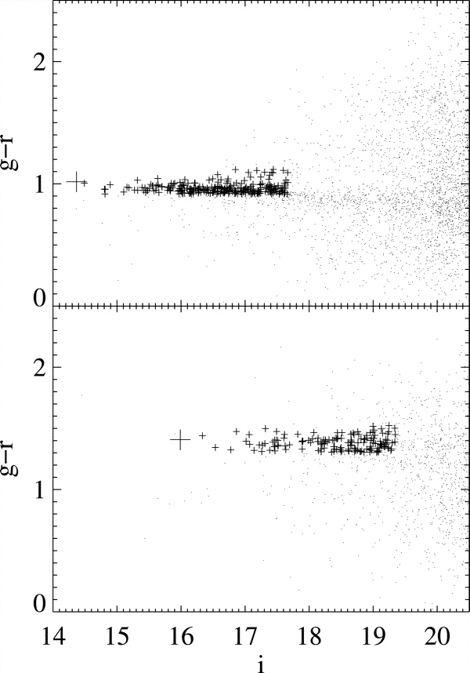
Abell 2142, z=0.094
Most cluster galaxies reside in a tight region of the galaxy color-magnitude space.
These marked regions are known as the red sequence where all those “red and dead” galaxies reside
Redder
Fainter
Abell 1682, z=0.23
Notes:
This can be seen more clearly if we plot up the colors and magnitudes of optical galaxies. The x-axis of this plot shows the apparent magnitude of all galaxies in the direction of a cluster, while the y-axis has the color of the galaxies. The bolder points are galaxies belonging to the cluster on what is known as the red sequence. This red sequence of galaxies is so ubiquitous and well measured in galaxy clusters that it can be used to identify new clusters that are observed in large surveys. You can also see that the red sequence moves to different locations in color space as the cluster’s redshift changes. For those of you not familiar with optical magnitudes, I thought this would be a good time to give you all a few numbers of note. The values of g,r, and i are all filters used to observe stars and galalxies. The i-band observes light at the reddest wavelengths of the human eye’s visible spectrum and some wavelengths too red for humans to see with their eyes. The r-band is a bit bluer than that, sampling colors that are visually orange and yellow. The g-band corresponds to blue, and violet wavelengths with some coverage in the near UV. Magnitudes are a logarithmic measure of brightness, with brighter sources having smaller magnitudes. So a magnitude 14 galaxy is brighter than a magnitude 19. The system is set up that a difference of five magnitudes corresponds to a factor of 100 in brightness. So that magnitude 14 galaxy is 100 times brighter than a magnitude 19 galaxy. Also note that the human eye can see down to about magnitude 6 on a good night. So there are all 10,000 – 1 million times fainter than the human eye can see unaided.

Slide 14
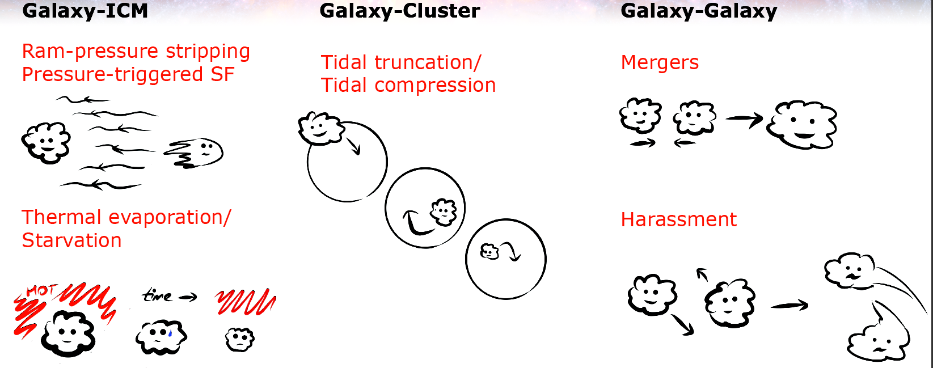
Galaxies in clusters can be disturbed by the ICM or by nearby galaxies
Notes:
So how does the red sequence form? There are many different processes that operate in galaxy clusters. All of these processes occur for field galaxies as well, although in a more extreme fashion. I will discuss three of these processes in a bit more detail. The first, ram pressure, is the pressure a galaxy experiences from the ICM as it moves throughout the cluster. You experience a similar kind of pressure every time you move through the air or water. Because of the speeds involved with cluster galaxies (of order 1000 km/s), the gravitational potential of the galaxies, and the density of the ICM, the ram pressure from the ICM can actually “strip” the galaxy of its locally hosted gas reservoirs, leaving spectacular tails of cold gas in their wake. The other more ubiquitous process in cluster galaxies is galaxy-galaxy mergers and tidal interactions. Mergers are actually relatively rare in clusters: the relative speeds and angular momentum are typically too high. But tidal interactions between galaxies are very common. What I mean by tidal interactions can be inferred by this little cartoon. In the before figure, two galaxies are moving through the cluster and pass by one another. The sides of the galaxies closer to each other are subject to a higher gravitational force (1/r^2) than the outer regions. Over time, the two galaxies are stretched out in the direction of their interaction. The affects of repeated tidal interactions is known as harassment. So what do these look like in real galaxies?

Slide 15
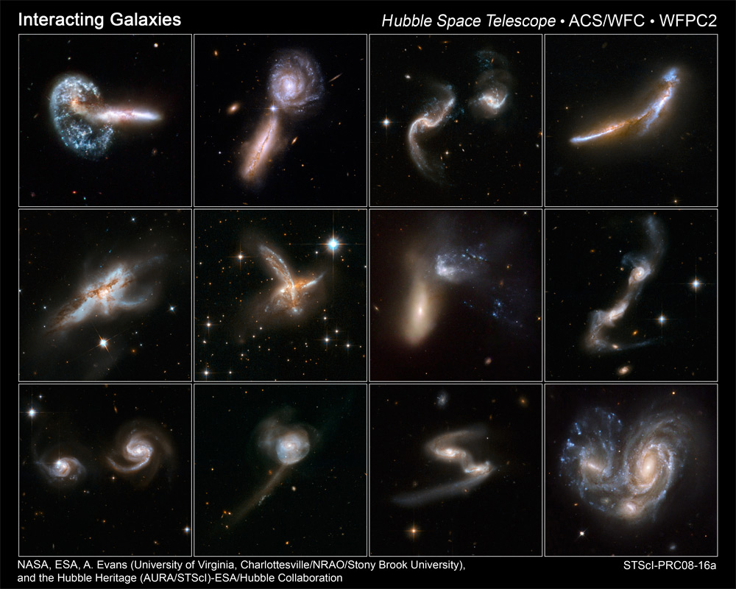
Here are some real examples of interacting and merging galaxies (although not specifically in clusters)
Notes:
I thought it would be nice to provide some Hubble images of some merging galaxies, although these are not specifically for cluster galaxies. You can see that each galaxy pair is a different stage of merging, and the collisions can be violent.

Slide 16
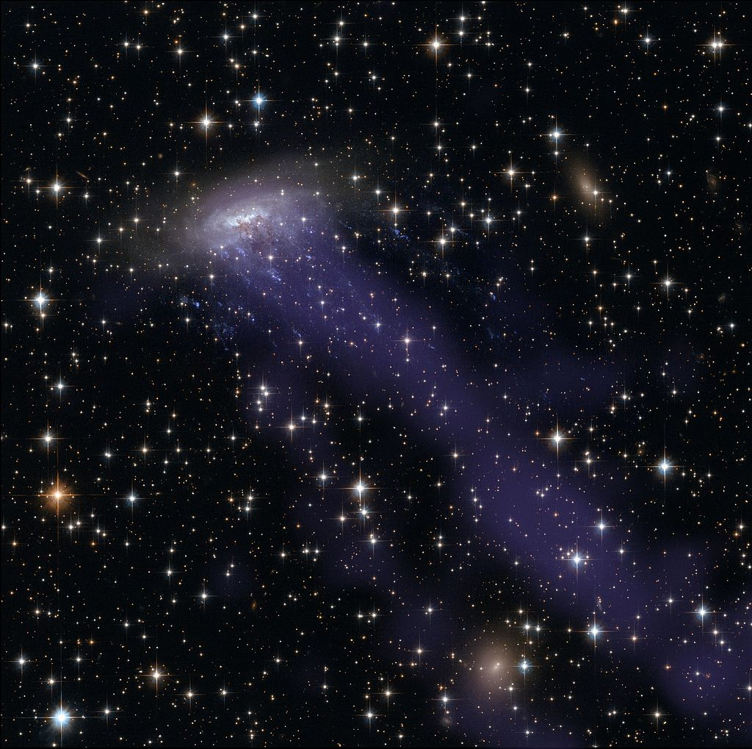
This galaxy is undergoing severe ram pressure stripping.
Spiral galaxy being stripped
Blue is X-rays
Notes:
This is a galaxy known as ESO 137-001 that is undergoing ram pressure stripping. You can see the trail of X-ray bright gas behind this spiral galaxy in a pale blue color. The scale of this image is such at this tail is about 250,000 light years across. By observing these systems we not only learn about the fate of galaxies in clusters but also the physics of how this galaxy gas mixes and merges with the ICM gas. Because the gas is so hot magnetic fields can play a crucial role in how these two phases of gas will ultimately mix in together. Hubble has provided the optical data here.

Slide 17
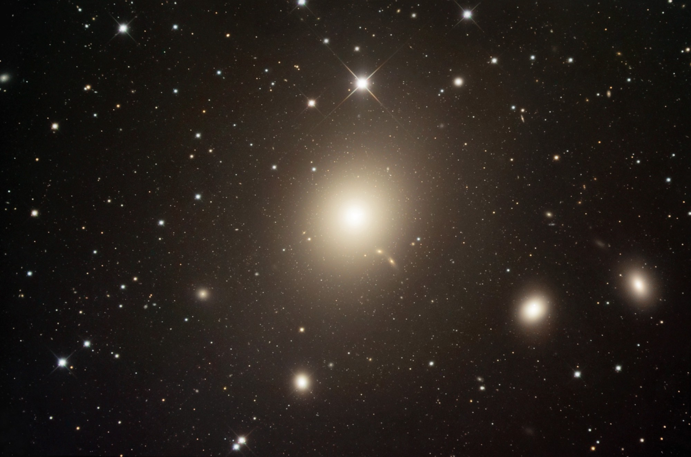
Central galaxies such as M87 can also have an important influence on the ICM through a process known as AGN feedback.
Supermassive black hole here
Notes:
But the interactions don’t simply go one way. The galaxies themselves can inject a lot of energy into the ICM. You may have noticed that at the center of most every galaxy cluster is an extra-large galaxy such as this one – M87 at the center of the Virgo Cluster. You can see just how big it is compared to some of the neighboring galaxies here – it is huge!
In many cases the centers of galaxies are cooler than the outer regions, for reasons we discussed before. When that gas has had enough time to cool, the gas can start falling onto this central galaxy (which is located right at the center of the cluster gas). When too much cool gas starts falling onto the galaxy, its central black hole gets fueled and goes active, launching jets of material that uplift and heat the cooled cluster gas.

Slide 18
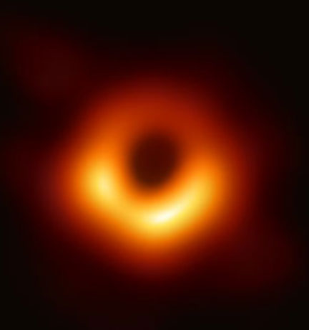
Radio image of M87 from Event Horizon Telescope
The ICM gas at the center of the cluster can cool and condense onto the central galaxy’s central black hole
The white line is ~ 2 light days long
Notes:
In short, the central galaxy of a cluster turns into an active galaxy. I want to now give you all a sense of scale as to how powerful these AGN outbursts can be. Here is the black hole of M87 as imaged by the Event Horizon Telescope. We can see the disk of gas orbiting the black hole here, and the width of this image is approximately 2 light days across. This is the size of M87’s black hole. M87 itself is about 53 million light years away. To take this image, radio telescopes from all over the world needed to be viewing the galaxy simultaneously in order to combine their signals into one radio mega-telescope with an effective diameter comparable to the Earth itself. The signals from each radio telescope then needed to be correlated with each other extremely carefully and the image painstakingly reconstructed from those correlated signals. It isn’t especially relevant for the rest of this talk, but I thought the image production process was so extraordinary it would be worth sharing with this enthusiastic audience.
So given that the black hole radius is about 2 light days, how large do you believe the sphere of influence might be?

Slide 19
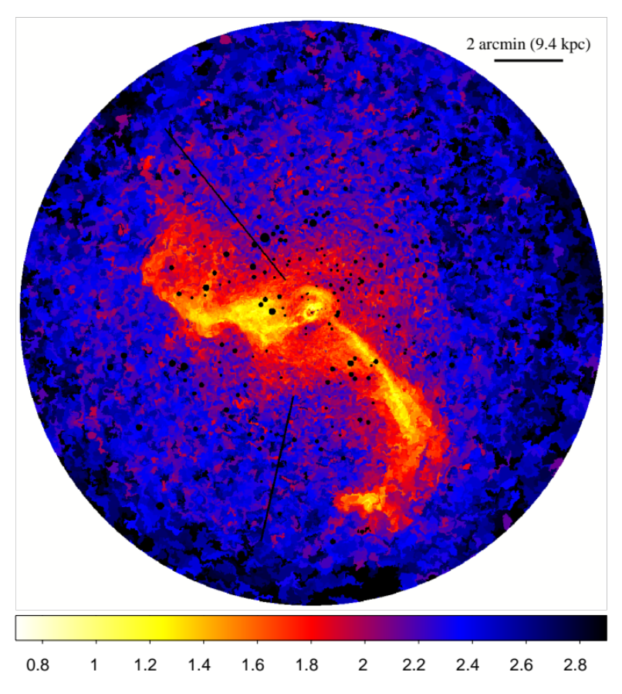
The condensing gas can fuel an outburst from the black hole, which can uplift huge masses of cooler ICM gas huge distances
The white line is now ~ 100,000 light years long
Notes:
The answer is 100,000 light years, or about 35 million light days. In terms of proportions, that’s not much different than a typical army tank being able to shoot to the Moon. Or Mauna Kea being able to eject dust to Mars. This map shows the temperature of the ICM around the center of M87, and these long yellow structures are plumes of cool gas (the color bar units are temperature in the weird X-ray units of keV). These plumes are being uplifted by the central black hole, but they used to be much closer to the center of the galaxy. The volcano analogy I gave earlier is particular apt here, as you can think of the central black hole as a volcanic eruption of cooler gas to much higher altitudes than before.

Slide 20
Dark Matter
Notes:
So now that we know a bit about the galaxies and gas, we can now discuss the larger component of galaxy clusters by mass – dark matter. I am not sure how much you may or may not know about dark matter, but I will try and give you a far too quick introduction.

Slide 21
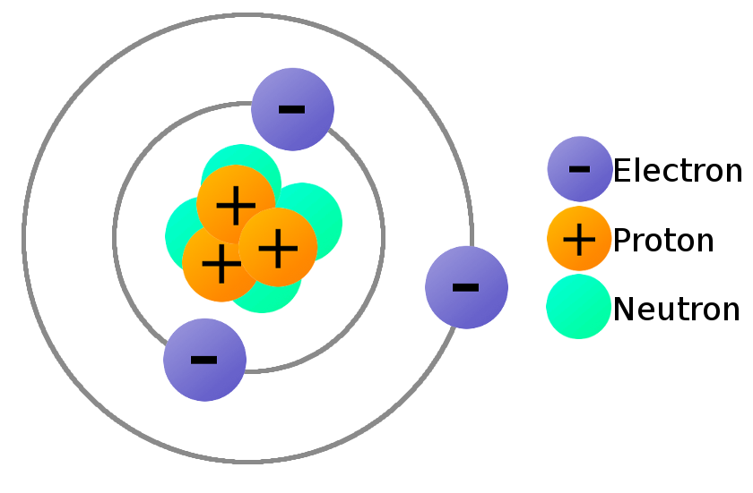
Dark matter cannot be composed of protons/neutrons/electrons. Nor can it be any other particle that has been discovered in accelerator experiments.
Notes:
Before I can really discuss what dark matter is, I need to give a very fast description about what dark matter is not. Dark matter appears to be fundamentally different from the protons, neutrons, and electrons. Ever more exotic particles that we have observed in particle accelerators cannot account for dark matter. It is a very clear way in which our Standard Model of particle physics is clearly incomplete, as the Standard Model does not even have an obvious spot for a dark matter particle.

Slide 22
Unlike every other particle physicists have encountered thus far dark matter appears to only interact with these standard model particles through gravity.
Notes:
The only observational signature of dark matter we have is through its gravitational influence. There are astronomical objects on many different scales that require more gravitational binding than be accounted for by what we observe. Galaxy clusters are one of these systems. They also provide one of the most compelling arguments that dark matter is likely a particle. Now we have a lot of different questions we need to ask about clusters.

Slide 23
How do we know that dark matter composes 90% of the mass of a galaxy cluster?
Notes:
The big question is shown above, but there are lots of auxiliary questions that we need to ask as well, such as “How do you weigh a galaxy cluster in the first place?”, “How do you know you’re not just overlooking ordinary matter instead of resorting to dark matter?” So let me provide you with two ways to measure the mass of a galaxy cluster. These are not the only two, however.

Slide 24
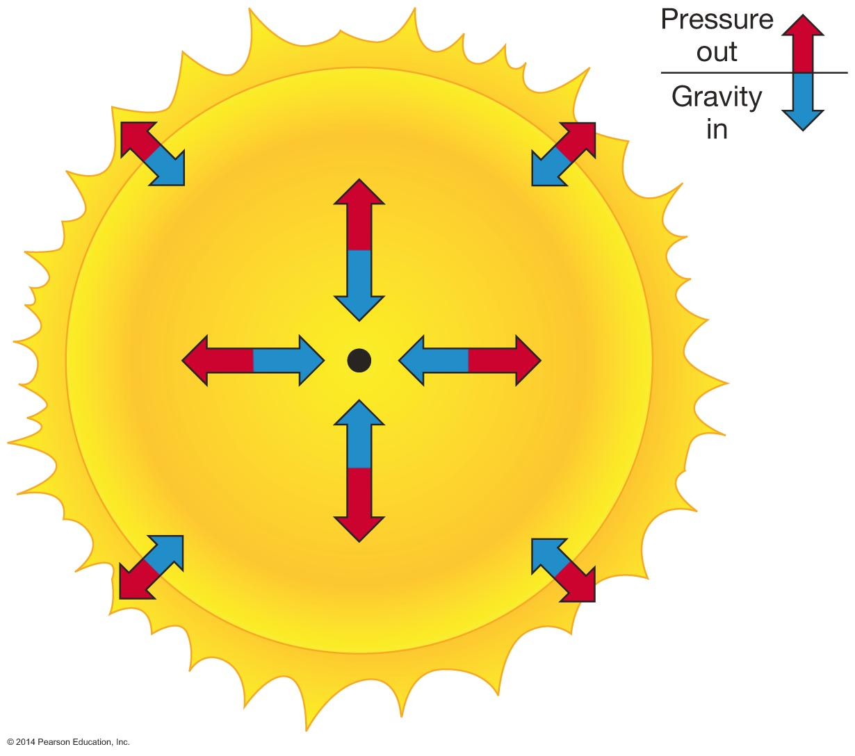
We can measure total mass of a galaxy cluster by measuring the thermal pressure of the ICM (temperature x density) and assuming hydrostatic equilibrium
Notes:
The first method is to assume that a galaxy cluster is in hydrostatic equilibrium, which means that thermal pressure of the gas balances out the pressure of gravity trying to bring the entire system to a point. You can see this illustrated for a star in this figure, but the physics is identical. We can measure the thermal pressure using the variables I showed you before – pressure = temperature * number density. By calculating the thermal pressure profile of the galaxy cluster, we can infer how much mass needs to be enclosed.
The next thing you may wish to ask yourself is the following – how do we know that the gas in a cluster is in hydrostatic equilibrium? And how do we know that there isn’t any other significant source of pressure? Well, those hypotheses can be tested. It is a bit beyond the scope to describe the full litany of ways to test this, but I’ll describe one test in a few slides.

Slide 25
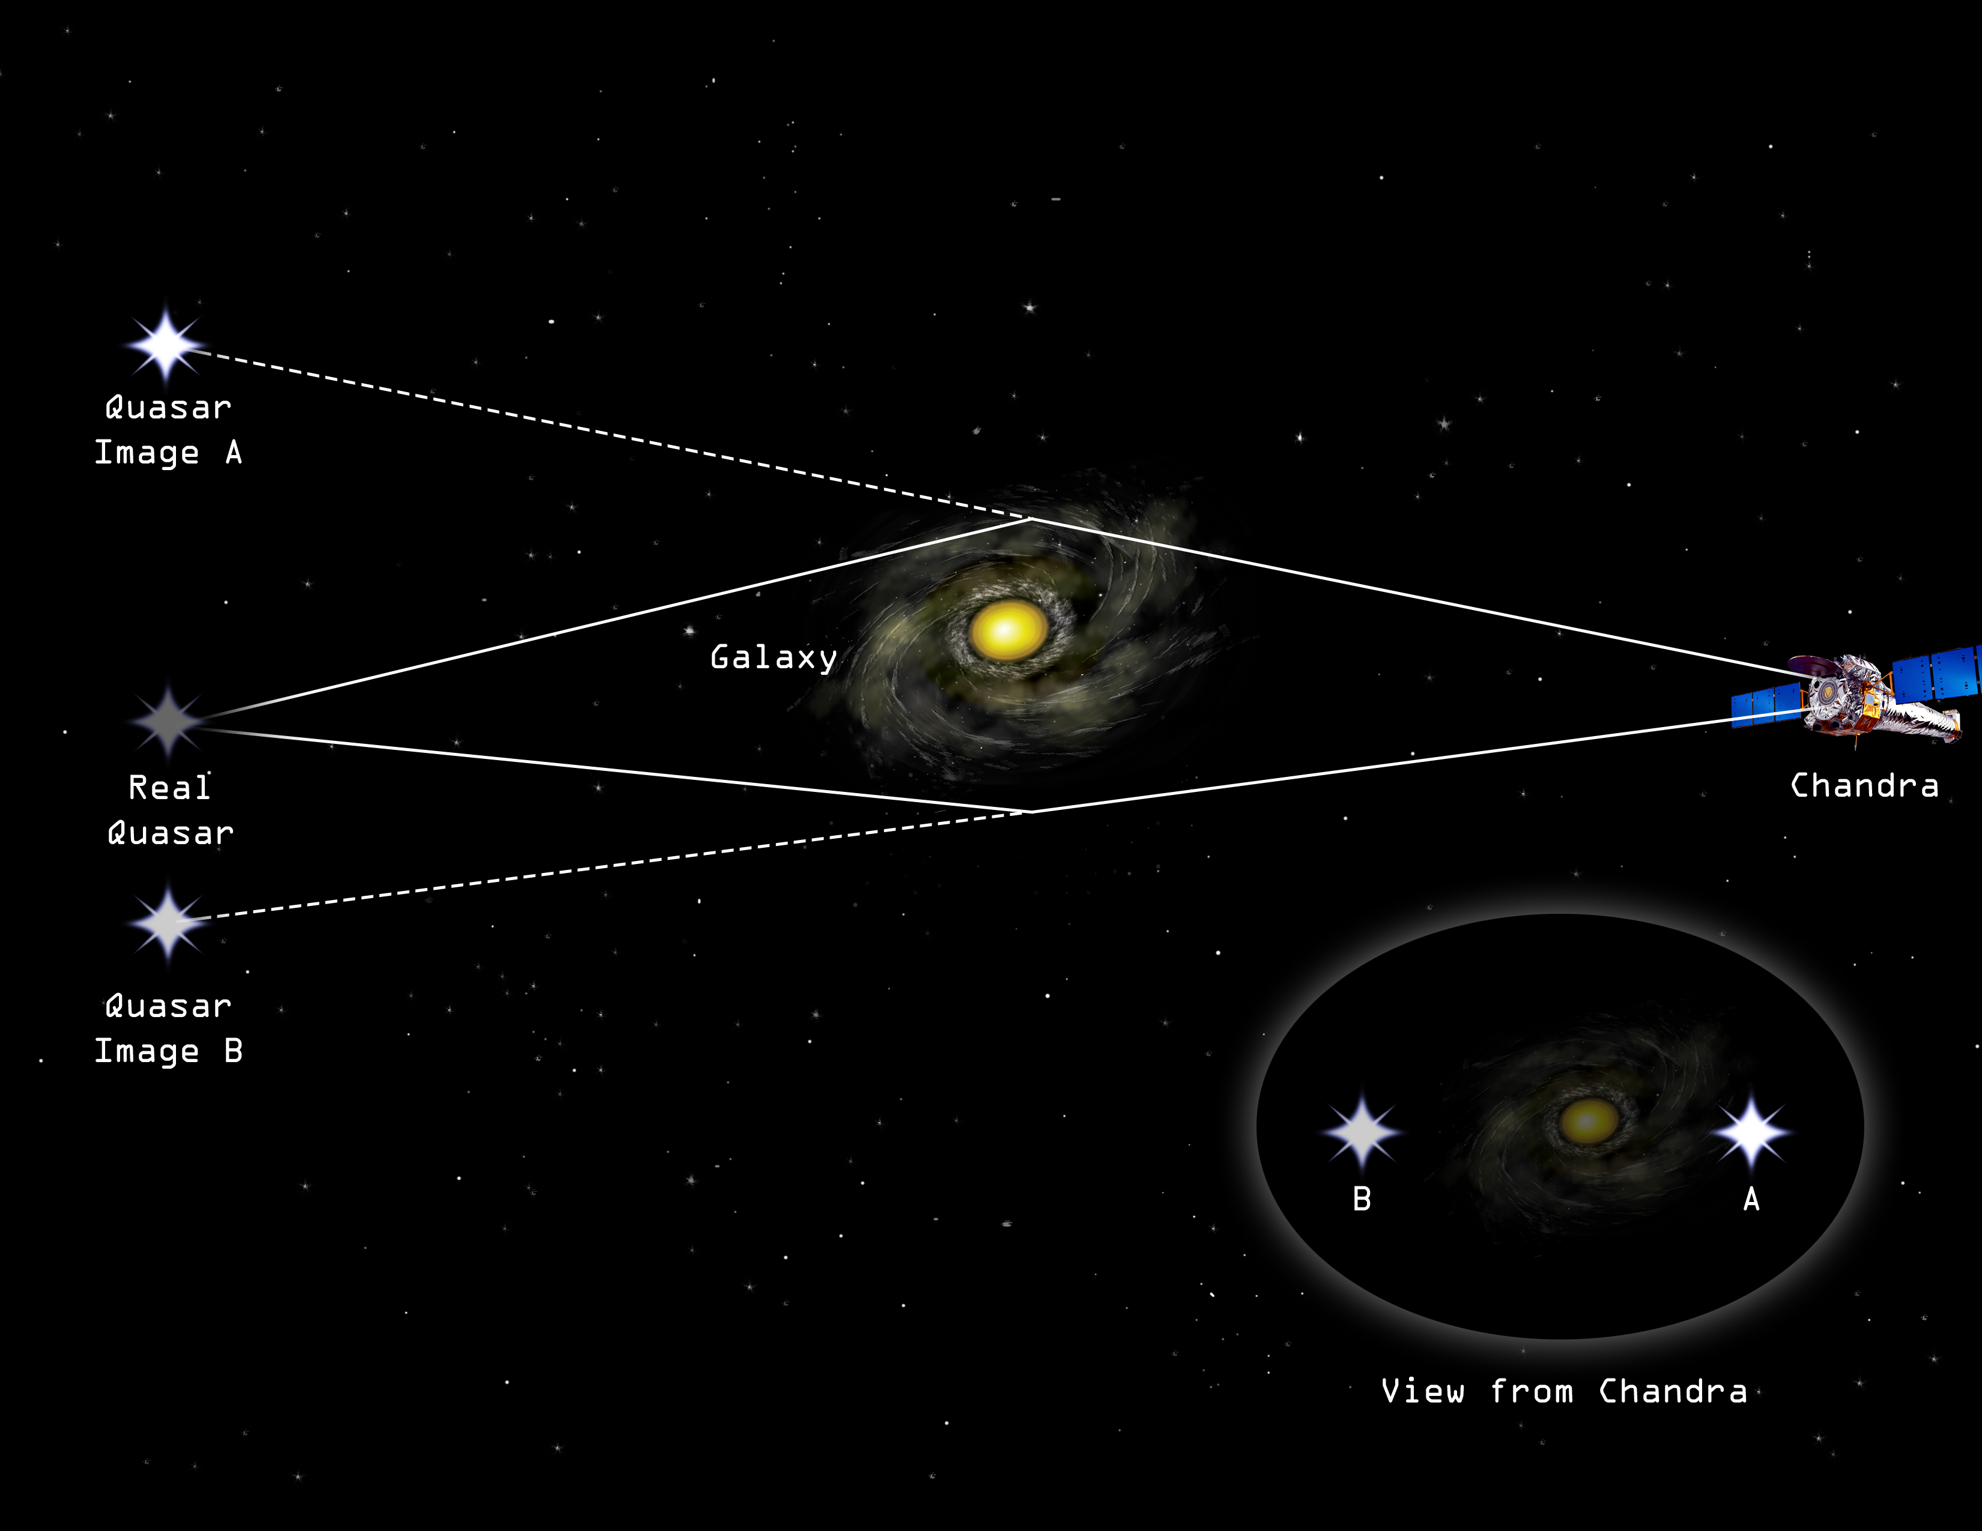
Gravitational lensing is a general relativity effect where images of background objects are distorted by the enormous mass of the cluster along the way
Notes:
Another method for measuring galaxy cluster masses involves a nifty phenomenon known as gravitational lensing. This effect, which is a consequence of Einstein’s Theory of General Relativity, leads to measurable distortions in the images of galaxies located behind the cluster. You can see how this works in the figure here. A source is located at the position labelled “real quasar”, but as the light from that quasar makes its way close to the cluster it gets bent by the cluster’s enormous mass and gravity. So when we observe the background source, we see it at a different location than it “really” is. If the alignment of the background source is just right, we can even see multiple images of the same source around the cluster, resulting from the different paths that light can reach our telescopes. For a given background source, the number of images and where they are located depends on the enclosed mass of the cluster, so we can measure cluster masses like this.

Slide 26
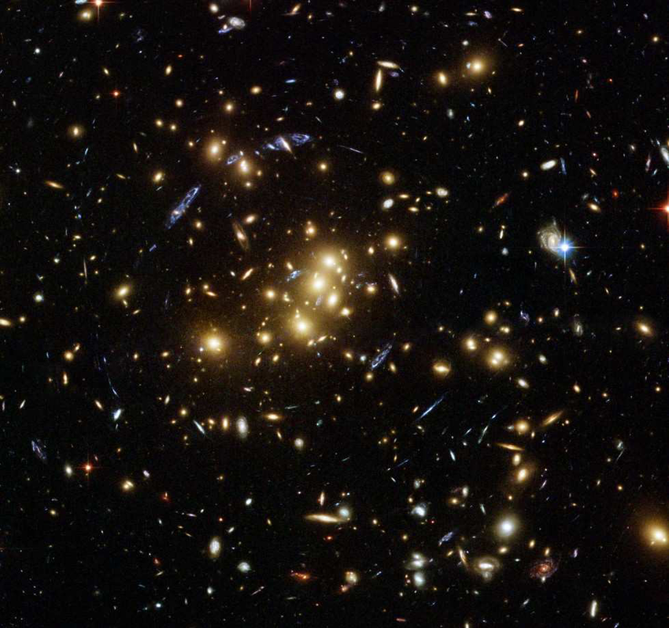
Gravitational lensing can create multiple arcs of a single galaxy located behind the cluster to appear. A weaker effect is that background galaxies appear to ”circle” around the cluster center.
Notes:
We can see some examples of lensing in a real system here. See the blue arcs around the center of this galaxy? Those are distorted images of a galaxy behind the center of the cluster. If you look very carefully, you can also notice that the background galaxies appear to be distorted in a way that traces circles or ellipses around the center of the cluster. This is another signature of lensing known as “weak lensing” as opposed to the strong lensing that creates multiple arced images of a background source.

Slide 27
The masses measured with both techniques agree with one another.
Notes:
When the two methods of measuring mass are compared to one another, they both agree overall. And they both suggest that the mass is significantly higher that the mass of the X-ray gas by itself. You should also notice that these two methods are sensitive to do different things – the lensing mass makes few assumptions about the source being dark matter or visible matter, while the hydrostatic masses can provide a good estimate of the visible mass in the cluster.
You can see that this is one way to test some of these assumptions about the hydrostatic masses I mentioned earlier. If there were other significant sources of pressure support or we weren’t in true equilibrium, we could actually measure this with the lensing masses. This is a common general technique in astronomy – try to measure something in multiple ways, as each of those methods usually have different measurement uncertainties and are sensitive to different physics. When you combine the measurements, one can do much better than any single measurement.

Slide 28
The combination of X-ray observations (to measure the ICM) and optical observations (for galaxies and/or lensing) allows for powerful tests of fundamental physics to be performed.
Notes:
So now that we know what galaxy clusters are made of, we can now discuss a few spectacular examples of clusters and how these interactions between the different constituent components can be used to test theories about the Universe on much larger scales than the clusters. So lets look at three clusters from your test materials.

Slide 29
Some particularly interesting galaxy clusters
Notes:
So now that we know a bit about the galaxies and gas, we can now discuss the larger component of galaxy clusters by mass – dark matter. I am not sure how much you may or may not know about dark matter, but I will try and give you a far too quick introduction.

Slide 30
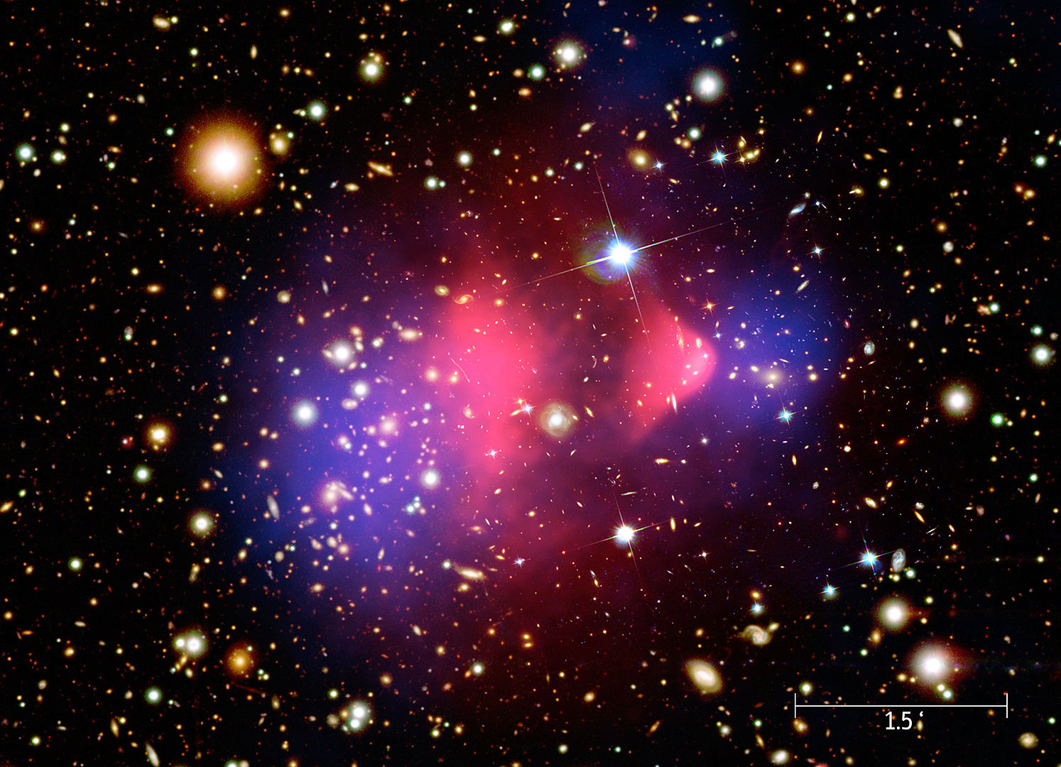
The Bullet Cluster (1E 0657-56) shows a collision between two nearly equally massive clusters. The separation between the ICM and lensing derived mass and galaxies is some of the best evidence for dark matter.
Pink is X-rays/ICM
Blue is lensing mass
Notes:
The first is arguably one of the most famous images ever taken by Chandra – the Bullet cluster. Because every cluster image you will see has a different color scheme, I will make sure to have it labelled. The yellow denotes an optical image with Hubble, where you can see the galaxies. The pink is the X-ray bright hot gas from Chandra, and the blue denotes the location of mass peaks as determined by gravitational lensing analysis. The first and most obvious thing to note here is that the pink and blue are offset from one another. This is because this system is actually two subclusters of comparable size merging with one another. The gas from these two clusters is slowed down during the collision, but the galaxies and dark matter in each subcluster don’t collide and simply pass on through. So this image shows us that in this collision of galaxy clusters the majority of the mass has separated from the majority of the gas, demonstrating that the mass operates under a fundamentally different set of rules than the ICM.
This image is arguably the best evidence to date that dark matter is ubiquitous in the Universe and that it is a very different type of matter than what we are used to.

Slide 31
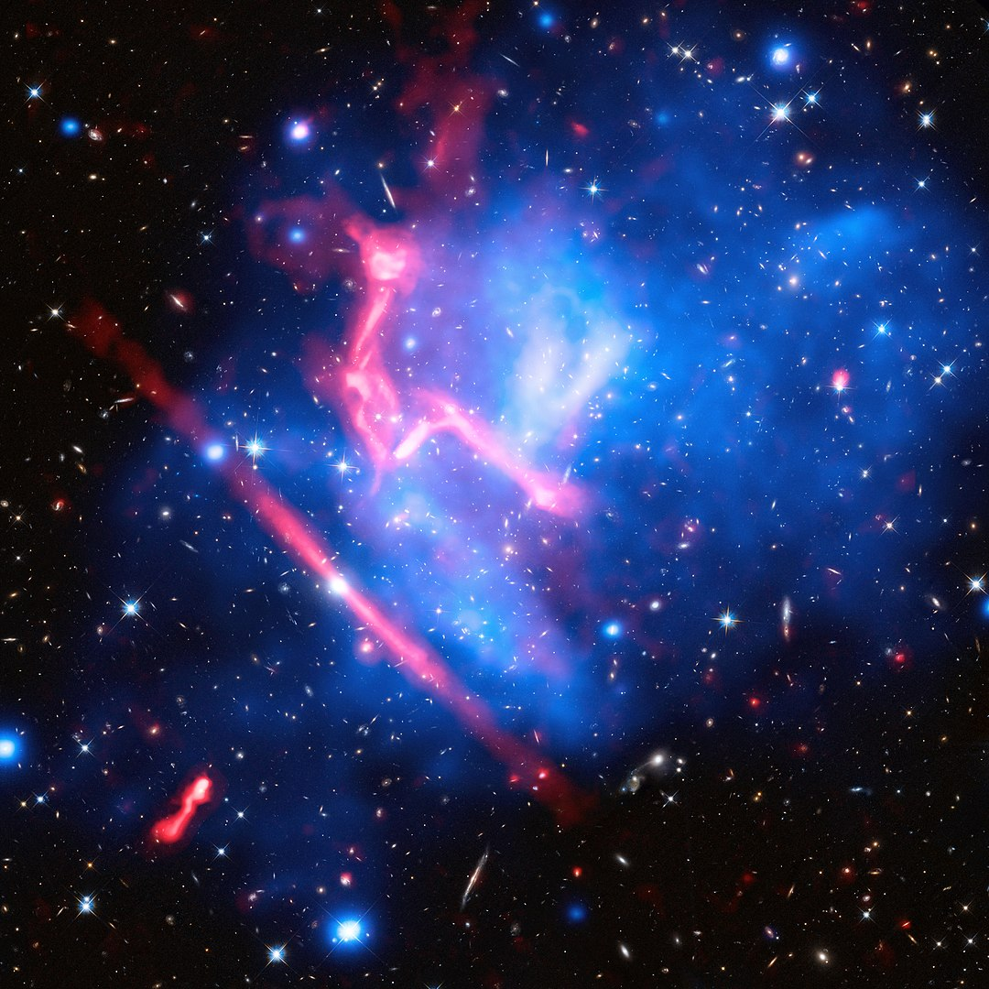
MACS J0717.5+3745 is a merging system where four smaller clusters are coalescing into one larger system.
The pink radio emission traces a shockwave formed as these clusters collide with one another at supersonic speeds
Blue is X-rays/ICM
Pink is radio
Notes:
This is another merging system known as MACS J0717.5+3745. Names like this are rather common for newly discovered objects, which some astronomers refer to as “telephone numbers”. Because modern astronomy surveys are finding so many objects over the sky, the best way to identify them all is to use their coordinates. So this particular cluster can be found at RA 07 hours 17.5 minutes and +37 degrees 45 arcminutes declination. In this image, the Hubble optical image is overlaid with blue X-ray imaging and pink radio emission. You can see that this particular cluster looks very messy, as it is in the process of mixing together from the collision of four individual subclusters. Most intriguing in this image is the long filament of radio emission spanning the bottom left corner of the image., That region denotes a shock wave (think sonic boom) arising from the very high, supersonic speeds of the subcluster ICM’s colliding with one another.

Slide 32
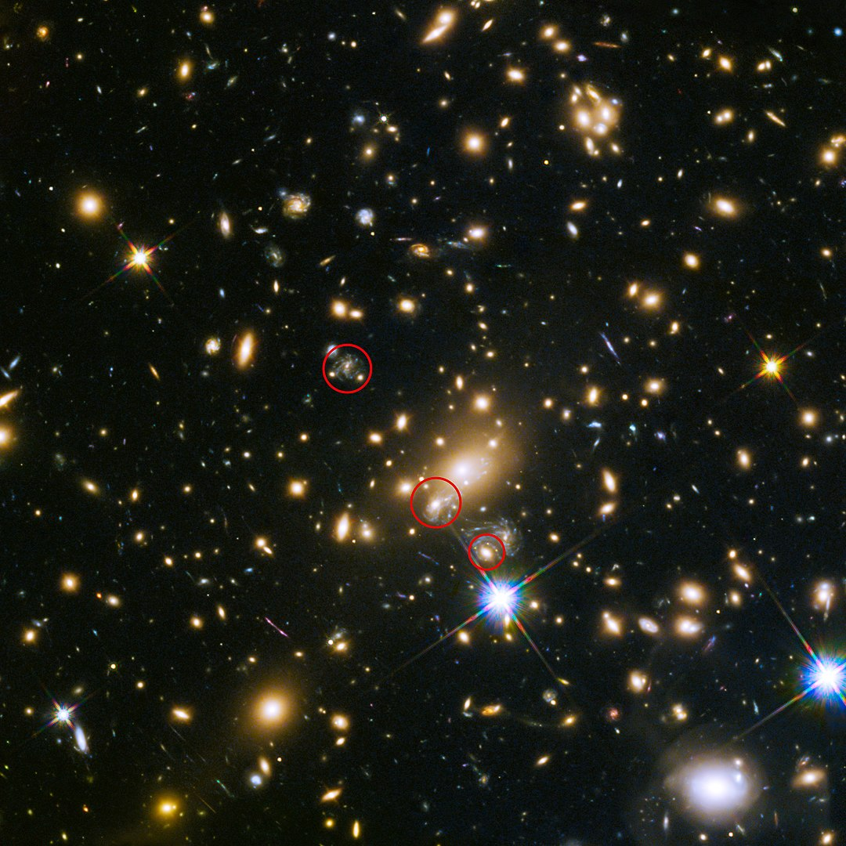
A supernova was observed in a multiply imaged galaxy lensed by the galaxy cluster MACS J1149.5+2223. This cluster also magnified an individual star hosted by this same galaxy, briefly.
Notes:
The final cluster I wish to discuss is called MACS J1149.5+2223. This cluster had some remarkably interesting transient events observed over the years. Do you see the elliptical galaxy in the bottom red circle? That galaxy lensed a supernova from a background galaxy in such a way that it created four images on each side of the galaxy. The supernova was hosted in the blue spiral galaxy right next to it. In fact, the other two red circles above it are the same spiral galaxy. Now here is where things get really interesting – because the supernova is short lived and the light travel times for each path the spiral galaxy image can reach us are different, scientists were able to predict when the supernova was going to appear in the other two galaxies. Unfortunately, the supernova was predicted to be observable in the top-most galaxy about 20 years before the original image was taken. But the spiral galaxy image in the middle circle was supposed to show the supernova about a year after the original paper was published. And it actually showed up right within the prediction window!
Even stranger was that one of the images appeared, based on some very careful analysis, to have a single star in that same spiral galaxy be lensed to be individually seen as well. Studies like these help us observe the very distant Universe, exploiting the cluster as a sort of cosmic telescope that lets us image sources we normally couldn’t due to instrumental limitations. And that is extremely cool.

Slide 33
Conclusions
Notes:
So that is where I will end my talk, and I will put up our three spectacular NSO approved galaxy clusters for you to view. Hopefully you have all learned about the many ways that galaxies, gas, and dark matter interact in clusters as well as the sorts of science we can learn from these gargantuan structures. I will now take any questions you may have.

