Slide 1
Human Research Program (HRP)
Research Operations and Integration (ROI)
Remote Support of ISS Payload Operations During the COVID-19 Pandemic
Lyndon B. Johnson Space Center

Slide 2

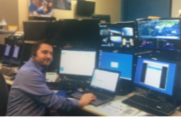
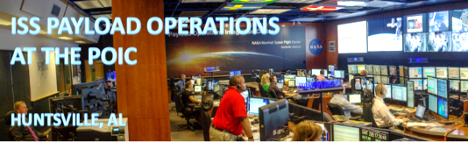
What is the Human Research Program?
NASA-sponsored Human Life Sciences investigations
The Human Research Program’s (HRP) Research Operations and Integration (ROI) element conducts the planning, implementation and closing of human research operations on-board the International Space Station (ISS)
Two Human Research Facility (HRF) Racks in the Columbus module enable HRP science as well as International Partner science, Rodent Research, and Med Ops activities
Managed from the Telescience Support Center (TSC) in Mission Control Center-Houston (MCC-H)
ISS
JSC B30 TSC

Slide 3
How we responded to COVID-19
HRP ROI has an Emergency Management Plan that it uses to deploy personnel and equipment for various contingencies such as inclement weather.
  The plan is tested on an annual basis to ensure it is ready for use
    This includes monthly hardware checkouts during hurricane season
  Successfully utilized during Hurricane Harvey in 2017
  Only designed for one to two weeks of remote support
  Significant modifications were required and deployed ad hoc to transition the remote support from temporary to indefinite
    Both in how we communicate externally to the ISS, MCC-H, and Payload Operations Integration Center (POIC) as well as internally with our other team members
    Includes a hybrid configuration for operating remote in conjunction with limited personnel in TSC

Slide 4
Team Coordination
Microsoft Teams closes the gap due to lack of face-to-face internal communication
Use Microsoft Teams to create a group for each operation
  NASA has approved this method of communication as secure for Personally Identifiable Information (PII)
  HRF Payload Systems Engineers (PSEs) can share screens to the HRP ROI console team for telemetry and remote desktop
  Reduce voice loop traffic by asking non-pressing questions or giving non-pressing actions
  Microsoft Teams connection does not need a Virtual Private Network (VPN) connection to either JSC or MSFC; it can be used to inform other team members when technological issues arise such as a loss of VPN connection
  Boost team morale by being able to chat with each other during Loss of Signals
Microsoft Teams has also allowed communication with ground positions whose voice loops we cannot access with our remote audio system

Slide 5
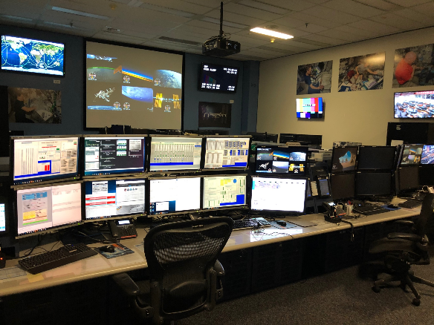
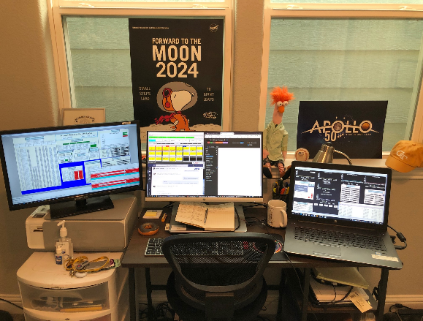
Telemetry, Commanding & Data Downlink
Through the use of Huntsville Operations Support Center (HOSC) provided software and VPN, all telemetry, commanding, and data downlinking is virtually the same
HRF PSEs deploy Emergency Response Laptops for use at home to supplement our personal NASA computers
TSC Console
Home Console

Slide 6
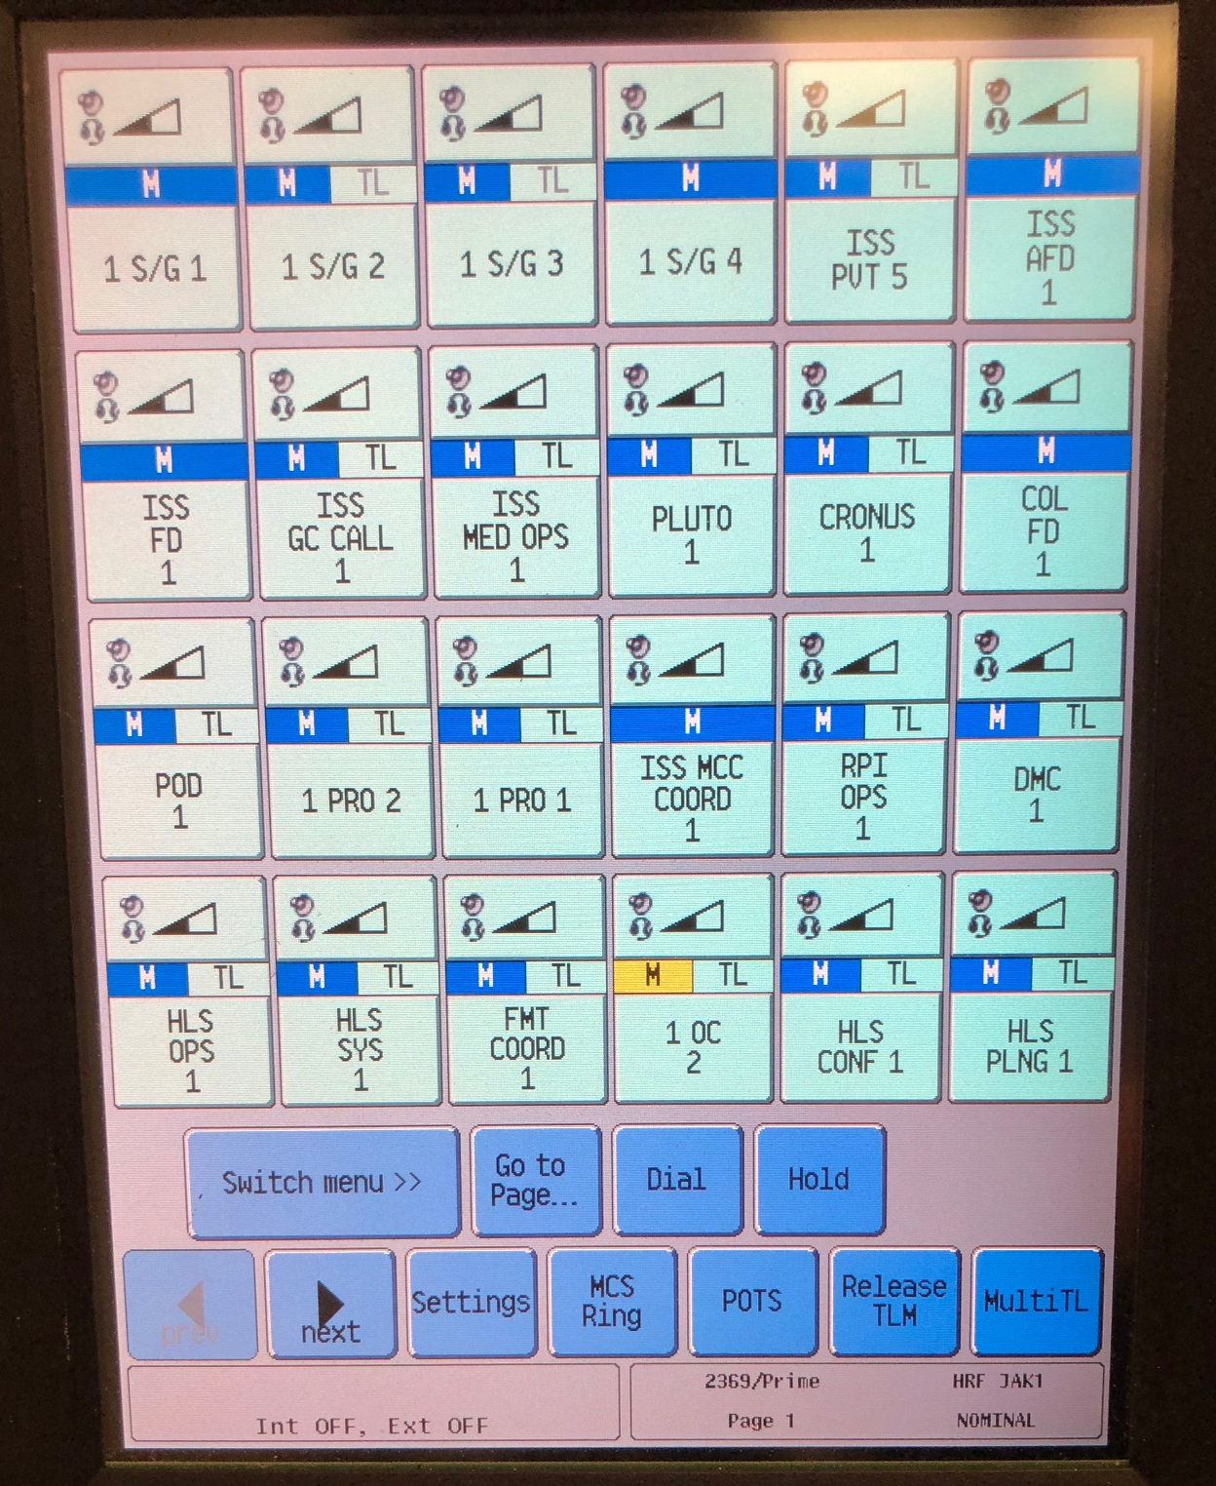
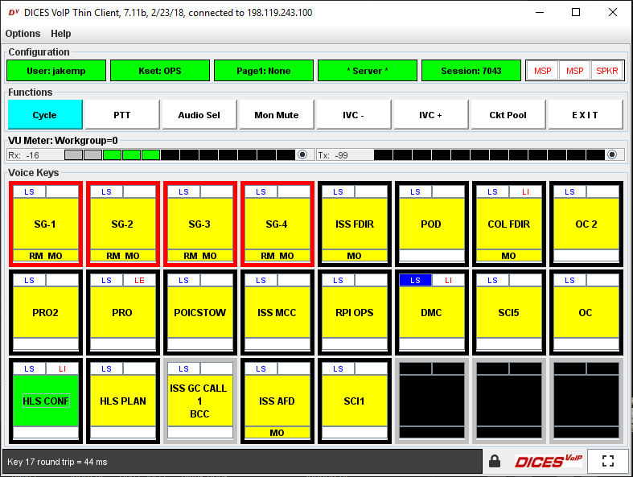
Audio
In lieu of Digital Voice Inter-Communications Equipment (DVICE) used on site in the TSC, we use Internet Voice Distribution System (IVoDS)
IVoDS is a software-based program that requires a user to connect to the JSC network via a VPN or to have their IP address whitelisted by POIC to be used on the MSFC VPN
We have limited voice loops on IVoDS compared to DVICE
Specialized conference line created to provide secure and standardized phone patches for private Space to Ground (S/G) communication with crew
DVICE
IVoDS

Slide 7
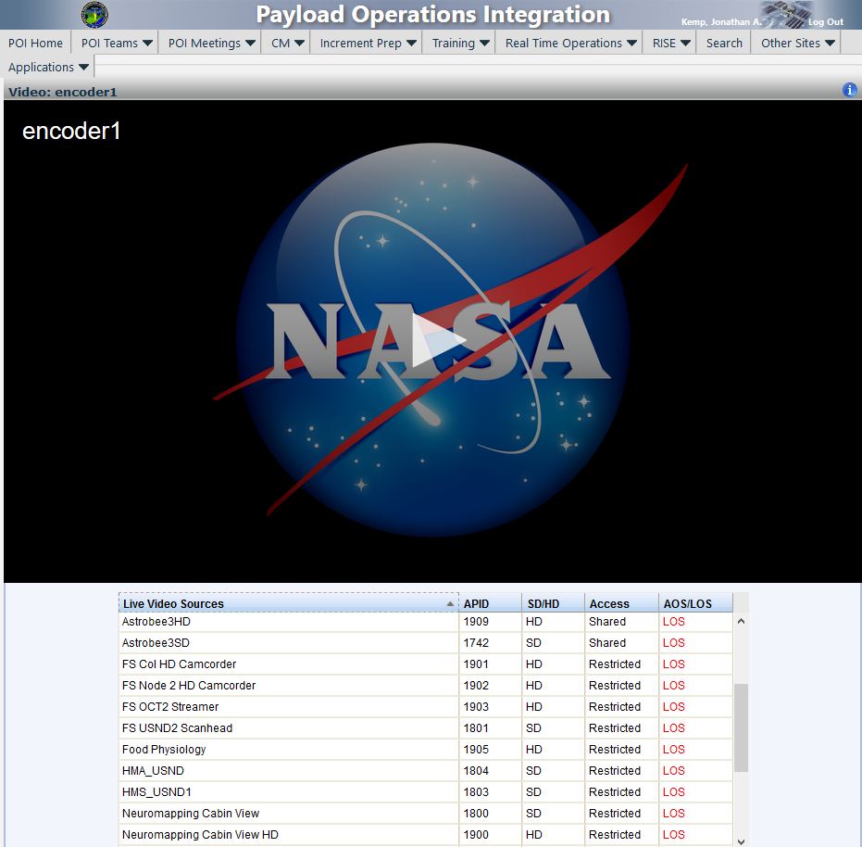
Video
HRF utilized HOSC Encrypted video to stream live, privatized video to all remote support personnel
HOSC Encrypted video streams over the web on a SharePoint site that payload users can access
Only users assigned and approved to certain account roles can view the video stream tied to those accounts
A three to six second lag is inherent when
using HOSC Encrypted video. This is
manageable with over the shoulder activities
but makes any remote guidance from the
ground challenging. For this reason, remote
guidance operations are still done out of
the TSC.
HOSC Encrypted Video

Slide 8
Advantages
Lack of commute provides extra safety, time, and sleep after overnight console sessions
Ability to perform on-orbit ops from anywhere
  Simple operations (e.g., 10-minute crew conferences) are streamlined and more time efficient
New trainee learning is accelerated due to sink-or-swim
  Team communication is forced to be more efficient (e.g., Failure-Impact-Workaround)
  Ground Command Procedures are more thorough and concisely written
Long-term remote support infrastructure and implementation plans are now in place
Better amenities at home such as coffee

Slide 9
Disadvantages
Loss of in-person, quick communication
Some audio loops with MCC-H personnel are not available remotely so use of Teams is required for communication
Difficulty in grading console presence of trainees
  Only see end result reactions, not the thought and strategy that went into the decision-making process
Lack of nice-to-have equipment (e.g., multiple monitors/computers, high speed internet)
Multiple VPNs require either multiple laptops or sacrifices in capability

Slide 10
Lessons Learned
Screen real-estate is at a premium when remote
  Monitors needed for commanding displays, monitoring telemetry, live video feeds, audio loops, console logs, ground procedures, etc.
Technical certification for trainees is less hindered than originally thought, but console presence is harder for trainers to monitor and critique
Identify remote needs (video, audio, etc.) for every experiment as if it will be supported completely remotely early on
Redundancy of hardware such as mobile hotspots and supporting personnel is required due to unforeseen technical issues (power outages, VPN dropouts, unreliable internet connection, etc.)

Slide 11
Acronyms
DVICE
HOSC
IVoDS
HRF
HRP
ISS
JSC
MCC-H
MSFC
NASA
PII
POIC
PSE
ROI
S/G
VPN
Digital Voice Inter-Communications Equipment
Huntsville Operations Support Center
Internet Voice Distribution System
Human Research Facility
Human Research Program
International Space Station
Johnson Space Center
Mission Control Center – Houston
Marshall Space Flight Center
National Aeronautics and Space Administration
Personally Identifiable Information
Payload Operations Integration Center
Payload Systems Engineer
Research Operations and Integration
Space to Ground
virtual private network

