Slide 1

HUMAN LANDING SYSTEM PROGRAM
Dr. Lisa Watson-Morgan, Program Manager
National Space Club - Huntsville
August 18, 2020

Slide 2
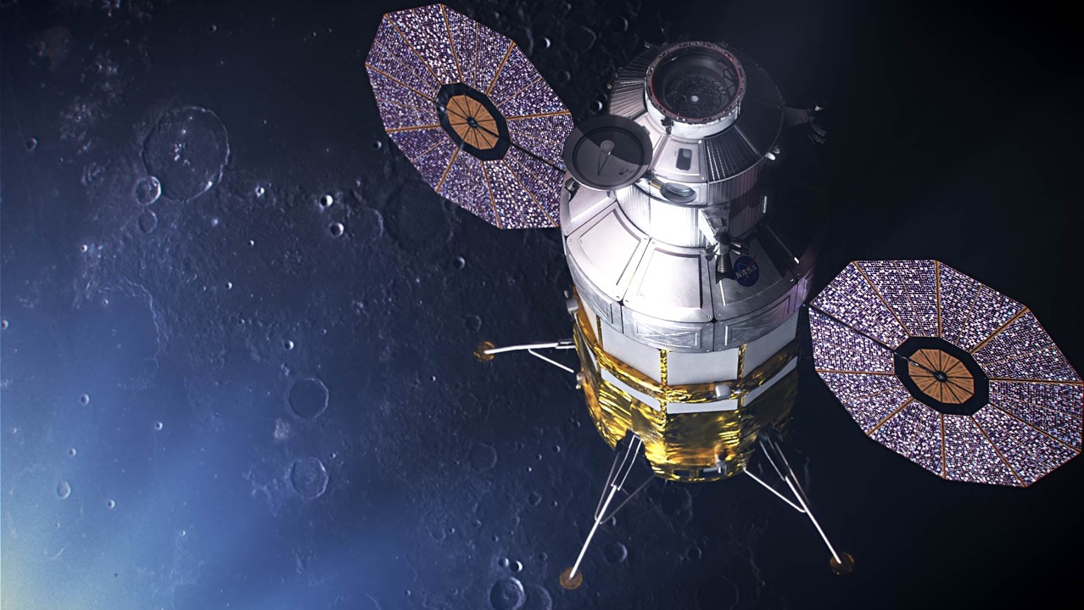
HLS Vision
The Human Landing System
Program will…
Boldly return humans to explore
the uncharted lunar South Pole
by the end of 2024; including the first woman
Leverage the best of industry and government knowledge, capabilities
& experience to routinely take
humans to the Moon as a proving ground for Mars
Accept reasonable risk to achieve
the rapid schedule
Notes:
Starting with the “ethos” of the Program – the Program was stood up at MSFC exactly a year ago yesterday (Aug 17)
Stream-lined boards
Making decisions through the lens of schedule and risk
We are open to new ways of operating

Slide 3
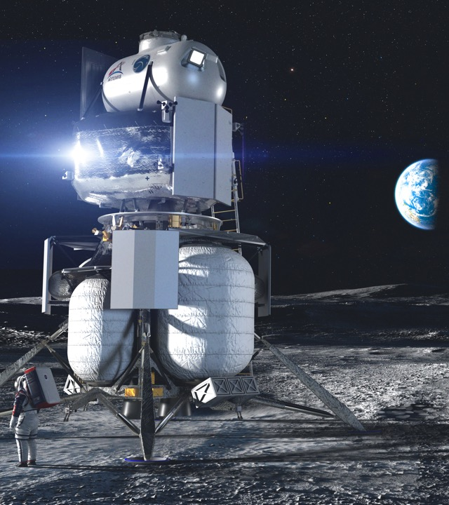
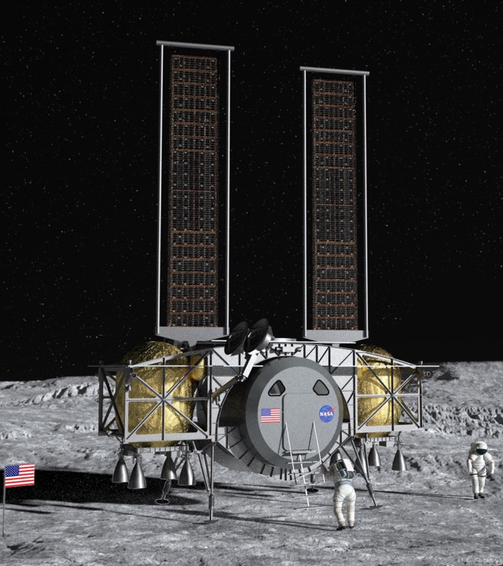
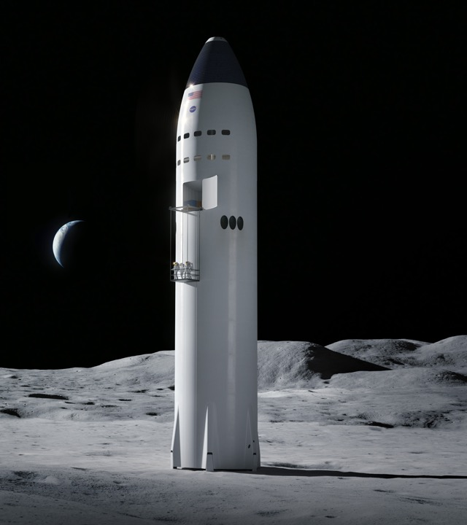
Human Landing System Program
Rapid development and crewed demonstration mission to the lunar surface by 2024
Evolved design & development of a sustainable crewed lunar landers as early as 2026, as precursor to procuring commercial lunar landing services
Leveraging commercial capabilities to maximum extent
Firm Fixed Price Performance-Based Milestones
NASA not taking ownership of HLS
HLS will launch uncrewed on commercial launch vehicles; checkout in lunar orbit prior to crew launch
NASA provides certification and technical expertise
HLS using risk based insight for efficiency
Resulted in 3 substantively different designs
NASA is using the Base Period contract to inform requirements and prepare for rapid execution
Notes:
Get into the technical specifics

Slide 4
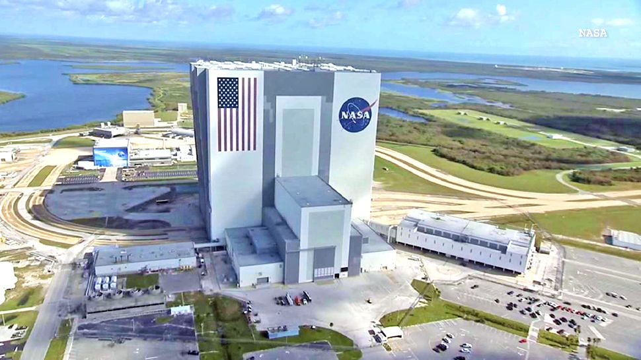
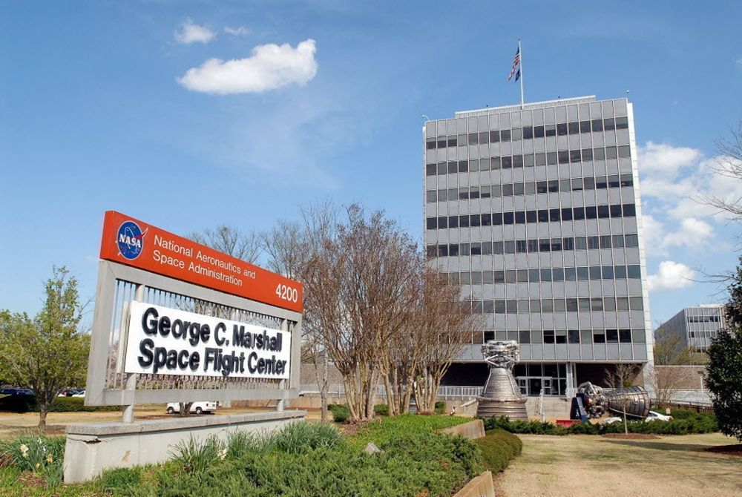
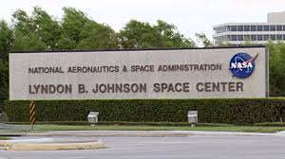
Human Landing System Overview
Program Management at MSFC
Engineering, insight & collaboration spread across the Agency
Offices at MSFC, JSC, and KSC

Slide 5
Notes:
Cannot land on the moon without SLS and Orion carrying the crew

Slide 6
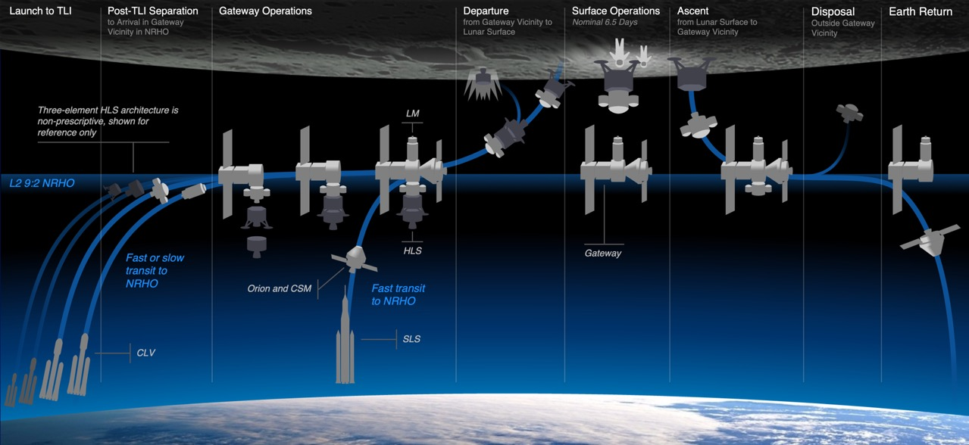
Generic Concept of Operations
Notes:
The plan is for the HLS to launch uncrewed to lunar orbit, where it will await the crew’s launch in Orion on SLS. The HLS and Orion will dock, either directly or via Gateway, and the crew will transfer into the HLS. The HLS will go down to the surface for a several-day mission of science and EVAs, then ascend back up to Orion, which the crew will get back into and head back to Earth.

Slide 7
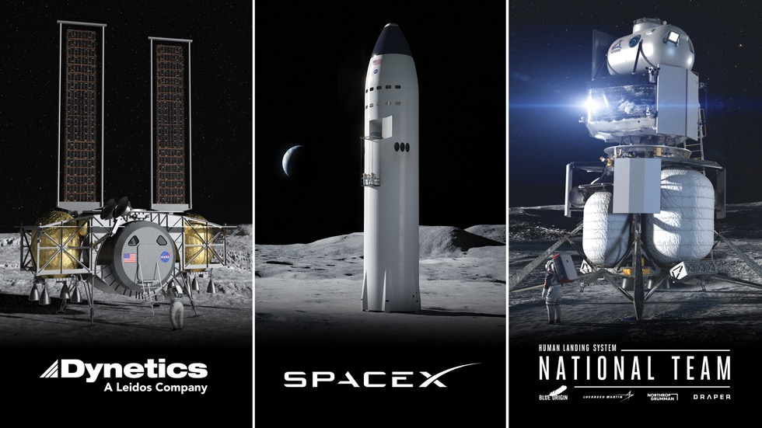

Overview
3 HLS contracts awarded April 30, 2020
Complete lander systems were proposed including launch vehicles for an end to end solution for 2024 and sustaining
Base Period: May 2020 – February 2021
The Broad Agency Announcement achieved the innovation from US Industry it was designed to do.

Slide 8

“INTEGRATED LANDER VEHICLE” (ILV)
Three-stage landing system
  Ascent – Lockheed Martin
  Descent – Blue Origin
  Transfer – Northrop Grumman (future refueler)
  GN&C, Avionics, Software – Draper
Rockets: New Glenn & ULA Vulcan
KEY ATTRIBUTES
Significant proven spaceflight heritage
Orion and Gateway compatible

Slide 9

“DYNETICS HUMAN LANDING SYSTEM”
Single element providing the ascent and descent capabilities
Multiple modular propellant vehicles (MPVs) prepositioned to fuel the engines
Large subcontractor team
Rockets: ULA Vulcan
KEY ATTRIBUTES
“Mass produced” MPVs
Crew cabin sits low to the surface
Double-androgynous docking system
Orion and Gateway compatible

Slide 10

“STARSHIP”
Integrated lander
Fully reusable launch and landing system
Fueling in low-Earth orbit with Starship storage and Starship Tanker variants
Rocket: SpaceX Super Heavy
KEY ATTRIBUTES
Spacious cabin
Two airlocks
Orion and Gateway compatible; Orion for first demo

Slide 11

Human Landing System – NextSTEP-2 Appendix H
  Sept 2019 Final solicitation issued
  Nov 2019 Proposals submitted
  Apr 2020 Selections announced for Base Period
  May 2020 Base Period contracts awarded
  Aug 2020 Certification Baseline Reviews
          Requirements and Design/Construction, Safety
          & Human System Standards finalized
  Dec 2020 Continuation Reviews
          Option A proposals due
  Mar 2021 Base Period contracts end;
  Spring 2021 Option A contracts awarded for
  2024 Crewed Demo Mission
  2024 Crewed Demo Mission
Notes:
HLS timeline – where we’ve been and where we’re going

Slide 12
HLS Program Status Update
Design & Construction Standards – culmination of a 13 week review
Option A draft solicitation NET September – will explore provider feedback again
Evaluation Criteria – keeping the same as for the Base Period.
  Technical Approach
  Price
  Management Approach

Slide 13
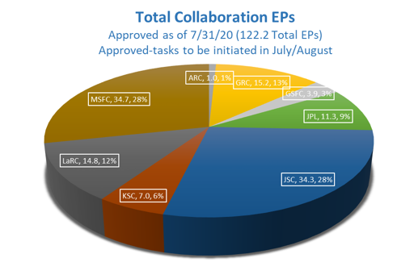
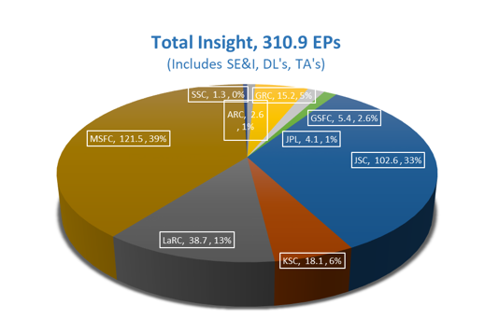
HLS: An Agency-wide Team
Notes:
A lot happening here in Huntsville as you can see, but also throughout the Agency

Slide 14
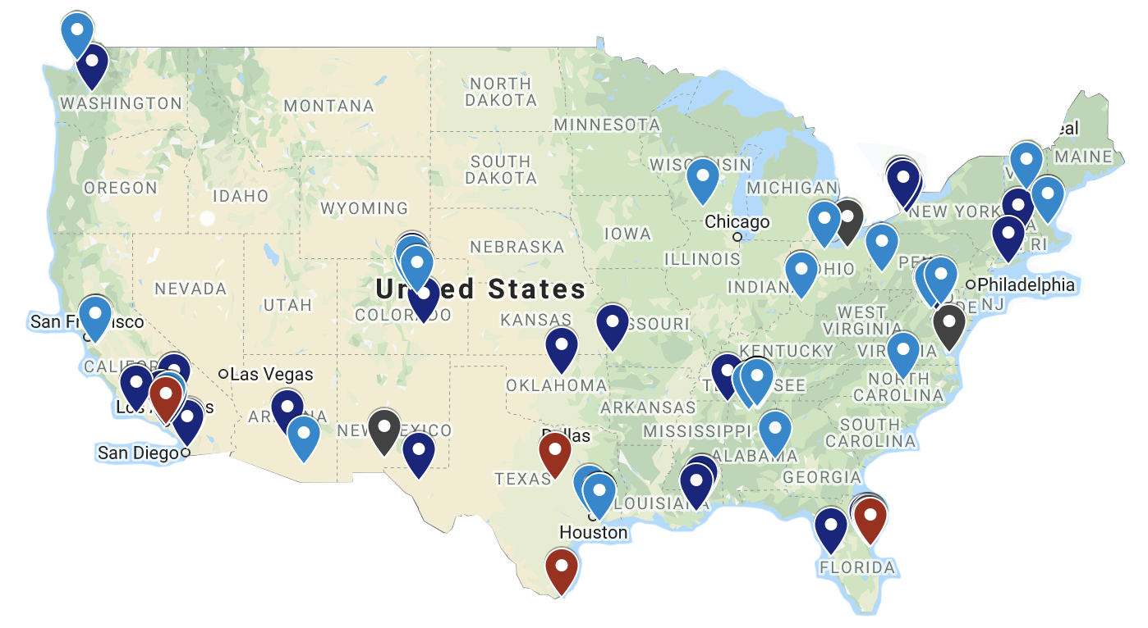
HLS NATIONAL FOOTPRINT
Utilizing the speed and innovation of industry to land the first woman and next man on the Moon
CONTRACTOR JOBS BY STATE
Alabama | 2,415
Arizona | 40
California | 1,266
Colorado | 2,336
Connecticut | 73
Florida | 1,161
Louisiana | 70
Maryland | 14
Massachusetts | 160
Mississippi | 50
Missouri | 30
New Hampshire | 40
New York | 44
North Carolina | 35
Ohio | 82
Oklahoma | 15
Pennsylvania | 10
Texas | 1,477
Virginia | 5
Washington | 2,716
Wisconsin | 40
TOTAL: | 12,079
BLUE ORIGIN
DYNETICS
SPACEX
NASA CENTERS & FACILITIES
More than 12,000 JOBS
in 23 STATES + D.C.

Slide 15

Let’s go.
The time is now.
We have the capability
We have the purpose
We have the charge
We have the responsibility

Slide 16



Slide 17

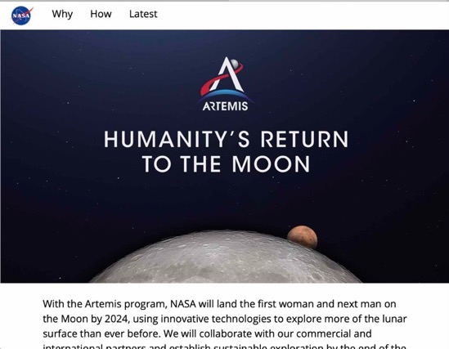




Connect with us
@NASAExplores
@ExploreNASA
@NASAExplores
blogs.nasa.gov/artemis
Sign up for updates at nasa.gov/subscribe
nasa.gov/artemis

