Slide 1
Using MBSE on a Working Project
Presenters:
Kerry McGuire, PhD
Jeff Cohen, PE
Moderator:
Karen Weiland
NESC Webinar – August 31, 2020
www.nasa.gov
Notes:
Good afternoon everyone. My name is Kerry and before we get into the main focus of the presentation in which we will be providing an example of “How” we are using Model Based Systems Engineering on a project we are currently working on, I am going to provide you the context so you have a better understanding of the “What” and “Why” behind our work. So let’s go on a little journey…

Slide 2
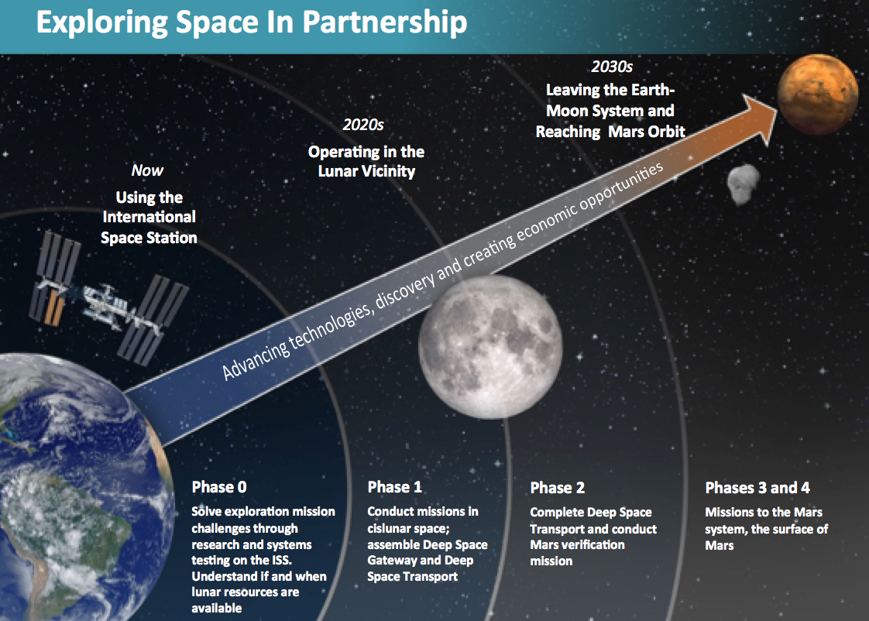
Exploration Missions
New challenges:
Limited to no resupply
Delayed communication
Limited to no evacuation
Unknown effects on crew health and performance
Limited flight resources
Increased crew autonomy
Notes:
Our future missions are changing the way in which we will practice medicine. For these missions we need to design the crew health and performance system as an integrated part of the vehicle system. ExMC is using a systems engineering approach to do this integration.

Slide 3
NASA-STD-3001 Levels of Care
Level 1
LEO <8d
Space Motion
Sickness
First Aid /
Anaphylaxis
Response
Basic Life
Support
Private Audio
Level 2
LEO <30d
Clinical
Diagnostics
Ambulatory
Care
Private Video
Private
Telemedicine
Level 3
Post LEO <30d
Limited
Dental Care
Limited
Advanced
Life Support
Trauma
Care
Level 4
Lunar >30d
Medical
Imaging
Dental Care
Sustainable
Advanced
Life Support
Limited
Surgical Care
Level 5
Lunar/Planetary
>210d
Autonomous
Ambulatory
Care
Autonomous
Advanced
Life Support
Basic
Surgical Care
Notes:
ExMC is guided by NASA STD 3001 to provide high level requirements for medical care as it scopes a medical system. These standards dictate the level of care required and provide example capabilities, with levels delineated by distance from Earth and the duration of the mission.
3001, by design, leaves the medical capabilities for each level up to interpretation by the program that relies upon these requirements. ExMC embarked on an exercise to define/interpret the 5 levels of care and provide concrete examples of actions for each level. In some cases, the definitions were very similar to terrestrial interpretations of the capability, such as first aid. In other cases, it relied upon the definition and example actions to fully articulate what the team’s interpretation of the capability truly was.
So what this means is that
Preventive strategies pre- and inflight are critical
Autonomous advanced care will be necessary, with a bigger focus on Diagnosis, Treatment, Rehabilitation than current space-flight ops do today.
A crewmember with physician-level training will be important, as they will serve as the in-flight, primary caregiver of the crew. This is a paradigm shift from today’s operations.
This physician astronaut will be self-sufficient, autonomous from the ground, and will rely on ground support only for consults when needed and as comm is available.
Overall objective:
Prevent, diagnose and treat

Slide 4
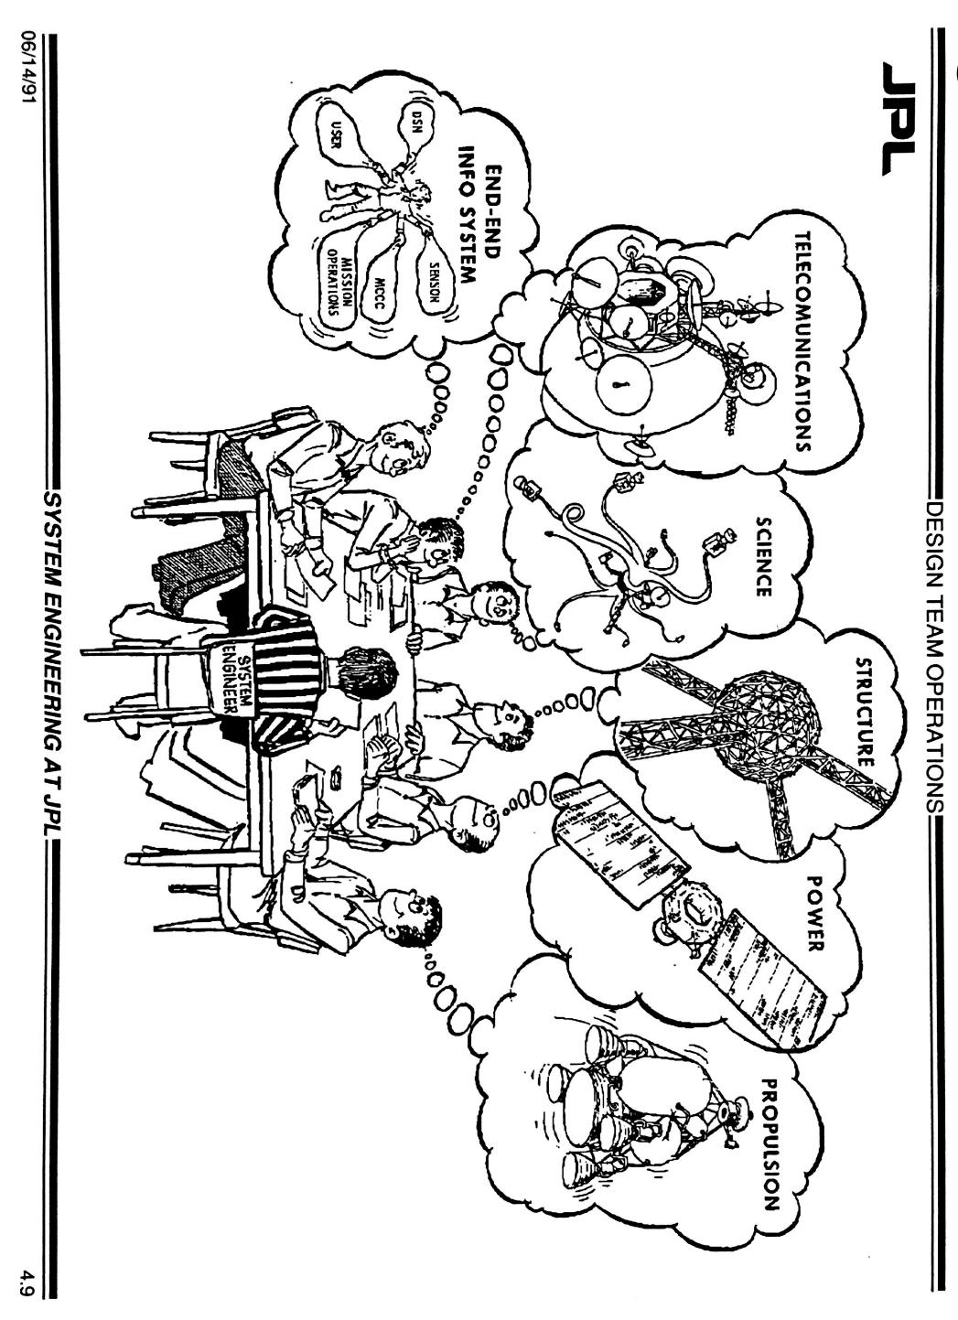

What is Systems Engineering?
Crew health &
performance
From “System Engineering at JPL” training course material, June 1991.
Notes:
Systems engineering is required approach by the agency for vehicle development.
What is Systems Engineering?
A methodical, disciplined and holistic approach for the design, realization, technical management, operations, and retirement of a system
What is a “System”?
Collection of different elements producing results not obtainable by elements alone
Elements = people, hardware, software, facilities …
Systems Engineering IS:
a way of looking at the “big picture” when making technical decisions
a way of achieving functional, physical, and operational performance requirements
the art and science of developing a system within opposed constraints
a holistic, integrative discipline, wherein the contributions of e.g.,
structural engineers, electrical engineers, mechanism designers, power engineers, human factors engineers, and many more disciplines (medical!) are evaluated and balanced… to produce a coherent whole that is not dominated by the perspective of a single discipline.²
Other notes:
- Ensure human is not forgotten
- Speak in the language of other technical - creates a common knowledge among sub-systems
¹Rechtin, Systems Architecting of Organizations: Why Eagles Can’t Swim.
²Comments on systems engineering throughout the handbook’s Chapter 2.0 are extracted from the speech “System Engineering and the Two Cultures of Engineering” by Michael D. Griffin, previous NASA Administrator.

Slide 5
Bridging the Communication Chasm
Questions engineers ask…
What do you need to bring?
How much mass/power/volume/data?
How will you use it? How often?
Who is going to use it?
How do you make a medical decision?
What medical events are you expecting?
What skills do you need for each medical event?
Are you sure you really need all that stuff?
What happens if I take things out of your system?
Questions doctors ask…
How do we do medicine in Exploration Missions?
What is likely to happen and how often?
What resources do we need and why?
How do we communicate to engineers?
Notes:
Different disciplines and individuals ask different questions and use different terms. It is the role of the systems engineering to bridge these communication chasms for everyone to have a shared vision and path forward. That we act as a unit.

Slide 6
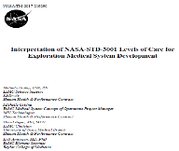
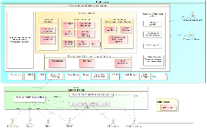
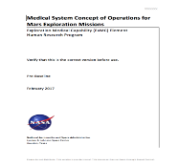
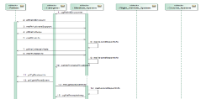
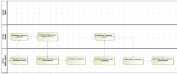
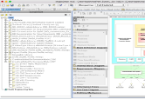
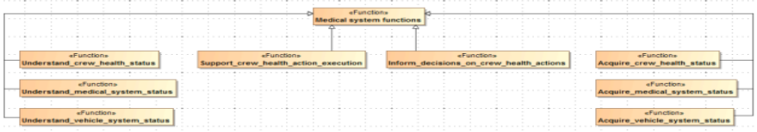
Systems Engineering Approach to Get There
Stakeholder needs, goals
NASA Standards
Program requirements & architecture
System functions & behaviors
System requirements & architecture
Using Model-Based Systems Engineering:
Subsystem requirements & architecture
Characterize system
Do we have the capabilities to meet the needs?
Do we need altered allocations?
Analyze & trade
Design & Build
Notes:
There are multiple ways that Systems Engineering process can be visualized. This is just one of them. No matter which you use the steps are the same. For each box you see in this waterfall method there are products that are produced. In the past these products were word documents and/or spreadsheets. Our team decided to take a more visual approach to these products. The same content will be presented but how we communicate it will be less “paper” based.
Something else our team is doing is taking a human-centric approach to design. For example, in our Concept of Operations. Which is a document that is defining what are the needs of this systems. We use scenarios that are short narratives from the perspective of the user. They portray how the user interacts/uses this systems. From these narratives is where we derive the functions of our system that will drive our requirements.
You may think being human-centric is a common practice and not always. Throughout this presentation we will provide you examples of how we are designing this medical system to meet the needs of its users.

Slide 7
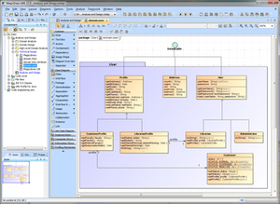

What is MBSE?
Model Based Systems Engineering (MBSE) IS Systems Engineering!
Difference:
Moves from a bunch of separate text based documents to an integrated, visual method for showing information
Notes:
First point - Model based Systems Engineering is Systems Engineering, the difference is that MBSE is more closely aligned with how Engineers and Technical People THINK. Let me give you an example, if I were to toss you a marker and ask you to describe a project you are working on, how many of you would come up to the white board and start writing paragraphs? None of you, of course not. You would draw a bunch of boxes and arrows to explain it. Because that is how we, that is, technical people think.
Second point – a document is out of date as soon as you print it.
Third point – Integrated – all artifacts in one place instead of lots of documents
Bottom line: MBSE is Systems Engineering that moves from a bunch of separate text based documents to an integrated, visual method for showing information

Slide 8
How is the Model Used?
The Foundation(s)
  Define the needs of a medical system for a Level of Care
  A place for mission planners/engineers to start when defining the medical system for an exploration mission
  Examples
    Short Duration Lunar Orbit
    Long Duration Lunar Orbit and Lunar Surface
IMPACT
  Perform trade studies on candidate medical systems
  Helps comparing candidate medical systems by mass, volume, and power
  Model provides subset of content and relationships among
    Clinical Capabilities
    Clinical Conditions
    Clinical Resources
    Requirements
Notes:
Used for two very different purposes
Defining the foundation
Used dynamically with IMPACT to perform trade studies – the model provides source data
Bottom Line: the model is NOT just a specification tool, it can provide information as needed to other tools. It can be used independently or integrated with information from other sources.

Slide 9
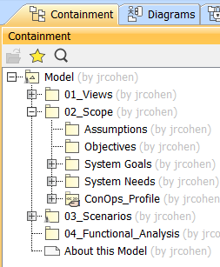
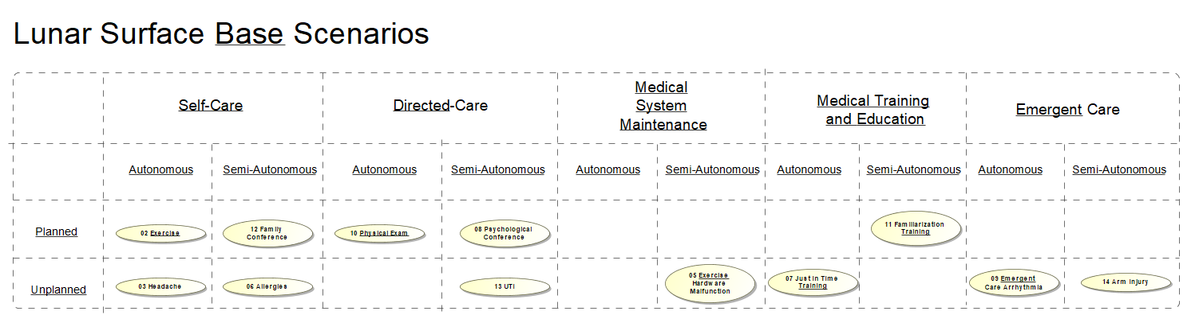
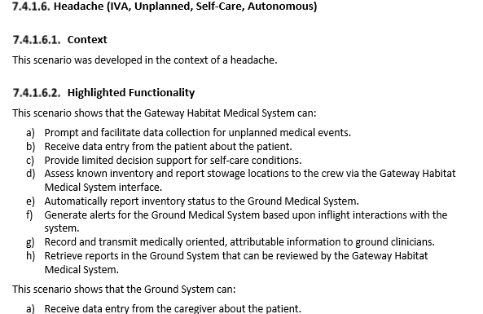
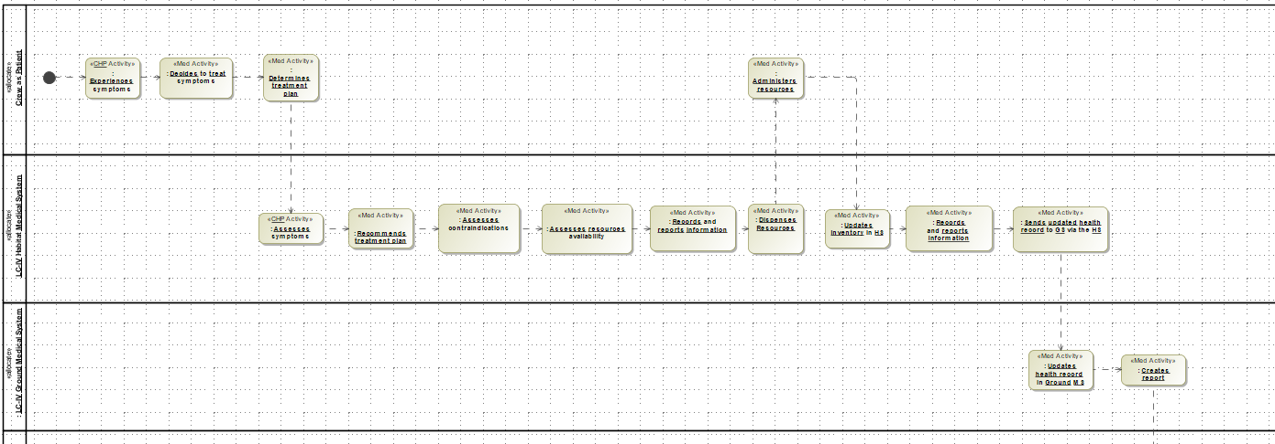
How Do You Visually Represent a ConOps?
Notes:
Let’s talk a little more about our process.
We are modeling the knowledge SMEs provide. In our case, the SMEs are Clinicians – Nurses, Doctors, Pharmacists
There are different ways to organize. This is one. As things change, the organization changes, too. You should expect to reorganize, or refactor your model.
We are providing information for the ConOps. Our goal is to provide as much of the information you would find in a document-centric ConOps as possible.
We Identify Assumptions, Objectives, System Needs, System Goals
Identify Scenarios and provide a short text description
We build Activity Diagrams to show step by step what the Medical System has to do
IMPORTANT – Many systems treat people as actors that are external to the system. In our model, the human is IN the system, not an actor. You see the humans represented as swimlanes on the activity diagram

Slide 10
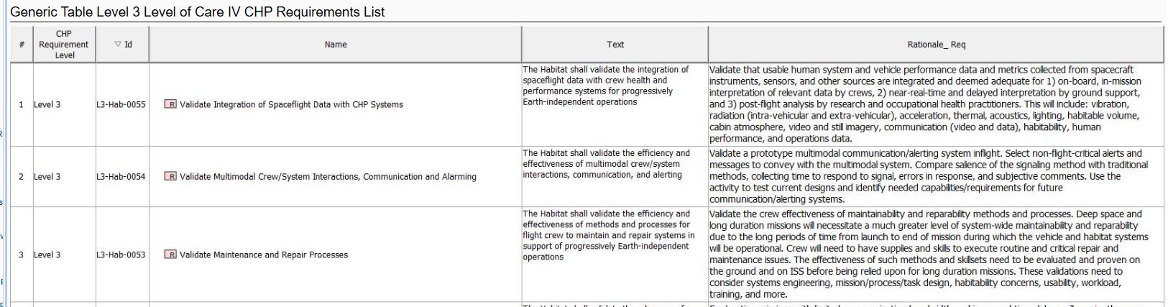
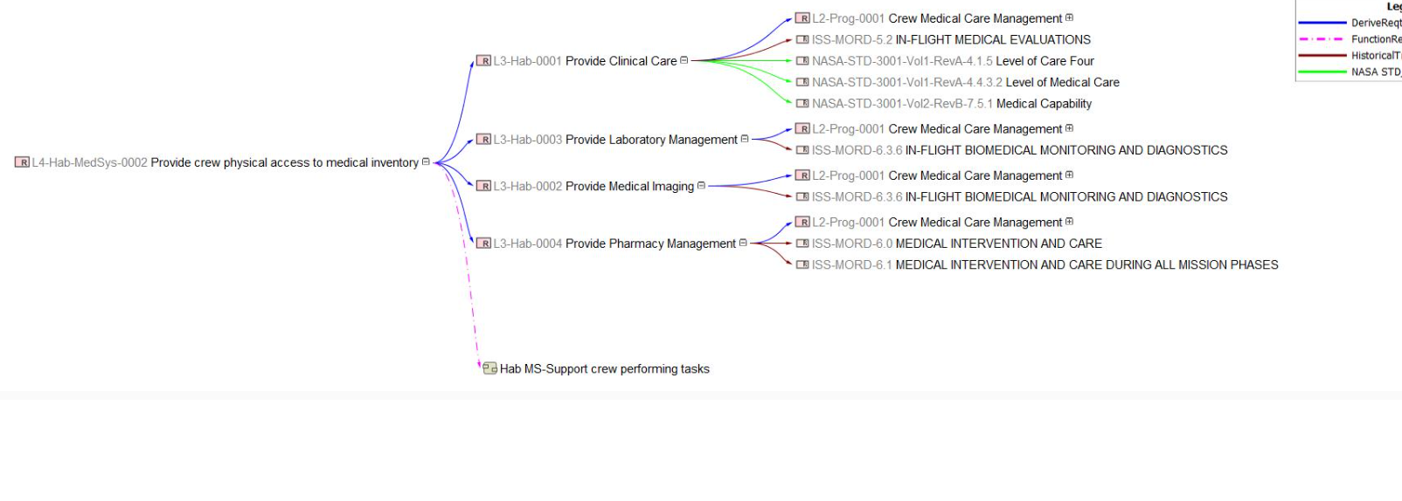
How Do You Model Requirements?
Requirement Sources and Types
NASA-STD-3001
Historical (ISS) Documents
Level 2, Level 3, Level 4, Level 5 Requirements
Tracing
Requirements to Parent Requirement
Functions to Requirement
Clinical Capabilities to Clinical Conditions
Clinical Resources to Clinical Capabilities
Take away = There isn't one way
Notes:
Once we know what the System will do, we capture the requirements.
Typically people are trying to capture the requirements in tables or show traces as relationship diagrams.
These approaches show several ways to visualize the requirements and their traces. The key take away is that the information is in the model. How we show it is based on what user needs and prefers to see.
Along the same line, you don't tie your model to ONLY one tool or language. The goal is showing the information. The understanding is the key. We chose to use MagicDraw and SysML, but there are other ways to show the information. But you should use what makes sense for your environment.

Slide 11
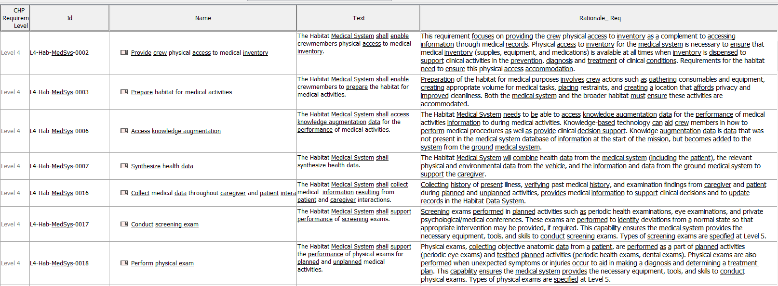
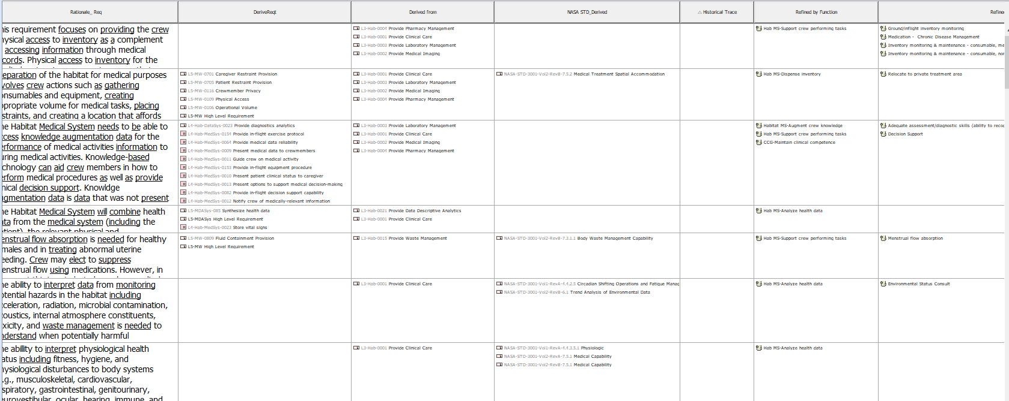
What Requirement Information Is Modeled?
Requirement id, text, rationale
Traces to specifications, requirement levels, clinical data
Notes:
We typically capture requirements in tables or a spread sheet. It is what was easiest for our team. Similarly, one could use a requirements management tool, but you want to be sure those requirements get into your model for tracing.
We capture Level 2, 3, and 4 (also 5) requirements.
We trace requirements to specs and to different levels of requirements
In this table, and these images are from the same table, that I broke to fit on the slide, we show the requirement id, text, the rationale for the requirement, and the other requirements that the requirement traces from or to. Not shown in this view are the traces from clinical data to the requirements.
Having these traces makes it easy to see if a requirement or condition is missing. It also makes it easy to see how one requirement or term affects others. In a tool, that is relatively easy. It is much harder in a Word document.

Slide 12
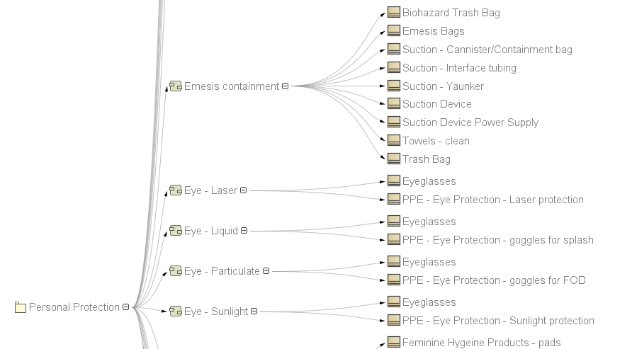
How Have You Involved and Designed to Users?
Goal is to capture and visualize the information provided by subject matter experts (e.g., Clinicians) and other sources to meet the needs of our users.
Clinicians:
Identify the medical conditions
Map the treatment of conditions to the medical capabilities
Identify medical resources needed by those capabilities to treat the conditions
Systems Engineers:
Import information into a model
Show relation maps that visualize the traces
Derive and trace requirements
DISCLAIMER: This is a representative example
Notes:
Here is another view of the traces. The Clinicians and our customers use the traces to confirm the proper relationships between conditions and capabilities using a Relation Map like this one.

Slide 13
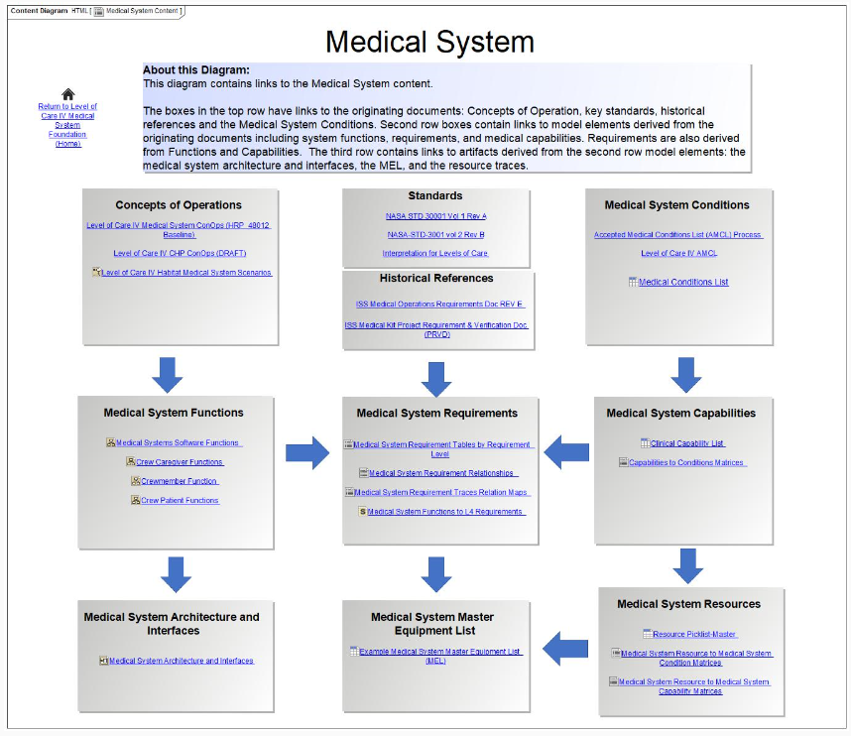
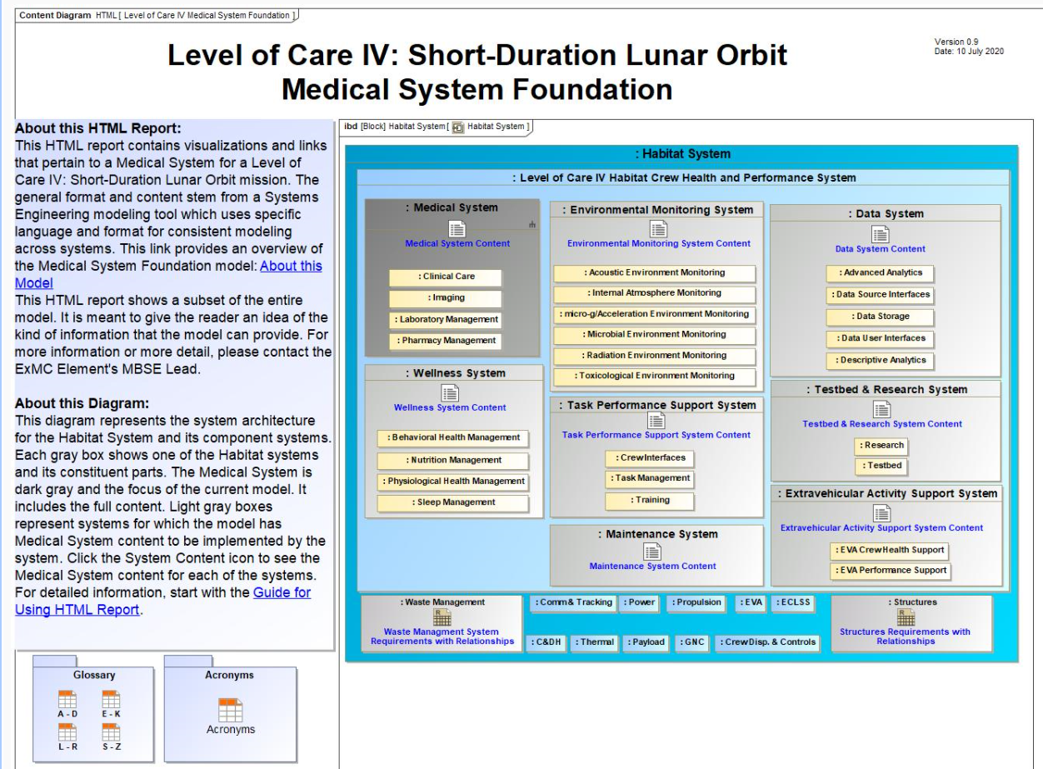
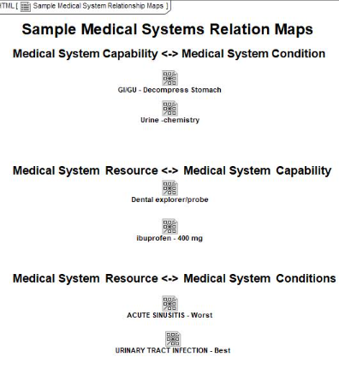
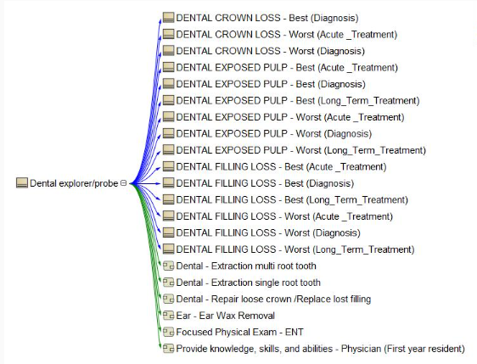
How Do You Share To Modelers and Non-Modelers?
Notes:
Enabling our customers to see what is in the model without having to open the model in a tool is a key requirement for our system.
We generate an HTML report from the model for our users to view the model contents that is important to them.
I’ll show these in more detail on the next few slides.
(only use this if the following slides not allowed)
This visualizes our process. Notice it does not look like the waterfall diagram, but it shows the same content and guides the user from source material, though our derivations, to the needed outputs

Slide 14
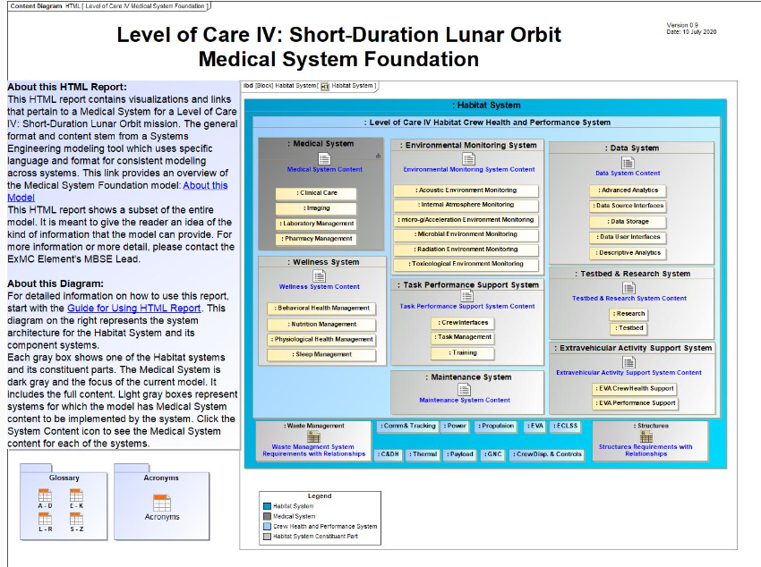
HTML Report – Landing Page
Custom Page
Includes information to guide users
Notes:
This is the landing page of the HTML Report. The version of MagicDraw we are using has a report generator built in.
Notice that this isn’t a standard SysML diagram. It is a custom diagram and you will see several more of these.
We include information that the user needs to know to guide them through using the model report.
We also include an IBD showing the overall environment. This part of the diagram helps the user understand the context of the system.

Slide 15
HTML Report – System Page
Custom page in the model
Links to information
One page for each (sub)system
Notes:
Top Row – Source information. These are links to external documents
Middle Row – Derived information. Center has requirements
Bottom Row – Output Information. Detailed functional analysis, the MEL, and the Resources
Note that this information is the same information shown on the waterfall diagram we saw earlier.
We are going to drill into the model by selecting one of the links, specifically, the link to the Medial System Requirements Relationships.

Slide 16
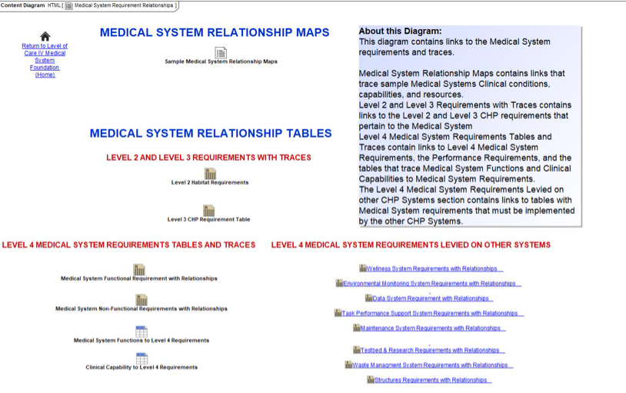
HTML Report – Presenting Requirements
Custom diagrams
Links to requirement tables
Links to relationship maps
Notes:
Again, this is a custom diagram, not a SysML diagram. It has links to the requirements tables and to relationship maps.
We include the tables for level 2, 3, and 4. We also show the trace tables for the Medical System Functions to the requirements and the Clinical capabilities to the requirements. We saw an example of these tables earlier.
On the right side, we have the Medical System Requirements that are Levied on Other Habitat Systems.
Now let’s look at the Medical System Relationship Maps

Slide 17
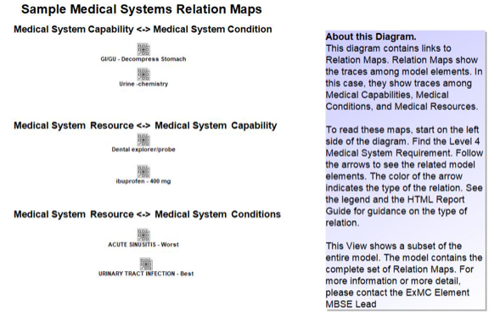
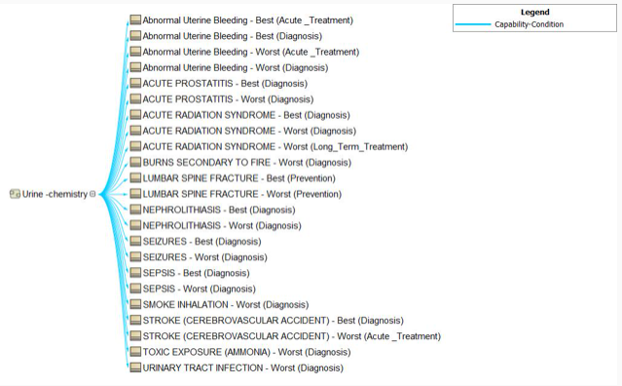
HTML Report – Medical Systems Relationship Maps
Notes:
This is yet another custom, non-SysML diagram.
There are a lot of these relationship maps and we felt it was not beneficial for our audience to view all of them. Therefore, the Clinicians recommended a few examples. As you see in the box, there are many others in the model and we can produce others as needed.

Slide 18

Lessons Learned
Sharing with non-modelers
Who can do the work
Supporting multiple schedule demands
Model centric requires some training
Expect to reorganize (refactor) the model
Need good supporting processes
Have an architecture that supports future uses
Create and use a model management plan
Notes:
Sharing with Non-Modelers
Who Can Do the Work
Student Interns
Limited Time (typically 2-3 months)
Very Good at Coming Up to Speed, with Guidance
Requirements Engineers
SMEs to Capture/Write Requirements
Modeling Systems Engineers
Supporting Multiple Schedule Demands
Challenging, But Very Doable
SE/Modeler Must be on Each Project Team to Keep Focus and Provide Deliverables
Moving from Document Centric to Model Centric
Some Work is Easier on Paper First
All Systems Engineers Need Some Modeling Training
Expect to Reorganize (Refactor) the Model
Need Good Supporting Processes
Change and Configuration Management
Requirements Management
Reviews

Slide 19
Applicable Documents
NPR 7123.1C – NASA Systems Engineering Handbook
JPR 7210.3C – Program/Project Management and Systems Engineering
SP 6105 rev2 – NASA Systems Engineering Handbook
Expanded Guidance for NASA Systems Engineering – Volume 1 and 2
SP-2015-3079 – HSI Practitioners Guide
NASA-STD-3001, Volume 1 – NASA Spaceflight Human-Systems Standard Volume 1
TM 2017-219290 – Interpretation of NASA-STD-3001 Levels of Care for Exploration Medical System Development

Slide 20
ExMC System Engineering Publications
Concept of Operations
HRP 48012 – Recommendation for a Medical System Concept of Operations for a Gateway Mission
JSC 67070 - Medical System Concept of Operations for Mars Exploration Missions
Conference Papers
Amador, J., et al. (2020). Enabling Space Exploration Medical System Development Using a Tool Ecosystem. IEEE Aerospace Conference. Big Sky, MT.
Mindock, J., et al. (2019). A Model-Based Systems Engineering Approach to Exploration Medical System Development. IEEE Aerospace Conference. Big Sky, MT.
Antonsen, E., et al. (2018). Prototype Development of a Tradespace Analysis Tool for Spaceflight Medical Resources. Aerospace Medicine and Human Performance, 108-114.
Mindock, J., et al. (2017). Systems Engineering for Space Exploration Medical Capabilities. Proceeding of the AIAA Space and and Astronautics Forum and Exposition.
Canga, M., et al. (2016). A Strategic Approach to Medical Care for Exploration Missions. International Astronautical Congress. Guadalajara, Mexico.

Slide 21

2020 NASA Systems Engineering Webinar Series
Date | Title | Presenter
June 8th | How to Get Started Using MBSE: The Basics of What, How and Who | Trevor Grondin
July 20th | Systems Engineering and Model Based Systems Engineering Stakeholder State of the Discipline | Jessica Knizhnik
August 17th | An Innovative Jump Start for MBSE Tooling, NTL Results | Samantha Infeld
August 31st | Using MBSE on a Working Project | Kerry McGuire and Jeff Cohen
September 14th | MBSE to MIAMI to Implementation, An Overview | Jessica Knizhnik

Slide 22
Backup

Slide 23
Systems Engineering
From NASA Systems Engineering Handbook
What is Systems Engineering?
A methodical, disciplined approach for the design, realization, technical management, operations, and retirement of a system
What is a “System”?
Collection of different elements producing results not obtainable by elements alone
  Elements = people, hardware, software, facilities …
Value created by relationship among parts - how they are interconnected
Systems Engineering IS:
a way of looking at the “big picture” when making technical decisions
a way of achieving functional, physical, and operational performance requirements
the art and science of developing a system within opposed constraints
a holistic, integrative discipline, wherein the contributions of e.g.,
  structural engineers, electrical engineers, mechanism designers, power engineers, human factors engineers, and many more disciplines (medical!)
are evaluated and balanced… to produce a coherent whole that is not dominated by the perspective of a single discipline.
¹Rechtin, Systems Architecting of Organizations: Why Eagles Can’t Swim.
²Comments on systems engineering throughout the handbook’s Chapter 2.0 are extracted from the speech “System Engineering and the Two Cultures of Engineering” by Michael D. Griffin, previous NASA Administrator.

Slide 24




Crew Health and Performance System Must…
Protect from environmental hazards
  Radiation (SPE, GCR)
  Noise, vibration, CO₂, etc.
  Microbiome of the built environment
Keep healthy crew well
  Exercise
  Other physiological countermeasures
  Food
  Behavioral health
Prevent, diagnose, treat, manage long-term health care
  Data system
  Medical devices
  Medical supplies
Support crew to accomplish mission tasks
  Procedures
  Training
  User interfaces

Slide 25





Applying Systems Engineering to Support CHP Integration
Habitat System
Crew Health and Performance
Crew Health
and Wellness
Environmental Health
Crew Performance
Crew as Caregiver
Medical
Crew as Explorer or Patient
Crew Health and Performance Data
Structures
Avionics & Software
Guidance, Navigation and Control
Comm & Tracking
Power
etc.
Ground System
MedOps
Notes:
This is a way we had showed the model. You can see how different this is from where we are now.

Slide 26
Level of Care Capabilities
Mission
Risk
In Flight
Capability
In Flight
Decision Making
Med Evac
Capability
Level 1
LEO <8d
Low
Low
High
Low
Level of Care Influencers
Mission and Objectives
Risk
Duration
Time to Definitive Care
Health and Performance
Level of Training for Medical Provider
Technology and Medical Advances
Level 2
LEO <30d
Level 3
Post LEO <30d
Level 4
Lunar >30d
Level 5
Lunar/Planetary
>210d
High
High
High
Low
Notes:
As team embarked on this exercise, it was important for us to recognize factors that impact the level of care as we wrote definitions and identified the example actions: (see “Level of Care Influences”)
For example, Capability at each of the Levels of care increases as the mission duration and distance from earth increases. The definitions and example actions were written to show this graduation. This is helpful when considering that planetary missions might include multiple phases of varying levels of care and how those levels will change when transitioning between the phases.

