Slide 1


NASA GEOS Composition Forecast System: “GEOS-CF”
K. Emma Knowland
USRA/GESTAR
NASA Global Modeling and Assimilation Office (GMAO)
In collaboration with:
GMAO: Christoph Keller, Lesley Ott, Steven Pawson, Pamela Wales
Atmospheric Chemistry and Dynamics Lab: Bryan Duncan
13 August 2020

Slide 2
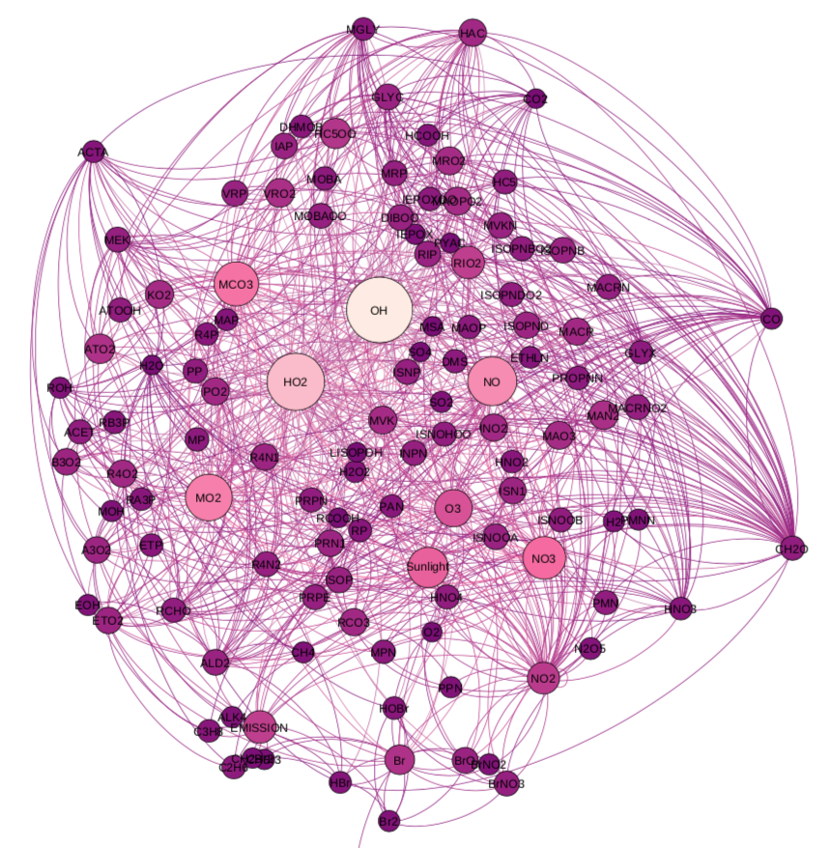
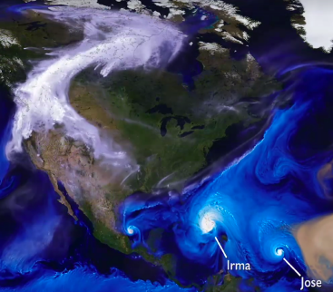

GEOS Composition Forecast
GEOS - CF
GEOS NWP
GEOS - Chem
25-km global resolution analyses based on daily weather/emissions and daily five-day forecasts
Released to the community on September 17, 2019; products start on January 1, 2018
https://gmao.gsfc.nasa.gov/weather_prediction/GEOS-CF/
k.e.knowland@nasa.gov christoph.a.keller@nasa.gov
Notes:
The GEOS Composition Forecast system was many years in the making; we run a coupled version of the GEOS model with the GEOS-Chem chemistry module. This capability is a successful result of MAP-funded research aligning with GMAO’s Core work. We started in early 2017 with our first experimental GEOS-CF forecast system, and in late 2018 shared the forecasts as images only on the GMAO FLUID website and last September we released the forecast and analysis data to the public. Next slide.

Slide 3
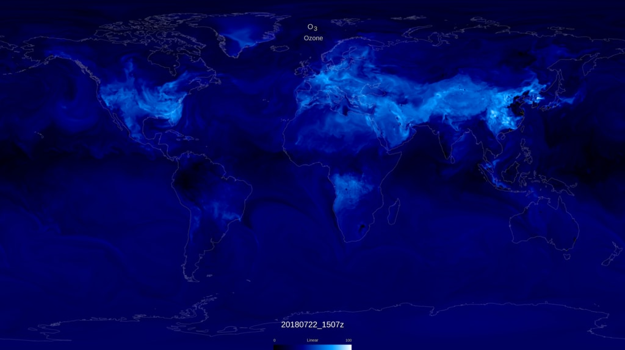
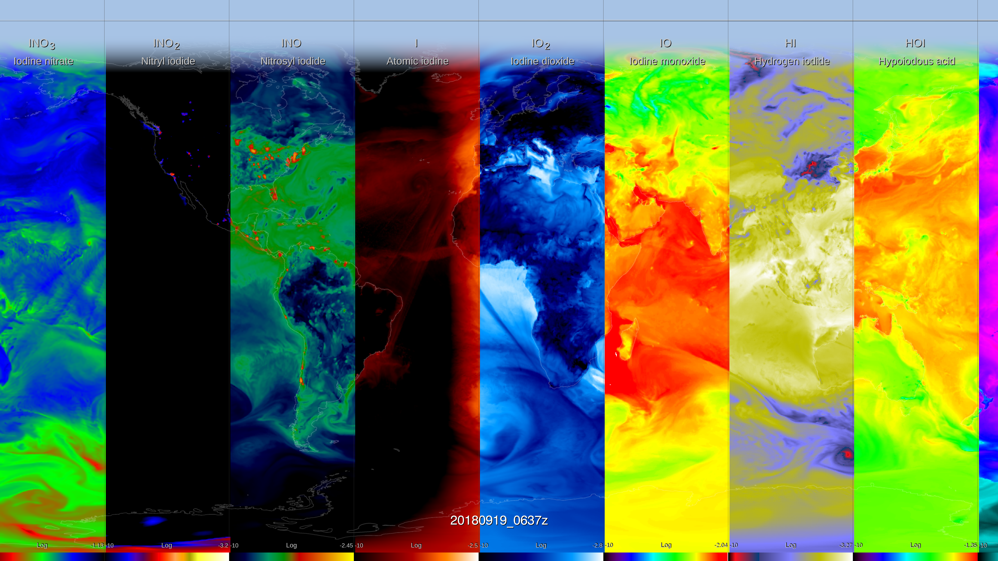
GEOS - Chem
  250 Chemical Species
  725 Chemical Reactions
https://svs.gsfc.nasa.gov/4754
GEOS-Chem v12
Tropospheric and Stratospheric chemistry
https://gmao.gsfc.nasa.gov/weather_prediction/GEOS-CF/
k.e.knowland@nasa.gov christoph.a.keller@nasa.gov
Notes:
GEOS-Chem is a state-of-the science chemistry transport model maintained by the Harvard folks with a global community of developers and users. It’s a complex chemistry model, with full tropospheric and Stratospheric chemistry with about 250 reactive species and over 700 reactions in the version 12 that we are running. These images are from two SVS animations produced last year, illustrating surface ozone in the top right, and in the animation, we can see the diurnal cycle of surface ozone, with highest concentrations in white during the day close to urban centers and near forest fires, while at night the ozone is low in these urban areas due to NOx titration.
The animation captured in the bottom left highlights the complexity of the GEOS-Chem chemistry, showing 96 species that play a part either directly or indirectly in simulating ozone chemistry. The bottom left shows just a few of these different species and you can see the interaction with the large-scale synoptic weather systems, as well as evidence for the emission sources like the ship tracks. Next slide.

Slide 4
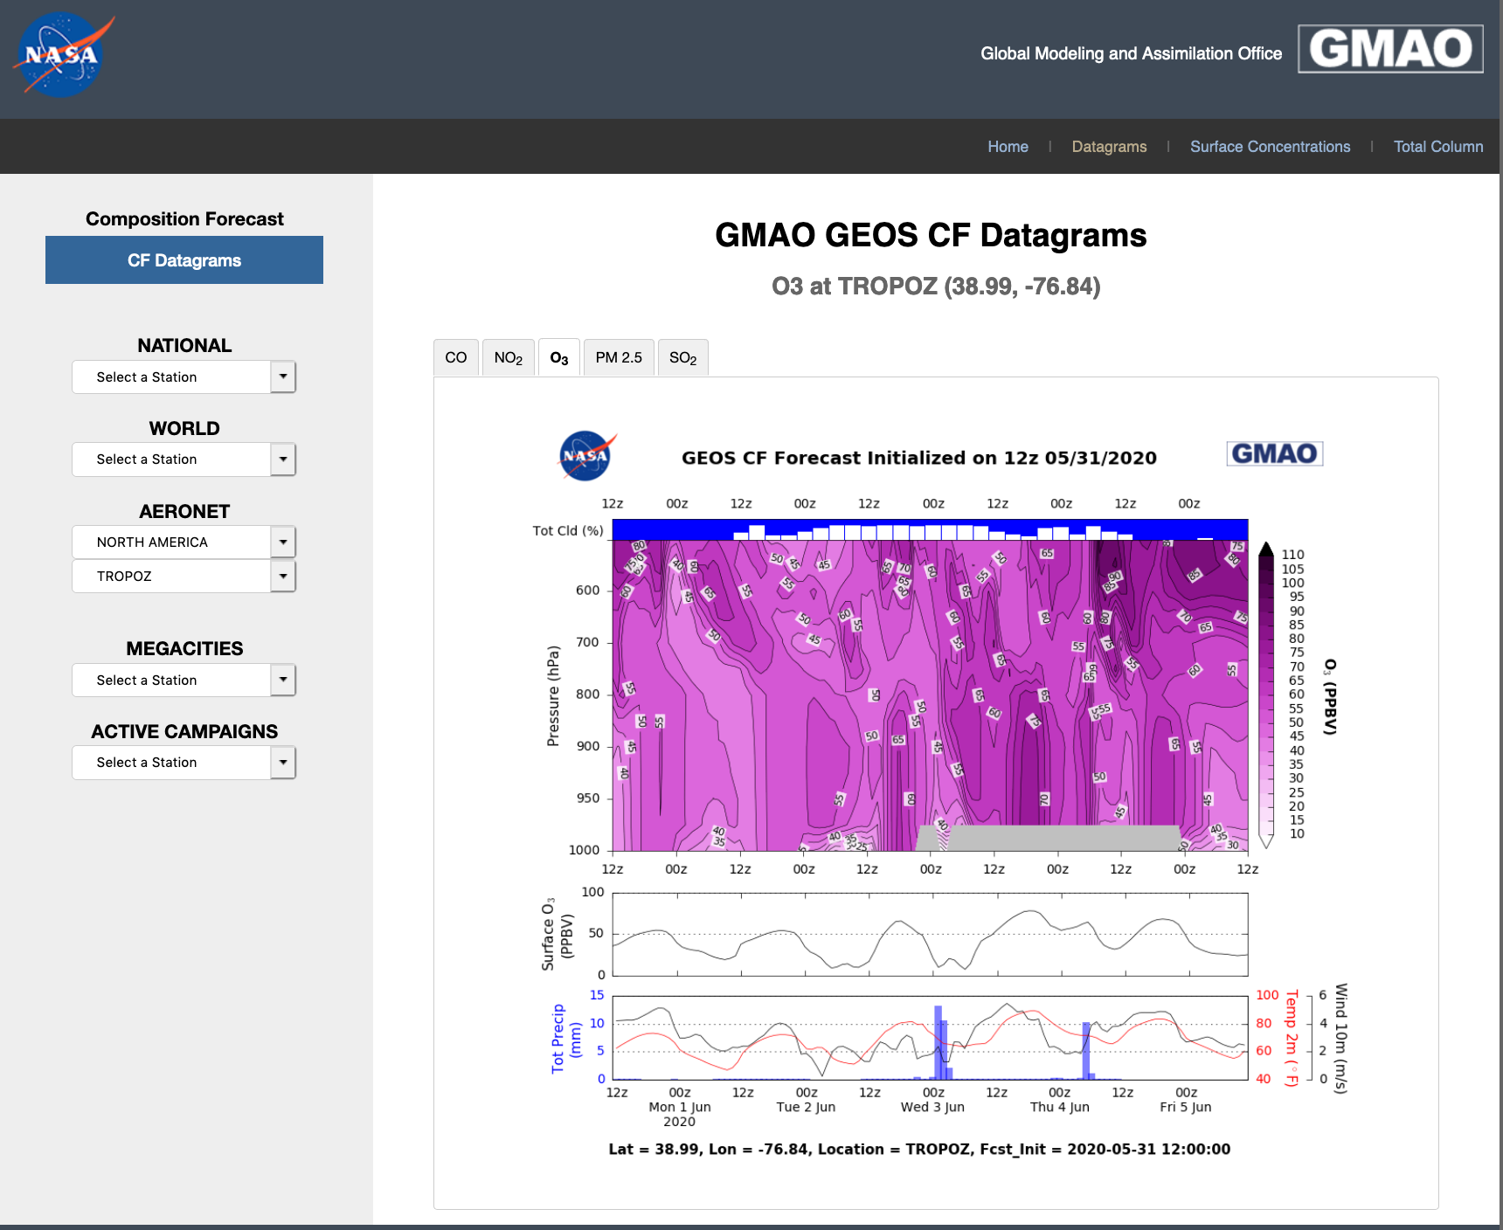
GEOS-CF Products
One 5-day global forecast per day:
  1-day meteorological replay (“analysis”)
  5-day forecast, initiated at 12Z
  c360L72 resolution (0.25°), ~25x25 km², 72 layers
  Chemistry: O₃, NO_{x}, CO, VOCs, PM, …
  Meteorology: T, U, V, RH ....
Data distributed via OpenDAP and web link:
  15 minute “surface” fields
  1-hour average and instantaneous 2D & 3D
  Summary plots on “FLUID” website
  Documentation in GMAO Office Note #17
https://fluid.nccs.nasa.gov/cf/
https://gmao.gsfc.nasa.gov/weather_prediction/GEOS-CF/
k.e.knowland@nasa.gov christoph.a.keller@nasa.gov
Notes:
Each day, starting around 3pm, we launch the GEOS-CF following the completion of the 12z GEOS-FPIT run. This is because, in order to have the best initial conditions for our 5-day forecast, we first run a meteorological replay to GEOS-FPIT now with the GEOS-Chem chemistry. We run the model at the highest spatial resolution of a global composition forecast system that we are aware of, at 0.25 degree, and now we have the chemistry on the same spatial and temporal resolutions as the meteorology. Since the end of each replay simulation is the start of the next day’s simulation, we can stitch these together for a continuous dataset since January 2018. We released to the public high-temporal frequency data with a focus on air quality, so we have surface level concentrations and meteorological fields at 15-minute intervals, which makes for great animations as highlighted in the previous slide, and also 1-hourly intervals again for surface diagnostics and 3D composition and meteorology limited to the troposphere and lower stratosphere. Next slide.

Slide 5
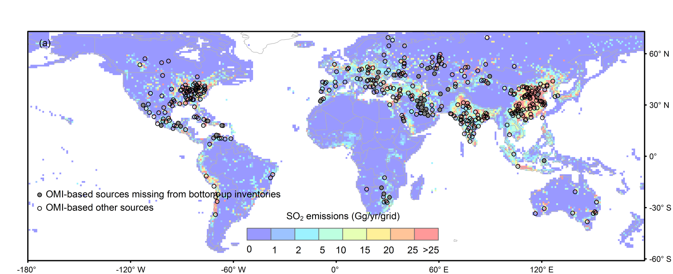
Year-to-year emissions changes
Emissions:
  HTAP (global bottom-up) for anthropogenic.
  Online dust, sea salt, plant emissions
  Annual gridded scale factors based on satellite data are applied to the emissions of CO (Oda et al., 2017) and SO₂ (Liu et al., 2018).
  “Business-as-usual” assumed for 2020
SO₂ emissions in the OMI-HTAP inventory
A new emission inventory, OMI-HTAP, combines OMI-based SO₂ emissions for large sources and the bottom-up inventory, HTAP, for smaller sources.
Liu, F., et al., Atmos. Chem. Phys., 18, 2018.
https://gmao.gsfc.nasa.gov/weather_prediction/GEOS-CF/
k.e.knowland@nasa.gov christoph.a.keller@nasa.gov
Notes:
But what goes into the model also helps us to correctly simulate air quality.
We use the monthly averages from HTAP v2.2 for the anthropogenic emissions, and several online parameterizations for things like dust, sea salt and biogenic emissions
To improve on the base emissions, we use a bunch of different scale factors, such as annual gridded scale factors based on satellite data to better capture sources and trends. Specifically, we use Fei Liu’s OMI-HTAP inventory.
Given COVID-19 era that we are living in right now, it is important to mention that our base year for emissions is 2018, and this was continued for 2019 and 2020, so any changes in anthropogenic emissions due to COVID-19 restrictions are not likely picked up by the model. Next slide.

Slide 6
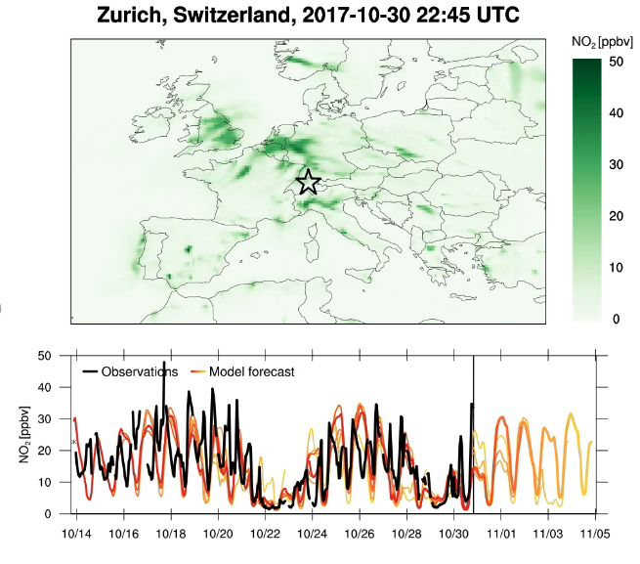
Daily variations of emissions
  Scale factors applied to emissions for diurnal and weekly variations
  These are clearly beneficial for surface NO₂ analyses and forecasts
  Shown for Zurich - weather and diurnal/weekly signals are prominent
  Surface observations obtained through emerging connection to OpenAQ (openaq.org)
Observation
0 +1 +2 +3 +4 +5
GEOS-CF
https://gmao.gsfc.nasa.gov/weather_prediction/GEOS-CF/
k.e.knowland@nasa.gov christoph.a.keller@nasa.gov
Notes:
In addition, the monthly average anthropogenic emissions are broken down into hourly values using sector-specific day-of-week and diurnal scale factors. This can be seen nicely in the example on the left of surface concentrations of NO2 over Europe. On the bottom is a time series comparing the observations of NO2, shown in black, from Zurich, Switzerland obtained from OpenAQ’s database, and the daily GEOS-CF replay (in red) and 5-day forecast (transitioning to more yellow colors). And what you can see, is the diurnal variability of the model agrees well with the observations, and we can see the flattening of the diurnal variability on Sundays October 22nd and October 29th. Next slide, please

Slide 7
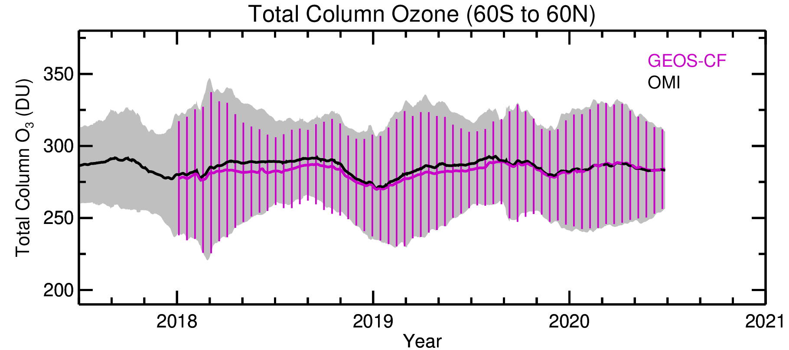
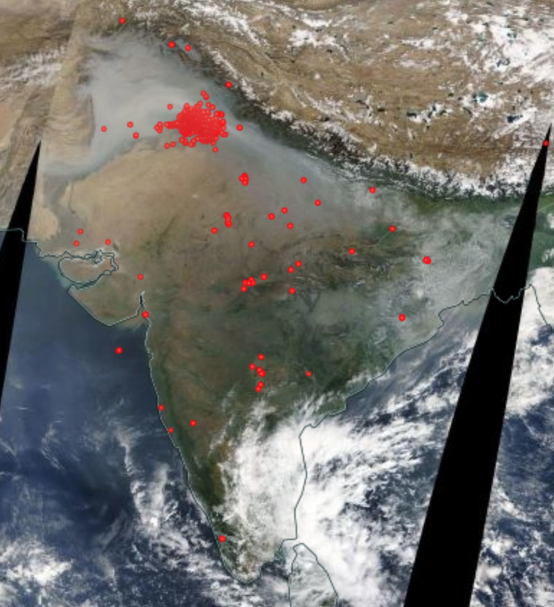
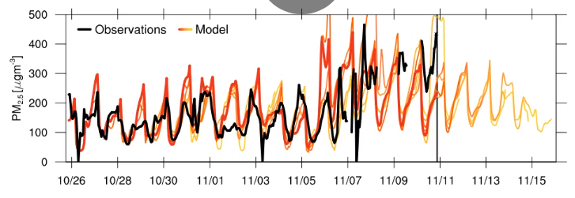
Near-real time updates from satellite data
  Biomass burning emissions from near-real time QFED v2.5
  GEOS-CF Stratospheric O₃ is weakly nudged to the GEOS FP assimilated O₃
MODIS fires Nov 01, 2017
Delhi, India Nov 2017
Observation
0 +1 +2 +3 +4 +5
GEOS-CF
https://gmao.gsfc.nasa.gov/weather_prediction/GEOS-CF/
k.e.knowland@nasa.gov christoph.a.keller@nasa.gov
Notes:
While there is no direct data assimilation of chemical species in the GEOS-CF system, there is near-real time information constraining parts of the system, even during this COVID-19 period. We use the near-real time QFED to inform the system of biomass burning emissions. On the right, is a MODIS image from Nov 2017, with the red dots indicating the fire locations. On the left, is a time series of PM2.5 for Delhi for this same time period. In the forecasts, with persistence of the biomass burning emissions, there can be large discrepancies between the forecasted PM2.5 and the observed PM2.5, depending on the meteorological conditions and the fire intensity.
In order to take advantage of the established GEOS ozone data assimilation system before we could implement the das in the GEOS-CF, we devised a way to nudge only stratospheric ozone toward the GEOS FP assimilated O3, with the intention to keep our ozone in line with observations while still allowing GEOS-Chem to do its thing. We’ll show examples for the ozone later. Next slide.

Slide 8
Planned upgrades for GEOS-CF
Model update to GEOS-Chem v13.0
  Improvements to ozone deposition
  Updates to isoprene scheme ⇢ likely improve the summertime O₃ high bias SE US
  Updates to NO₃ washout ⇢ likely reduce PM2.5 bias
Coupling GEOS-Chem aerosols with GOCART aerosols (ongoing R&D)
  Aerosol data assimilation
  Climate interactions
Chemical data assimilation system (ongoing R&D)
  Multi-constituent assimilation with O₃, CO, NO₂
  Satellite-based emission scale factors (already tested for COVID-19 experiment)
Meteorology update to GEOS-FP
  Alignment to transport, convection, PBL (etc.) in most recent GEOS systems
  Potential for higher spatial resolution
https://gmao.gsfc.nasa.gov/weather_prediction/GEOS-CF/
k.e.knowland@nasa.gov christoph.a.keller@nasa.gov

Slide 9
Summary of GEOS-CF Status
GEOS-CF daily global composition forecasts at 25km resolution are generated in near-real time:
  High-resolution “Analysis” fields are available since January 2018
  Forecasts remain available on data servers for two weeks
  The forecasts of the five most-requested surface pollutants (O₃, NO₂, CO, PM2.5, and SO₂ ) – remain accessible via data servers for January 2019-present
Forecast visualizations and links to data available at: fluid.nccs.nasa.gov/cf
Emerging applications users, including:
  NASA field missions (SCOAPE, FIREX-AQ, ACT-America)
  Daily alerts sent to NASA TOLNet lidar teams (Matt Johnson, NASA/Ames)
  TEMPO a priori for trace gas product
Notes:
for January 2019 – present

