Slide 1

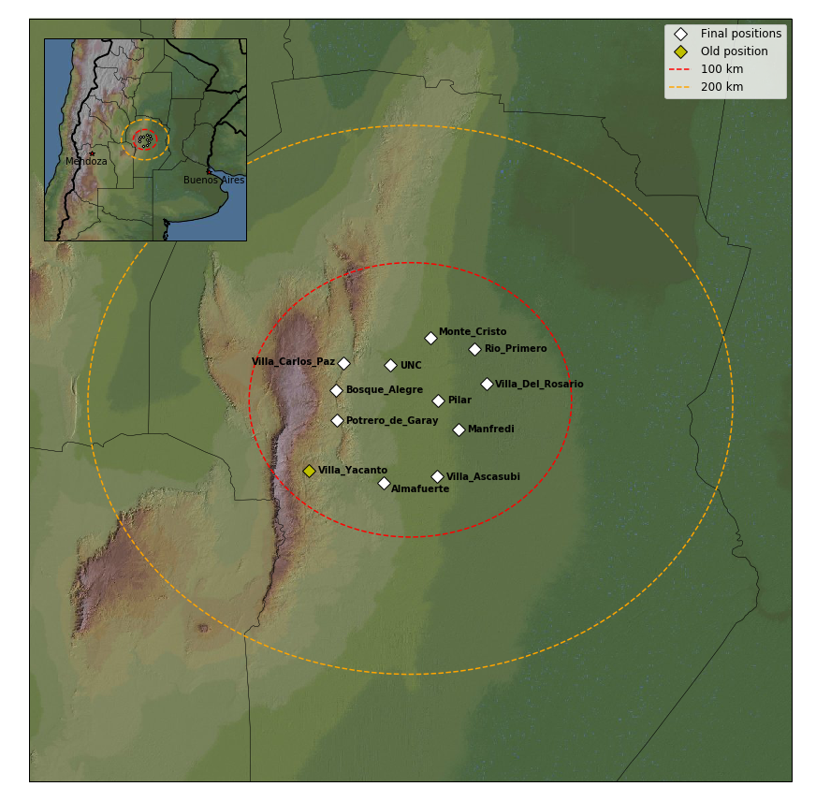
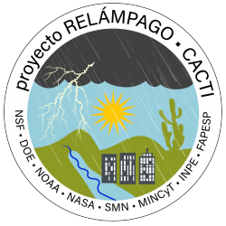
GLM Validation with the RELAMPAGO Lightning Mapping Array
Timothy Lang – NASA Marshall Space Flight Center
Introduction
11-station LMA near Cordoba, Argentina
Ops 8 Nov 2018 – 19 Apr 2019
Primarily funded by GOES-R, deployed by MSFC & partners
Supported NSF/DOE/NASA/NOAA/ Argentina/Brazil RELAMPAGO-CACTI field campaign

Slide 2
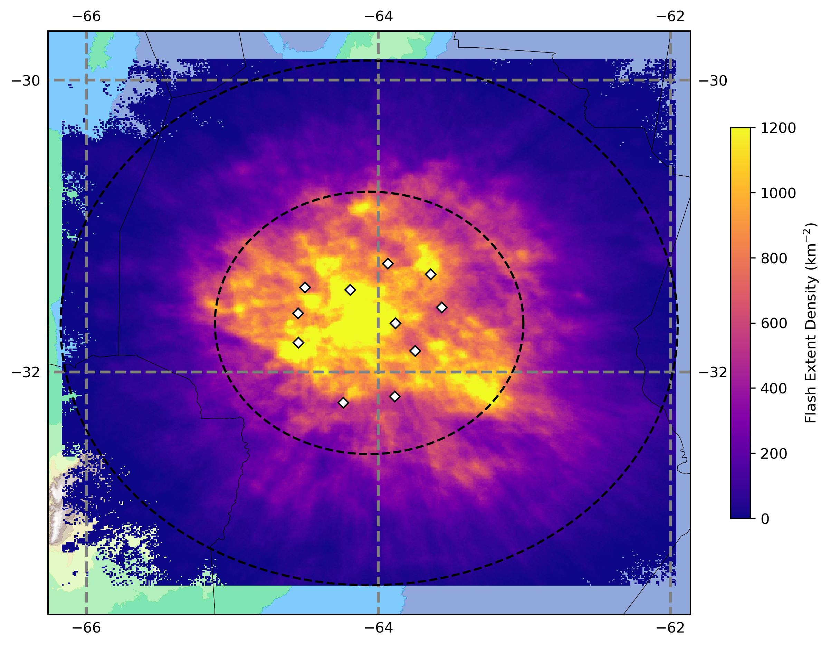
Methods
Focus on lightning within 100 km of LMA
71 case days – Full thunderstorm spectrum
LMA source data processed to flashes using lmatools
Flash-level GLM-16 from L2 LCFA
Unit of comparison: 10-minute blocks
Thresholding: 25-km distance and +/- 500 ms
Allowing 1 GLM flash to correspond to multiple LMA flashes
Day = 11-22 UTC; Night = 00-08:30 UTC
RELAMPAGO LMA FED – Whole Deployment

Slide 3
Results
Overall good GLM performance in north-central Argentina
DE negatively correlated with flash rate – implications for usage in case studies (see next slide)
(Spearman rank correlations significance
p << 0.01)
 | Day | Night | Overall | Notes
GLM Detection Efficiency | 71% | 84% | 77% | 10+ LMA pts (2% less for 3+ pts)
GLM/LMA Flash Rate Correlation | 0.95 | 0.97 | 0.95 | 3+ LMA pts
Correlation of DE w/ TFR | -0.38 | -0.62 | -0.50 | 3+ LMA pts
Correlation of DE w/ Points per LMA Flash | 0.28 | 0.22 | 0.24 | 3+ LMA pts
Correlation of DE w/ Flash Altitude | -0.28 | -0.35 | -0.31 | Influence of stratiform lightning

Slide 4
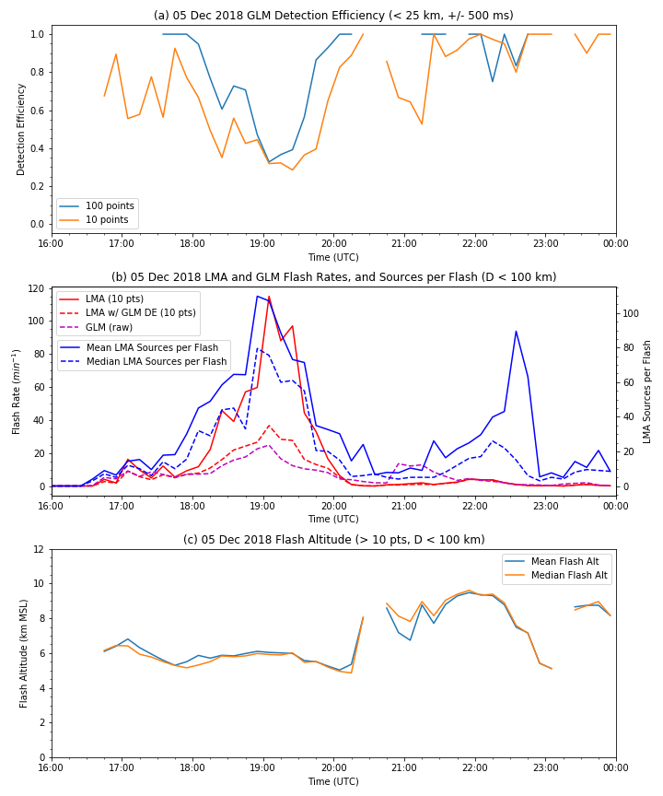
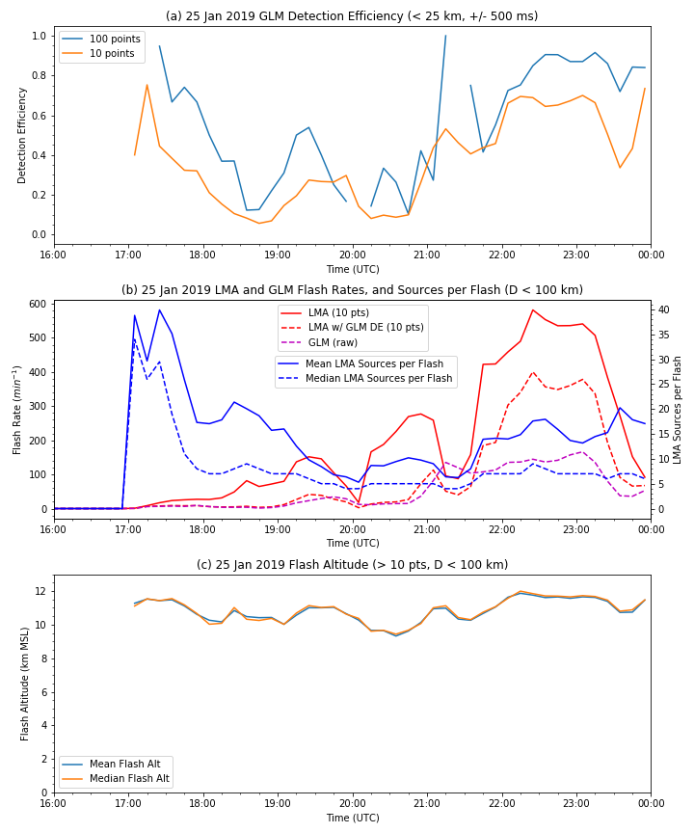
5 Dec 2018
25 Jan 2019
GLM DE
GLM DE
LMA Rate/Size
LMA Rate/Size
LMA to 6 stns
Altitude
Altitude
Anomalous storm – Low-altitude convective flashes
Severe convection – Small flashes, increase in DE @ dusk

Slide 5
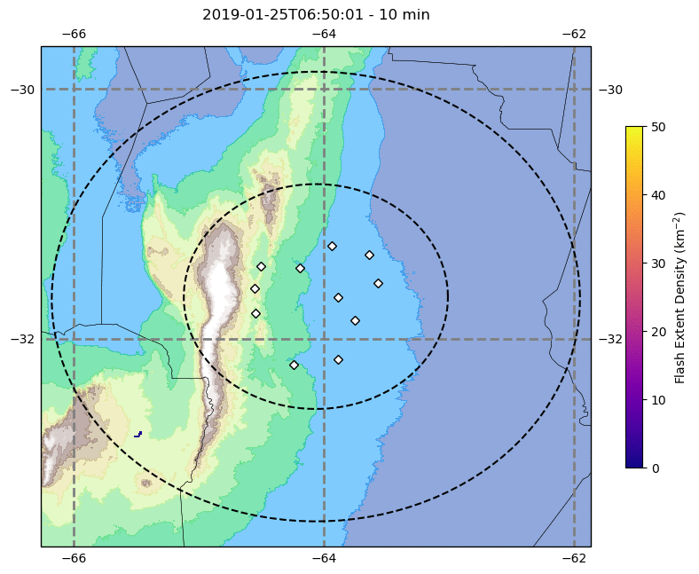
Conclusions
Despite favorable bulk statistics, RELAMPAGO LMA provides significant evidence that GLM detection efficiency degrades in intense, high-flash-rate convection, as well as anomalous storms
Sensitivity study – Halving match criteria to 250 ms & 12.5 km gives 65% night & 57% day DE (60% overall)
RELAMPAGO LMA data available @ http://dx.doi.org/10.5067/RELAMPAGO/LMA/DATA101
RELAMPAGO LMA FED – 25 Jan 2019
RELAMPAGO LMA References
Lang, T. J., and Coauthors, The RELAMPAGO Lightning Mapping Array: Overview and initial comparison to the Geostationary Lightning Mapper. J. Atmos. Oceanic Technol., doi: https://doi.org/10.1175/JTECH-D-20-0005.1.
Peterson, M. J., Lang, T. J., Bruning, E. C., Albrecht, R., Blakeslee, R. J., Lyons, W. A., et al. (2020). New WMO Certified Megaflash Lightning Extremes for Flash Distance (709 km) and Duration (16.73 seconds) recorded from Space. Geophysical Research Letters, 47, e2020GL088888. https://doi.org/10.1029/2020GL088888
Zhu, Y., Bitzer, P., Stewart, M., Podgorny, S., Corredor, D., Burchfield, J., et al. (2020). Huntsville Alabama Marx Meter Array 2: Upgrade and capability. Earth and Space Science, 7, e2020EA001111.https://doi.org/10.1029/2020EA001111
Borque, P., L. Vidal, M. Rugna, T. J. Lang, M. G. Nicora, and S. W. Nesbitt (2020). Distinctive Signals in 1-minute Observations of Overshooting Tops and Lightning Activity in a Severe Supercell Thunderstorm. Conditionally accepted in Journal of Geophysical Research: Atmospheres.

