Slide 1
NASA Electrified Aircraft
Propulsion Control
Joseph W. Connolly
NASA Glenn Research Center
Propulsion and Power Systems Alliance
Virtual Meeting
August 26th, 2020
NOTICE FOR COPYRIGHTED INFORMATION
This is a work of the United States Government authored as part of the official duties of employee(s) of the National Aeronautics and Space Administration. No copyright is claimed in the United States under Title 17, U.S. Code. All other rights are reserved by the United States Government. Any publisher accepting this work for publication acknowledges that the United States Government retains a nonexclusive, irrevocable, worldwide license to prepare derivative works, publish or reproduce the published form of this work, or allow others to do so, for United States Government purposes.

Slide 2
Aeronautics Research Mission Directorate Drivers
Strategic Thrust 3 | Critical Commitment 3.1
Ultra-Efficient Subsonic Transports: Realize revolutionary improvements in economics and environmental performance for subsonic transports with opportunities to transition to alternative propulsion and energy. | Demonstrate technologies for practical vehicle-level integration of high-power (1MW+) electrified aircraft propulsion systems with advanced airframe systems for initial applications to small transport aircraft.
Electrified Aircraft Propulsion (EAP) architectures require a high level of propulsion, power, and thermal system integration to realize benefits at the vehicle level.
Transformative Aeronautics Concepts Program
  Transformational Tools and Technologies
Advanced Air vehicles Program
  Advanced Air Transport Technologies
Integrated Aviation Systems Program
  Electrified Powertrain Flight Demonstration
FY18-19
Controls
Development
FY20-23
Controls Hardware
Component Test
Potential Controls Technology for Parallel Hybrid
NASA Glenn Research Center
www.nasa.gov
2
Notes:
Proposed Technical Challenges Address Needs for Critical Commitment 3.1
TC 10.1: Focused Technologies for EAP Demo
Focuses on a practical demonstration of the electrical portions of a vehicle’s electrified powertrain
TC 14.1: Turbofan Power Extraction
Focuses on the demonstration of turbofan power extraction with sufficient thrust, efficiency, operability, and durability to enable EAP concepts

Slide 3
EAP Control Technology Roadmap
Dynamic Modeling and Control Design Tools
Tools for dynamic modeling of EAP systems
TTT Project
Linearization process
Integration of thermal management models
Modeling of control system redundancy
Real-time model generation process
Component degradation modeling and system fault modeling
EAP Control Strategies
Turbine Electrified Energy Management (TEEM)
AATT/TTT Project
Integrated EAP Control for Efficiency, Operability, Stability, and Thermal Management
Optimal Energy Management for Hybrid Electric Designs
Fault Management & Certification
Novel cycle engine control
AATT Project
Define thrust control interface between aircraft and EAP
EAP fault detection approaches
Functional hazard assessment of EAP systems
Integrated EAP fault detection and accommodation approaches
Real-Time Simulation and HIL Testing
Real-time simulation and hardware-in-the-loop testing of EAP control strategies
EPFD/AATT Project
Controls HIL, AATT, EPFD Potential Demos
FY2019
FY2020
FY2021
FY2022
FY2023
FY2024
FY2025
Notes:
Challenges:
Growing need for integrated tools that enable a faster assessment of changes in dynamic modes of operation and their impact on system level design.
Future Work:
Continue to develop dynamic modeling tools to provide a common controls modeling environment, integrating propulsion, power, and thermal systems.
Verify concepts and algorithms in hardware in the loop demonstrations.
Push relevant technology into flight demonstration to reduce risk of technology being adopted by industry partners.

Slide 4
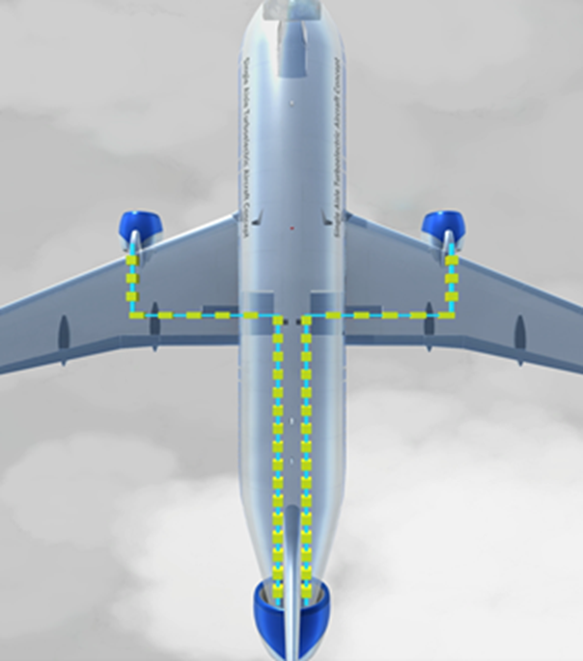
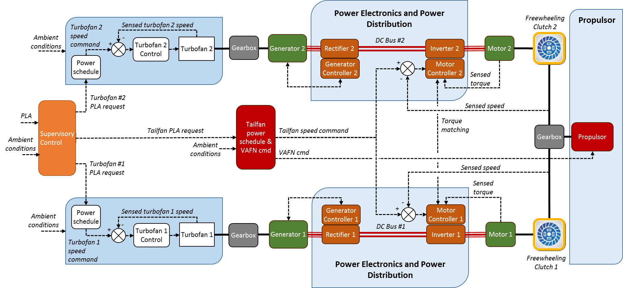
Simple Distributed Propulsion Concept Overview
GTF 1
GTF 2
Pwr Sys 1
Pwr Sys 2
Tailfan
NASA Single-aisle Turboelectric AiRCraft with Aft Boundary Layer propulsor (STARC-ABL)
Two wing-mounted geared turbofan engines produce thrust and supply mechanical offtake power to generate electricity
Generators and rectifiers convert mechanical power into electricity
Electricity transferred over two parallel power buses
Inverter and motors convert electricity into mechanical power supplied to tail fan propulsor
Tail fan propulsor applies boundary layer ingestion for increased propulsive efficiency
Notes:
GTF Control
Tailfan Control
Power schedule
Power Lever Angle (PLA) commands target fan speed (N1)
Power Lever Angle (PLA) commands target fan speed (N1)
Primary control loop
Modulates fuel flow (Wf) to achieve target N1
Modulates motor power to achieve target N1
Transient control schedule
Wf/Ps3 vs N1
N1dot vs N1
Variable geometry
Variable Area Fan Nozzle (VAFN)
Variable Bleed Valve (VBV)
Variable Area Fan Nozzle (VAFN)
Control limits
Speeds, fuel flow, Wf/Ps3
Speed, motor power

Slide 5
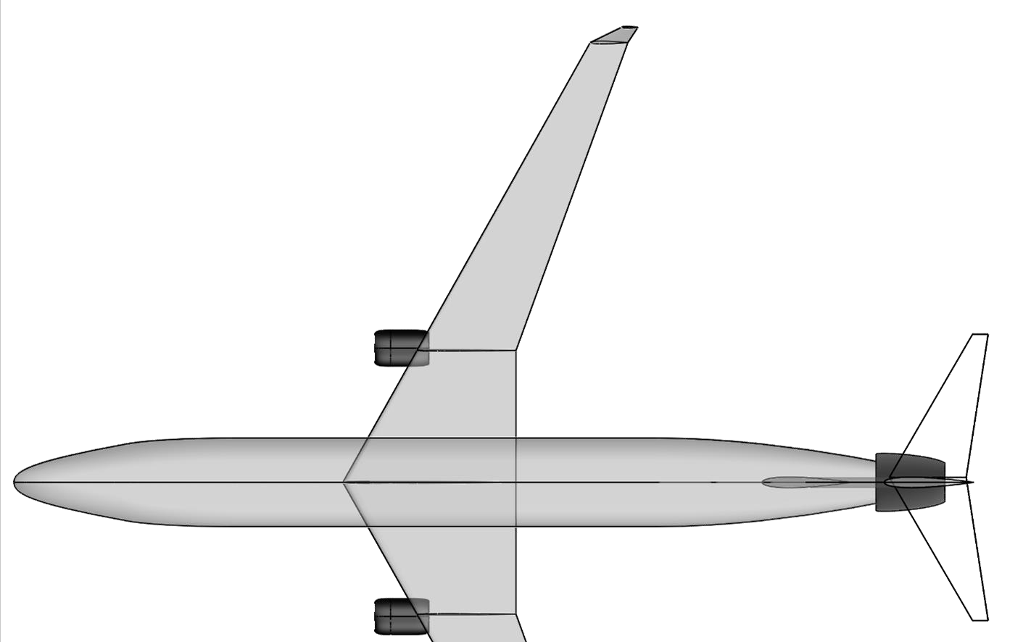
STARC-ABL Architecture
STARC-ABL design in NPSS and converted to MATLAB® Simulink®
  Turbomachinery coded in Toolbox for Modeling and Analysis of Thermodynamic Systems
  Electrical component coded using a power flow modeling approach
  Separate controllers for each GTF and the Tailfan
Initial architecture contained no energy storage, controls and failure analysis could require minimal energy storage for bus stability and transient optimization.
1.3 FPR engines
2000 HP (1.4 MW)
generator
57 inch fan
1.25 FPR Electric Fan
3500 HP (2.6 MW) motor
77 inch fan
1/3 Cruise Thrust
90% efficient transmission
1000 Volt electrical system
Electrical Component Assumptions
Component | Spec Pwr/Wt | Efficiency
Generator | 8 hp/lb | 96%
Motor | 8 hp/lb | 96%
Inverter | 10 hp/lb | 98%
Cable | 3.9 kg/m | 99.6%
1/3 Cruise Thrust
Notes:
Design cruise Mach number increased from 0.7 to 0.785
Modified wing sweep angle to accommodate increased Mach number
Using NASA Glenn N+3 geared turbofan model
Empirical estimates for propulsion weight replaced by WATE++ analysis
Improved weight estimates of thermal management system
Onboard voltage increased from 750 to 1000 volts
Underwing engine fan pressure ratio decreased from 1.45 to 1.3
Modified mission constraints to provide comparable performance to N3CC
All other assumptions and methods unchanged from previous analysis

Slide 6
References
EAP Fault Management:
  Simon, D. L., Connolly, J. W. “Electrified Aircraft Propulsion Systems: Gas Turbine Control Considerations for the Mitigation of Potential Failure Modes and Hazards”, ASME Turbo Expo 2020, GT2020-15945.
  Simon, D. L., Connolly, J. W. Culley, D. E. “Control Technology Needs for Electrified Aircraft Propulsion Systems” Journal of Engineering for Gas Turbines and Power, 2019, Vol.142.
EAP TEEM Control:
  Culley, Kratz, Thomas, “Turbine Electrified Energy Management (TEEM) for Enabling More Efficient Engine Designs” AIAA 2018-4798
  Kratz, Culley, Thomas “A Control Strategy for Turbine Electrified Energy Management” AIAA 2019-4499
EAP Optimal Control:
  Accepted: Richter, Connolly, Simon, “Optimal Control and Energy Management for Hybrid Gas-Electric Propulsion” Journal of Engineering for Gas Turbines and Power, Vol. TBD 2020

