Slide 1


ATM-X
Air Traffic Management – eXploration
KDP-CA
July 14th, 2020
William N. Chan, Project Manager
Mike Madson, Deputy Project Manager
Bryan Barmore, Ph.D., Deputy Project Manager for Technology
Kevin Witzberger, Phase 2 Planning

Slide 2
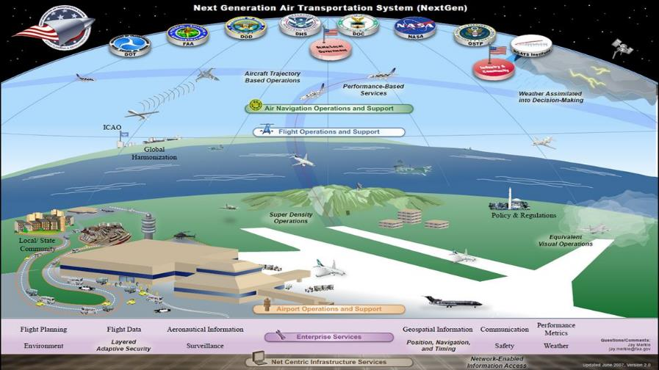
NextGen Vision for 2025

Slide 3
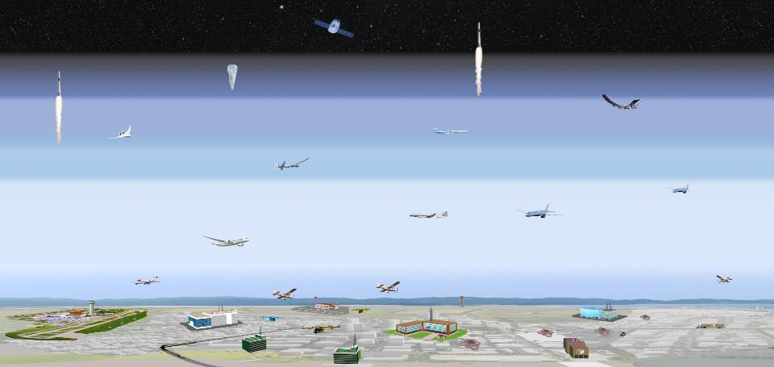
Future NAS with More Diverse Operations
High Altitude
Launch Vehicle
Operations
Supersonic
Large UAS
Commercial
Regional
General Aviation
Low Altitude Urban
Small UAS

Slide 4
Emerging Operations Challenges
Emerging operators want to enter the airspace and cannot always fly their desired missions
Operational flexibility is inhibited by flight rules and procedures based on legacy technologies
Airspace Management Systems are centralized and slow to modernize
Emerging operations will increase controller workload without changes to airspace procedures or improved airspace automation

Slide 5
Project Strategy
Develop Requirements for a Scalable Service-Oriented Architecture to Accelerate NAS Modernization
Improve Operational Flexibility with the Development of User-Informed Airspace Management Services
Collaborate with Diverse Range of Industry in NAS Development
Increase the use of NAS Information powered by Advanced Technology

Slide 6
ATM-X Vision and Goal
Vision: Accelerate transformation to a digitally-integrated air transportation system that enables access and increases mobility for all users
Goal: Catalyze the community to provide an all-access, safe, and efficient airspace system through innovative solutions that remove barriers

Slide 7
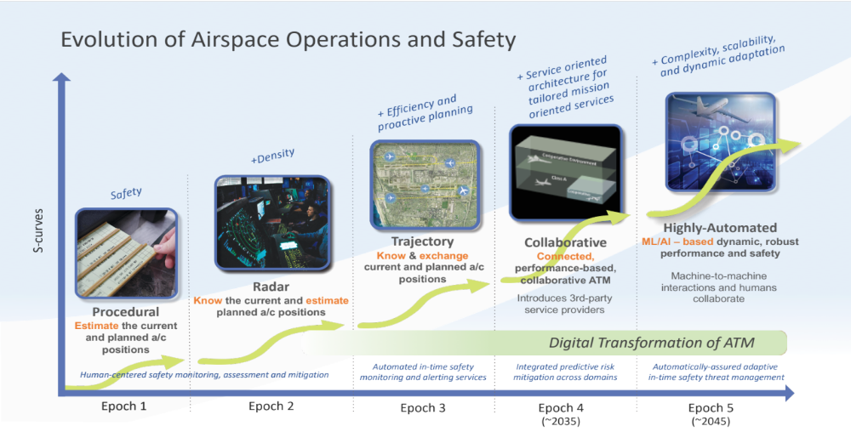
Evolution of Airspace Operations and Safety

Slide 8







Phase 2 Portfolio Down-Select Process
Assess stakeholder needs and timelines
Phase 1 + Engagement
1
2
Phase 1 Deliverables to Phase 2
Other NASA research for Phase 2
Scope within available resources
Phase 2
Portfolio

Slide 9
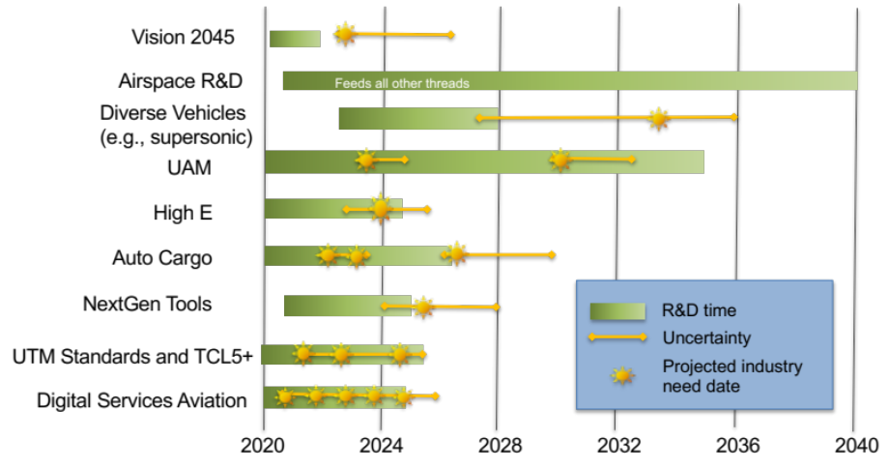
Stakeholder Needs and Timelines – AutoCargo Example
Community Pull
Vehicle manufacturers with timelines ~2024-2026
Operators want initial operations in next few years
Market overlaps with large cargo drones that could operate in a UAM-environment.
Supply delivery to remote areas such as mountainous
or island locations.
Needs
“NASA should….establish strategic partnerships with first adopter cargo logistics providers” and “conduct scenario-based studies to assess societal impacts …of advanced aerial mobility vehicles and associated infrastructure. These studies should recommend a path to implementation...”*
Concept for airspace operations and integration to support all future operators
Technologies that address the major barriers for File and Fly
*National Academies of Sciences, Engineering, and Medicine. 2020. Advanced Aerial Mobility: A National Blueprint.

Slide 10





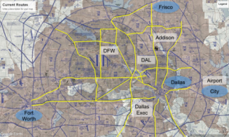

Pathway from Phase 1 to Phase 2
Insight Assessment Gaps
Common Vision for 2045
Contingency management
Robust CNSi
External to ATM-X
ATM-X
Phase 2
Community
Digital Information Platform
High-E airspace mgt
Interactions - Services & ATC
Leverage AI/ML for services
Traditional
IDM assessment of services for trad ops
Trajectory management as a service
User flexibility to submit options
395
Other Projects
AAM
ATD
SWS
UAS – NAS
UTM
UAM
UAM ConOps
UTM SOA applied to UAM and NC
Scheduling and Separation Services
Enable Vision 2045 for a future airspace with a Digital Information Platform initially focused on these use cases:
• UAM at UML-4 • Traditional • High-E • Increasingly Autonomous Vehicles

Slide 11
ATM-X is Aligned with ARMD and AOSP Priorities
Vision 2045
  Develop community-supported concept of operations for 2045
Digital Information Platform
  Develop a digital information platform to catalyze services and building towards digital transformation of the NAS
UAM UML-4
  Develop concept and technology utilizing NC to develop an airspace management system for UML4
Autonomous Cargo Airspace Integration
  Partner with industry and FAA to develop concept and identity critical requirements to enable seamless NAS operations leveraging work from UAS in the NAS
Traditional Operations
  Enable new industry services for improved efficient and safe operations
  Demonstrate services in an operational environment

Slide 12
A New Way Forward
Industry is poised to invest and contribute to developing airspace management systems
  Accelerating scaled operations for small UAS (UTM)
  Collaborative airspace management system framework
  Service based - faster to deploy, scalable, and extensible to new entrants
Technological advances in non-aviation industries
  Increased computing speeds
  Cloud-based infrastructures
  Faster communications systems and more data
  AI/Machine Learning
ATM-X will leverage this convergence of industry involvement and
technological advances with a new architecture to transform the NAS

Slide 13
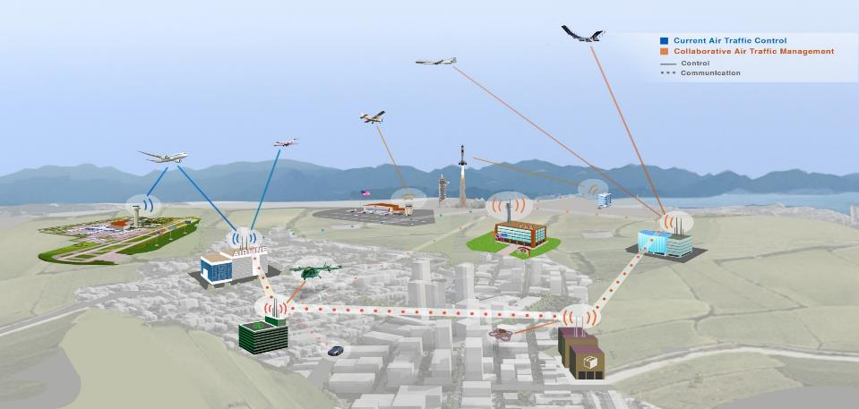
Collaborative Service-Based ATM (xTM)

Slide 14
Baseline UTM Architecture
UTM
Supplemental Data Service Provider
Industry Development & Deployment
FAA Development & Deployment
Inter-USS communication and coordination
Terrain
Weather
Surveillance
National
Airspace
System
Inter-data provider communication and coordination
NAS Data Sources
Flight
Information
Management
System
Constraints, Directives
UAS
Service
Supplier
Requests, Decisions
NAS
state
Operations, Deviations
NAS
impacts
Operations, Constraints,
Notifications, Information
Operations
Constraints
Modifications
Notifications
Information
Operation
requests
Real-time
information
Public Safety
Public
UAS
Operator
UAS
Operator
UAS
Operator
Color Key:
…
ANSP Function
Operator Function
Discovery
Registration Data/Services
Authentication/Authorization
V2V
Comm.
Other Stakeholders
Shared or TBD
responsibilities
UAS
UAS
UAS

Slide 15

Notional Future ATM Architecture
NAS data
sources
SDSP
SDSP
Integrator
SDSP
Integrator
SDSP
Integrator
Information
Information
Data
Information
distribution
USS
UTM
Provider of Services for UAM
UAS Service Supplier
USS
UTM
USS
UTM
USS
UTM
Comm Trans SS
High E SS
FIMS / FAA
FAA supplied
Industry supplied
UTM Operator
UTM Operator
UTM Operator
UTM Operator
UTM Operator
UTM Operator
UTM Operator
UTM Operator
Color Key:
sUAS Operator
UAM Operator
Airline
HE Operator
ANSP Function
FAA Safety Services/ATC
Operator Function
Client
Client
Client
Client
Client
Client
Client
Client
Other Stakeholders
Vehicle
Vehicle
Vehicle
Vehicle
Digital Info Platform
Discovery Service

Slide 16
Simplified Notional Future ATM Architecture
NAS
Data
Sources
UAS
Service
Supplier
PSU (UAM)
Comm
Transport
Service
Supplier
High-E
Service
Supplier
FIMS
…
FAA ATC
Digital Information Platform

Slide 17
Technical Challenge Proposals
TC-1: Achieve UML-2 Airspace Management
  Success Criteria: Completion of UAM airspace system for the National Campaign and transfer of requirements to the community for UML-2 operations {FY23} [FY21Q1]
TC-2: Digital Information Platform that supports Commercial Operations
  Success Criteria: Release Digital Information Platform requirements to advance industry-developed services that provide significant operational benefit to Commercial aviation operations {FY25} [FY21Q1]
TC-3: Enable Increasingly Autonomous Air Cargo Operations
  Success Criteria: Transfer of data and requirements to the FAA and relevant industry standards groups that enable file and fly operations for increasingly automated air cargo operations {FY25} [FY21Q2]
AAM
airspace
TC-1 – UML-2 airspace
TC-x – UML-3 airspace
TC-x – UML-4 airspace
Digital Info Platform
TC-2 – DIP - Traditional Aviation
TC-x – DIP - xTM Domain
Integrate autonomous
vehicles
TC-3 –Cargo ops in existing ATC
TC-x – remotely operated w/ DataComm
TC-x – Auto. pilot in NAS
FY21
FY22
FY23
FY24
FY25
FY26
FY27
FY28
FY29
FY30

Slide 18
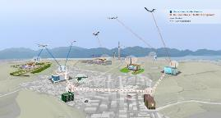
ATM-X Phase 2 Focus
Enable Vision 2045 for collaborative management of diverse operations with ML/AI enabled services using information from a digital information platform
Traditional Operations
UAM Airspace Management for UML-4 and National Campaign
High-E
Increasingly Autonomous Vehicles

Slide 19
Phase 2 Project Structure
Air Traffic Management – Exploration
Project Office
ARD Office
Project Support
Vision 2045
Systems Engineering
Digital Information Platform – Traditional Services
Topic: Digital Services for Aviation
UAM Airspace Management
Topic: UAM/UML-4
Increasingly
Autonomous Air Cargo Operations
Topic: Autonomous Cargo
Collaborative Service Based ATM
Topics:
Research & Development
UTM Standards
High-E
SUB-PROJECTS*
*Proposed Sub-Project Names

Slide 20
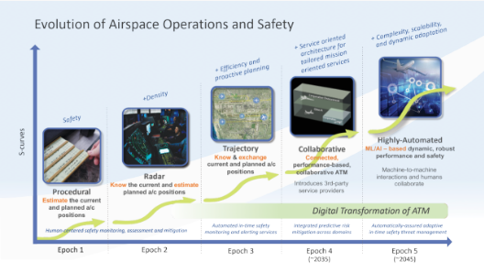
Digital Information Platform for Traditional Services
Goal: Accelerate modernization of the NAS through the implementation of advanced, data-driven, digital services for traditional operations

Slide 21
DIP-TS Objectives and Requirements
Objectives
Develop open architecture for highly-integrated data-driven information platform
Create community-supported framework to accelerate implementation and adoption
Build reference implementations of services and Digital Information Platform in collaboration with stakeholders
Performance Requirements
Uses state-of-the-art data and information exchange technologies for a DIP that is scalable, secure and robust based on a service-oriented architecture that complements NextGen technologies
Services are extensible and use ML/AI based on information from the DIP, and provide benefits validated in an operational environment

Slide 22
DIP-TS Partnership Approach
NASA to lead Industry engagement, including various working groups
  Will explore formalizing through newly established CFM RTT
Maintain current partnerships with FAA and flight operators
Establish new partnerships with solution providers with the goal of industry building the technologies
Continue to harmonize planned outreach to Universities through Open Challenges to leverage data science expertise with TACP/UI
Continue seeking opportunities to collaborate with SWS
  COVID-19 interrupted planned SWS/ATD workshop earlier this year

Slide 23
DIP-TS Milestones
Project
Overarching
Demo
Research Area
  FY21
  FY22
  FY23
  FY24
  FY25
  FY26
Initial Cohort established
Project
RFI published
Project Assessment and Decision: Assess level of interest and involvement, provide approach to further collaborative research
Close-out
SW sharing plan
Open University Challenge #1
Open University Challenge #3
Collaboration
Data sharing plan
Open University Challenge #2
Tech documentation transfer
NASA Reference
DIP
Research
Tech documentation transfer
NASA Reference
Service
Tech documentation transfer
Collaborative Demo #1
Collaborative Demo #3
Demos
Demonstration
Roadmap
Capstone collaborative demo: Complex, multi-operator, high-impact service led by Industry, guided by NASA
Collaborative Demo #2

Slide 24

Urban Air Mobility Airspace Management
Goal: Enable UML-4 operational density and complexity through development of concept of operations and requirements for a UAM airspace management system

Slide 25
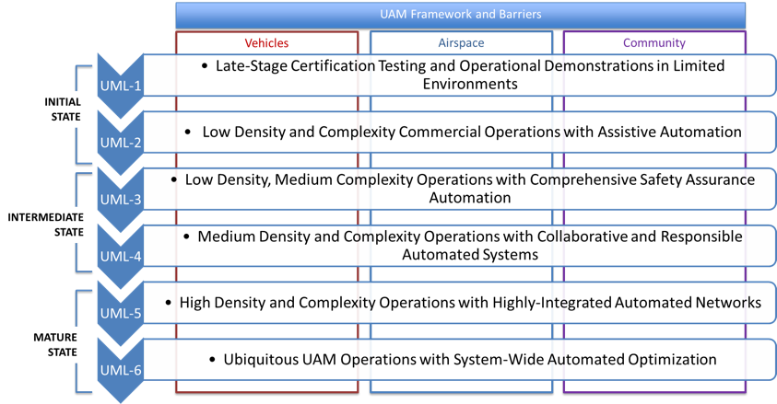
UAM Maturity Levels (UML)

Slide 26

UAM Airspace Management Objectives
Develop community informed concept of operations to guide research towards UML-4
Test advanced airspace management services with partners to address foundational issues to enabling mature UML operations
Define requirements towards UML-4 airspace management system in support of standards-making organizations to ensure a consistent system architecture
Refine UML-4 requirements with field data from National Campaign

Slide 27
UAM Airspace Management System Outcomes
Research Activities
Products
Outcomes
Research Transition Team Working Groups
Concept Documents
UAM Rule Making
UAM Airspace ConOps
Roles and Responsibilities
Roles and Responsibilities
AAM Ecosystem Airspace WG
AAM Ecosystem Airspace WG
Reference Models
eVTOL Perf Models
eVTOL Noise Impact Model
Industry Guidance
Safety Case Development
Data Exchange and Protocols
Airspace Management Standards (e.g., ASTM, RTCA)
Secure Communications Standards (e.g., SAE, AIA)
Concept and Software Development
Safety Case Development
Data Exchange and Protocols
Airspace Management Standards (e.g., ASTM, RTCA)
Secure Communications Standards (e.g., SAE, AIA)
ICDs and APIs
UAM Airspace Concept
Flight Information Mgmt System (FIMS)
Provider of Services for UAM (PSU)
Supplemental Data Service Providers
UAM Airspace Concept
Flight Information Mgmt System (FIMS)
Provider of Services for UAM (PSU)
Supplemental Data Service Providers
PSU-FIMS Specification
PSU-PSU Specification
Software Prototypes
UAM Airspace Management System and Architecture
FIMS, Discovery Service, PSU
Harmonization
Simulation and Risk Analysis
UAM Airspace System (AIRXOS, ANRA, OneSky, Uber, et al)
Research (Route Structure, Traffic Demand, Weather, Noise)
Specific UAM Use Cases
UAM Airspace System (AIRXOS, ANRA, OneSky, Uber, et al)
Research (Route Structure, Traffic Demand, Weather, Noise)
Specific UAM Use Cases
Reference Technology Implementations
Real-time and Fast-time Studies
Safety Metrics
Simulations with Industry Partners
Real-time and Fast-time Studies
Safety Metrics
Simulations with Industry Partners
Scheduling and Vertiport Mgmt Service
Separation Service
Detect-and-Avoid Service
Field Testing and Technology Evaluation
Fielded Systems
Airspace Requirements
Airspace Services
Secure Communications
CNSI
NC Flight Demos
Partner Flight Demos in NAS
NC Flight Demos
Partner Flight Demos in NAS
NC Flight Demos
Partner Flight Demos in NAS

Slide 28
AAM Mission Research Plan
National Campaign UAM airspace requirements coordinated with AAM

Slide 29
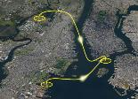



UAM System Development Progression and Requirements
Planned 2021
Planned 2024
Planned 2028
Planned 2030
UML1
UML2
UML3
UML4
Airspace ConOps
Airspace Procedures
Information Exchange Protocols
Airspace System Tested During NC-DT
UML-2 Airspace ConOps
Airspace Procedures for Low-Density Operations
Service Info Exchange Protocols for Low-Density, Low-Complexity Ops
UAM Airspace System with Operation Planning Services
X3/X4 Simulations for NC-1
UML-3 Airspace ConOps
Airspace Procedures for Low-Density, Med-Complexity Ops
Service Info Exchange Protocols for Med-Density Ops
Fleet Management Services
Secure Communications
Field Data to Inform Airspace System Development
UML-4 Airspace ConOps
Airspace Procedures for Med-Density, Med- Complexity Ops
Service Info Exchange Protocols for Med-Density/Complexity Ops
Integrated Fleet Management Services for Multiple Users
Integrated Collaborative Airspace and Safety Services
Field Data to Inform Airspace System Development

Slide 30
UAM Airspace Management Milestones Toward UML-4
Overarching
Research
UML-#
UML-#
#
#
FY21
FY22
FY23
FY24
FY25
FY26
2
UAM ConOps v1.0
3
UAM ConOps v3.0
Concept
2
UAM ConOps v2.0
UAM ConOps v4.0
4
Operational Description Document
Occupied UAM Separation Standards
Unoccupied UAM Separation Standards
UAM Separation Standards
2
2
3
Design of Autonomous Service
Integration
Evaluate Autonomous Service
Integration (Two Services)
Evaluate Autonomous Service
Integration (Three or More Services)
Connect Autonomous Service
Integration for NC Flight
UML Development
Interoperability of UAM Services
4
4
4
4
UAM Information Exchange
Catalog Security Vulnerabilities
Assess Security Vulnerabilities
Validate Methods of Detecting Security Vulnerabilities
Validate Methods of Mitigating Security Vulnerabilities
3
3
3
3
UML
1
2
X2 Sim for NC-DT
X3 Initial Sim for NC-1
X4 Final Sim for NC-1
X5 Initial Sim for NC-2
X6 Final Sim for NC-2
X7 Initial Sim for NC-3
X8 Final Sim for NC-3
NC
Airspace
2
2
2
3
3
3
4
SWS

Slide 31
UAM Airspace Management Deliverables
FY | Deliverable
2021 | UAM airspace system for NC-DT
 | Airspace and flight procedure guidelines for NC-DT
2022 | UAM airspace system for NC-1
 | Airspace and flight procedure guidelines for NC-1
 | Information exchange requirements for UML-2
 | UAM Concept to guide UML-2 airspace research
2023 | UAM separation standards to define capacity for occupied vehicle operations
 | Initial requirements for interoperability of UAM services to ensure harmonized system development
2023+ | UAM airspace system components for NC-2 and NC-3
2025 | UAM separation standards to define capacity for unoccupied vehicle operations

Slide 32






Increasingly Autonomous Air Cargo Operations
Goal: Seamless, scalable integration of increasingly automated air cargo operations into the NAS
Non-cooperative Traffic
Class E
Class E
Class C
Class C
Airspace Management (ATC)
Ground Control Station
Class D
Class D

Slide 33
Increasingly Autonomous Air Cargo Operations Objectives
Develop a research roadmap with FAA and Industry to identify future needs and enabling technologies for integration of increasingly autonomous cargo operations into the NAS
Conduct research to identify system requirements to address major barriers to routine file and fly operations
Identify increasingly automated functions needed for robust and scalable cargo operations and examine changes to roles and responsibilities between humans and automation
Improve technology and validate selected procedures and/or technology requirements using real-world data

Slide 34
Requirements for Increasingly Autonomous Air Cargo Operations
Stakeholder informed ConOps to integrate increasingly autonomous cargo operations into the NAS
Obtain real-word data from partner flight evaluation in the NAS to evaluate technologies and improve requirements
Resilient to disruption and contingencies
Management services conforms to near-term ATC procedures
Robust, seamless, secure communication
Integrated terminal, runway and taxi management
Ground Station Operator
Non-cooperative Traffic
Ground Station Operator
Class E
Assured separation with all traffic and hazards
Class C
Robust ground station network operation
Class D
Ground Station Operator
Airspace Management (ATC)

Slide 35

IAACO Milestones and Industry Proposed Timeline
  Industry
Overarching
Demo
Near-Term Research
Mid-Term Research
  FY21
  FY22
  FY23
  FY24
  FY25
  FY26
Freight Company Automated Air Cargo Concept Awaiting Approval to Operate
Industry
Timeline
Automated Air Cargo Vehicle Operational
Automated Air Cargo airframe company ready to demo
Engage FAA
Industry/FAA Workshop
Industry/FAA Workshop
Industry/FAA Workshop
All ConOps‚ Vetted with FAA
Outreach
Flight Demo-2 to Validate Select Concepts, Tools and Procedures in
Current NAS
Demos
Complete Agreement for Demo Partner(s)
Flight Demo-1
Complete Flight Demo Plans
Flight Demo Report
Initial Near-Term ConOps
Final Near-Term ConOps
Initial mid-term ConOps
Final mid-term ConOps
Integrated Sims
(Combined Near-Term Barriers)
Flight Demo-2 Sim
Focused Sims
(Separation Assurance)
Focused Sims
(Contingency Mgt)
Research
Focused Sim for
Increased Automated System
Integrated Sim of Increasingly Autonomous Flight

Slide 36
IAACO Deliverables
FY | Deliverable(s)
2021 | Initial Near-Term ConOps to enable harmonized research Results from simulation of current separation standards to define airspace capacity
2022 | Finalized Near-Term ConOps to enable harmonized research Results from simulation of contingency management procedures for robust system performance
2023 | Requirements to define multiple service interaction from integrated simulation Results from flight Demo-1 to improve service requirements from real-world data
2024 | Initial Mid-Term ConOps to enable harmonized research Complete plans for flight Demo-2 with partner towards acquiring real-world data to improve services
2025 | Final Mid-Term ConOps to enable harmonized research Results from flight Demo-2 to improve service requirements from real-world data
2026 | Integrated simulation in Mid-Term scenario to define multiple service interaction Flight informed requirements to inform initial and mid-term ConOps to industry

Slide 37
Evolution of Airspace Operations and Safety
High-E
UTM Stds
Roadmap
R&D

Slide 38
xTM Goal and Objectives
Goal
Develop a stakeholder informed research roadmap and technology to enable digital transformation of the NAS for seamless access and increasingly autonomous operations
Objectives
Conduct relevant R&D to define requirements that address barriers to achieve Vision 2045
Improve access to High-E airspace
Collaborate with stakeholders to ensure a harmonized UTM system
Performance Requirements
Complete a stakeholder-informed research roadmap:
  Identify critical research questions and timelines to guide technology development efforts
  Define system requirements to support implementation of Vision 2045
Provide NASA data to support standards development for a harmonized UTM system

Slide 39
xTM Milestones
Overarching
Research
  FY21
  FY22
  FY23
  FY24
  FY25
  FY26
Develop towards Vision 2045
Initial Vision 2045 Research Roadmap
Final Vision 2045 Research Roadmap
ETM Community Requirements
ETM ConOps v2.0
ETM ConOps v3.0
ETM Public Security ConOps
ETM
ETM Collaborative Simulation
ETM Collaborative Sim. with ATC HITL
ETM Fast-time Simulation
Future Flow Mgmt. Concept
Research Topics
Future Flow Mgmt. Initial Sim.
Future Flow Mgmt. Final Sim.
xTM-ATC Interactions Initial Eval.
xTM-ATC Interactions Final Eval.
UTM Standards
UTM
Inter-USS
UTM
UPP 2.0

Slide 40
xTM Deliverables
FY | Deliverable
2021 | Data, guidance, and document lessons learned to FAA and ASTM UTM working groups and UTM Pilot Program
 | Data to evaluate system readiness for future simulation from connectivity test with external partner system for High-E access
 | Initial collaborative document describing Future Flow Management Concept to address strategic management of diverse vehicles
2022 | ETM ConOps V2.0 to coordinate R&D for improved High-E access
 | Results from fast-time simulation to determine efficacy of collaborative services for High-E access
2023 | Stakeholder informed xTM research roadmap to guide technology development towards implementing Vision 2045
2025 | Results from HITL simulation of a partner informed use-case to inform requirements for collaborative service based management
2026 | Results from HITL simulation to determine efficacy of collaborative High-E access with ATC interaction

Slide 41
Phase 2 Project Structure
Air Traffic Management – Exploration
ARD Office
ARC APM: in process
LARC APM: Taumi Daniels
GRC APM: in process
Project Office
Project Manager: William Chan
Deputy Proj. Mgr.: Mike Madson
Deputy Proj. Mgr. - Tech: Dr. Bryan Barmore
Project Support
Coordinator: Roxana Corzo
Lead Analyst: Christian Aguilar
Center Analysts: Brenda McKay, Meredith Irwin
Schedulers: Natalie Condon, Donna Gilchrist
Vision 2045
Lead: Shawn Engelland
Systems Engineering
Lead: Dr. James Chartres
Risk Mgr: Joshua Moody
Management approach governed by NPR 7120.8A
Digital Information Platform – Traditional Services
SPM: Dr. Joey Rios
TL: Al Capps
UAM Airspace Management
SPM: David Thipphavong
DSPM: Lindsay Stevens
TL: in process
Increasingly
Autonomous Air Cargo Operations
SPM: Rob Fong
TL: Kurt Swieringa
Collaborative Service Based ATM
SPM: Jaewoo Jung
TL: in process
SUB-PROJECTS

Slide 42
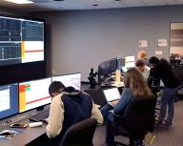
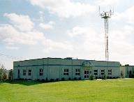
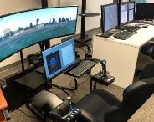



Facilities
Airspace Operations Lab
DIP
  North Texas Research
  Station (NTX)
  ATC Lab
UAM
  Airspace Operations Lab
  UAM Flyers
  ATC Lab
  UAM Lab
  Testbed
  PC-12 aircraft
IAACO
  Air Traffic Operations Lab
  Human – Autonomy Teaming Lab
xTM
  Airspace Operations Lab
NTX
Developmental UAM Simulator - Flyer
Air Traffic Control Lab
Air Traffic Operations Lab
UAM Lab

Slide 43
ATM-X Partnerships
Airlines and Operators
Airlines and Operators
ASTM
RTCA
Industry
FAA
Industry
Requirements and Standards
Knowledge and Technology Transfer
FAA
Concept of Operations
OEMs
FAA
RVLT
ATM-X
Research and Development
ATM-X
AAM
Int’l
Internal
AAM Mission
Universities
Industry
RTT
ATD
SWS
UI

Slide 44
ATM-X Phase 2 Focus
Enable Vision 2045 for collaborative management of diverse operations with ML/AI enabled services using information from a digital information platform
Traditional Operations
UAM Airspace Management for UML-4 and National Campaign
High-E
Increasingly Autonomous Vehicles

Slide 45

Summary
ATM-X is Ready to Set the Path to Transform the NAS with a Digital Platform for Collaborative Services to Improve Efficiency and Safety for all Users
  Pathway to Seamless Airspace Access for all Users in 2045
  R&D to Enable Vision 2045
  Digital Information Platform
  Collaborative ATM Services for UAM and High-E
  File and Fly Access for Increasingly Autonomous Vehicle Operations

