Slide 1
Increasing Engagement Through Storytelling
Sharon Goza
NASA-Johnson Space Center
Notes:
Hello.
Name, what I do, how long, master’s certification in gamification 2019, author, gamer, etc.

Slide 2
Important Directions!
To get to my favorite coffee shop
  Go North
  Turn left at the light
  Take the second left
  Turn left at the second stop sign
  The shop is on the right
Notes:
First, I’d like to start off my talk with giving you several things I’d like you to remember. Oh, and don’t write it down.

Slide 3

The Princess and the Rose
Once Upon a Time
Notes:
Now that that’s over, I’d like to tell you a story.

Slide 4


Notes:
There once was a princess who was destined to inherit her family’s kingdom. She was a small woman, with purple streaked hair and a pointed nose. She was not beautiful, by the people’s standards, but she was intelligent and organized. Her father knew she’d make a good leader, but before she could become queen, she had to perform one task. She must teach the town council to grow the sacred rose that would be used in her coronation crown. The seeds had been cultivated from a combination of her father’s sacred rose and her mother’s. Growing the rose symbolized the town’s commitment to the kingdom as much as the rose symbolized her.
“Hali,” her father said, “it’s time for you to travel to town and teach the council how to grow the sacred rose. Here are the steps.”

Slide 5

Notes:
Her father handed her a piece of paper and she read the list.
Find a location that has a half day of sun
Till the soil until there are no lumps or weeds
And the list went on for 10 more steps.
Hali loved lists, so she hugged her father in gratitude, made 10 copies of the list on Royal parchment, put three of the sacred seeds in a pouch, and headed off to town.

Slide 6







Find a location that has a half day of sun
Notes:
When she arrived, she gathered the town council and presented her list. They accepted the parchment happily and assured her that the task would be done in one month. Hali rode home, happy and content with her training and eager to see what the council would produce.

Slide 7

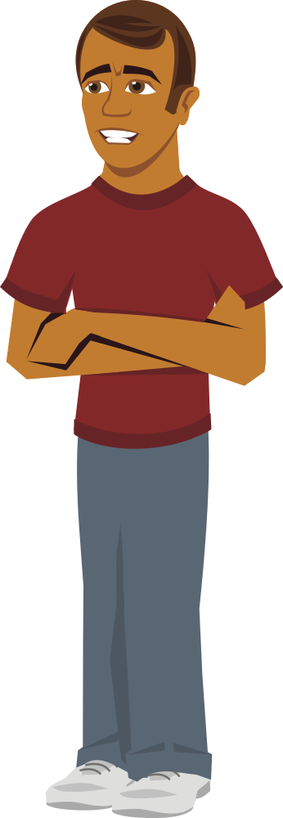

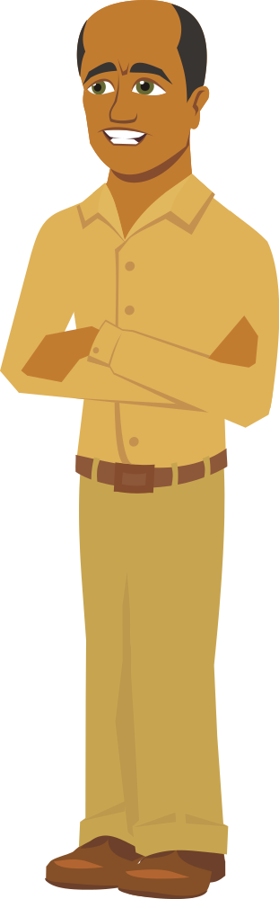



Notes:
A month later, she returned to the town to find no rose plant growing. When she asked the council, they apologized profusely, but told her although the list was wonderful, it had been hard to follow and all the seeds had died. Hali left discouraged. She went to her father and asked him what she could do.

Slide 8

Notes:
“Hali, what things have I taught you that you remember the most?” asked her father.
“Hmm, I remember your method of handling land disputes pretty well.”
“And how did I teach you?”
“You told me a story of one of your first cases.”
“And what did you like about the story?”
“Well, I could sympathize with the people in the story, and just how hard it was for you to make the decision. You had to overcome several problems along the way, but in the end everything worked out.”
Her father smiled at her and nodded. “So, what can you do different?”
“Maybe I should tell them how to do this through a story?”
“Now, that’s an idea,” her father said.

Slide 9








Notes:
Hali went off and wrote a story. She loved stories about fairies, so she made her main character a fairy. She included a nice description of the fairy and included a bit of her background. She made up a reason as to why it was important for this rose to be planted. She included each of the dozen steps to plant the rose and emphasized why each step was important within the story. Hali felt she was getting the hang of storytelling when she came up with a battle in which the fairy almost died protecting the young rose sprout but triumphed by the use of her magic. Pleased with her work, Hali set off to town once more to teach the council.

Slide 10




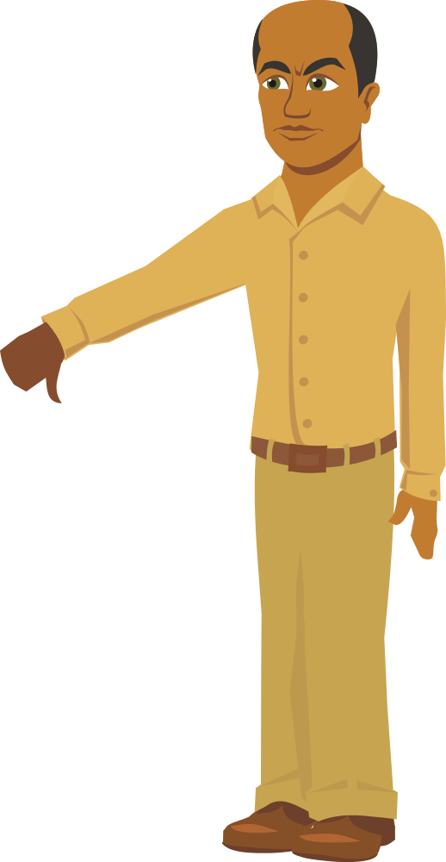
Notes:
Hali stood before the council and began her story. The council, being a practical group, looked at her with furrowed brows until the council leader stopped her.
“I thought you were going to teach us what we needed to do? Instead, you’re telling us a children’s tale. Should we have brought our families?” the leader asked her.
Hali was caught between anger and embarrassment. She took a deep breath and apologized to the council. Hali thanked them and told them she would return soon to help them with the rose.

Slide 11



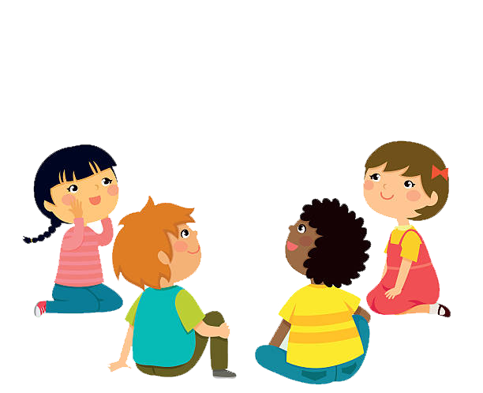
Notes:
They had given her an idea, however, and that afternoon she invited the town’s children and their parents to listen to her story. Many people loved the story and thanked her for the entertainment.

Slide 12


Notes:
When she returned home, she was still perplexed about what went wrong and spoke to her father. Indignantly she told him about the elder’s reaction. Her father, patient as ever, waited until she was finished, a knowing smile upon his face.
“I commend you, my daughter, for such a grand story,” he began. “I can see all of the effort you put into it as well as all of the steps of growing the rose and why they had to be done. I have no doubt the children in town and the adults that enjoy stories about fairies would very much enjoy the tale, and most likely remember it as well. However, think about the council.”
“What do you mean?” she asked.
“What type of people are they? How do they work? What do they do all day? Do you know any of their likes and dislikes?”
Hali shook her head. “No, I just know they run the town.”
“Perhaps you should get to know them a bit and then try again.”

Slide 13
Notes:
“I commend you, my daughter, for such a grand story,” he began. “I can see all of the effort you put into it as well as all of the steps of growing the rose and why they had to be done. I have no doubt the children in town and the adults that enjoy stories about fairies would very much enjoy the tale, and most likely remember it as well. However, think about the council.”
“What do you mean?” she asked.
“What type of people are they? How do they work? What do they do all day? Do you know any of their likes and dislikes?”
Hali shook her head. “No, I just know they run the town.”
“Perhaps you should get to know them a bit and then try again.”
Hali sighed and nodded. She set out the next day.

Slide 14

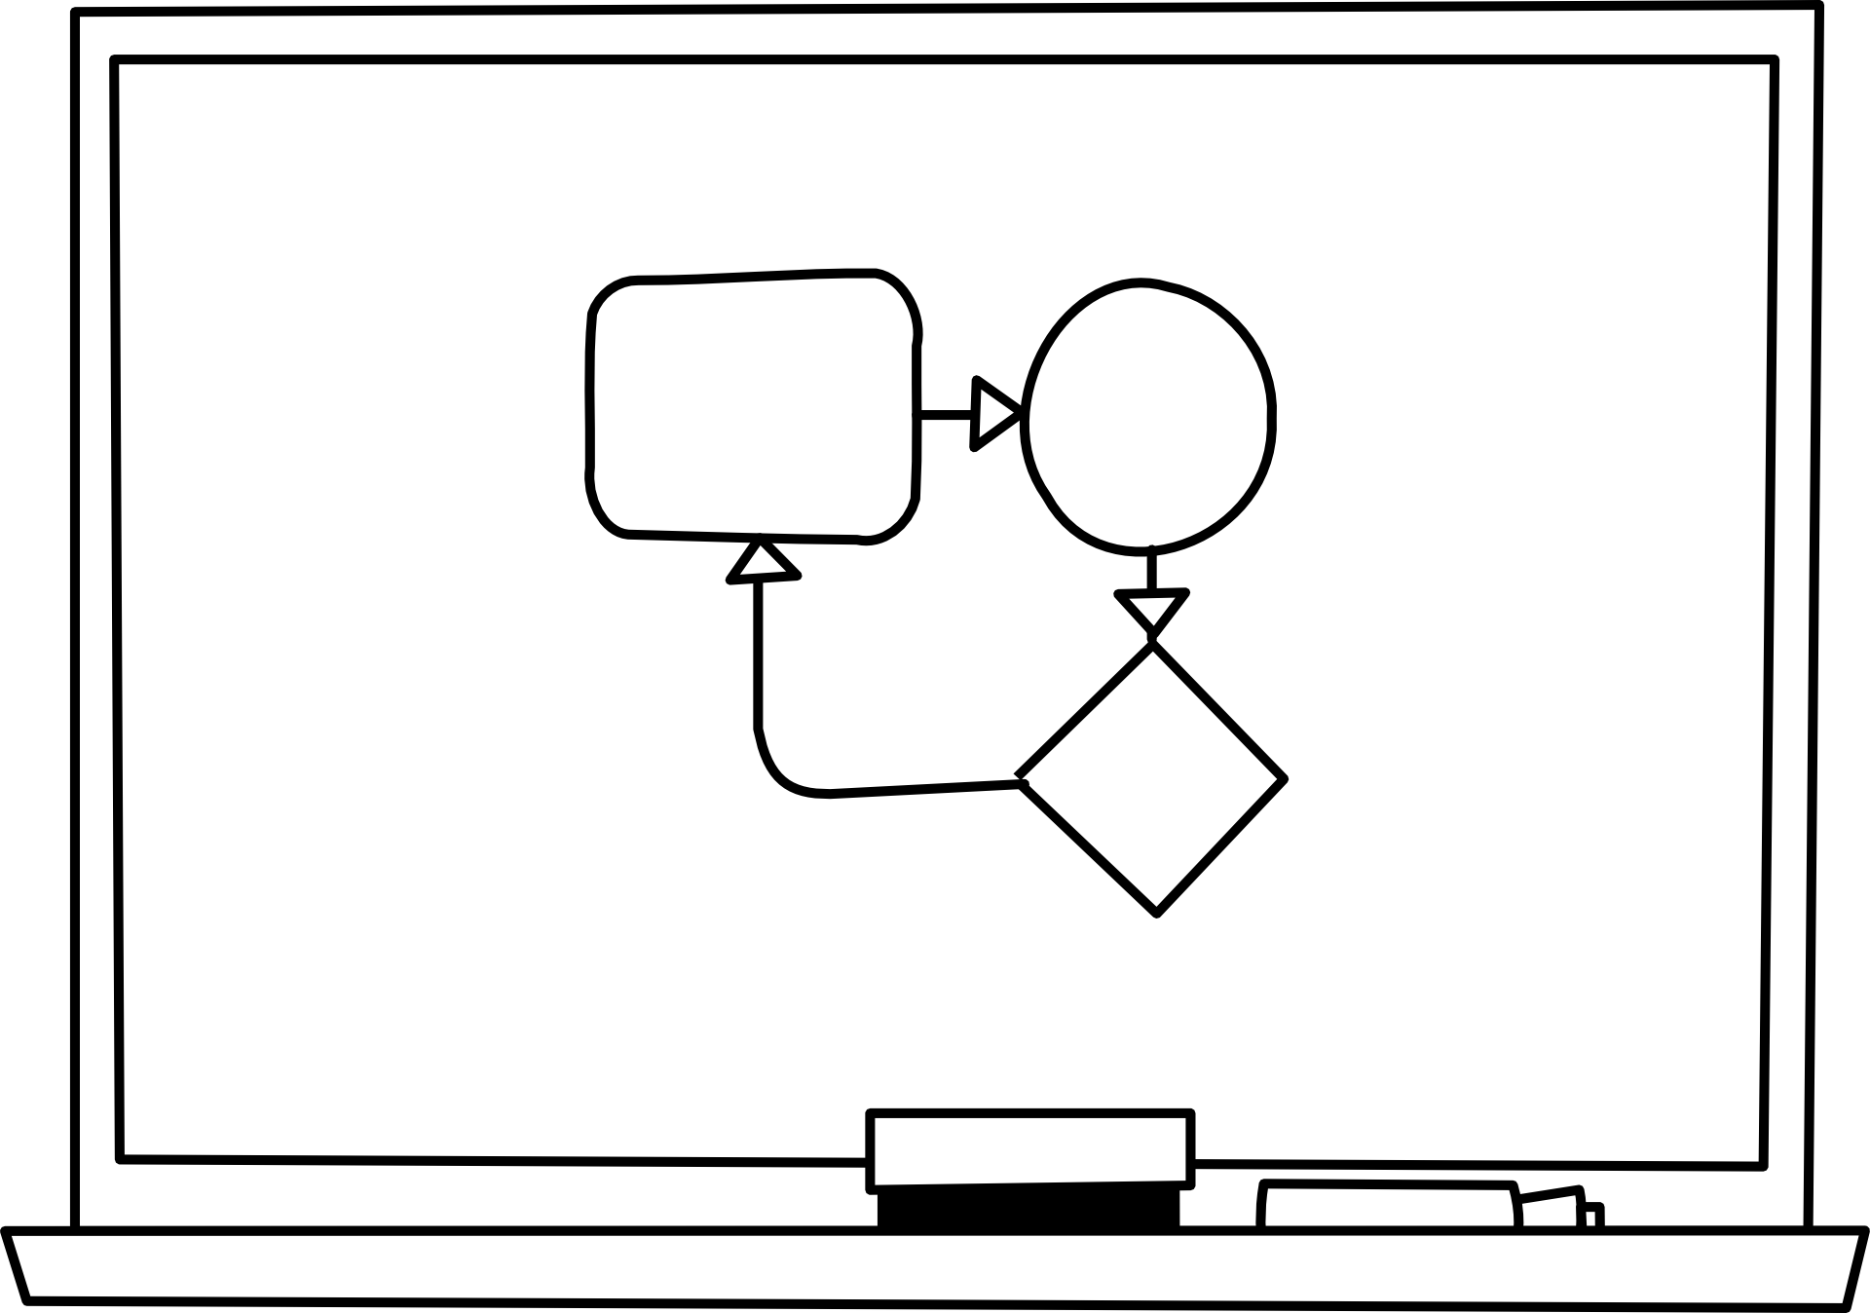


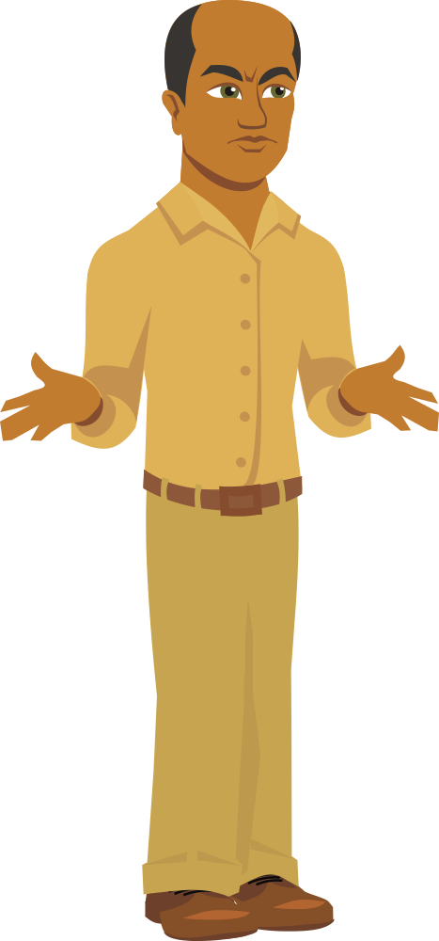

Notes:
When she got to town, she spent a week with the council, listening to their meetings and watching what they did and how they did it. They were a very practical group. The council were elbows deep in budgets and conflict resolutions. Things such as fairies were for children. But, they were also very much family people. She spent an evening at each one’s house, enjoying a meal and time to get to know them.

Slide 15


Notes:
At the end of the week, Hali had a new idea. She’d analyzed her audience and knew what appealed to them. Another story was forming in her mind and she worked long into the night penning her prose.

Slide 16



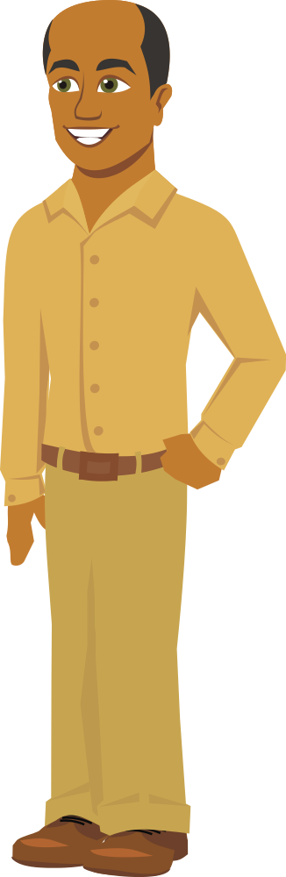

Notes:
The next day she met with the council. This time she presented them with a story about family, leadership, and a rose. After the story, she reiterated the steps of planting the rose and tied each point back to a point in the story. The council members smiled and nodded. Once her presentation was over, they met and discussed the procedures and what it would take to grow the sacred rose. She left them with three more seeds and more confidence than before.

Slide 17



Notes:
A month later not one, but three rose plants were growing heartily in the town’s garden. The council, and their families were pleased as was she.
“Three! You got all three to grow. Thank you so much!” Hali exclaimed.
The council leader smiled, “The stories you told along with the steps you gave us helped so much. We thought we were going to lose them at one point.”
One of the children broke out in a grin, “But the fairy in the story you told us had to use a specific fertilizer to nurse the plant back to health. So, I made sure Dad did exactly what she did.”
Hali laughed. She’d thought that her fairy story was useless, but it appeared that she had told it to the correct audience after all. Hali returned to her father, confident that she would now have the sacred roses needed for her coronation.

Slide 18

Notes:
Her father smiled proudly. “So, tell me, what did you discover in teaching the council?”
“First, you need to analyze your audience. It helps to know what they like and don’t like and even how they learn,” said Hali. “I had to alter how I taught them as well. Although they liked lists and charts and worked with them every day. They had so many of them that they couldn’t remember many of the finer points of the presentation. So, I went with a story they could relate to, wove in the points I wanted to make as part of the experience my main character was going through and included some conflict to keep them interested. Then, I resolved the conflict and re-iterated the steps they had taken to overcome the conflict.”
Her father pulled her in for a hug and kissed her cheek lightly. “Well done, my daughter. Now it’s time to work on the arrangements for your coronation. Shall we go see your mother?”
“Do you think she’d enjoy a story about what I’d like to do for my coronation?” Hali said with an impish grin.
Her father laughed, “Maybe, though I’m sure your mother has her own coronation stories to share with you.”
Hali laughed as well and the two headed out of the room happily chatting about just what those stories might contain.

Slide 19
Including Narrative in Your Training
Analyze your audience
  Don’t tell a fantasy story to an audience that likes only non-fiction
Create a main character your audience can relate to
Weave your training points into your story
  You can use training points as part of your story outline
  Can be revealed as experiences for your main character
Include conflict to keep learner engaged
  Increases emotional content in narrative
  Relate the conflict to at least one learning point if possible
Resolve the conflict
  Touch on learning points as part of the solution
Include audience participation if possible
Notes:
So, like Hali learned,
We need to analyze our audience, and choose a character the audience can relate to. If our audience is all managers, we may find that stories of fairies aren’t appropriate. However, if our audience is managers of a game design company, fairies may be perfectly appropriate.
We already have the steps of our story contained in the information we want to convey. These steps can be revealed as experiences for our main character.
Our story needs to contain conflict to keep the learner engaged and increase the emotional content in our narrative. Then as our conflict is resolved, we can once again touch on our learning points as part of the solution to the resolution.
Lastly, if at all possible, include audience participation. I’d love to have made you all part of the narrative, but with this online format, it’s hard to include audience participation so I’ll go over a few examples in the old fashioned way.

Slide 20
Examples of Audience Participation in Narrative
Overarching story
  Story serves as vehicle for training, but doesn’t directly address points
  Trainee’s answers affect the outcome of the story, but not the story itself
Example:
  answer to question affects a score which at the end of the story is reflected in the story outcome
Notes:
One way to include audience participation is by making an overarching story.
In an overarching story, the story serves as a vehicle for the training, but doesn’t directly address the training points. The trainee’s answers can affect the outcome of the story, but not the story itself. For example, an answer to a question in the training affects a score, which at the end is reflected in the story outcome.

Slide 21
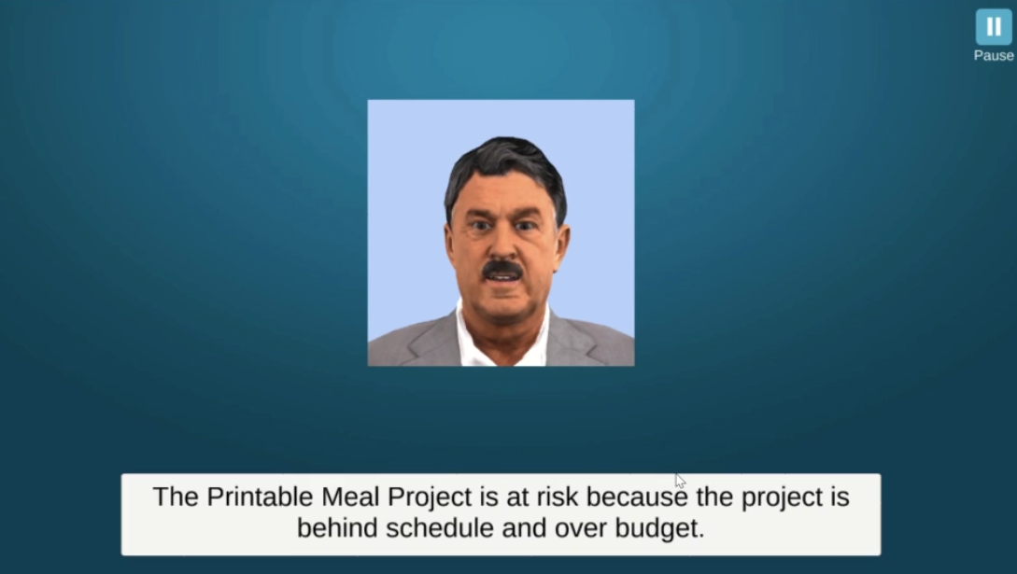
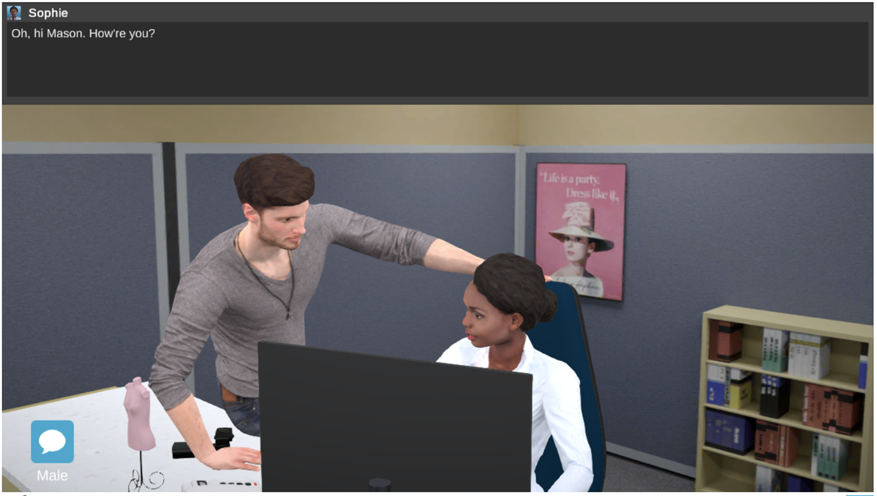
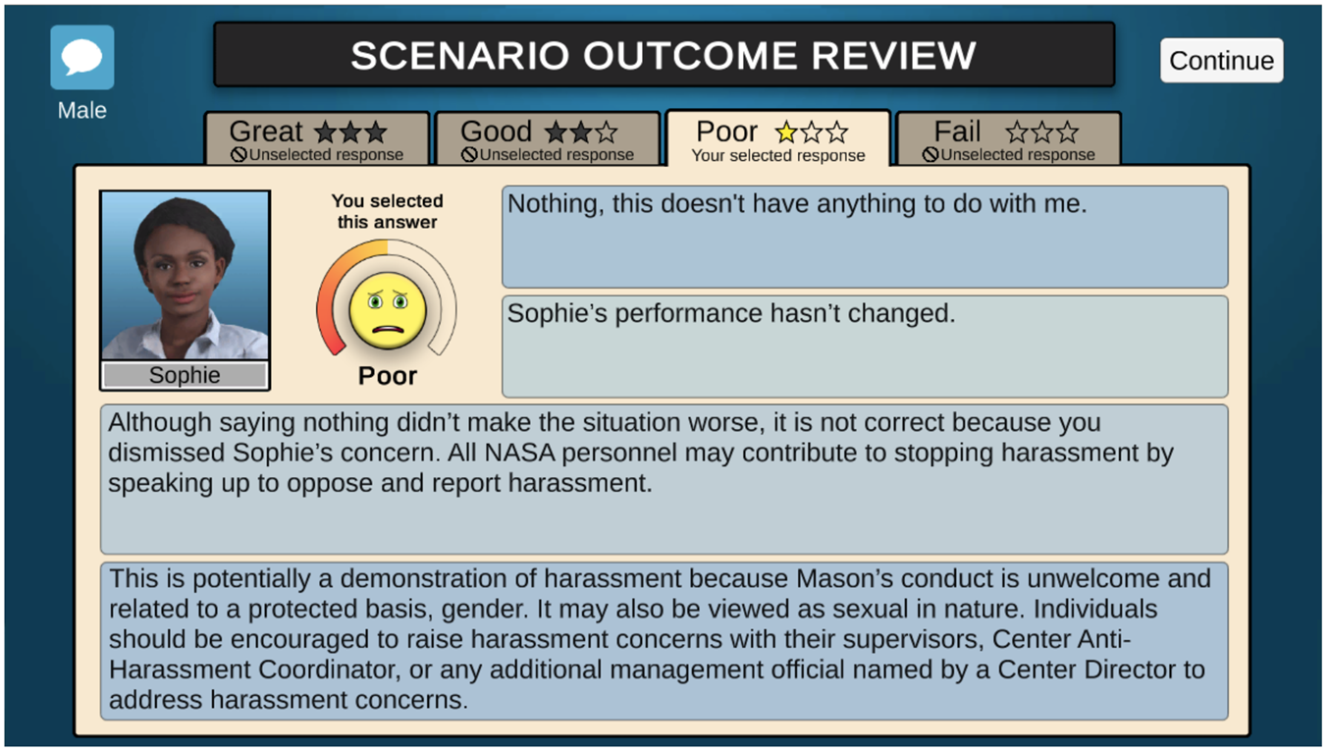
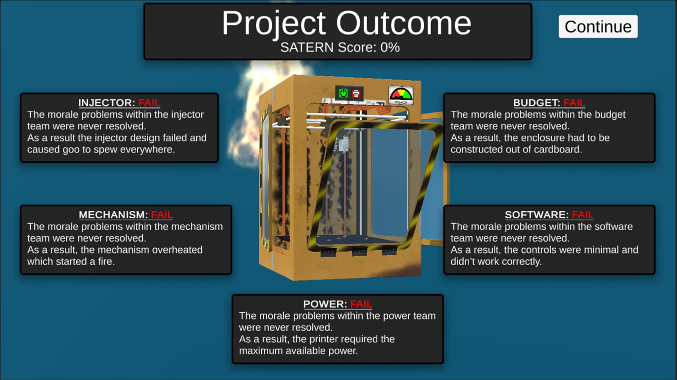
Notes:
In this example, the overarching story was the development of a 3D food printer. The outcome on how the printer performed, was based on the learner’s score after they answered questions to solve morale problems. In this case, you can see the results of a complete failure.

Slide 22
Examples of Audience Participation in Narrative
Integrated story
  Trainee’s answers affect the story
  “Choose your own adventure”
Example:
  Choice could mean an immediate failure in the story, or along another branch of narrative
Notes:
Another example of audience participation is an integrated story. In an integrated story, the trainee’s answers affect the story. This is akin to the old “Choose your own adventure” stories. A choice the learner makes could mean immediate failure in the story, or take them along another branch of narrative.

Slide 23
First Aid Training
You’re a first year medical student on your way to class. As you’re driving down the road you hear a screech and bang.
You decide to:
Investigate and see if anyone needs help
Drive on and ignore the sound
If you answered A, you might find the accident and be able to help.
If you answered B, you could branch down a narrative that questions your decision to become a medical student or even fails you in the training.
Notes:
For example: (read the slide)

Slide 24
Examples of Audience Participation in Narrative
Escape Room/Simulator
  Trainee must solve problems in the story in order to “escape” their situation
Example:
  Presented with a conundrum and have to solve it by interactive with a graphical environment
Notes:
One last example is that of an escape room or simulator. In these, the trainee must solve problems in the story in order to solve a problem or escape their situation.

Slide 25
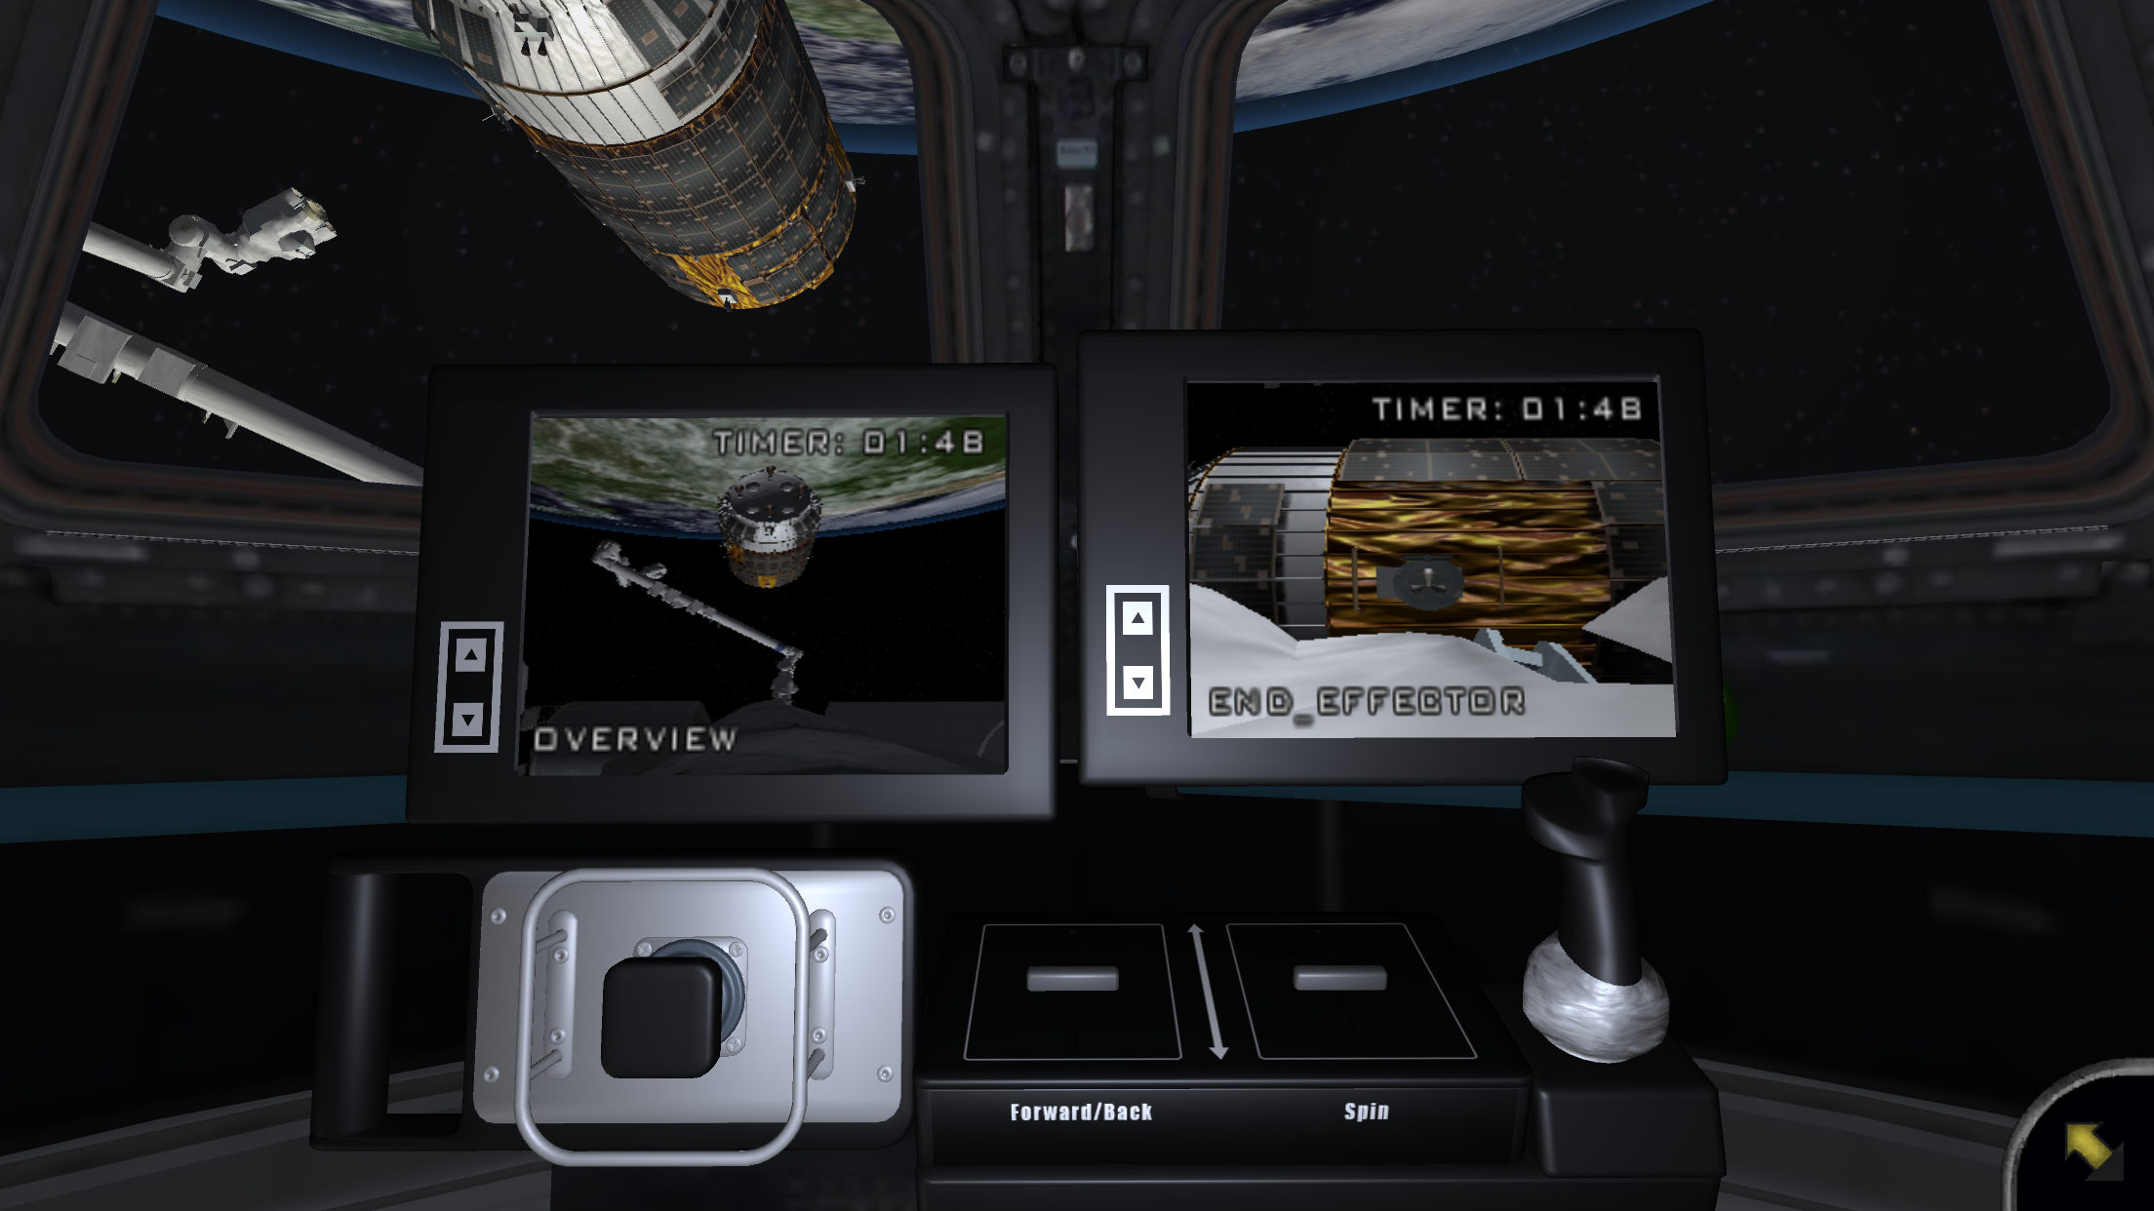
Notes:
In this simulator, the story is that you’re an astronaut needing to berth a cargo vehicle to the station. By interacting with the controls on the screen, you can fail or succeed at the task and can either continue your mission or return for more training.
These are only a few examples of audience participation and narrative. There are many ways to weave a story into your training, and many types of stories. Training can include audience participation, or be a stand-alone narrative. I could give you web sites and psychological proof that stories and learning go hand in hand. If you’d like some sources, feel free to e-mail me or google. However, if you ever doubt the value of story in your training. Just think back to what lessons you remember most in your life.

Slide 26
Now, tell me how do I get to my favorite coffee shop?

Slide 27
Feel free to contact me at:
Sharon.p.goza@nasa.gov
Educational mobile games available on iTunes and Google Play:
NASA Science Investigations: Plant Growth
Why is growing food important in space? Collect mission patches for completing tasks and for making discoveries. Can you grow enough plants to create a salad for the astronauts to eat? Launch time! The app also contains information on plant growth experiments, for use in the classroom and at home.
Android: https://play.google.com/store/apps/details?id=gov.nasa.jsc.igoal.SSIPlants
Apple: https://apps.apple.com/us/app/space-science-investigations-plant-growth/id1131254597
NASA Science Investigations: Humans in Space
It’s your job to make sure the H-II Transfer Vehicle is successfully berthed to the International Space Station. But can you perform your tasks while experiencing the effects of microgravity?
Android: https://play.google.com/store/apps/details?id=gov.nasa.jsc.igoal.SSIHRP
Apple: https://apps.apple.com/us/app/nasa-science-humans-in-space/id1469118438

