Slide 1

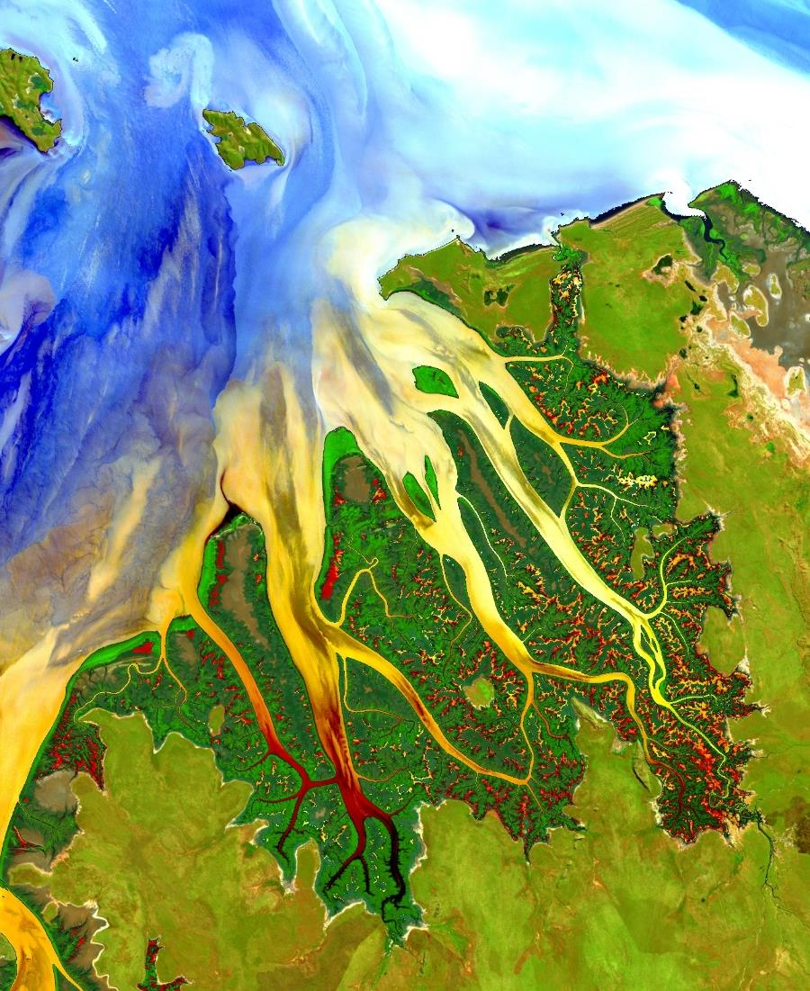
Applied Sciences’ Capacity Building
DEVELOP
Information Session
September 8th, 2020
Notes:
Hello everyone, and thank you so much for taking the time to join me today for this DEVELOP Program presentation. My name is _________, and I am a DEVELOP Fellow based at ___________. Today I’m excited to walk you through the DEVELOP National Program, going over a couple of project highlights, and then talking about our upcoming opportunities.

Slide 2

NASA Earth Science
Advancing understanding of the Earth and developing technologies
to improve the quality of life on our home planet.
Earth is a complex, dynamic system we do not yet fully understand. The purpose of NASA's Earth science program is to develop a scientific understanding of Earth's system and its response to natural and human-induced changes, and to improve prediction of climate, weather, and natural hazards.
Notes:
To start off with, the DEVELOP Program falls under the larger umbrella of NASA’s Earth Science Division. This division of NASA advances the understanding of the Earth as a system to improve the quality of life on our home planet.
The division conducts and sponsors research, collects new observations, develops technologies, and extends science and technology education to the global community. Working closely with global partners in government, industry, and the public, the Earth Science Division enhances economic security, and environmental stewardship, benefiting society in a lot tangible ways.
The Earth Science Division conducts and sponsors research to answer fundamental science questions about the environmental changes challenging our planet, and delivers sound science that helps decision-makers make informed decisions.

Slide 3

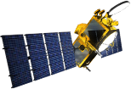



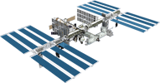

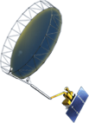


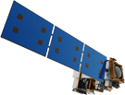

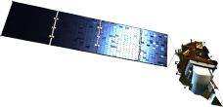
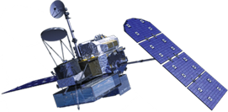


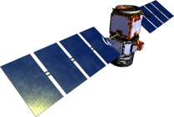
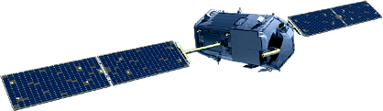

NASA Earth Observations
NASA Earth observations include a coordinated series of 17 polar-orbiting and low inclination satellites and 6 instruments on the ISS for long-term global observations.
OSTM/Jason-2
(NOAA)
ICESat-2
Terra
GRACE-FO (2)
ISS: LIS, SAGE III, TSIS-1, ECOSTRESS, GEDI, OCO-3
CYGNSS (8)
InVEST/CubeSats
RAVAN
RainCube
TEMPEST-D
CubeRRT
CSIM
Landsat 7
(USGS)
SMAP
Aqua
Suomi NPP (NOAA)
NISTAR, EPIC
(DSCOVR / NOAA)
SORCE (NOAA)
Landsat 8
(USGS)
Aura
CALIPSO
GPM
CloudSat
OCO-2
09.10.19
Notes:
All of our projects utilize data from NASA Earth observations. This series of satellites & sensors includes a coordinated series of 17 polar-orbiting and low inclination satellites as well as 6 instruments on the International Space Station for long-term global observations.
NASA Earth observations are designed for various purposes related to global monitoring, such as precipitation estimation, water quality assessment, land cover change analysis, and air quality evaluation. And many other applications.
Jan. 16, 2018: Reformatted with entire set, operating missions only
OPERATING MISSIONS ONLY 06/16/2017
12/20/17: Reformatted to 16:9 ratio only.
12/01/17: edited to remove CATS from ISS
10/27/17: DGH updated to remove Grace after end of mission

Slide 4











NASA Applied Sciences
Discovering Innovative & Practical Applications of NASA Earth Science
Thematic Application Areas
Capacity Building
Partner with public and private organizations
Discover innovative NASA Earth science applications
Support environmental decision-making activities
Demonstrate practical benefits of NASA Earth science
Help improve the quality of life and strengthen the economy
Food Security & Agriculture
Ecological Forecasting
Water Resources
Energy
Urban Development
Transportation & Infrastructure
Health &
Air Quality
Disasters
Notes:
More specifically within the Earth Science Division, you can find DEVELOP under NASA Applied Sciences. The main goal of NASA Applied Sciences is to discover innovative and practical applications of NASA Earth Science. And we do this by partnering with public and private organizations to examine ways in which our work may support their environmental decision making activities, with the ultimate goal of improving quality of life and strengthening the economy.
Applied sciences works in 8 different application areas, completing projects in Food Security & Agriculture, Ecological Forecasting, Water Resources, Energy, Urban Development, Transportation & Infrastructure, Health & Air Quality, and Disasters. DEVELOP completes projects in all of these application areas.
DEVELOP is a part of NASA Applied Sciences’ Capacity Building Program, along with ARSET and SERVIR. ARSET is our Applied Remote Sensing Training Program. They complete various trainings and webinars to build skills in the use of remote sensing analysis. Many of their trainings are available online and are self paced. SERVIR is a joint collaboration between NASA and USAID and provides state-of-the-art, satellite-based Earth monitoring data, geospatial information and tools to help improve environmental decision-making among developing nations.

Slide 5
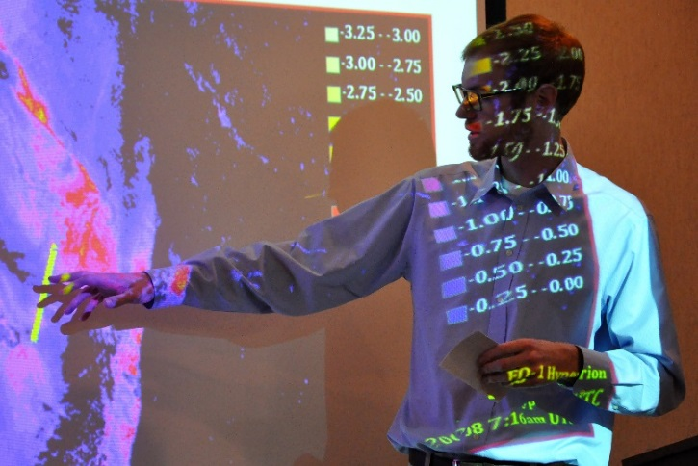
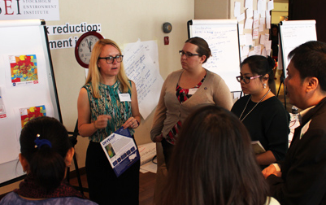
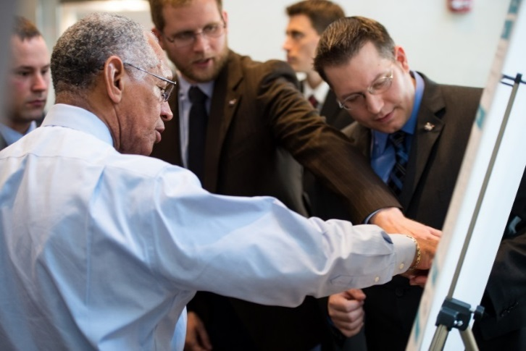
What is DEVELOP?
NASA DEVELOP
Measurements & Predictions
Communities
DEVELOP bridges the gap between NASA Earth Science and society, building capacity in both its participants and end-user organizations to better prepare them to handle the environmental challenges that face society.
DEVELOP is a dual-capacity building program:
Partners & Participants
Notes:
Now that we’ve kind of set the stage, we can talk more about the DEVELOP Program specifically. DEVELOP collaborates with decision makers to conduct feasibility projects that apply NASA Earth observations to address environmental issues. These projects engage young professionals (including students and recent graduates) as well as decision makers in 10-week projects that identify opportunities to use NASA satellite data to create methodologies and tools for project partners. This directly supports both individuals and institutions, and increases the use of Earth observation data and enhances decision and policy making.

Slide 6
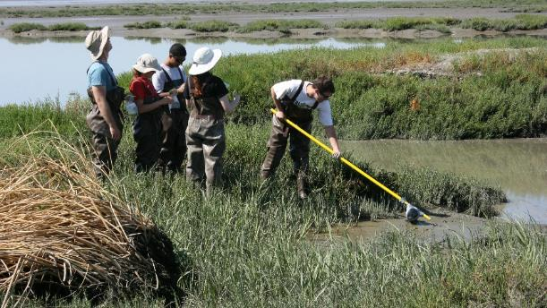
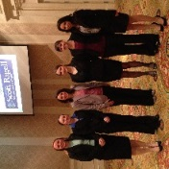

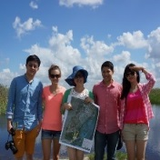
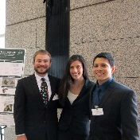
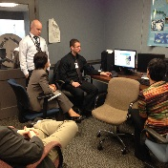
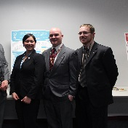
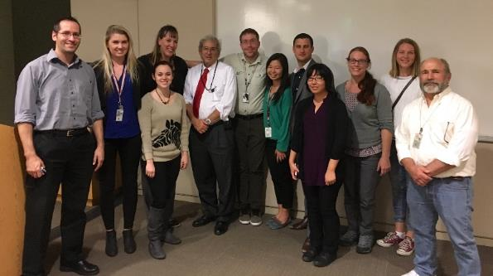
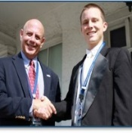
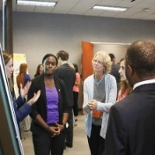
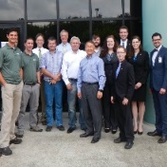
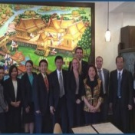
Who Participates in DEVELOP?
Participants
Advisors
Recent Graduates
Military
Personnel
Students
Transitioning Professionals
Decision Makers
NASA
Researchers
Partner Organizations
State & Local Govt.
Federal
Agencies
NGOs
International
Notes:
Going off of that, who participates in DEVELOP? The participants who make up our teams come from various backgrounds and include recent graduates, military personnel, students, and transitioning professionals. The advisors on our projects are typically NASA researchers or scientists from partner organizations. And the decision makers we work with come from state & local government, federal agencies, NGOs, and international institutions. Some of our frequent partners include The Nature Conservancy, USGS, and the National Park Service.

Slide 7
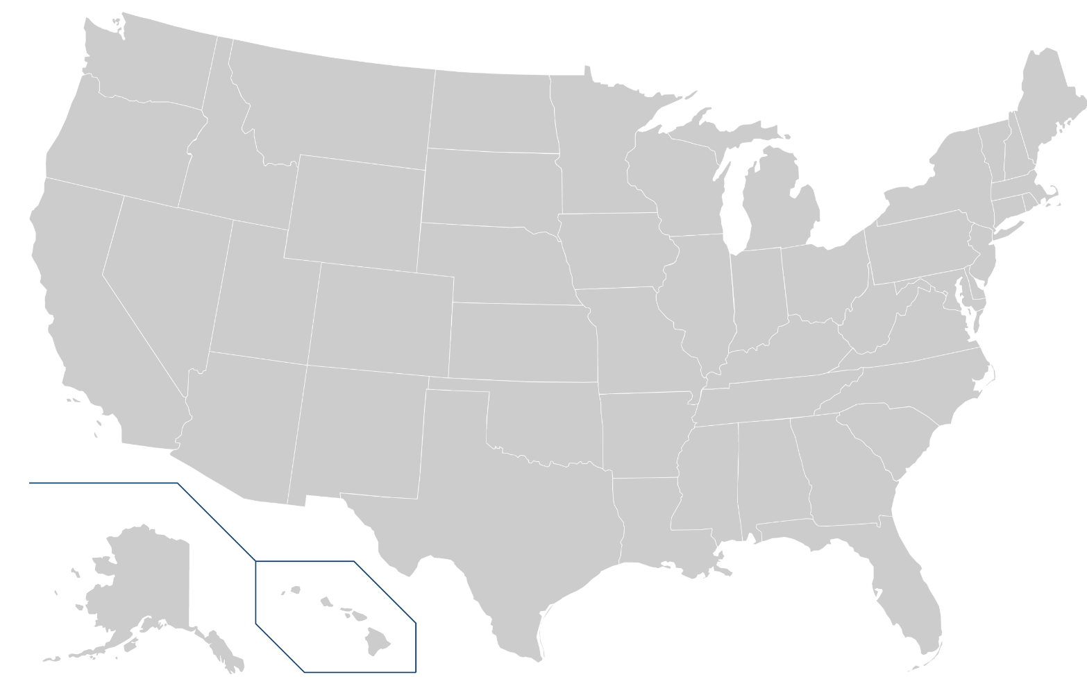
Where is DEVELOP?
Locations
Alabama – Marshall (Huntsville, AL)
Arizona – Tempe (Tempe, AZ)
California – Ames (Moffett Field, CA)
California – JPL (Pasadena, CA)
Colorado – Fort Collins (Fort Collins, CO)
Georgia – Athens (Athens, GA)
Idaho – Pocatello (Pocatello, ID)
Maryland – Goddard (Greenbelt, MD)
Massachusetts – Boston (Boston, MA)
North Carolina – NCEI (Asheville, NC)
Virginia – Langley (Hampton, VA)
1
2
3
4
5
7
9
6
7
3
5
8
8
11
v
9
10
4
v
10
2
1
6
11
v
Notes:
Now, you might be wondering, where are these opportunities located? DEVELOP locations are housed in various NASA centers and institutions across the country. Our National Program Office is located at the NASA Langley Research Center in Hampton, VA. Closest to you all is ___________. You can apply to any project at any DEVELOP node, meaning one of the really cool parts about DEVELOP is that it can provide you with opportunity to become familiar with places around the country. Each node has a unique set of opportunities – for example, the Colorado node works closely with USGS while the Alabama node tends to partner with NASA SERVIR. Feel free to reach out to a node you’re interested in to hear more about what they have to offer.

Slide 8
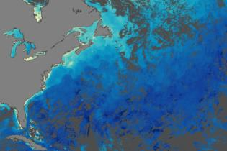
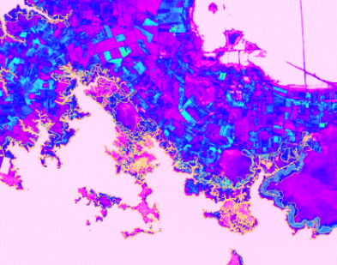
DEVELOP Project Characteristics
55-65 projects take place each year – at their core they share these characteristics:
Highlight the applications and capabilities of NASA Earth observations
Address community concerns relating to decision-making for real-world environmental issues
Partner with organizations who can benefit from using NASA Earth observations to enhance decision-making by providing decision support tools
Align with at least one of the eight NASA Applied Sciences Program’s thematic Application Areas
Research is conducted by interdisciplinary teams under the scientific guidance of DEVELOP Science Advisors and Mentors from NASA and partner organizations
Create a comprehensive set of deliverables
Notes:
In terms of project characteristics. Approximately 55-65 projects take place each year and all projects share similar characteristics. Each project must highlight the applications and capabilities of NASA Earth observations, though we do often use data from other space agencies in conjunction with NASA data. Our projects address real-world community concerns related to environmental decision-making. DEVELOP teams must also partner with organizations who can benefit from using NASA Earth observations to enhance decision-making. All projects have to align with one of the eight application areas I mentioned a few slides ago. And all of our projects are completed by interdisciplinary teams under the guidance of science advisors and mentors from NASA and partner organizations. Each of our teams also create a comprehensive set of deliverables to communicate their work. These deliverables include a technical report, a poster, and a presentation.

Slide 9
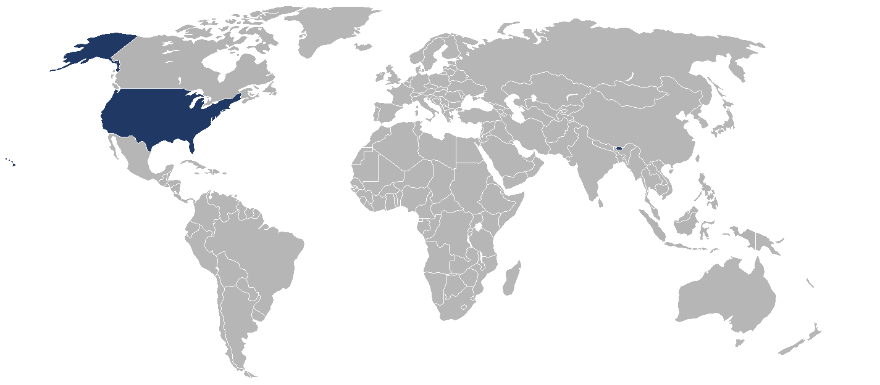
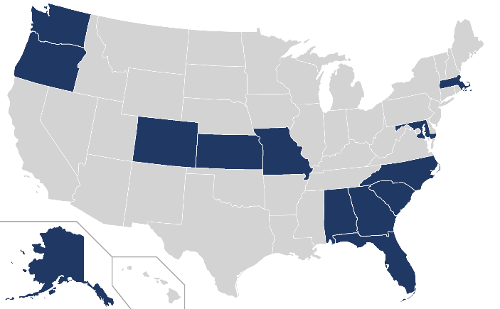
2020 Summer Portfolio
13 States &
2 Countries Impacted
65 Participants
15 Projects
87% Domestic
13% International
1ST Term (13)
Application Areas Addressed
23 Partners
Partner Total by Type
3rd Term (2)
*Impacts and partners are tentative

Slide 10
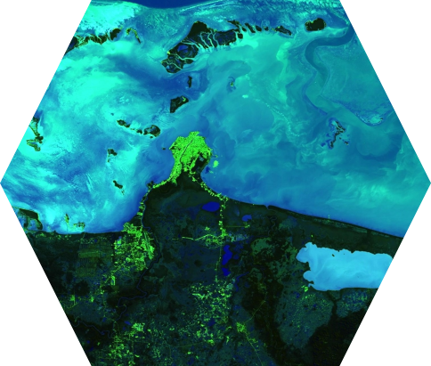
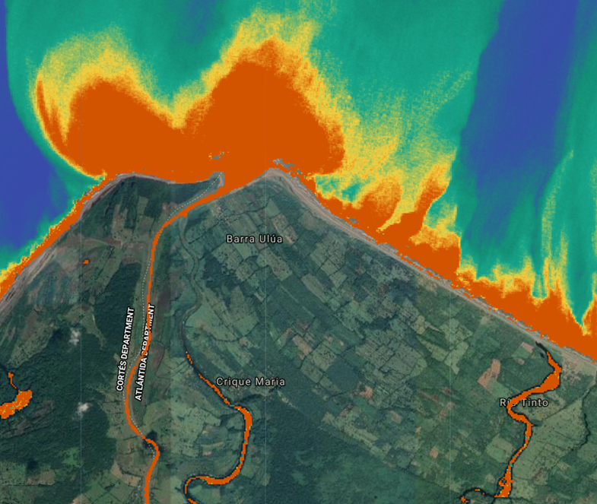
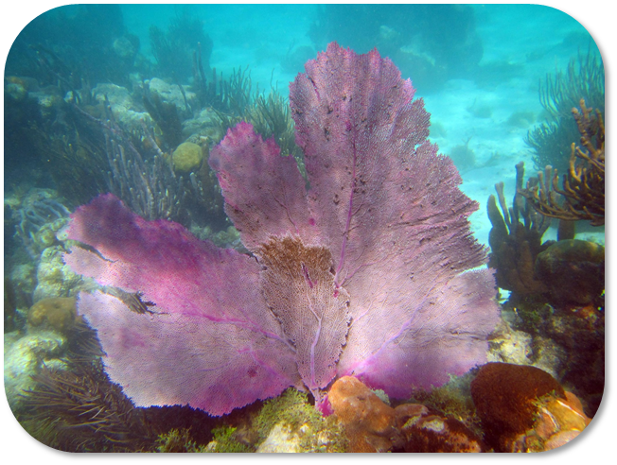
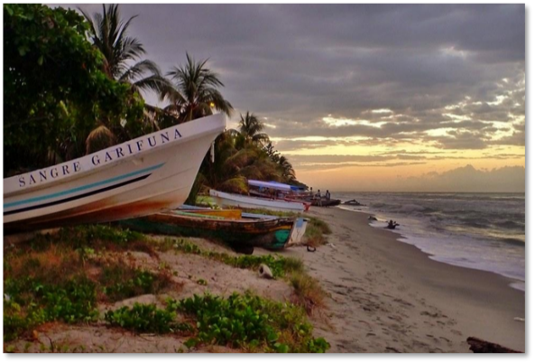


DEVELOP Project Highlight:
Belize & Honduras Water Resources II
Developing a Google Earth Engine Dashboard for Assessing Coastal Water Quality in the Belize and Honduras Barrier Reefs to Identify Adequate Waste Control and Inform Coastal Resource Monitoring and Management
N
0 5 km
Low CDOM High CDOM
Notes:
Now I’m going to go through a couple of project highlights. I’ll start off with our Belize & Honduras WR II project that happened over this past Fall term. The project’s objective was to generate a tool to assess coastal water quality in Latin America.
The Mesoamerican reef is a biodiverse ecosystem that stretches more than 600 miles along four Central American coasts and is the longest barrier reef in the western hemisphere. The national economies of Belize and Honduras heavily depend on the commercial, recreational, and subsistence fishing services the reef supplies. While the reef has benefitted from sustainable collaborative management practices, ecosystem stress resulting from the destruction of coastal habitats and overfishing threatens its diverse communities and ecological functions.
The team was able to work with international partners, including government agencies of Belize and Honduras, to generate analyses of several water quality parameters, including colored dissolved organic matter, turbidity, chlorophyll-a, and sea surface temperature.
They utilized the NASA Earth observations Landsat 8 Operational Land Imager and Terra Moderate Resolution Imaging Spectroradiometer (MODIS) and the ESA Earth observation Sentinel-2 Multispectral Instrument to calculate these parameters. They input these data into a tool in Google Earth Engine, a cloud-based remote sensing computing platform. With the results of this project, the team built capacity in the partners’ to use NASA Earth observation and ESA satellites for coastal water management. Moving forward, they can use this tool to remotely assess data to monitor marine health parameters.
An example result is shown on the right. This map shows the concentration of Colored Dissolved Organic Matter, which the team hypothesized correlates with agricultural runoff from nearby palm oil plantations.
Image Credits (from top to bottom): “Image Credit: Shared with us by Dr. Juan Torres-Perez, taken while collecting in situ data.
; “Sangre Garifuna” by Recovering Vagabond. Licensed under CC-BY-NC-SA 2.0. https://ccsearch.creativecommons.org/photos/7bc0a959-9452-47b5-81e8-87b3497fabf0

Slide 11
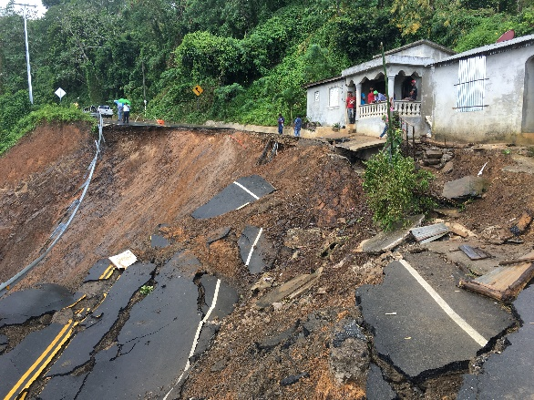
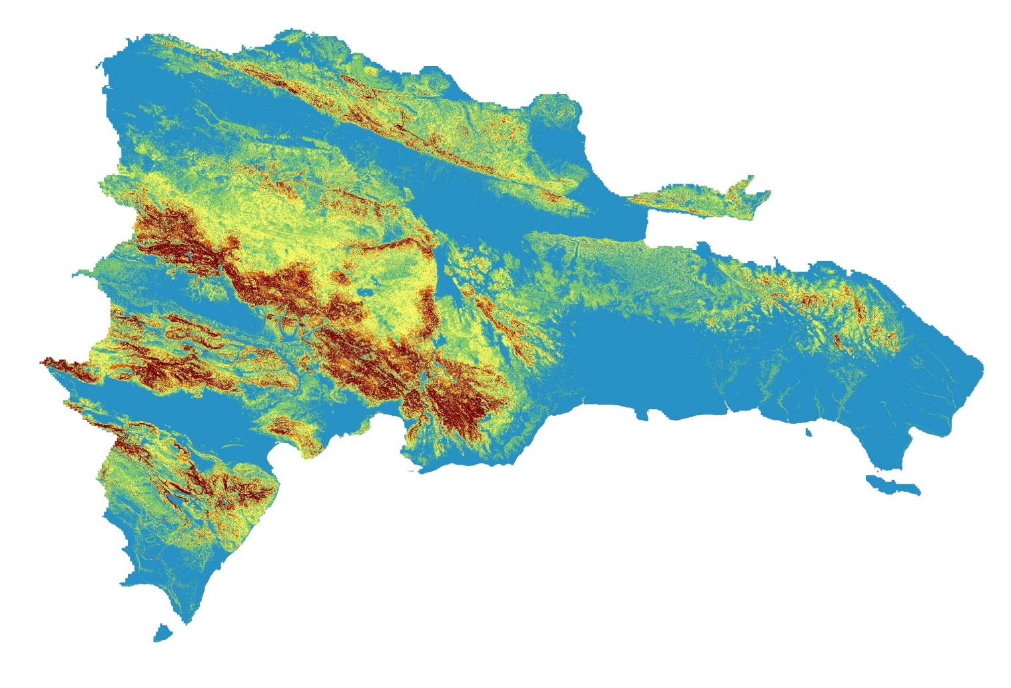
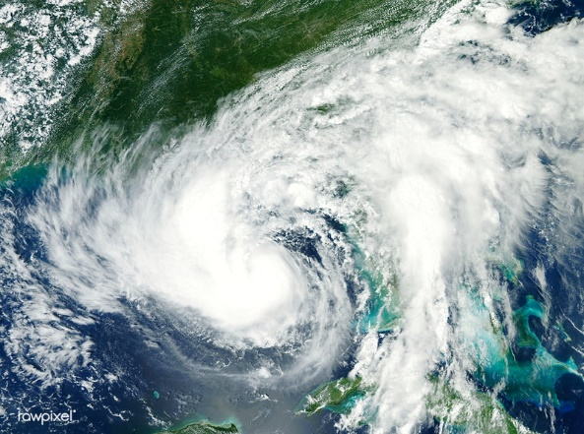
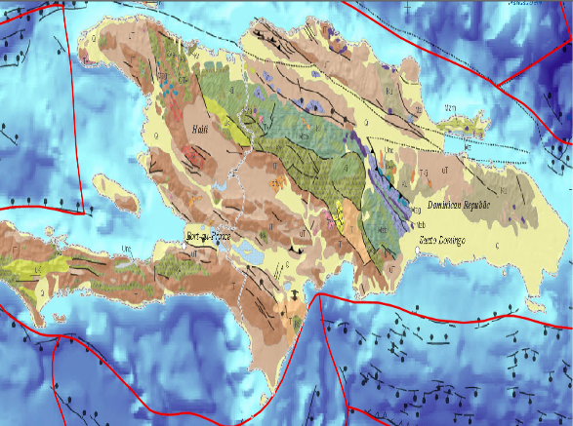
DEVELOP Project Highlight:
Dominican Republic Disasters
Mapping Landslide Susceptibility and Exposure in the Dominican Republic Using NASA Earth Observations
High
Low

Slide 12
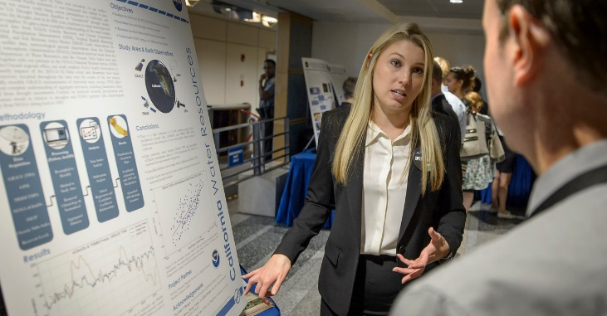
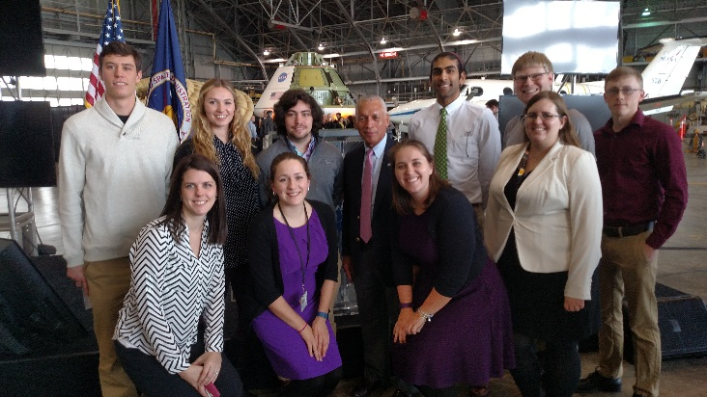
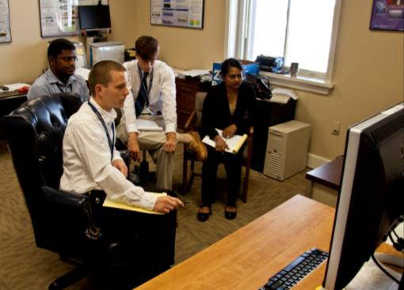
Participant Eligibility
Age 18+ with a minimum 3.0 GPA
Current students, recent graduates, early career professionals, transitioning career professionals, US Military service members & veterans
Interdisciplinary backgrounds (majority from STEM fields), no experience is required but a strong interest in GIS, remote sensing, and science is important
US Citizens & Foreign Nationals*
* US citizenship is required to apply to DEVELOP locations at NASA Centers. Foreign nationals must be currently enrolled or recently graduated from an accredited U.S. school. Acceptances are conditional upon proof of a visa or approved CPT/OPT that will allow them to legally work within the U.S.
Three 10-week terms per year
Spring, Summer, and Fall
Participants must reapply each term
Notes:
In terms of eligibility, you must be 18 years or older and have a minimum 3.0 GPA to participate – this can be your cumulative GPA or your most recent semester. As I mentioned earlier, we accept current students, recent graduates, early career professionals, transitioning career professionals, and US military service members and veterans. We like our applicants to come from interdisciplinary backgrounds, though most of our applicants tend to be from STEM fields. No experience is required, but a strong interest in GIS, remote sensing, and science is super important. We accept US Citizens as well as foreign nationals, with a few caveats. US citizenship required to apply to DEVELOP locations at NASA Centers. Our regional locations in Massachusetts, Colorado, Idaho, Arizona, and Georgia do not require US Citizenship. Foreign nationals must also be currently enrolled in or recently graduated from an accredited U.S. school. And acceptances are conditional upon proof of a visa or approved CPT/OPT that will allow them to work within the U.S.
We also have three 10-week terms per year in the spring, summer, and fall. This means we accept applications three times a year. Note that participants who would like to continue on to another term must reapply each term.

Slide 13
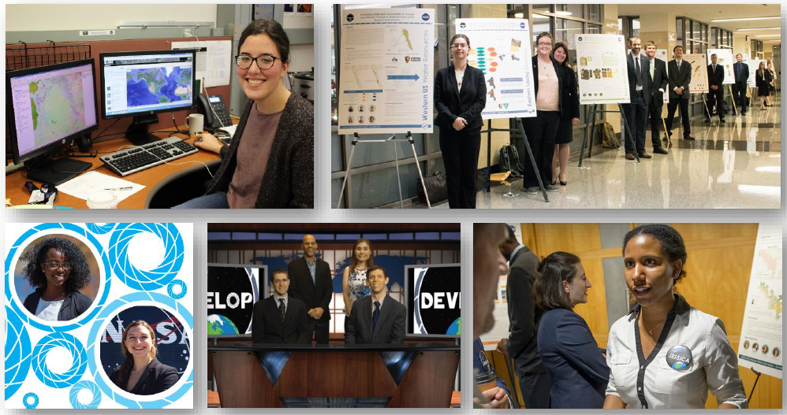




What Makes a Successful DEVELOPer?
CORE VALUES
COLLABORATION
SERVICE
PASSION
DISCOVERY
DEVELOPers are passionate about the environment and serving society!
Notes:
You might be wondering, what makes a successful DEVELOPer?
First, someone works well on a team
Collaboration is really key to the success of a project.
Participants should also have a willingness to learn
Skills you learn at DEVELOP go beyond GIS and Remote Sensing. Participants should want learn to improve technical writing, presentation, and professional skills.
We want DEVELOPers to be flexible
Flexibility with project changes and learning to overcome challenges is necessary throughout the term.
Participants benefit from being hard working and positive
There is a lot to accomplish in 10 weeks.
A DEVELOPer should also be motivated and seeks to motivate others
Projects are unique and led entirely by DEVELOP teams, so you’ll need to be motivated to meet deadlines and advocate for the needs of your partner organizations.
But most of all, DEVELOPers are passionate about the earth and excited to grow there skillsets both technically and professionally!

Slide 14
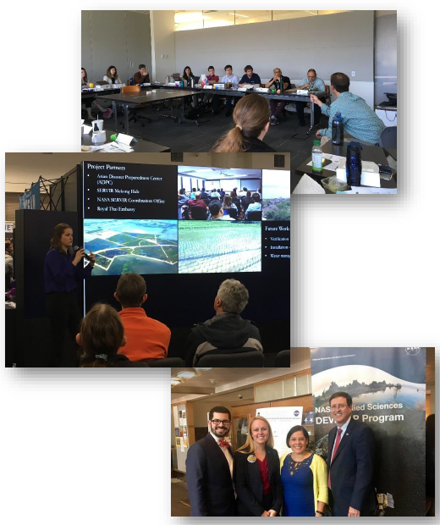
Benefits of DEVELOP
Scientific & Technical Skills
  Experience using NASA Earth observations
  GIS & remote sensing
  Project execution
  Science communication
Personal Development
  Presentation & communication skills
  Personality typing & working with diverse groups
  Confidence
  Interpersonal communication
Professional Development & Networking
  Management & leadership
  NASA scientists and managers
  Partner organizations
  Peers – teams, node, & national
Notes:
In DEVELOP, you will improve your scientific & technical skills in the use of NASA Earth observations, GIS & remote sensing, and science communication. But participants also develop personally and professionally by improving their presentation and communication skills, confidence in the work place, leadership skills, ability to network with science professionals and partner organizations, and capacity for team work. We often say that gaining technical skills is just one part of what you will gain from DEVELOP.

Slide 15
Participant Opportunities
Common Majors
Common Software and Programming Languages
Geography
Environmental Science
Computer Science
Remote Sensing
GIS
Biology
Engineering
Chemistry
Meteorology
Physics
Accounting
Economics
Mathematics
Public Policy
Communications
ESRI ArcGIS
ERDAS IMAGINE
ENVI/ IDL
Python
MATLAB
R
Microsoft Office Suite
Google Earth Engine
Note: no previous experience with these programs is required, but an eagerness and ability to learn quickly is a necessity.
Note: open to all majors!
Pay level is determined by education level and DEVELOP location
Notes:
You’ll notice that many of our participants come from technical and science related majors, such as geography, environmental science, GIS, engineering, and chemistry. I personally was a _______ major in undergrad. We also have participants from accounting, public policy, economics, and communications backgrounds. But also note that DEVELOP is open to all majors. Some common software and programming languages we use in our projects include ESRI ArcGIS, ENVI, Python, R, and Google Earth Engine. No previous experience with these programs is required, but applicants should be eager to learn and recognize that an ability to learn quickly is necessary. All of our positions are paid and pay level is determined by education level as well as DEVELOP location.

Slide 16
Interested in Applying?
Spring 2021 Application: August 31 – October 9, 2020
Term Dates: January 25 –April 2, 2021
Summer 2021 Application: January 18 – February 26, 2021
Term Dates: May 31 – August 6, 2021
Notes:
If you think DEVELOP might be right for you, here are the relevant dates for our upcoming summer and fall terms. It’s never to early to be thinking about what you plan to do for your summer. The Fall 2020 application window is from May 18th to June 26th , with the term occurring from Sept 14th to Nov 20th.

Slide 17



Find DEVELOP on Social Media!
NASA DEVELOP National Program:
VPS and promotional videos www.youtube.com/user/NASADEVELOP
Articles & Important Events: Tweet @NASA_DEVELOP or #NASADEVELOP
http://twitter.com/#!/nasa_develop
DEVELOP National Program: features projects, node highlights & accomplishments, VPS announcements www.facebook.com/developnationalprogram
Once a DEVELOPer, Always a DEVELOPer: job posts
https://www.facebook.com/groups/387243741376125/
Notes:
You can also find DEVELOP on social media. Facebook and Twitter are great ways to see what we are currently up to. We also have a huge archive of project videos from past projects up on our Youtube channel, if you’d like more detail about the topics and community concerns our work addresses.

Slide 18
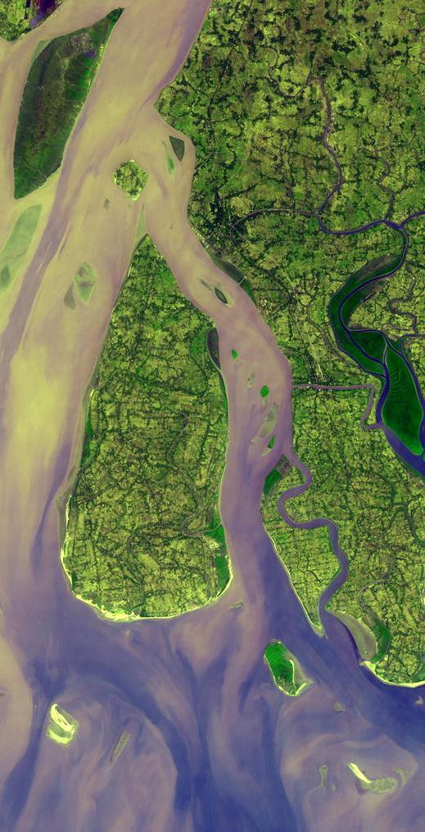
Thank You!
Visit the DEVELOP website: https://develop.larc.nasa.gov
-OR-
Email us at: NASA-DL-DEVELOP@MAIL.NASA.GOV
Notes:
Our website also has a ton of information related to the program and there is a page with an archive of our projects. You can also ask us any questions you may have anytime via this email, which can also be found on the website. And with that, I would just like to say thank you for taking the time to listen to my presentation, and I would be happy to take any questions at this time.

Slide 19
Frequently Asked Questions
“How much will I be paid?”
DEVELOP participants are paid on an hourly basis. Rates are based on your current level of education, applicant classification, and locality. If you’d like to know your specific rate, please email us at NASA-DL-DEVELOP@mail.nasa.gov
”How much would I work per week?”
DEVELOP participants are expected to commit 20-29 hours per week throughout the term.
“Can I telecommute?”
In order to participate in DEVELOP, participants must be able to work onsite at an established DEVLOP location.
“How are teams structured?”
Teams typically range in size from three to six participants, working under the guidance of a NASA DEVELOP Fellow and science advisors.
“Can I participate during the school year while I am taking classes?”
Yes! Many DEVELOP participants are current students and work the required number of hours around their class schedule during normal business hours (8am – 5pm).
“How strict is the GPA requirement?”
Participants must have and maintain a 3.0 GPA (on a 4.0 scale) to apply. This GPA can be the cumulative and/or most recent semester.
“Who should I ask for Letters of Recommendation?”
New participant applicants will need to list two recommenders, preferably one from an academic source and one from a professional source. Two academic recommendations are acceptable if necessary.
“Is housing provided?”
It is not, however once you are accepted to the program your node Fellow can work with you to find housing.
Notes:
Here are just a few of the most commonly asked questions that I’ve heard before, so hopefully this gives you all a bit more perspective. Please let me know if you have any other questions!

Slide 20

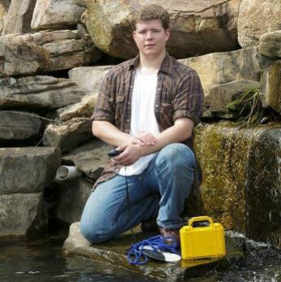
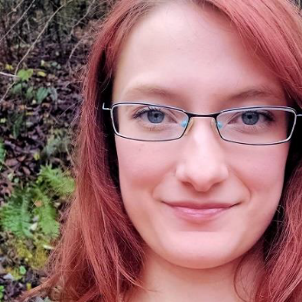
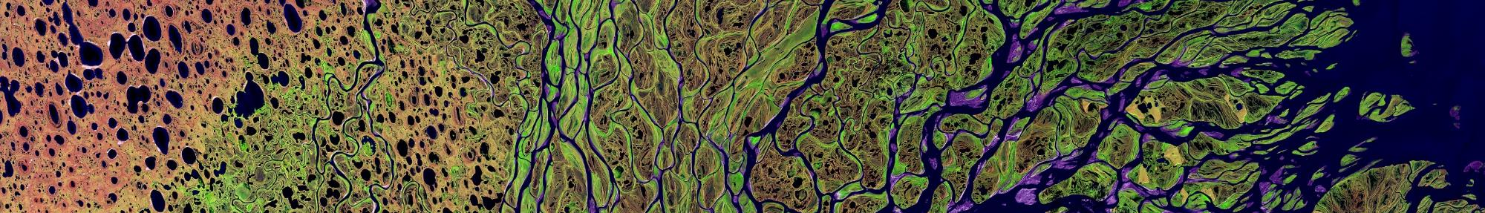
Participant Testimonials
“DEVELOP allowed me to work on some
real-world applications with GIS and remote sensing as a student. This unique opportunity
to employ what I learned in course work, and learn new analytical methods along the way, put in perspective what a job in this
field would look like, earned
confidence in my abilities,
and showed me
that I enjoy this
type of work.”
Casey Calamaio
Research Associate,
University of Alabama in Huntsville
“Even though my major and career field are electrical engineering, DEVELOP helped me improve many skills I use now, such as programming, working on a team, writing technical documents, giving presentations, and more. Perhaps even more importantly, DEVELOP gave
me confidence as a
student transitioning
to the professional world….”
Annabel White
Electrical
Engineering Co-Op.,
BAE Systems, Inc
Alicia Nelson
Natural Resource Manager, Virginia
Marine Resources Commission
“Skills learned during the
DEVELOP term really
assisted a smooth transition
to the workplace - in
particular, presentation
and interview skills.”
Visit the DEVELOP website: https://develop.larc.nasa.gov

Slide 21
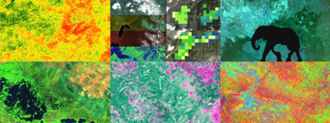
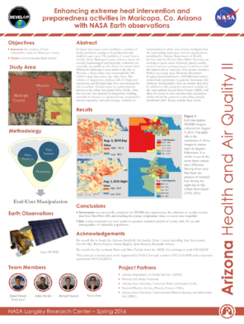
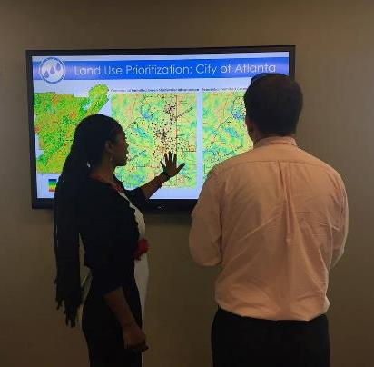
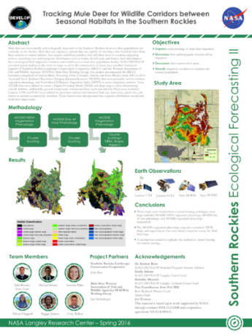
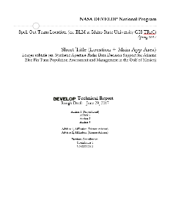
DEVELOP Project Deliverables
Project Deliverables:
Created by all DEVELOP teams.
Poster
Presentation
Technical Report
Shapefiles
Additional products:
Created by some teams based on specific partner needs and identified ahead of time with team.
Tutorial
Code
Brochure
Project Video

