Slide 1

Flight Test Results of a Distributed Merging Algorithm for Autonomous UAS Operations
Andrew Peters¹, Swee Balachandran¹, Brendan Duffy¹, Kyle Smalling^{1,}
María Consiglio², César Muñoz²
¹National Institute of Aerospace, Hampton, VA
²NASA Langley Research Center, Hampton, VA
National Aeronautics and Space Administration
Notes:
Hello. My name is Andrew Peters. I am a research engineer at the National Institute of Aerospace.
And, Today I am presenting the Flight Test Results of a Distributed Merging Algorithm for Autonomous UAS Operations.

Slide 2
Overview
Introduction
Background – ICAROUS/Distributed Merging Algorithm
Test Setup – Hardware/ Scenarios/Parameters
Video
Results
Conclusions
Notes:
I will be briefly introducing the concept of Merging and how it applies to Autonomous UAS Operations.
Then I will give a bit of background on the software we are using. Specifically, ICAROUS, and The Distributed Merging Algorithm.
I will go over the test setup, describing the hardware configuration, the scenarios flown, and the parameters used.
Then there is a brief video where we will go step by step through the merging process, explaining what is happening at each stage of the flight.
After that, we will look at the results of the flight tests and conclude with a a few thoughts on further research needs.

Slide 3
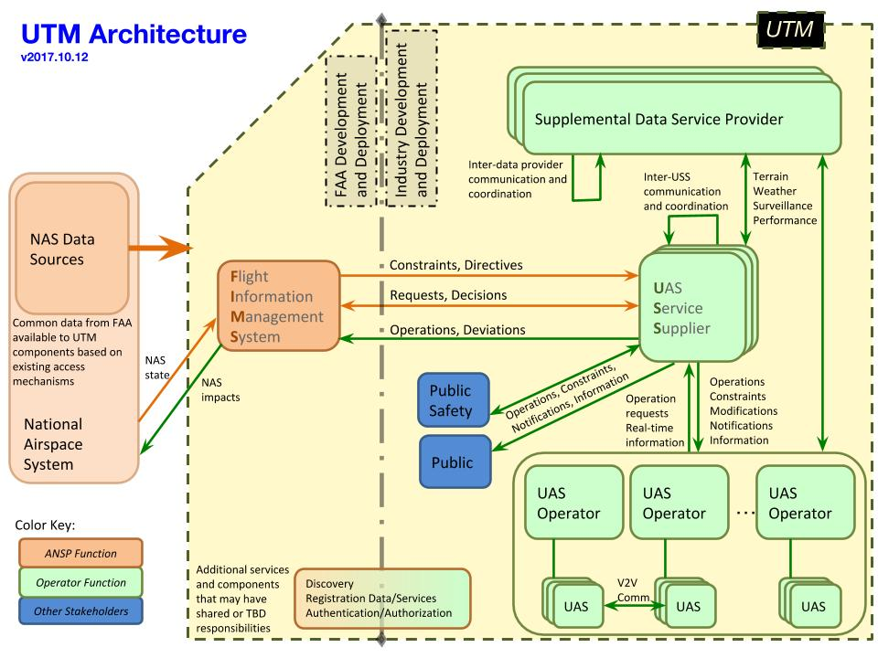
UAS Traffic Management (UTM) Project
NASA funded project (2015-2020)
In the UTM concept, UAS Service Suppliers (USS) are responsible for pre-flight strategic deconfliction of flight plans
UAS remain safely separated if they conform to pre-approved flight plans and schedules provided by the USS
Unexpected conditions may force a UAS to become non-conforming and require tactical guidance to resolve conflicts with other UAS
The USS may attempt to provide this tactical guidance using a centralized autonomous system or manual input from an operator, but results could be sensitive to communication latency and dropouts
2015-2020
Onboard Autonomous Merging can provide tactical separation, guidance and coordination through a shared fix in real time without relying on communication with the USS
Notes:
These flight tests were conducted at NASA Langley Research Center as a part of the UTM project with the goal of introducing UAS safely into the national airspace.
As we look at large scale high-density UAS operations, That will be conducted at locations like warehouse distribution centers for package delivery,
it becomes apparent there is a need for technologies that can safely and efficiently deconflict the flight paths of incoming and outgoing aircraft.
While centralized scheduling and planning of operations will ensure strategic deconfliction of flight plans, a distributed, autonomous, onboard vehicle-to-vehicle coordination capability for merging and spacing will provide tactical deconfliction of converging flights.

Slide 4
Merging
Enable multiple vehicles to access a common merge fix while maintaining sufficient separation.
Additional requirements:
  Fully autonomous.
  No reliance on ground systems to enable merging operations.
  No reliance on a centralized entity for coordination.
  Coordination among vehicles must happen in real time on demand
A
B
Notes:
Ok, so what exactly is merging?
The basic idea is we have multiple aircraft trying to fly through point A, on their way to point B. All of the aircraft need to be able to move through these positions, while maintaining sufficient separation.
Deconflicting these traffic flows needs to happen fully autonomously, without relying on ground systems or a centralized entity for coordination and It must happen in real time as it is needed.
To accomplish this, a merging application was developed and integrated into the ICAROUS software suite.
This application leverages Vehicle to Vehicle (V2V) communication technology
enabling the exchange of the information required to achieve arrival time deconfliction.

Slide 5
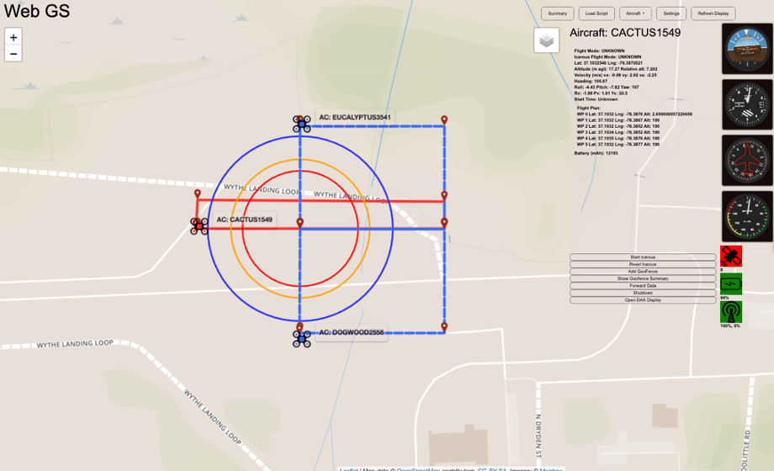
Distributed Merging Algorithm
Scheduling
Communication
Operating Procedures
Zones
  Coordination – Establish the network
  Scheduling – Compute optimal schedule for all vehicles
  Entry – Execute trajectory adjustments to meet schedule
Swee Balachandran, César Muñoz, and María Consiglio, Distributed Consensus to Enable Merging and Spacing of UAS in an Urban Environment, Proceedings of the 2018 International Conference on Unmanned Aircraft Systems (ICUAS 2018), Dallas, Texas, USA, 2018
Notes:
The distributed merging algorithm consists of three main components:
A scheduling function which takes in the earliest and latest feasible arrival time for each vehicle,
A mechanism to exchange the earliest and latest arrival times among vehicles so that there is consensus on the inputs used for scheduling and
A set of operating procedures that dictate when each vehicle is required to exchange data, start scheduling and execute required trajectory.
To do this, the volume of airspace around the merge fix is abstracted into three concentric zones.
In the outermost zone or coordination zone the network is established,
In the middle zone or schedule zone optimal schedules are computed,
and in the inner most zone or entry zone trajectory adjustments are executed in order to meet the schedule.

Slide 6
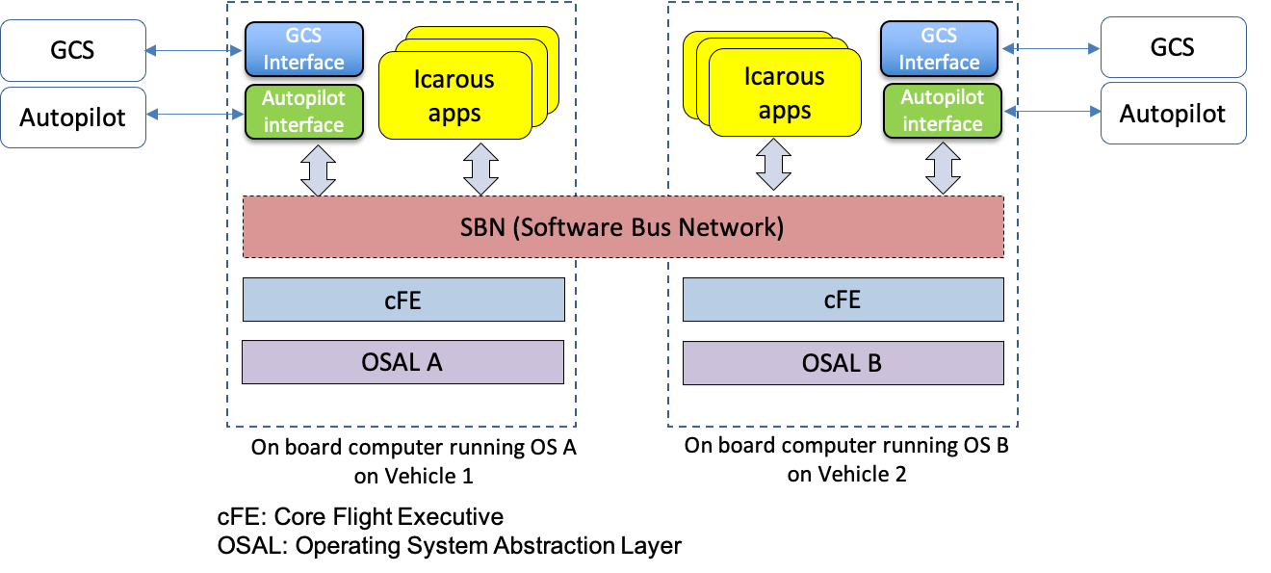
ICAROUS Configuration
María Consiglio, César Muñoz, George Hagen, Anthony Narkawicz, and Swee Balachandran, ICAROUS: Integrated Configurable Algorithms for Reliable Operations of Unmanned Systems, Proceedings of the 35th Digital Avionics Systems Conference (DASC 2016), Sacramento, California, 2016
Swee Balachandran, César Muñoz, María Consiglio, Marco Feliú and Anand Patel, Independent Configurable Architecture for Reliable Operation of Unmanned Systems with Distributed On-Board Services, Proceedings of the 37th Digital Avionics Systems Conference (DASC 2018), London, England, UK, 2018.
Notes:
ICAROUS [1,2] is a distributed software architecture designed to provide UAS with decision making capabilities to operate autonomously. The core functionalities include maintaining safe separation with other intruders in the airspace, conforming to geospatial airspace constraints, avoiding obstacles and performing path planning.
ICAROUS is implemented using the NASA core Flight Systems middleware (cFS) . Each ICAROUS functionality is developed as an independent cFS application. cFS applications can interact with each other by publishing or subscribing to messages on the cFS software bus.
The distributed nature of this architecture enables the easy integration of new functionality as modular cFS applications.
The cFS software bus can be extended over a network enabling multiple instances of cFS nodes on a network to communicate with each other. This specific feature enables multiple vehicles running ICAROUS to interact with each other over a network connection.
An ICAROUS application was developed to run the Distributed Merging Algorithm
It takes in parameters such as the min/max merging speeds and zone sizes, uses the Software Bus Network to conduct V2V communications, and commands are passed to the autopilot via the auto pilot interface.

Slide 7
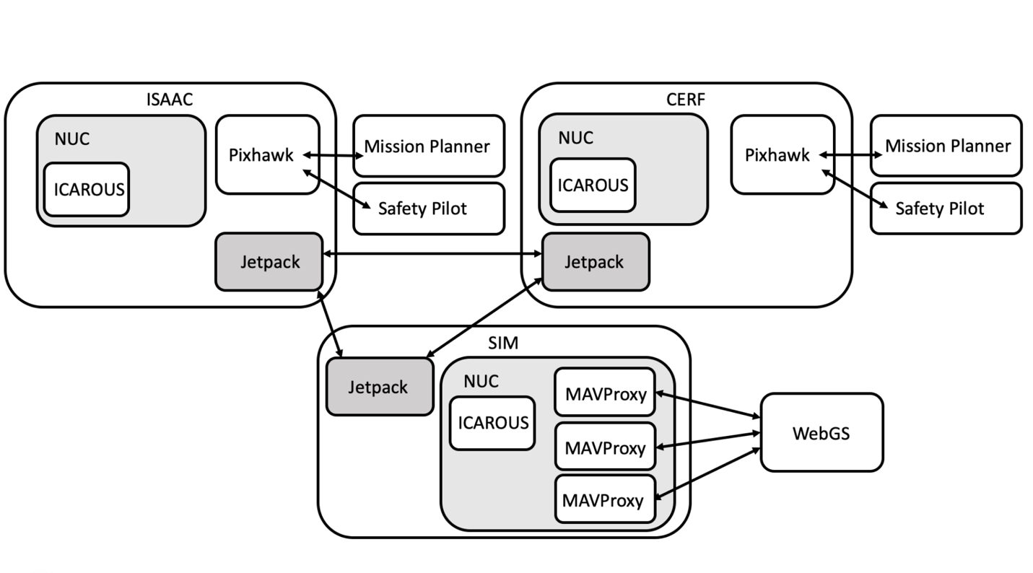
Aircraft Configuration
2 - DJI S1000 Octocopter, Pixhawk Autopilot running ArduCopter, a companion NUC computer running ICAROUS, a 900MHz telemetry link and a 2.4GHz C2 link.
1- Simulated vehicle running on a NUC using ArduCopter SITL and ICAROUS.
Verizon Jetpack for V2V communications.
Notes:
For these flights we used 2 real aircraft and one simulated vehicle. The two real aircraft, named CERF and ISSAC, were built on DJI S1000 frames with a Pixhawk autopilot running arducopter and a companion intel NUC computer running ICAROUS. Each had a 900 MHz telemetry radio for the ground station operators and a 2.4 GHz Command and Control radio for the safety pilot.
The simulated vehicle, SIM, was also running on a NUC. It ran ArduCopter SITL and ICAROUS.
Each vehicle had a Verizon Jetpack on board for Vehicle to Vehicle communications. This allowed us to not only pass the required Merging Algorithm data, but we were also able to use this link to monitor each instance of ICAROUS and pass the telemetry data to WebGS using MAVProxy to forward the data.

Slide 8
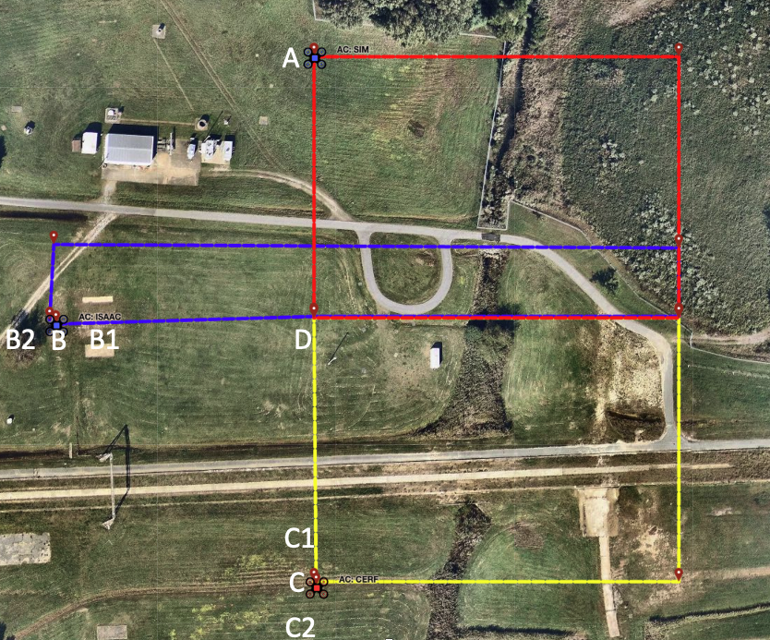
Flight Scenarios
Flight Plans
 | ISAAC |  | CERF |  | SIM
Scenario | Start Point | Start Speed (m/s) | Start Point | Start Speed (m/s) | Start Point | Start Speed (m/s)
1 | B | 3 | C | 3 | A | 3
2 | B | 3 | C | 5 | A | 5
3 | B | 3 | C | 5 | A | 3
4 | B | 5 | C | 5 | A | 3
5 | B2 | 7 | C | 5 | A | 5
6 | B2 | 7 | C1 | 3 | A | 5
7 | B1 | 3 | C | 5 | A | 5
8 | B2 | 7 | C2 | 7 | A | 5
Notes:
Eight scenarios were developed for this set of flight tests.
With each scenario we varied the distance to the merge fix (point D on the map) and the starting velocity of the aircraft as they approached the merge fix.
The starting speeds ranged from 3 to 7 meters per second and the starting distances ranged from 80 to 120 meters from the merge fix.
These looping flight paths allowed us to attempt up to four merges per flight.

Slide 9
Parameters
Configuration A
  The minimum and maximum merge speeds 0.5 m/s and 7.0 m/s.
  The radius of the coordination, schedule and entry zones were set to 80, 60 and 50 meters.
  The mission speed parameter, which determined the vehicle’s speed upon exiting the merge fix was fixed at 3.0 m/s.
Configuration B
  The minimum and maximum merge speeds 0.5 m/s and 8.0 m/s.
  The zones were expanded to 100, 75, and 50 meters.
  The mission speed parameter was adjusted to match the initial speed of the aircraft for each flight (as defined in the flight plan).
Notes:
Parameters were chosen to based on the limited size of the test range, the capabilities of the aircraft, and the results of initial simulation testing.
On day 1 we used configuration A, which allowed minimum and maximum merge speeds in the range of 0.5 to 7 m/s and set the radius of the coordination, scheduling and entry zones to 80,60,and 50 meters, respectively.
On day 2 configuration B was used. This expanded the merge speed range, and zone sizes.
The mission speed parameter was changed from a fixed 3 meters per second in configuration A to match the aircraft speed in configuration B. This had no affect on the merge. It just controlls the vehicle speed upon exiting the merge.

Slide 10
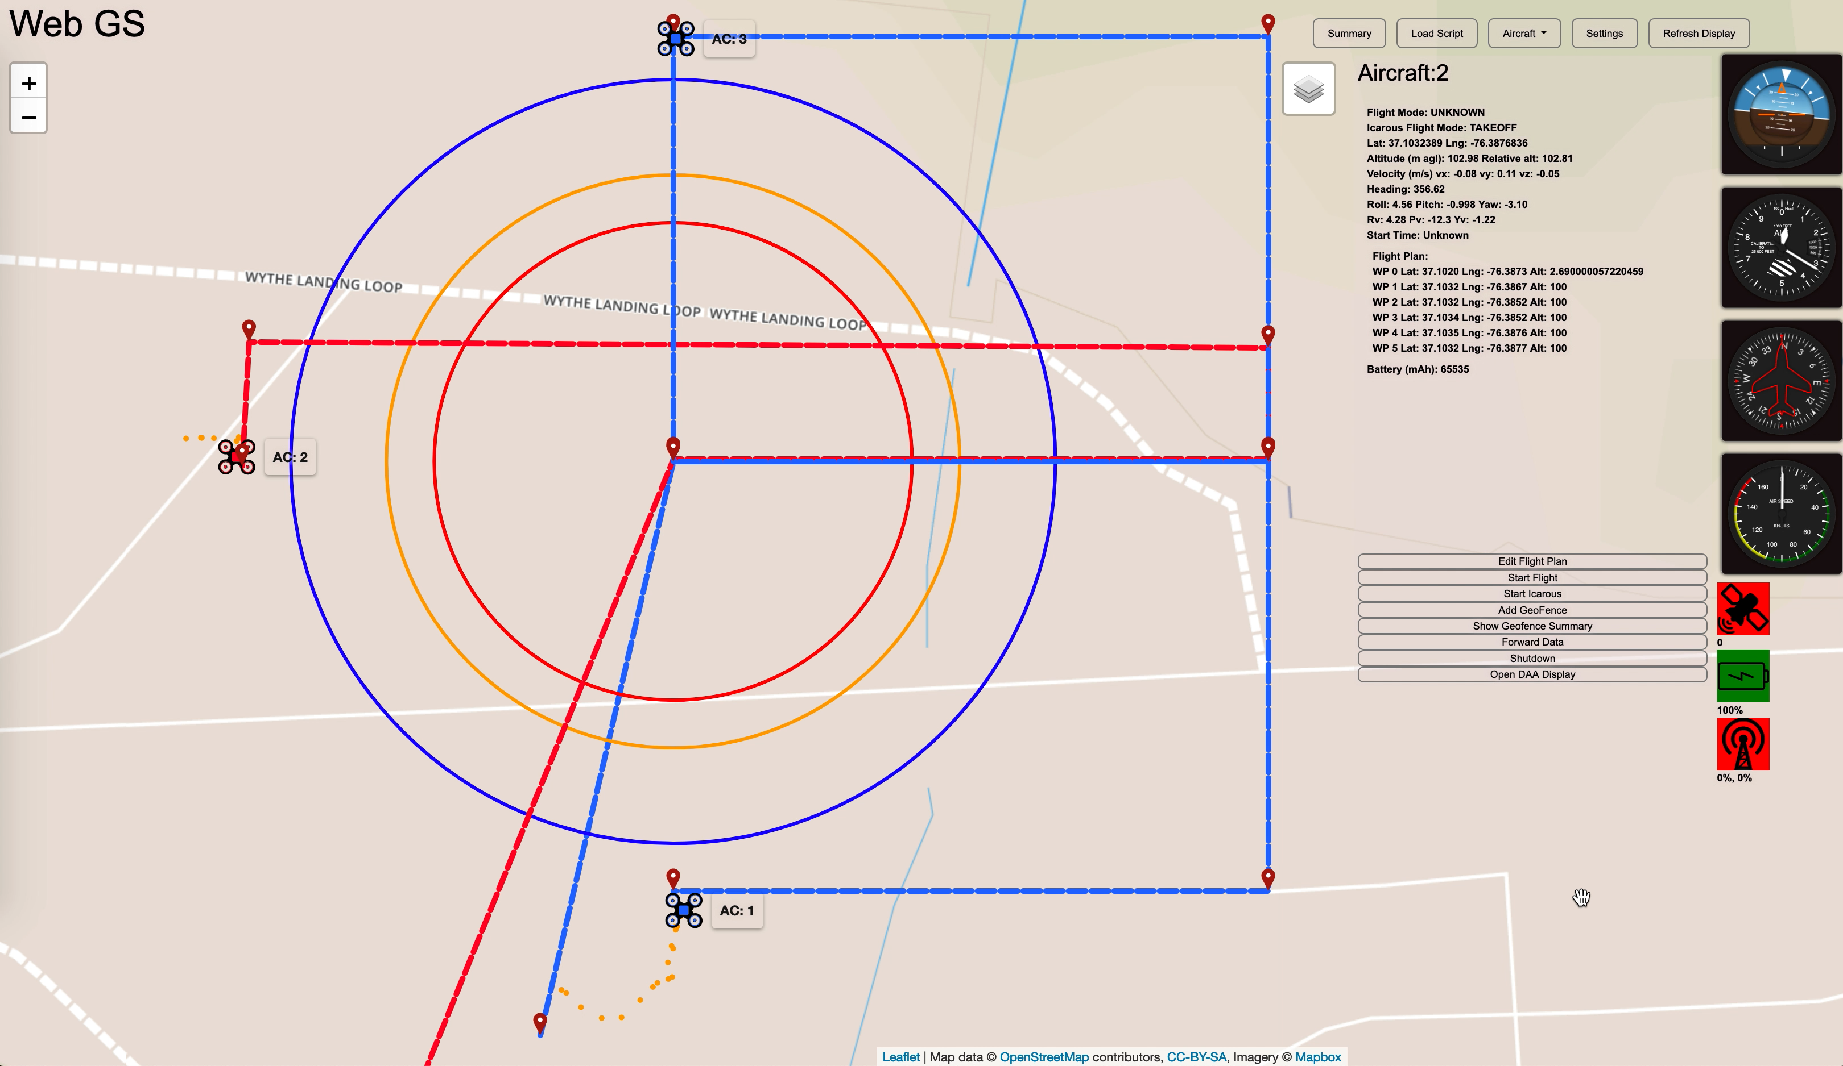
Notes:
This short video is a playback of the telemetry from one of the merge attempts. In this scenario all of the aircraft approach the merge fix at the same speed.
0:00 Each flight begins by manually moving the aircraft into position, then engaging the autopilot on all three vehicles simultaneously. Sending them flying towards the merge point.
0:08 The first vehicle approaching the merge fix enters the coordination zone.
ICAROUS takes control from the autopilot and establishes a network to enable information exchange.
Subsequent vehicles join the established network and exchange information about their possible arrival times at the merge fix.
Data is exchanged on the network by means of a leader-follower heartbeat mechanism.
Nodes or vehicles in the network vote to elect a leader and the leader ensures the synchronization of data exchanged between nodes.
0:15 When the vehicles enter the schedule zone, they use all the received arrival times to compute an optimal schedule of arrival for all the vehicles participating in that merge.
All vehicles compute the schedule using the same input information, therefor the scheduled arrival times for all the nodes in the network are guaranteed to be the same.
0:20 Vehicles start making trajectory changes upon arrival at the entry zone.
As you can see Aircraft 1 maintains its speed, aircraft 2 slows slightly and aircraft 3 slows dramatically.
0:42 As Aircraft 1 passes the merge fix and starts moving towards its next waypoint, ICAROUS passes control back to the autopilot and new rings are drawn around the next potential merge fix.
0:60 Each aircraft returns to its pre-merge velocity as it passes the merge fix, and you can see we are maintaining good time based separation between aircraft.

Slide 11
Definition of a Successful Merge
All three vehicles communicated with each other, coordinated and adjusted speeds as needed
Arrival order and velocities matched computed schedules
Maintained proper time-based separation
Returned to autopilot control upon reaching the merge fix
Notes:
Before we looks at the results of the testing, we need to define success.
For this set of tests,
a merging encounter was considered successful when all three vehicles communicated with each other,
coordinated and adjusted speeds as needed,
the arrival order and velocities of each aircraft matched computed schedules,
the vehicles maintained proper time-based separation,
and returned to autopilot control upon reaching the merge fix.
This is a stricter definition than just making sure the algorithm works as expected, it also affected by our hardware setup and reliability, our operational procedures, our communications and our parameter settings.

Slide 12
Overall Results
2 days, 12 flights, covering 8 scenarios
38 merge attempts, 21 considered successful 55%
Day 1
  5 Flights, 9 of 15 attempts succeeded, 60%
  Parameters, Config A: Zones 80/60/50 meters, Min/Max - 0.5/7.0 m/s
Day 2
  7 Flights, 12 of 23 succeeded, 52%
  Repeated Scenarios 2,5,6
  Parameters, Config B: Zones 100/75/50 meters, Min*/Max - 0.5/8.0 m/s
    *adjusted higher later
Notes:
Overall, over two days of testing we conducted 12 flights covering the 8 scenarios, Repeating scenarios with failed merges.
In total there were 38 merge attempts, 21 were considered successful, or 55%.
On day 1, we noticed the higher velocity scenarios were failing. So, we adjusted the zone sizes and opened the allowable merge velocity range on day 2. Also, on day 2 we repeated the failed scenarios conducted on both days with mixed results.
Next we will look at the failed merges, and then the successful merges.

Slide 13
Failed Merges
Communication
  Vehicle to ground – 1, RTL
  Vehicle to Vehicle – 3, Schedule Computation
  Vehicle Internal – 2, Research Cutoff and NUC crash
Parameter Settings
  Zone sizes – 2, Schedule Computation
  Minimum Merge Speed – 6, control not returned to Autopilot
Unknown
  3, Schedule Computation – Assumed to be due to V2V communication loss
Notes:
The issues encountered on the failed merges can be broken down into 2 categories; they were either communication related, or due to inadequate parameter settings.
Looking at the communication issues. We had a loss of telemetry link, causing an automatic return to launch, a loss of power to one of the onboard NUC’s, resetting ICAROUS on that vehicle, causing the vehicle not communicate and coordinate with the others, and a research cutoff switch was in the wrong position for one merge causing the autopilot not to receive commands from ICAROUS.
We also had less obvious communication issues that presented as a scheduling failure,
A deeper look into the logs showed heartbeat acknowledgement messages were not being passed between leader and follower indicating there may have been intermittent communication losses between vehicles. This happened definitively on 3 of the merges, and it is the assumed cause on another three merges that presented the same symptoms.
(PAUSE)
The parameter settings were also a source of failed merges. One of the main problems was caused by setting the minimum merge speed two low, in flights 7, 8 and 9 as the initial flight speeds increased, some of of the aircraft were being scheduled lower merging speeds to allow sufficient separation between the arrival times of vehicles.
The lower merging speeds illuminated a discrepancy in the criteria used by the merging algorithm vs the autopilot to determine if a given waypoint was reached. The result was the aircraft stopping just before reaching the merge fix and not continuing along the flight plan.
The minimum speed parameter was adjusted over the following two flights to find a correct setting that would avoid this behavior. It took four successive merge attempts to find a suitable minimum speed setting.
And the other main issue was setting the scheduling zone too small for the velocities the aircraft were flying, not allowing enough time to complete the scheduling calculations.
For example, with a scheduling zone that is 10 meters wide a UAS traveling at 7 m/s would have only 1.4 seconds to compute, communicate, and agree upon a schedule. And this assumes all vehicles are in the scheduling zone at the same time. Any delay in start time or latency in the issuance of commands would decrease the time all vehicles were in the scheduling zone together, reducing the time allowed to compute a schedule.

Slide 14
Analysis of Successful Merges
Did the aircraft execute the commanded speed change?
Did the aircraft arrive at the merge point at the scheduled time and in the proper order?
Did the aircraft maintain proper time separation?
And did the aircraft maintain a safe minimum horizontal distance?
Notes:
Looking at the successful merges we can answer a few basic questions about the execution of the merge.
Did the aircraft execute the commanded speed change?
Did the aircraft arrive at the merge point at the scheduled time and in the proper order?
Did the aircraft maintain proper time separation?
And did the aircraft maintain a safe minimum horizontal distance?

Slide 15
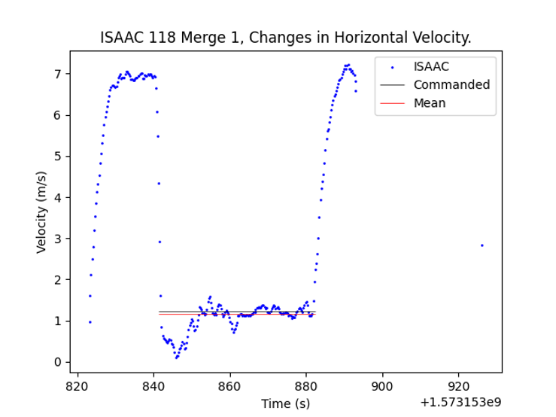

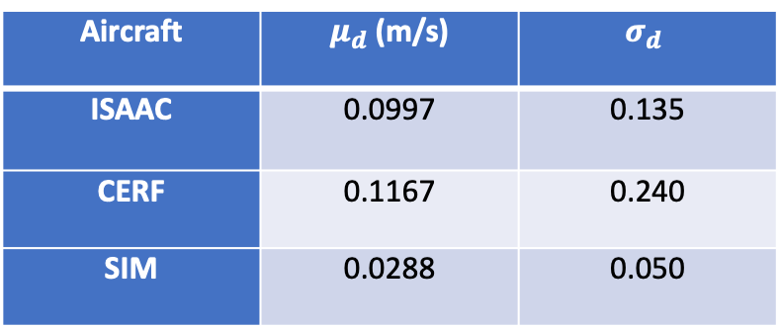
Commanded vs. Actual Velocity
$$d= v_{commanded}− μ_{v_{\left\{t_{c},…,t_{n}\right\}}}$$
Aircraft | $μ_{d}$ (m/s) | $$σ_{d}$$
ISAAC | 0.0997 | 0.135
CERF | 0.1167 | 0.240
SIM | 0.0288 | 0.050
Notes:
Comparing the actual average velocity vs. commanded velocity, we can see the sim was better at matching the commanded velocity
The graph shows the changes in velocity for an individual merge.
At the beginning of the flight the aircraft was switched into auto from a hover. It then accelerated to its assigned velocity, for this flight it was 7 m/s.
When it entered the entry zone it was commanded to change to a velocity of 1.2 m/s.
When aircraft reached the merge fix, control was returned to the auto pilot and the aircraft returned to its initial velocity.
The mean velocity was calculated from the time the command was given $t_{c}$ to the arrival at the merge fix $t_{n}.$ The average for each aircraft was calculated, as reported in the table.
One thing to that needs to be pointed out is CERF was commanded the highest velocities on most of the merges, followed by ISAAC, then the SIM. The size of the change will have an affect how quickly the aircraft reaches and can stabilize at a given velocity.

Slide 16
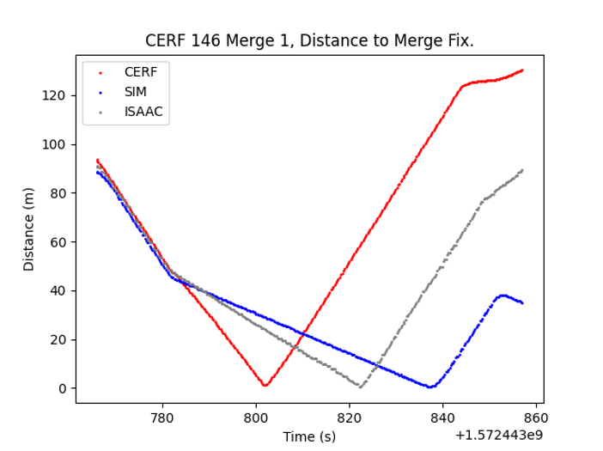


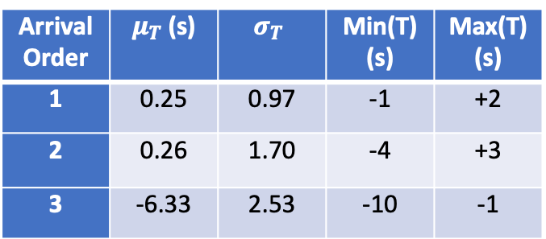
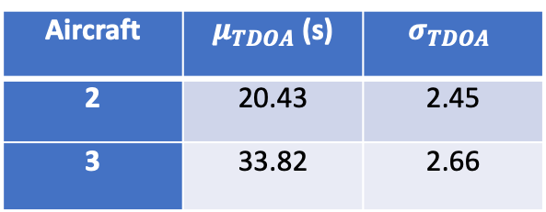
Actual vs Scheduled Arrival and TDOA
$$T= t_{scheduled}− t_{actual}$$
Arrival Order | $μ_{T}$ (s) | $$σ_{T}$$ | Min(T) (s) | Max(T) (s)
1 | 0.25 | 0.97 | -1 | +2
2 | 0.26 | 1.70 | -4 | +3
3 | -6.33 | 2.53 | -10 | -1
$$TDOA= t_{{ac}_{1} Arrival}− t_{{ac}_{n} Arrival}$$
Aircraft | $μ_{TDOA}$ (s) | $$σ_{TDOA}$$
2 | 20.43 | 2.45
3 | 33.82 | 2.66
Notes:
Comparing actual versus scheduled arrival times shows all aircraft arrived in their scheduled order.
For all of the merges, the the vehicles were expected to arrive 20 seconds apart.
The first two vehicles were able to arrive an average of 0.25 seconds after the scheduled time, as shown in the upper Table.
The third vehicle, SIM on all of the successful flights, consistently arrived early to the merge point.
This is inconsistent with the SIM’s ability to fly a desired velocity better than the real vehicles as shown in the previous slide.
This may be accounted for by the extremely slow velocities SIM was commanded to fly, and since the algorithm does not adjust velocities after the initial command to ensure proper arrival times, a small error in commanded velocity would be compounded over time.
Another factor may be the time between issuing the command and execution of that command would have a disproportionate effect on slower velocities. This delay in execution may account for part of the discrepancy between scheduled and actual arrival times.
The time difference of arrival (TDOA) between the first and subsequent vehicles shows the same result as actual versus scheduled arrival times.
The bottom table shows on average the second vehicle arrived 20.43 s after the first aircraft and the third arrived 33.82 s after the first.
The graph shows the distance from each aircraft to the merge fix for an individual merge. The change in slope at ~780 s indicates a change in commanded velocity and the change from a negative to positive slope indicates the arrival time at the merge fix then flying towards the next waypoint.

Slide 17
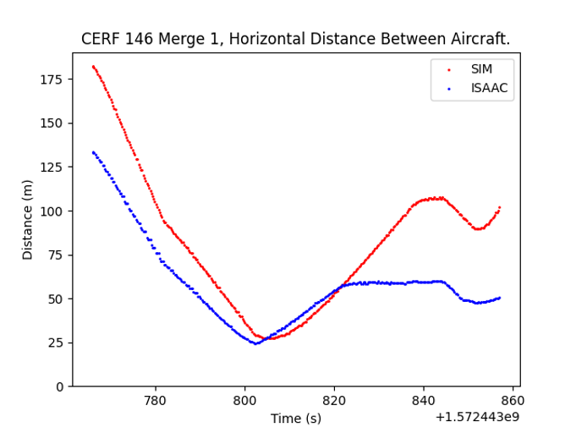
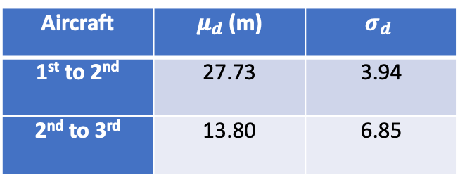
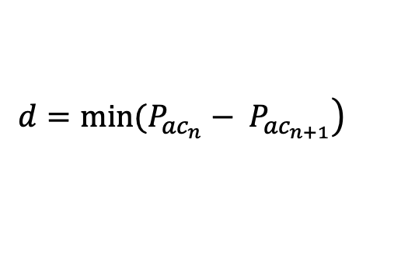
Horizontal distance between Aircraft
$$\left.d=min(P_{{ac}_{n}}− P_{{ac}_{n+1}}\right)$$
Aircraft | $μ_{d}$ (m) | $$σ_{d}$$
1st to 2nd | 27.73 | 3.94
2nd to 3rd | 13.80 | 6.85
Notes:
For all of the successful merges we were able to maintain horizontal separation between vehicles.
The graph shows the horizontal distance between each aircraft reaching a minimum as they approach the merge fix. This minimum was calculated for each successful merge and averaged based on arrival order and shown in the table.
The horizontal distance between the first and second aircraft to arrive averaged 27.73 meters, while the average for the second to third was 13.80 meters.
These values deviated considerably due to variations in commanded velocity and are in a large part a product of the flight plan geometries.
Overall, the results show safe distributed autonomous merging is possible using onboard systems and can be conducted on demand in real time.

Slide 18
Future Work
Number of vehicles / Communications throughput and latency
Deeper evaluation of V2V communication technologies
Notes:
Looking at future work,
Additional simulation and flight test studies are essential to understand the scalability limitations of the merging algorithm with respect to vehicle type and the number of vehicles approaching the merge fix,
especially regarding communication throughput and latency.
Knowledge of these limitations can help define operational constraints in terms of total number of allowed aircraft in a given time for the given airspace,
and minimum and maximum airspeed constraints to ensure a successful merge.
Through the testing process we attempted to use a few radio types with little success.
All of these radios operated in the 900MHz frequency range which was in the same range as our ground station telemetry links.
Adding more radios to this band caused reliability issues and forced us to find options outside of this range.
A deeper evaluation of other V2V communication options needs to be done to ensure merging operations can be conducted with a larger number of vehicles in a crowded rf environment.

Slide 19
Conclusion
sUAS vehicles, with limited computing power, can successfully coordinate their arrival at a common merge fix
The presence of a robust communication link is essential to achieve coordination among vehicles
More research is needed to identify configuration parameters for the merging algorithm as well as reliability of V2V communication technologies
Notes:
In Conclusion, we have presented the results of a set of flight test experiments to evaluate an autonomous, decentralized, consensus based, merging algorithm.
These results establish that it is possible for sUAS vehicles, with limited computing power, to successfully coordinate their arrival at a common merge fix given a range of starting velocities and starting distances to the merge fix while maintaining a safe time based, separation distance.
The results also show the presence of a robust communication link is essential to achieve coordination among vehicles.
More research is needed to identify configuration parameters for the merging algorithm as well as assessing reliability of Vehicle to Vehicle communication technologies.
Thank you for your time, and I am looking forward to answering your questions in the virtual session.

Slide 20
Questions

Slide 21
Overall Results
Flight | CERF (m/s) | ISAAC (m/s) | SIM (m/s) | Attempts | Success | Parameter configuration | Notes
1 | 3 | 3 | 3 | 3 | 3 | Config A | All merges successful
2 | 5 | 5 | 5 | 2 | 0 | Config A | Inadequate parameter configuration
3 | 5 | 3 | 3 | 4 | 3 | Config A | RTL triggered on ISAAC
4 | 3 | 5 | 3 | 3 | 2 | Config A | Incorrect schedule computation
5 | 5 | 3 | 5 | 3 | 1 | Config A | Incorrect schedule computation
6 | 5 | 5 | 5 | 2 | 1 | Config B | NUC Crash
7 | 5 | 7 | 5 | 4 | 1 | Config B | Research Cutoff/Control issues
8 | 3 | 7 | 5 | 3 | 0 | Config B | Control issues
9 | 3 | 7 | 5 | 3 | 2 | Config B | Control issues
10 | 7 | 7 | 5 | 4 | 4 | Config B | All merges successful
11 | 5 | 7 | 5 | 4 | 1 | Config B | Incorrect schedule computation
12 | 5 | 5 | 5 | 3 | 3 | Config B | All merges successful

