Slide 1
Cryogenic Fluid In-Situ Liquefaction for Landers “Brassboard” Overview
JANNAF In-Space Propulsion TIM - Sept 2020
Juan Valenzuela – MSFC/ER64
Notes:
Jonathan Stephens … Brassboard Test Team Lead
Working with James Smith, Juan Valenzuela and Noah Rhys in the Brassboard Test Program here at MSFC

Slide 2
Agenda
  Brassboard Overview
  Ground Test Objectives
  Heat Load Data
  ZBO Data
  Constant Liquefaction Cases
  Non-Constant Liquefaction Cases
  Conclusions

Slide 3
ISRU Liquefaction Brassboard Testing
Introduction
Objective(s):
Demonstrate the liquefaction and storage of “In-Situ like” propellant via a Tube-On-Tank Heat Exchanger integrated with Active Cooling (cryocooler)
  Verify proof of concept
  Obtain relevant data for model validation
Gather lessons learned from “brassboard” testing which will be applied to future liquefaction system prototype testing, then eventually to an end-to-end demonstration.
Background:
To enable NASA’s planned long duration missions, the agency is putting emphasis on reusable cryogenic systems
Such systems will require replenishing of cryogens on-orbit via a cryogenic tanker or refueling depot, and potentially on the lunar or Martian surfaces with the utilization of in-situ resources.
Surface replenishing requires the in-situ production of gaseous oxygen (and hydrogen if on the lunar surface), followed by liquefaction and storage.
Funded by NASA’s Advanced Exploration Systems, and managed under the Advanced Cis-Lunar Space Capability Project, the Cryogenic Fluid In-Situ Liquefaction for Landers (CryoFILL) multi center team was formed to develop a liquefaction and storage system that is efficient, reliable and scalable.

Slide 4
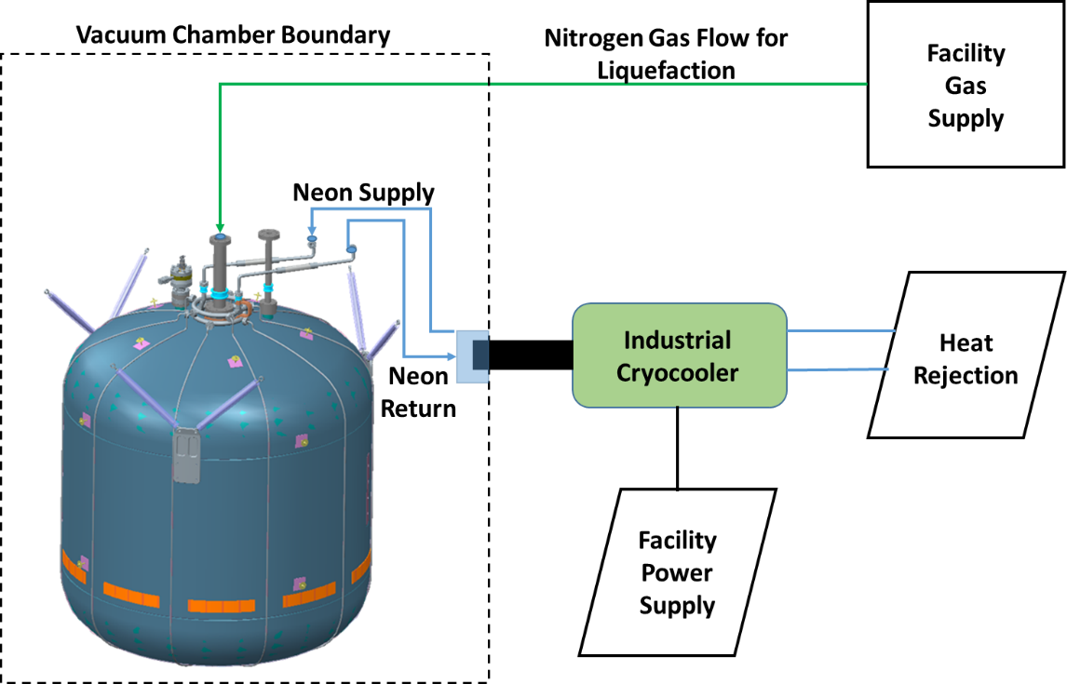
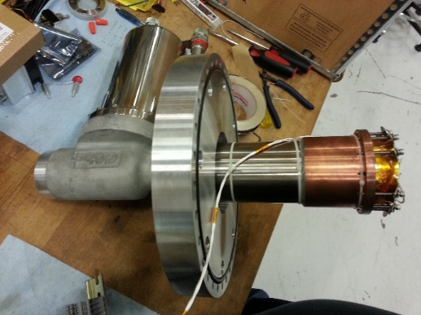
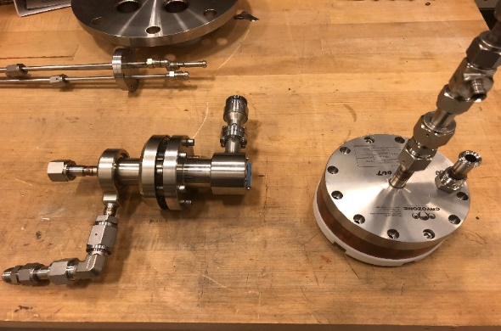
ISRU Liquefaction Brassboard Testing
Hardware and Experimental Setup
*Glenn Research Center’s Zero Boil-Off Propellant Tank
  Stainless Steel
  630 lbm dry mass
  48.5 ft³ total volume
  Hangs from six low conductivity struts
  Tube-On-Tank Heat Exchanger
  Outfitted with 80 layers of tMLI
Gifford-McMahon 90K cryocooler
Custom build heat exchanger to integrate cryocooler cold head to Tube-On-Tank Heat Exchanger
Cryofan to circulate working fluid (neon) through the refrigeration loop.
GN2 used as a surrogate for GOX
  Facility supplied at ~ 292K
Constant flowrate set via Mass Flow Controller
Tested at high vacuum: ~4.0E-6 Torr
  *See D.W. Plachta, W.L. Johnson, and J.R. Feller, “Zero Boil-Off System Testing”, presented at the 26th Space Cryogenics Workshop, June 2015
PHPK Cryocooler
CryoZone Cryofan (left) and cold head Heat Exchanger (right)

Slide 5
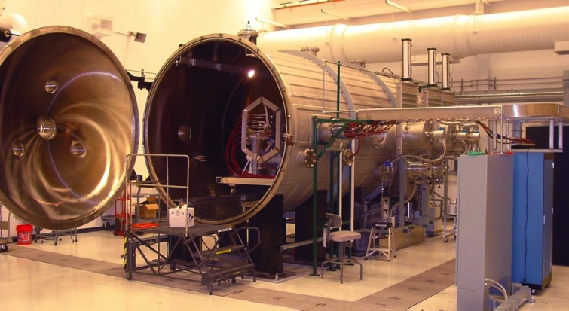
MSFC PRDL Exploration Systems Test Facility
  NASA MSFC Propulsion Research and Development Laboratory (Bld. 4205/Rm. 108)
  9 ft diameter by 20 ft long vacuum chamber (10⁻⁸ torr)
  Pumps: 1 roughing (Kinny-CB7230), 2 turbos (TMG2400), 2 cryos (ADPSHD22)
  240 kW DC power (16 supplies @ 150 V, 100 Amps)
  Control, Data Acquisition via LabVIEW, NI, and Iotech
  Liquid nitrogen (150 psig) / gaseous nitrogen (4500 psig) / Missile grade air (3500 psig)

Slide 6
ISRU Liquefaction Brassboard Testing
Ground Test Objectives (GTOs)
GTO 1 | Demonstrate liquefaction for a given Tube on Tank configuration
1.1 | Experiment constant liquefaction rate control.
1.2 | Experiment with pre-cooling of gas stream
1.3 | Determine system efficiencies/operations at different fill levels
GTO 2 | Demonstrate liquefaction of non-constant process/propellant flow rates
2.1 | Sinusoidal process (average flow with periodic swings, mdot always greater than 0)
2.2 | Batch process (mdot is 0 for a certain amount of time)
GTO 3 | Demonstrate ZBO
3.1 | Determine heat leak into tank
3.2 | Allows for determination of net cooling power ratios
Notes:
Ground test objectives…lay out the objectives prior to developing a test matrix.
GTO 1 Demonstrate the Liquefaction of “ISRU” like generated propellant (GN2) using a tube-on-tank HTX integrated with Active Cooling
Look at the changes in liquefaction rates associated with liquid levels.
GTO 2 Demonstrate liquefaction with non-constant propellant generation and non-constant active cooling to capture the diurnal effects and the interruption of solar power
GTO 3 Measure Steady-State Heat Load and Demonstrate ZBO
GTO 4 Provide data for current modeling efforts

Slide 7
GTO 3.1- Steady State Heat Load
ZBO Tank Loaded with LN2 to 100%
Venting with Back Pressure Control set to 18 PSIA
Monitoring Vent Flowmeter and Load Cells
Approximately 7.29 Lbm/day boil-off
Q_{total} = 10.5 W
Q_{latent} = 7.5 W
Q_{sensible} = 3.0 W

Slide 8
GTO 3.2- Neon Loop Checkout and ZBO Demonstration
Tank Ullage Pressure
SD-208
ZBO fill to 57%
Tank vented to atmosphere/ cryofan set to 15,000 RPM
Tank filled to ~ 57% Liquid Level
  Loaded at Atmospheric Pressure
Neon Loop Checkout
  Loop Pressure ~ 200 PSIA
  Cryofan Speed ~ 15,000 RPM
Tank Pressure was 7.4 PSIA as of Sunday, October 14th at 10:00AM CST
Tank Pressure continuing to decrease
  0.1314 PSI / hour reduction in tank pressure
Tank Pressure as of Monday, October 15th morning was < 6 PSIA
Ullage Pressure begins to decay as soon as neon inlet into tank falls to LN2 temperature

Slide 9
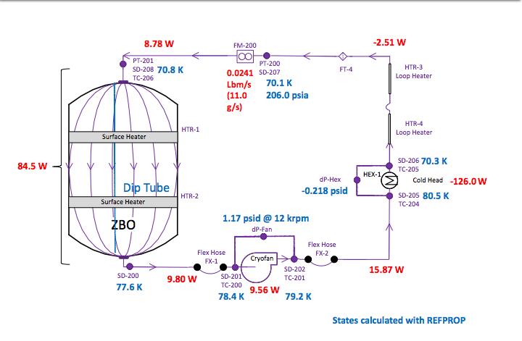
GTO 1.3- Neon Loop System efficiencies
Const Liquefaction (1lbm/hr) - 90% fill level in ZBO

Slide 10

GTO 1.3- Neon Loop System efficiencies
Const Liquefaction (1lbm/hr) - 50% fill level in ZBO

Slide 11

Determining Liquefaction Rate
GN2 Flow turned off
LIQ Rate= $\frac{M2−M1}{T2−T1}$=Lbm/Day
14.7 PSIA
T2-T1
M1
M2

Slide 12
GTO 1.1- Liquefaction at Various Liquid Levels
Constant GN2 Flowrate – Injected Into Tank Ullage Space
90% Liq Lvl
Pressure decreases when flow is discontinued
Constant GN2 Flow: 1.0 lbm/hr
75% Liq Lvl
50% Liq Lvl
25% Liq Lvl
0% Liq Lvl

Slide 13
GTO 1.2- Liquefaction at Various Liquid Levels
Constant GN2 Flowrate – Injected Thru Diptube
Liquid Level | Mass Added | Liquefaction Rate | Liquefaction Rate
% | Lbm | Lbm/day | % of Baseline
90 | 156.1 | 20.2 | 94
50 | 157.9 | 21.9 | 102
0 | 149.4 | 21.5 | 100
90% Liq Lvl
0% Liq Lvl
50% Liq Lvl
Constant GN2 Flow: 1.0 lbm/hr

Slide 14
GTO 2.1- Liquefaction at Various Liquid Levels
Non-Constant GN2 Flowrate (12 hr cycles) – Injected Into Tank Ullage Space
High pressures limit GN2 flow into tank
12 Hr Cycles GN2 Flow: 2.0 lbm/hr
90% Liq Lvl
50% Liq Lvl
0% Liq Lvl

Slide 15
GTO 2.1- Liquefaction at Various Liquid Levels
Non-Constant GN2 Flowrate – Injected Thru Diptube
12 Hr Cycles GN2 Flow: 2.0 lbm/hr
Liquid Level | Mass Added | Liquefaction Rate | Liquefaction Rate
% | Lbm | Lbm/day | % of Baseline
90 | 189 | 25.1 | 101.6
50 | 189.3 | 25.16 | 101.8
0 | 186 | 24.7 | 100
90% Liq Lvl
50% Liq Lvl
0% Liq Lvl

Slide 16
CryoFILL Conclusions/Lessons Learned
Conclusions:
Loaded with Liquid Nitrogen, the heat load into the test article is 10.5 Watts at high vacuum
Both Zero Boil-Off and Liquefaction were demonstrated with the Tube-On-Tank Heat Exchanger integrated with a Cryocooler
The Cryocooler consistently removes ~ 126 W heat from the refrigeration loop which removes ~ 85 W from the test article at fill levels higher than 50%.
The Cryocooler consistently removes ~ 130 W heat from the refrigeration loop which removes ~ 105 W from the test article at fill levels below 50%.
Liquefaction at higher liquid levels results in higher pressures and reduced liquefaction rates due to smaller ullage volumes, and decreased surface areas available for liquefaction
  Excessive pressures can reduce the inflow of propellant gas
Changes in liquefaction rates were not very significant
  Less than 6% change over liquid levels tested
  Slightly increase, ~ 2% to 5%, when introducing flow in 12 hour cycles rather than a constant 24 hours
Sub-Surface Injection results in lower tank ullage pressures compared to ullage injection. Recommended method for liquefaction for future tests.

