Slide 1



Tesla Valve Integration Into Propulsion Systems For
Water Hammer Mitigation
JANNAF IN-Space Propulsion TIM
Adam Willis
David Eddleman
James Richard
Dr. David Young

Slide 2
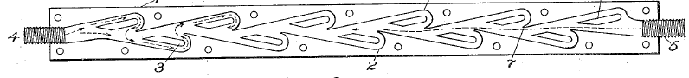
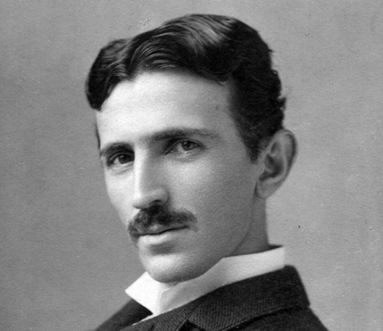
Tesla Valve History
Original designed and patented by Nikola Tesla
Functions as a one-way valve without the use of moving mechanical parts
Flow geometry limited to 2 dimensions
Tesla filed for bankruptcy soon after this patent was established. Thus it was never implemented.
(1.) Fig1 From Tesla’s Original Patent

Slide 3
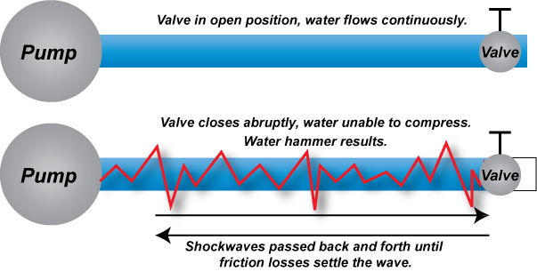
The Water Hammer Effect
The water hammer effect occurs when a valve downstream in a pressurized propulsion system closes rapidly and creates a pressure wave in the opposite direction of the normal flow path.
The pressure spikes upstream in the system and can cause damage to other components.
Current measures for dealing with water hammer requires components with seals or bellows, which wear out over time.
(3.)

Slide 4
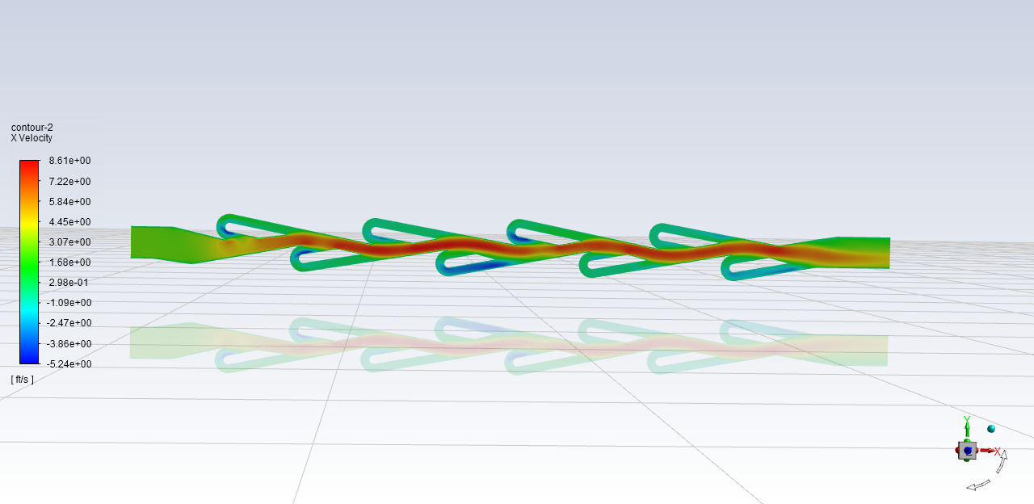
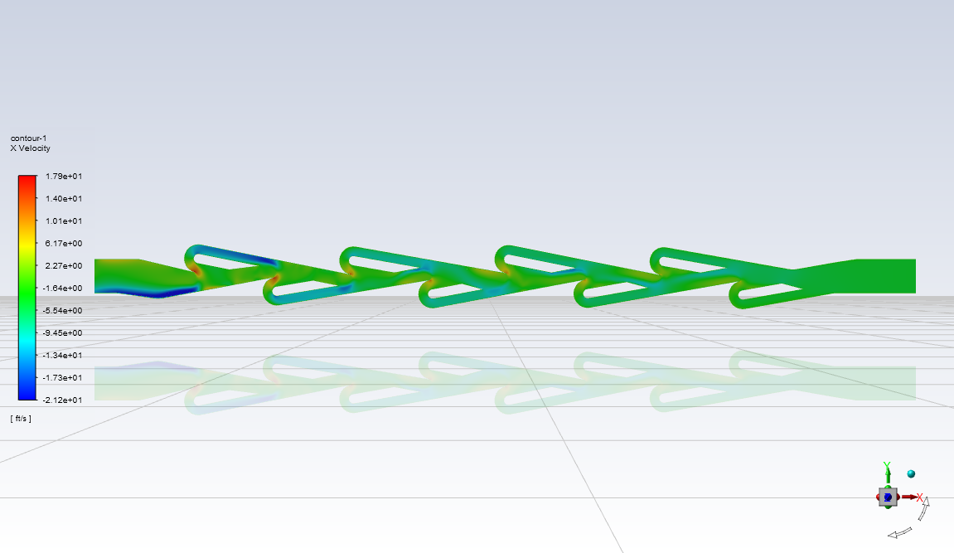
Hypothesis
By using a tesla valve in a liquid propulsion system it could prove useful to reduce or remove the max pressure surge from valve cycling which causes the water hammer effect.
Others have done CFD analysis to show that the fluid passing in the forward flow direction has minimal restrictions
While the reverse direction causes the pressure wave and flow reversal to work against itself. The tesla valve works effectively under transient pressure spikes
The valve could be designed to reduce the Maximum Expected Operating Pressure (MEOP) which could help with overall weight and performance of a Pressurized Propulsion System
Forward Flow
Reversed Flow

Slide 5
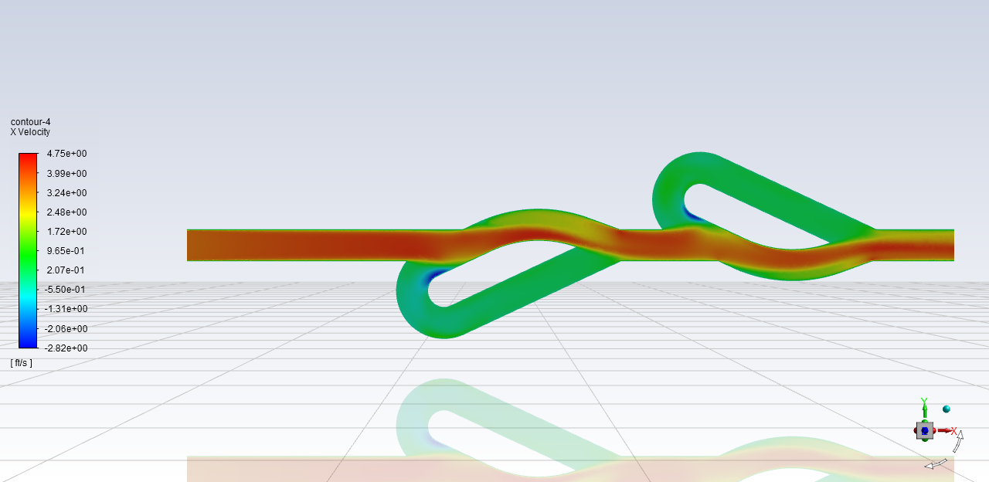
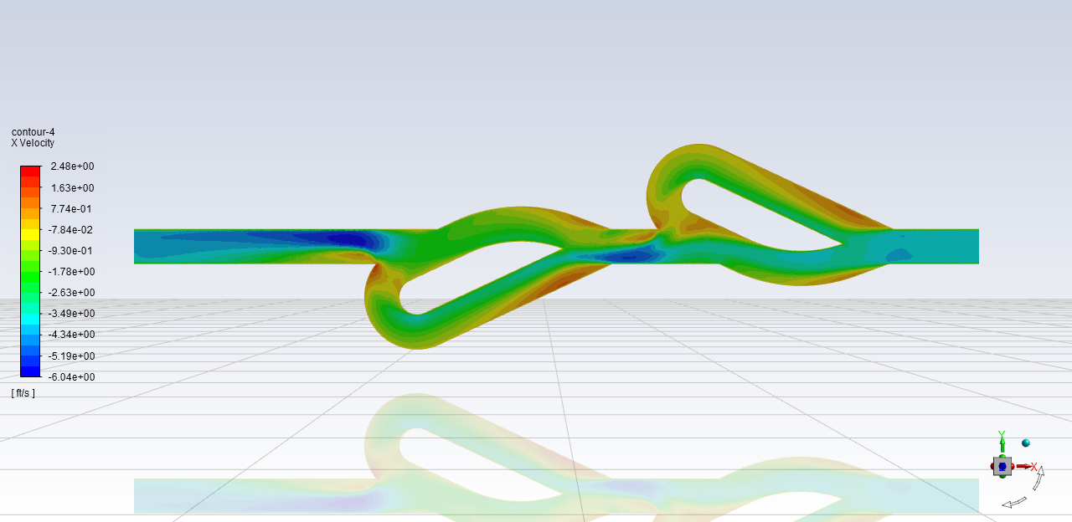
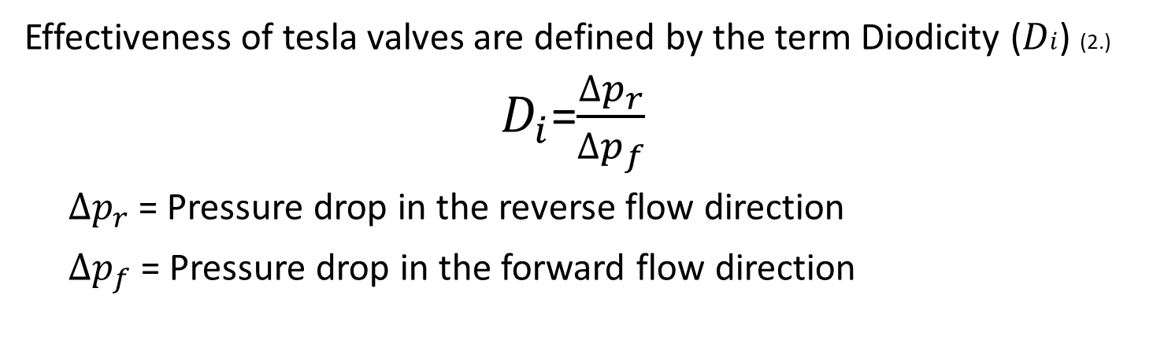
Diodicity
Effectiveness of tesla valves are defined by the term Diodicity ($Di$) (2.)
$D_{i}$=$\frac{∆p_{r}}{∆p_{f}}$
$∆p_{r}$ = Pressure drop in the reverse flow direction
$∆p_{f}$ = Pressure drop in the forward flow direction
Forward Example
Reversed Example

Slide 6
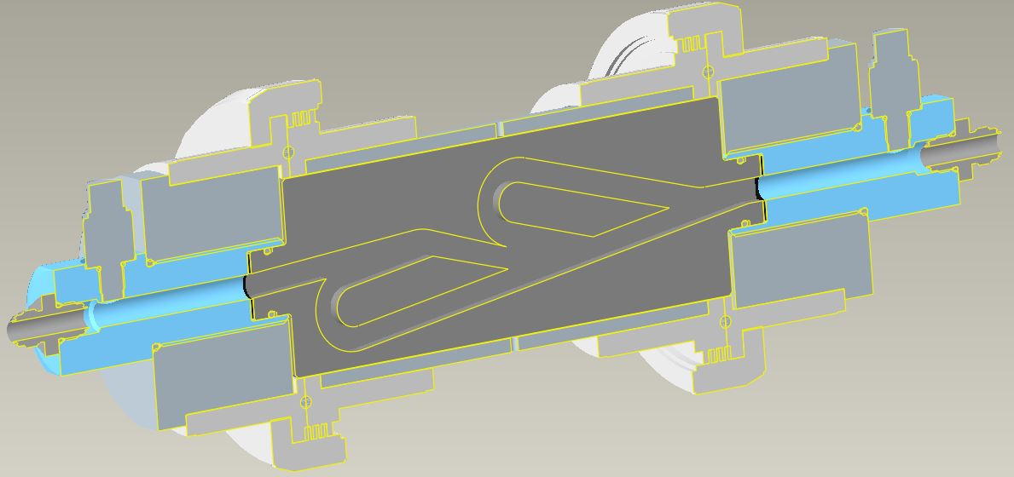
Valve Test Fixture
Quick disconnect and PVC couplings
O-rings and gaskets to help prevent leaks
3D Printed acrylic inserts for different valves
Reasoning:
3D printing has made it possible to design and create rapid prototypes
Ease of disassembly and assembly
Quick turnaround on data
To explore 3 dimensional flow geometries
Variables Considered:
Straight length (S) Vs. Loop Length (L)
Effective Diameter of Straight Vs. Loop Length
Number of Loops

Slide 7
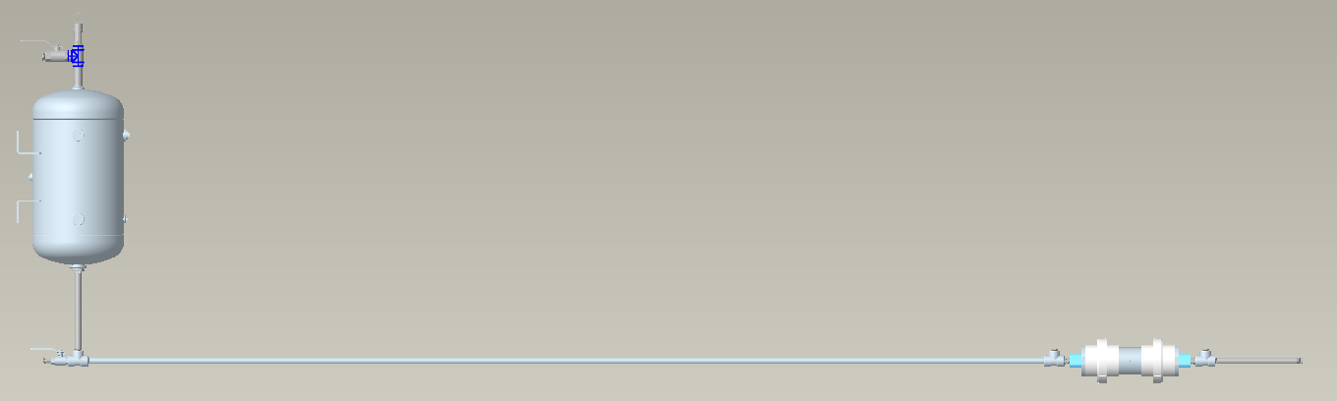
Bench Test Setup
Air compressor quick release
Pressure relief pop valve
10 gal Pressure Tank
Ball valve to water hose transition
20ft, 1” DIA steel pipe
Valve Insert Assembly
Pressure gauge both FWD and AFT (not shown)

Slide 8
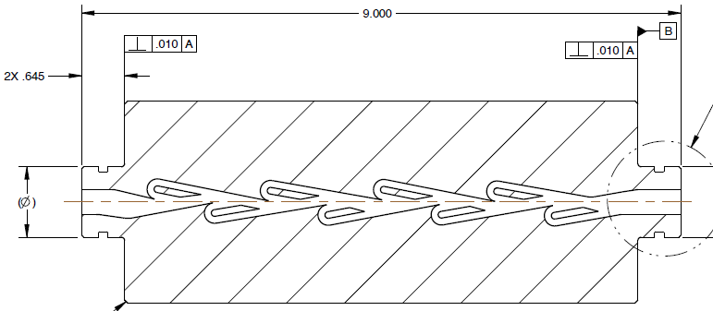
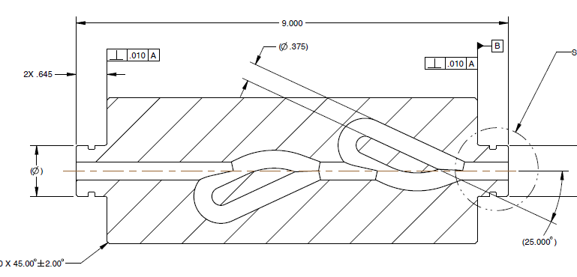
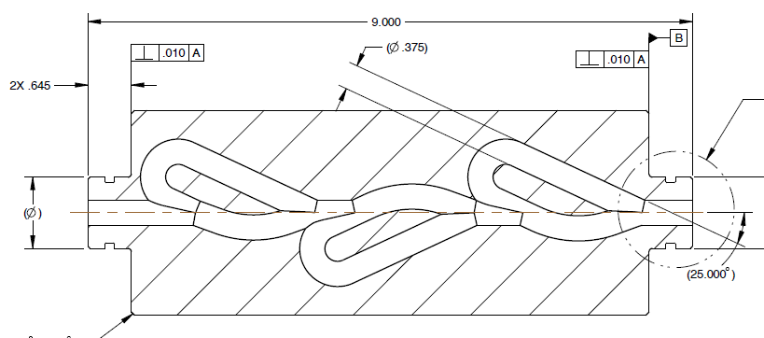
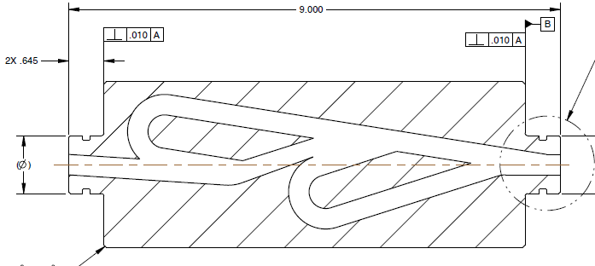
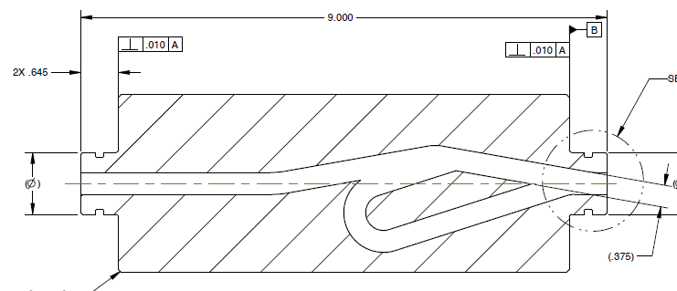
Valve Designs &
Preliminary Analysis
Analysis Software: ANSYS FLUENT 2020 R1
Type: Steady State Analysis
Min mesh size: .01”
Max mesh size: .02”
Fluid: Water
Inlet Pressure: 50 psi
Flow Rate: 10.4375 lbm/min
*All results are preliminary and have not been validated
Tesla’s Original Design
2 Loop Round Cross-section
3 Loop Round Cross-section
2 Loop Square Cross-section
1 Loop Square Cross-section

Slide 9
Valve Designs &
Preliminary Analysis
4488-301
Direction | Inlet P | Outlet P | Delta
Reversed | 16.9459 | 9.7023 | 7.2436
Forward | 15.219 | 14.6322 | 0.5868
Diodicity | 12.3
ORIGIONAL UNRESTRICTED, 10.4375 lbs/min 50PSI STATIC PRESSURE, X-VELOCITY
ORIGIONAL RESTRICTED, 10.4375 lbs/min 50PSI STATIC PRESSURE, X-VELOCITY

Slide 10
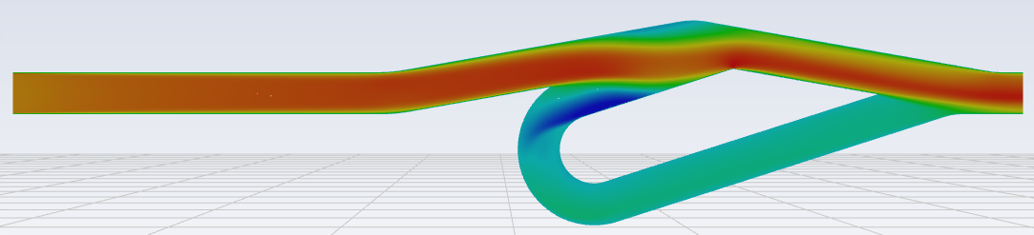
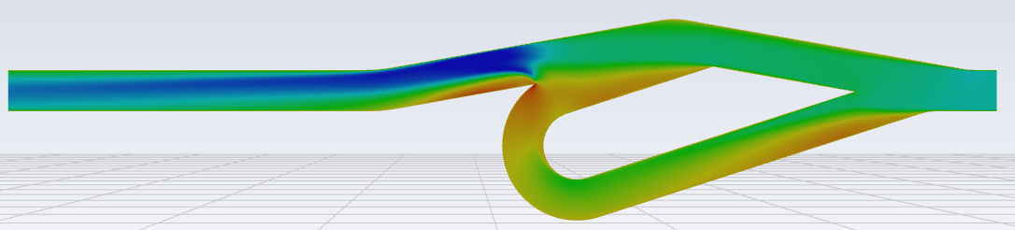
Valve Designs &
Preliminary Analysis
4488-401
Direction | Inlet P | Outlet P | Delta
Reversed | 14.8456 | 14.7528 | 0.0928
Forward | 14.735 | 14.6731 | 0.0619
Diodicity | 1.5
- 401 Steady State:
.375” Square constant
6.35” Restricted loop length @ 18 deg angle
2.06” Unrestricted length @ 10 deg angle
50 psi @ 10.4375 lbm/min
UNRESTRICTED, 10.4375 lbs/min, 50PSI STATIC PRESSURE, X-VELOCITY
RESTRICTED, 10.4375 lbs/min, 50PSI STATIC PRESSURE, X-VELOCITY

Slide 11
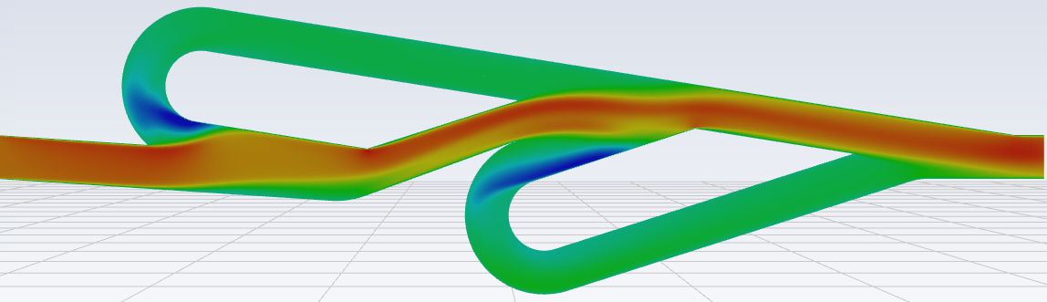
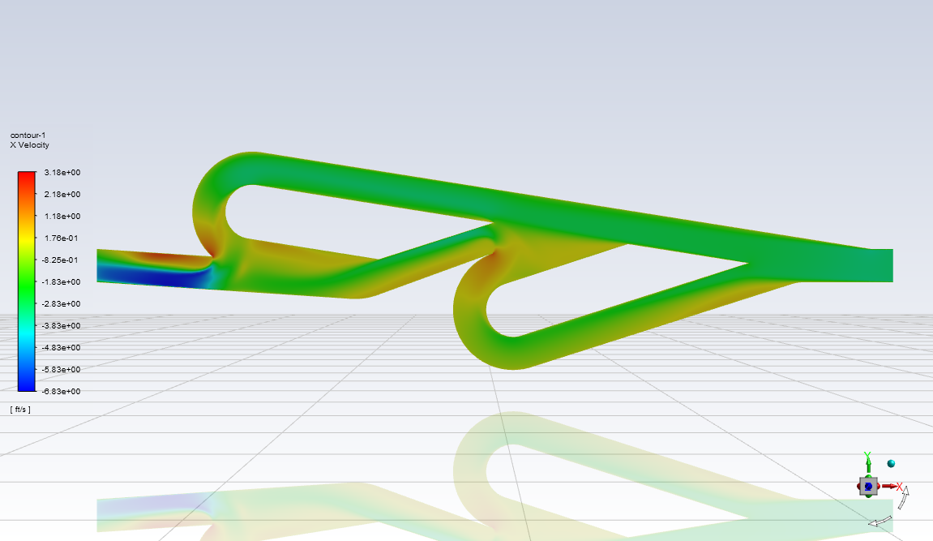
Valve Designs &
Preliminary Analysis
4488-501
Direction | Inlet P | Outlet P | Delta
Reversed | 14.6953 | 14.5137 | 0.1816
Forward | 14.7765 | 14.6856 | 0.0909
Diodicity | 2.00
- 501 Steady State:
.375” Square constant
50 psi @ 10.4375 lbm/min
- Loop 1:
  6.49” Restricted loop length @ 17.7 deg angle
  2.21” Unrestricted length @ 9 deg angle
- Loop 2:
  5.23” Restricted loop length @ 9 deg angle
  3.64” Unrestricted length @ 17.7 deg angle
UNRESTRICTED, 10.4375 lbs/min, 50PSI STATIC PRESSURE, X-VELOCITY
RESTRICTED, 10.4375 lbs/min, 50PSI STATIC PRESSURE, X-VELOCITY

Slide 12
Valve Designs &
Preliminary Analysis
4488-101
Direction | Inlet P | Outlet P | Delta
Restricted | 14.825 | 14.5729 | 0.2521
Forward | 14.7418 | 14.616 | 0.1258
Diodicity | 2.0
-101 Steady State:
.375” constant diameter
3.70” Restricted loop length @ 25 deg angle
1.85” Unrestricted length @ 20 deg angle
50 psi @ 10.4375 lbm/min
UNRESTRICTED, 10.4375 lbm/min, 50PSI GAUGE
X VELOCITY
RESTRICTED, 10.4375 lbm/min, 50PSI GAUGE
X VELOCITY

Slide 13
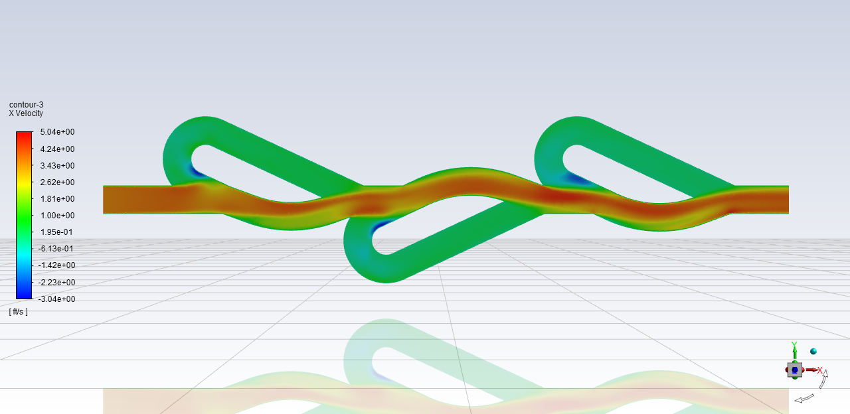
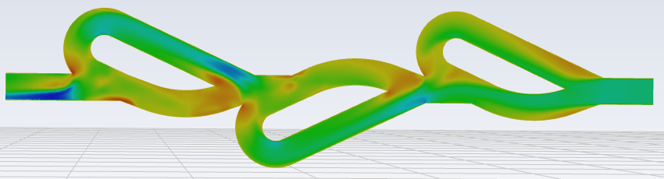
Valve Designs &
Preliminary Analysis
4488-201
Direction | Inlet P | Outlet P | Delta
Reversed | 14.8256 | 14.2052 | 0.6204
Forward | 14.7843 | 14.6328 | 0.1515
Diodicity | 4.1
-201 Steady State:
.375” constant diameter
3.70” Restricted loop length @ 25 deg angle
1.85” Unrestricted length @ 20 deg angle
50 psi @ 10.4375 lbm/min
UNRESTRICTED, 10.4375 lbm/min, 50PSI GAUGE
X VELOCITY
RESTRICTED, 10.4375 lbm/min, 50PSI GAUGE
X VELOCITY

Slide 14
Forward Work
Finish fabrication of hardware (3D prints)
Continue with new design concepts of valves
Determine the important variables for performance
Test valves in assembly
Finalize design of a valve for specialized propulsion Systems

Slide 15
Questions?
References:
1. Tesla Original Patent- US1329559
2. “Simulation and Optimization of Tesla Valves” T-Q. Truong & N-T. Nguyen,2003.
3. “WHAT IS WATER HAMMER?” https://blog.craneengineering.net/what-is-water-hammer

Slide 16
BACKUP

Slide 17
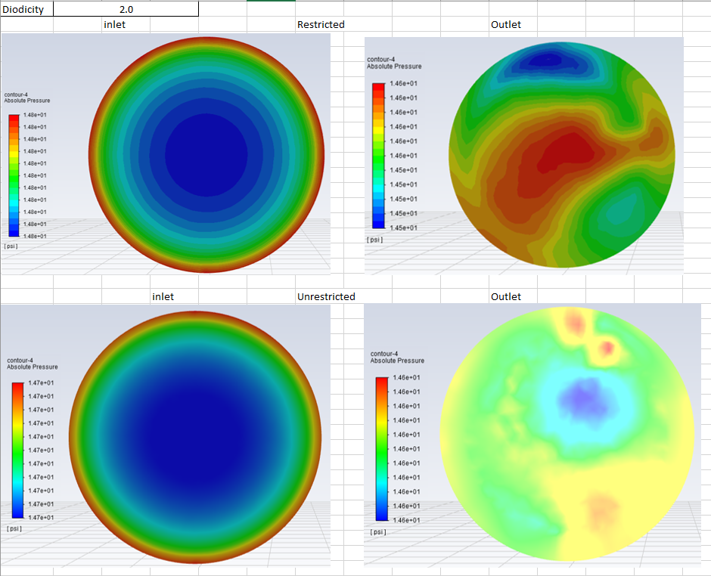
4488-101

Slide 18
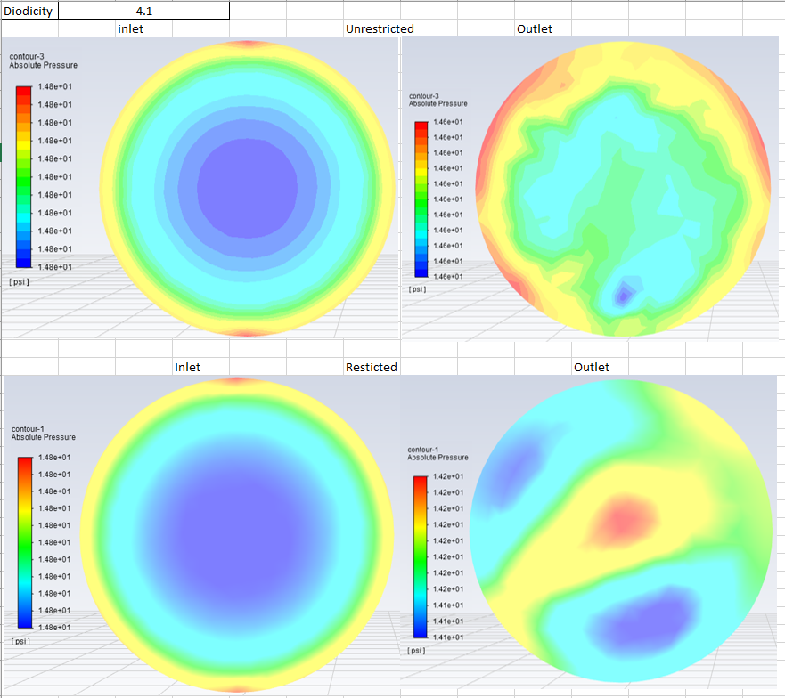
4488-201

Slide 19
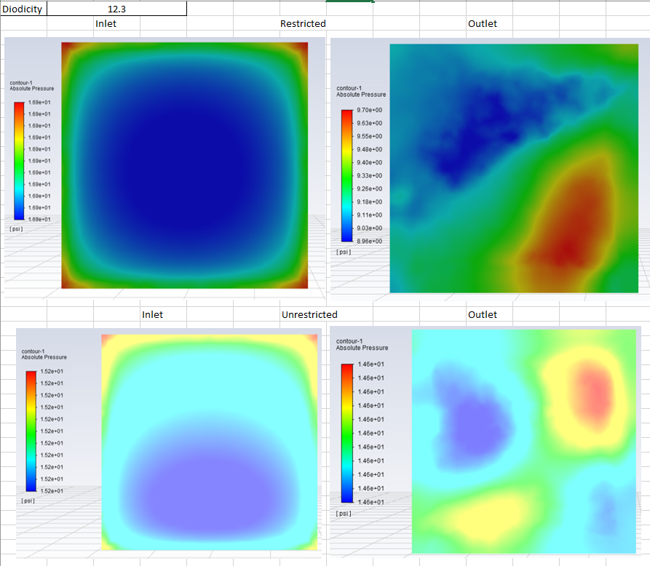
4488-301

Slide 20
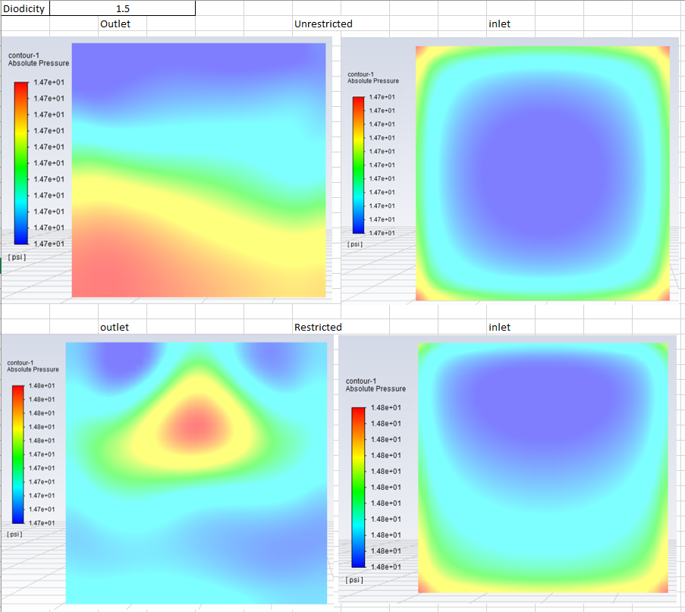
4488-401

Slide 21
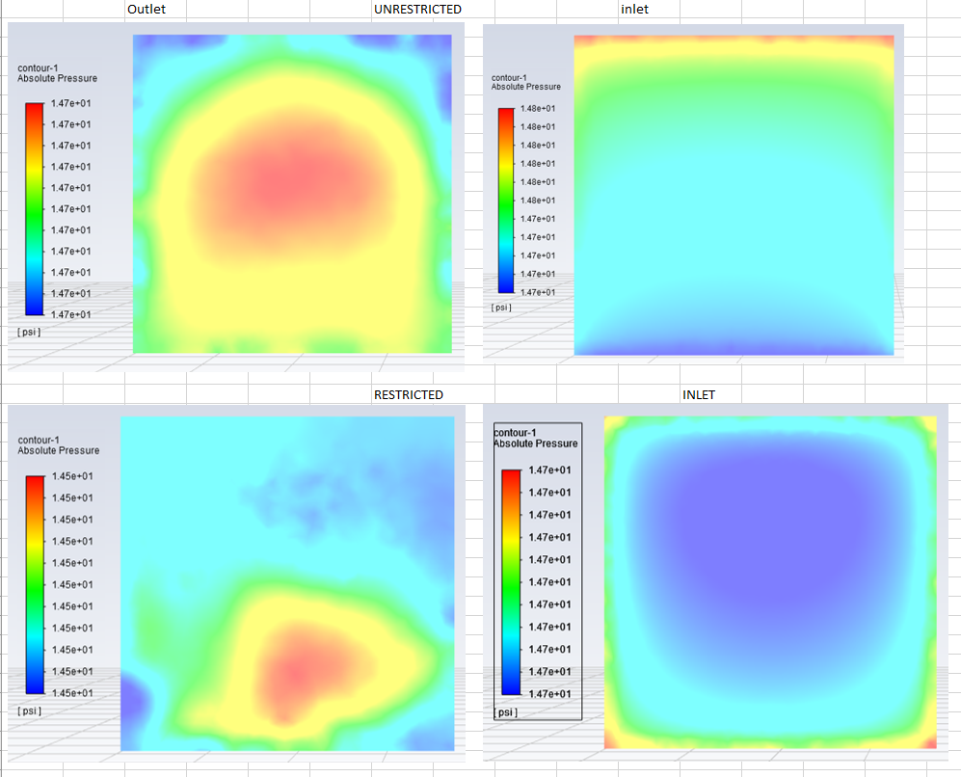
4488-501

Slide 22
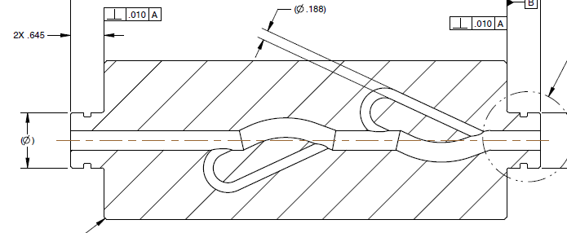
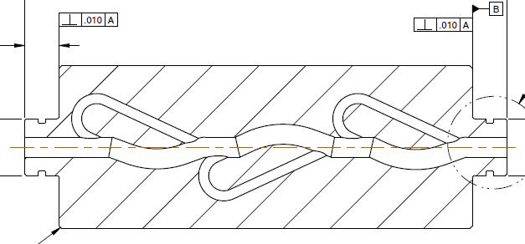
Valve Designs &
Preliminary Analysis
- 108 Steady State:
.375” Dia (Unrestricted) .188 (Restricted)
3.70” Restricted loop length @ 25 deg angle
1.85” Unrestricted length
50 psi @ 10.4375 lbm/min

